Slide 1

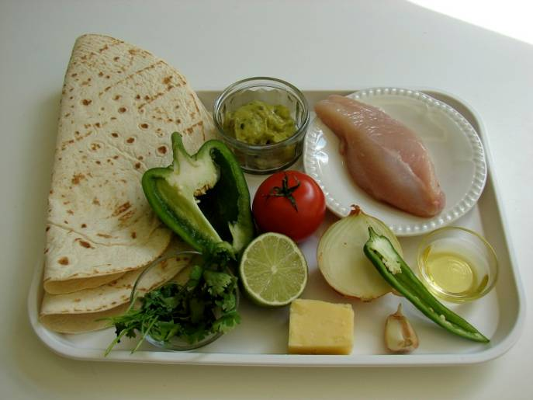
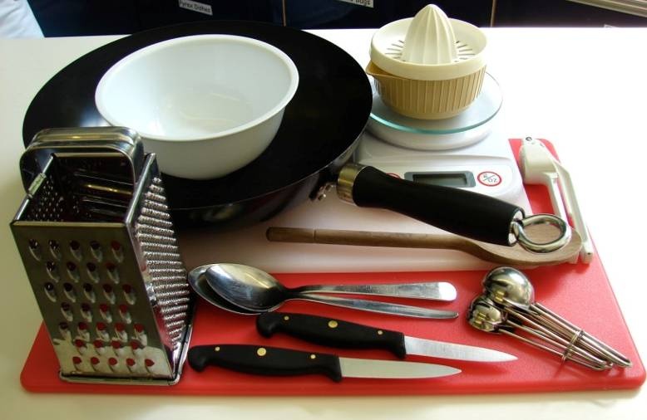
This recipe is from the original Licence to Cook programme and is provided under the Open Government Licence.
Fajitas
Ingredients
1/2 lime
1 clove garlic
1/2 green chilli
Small bunch coriander
1 x 10ml spoon oil
1 small chicken breast (or 3-4 thighs)
1/2 onion
1/2 green pepper
1 tomato
25g Cheddar cheese
2 tortillas
1 x 15ml spoon guacamole (or salsa), optional
Equipment
Juice squeezer
Garlic press
2 chopping boards
2 knives
Small bowl
2 spoons
Weighing scales
Grater
Measuring spoons
Frying pan
© Food – a fact of life 2019
www.foodafactoflife.org.uk

Slide 2
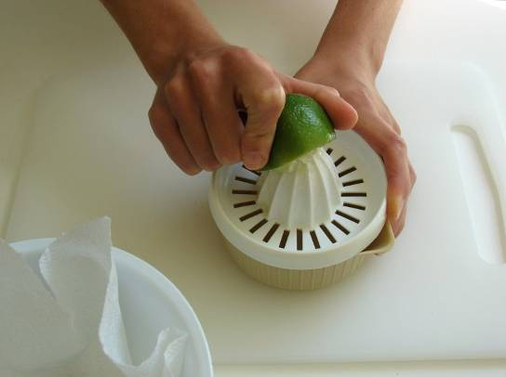
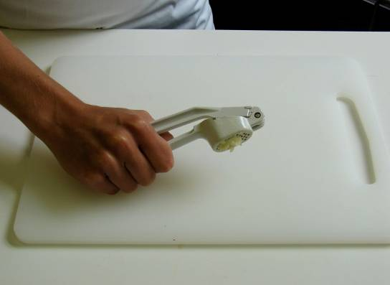
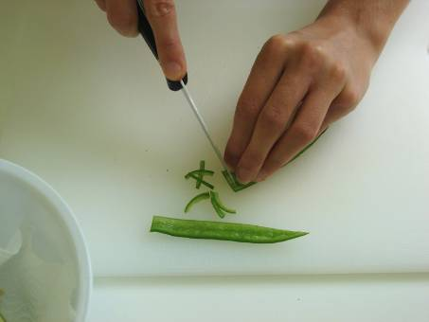
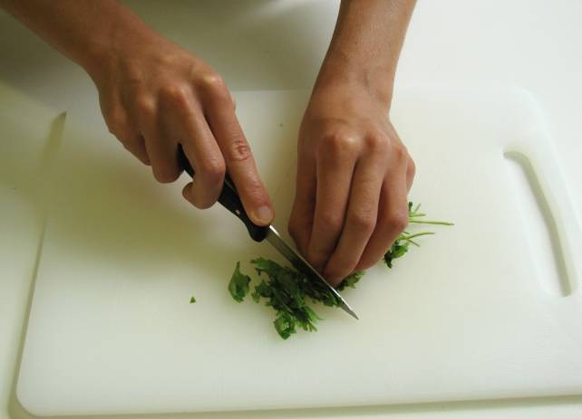
This recipe is from the original Licence to Cook programme and is provided under the Open Government Licence.
Method
Prepare the vegetables:
  squeeze the lime;
  peel and crush the garlic;
  de-seed and slice the chilli;
  chop the coriander;
© Food – a fact of life 2019
www.foodafactoflife.org.uk

Slide 3
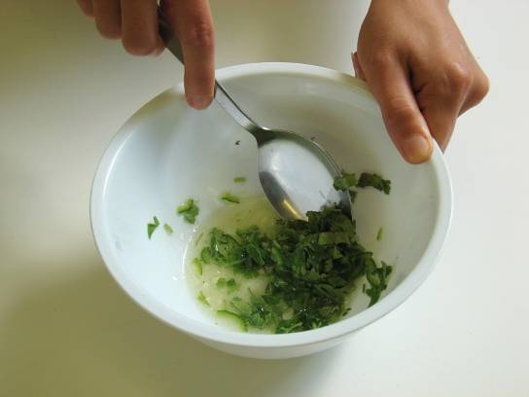
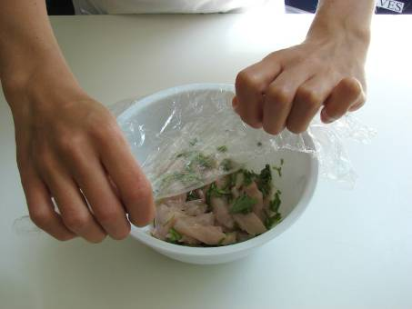
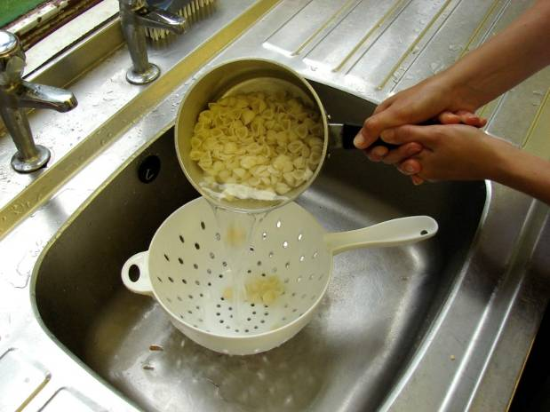
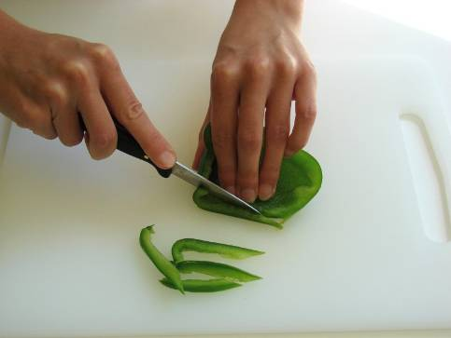
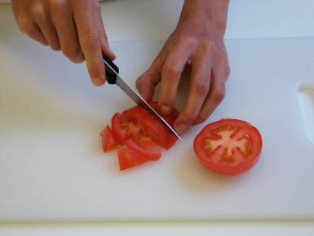
This recipe is from the original Licence to Cook programme and is provided under the Open Government Licence.
Method
  stir everything together with the oil.
Remove any skin from the chicken and cut into strips. Mix with the marinade and place in the fridge, covered, until needed.
Slice the pepper into small strips.
Prepare the remaining ingredients with a clean knife on a clean chopping board:
  slice the onion and green pepper;
  chop the tomato;
© Food – a fact of life 2019
www.foodafactoflife.org.uk

Slide 4
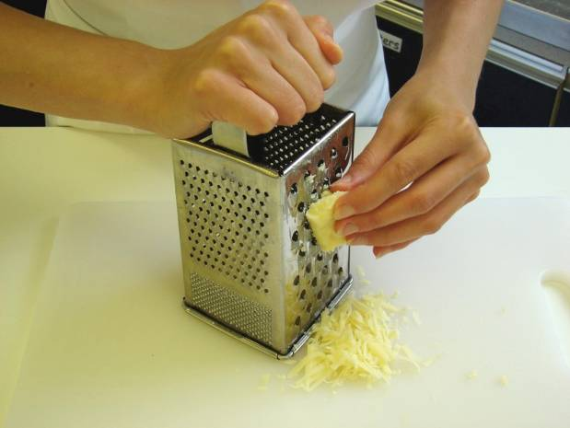
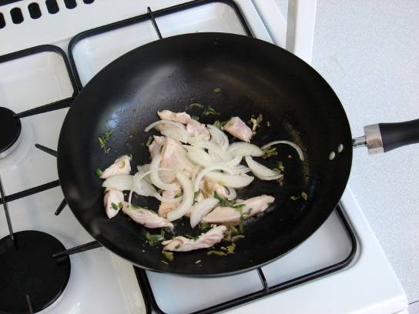
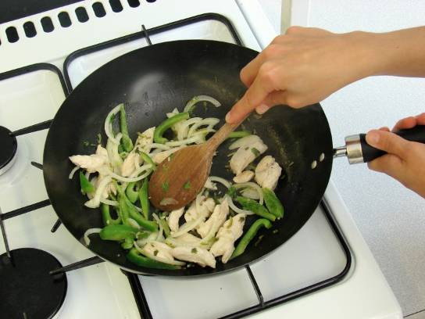
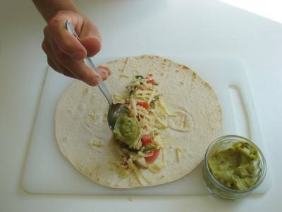
This recipe is from the original Licence to Cook programme and is provided under the Open Government Licence.
Method
  grate the cheese.
Add the marinated chicken to the wok or saucepan and stir-fry for about 4 minutes. Check that the chicken is cooked.
Slice the pepper into small strips.
Add the onion and green pepper and continue to cook for a further 2 minutes.
Spread a little chicken in the centre of the tortilla, add some tomato, cheese and guacamole, then roll up.
© Food – a fact of life 2019
www.foodafactoflife.org.uk

