Slide 1

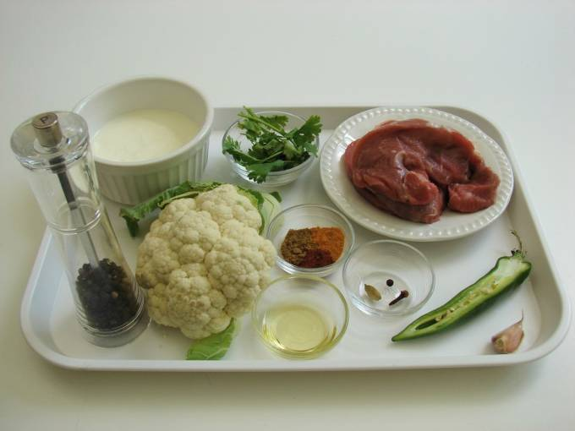
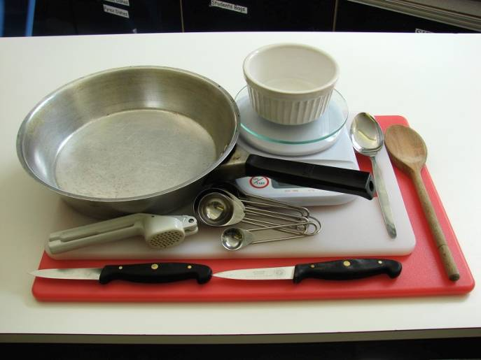
This recipe is from the original Licence to Cook programme and is provided under the Open Government Licence.
Lamb korma
Ingredients
1 clove
1 clove of garlic
1 black peppercorn
1 cardamom pod
1 x 10ml spoon oil
200g lamb leg steaks
1/2 small cauliflower
1/2 green chilli 1/2 x 5ml spoon turmeric
1/2 x 5 ml spoon ground cumin
1/2 x 5ml spoon chilli powder
4 x 15ml spoons plain yogurt
pinch black pepper
1 x 15ml spoon coriander
Equipment
Weighing scales
2 chopping boards
2 knives
Frying pan
Measuring spoons
Garlic press
Wooden spoon
Spoon
Small bowl
© Food – a fact of life 2019
www.foodafactoflife.org.uk

Slide 2
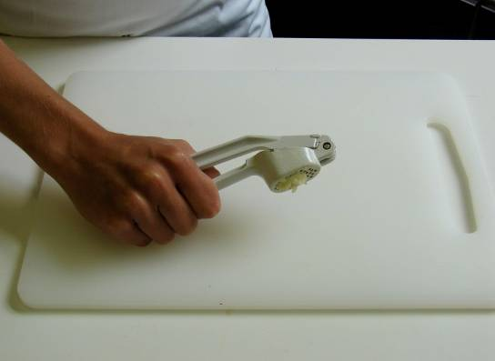
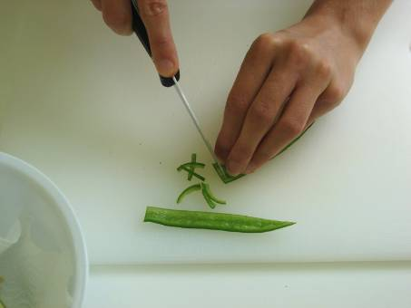
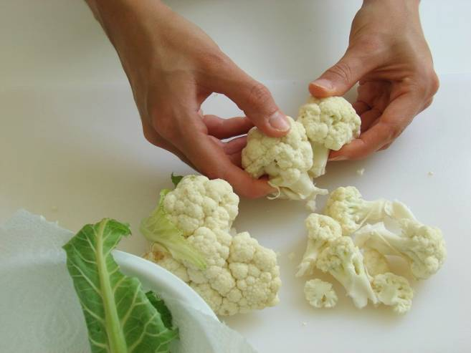
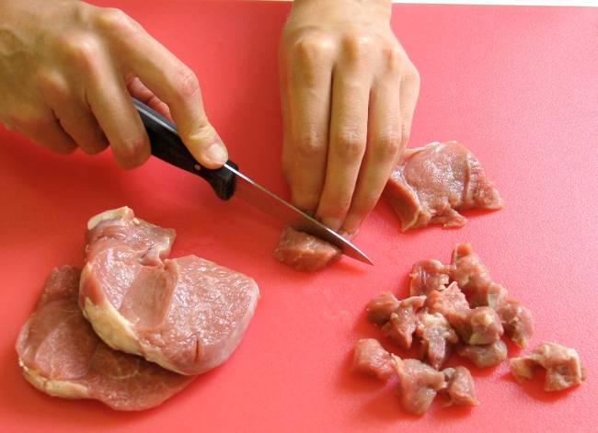
This recipe is from the original Licence to Cook programme and is provided under the Open Government Licence.
Method
Prepare the vegetables:
peel and crush the garlic;
de-seed and slice the chilli;
break the cauliflower into florets.
On a clean chopping board, using a clean knife, cut the lamb into cubes.
© Food – a fact of life 2019
www.foodafactoflife.org.uk

Slide 3
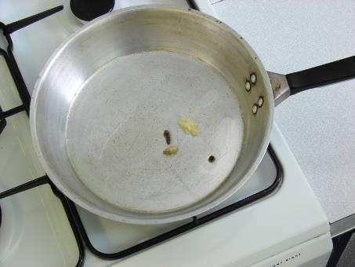
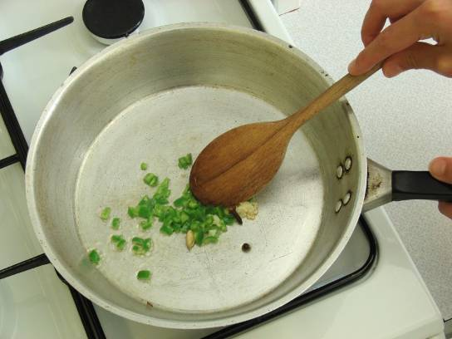
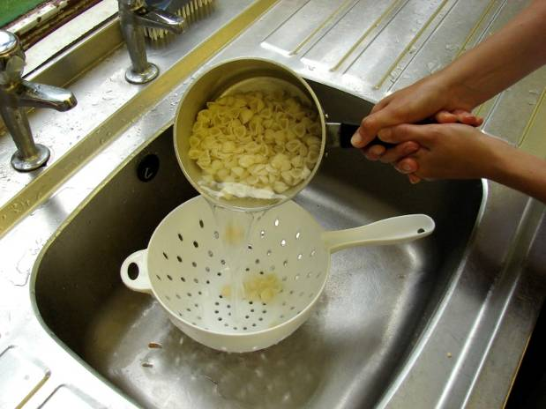
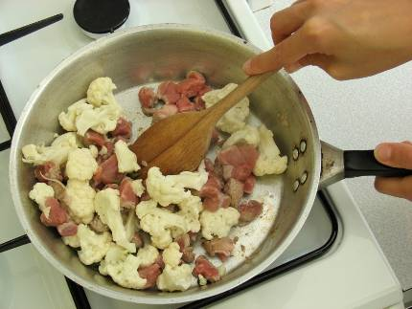
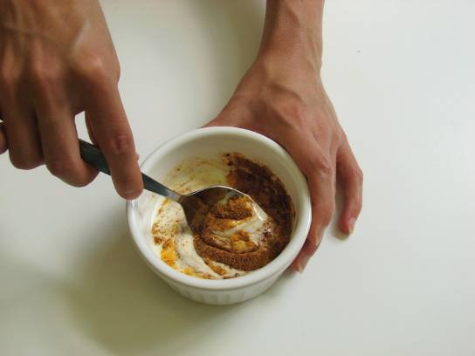
This recipe is from the original Licence to Cook programme and is provided under the Open Government Licence.
Method
Fry the clove, peppercorn and cardamom in the oil until they sizzle.
Slice the pepper into small strips.
Stir in the garlic and chilli.
Add the lamb and cauliflower, cover and slowly cook for about 10 minutes.
Mix the turmeric, chilli powder, pepper and cumin into the yogurt in a small bowl.
© Food – a fact of life 2019
www.foodafactoflife.org.uk

Slide 4
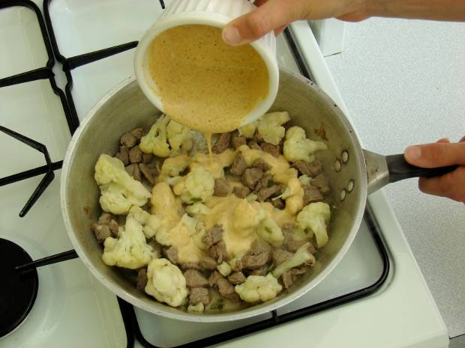
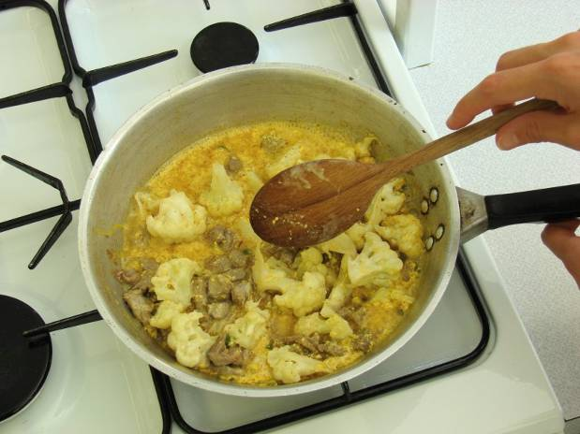
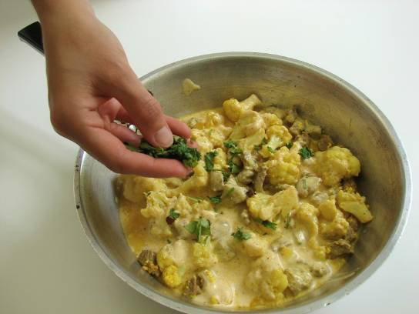
This recipe is from the original Licence to Cook programme and is provided under the Open Government Licence.
Method
Increase the heat and stir in the yogurt mix to the frying pan.
Allow to cook for a further 10 minutes.
Slice the pepper into small strips.
Chop the coriander and stir into the korma.
© Food – a fact of life 2019
www.foodafactoflife.org.uk

