Slide 1

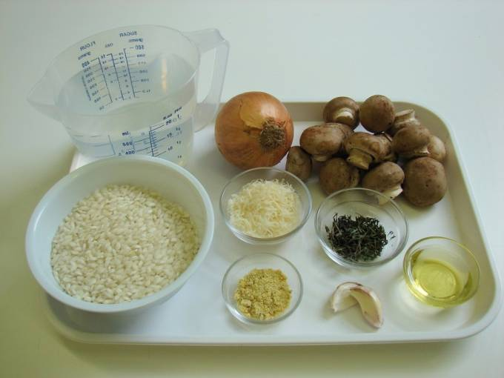
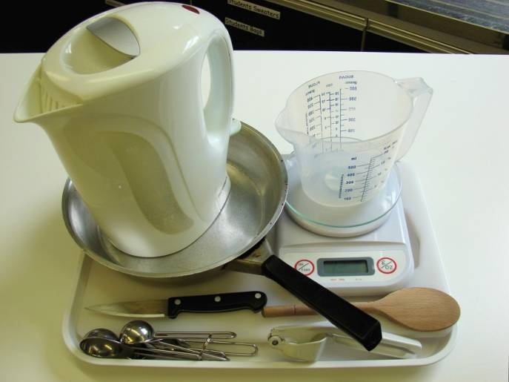
This recipe is from the original Licence to Cook programme and is provided under the Open Government Licence.
Mushroom risotto
Ingredients
1 onion
150g chestnut mushrooms
2 cloves garlic
1 x 15ml spoon olive oil
250g risotto rice
1 x 5ml spoon vegetable stock powder or cube
1 – 1.5 litres water, boiling
1 x 15ml spoon parmesan, grated
1 x 10ml spoon thyme, chopped
Equipment
Chopping board
Knife
Garlic press
Weighing scales
Measuring spoons
Frying pan
Wooden spoon
Kettle
Measuring jug
© Food – a fact of life 2019
www.foodafactoflife.org.uk

Slide 2
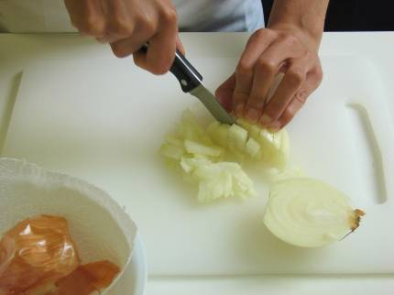
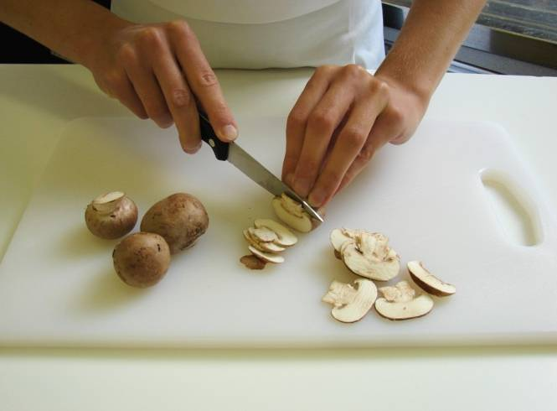
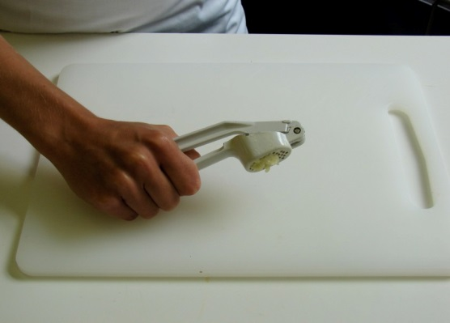
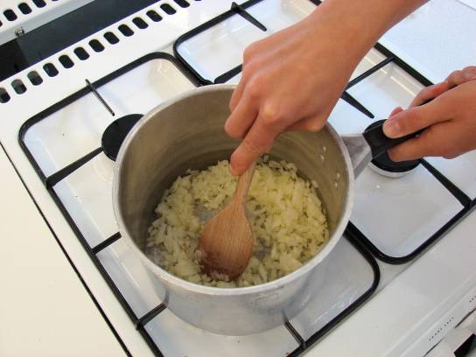
This recipe is from the original Licence to Cook programme and is provided under the Open Government Licence.
Method
Prepare the vegetables:
peel and chop the onion;
slice the mushrooms;
peel and crush the garlic.
Fry the onion and garlic in the oil until softened.
© Food – a fact of life 2019
www.foodafactoflife.org.uk

Slide 3
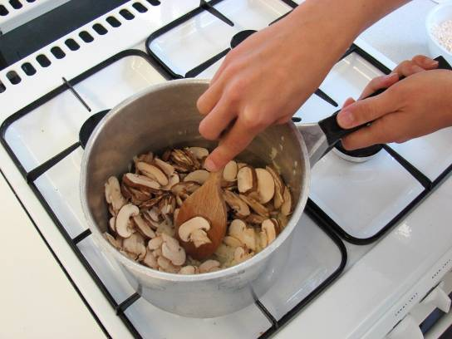
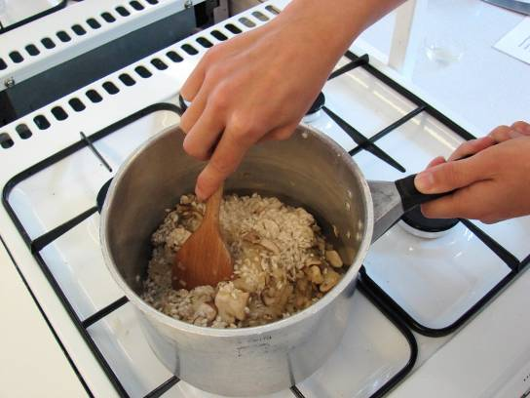
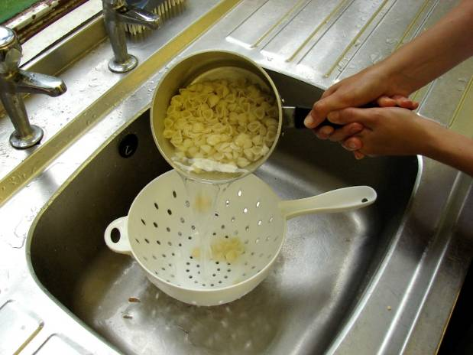
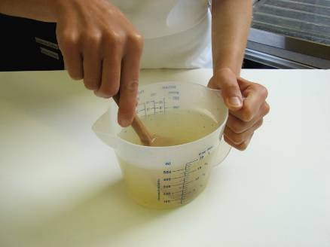
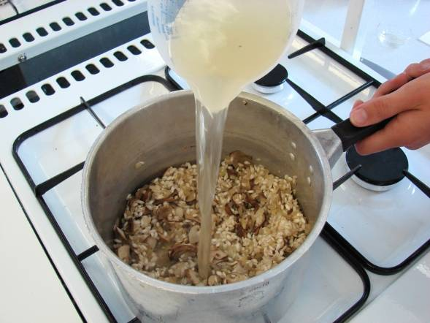
This recipe is from the original Licence to Cook programme and is provided under the Open Government Licence.
Method
Add the mushrooms and fry for another 2 minutes.
Slice the pepper into small strips.
Stir in the rice.
Mix the stock powder with the water.
Add the stock into the rice – a little at a time. Wait for the stock to be absorbed, stirring constantly.
© Food – a fact of life 2019
www.foodafactoflife.org.uk

Slide 4
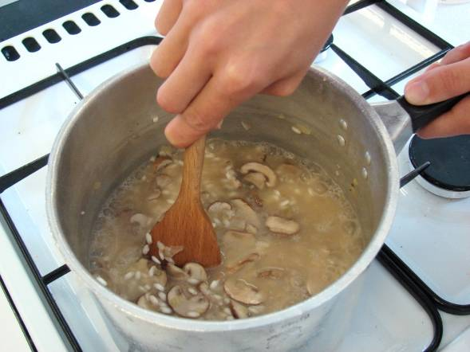
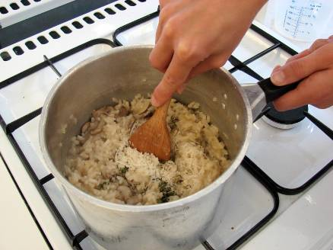
This recipe is from the original Licence to Cook programme and is provided under the Open Government Licence.
Method
Continue adding the stock until the rice cooks – this will take 20-25 minutes. The rice should be soft, but still retain a nutty bite.
Stir in the parmesan and thyme into the rice.
Slice the pepper into small strips.
© Food – a fact of life 2019
www.foodafactoflife.org.uk

