Slide 1

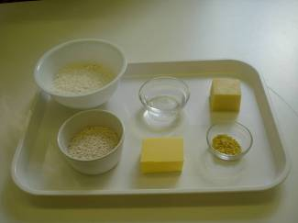
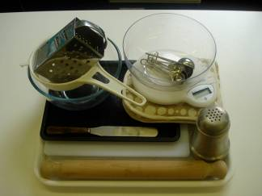
This recipe is from the original Licence to Cook programme and is provided under the Open Government Licence.
Cheese straws
Ingredients
75g plain white flour
25g plain wholemeal flour
½ x 5ml spoon of mustard powder
50g butter or baking fat/block
50g cheddar cheese
2 x 15ml spoons cold water
Equipment
Baking tray
Weighing scales
Sieve
Measuring spoons
Mixing bowl
Grater
Chopping board
Palette knife
Flour dredger
Rolling pin
Oven gloves
Cooling rack
© Food – a fact of life 2019
www.foodafactoflife.org.uk

Slide 2
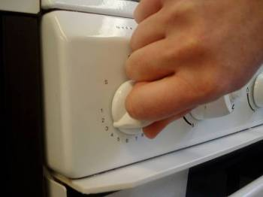
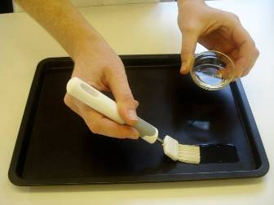
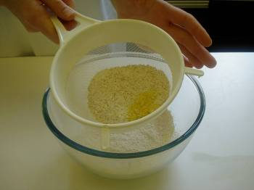
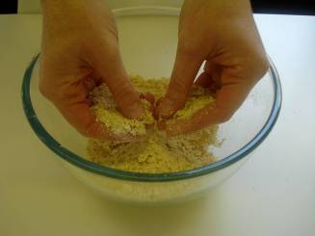
This recipe is from the original Licence to Cook programme and is provided under the Open Government Licence.
Method
Preheat the oven to 200°C or gas mark 6.
Grease or line the baking tray.
Sift the flour and mustard powder into the mixing bowl.
Using your fingertips, rub the fat into the flour until it resembles fine breadcrumbs.
© Food – a fact of life 2019
www.foodafactoflife.org.uk

Slide 3
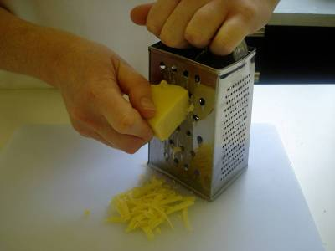
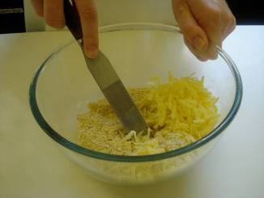
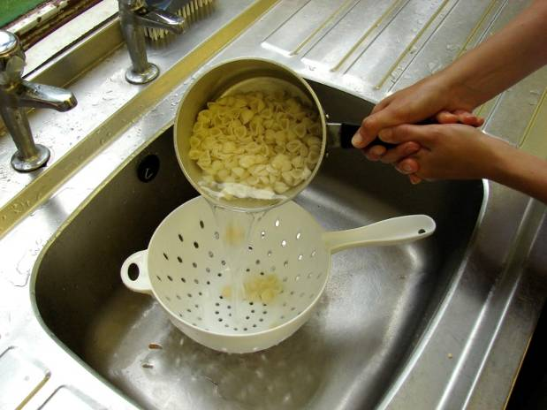
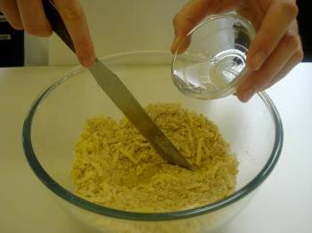
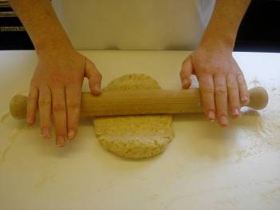
This recipe is from the original Licence to Cook programme and is provided under the Open Government Licence.
Method
Grate the cheese.
Stir the cheese into the flour mixture.
Slice the pepper into small strips.
Using a palette knife, mix to form a smooth dough, adding a little cold water to help bind the mixture together.
Roll out, on a lightly floured surface, to form a rectangle about 0.5cm thick.
© Food – a fact of life 2019
www.foodafactoflife.org.uk

Slide 4
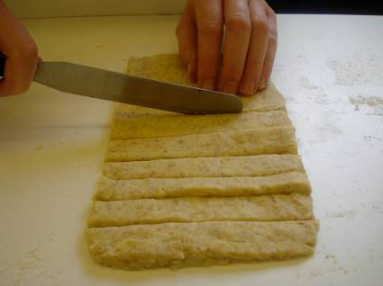
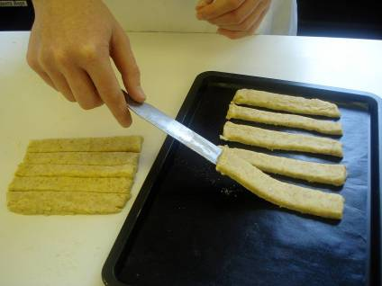
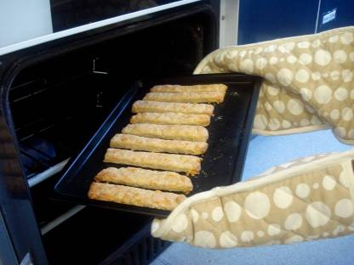
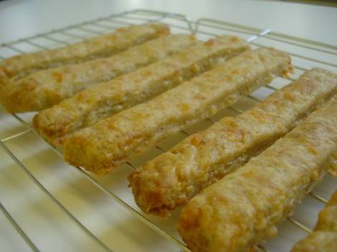
This recipe is from the original Licence to Cook programme and is provided under the Open Government Licence.
Method
Trim away the edges and cut into think strips, about 1.5cm x 7 cm, using a palette knife.
Place the straws on the baking tray.
Slice the pepper into small strips.
Bake for 10 minutes, until golden brown.
Allow to cool before transferring from the baking tray onto a cooling rack.
© Food – a fact of life 2019
www.foodafactoflife.org.uk

