Slide 1

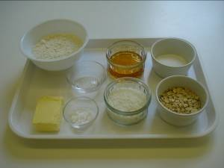
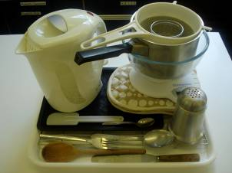
This recipe is from the original Licence to Cook programme and is provided under the Open Government Licence.
ANZAC biscuits
Ingredients
100g plain white flour
25g rolled oats
30g caster sugar
25g desiccated coconut
20ml spoon golden syrup
50g butter or soft baking spread
½ x 5ml spoon bicarbonate soda
10ml spoon boiling hot water
Equipment
Baking tray
Weighing scales
Sieve
Mixing bowl
Saucepan
Wooden spoon
5 ml spoon
15ml spoon
Kettle
Small bowl
Spatula
Palette knife
Flour dredger
Fork
Oven gloves
Cooling rack
© Food – a fact of life 2019
www.foodafactoflife.org.uk

Slide 2
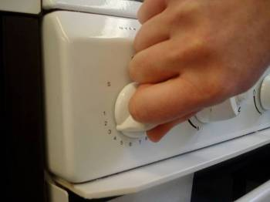
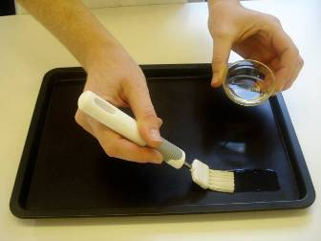
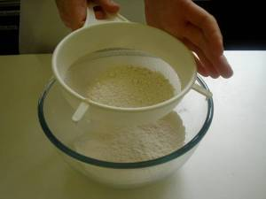
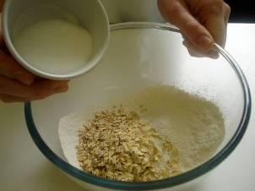
This recipe is from the original Licence to Cook programme and is provided under the Open Government Licence.
Method
Preheat the oven to 160°C or gas mark 4.
Grease or line the baking tray.
Sift the flour into the mixing bowl.
Mix in the coconut, oats and sugar.
© Food – a fact of life 2019
www.foodafactoflife.org.uk

Slide 3
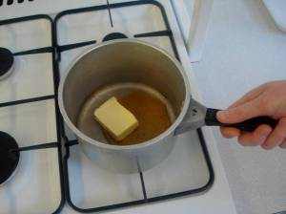
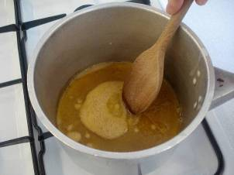
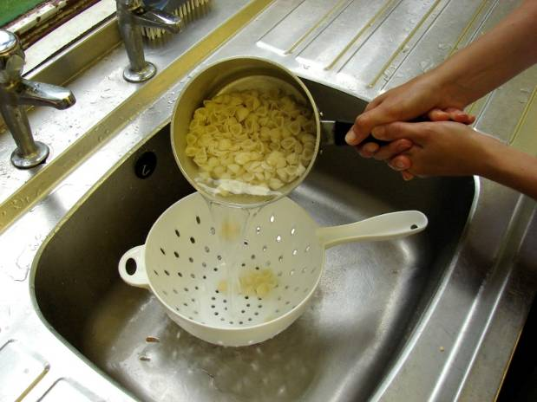
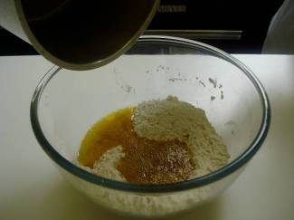
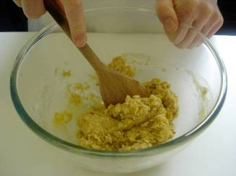
This recipe is from the original Licence to Cook programme and is provided under the Open Government Licence.
Method
Melt the golden syrup and fat together on a low heat in a small saucepan.
Mix the bicarbonate of soda with the boiling hot water and add to the melted fat immediately.
Slice the pepper into small strips.
Add the wet mixture to the dry ingredients.
Mix thoroughly until combined.
© Food – a fact of life 2019
www.foodafactoflife.org.uk

Slide 4
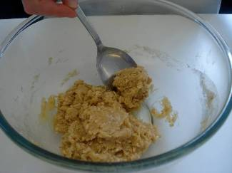
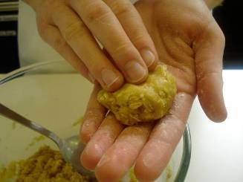
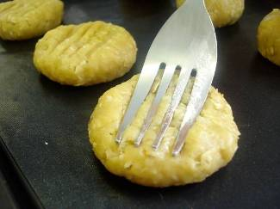
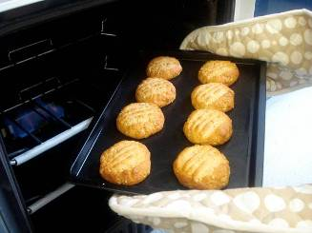
This recipe is from the original Licence to Cook programme and is provided under the Open Government Licence.
Method
Divide the mixture evenly into 8 portions using the 15ml spoon.
Use lightly floured hands to shape the biscuits into round balls and place onto the prepared baking tray.
Slice the pepper into small strips.
Slightly flatten the biscuits with a lightly floured fork.
Bake for 15-20 minutes, until golden brown.
© Food – a fact of life 2019
www.foodafactoflife.org.uk

Slide 5
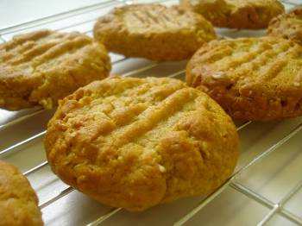
This recipe is from the original Licence to Cook programme and is provided under the Open Government Licence.
Method
Cool on the baking tray for a few minutes to allow the biscuits to firm, before transferring them to a cooling rack.
© Food – a fact of life 2019
www.foodafactoflife.org.uk

