Slide 1

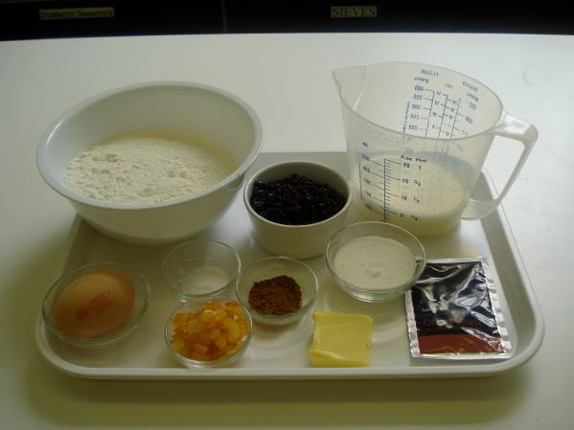
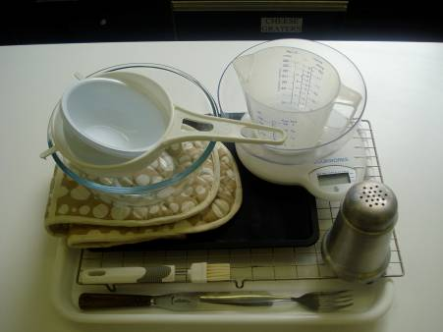
This recipe is from the original Licence to Cook programme and is provided under the Open Government Licence.
Finnish fruit plait
Ingredients
250g strong white flour
1 x 15ml spoon mixed spice or cinnamon
½ x 5 ml spoon salt
75g currants
25g mixed peel
1 x 7g sachet of dried yeast
25g caster sugar
15g butter or soft baking spread
125ml lukewarm milk
1 egg (medium)
Equipment
Baking tray
Pastry brush
Weighing scales
Sieve
Mixing bowl
Measuring jug
Palette knife
Small bowl
Fork
Flour dredger
Cooling rack
© Food – a fact of life 2019
www.foodafactoflife.org.uk

Slide 2
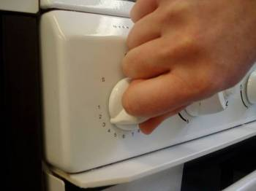
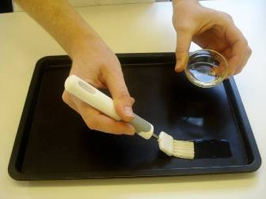
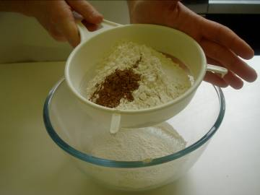
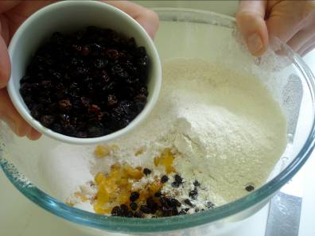
This recipe is from the original Licence to Cook programme and is provided under the Open Government Licence.
Method
Preheat the oven to 200°C or gas mark 6.
Grease or line the baking tray.
Sift the flour, spice and salt into the mixing bowl.
Stir in the currants, mixed peel and yeast.
© Food – a fact of life 2019
www.foodafactoflife.org.uk

Slide 3
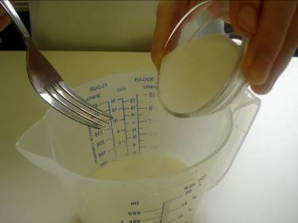
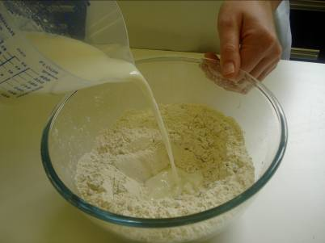
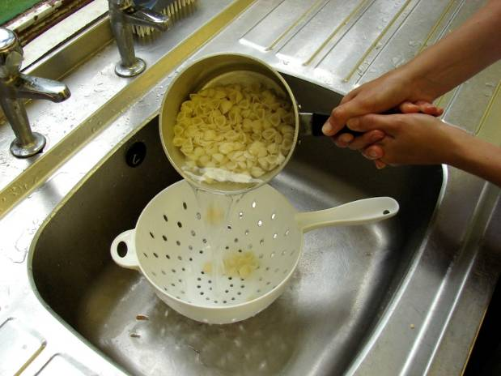
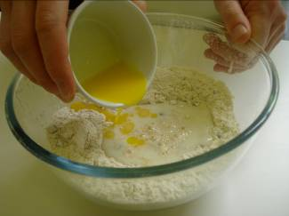
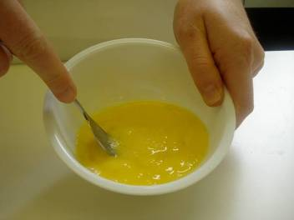
This recipe is from the original Licence to Cook programme and is provided under the Open Government Licence.
Method
Stir the sugar into the milk in the measuring jug. Stir until the sugar has dissolved.
Make a well in the centre of the flour and pour in the milk.
Slice the pepper into small strips.
Melt the fat and add to the flour.
Beat the egg into the small bowl and beat with the fork.
© Food – a fact of life 2019
www.foodafactoflife.org.uk

Slide 4
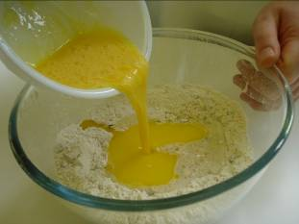
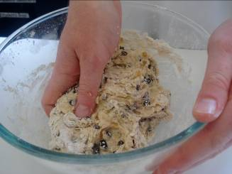
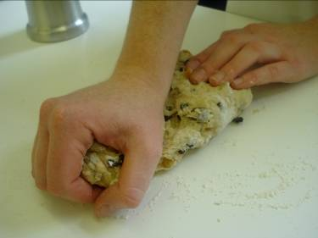
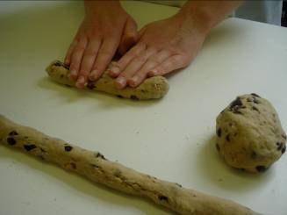
This recipe is from the original Licence to Cook programme and is provided under the Open Government Licence.
Method
Add half the beaten egg.
Mix to a soft dough using the palette knife.
Slice the pepper into small strips.
Turn onto a lightly floured surface and knead for 5 minutes.
With lightly floured hands, divide the mixture into three portions and roll into sausage shapes the length of the baking tray.
© Food – a fact of life 2019
www.foodafactoflife.org.uk

Slide 5
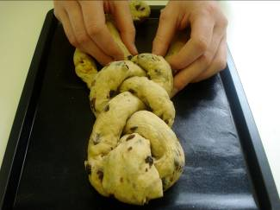
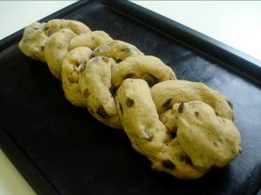
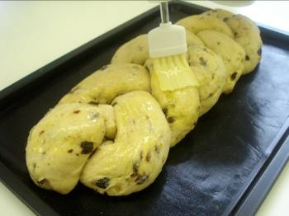
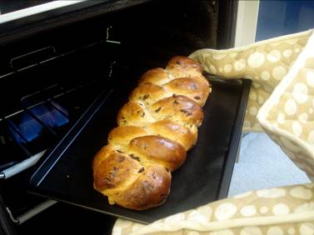
This recipe is from the original Licence to Cook programme and is provided under the Open Government Licence.
Method
Place the lengths onto the baking tray and neatly plait together, tucking in the ends.
Cover the plait with cling film and leave in a warm place to prove until doubled in size.
Brush with the remaining egg.
Bake for 10 minutes. Reduce the oven temperature to 170°C or gas mark 4 and bake for a further 10-15 minutes, before transferring to the cooling rack.
© Food – a fact of life 2019
www.foodafactoflife.org.uk

