Slide 1

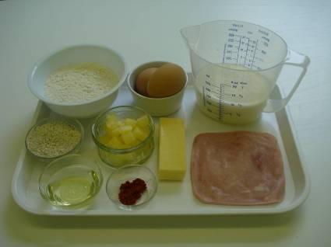
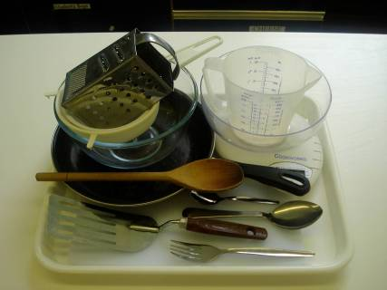
This recipe is from the original Licence to Cook programme and is provided under the Open Government Licence.
Savoury pancakes
Ingredients
100g white plain flour
25g wholemeal plain flour
2 eggs (medium)
275 ml semi skimmed milk
Pinch paprika powder
Oil for frying
6-8 slices of ham
60g canned pineapple pieces -drained
60g cheddar cheese
Equipment
Weighing scales
Grater
Chopping board
Sieve
Mixing bowl
Small bowl
Fork
Wooden spoon
Measuring jug
Frying pan
15ml spoon
Fish slice
Large metal spoon
© Food – a fact of life 2019
www.foodafactoflife.org.uk

Slide 2
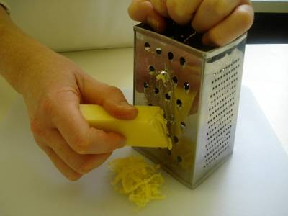
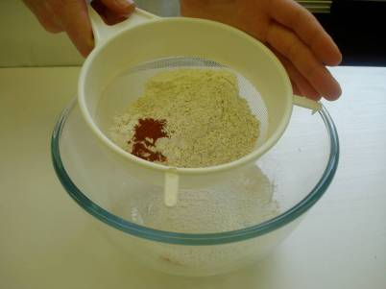
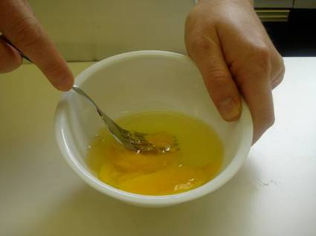
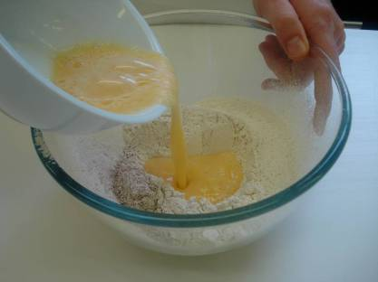
This recipe is from the original Licence to Cook programme and is provided under the Open Government Licence.
Method
Grate the cheese.
Sift the flour and paprika into the mixing bowl.
Break the eggs into a separate bowl and beat with a fork.
Make a well in the flour and add the eggs, mixing with the wooden spoon.
© Food – a fact of life 2019
www.foodafactoflife.org.uk

Slide 3
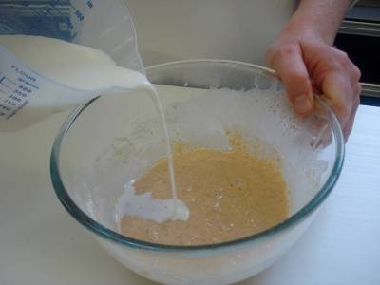
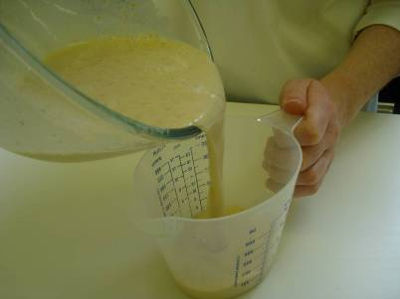
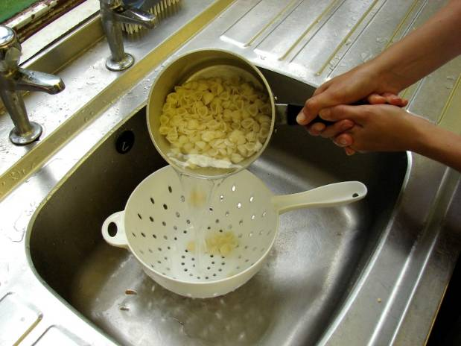
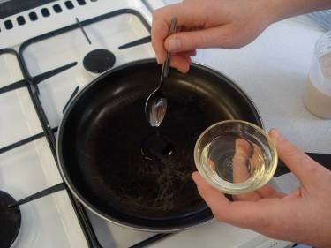
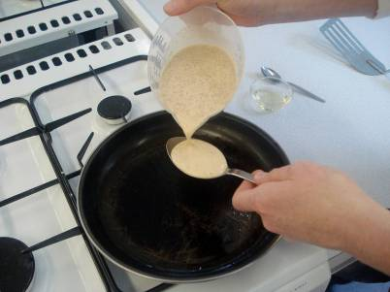
This recipe is from the original Licence to Cook programme and is provided under the Open Government Licence.
Method
Gradually add the milk, mixing well to remove any lumps.
Pour the mixture into the measuring jug.
Slice the pepper into small strips.
Add a little oil to a frying pan on a medium heat.
Pour three 15ml spoons of the mixture into the centre of the frying pan.
© Food – a fact of life 2019
www.foodafactoflife.org.uk

Slide 4
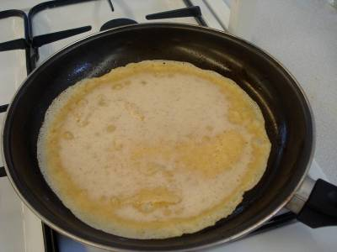
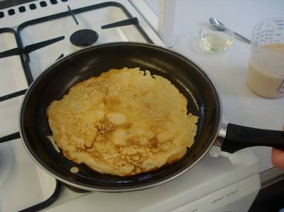
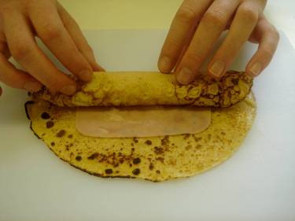
This recipe is from the original Licence to Cook programme and is provided under the Open Government Licence.
Method
Cook until bubbles appear on the surface, and then turn using the fish slice.
Cook the underside of the pancake for one minute, or until golden brown.
Slice the pepper into small strips.
Roll up the pancakes with the ham, pineapple and cheese inside.
© Food – a fact of life 2019
www.foodafactoflife.org.uk

