Slide 1
Onion cells – using a microscope

Slide 2
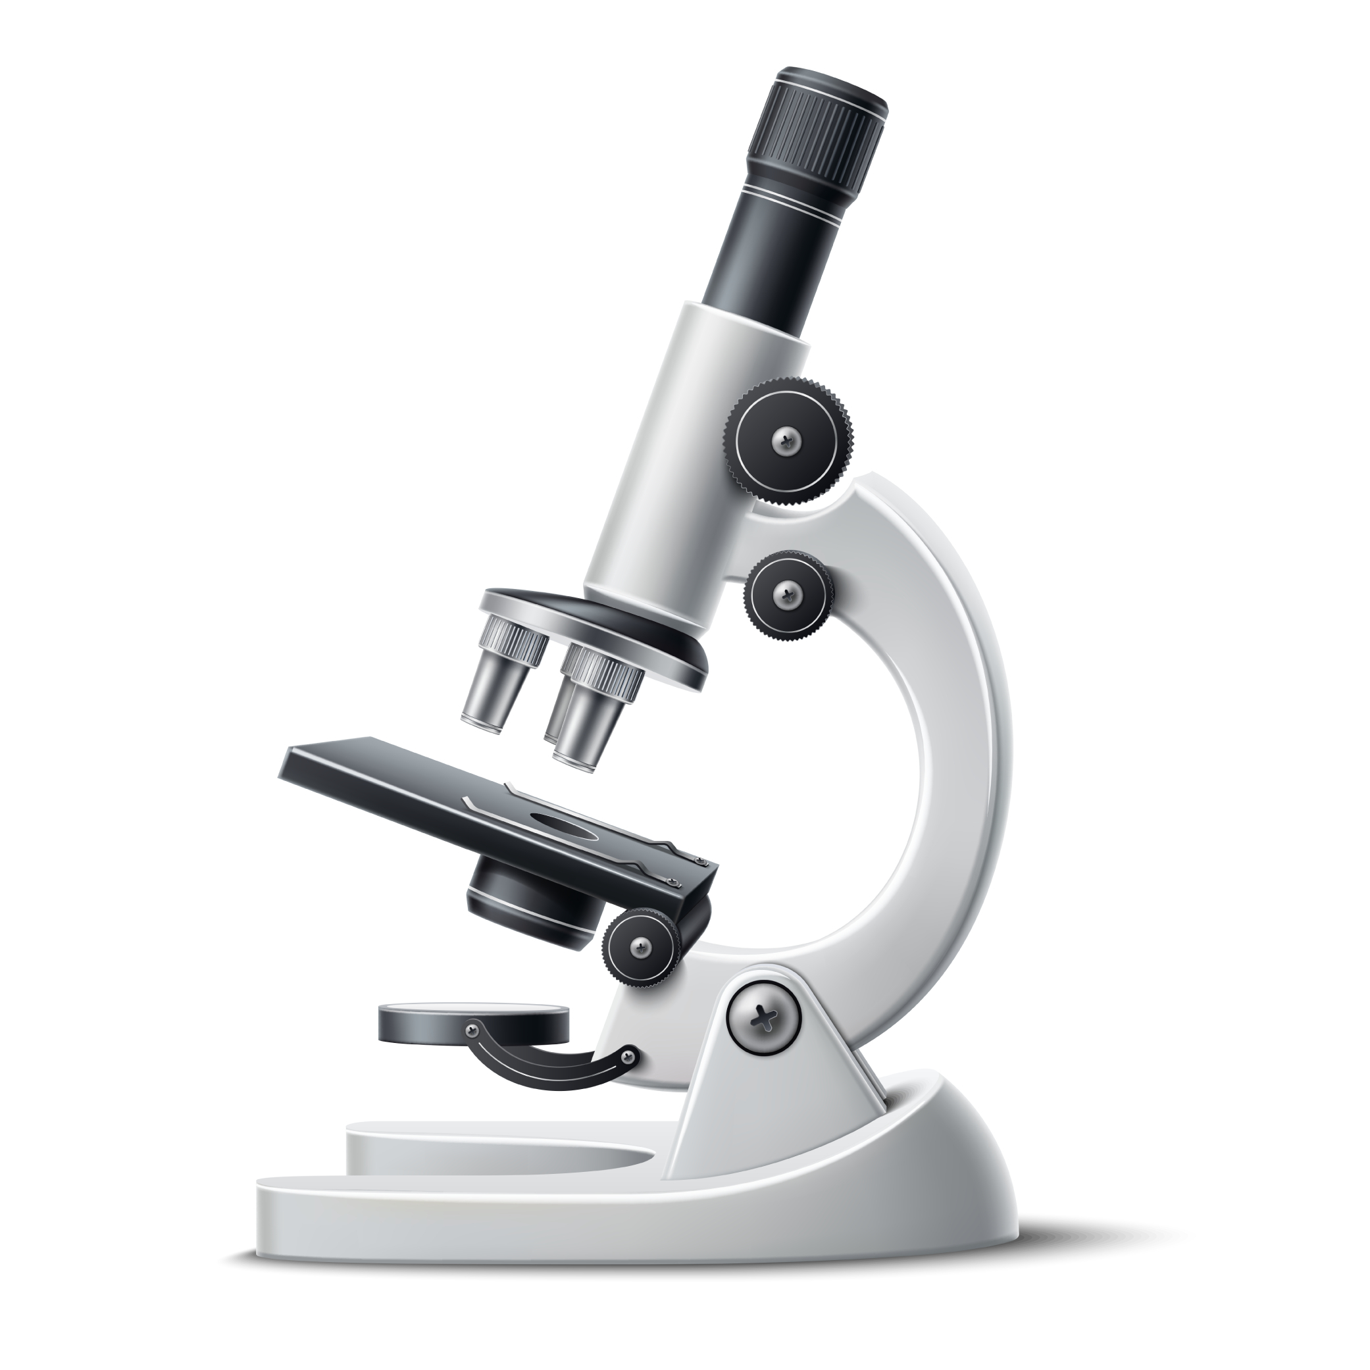
Starter
Name the parts of a microscope on the worksheet.
Extension
Describe how you would use the microscope to view a cell.

Slide 3
Eye piece lens
Coarse focusing knob
Fine focusing knob
Objective lens
Stage
Light/mirror

Slide 4
Mix and match – using a microscope
Eye piece lens
This is the place where you put a microscope slide.
Objective lens
Projects light onto the microscope slide (can be a mirror or an electric)
This is used to focus the image so it is very sharp and clear.
Fine focussing knob
Stage
This moves the stage up and down.
This is the lens closest to your eye that you look through.
There are three lenses of different strengths which can be used to magnify the image more clearly.
Course focussing knob
Light

Slide 5
Mix and match – using a microscope
Eye piece lens
Objective lens
Fine focussing knob
This is the lens closest to your eye that you look through.
There are three lenses of different strengths which can be used to magnify the image more clearly.
This is used to focus the image so it is very sharp and clear.
Stage
Light
Course focussing knob
This is the place where you put a microscope slide.
Projects light onto the microscope slide (can be a mirror or an electric)
This moves the stage up and down.

Slide 6
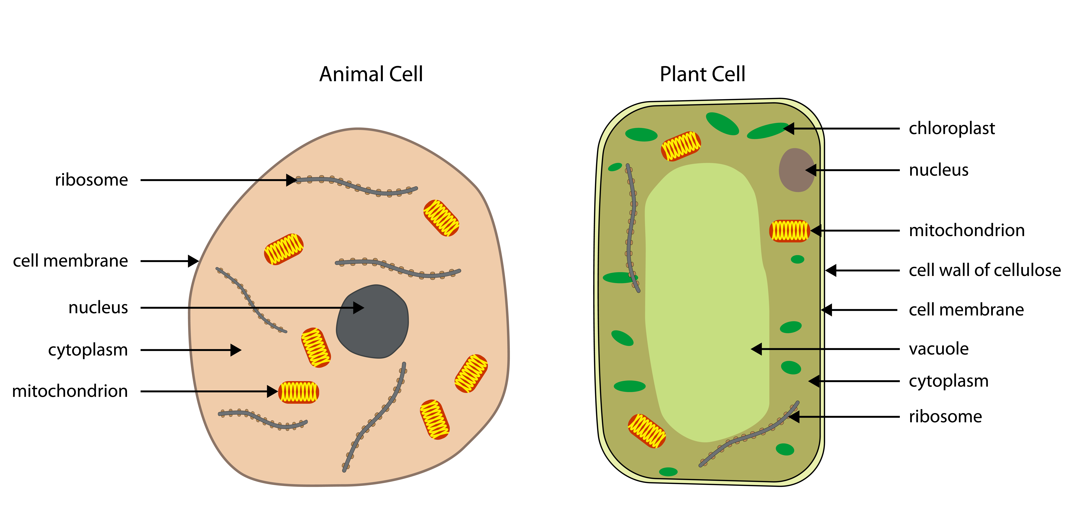
Animal cells
There are lots of different types of animal cells but they all have five main parts.
Each of the parts of a cell are named organelles and they have different jobs or functions in a cell.

Slide 7
Plant cells
There are lots of different types of plant cells but they all have eight main parts.
Each of the parts of a cell are named organelles and they have different jobs or functions in a cell.
There are three organelles that are not found in animal cells: cell wall, vacuole and chloroplast.

Slide 8
Round the room – plant and animal cell structures
Research the information in the following table about what these definitions relate too. Are each of these organelles found in plant or animal cells?
Extension: Some plant cells have chloroplasts and some do not, why do you think some plant cells do not have chloroplasts? Give one example of a plant cell which does not have chloroplasts.

Slide 9
Cell organelle | Function | In animal cells? | In plant cells?
 | where all reactions which keep the cell alive take place.
 | holds the cells together and controls what goes in and out of the cell.
 | controls all the chemical reactions in the cell. It contains 26 pairs of chromosomes, made of DNA.
 | responsible for releasing energy for the cell. This is where the reaction called respiration takes place
 | absorb energy from the Sun to help the plant make its own food. This is where the reaction called photosynthesis takes place
 | contains cell sap (water & nutrients) and are surrounded by a thin membrane. Provides the cell with inner support.
 | made of cellulose and gives the cell strength and support. It gives the plant cell a fixed shape.

Slide 10
Cell organelle | Function | In animal cells? | In plant cells?
Cytoplasm | where all reactions which keep the cell alive take place. | YES | YES
Cell membrane | holds the cells together and controls what goes in and out of the cell. | YES | YES
Nucleus | controls all the chemical reactions in the cell. It contains 26 pairs of chromosomes, made of DNA. | YES | YES
Mitochondria | responsible for releasing energy for the cell. This is where the reaction called respiration takes place | YES | YES
Chloroplasts | absorb energy from the Sun to help the plant make its own food. This is where the reaction called photosynthesis takes place |  | YES
Vacuole | contains cell sap (water & nutrients) and are surrounded by a thin membrane. Provides the cell with inner support. |  | YES
Cell wall | made of cellulose and gives the cell strength and support. It gives the plant cell a fixed shape. |  | YES

Slide 11
Plant and animal cells
Which one will we see under the microscope?

Slide 12
Plant and animal cells
Which one will we see under the microscope?
Plant cell

Slide 13
Looking at cells
What structures might we be able to see through the microscope?
Discuss with the person next to you.

Slide 14
Practical method
1. Put on goggles.
2. Collect a small piece of onion.
3. Using forceps, carefully peel away the thin skin (epidermis) between the onion layers.
4. Place the onion skin onto a clean glass slide.
5. Use your forceps to keep the onion skin flat on the glass slide.
6. Using a pipette, add one drop of iodine solution on top of the onion skin.
7. Carefully place a cover slip on top to spread out the iodine and to stop the specimen drying out.
8. Clip the slide to the microscope stage and view your specimen through the microscope.
Top tips:
Ask the teacher to cut out a small part of an onion.
Just put a maximum of two drops of iodine on the slide.
Be careful with the slide.

Slide 15
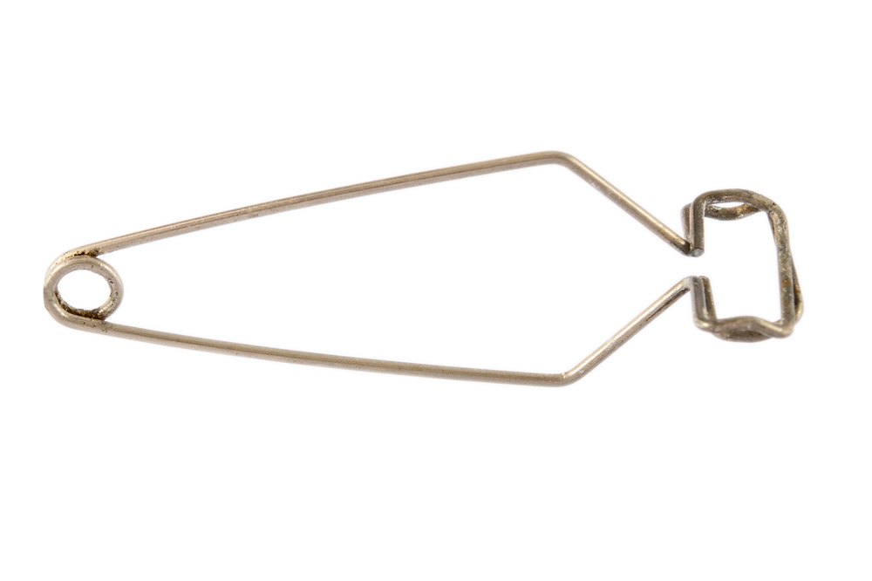
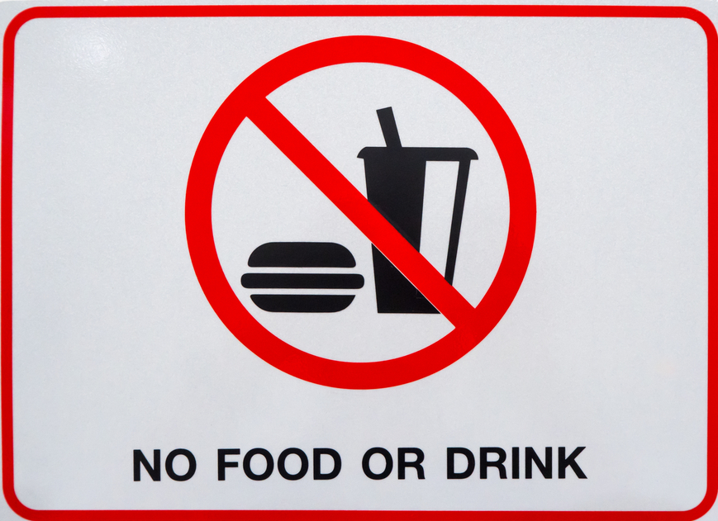
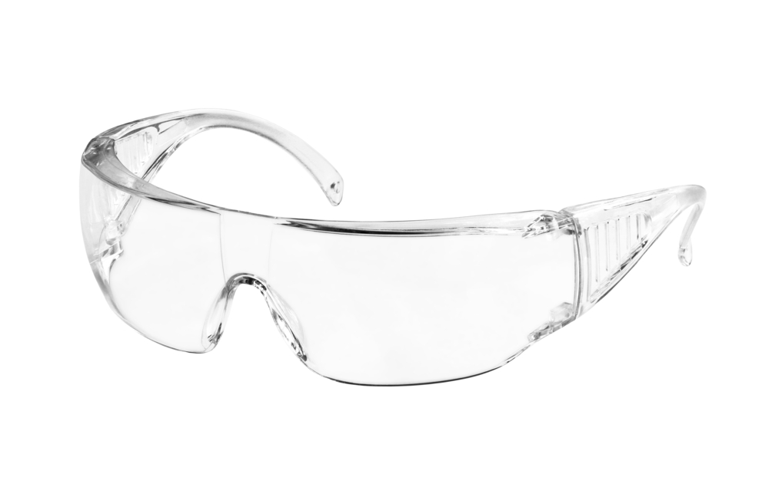

Turn and talk – how are we going to stay safe during this practical?
Wear safety goggles
Use test tube holders
No eating or drinking
Keep desks/benches tidy and make sure bags are not trip hazards

Slide 16
Turn and talk – how are we going to stay safe during this practical?
Hazard | Risk | Precaution
Glass slides and coverslips | Can cut yourself on broken glass | Handle with care and place in a safe position on bench. If broken, clean up carefully with a dustpan and brush
Iodine solution | Irritant to skin and eyes | Wear eye protection and take care when handling iodine. If contact to skin occurs then wash well with water

Slide 17
Plenary questions
What components of the cell can you see using the microscope?
……………………………………………………………………………………………………
……………………………………………………………………………………………………
Why did you add a drop of iodine solution to your specimen?
……………………………………………………………………………………………………
……………………………………………………………………………………………………
Why could you not see any chloroplasts? ……………………………………………………………………………………………………
……………………………………………………………………………………………………

Slide 18
Plenary questions
What components of the cell can you see using the microscope?
Clearly visible distinct cell walls surrounding the cells, Dark stained nucleus, Large vacuoles at the center, Small granules may be observed inside the cells (within the cytoplasm).
Why did you add a drop of iodine solution to your specimen?
We use iodine as it will bind to the starch to show the cell wall and nucleus.
Why could you not see any chloroplasts?
The chloroplast necessary for photosynthesis is largely present in the leafy part of the onion, which is exposed to the sun and absent in the bulb which is below ground and away from sunlight.

Slide 19
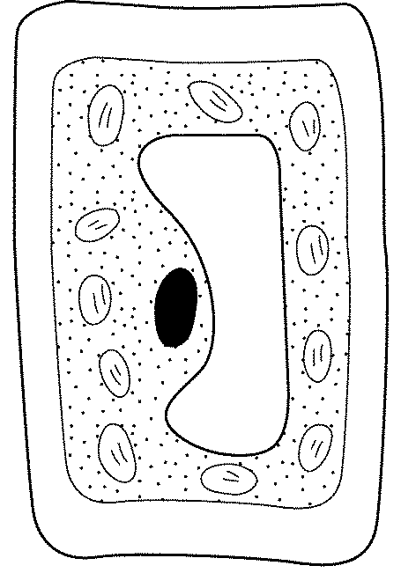

Build a cell dice game
Completed plant cell =
cell wall, cell membrane, vacuole, nucleus, cytoplasm, at least four chloroplasts, at least two mitochondria
2 - Plant cell nucleus
3 - Miss a go
4 or 5 - Chloroplast
6 - Cell wall
7 - Cytoplasm
8 - Vacuole
9 or 10 - Mitochondria
11 or 12 - Animal cell nucleus
Completed animal cell = cell membrane, nucleus, cytoplasm, at least two mitochondria

Slide 20
Homework
Complete a story board of the steps that you need to do to use a microscope to look at an onion cell.
Carefully cut a cell and place the layer cells on the glass slide. | Move the stage (the flat ledge the slide sits on) down to its lowest position. | Place the glass slide onto the stage. Be careful pushing it under the clips so that the cover slide doesn't move or crack.
Select the lowest power objective lens. | Turn the coarse focus knob slowly until you can see the cells. | Turn the fine focus knob slowly until the cells are in focus and you can see them clearly.

Slide 21
Key words
Key word​ | Meaning​
Cell membrane | An organelle that holds the cells together and controls what goes in and out of the cell.
Cell wall | An organelle made of cellulose and gives a plant cell strength and support.
Cytoplasm | An organelle where all reactions which keep the cell alive take place.
Iodine (chemistry) | An element on the periodic table which can be used to stain the onion cell.
Mitochondria | An organelle that is responsible for releasing energy for the cell. This is where the reaction called respiration takes place.
Nucleus | An organelle that controls all the chemical reactions in the cell and contains the cell’s DNA.

Slide 22
Teachers’ guide

Slide 23
Teaching about cells:
Identify the main parts of a light microscope.
Prepare a slide.
Use a light microscope to view the prepared slides.
To know how to use a microscope to view prepared slides.
Sketch an observational drawing of what was observed under the microscope.
Identify the main organelles (parts) in a typical plant and animal cell.
Explain the function (job) of the organelles in a plant & animal cell.

Slide 24
Running a microscope practical classroom
Common misconceptions:
Confusion with the stage and the slide – students can get confused with the two ‘s words’ when labelling the microscope. You can remember this by the slide slides into the clips and the stage is where the cells are performing and you are watching them.
The air bubbles – the best way to overcome air bubbles is to slowly lower the coverslip onto the slide (if you don’t have any other specialised equipment). Students can think this is due to the iodine so either use less (or sometimes more) to overcome this issue rather than focusing on how they put the coverslip on.

Slide 25
Running a microscope practical classroom
Common pitfalls:
Starting with the stage too high – starting with the stage of the microscope too high can make it more difficult to focus on the cell. The other issue with starting with the cell so high is that it can cause a broken slide if the objective lenses are changed with the stage at the top. You can overcome this by making sure the stage is set at the lowest point before turning the objective lens and moving the stage upwards.
Students searching for chloroplasts – due to the part of the onion that is being used, there won’t be any chloroplasts to see on the slides. However, because they are often the best remembered of the cells only found in plant cells, students can try and look for them or mislabel them on their drawings. Remind the students which part of the onion is being used and ask them why they think there might not be visible chloroplasts.

Slide 26
Running a microscope practical classroom
Common pitfalls:
Bottlenecking in the classroom – one risk with the microscopes practical is that students will bottleneck in one area of the classroom when collecting equipment, which can waste time and reduce safety. To combat this, spread out the equipment around the room for collection and, if students are working in pairs, get each to collect half of the equipment.

Slide 27
Progressing the learning
The topic of cells is also covered at GCSE (14-16 years).
For a required practical, students must use a light microscope to observe, draw and label a selection of plant and animal cells. A magnification scale must be included.
They will also learn the parts of animal and plants cells and need to understand the roles of each of the cell organelles.

Slide 28
Extra information for teachers
The following slides contain extra information for teachers to support the teaching and learning around this topic area.
This may be useful as background reading, or you may wish to extend the learning for students by using this information in the lesson.

Slide 29
Cells to organisms
Cells are the building blocks of living things.
Lots of cells work together to form a tissue, tissues work together to form an organ, organs work together to form organ systems and organ systems work together to form an organism (living thing)
Cell → Tissue → Organ → Organ system → Organism

Slide 30
Animal cells
There are lots of different types of animal cells but they all have five main parts.
Each of the parts of a cell are named organelles and they have different jobs or functions in a cell.

Slide 31
Plant cells
There are lots of different types of plant cells but they all have eight main parts.
Each of the parts of a cell are named organelles and they have different jobs or functions in a cell.
There are three organelles that are not found in animal cells: cell wall, vacuole and chloroplast.

Slide 32
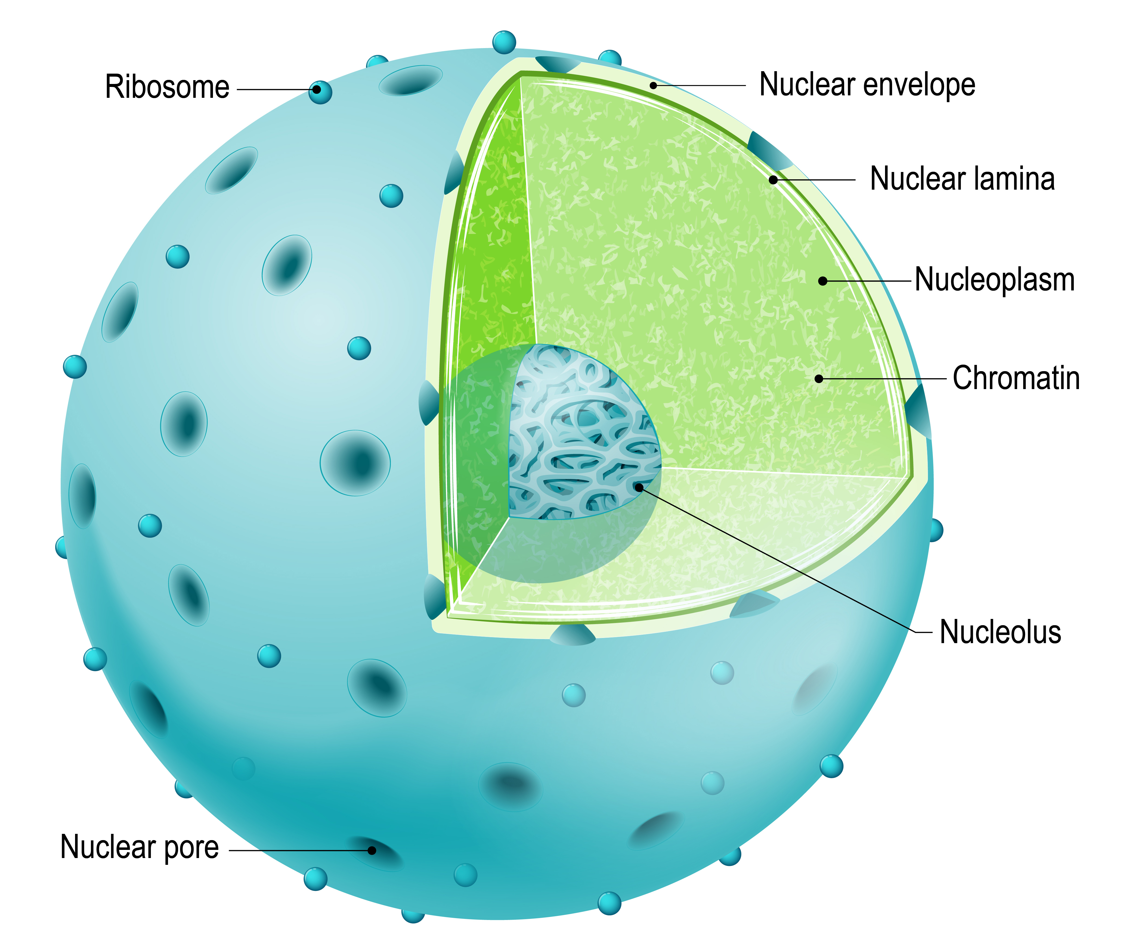
Nucleus
Controls the activities of the cell.
Contains genetic material.
Found in animal and plant cells.

Slide 33
Cytoplasm
A jelly like substance where the chemical reactions in a cell take place.
This is where most of the chemical reactions needed for life take place.
Found in animal and plant cells.

Slide 34
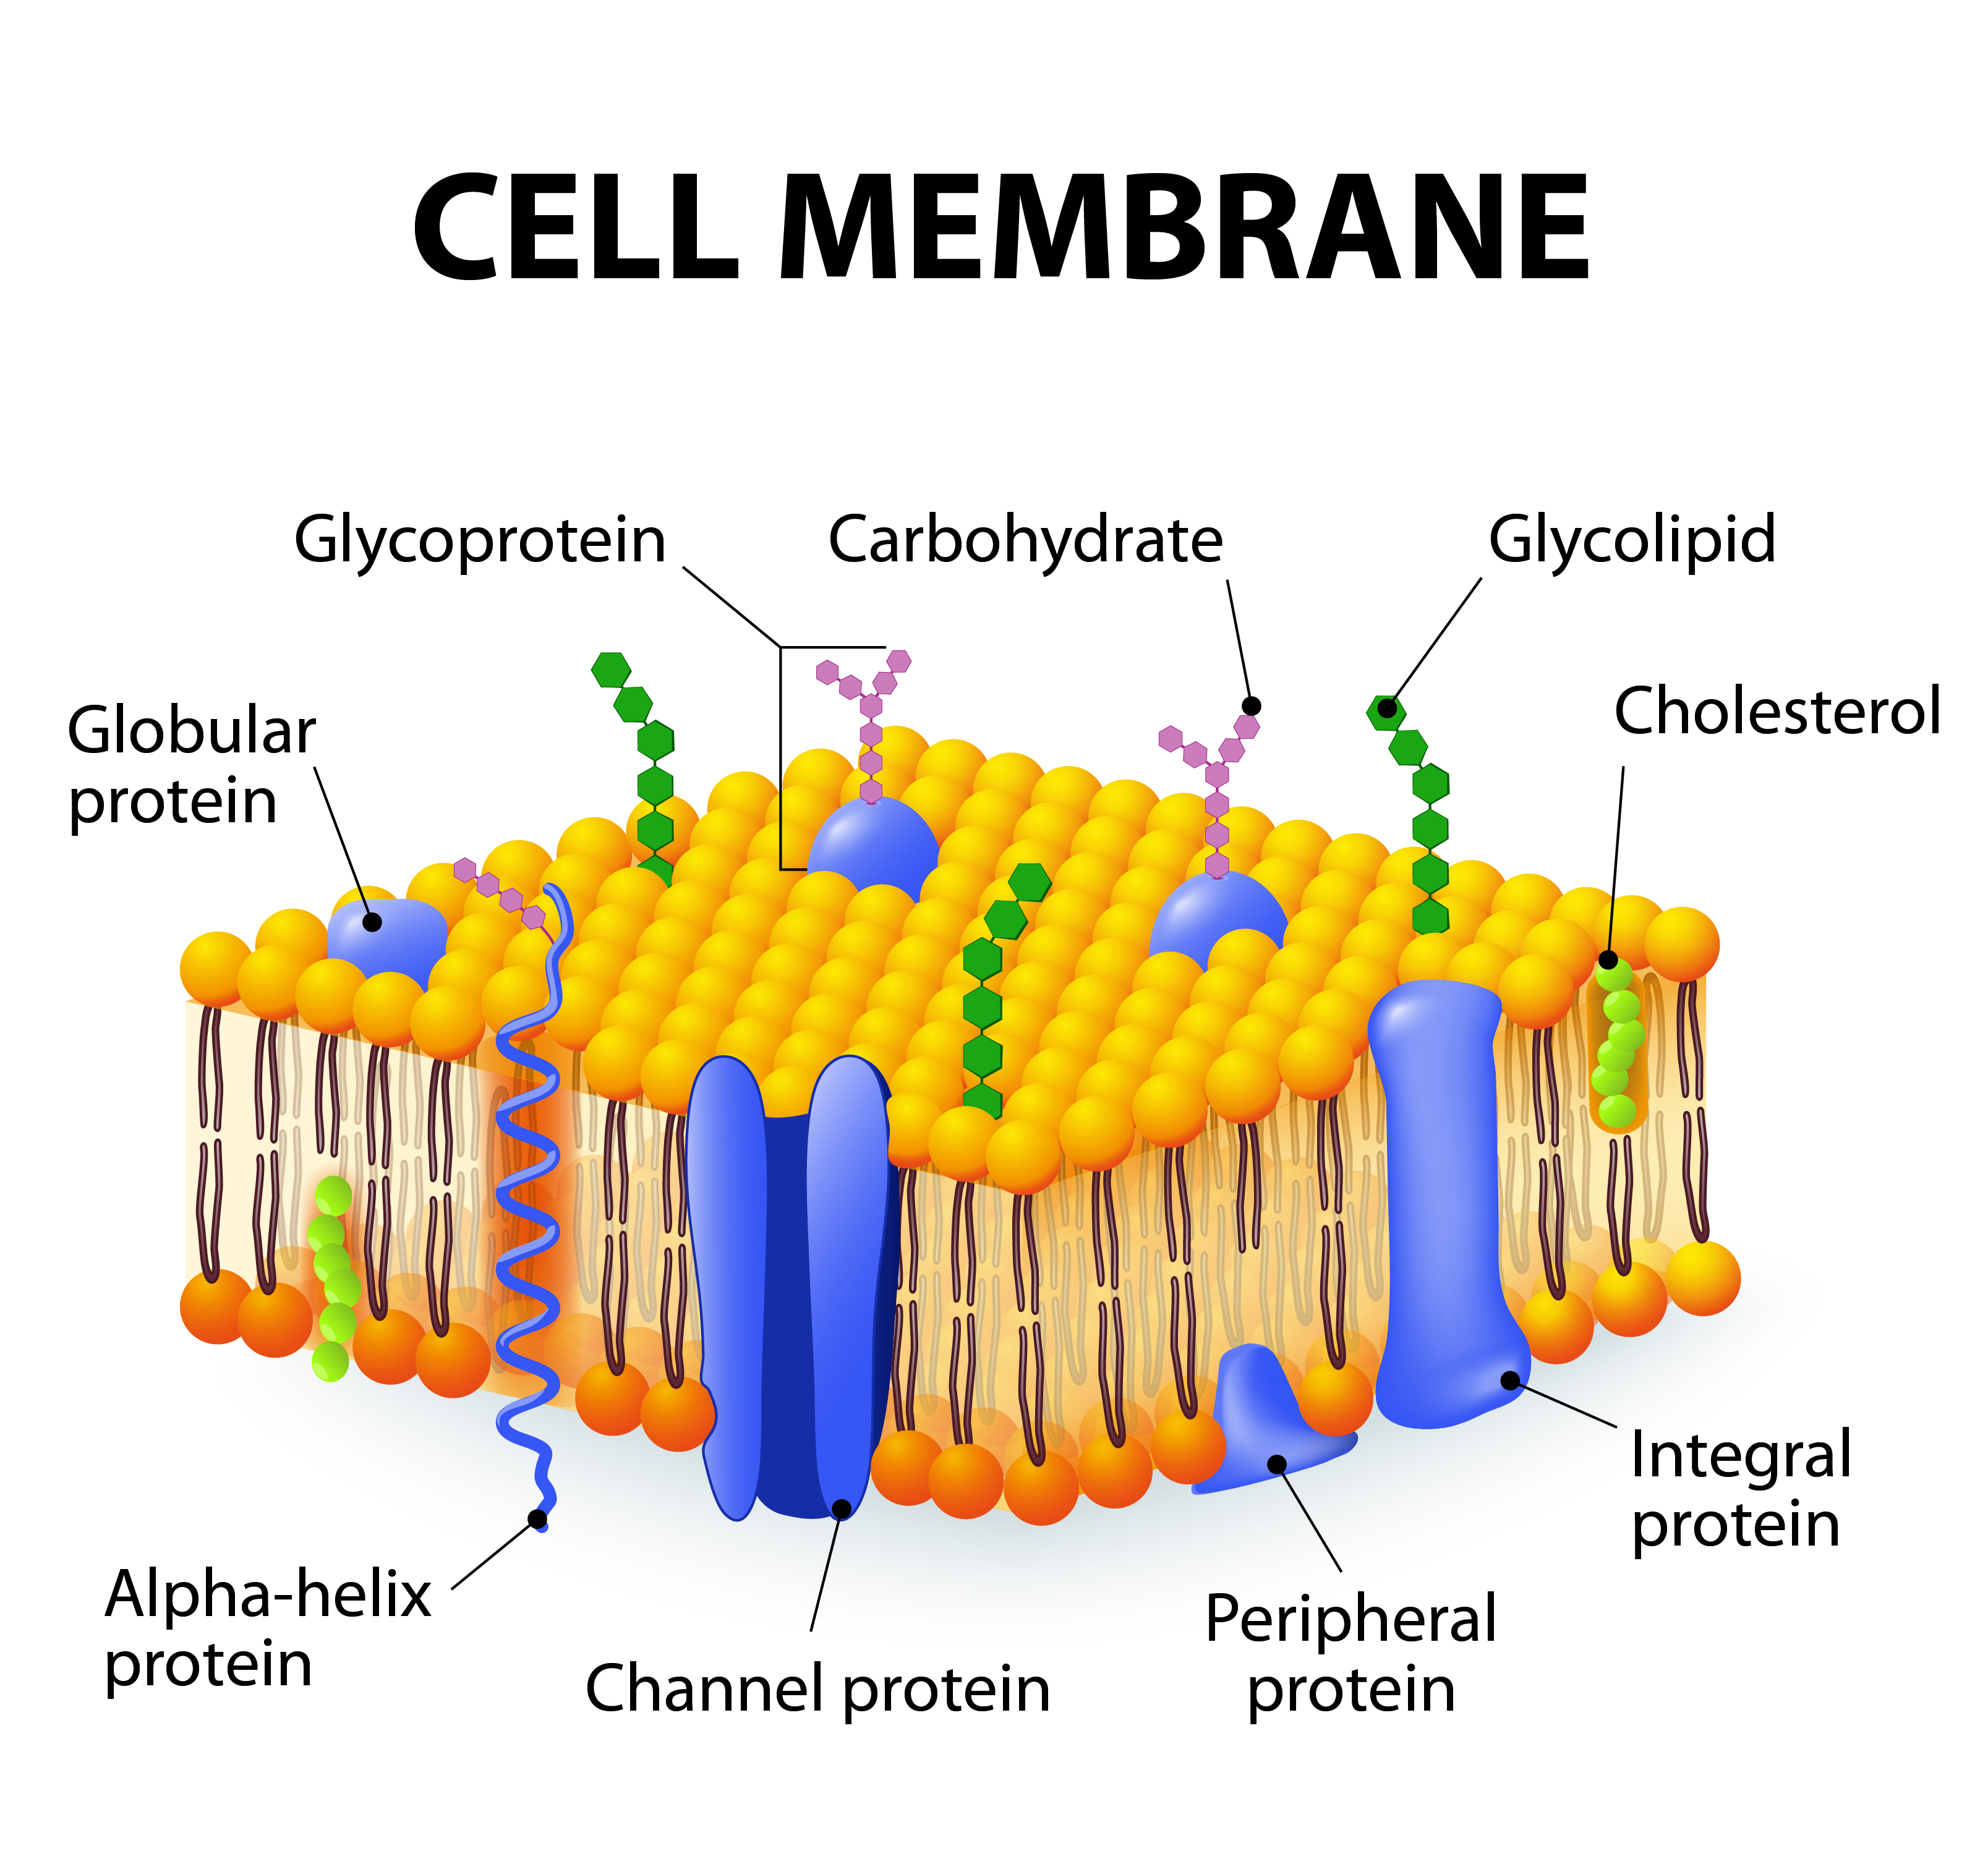
Cell membrane
A barrier around the cell. It controls what can come in and out of the cell.
Found in animal and plant cells.

Slide 35
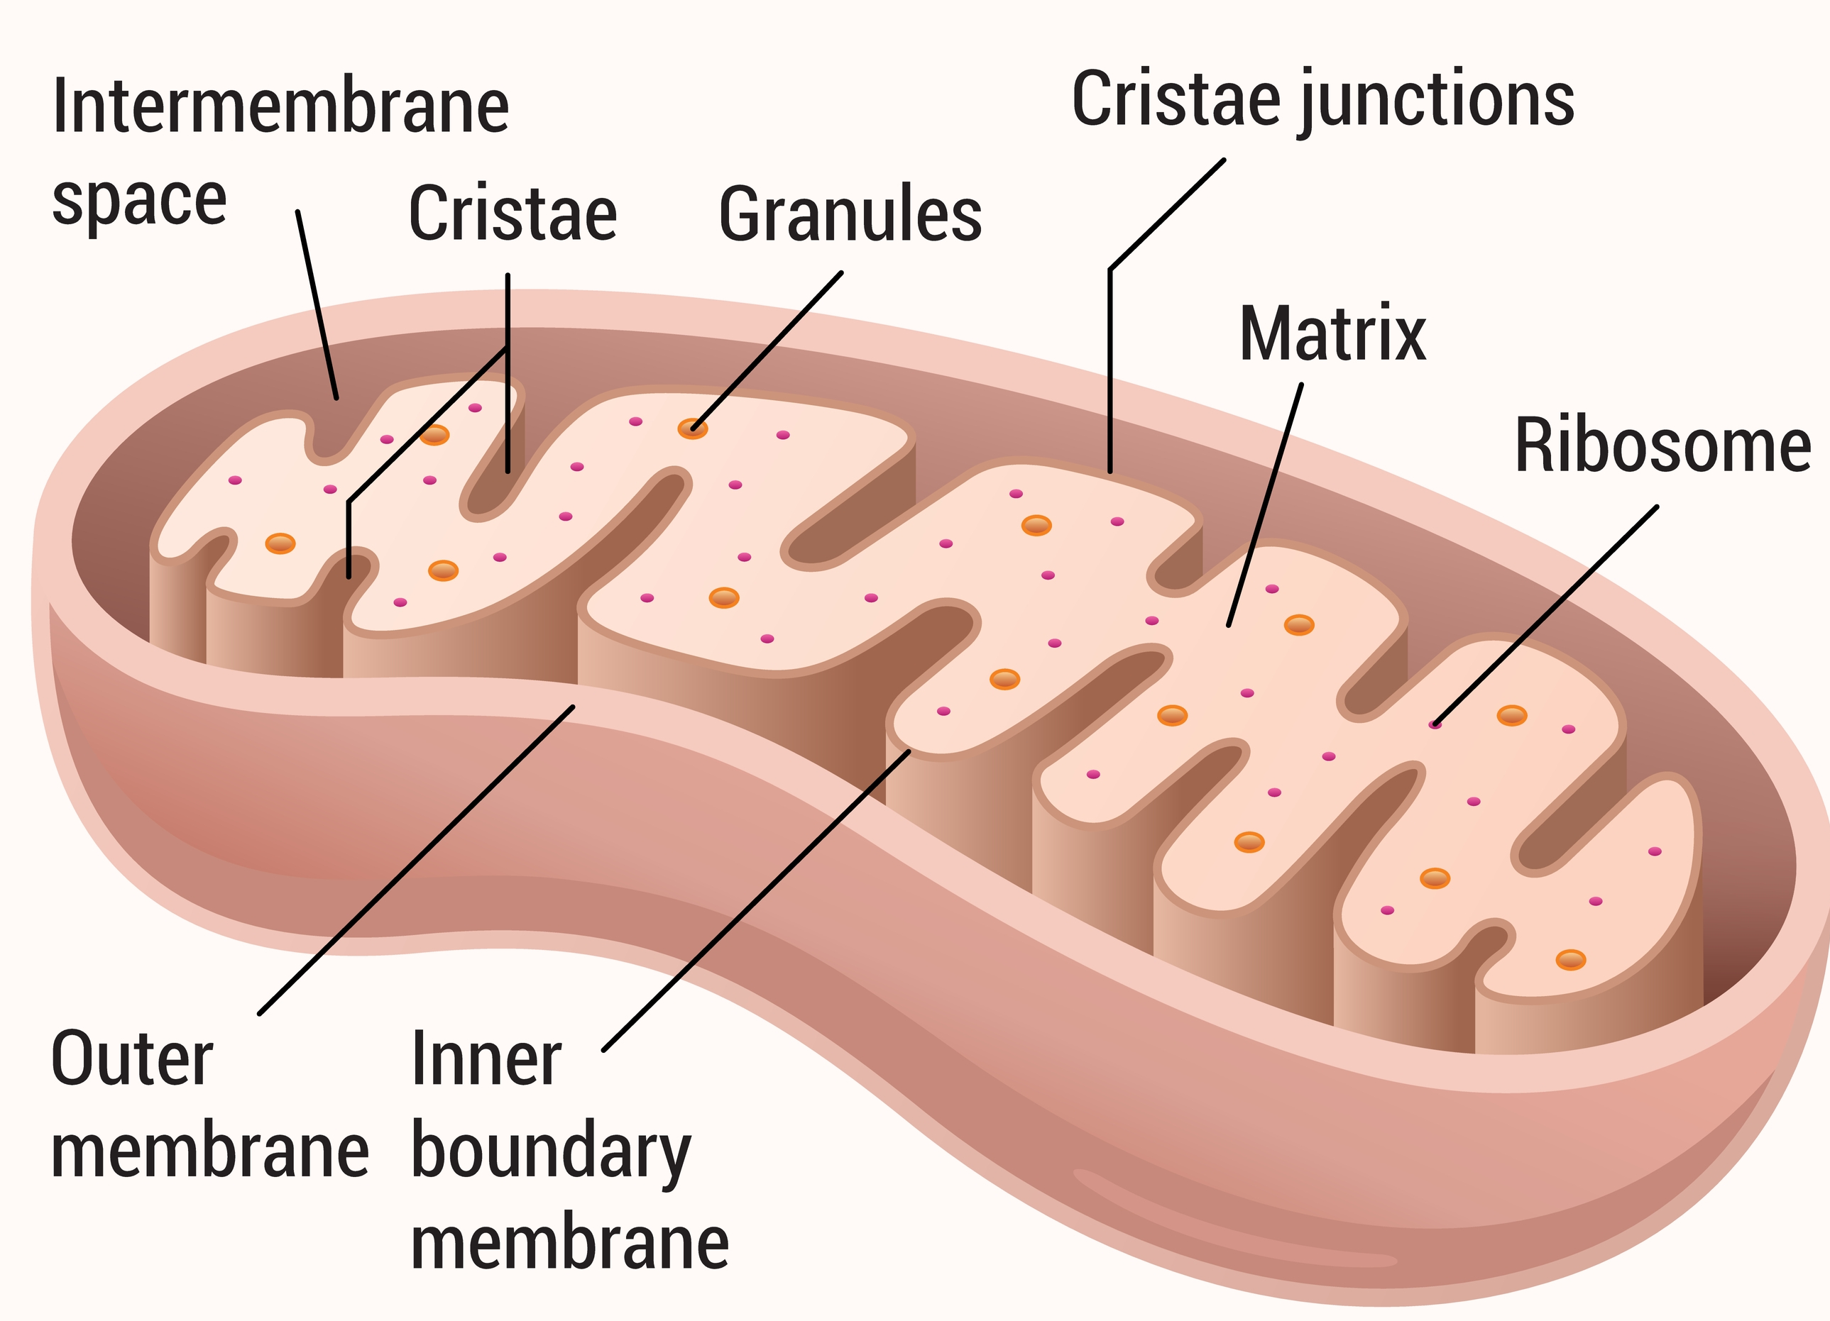
Mitochondria
Where respiration happens.
Respiration is a reaction that transfers energy for the organism.
Found in animal and plant cells.

Slide 36
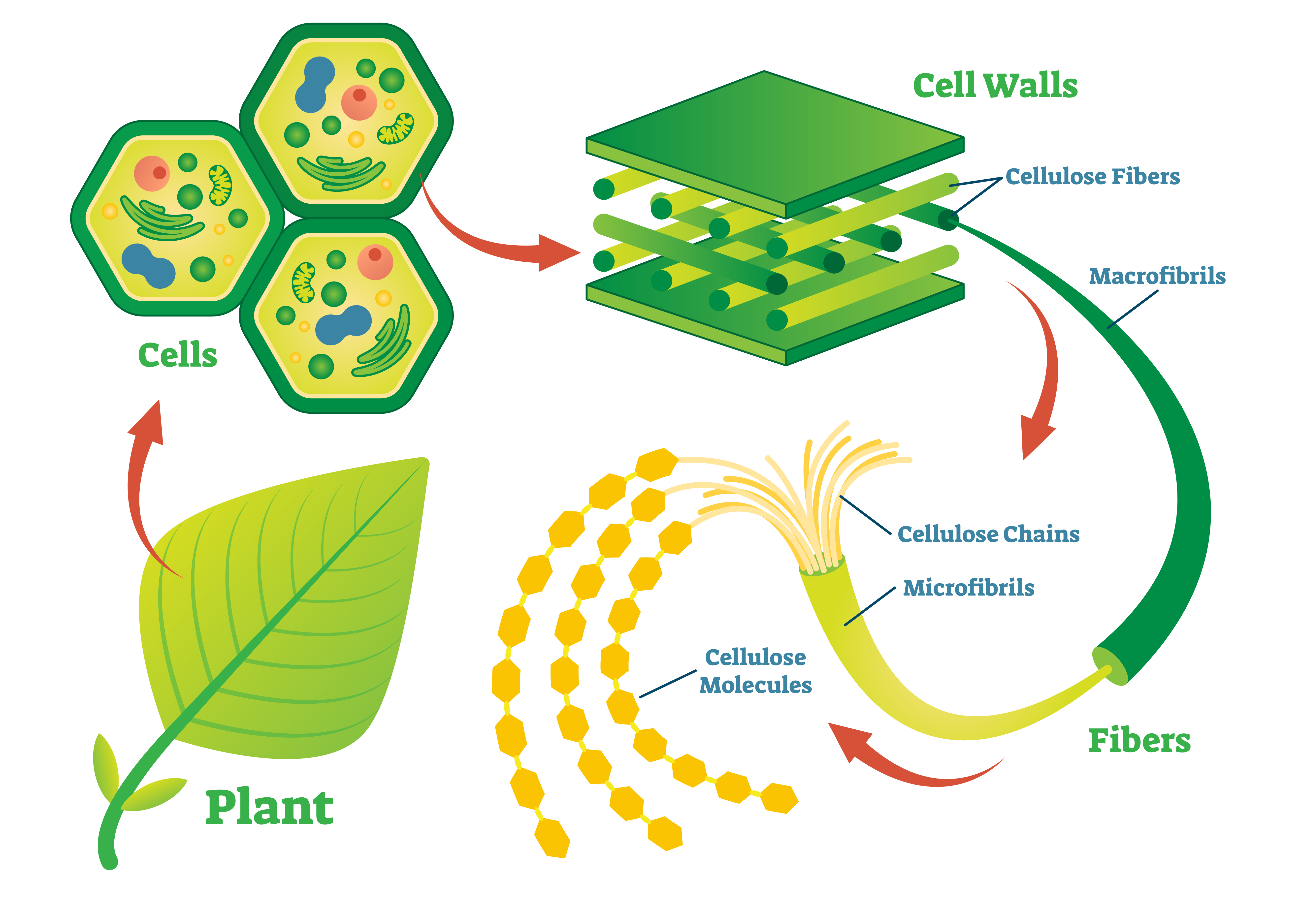
Cell wall
A structural layer surrounding cells.
Protects the cell and prevents damage/bursting. Provides rigidity.
Found only in plant cells.

Slide 37
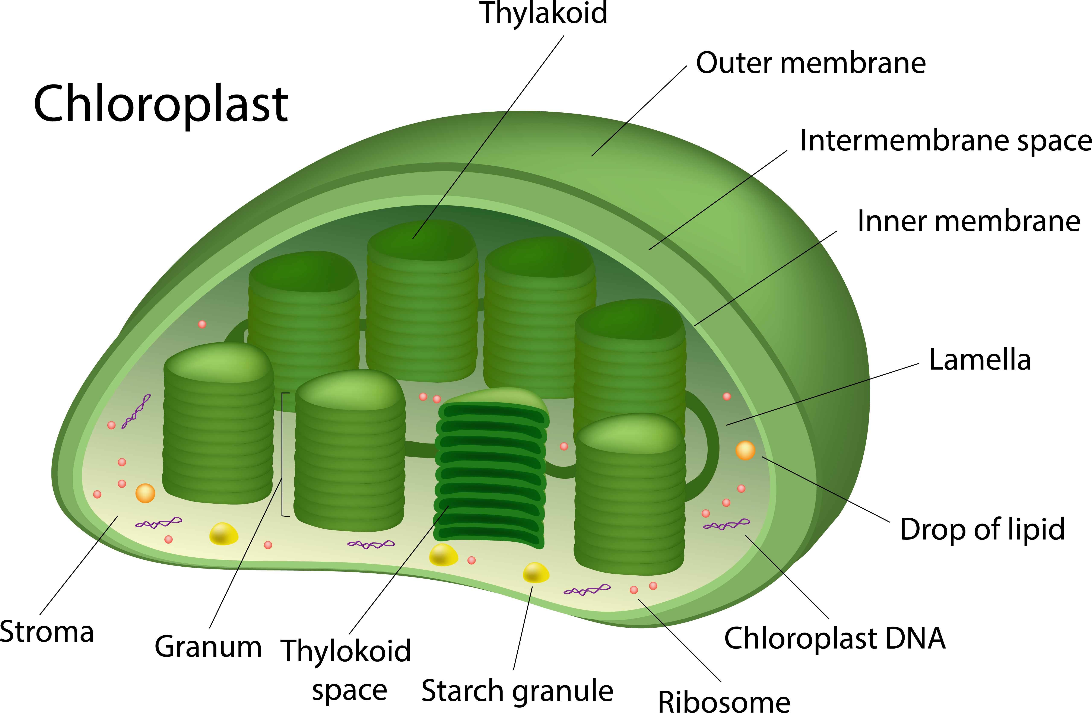
Chloroplasts
Found in all plant cells, but not found in animal cells.
Where photosynthesis happens.
Chloroplasts contain a green substance called chlorophyll which traps energy transferred from the sun.

Slide 38
Vacuole
Found in plant and animal cells, but perform different functions
Contains a watery liquid called cell sap and keeps the cell firm (in plants).
Vacuoles in animal cells are smaller and help to remove waste products.

Slide 39
Onion cells – using a microscope
For further information, go to:
www.foodafactoflife.org.uk
This science pack is one of a series of resources produced for the pHood Futures project, supported by the Royal Society of Chemistry.
This resource meets the Guidelines for producers and users of school education resources about food.

