Slide 1
Food contamination and spoilage

Slide 2


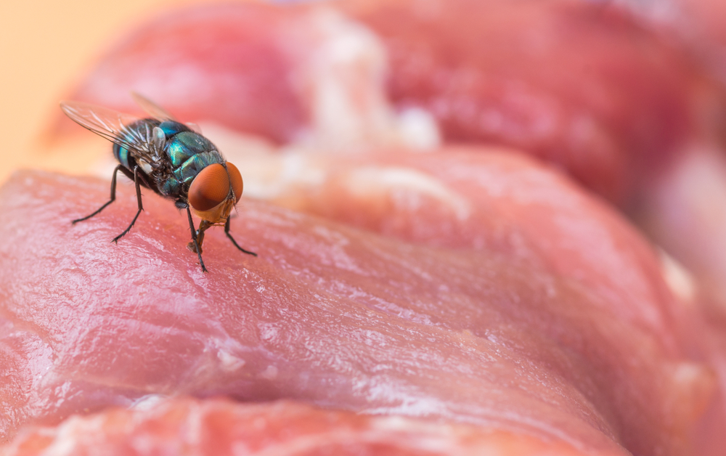

Food contamination
There are three ways which food can be contaminated:
physical;
chemical;
allergenic;
bacterial.

Slide 3
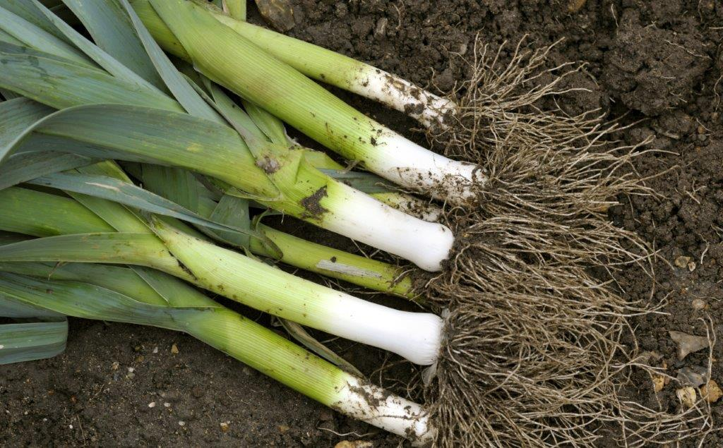
Physical contamination
Physical contamination can occur in a variety of ways at different stages of food processing and production. Some examples are:
• soil from the ground when harvesting;
• a bolt from a processing plant when packaging;
• a hair from a cook in the kitchen.
Care must be taken at each stage to prevent physical contamination.

Slide 4
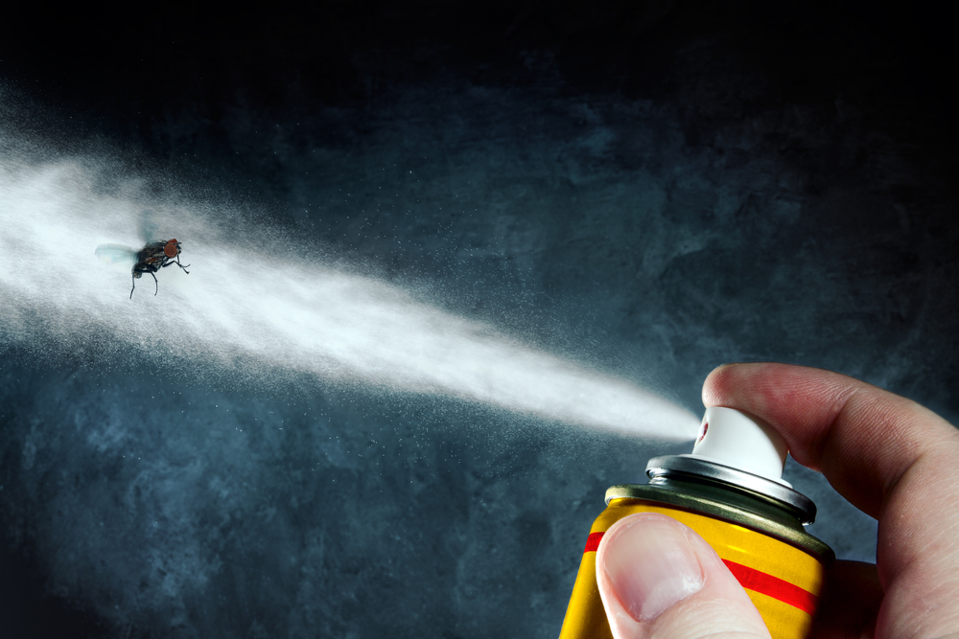
Chemical contamination
Chemical contamination can occur in a variety of ways at different stages of food processing and production. Some examples are:
chemicals from the farm;
a cleaning product used in the processing plant when packaging;
fly spray used in the kitchen when preparing food.
Care must be taken at each stage of food production to prevent chemical contamination.

Slide 5
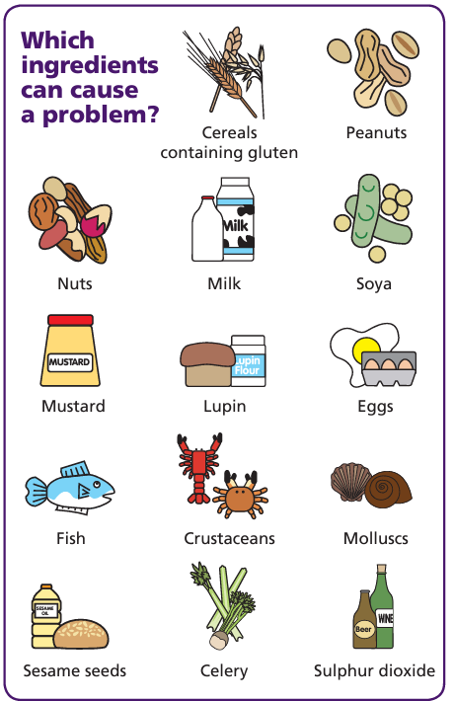
Allergenic contamination
Allergenic ingredients can cause severe adverse reactions to those people who are sensitive to the ingredients.
Allergic reactions can be caused by cross contamination of ingredients or food that contains an allergen.
Food can be contaminated due to poor cleaning of utensils or cross-contact during preparation.
Separate utensils, and areas, should be used when preparing and cooking foods containing allergens.
All food should be clearly labelled with allergen information.
FSA Think Allergy
FSA allergen information for businesses

Slide 6
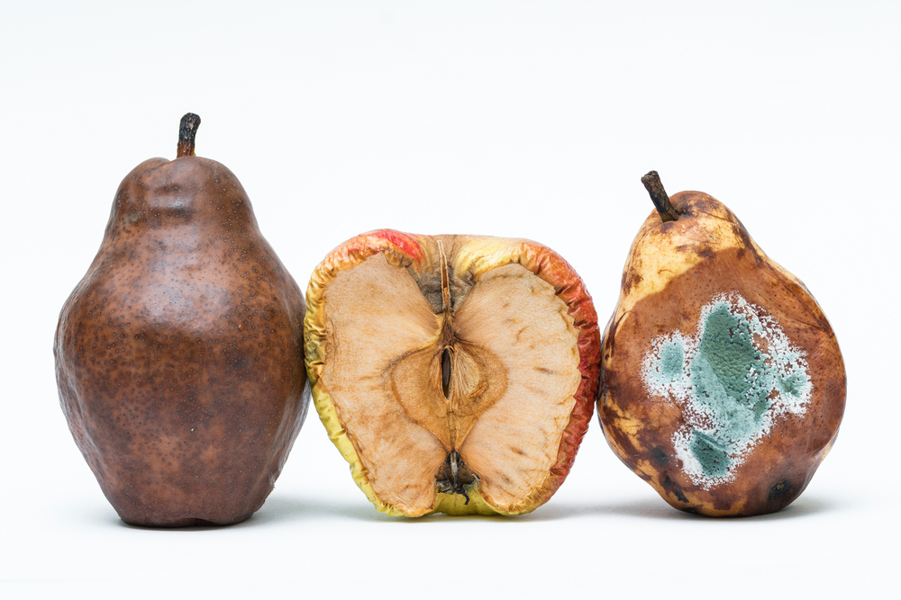
Bacterial contamination
As soon as food is harvested, slaughtered or manufactured into a product it starts to change. This is caused by two main processes:
autolysis – self destruction, caused by enzymes present in the food;
microbial spoilage – caused by the growth of bacteria, yeasts and moulds.

Slide 7
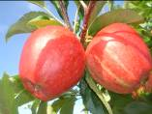
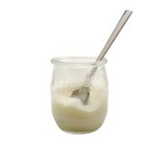
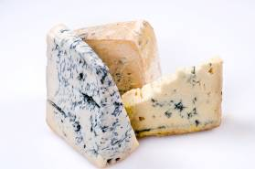
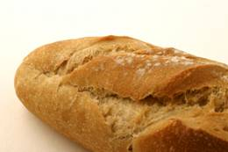
Desirable food changes
Autolysis and micro bacterial changes are sometimes desirable (and are not referred to as spoilage), for example enzymes cause fruit to ripen.
Here are some positive micro bacterial changes:
Bacteria in yoghurt production.
Mould in some cheeses, e.g. Stilton.
Yeast in bread production.

Slide 8
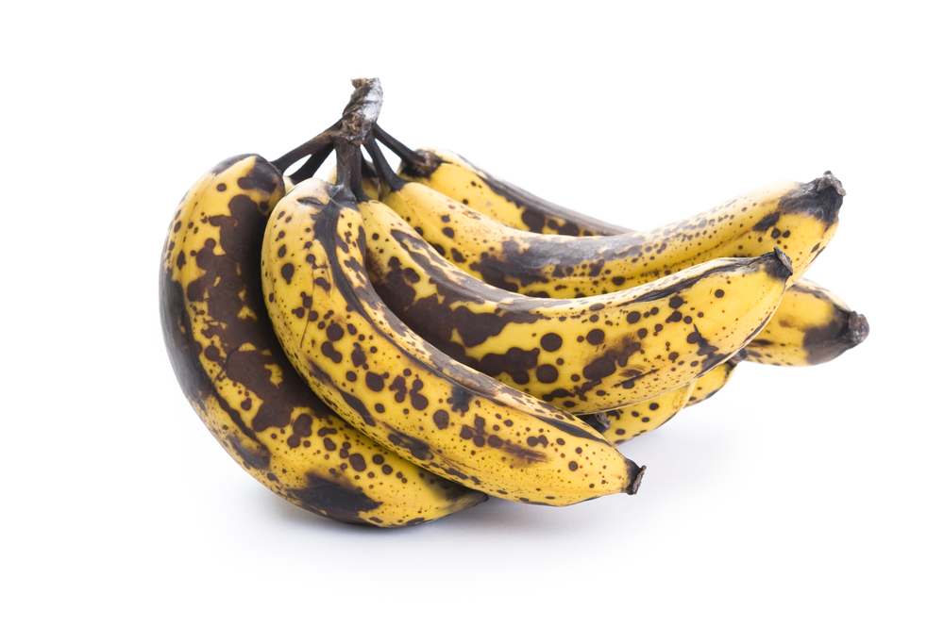
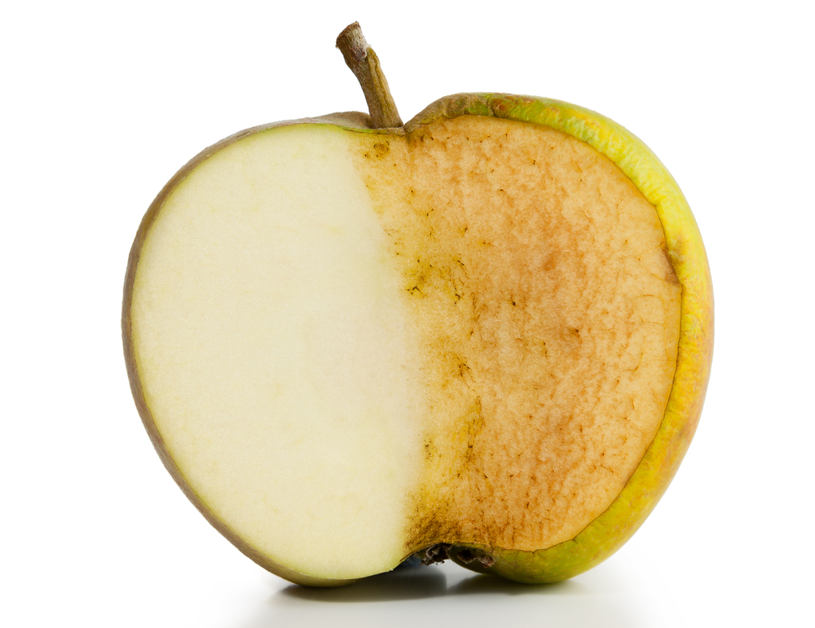
Autolysis – enzymes
Enzymes are chemicals that are found in food.
These chemicals have important uses in food. They can cause food to deteriorate in three main ways:
ripening – this will continue until the food becomes inedible, e.g. banana ripening;
browning – enzymes can react with air causing the skin of certain foods, e.g. potatoes and apples discolouring;
oxidation – loss of certain nutrients, such as vitamins A, C and thiamin from food, e.g. over boiling of green vegetables.

Slide 9
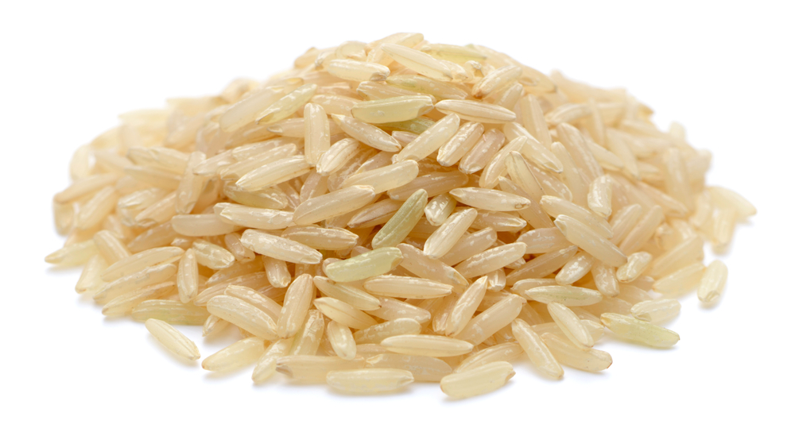
Microbial spoilage – bacteria
These are single celled micro-organisms (they cannot be seen by the naked eye) which are present naturally in the environment.
There are many different kinds, some are useful, e.g. in the production of yogurt, and some harmful.
The presence of bacteria in food can lead to digestive upset. Some bacteria produce toxins which can lead to this also.
Spores can also be produced by some bacteria leading to toxins being produced.
Bacillus cereous produces spores – rice should be cooled quickly to prevent multiplication

Slide 10
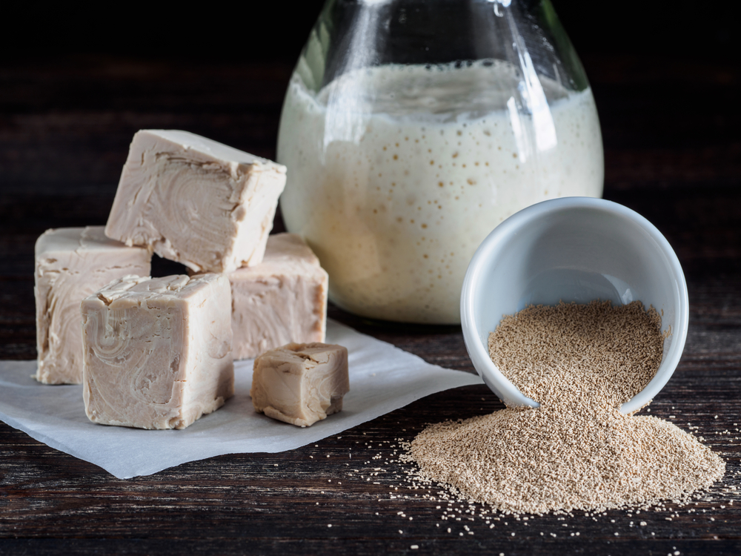
Microbial spoilage – yeast
Yeasts are single celled fungi which can reproduce by ‘budding’. This means that a small offshoot or bud separates from the parent yeast cell. Yeasts can also form spores which can travel through the air. These are easily killed by heating to 100ºC.
In warm, moist conditions in the presence of sugar, yeasts will cause foods like fruit to ferment producing alcohol and carbon dioxide gas.
Yeast is used in the production of bread and wine.

Slide 11
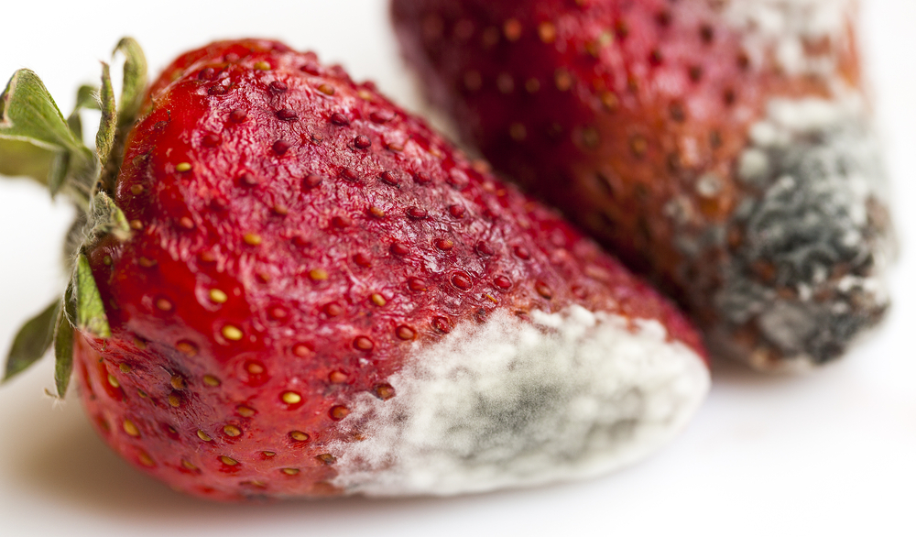
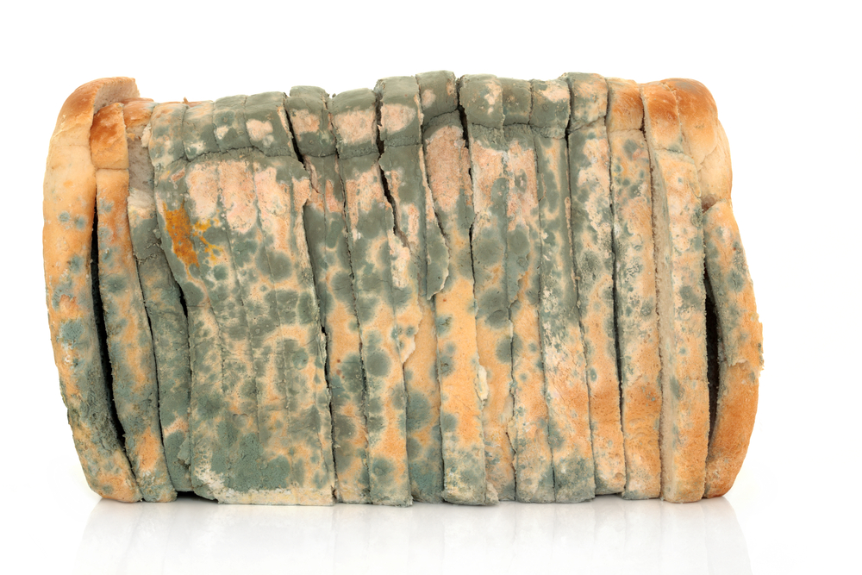
Microbial spoilage – mould
Moulds are fungi which grow as filaments in food. They reproduce by producing spores in fruiting bodies which can be seen on the surface of foods.
These fruiting bodies sometimes look like round furry blue-coloured growths, e.g. mould on bread.
Some moulds can be seen by the naked eye, e.g. on bread.

Slide 12
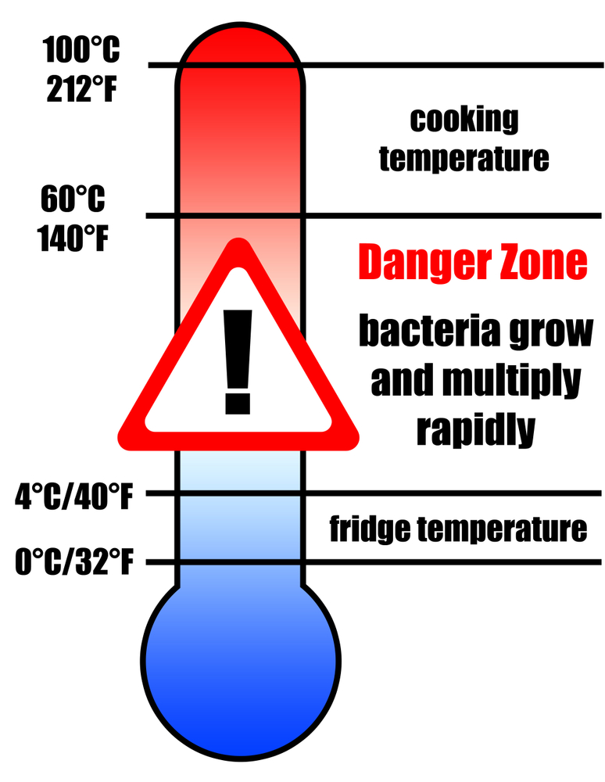
Conditions for bacterial growth
Micro-organisms need conditions to survive and reproduce these can include:
temperature;
moisture;
food;
time;
oxygen;
pH level.

Slide 13
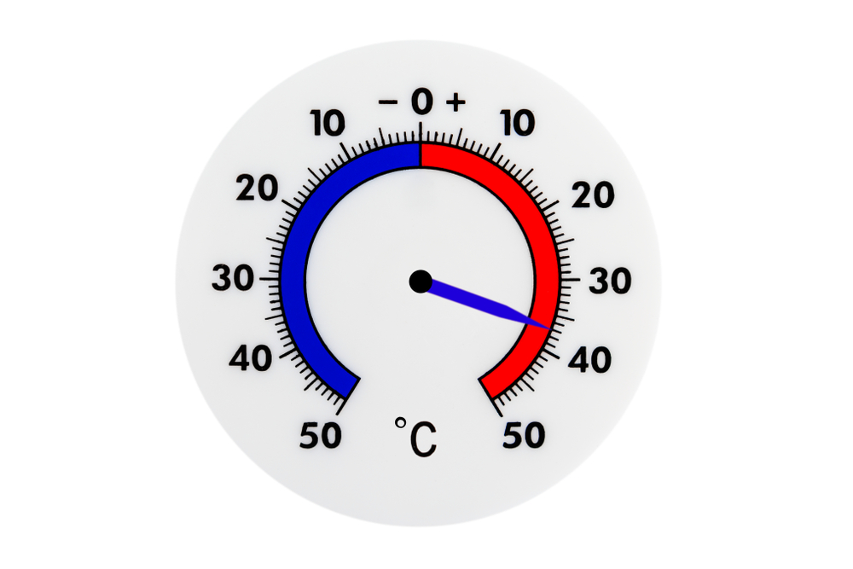
Conditions for bacterial growth
Temperature
Bacteria need warm conditions to grown and multiply.
The ideal temperature for bacterial growth is 30ºC – 37ºC.
Some bacteria can still grow at 10ºC and 60ºC. Most bacteria are destroyed at temperatures above 63 ºC. Bacterial growth danger zone in 5ºC - 63ºC.
At very cold temperatures, bacteria become dormant – they do not die, but they cannot grow or multiply.

Slide 14
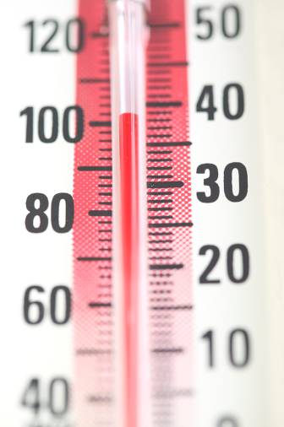
Temperature
100ºC Water boils
75ºC Core temperature of cooked/reheated food (82ºC in Scotland)
5ºC - 63ºC danger zone for rapid growth of micro-organisms
37ºC – optimum temperature for bacterial growth
1ºC - 4ºC temperature of fridge (good practice)
Below 8ºC temperature of fridge (legal)
0ºC Freezing point of water
-18ºC temperature of freezer

Slide 15
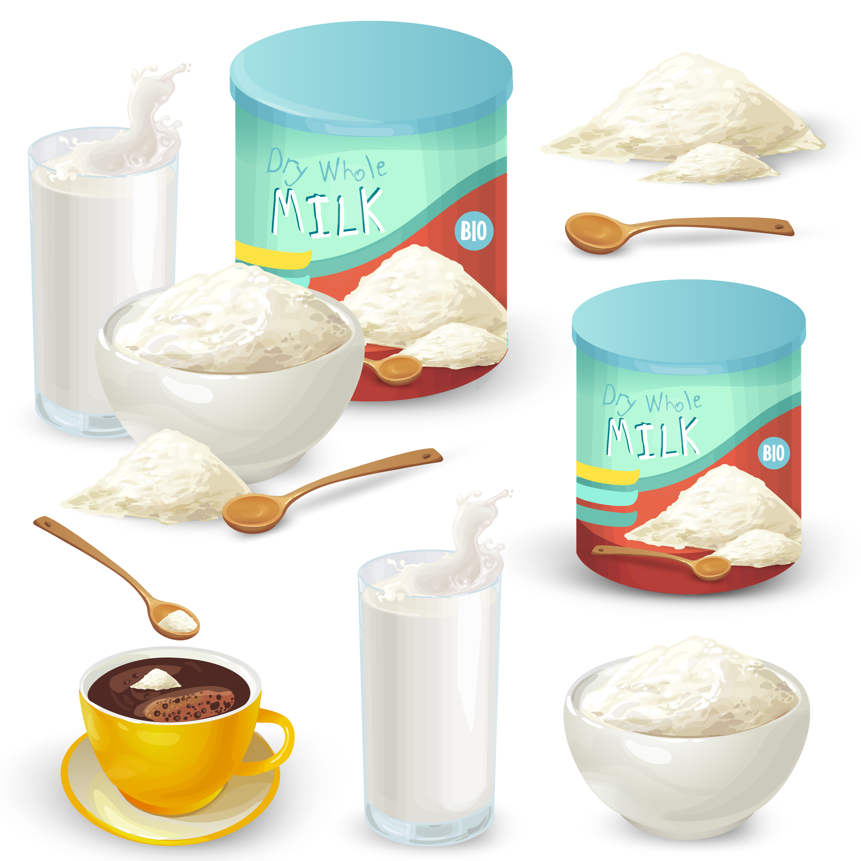
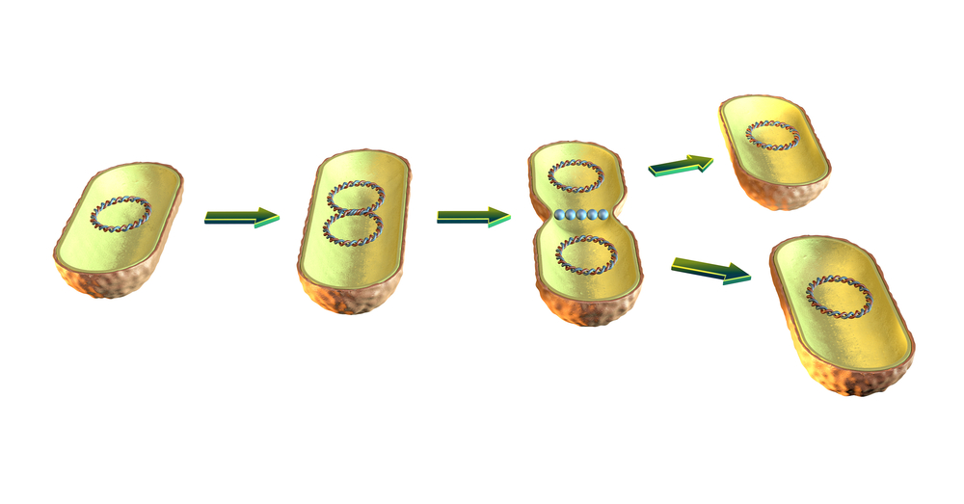
Conditions for bacterial growth
Moisture
Where there is no moisture bacteria cannot grow. However, bacteria and moulds can both produce spores which can survive until water is added to the food.
Food
Bacteria need a source of food to grow and multiply, these food usually contain large amounts of water and nutrients. Food where bacteria rapidly multiple in are called high risk foods.
Time
One bacterium can divide into two every 10-20 minutes.

Slide 16
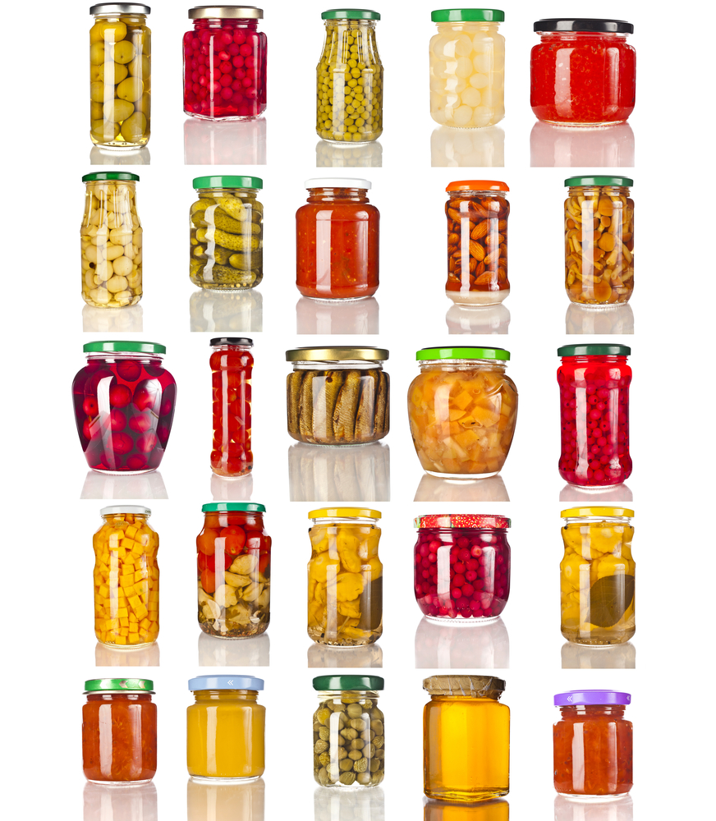
Conditions for bacterial growth
Oxygen
Some bacteria need oxygen to grow and multiply. These are called aerobic bacteria. Other bacteria grow well when there is no oxygen present, these are known as anaerobic bacteria.
pH level
An acidic or alkaline environment can promote or inhibit microbial growth. Most bacteria prefer a neutral pH (6.6 – 7.5). Moulds and yeasts can survive at pH levels of 1-1/5 (very acidic), food spoilage usually occurs by yeast and moulds.

Slide 17
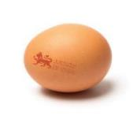
High risk foods
High risk foods include:
meat, meat products and poultry;
milk and dairy products;
eggs – uncooked and lightly cooked;
shellfish and seafood;
prepared salads and vegetables;
cooked rice and pasta.
Lion mark hen eggs can now be eaten raw or lightly cooked. Although people who have a severely weakened immune system and who are on a medically supervised diet prescribed by health professionals should cook all eggs thoroughly, even eggs that have the Red Lion stamp.

Slide 18
Food contamination and spoilage
For further information, go to:
www.foodafactoflife.org.uk
This resource meets the Guidelines for producers and users of school education resources about food.

