Slide 1
Animals

Slide 2
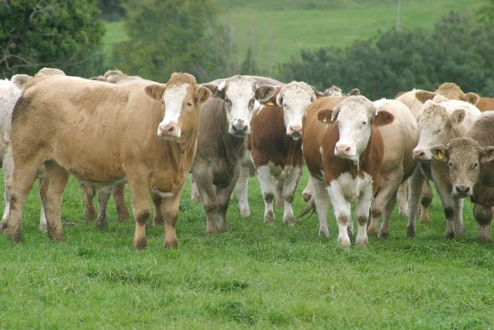
What are these?
Text here
Beef cattle

Slide 3
What do we call the meat we get from beef cattle?
Text here
Beef

Slide 4
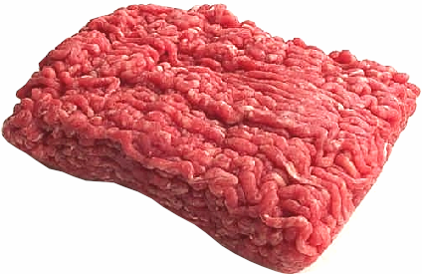
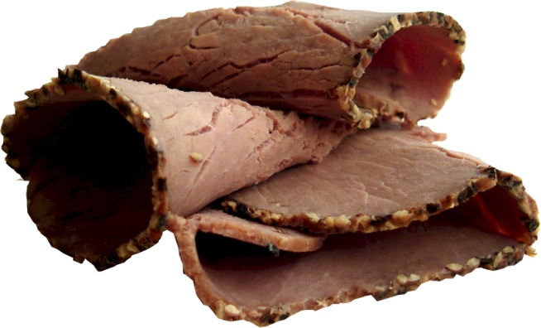
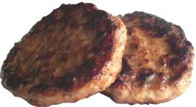
What foods are made from beef?
Minced beef
Roast beef
Beef burgers

Slide 5
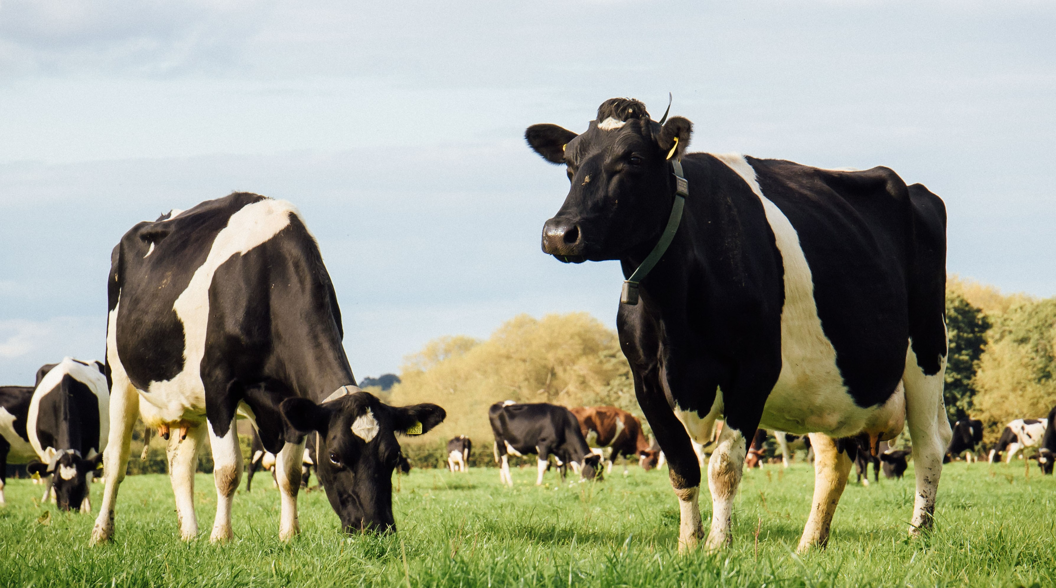
What is this?
A dairy cow

Slide 6
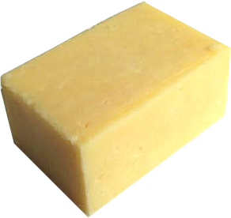
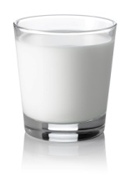
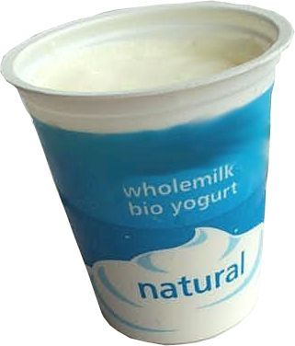
Can you guess what foods come from a dairy cow?
What foods are made from milk?
Cheese
Milk
Yogurt

Slide 7
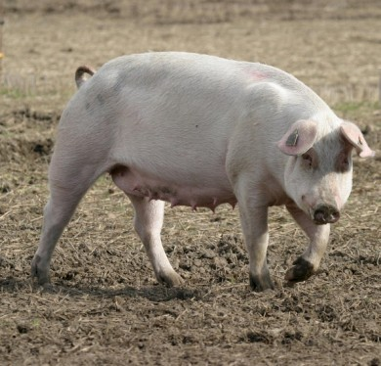
What is this?
A pig

Slide 8
What do we call the meat we get from pigs?
Pork

Slide 9
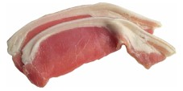
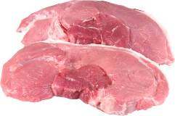
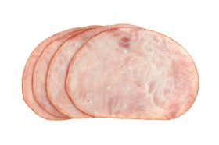
What foods are made from pork?
Bacon
Pork steaks
Ham

Slide 10
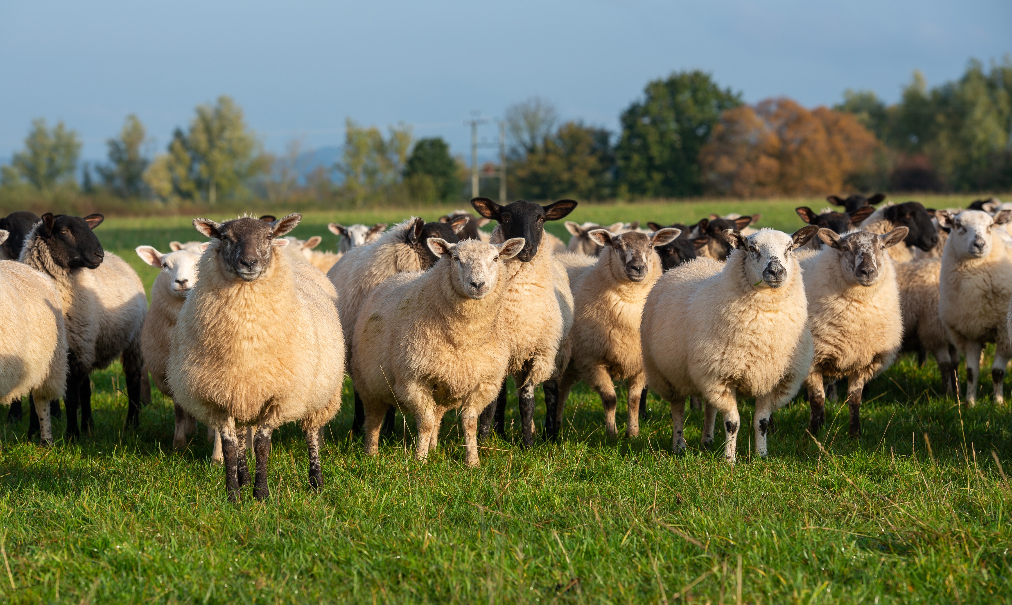
What can you see here?
Sheep

Slide 11
What do we call the meat we get from lambs?
Lamb

Slide 12
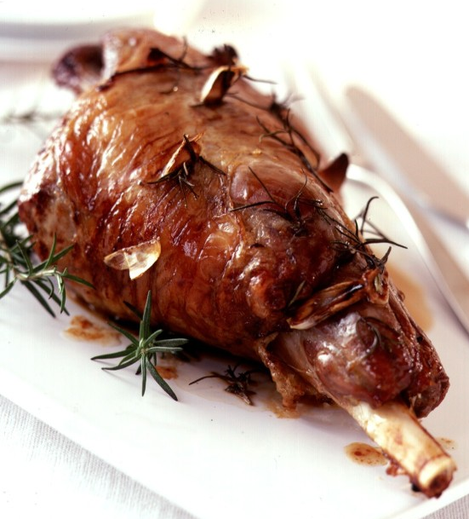
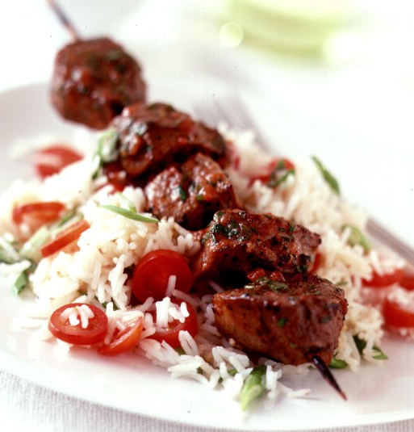
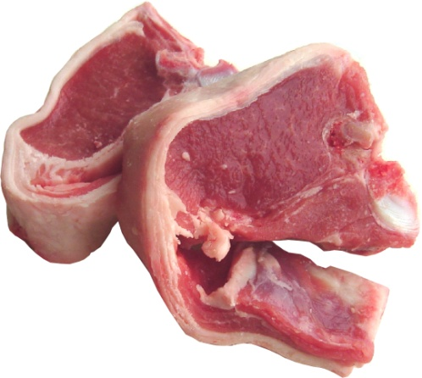
What foods are made from lamb?
Roast lamb
Lamb chops
Lamb kebab

Slide 13
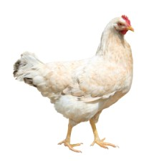
What can you see here?
A chicken

Slide 14
What do we call the meat we get from chickens?
Chicken
Chickens which provide meat are called broilers.

Slide 15
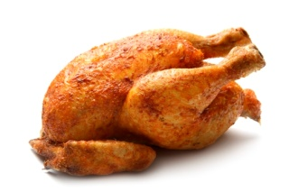
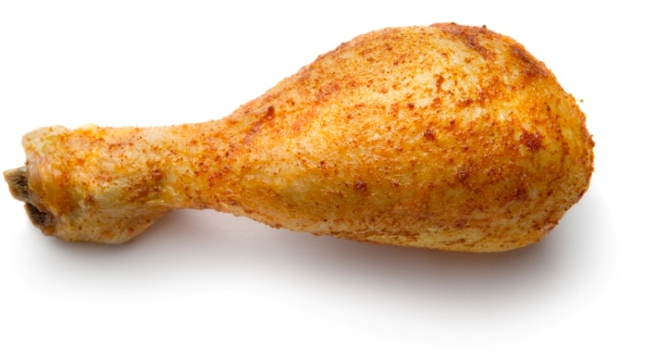
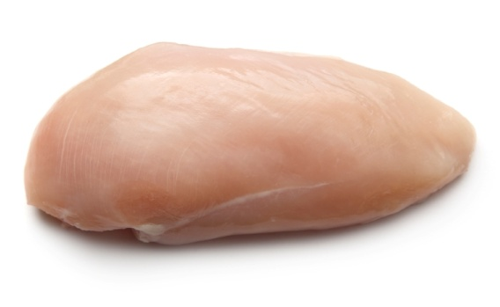
What foods come from chicken?
Chicken drumstick
Roast chicken
Chicken breast

Slide 16
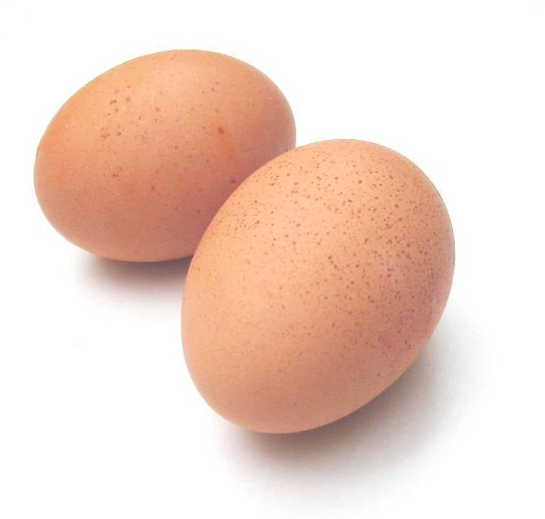
What other food can we get from chickens?
Eggs
Chickens that lay eggs are called hens.

Slide 17
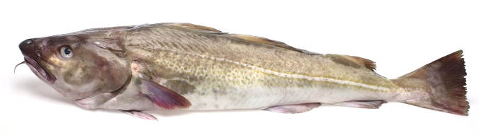
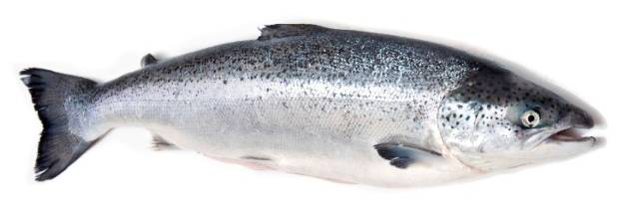
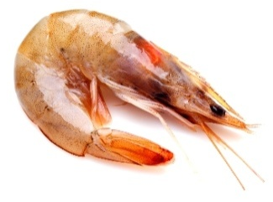
What can you see here?
Fish
There are lots of different types of fish.
Here is a cod, a salmon and a prawn.

Slide 18
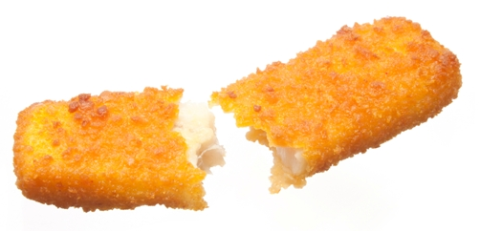
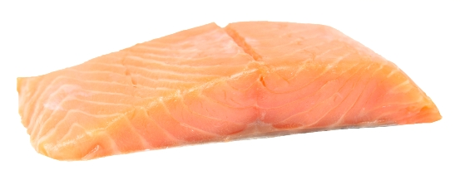
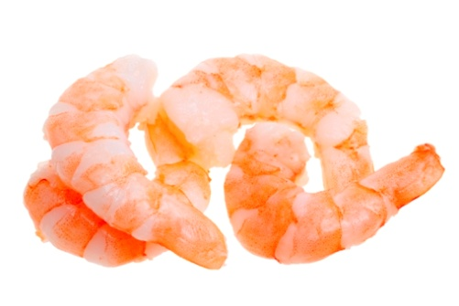
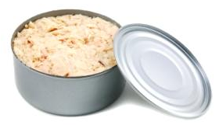
What foods come from fish?
Salmon
Fish fingers
Prawns
Canned tuna

Slide 19


All these foods come from beef cattle
Beef cattle
Can you think of any more?

Slide 20
All these foods come from dairy cows
Dairy cows
Can you think of any more?

Slide 21



All these foods come from lambs
Sheep
Can you think of any more?

Slide 22


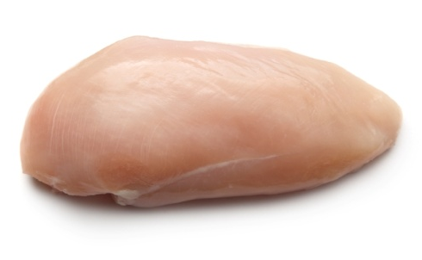
All these foods come from chickens
Chicken
Can you think of any more?

Slide 23
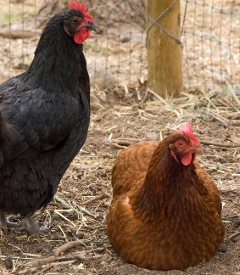
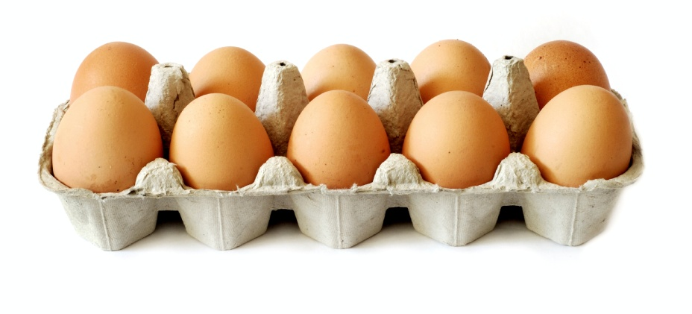
Eggs come from hens
Hens

Slide 24


All these foods come from different types of fish
Fish
Can you think of any more?

Slide 25
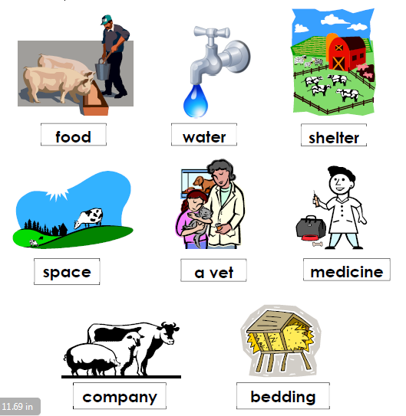
Animals need to be looked after so they are healthy. Here are some of the things they need:

Slide 26
Animals
For further information, go to:
www.foodafactoflife.org.uk
This resource meets the Guidelines for producers and users of school education resources about food.

