Slide 1
Food spoilage, hygiene and safety

Slide 2

Starter
How can food become contaminated?
What happens if we leave food out for too long?
Why do we need to cook food?
Extension
How can we make sure we are cooking food without making ourselves sick?
Key word: Contaminated – to make something impure by exposure to or addition of a poisonous or polluting substance.

Slide 3
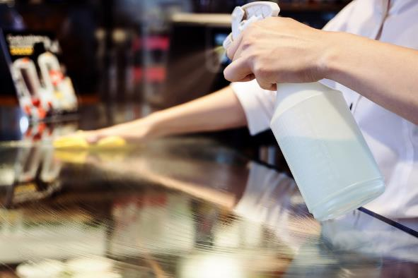
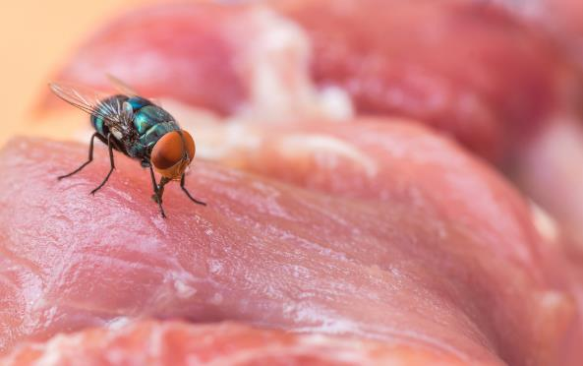
Food contamination
There are four ways which food can be contaminated:
physical;
chemical;
bacterial;
allergenic.

Slide 4
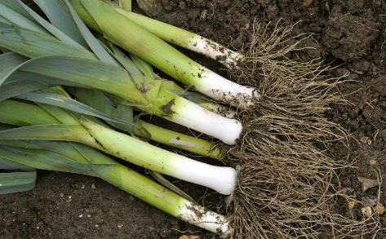
Physical contamination
Physical contamination can occur in a variety of ways at different stages of food processing and production. Some examples are:
• soil from the ground when harvesting;
• a bolt from a processing plant when packaging;
• a hair from a cook in the kitchen.
Care must be taken at each stage to prevent physical contamination.

Slide 5
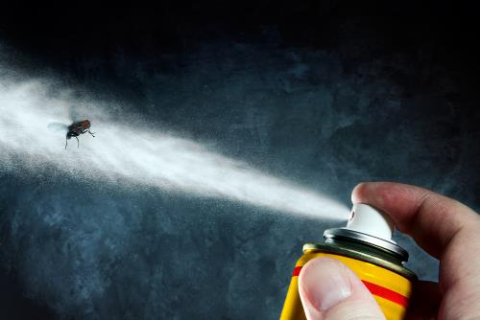
Chemical contamination
Chemical contamination can occur in a variety of ways at different stages of food processing and production. Some examples are:
chemicals from the farm;
a cleaning product used in the processing plant when packaging;
fly spray used in the kitchen when preparing food.
Care must be taken at each stage of food production to prevent chemical contamination.

Slide 6
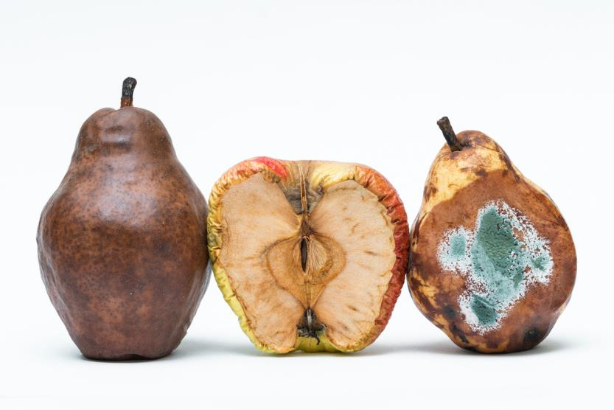
Bacterial contamination
As soon as food is harvested, slaughtered or manufactured into a product it starts to change. This is caused by two main processes:
autolysis – self destruction, caused by enzymes present in the food;
microbial spoilage – caused by the growth of bacteria, yeasts and moulds.

Slide 7
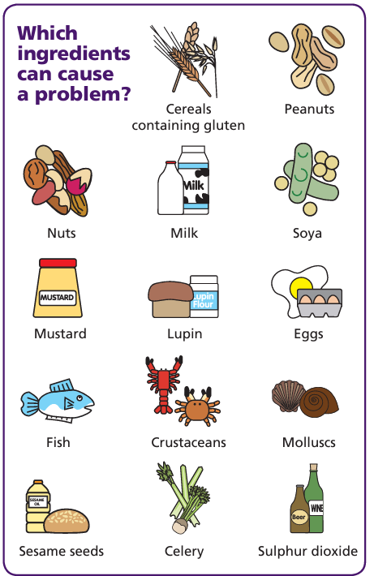
Cross contamination – allergenic ingredients
Allergenic ingredients can cause severe adverse reactions to those people who are sensitive to the ingredients.
Allergic reactions can be caused by cross contamination of ingredients or food that contains an allergen.
Food can be contaminated due to poor cleaning of utensils or cross-contact during preparation.
Separate utensils, and areas, should be used when preparing and cooking foods containing allergens.
All food should be clearly labelled with allergen information.
FSA Think Allergy
FSA allergen information for businesses

Slide 8
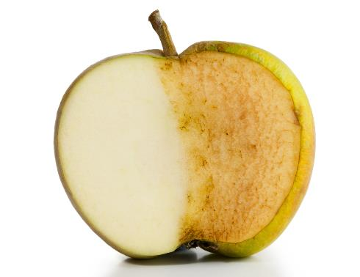


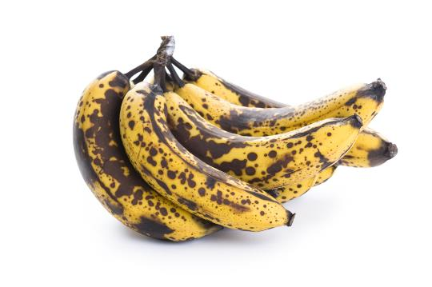


Which type of contamination?

Slide 9
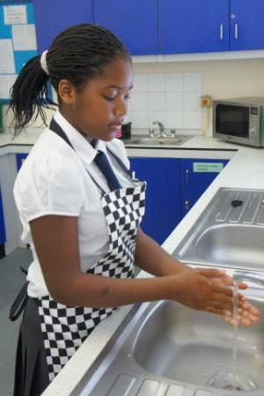
Why is personal hygiene important?
Your hands, hair, face, skin, clothing and jewellery can all be a source of bacteria which can be transferred onto food.
This is known as cross-contamination.
Good personal hygiene is important to prevent the risk of food poisoning.

Slide 10
Getting ready to cook – match up
Dry your hands
Bacteria can live on your hair and scalp and can easily be transferred onto food
Remove jumpers and roll up long sleeves
Tie up long hair
Jumpers and long sleeves may have dirt or bacteria on them
Remember to thoroughly dry them as bacteria can multiply more rapidly on damp hands.
Your hands may look clean, but you can’t see bacteria.
Wear an apron
Your clothes may have dirt, bacteria or hair on them
They can harbour dirt and bacteria which can get into food
Wash hands with warm soapy water
Remove jewellery and watches

Slide 11
Getting ready to cook – match up
Remove jumpers and roll up long sleeves
Wash hands with warm soapy water
Tie up long hair
Bacteria can live on your hair and scalp and can easily be transferred onto food
Jumpers and long sleeves may have dirt or bacteria on them
Your hands may look clean, but you can’t see bacteria.
Wear an apron
Remove jewellery and watches
Dry your hands
Your clothes may have dirt, bacteria or hair on them
They can harbour dirt and bacteria which can get into food
Remember to thoroughly dry them as bacteria can multiply more rapidly on damp hands.

Slide 12
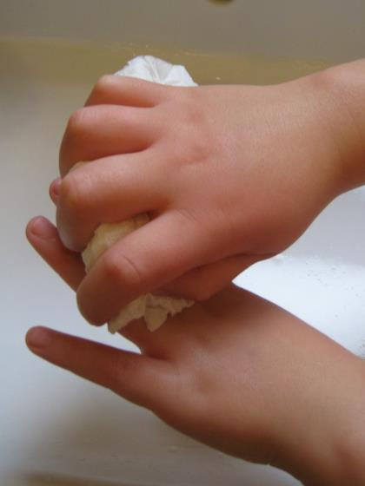
Hand washing
Six steps to effective hand washing
Wet hands thoroughly and squirt liquid soap (preferably anti-bacterial) onto the palm of one hand.
Rub your hands together to make a lather.
Rub the palm of one hand along the back of the other and along the fingers. Then repeat with the other hand.
Rub in between each of your fingers on both hands and round your thumbs.
Rinse off the soap with clean hot water.
Dry hands thoroughly using clean paper towels.

Slide 13


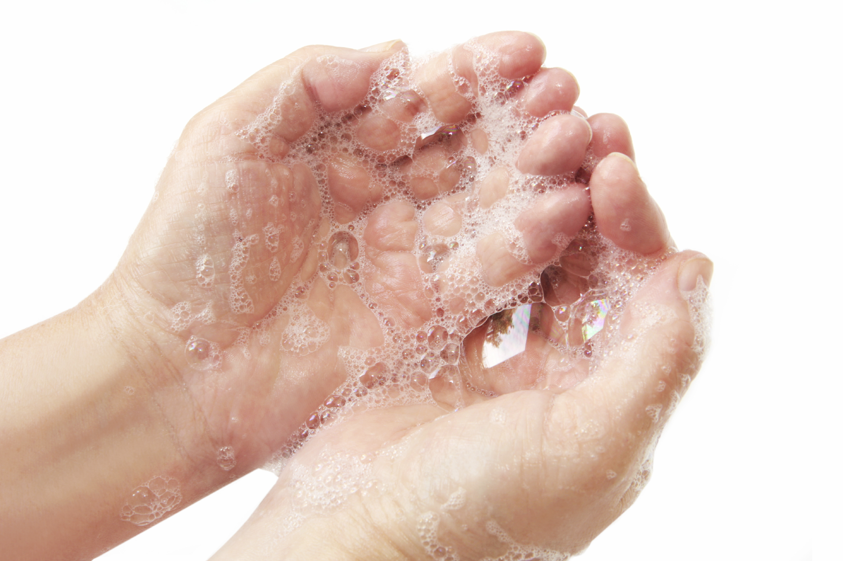


How to wash your hands
Thinking of the six steps in the previous slide, create a poem or song to describe how you wash your hands and why it is important.
Remember, washing your hands removes bacteria which can help you avoid becoming sick!

Slide 14
Food hygiene - The 4 Cs
Cleaning | Cooking
Chilling | Cross contamination
Food hygiene is necessary in order to produce and supply food which is safe to eat. This involves more than just being clean.
A simple way to remember is the 4 Cs. Copy down the table and write down why each is important.

Slide 15
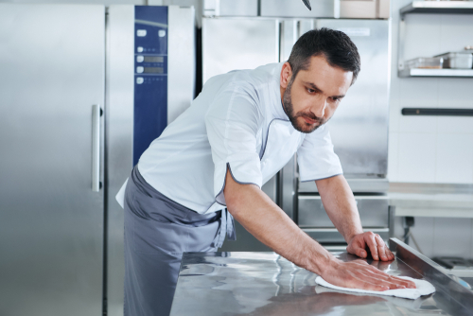
Cleaning
Cleaning the kitchen is important to keep food safe and prevent bacteria from spreading.
‘Clean as you go’ means people make sure that they clean the area and utensils they have been working in or with, as they prepare food.
This avoids build-up of mess and leads to better hygienic conditions.

Slide 16
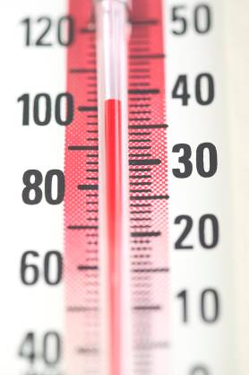
Cooking
Hot food must be served piping hot (above 63ºC).
Bacteria will begin to die when the temperature rises above 60ºC.
Some foods change colour when they are cooked.
Cooking food thoroughly to a minimum core temperature of 75°C will ensure most bacteria are destroyed.

Slide 17
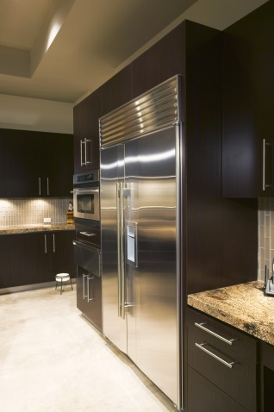
Chilling
The bacteria that cause food to deteriorate and lead to food poisoning rapidly reproduce around the temperature of 37ºC (body temperature). This is known as the ‘optimum temperature’ for bacterial multiplication.
The temperature between 5ºC– 63ºC is known as the ‘danger-zone’. Bacterial will multiply most rapidly within this temperature range.
Reducing the temperature below 5ºC slows the reproduction of microorganisms.
Cold temperatures do not kill bacteria.

Slide 18
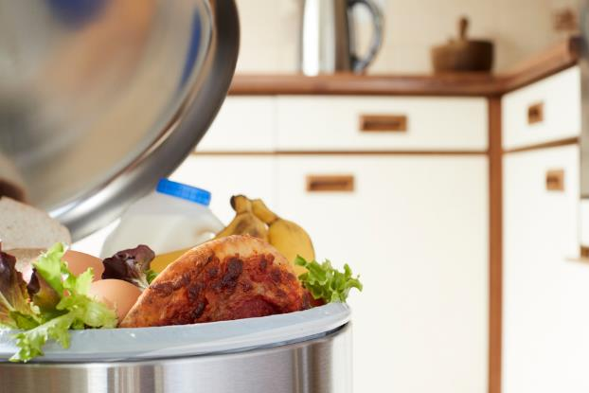
Cross contamination
The process by which bacteria are transferred from one area to another.
The main carriers of bacteria and causes of cross contamination are:
• humans;
• rubbish;
• pets and other animals;
• food, e.g. raw meat or poultry.

Slide 19

Preventing cross-contamination
In order to prevent cross-contamination during food preparation and cooking, it is also important to:
avoid touching your face or hair;
wash your hands regularly when cooking, especially after handling raw food, blowing your nose, touching the bin and using the toilet;
do not cough or sneeze over food;
cover cuts and sores with a waterproof dressing;
never handle food if you are suffering from a stomach upset or skin infection.

Slide 20
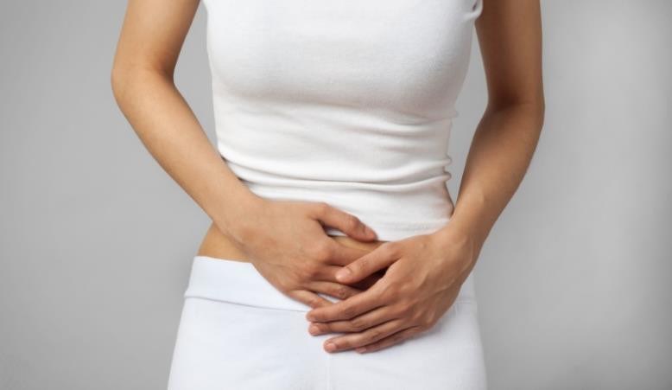
Food poisoning
What is food poisoning?
What are the symptoms?
Discuss with the person next to you.

Slide 21
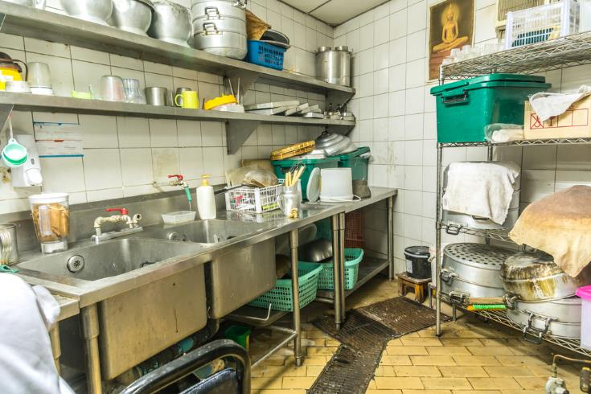
Food poisoning
Food poisoning is a food borne illness resulting from consumption of contaminated or toxic food.
There are thousands of cases of food poisoning each year, many of which are not reported or recorded in official statistics.
Food poisoning may result from poor domestic food preparation, or poor food processing in industry including restaurants, cafes and take-aways.
Food poisoning is usually caused by bacteria or viruses. We will focus on bacteria in this presentation.
The symptoms of food poisoning include:
nausea;
vomiting;
stomach pains;
diarrhoea.

Slide 22
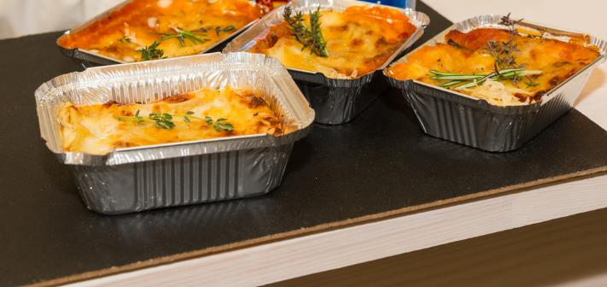
Bacterial growth and multiplication
All bacteria, including those that are harmful, have four requirements to survive and grow:
food;
moisture;
warmth;
time.

Slide 23
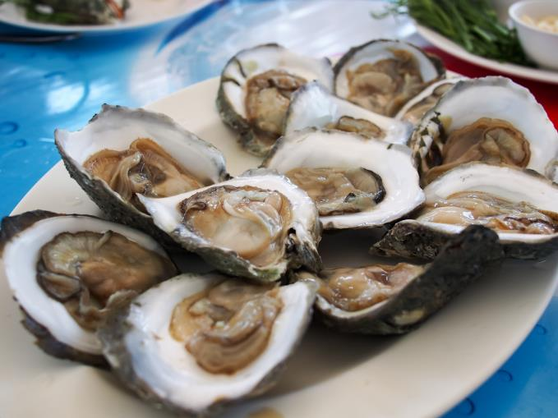
High risk foods for food poisoning
High risk foods include:
meat, meat products and poultry;
milk and dairy products;
eggs – uncooked and lightly cooked;
shellfish and seafood;
prepared salads and vegetables;
cooked rice and pasta.

Slide 24
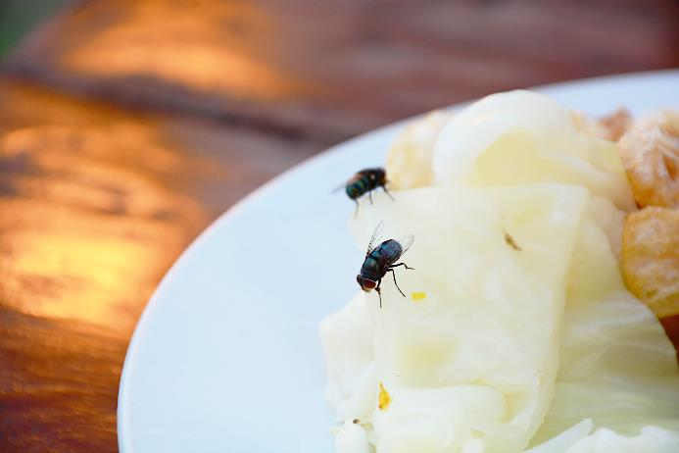
Food spoilage
Changes in food, either through enzyme deterioration of food or micro-organism growth, will eventually lead to the food becoming inedible or unsafe if eaten.
The rate of deterioration depends on a variety of factors which must be controlled carefully.
Contaminants may be already present in the food, e.g. salmonella in chicken or transferred to the food by humans, flies, rodents and other pests.

Slide 25
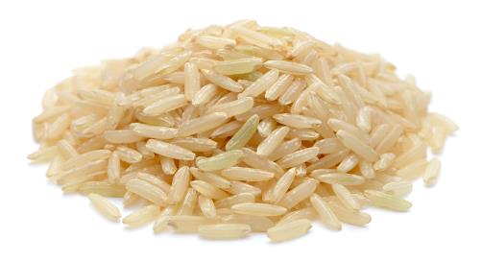
Microbial spoilage – bacteria
These are single celled micro-organisms (they cannot be seen by the naked eye) which are present naturally in the environment.
There are many different kinds, some are useful, e.g. in the production of yogurt, and some harmful.
The presence of bacteria in food can lead to digestive upset. Some bacteria produce toxins which can lead to this also.
Spores can also be produced by some bacteria leading to toxins being produced.
Bacillus cereous produces spores – rice should be cooled quickly to prevent multiplication

Slide 26
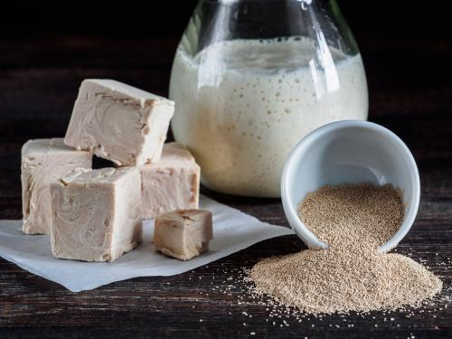
Microbial spoilage – yeast
Yeasts are single celled fungi which can reproduce by ‘budding’. This means that a small offshoot or bud separates from the parent yeast cell. Yeasts can also form spores which can travel through the air. These are easily killed by heating to 100ºC.
In warm, moist conditions in the presence of sugar, yeasts will cause foods like fruit to ferment producing alcohol and carbon dioxide gas.
Yeast is used in the production of bread and wine.

Slide 27
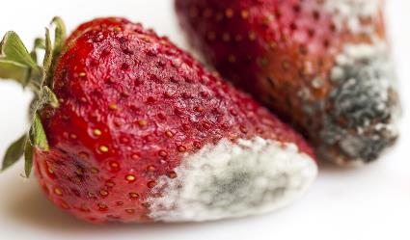
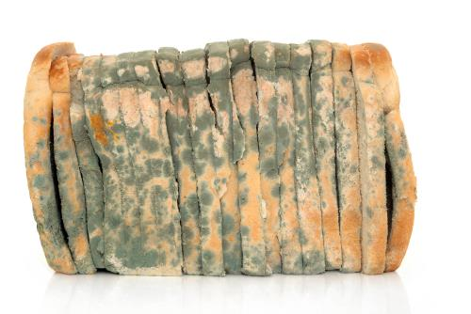
Microbial spoilage – mould
Moulds are fungi which grow as filaments in food. They reproduce by producing spores in fruiting bodies which can be seen on the surface of foods.
These fruiting bodies sometimes look like round furry blue-coloured growths, e.g. mould on bread.
Some moulds can be seen by the naked eye, e.g. on bread.

Slide 28
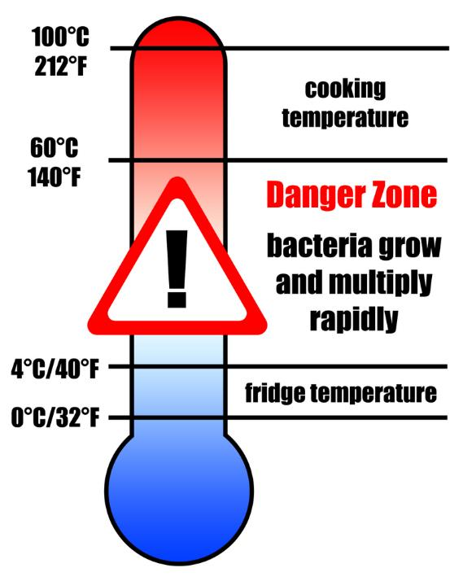
Conditions for bacterial growth
Microorganisms need conditions to survive and reproduce these can include:
temperature;
moisture;
food;
time;
oxygen;
pH level.
The ideal temperature for bacterial growth is 30ºC – 37ºC.

Slide 29
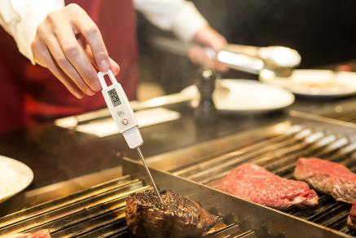
Preventing bacterial multiplication
If you take away any one of the four requirements that bacteria need to survive, the ability of bacteria to grow and cause food poisoning is reduced.
It is therefore important to:
store, prepare and cook high risk foods carefully;
store food either hot (above 63°C) or cold (below 5°C), never warm;
reduce the time food is in the danger zone;
cook food for the correct time at the right temperature – make sure it is piping hot and no pink remains in poultry, burgers or sausages.

Slide 30
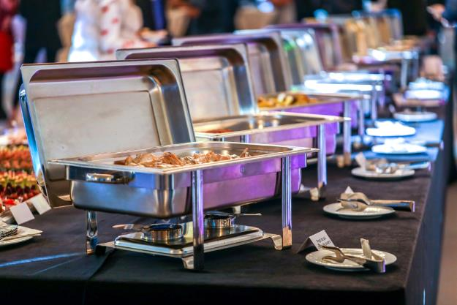
Factors affecting food poisoning
Some of the common factors leading to food poisoning include:
preparation of food too far in advance;
storage at ambient temperature;
inadequate cooling;
inadequate reheating;
under cooking;
inadequate thawing.

Slide 31

Factors affecting food poisoning
More common factors leading to food poisoning include:
consuming raw food;
improper warm holding (i.e. holding ‘hot’ food below 63ºC);
infected food handlers;
contaminated processed food;
poor hygiene.
How can we reduce the risk of food poisoning?

Slide 32
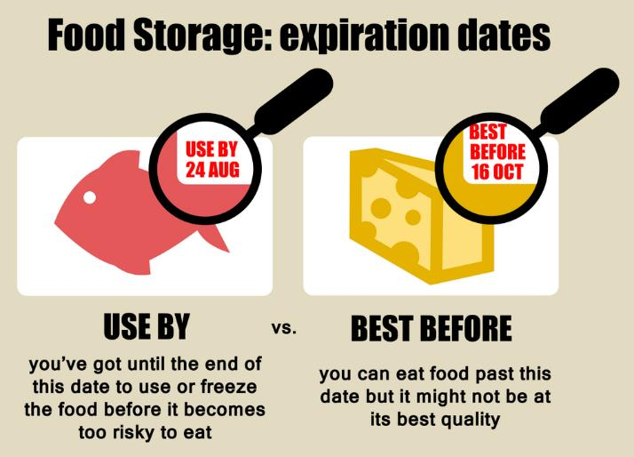
To reduce the risk of food poisoning, follow these simple rules:
Always follow ‘use by’ dates;
Store food correctly, either cold or hot, never warm;
Separate raw and cooked food;
Wash fruits and vegetables;
Thoroughly cook food;
Keep yourself and your workspace clean;
Don’t cough or sneeze over food;
Thoroughly wash and dry hands regularly.

Slide 33
Reducing the risks task
Complete the story board list to explain the ways we can reduce the risks of developing food poisoning whilst preparing food at school.
Always follow ‘use by’ dates | Store food correctly, either cold or hot, never warm
Separate raw and cooked food | Wash fruits and vegetables
Thoroughly cook food | Keep yourself and your workspace clean
Don’t cough or sneeze over food | Thoroughly wash and dry hands regularly

Slide 34
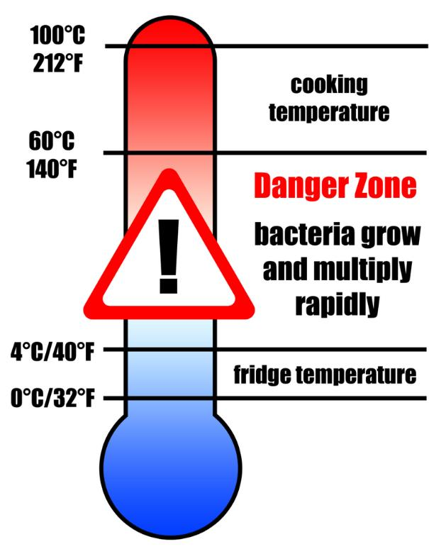
Food hygiene thermometer
Draw a thermometer with temperatures ranging from -18° to 75°.
Write out the key information on the temperatures to remember.

Slide 35
Temperatures to remember
To reduce the risk of food poisoning, good temperature control is vital:
75° - if cooking food, the core temperature, middle or thickest part should reach at least this temperature.
75° - if reheating food, it should reach at least this temperature. Remember to reheat food only once!
5-63°C – the danger zone where bacteria grow most readily.
37°C – body temperature, optimum temperature for bacterial growth.
8°C – maximum legal temperature for cold food, i.e. your fridge.
5°C (or below) – the ideal temperature your fridge should be.
-18° - the temperature your freezer should be.
If you are in Scotland, the core temperature should be at least 82°C when cooking or reheating food.

Slide 36
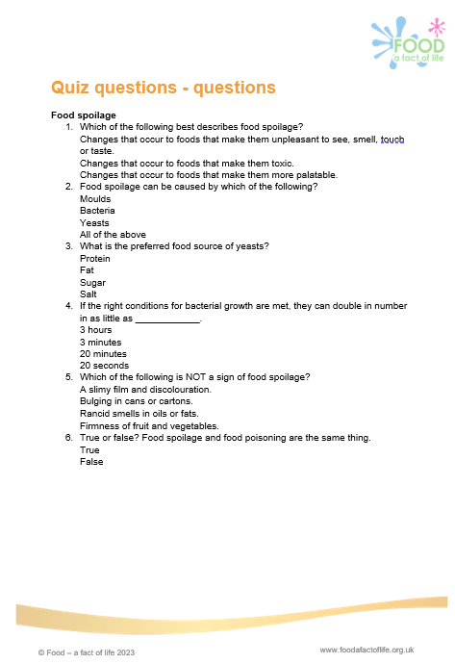
Food spoilage and food safety quiz
Use the worksheet to complete the food spoilage and food safety quiz.

Slide 37
Key words
Key word​ | Meaning​
Food spoilage | The process of food becoming unfit to eat through oxidation, contamination, or growth of micro-organisms
Food poisoning | Illness resulting from eating foods which contain food poisoning micro-organisms or toxins produced by micro-organisms.
Mould | Moulds can cause food poisoning. They are types of fungi and appear as a layer on the surface of food.
Bacteria | A group of micro-organisms which are too small to see with the naked eye.
Yeasts | Tiny micro-organisms which carry out the fermentation of sugars, to produce alcohol and carbon dioxide.

Slide 38
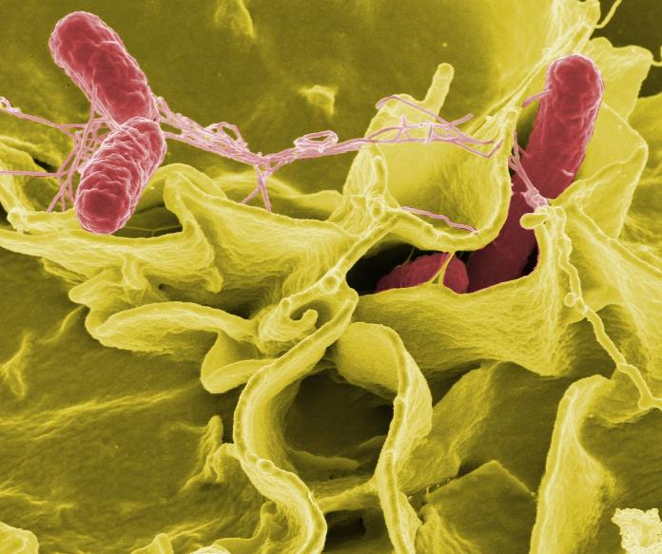
Homework task
Research Salmonella and create a leaflet explaining what it is and how to reduce the chance of developing food poisoning whilst preparing food at home.
You can use the information sheet on Salmonella or online research to help you.

Slide 39
Teachers’ guide

Slide 40
Information for teachers
The following slides contain information to support teachers in the topic of food hygiene and safety.

Slide 41
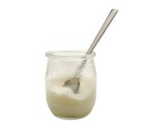
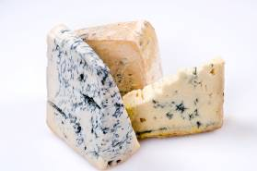
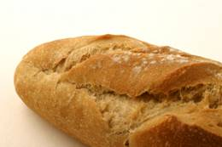
Desirable food changes
Autolysis and micro bacterial changes are sometimes desirable (and are not referred to as spoilage), for example enzymes cause fruit to ripen.
Here are some positive microbial changes:
Bacteria in yoghurt production.
Mould in some cheeses, e.g. Stilton.
Yeast in bread production.

Slide 42


Autolysis – enzymes
Enzymes are chemicals that are found in food.
These chemicals have important uses in food. They can cause food to deteriorate in three main ways:
ripening – this will continue until the food becomes inedible, e.g. banana ripening;
browning – enzymes can react with air causing the skin of certain foods, e.g. potatoes and apples discolouring;
oxidation – loss of certain nutrients, such as vitamins A, C and thiamin from food, e.g. over boiling of green vegetables.

Slide 43
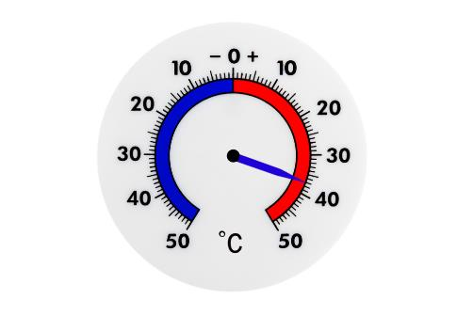
Conditions for bacterial growth
Temperature
Bacteria need warm conditions to grown and multiply.
The ideal temperature for bacterial growth is 30ºC – 37ºC.
Some bacteria can still grow at 10ºC and 60ºC. Most bacteria are destroyed at temperatures above 63 ºC. Bacterial growth danger zone in 5ºC - 63ºC.
At very cold temperatures, bacteria become dormant – they do not die, but they cannot grow or multiply.

Slide 44
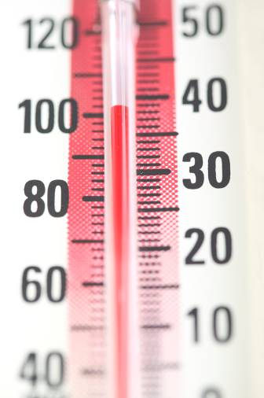
Temperature
100ºC Water boils
75ºC Core temperature of cooked/reheated food (82ºC in Scotland)
5ºC - 63ºC danger zone for rapid growth of micro-organisms
37ºC – optimum temperature for bacterial growth
1ºC - 4ºC temperature of fridge (good practice)
Below 8ºC temperature of fridge (legal)
0ºC Freezing point of water
-18ºC temperature of freezer

Slide 45
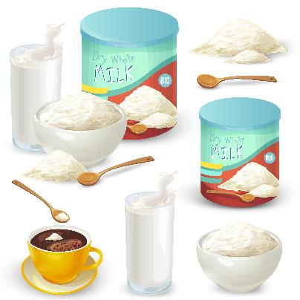
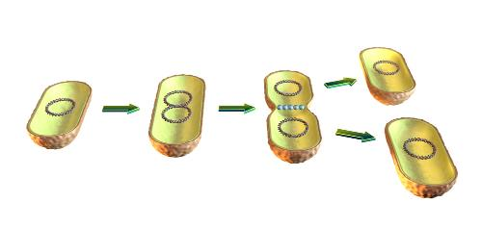
Conditions for bacterial growth
Moisture
Where there is no moisture bacteria cannot grow. However, bacteria and moulds can both produce spores which can survive until water is added to the food.
Food
Bacteria need a source of food to grow and multiply, these food usually contain large amounts of water and nutrients. Food where bacteria rapidly multiple in are called high risk foods.
Time
One bacterium can divide into two every 10-20 minutes.

Slide 46
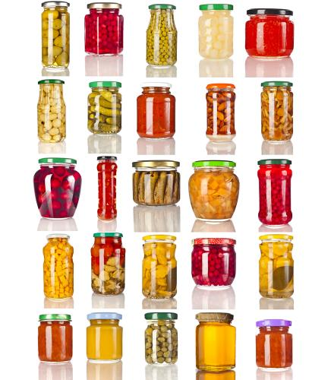
Conditions for bacterial growth
Oxygen
Some bacteria need oxygen to grow and multiply. These are called aerobic bacteria. Other bacteria grow well when there is no oxygen present, these are known as anaerobic bacteria.
pH level
An acidic or alkaline environment can promote or inhibit microbial growth. Most bacteria prefer a neutral pH (6.6 – 7.5). Moulds and yeasts can survive at pH levels of 1-1/5 (very acidic), food spoilage usually occurs by yeast and moulds.

Slide 47
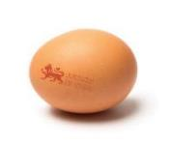
High risk foods
High risk foods include:
meat, meat products and poultry;
milk and dairy products;
eggs – uncooked and lightly cooked;
shellfish and seafood;
prepared salads and vegetables;
cooked rice and pasta
Lion mark hen eggs can now be eaten raw or lightly cooked. Although people who have a severely weakened immune system and who are on a medically supervised diet prescribed by health professionals should cook all eggs thoroughly, even eggs that have the Red Lion stamp.
NHS advice

Slide 48
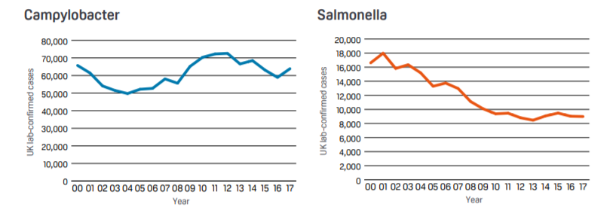
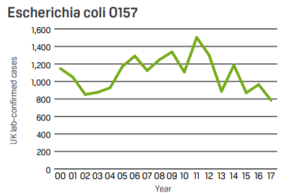
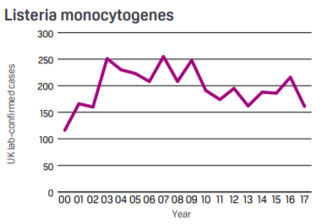
Food poisoning
An estimated one million people are affected by foodborne disease in the UK annually, costing the economy in excess of £1bn. Laboratory confirmed human cases in the UK from 2000 to 2017 of the four major bacterial pathogens (harmful bacteria) are shown below. Only a minority of cases are reported and samples sent for analysis. Note that this presentation covers bacteria, but viruses (e.g. norovirus) may also cause food poisoning.
Food standards Agency

Slide 49

Food poisoning
Food poisoning may result from poor domestic food preparation, or poor food processing in industry including restaurants, cafes and takeaways.
This may result in loss of business and people’s jobs if it is a serious outbreak.

Slide 50
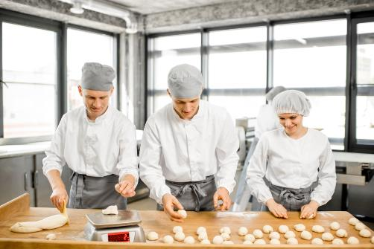
Food poisoning
Micro-organisms occur naturally in the environment, on cereals, vegetables, fruit, animals, people, water, soil and in the air.
Most bacteria are harmless, but a small number can cause illness.
Food which is contaminated with food poisoning micro-organisms can look, taste and smell normal.

Slide 51
High risk foods
Some foods are high-risk, as they provide the ideal conditions needed for micro-organisms to grow. These include:
meat, meat products and poultry;
milk and dairy products;
eggs – uncooked and lightly cooked;
shellfish and seafood;
prepared salads and vegetables;
cooked rice and pasta
If these foods become contaminated with food-poisoning micro-organisms and conditions allow them to multiply, the risk of food-poisoning increases.
Lion mark hen eggs can now be eaten raw or lightly cooked. Although people who have a severely weakened immune system and who are on a medically supervised diet prescribed by health professionals should cook all eggs thoroughly, even eggs that have the Red Lion stamp.
NHS advice

Slide 52

People at high risk
Elderly people, babies and anyone who is ill or pregnant needs to be extra careful about the food they eat.
For example, pregnant women or anyone with low resistance to infection should avoid high risk foods such as unpasteurised soft cheese.

Slide 53
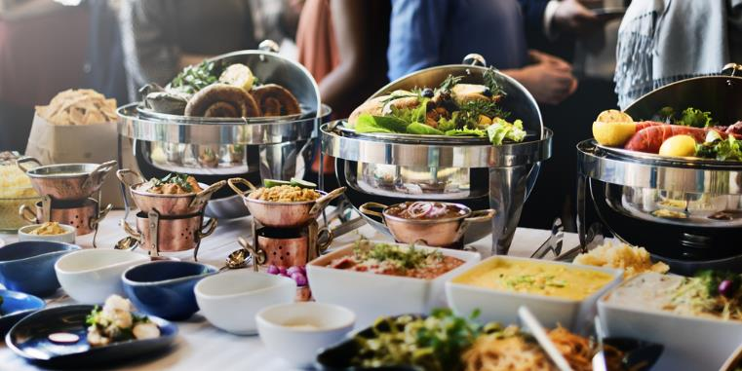
Factors affecting food poisoning
Some common factors leading to food poisoning include:
preparation of food too far in advance;
storage at ambient temperature;
inadequate cooling;
inadequate reheating;
under cooking;
inadequate thawing.

Slide 54

Factors affecting food poisoning
Further common factors leading to food poisoning include:
consuming raw food;
improper warm holding (i.e. holding ‘hot’ food below 63ºC);
infected food handlers;
contaminated processed food;
poor hygiene.

Slide 55

Symptoms of food poisoning
Food poisoning can be mild or severe.
The symptoms will be different depending on what type of bacteria is responsible.
Common symptoms include:
severe vomiting;
diarrhoea;
exhaustion;
headache;
fever;
abdominal pain;
tiredness.

Slide 56
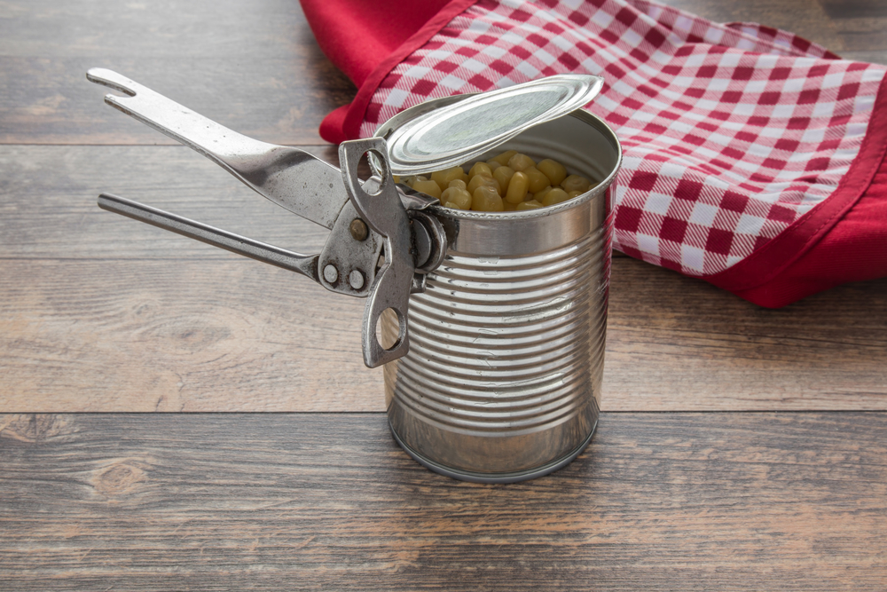
Preventing food spoilage, contamination and poisoning
Tips for buying food include:
it is illegal to sell food that has passed its ‘use by’ date;
dented, blown or rusted cans of food should not be purchased;
frozen food which has frozen together in the pack should not be purchased;
do not buy food where the packaging has been damaged;
only shop in clean and hygienic stores.

Slide 57
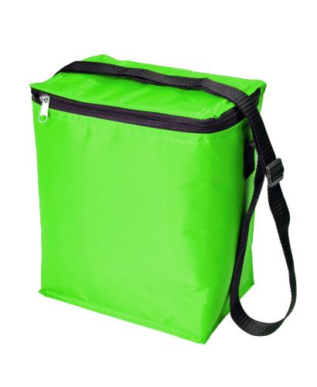
Preventing food spoilage, contamination and poisoning
Tips for transporting food back home:
buy chilled and frozen foods at the end of the shopping trip;
keep frozen and chilled foods cold, by using cool boxes/bags and packing these types of foods together;
cooked and uncooked foods should be kept separate;
dry and moist foods should be packed separately;
household chemicals should be packed separately.

Slide 58
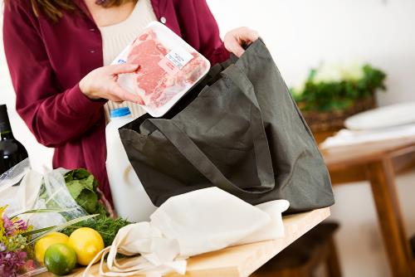
Preventing food spoilage, contamination and poisoning
Tips for storing food in the home:
food should be unpacked as soon as possible;
old stocks of food should be used before buying new ones (first in, first out theory);
store food in the correct place, i.e. dry food, in cool, dry clean places and chilled food in the refrigerator.

Slide 59
Further supporting resources
Food – a fact of life resources
Register for our Food Hygiene online course for free.
Use the Food hygiene and safety quiz to test your pupils (answers here)
Provide pupils with the Food poisoning fact files so they can learn about the different microorganisms that may cause food poisoning. They can complete the fact files worksheet to demonstrate their understanding.
Use the Good food hygiene practices Knowledge organiser to remind pupils of the essential facts about food hygiene.
Show pupils the Personal hygiene presentation, reminding them of their responsibilities in the kitchen.
Play the Food hygiene bingo game! Download the game here and the activity sheet here.
Use the Adverse reactions to food resources to highlight allergen awareness.
Teachers will need to decide on the level of complexity of the tasks chosen, depending on age, stage and need, and considering progression.

Slide 60
Food spoilage, hygiene and safety
For further information, go to:
www.foodafactoflife.org.uk
This science pack is one of a series of resources produced for the pHood Futures project, supported by the Royal Society of Chemistry.
This resource meets the Guidelines for producers and users of school education resources about food.

