Slide 1
Brilliant bread
Complexity: low - medium

Slide 2
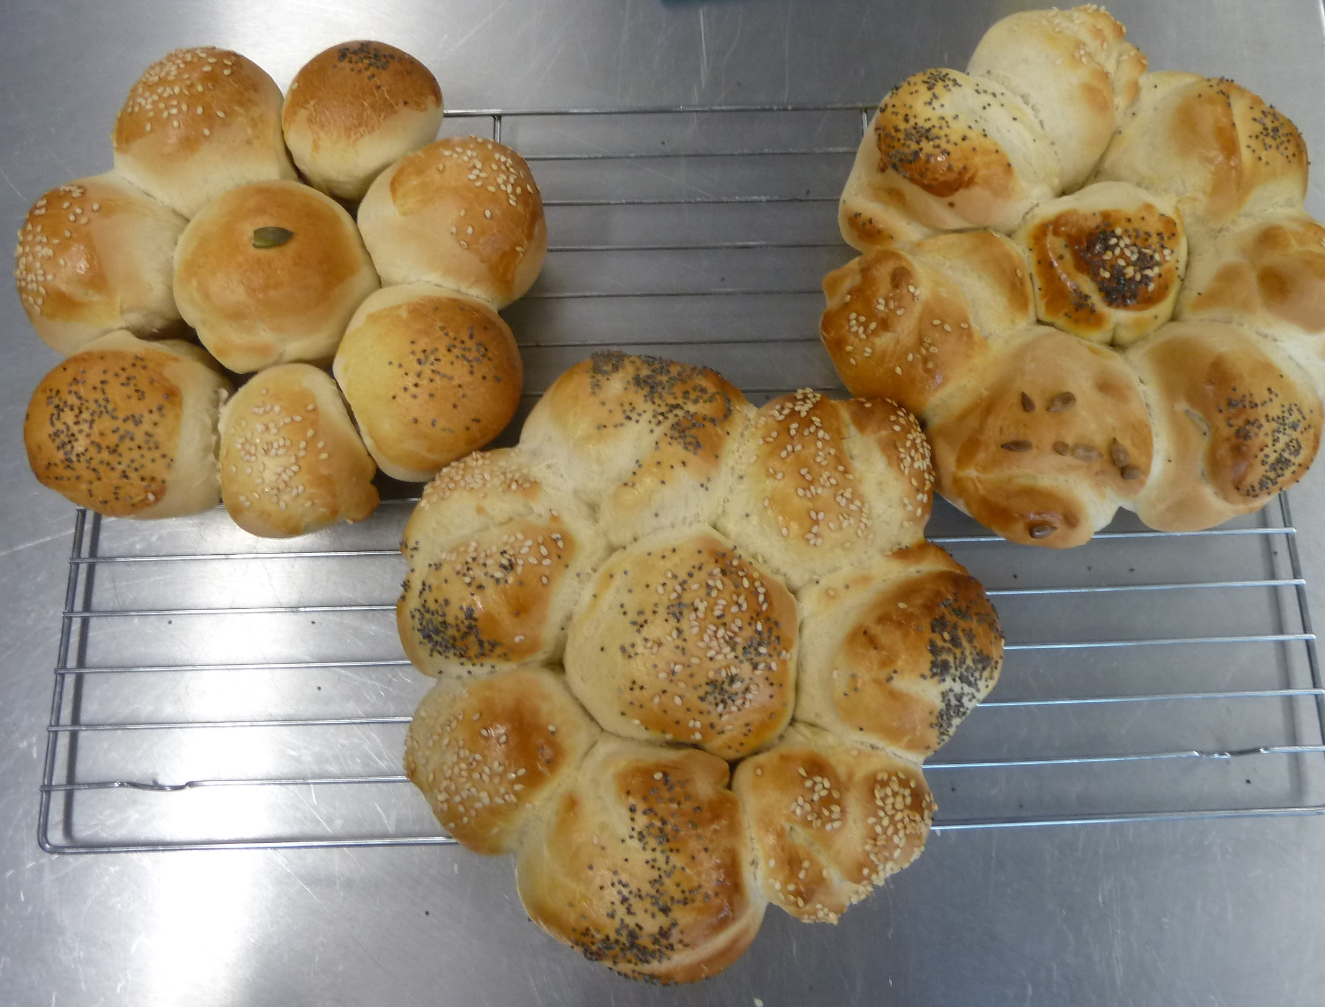
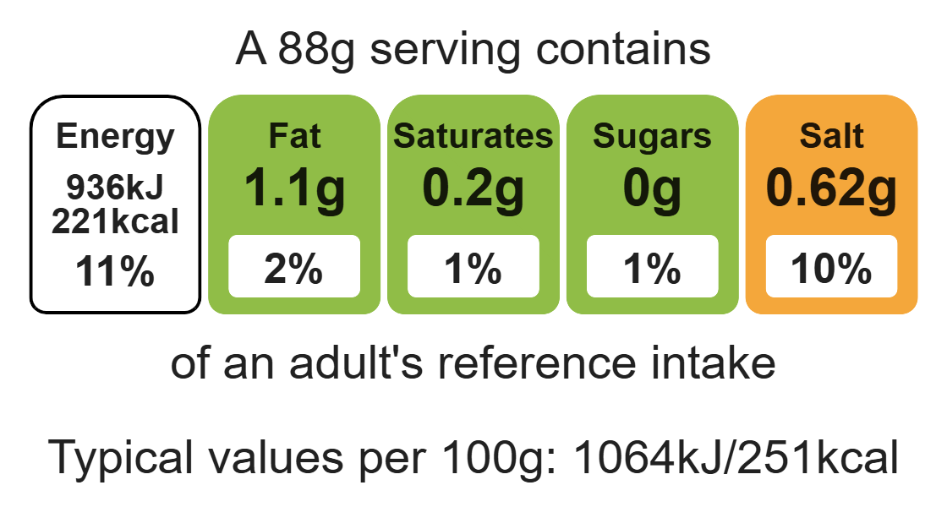
Nutritional analysis
Serves 4

Slide 3
Starter activity
Name 3 different types of flour.
What causes bread to rise?
Why is bread kneaded?

Slide 4
Example responses
Name 3 different types of flour.
Strong white, wholemeal, bran, self-raising, 00.
What causes bread to rise?
Yeast is the raising agent used in bread. It causes the bread to rise through the fermentation process where it gives off alcohol and carbon dioxide, which gets trapped in the gluten matrix and causes the bread to rise.
Why is bread kneaded?
The bread dough is kneaded to develop the gluten, making the dough stretchy.

Slide 5
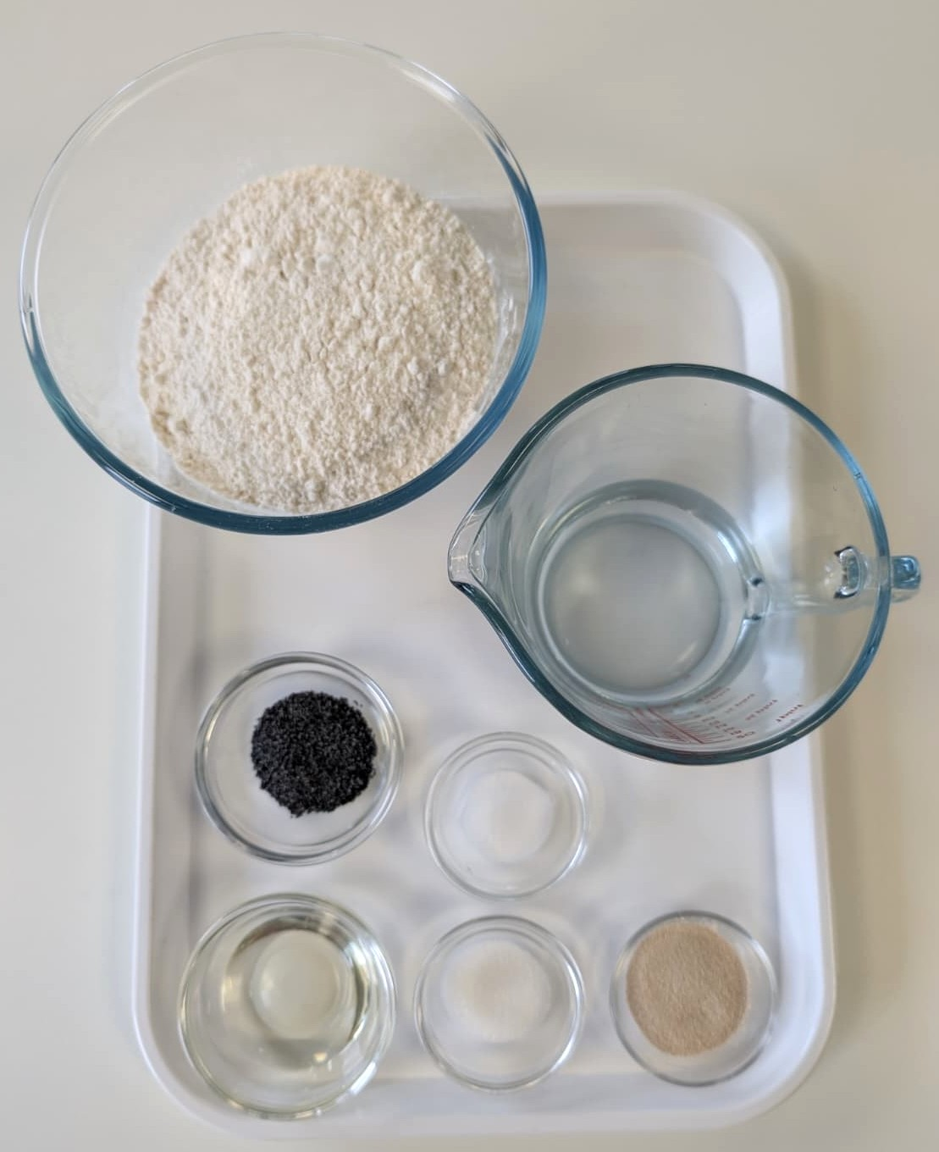

Ingredients (serves 4)
125g strong flour
125g strong wholemeal flour
½ x 5ml spoon salt
7g pack fast action dried yeast
150ml warm water
Check for any food allergy, intolerance, special dietary requirement or religious/cultural reasons for not handling or eating the ingredients in this recipe.

Slide 6
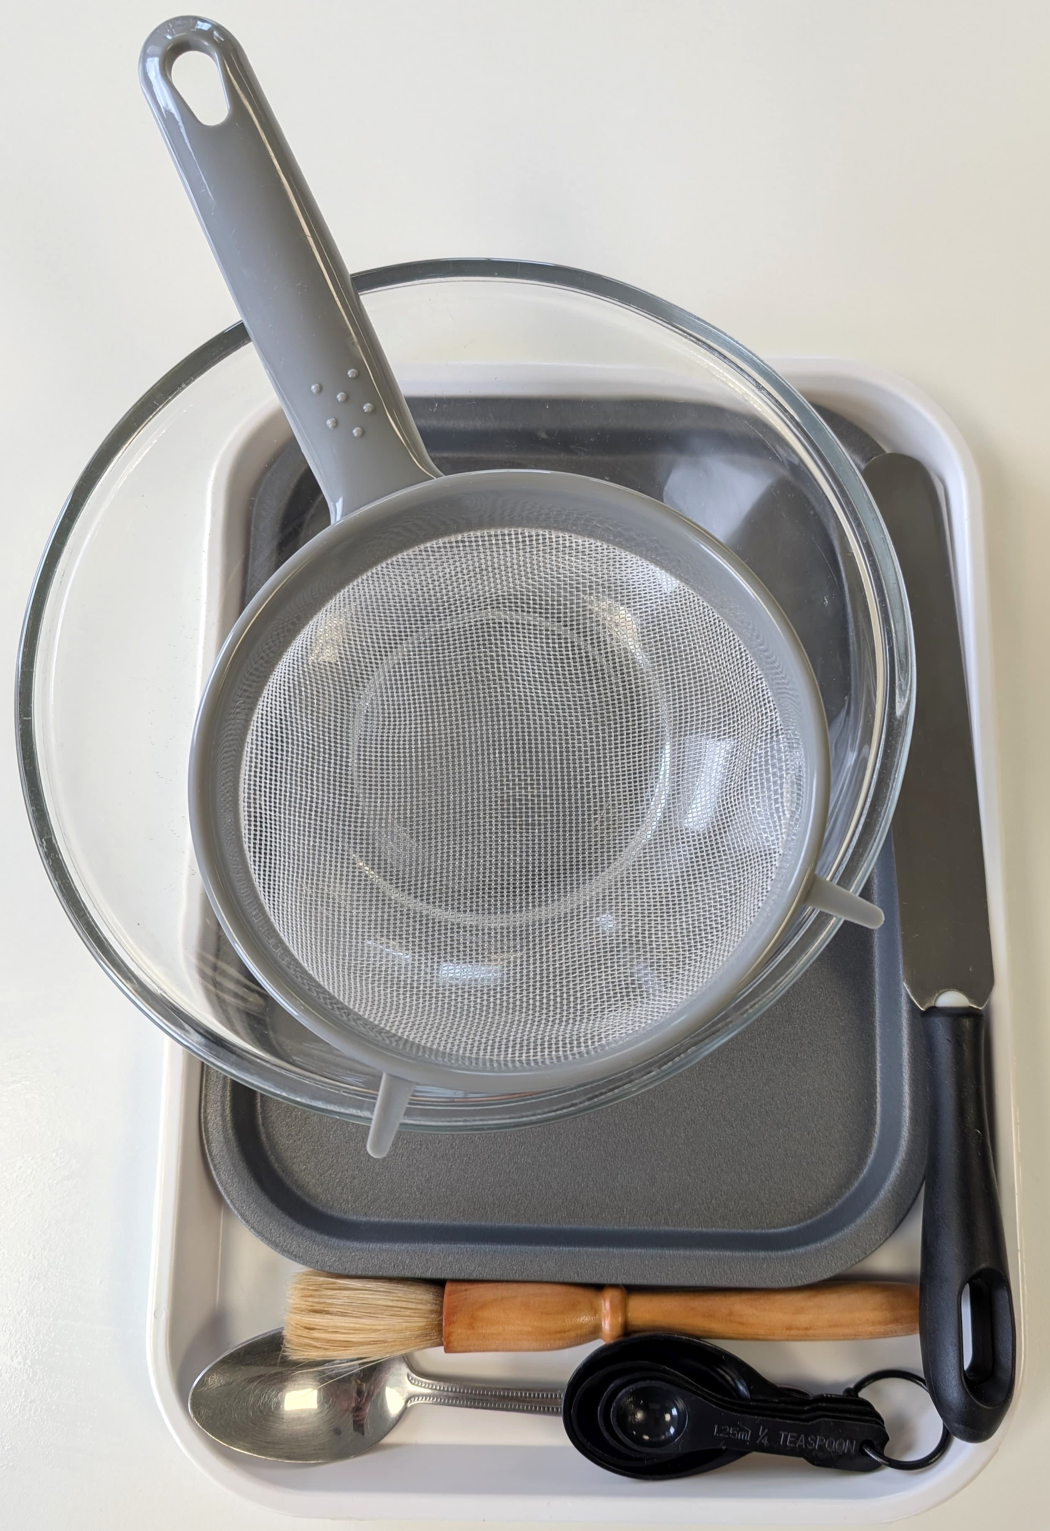
Equipment
Weighing scales
Measuring spoons
Measuring jug
Baking tray
Sieve
Mixing bowl
Mixing spoon
Flour dredger (optional)
Cooling rack

Slide 7
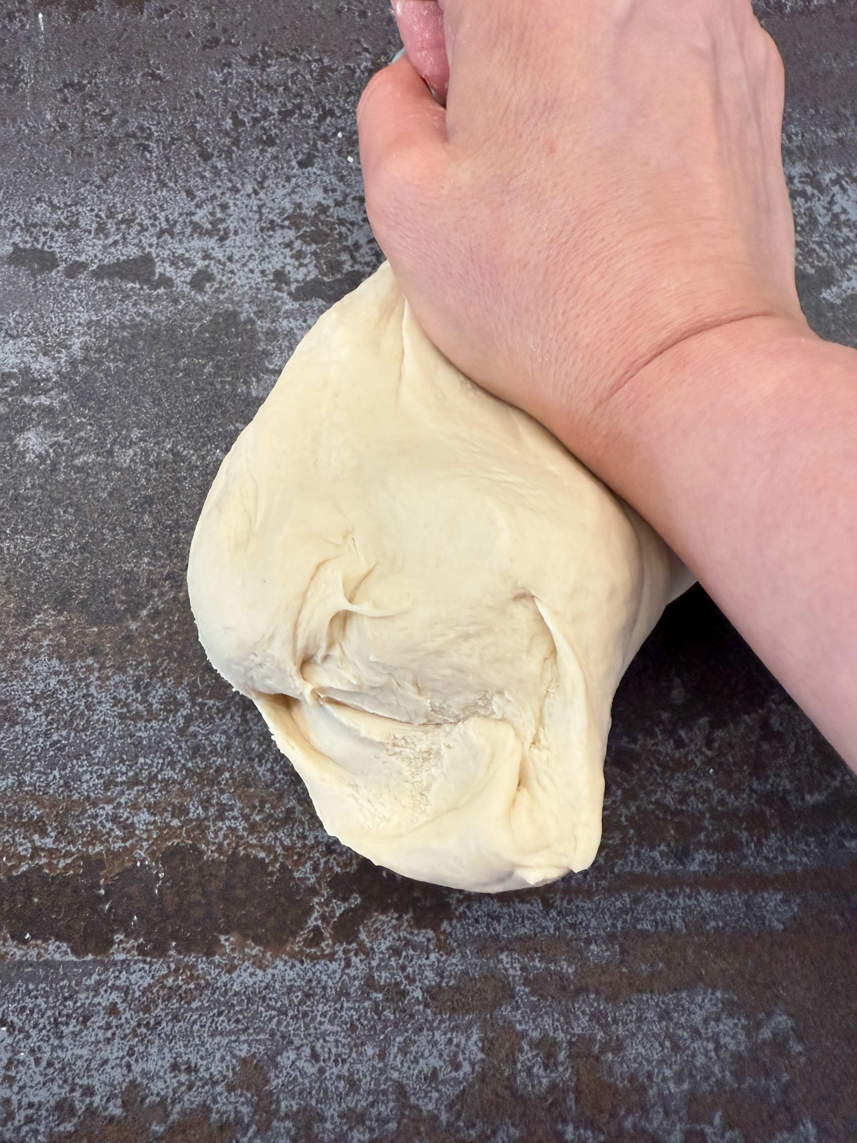
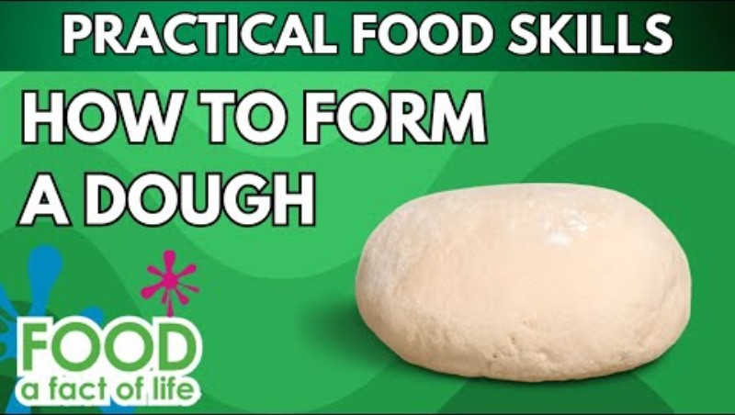
Food skills
Weigh
Measure
Mix
Stir and combine
Knead
Portion/ divide
Bake
Decorate and garnish
Roll out
Sift
Click below to watch how to form a dough

Slide 8
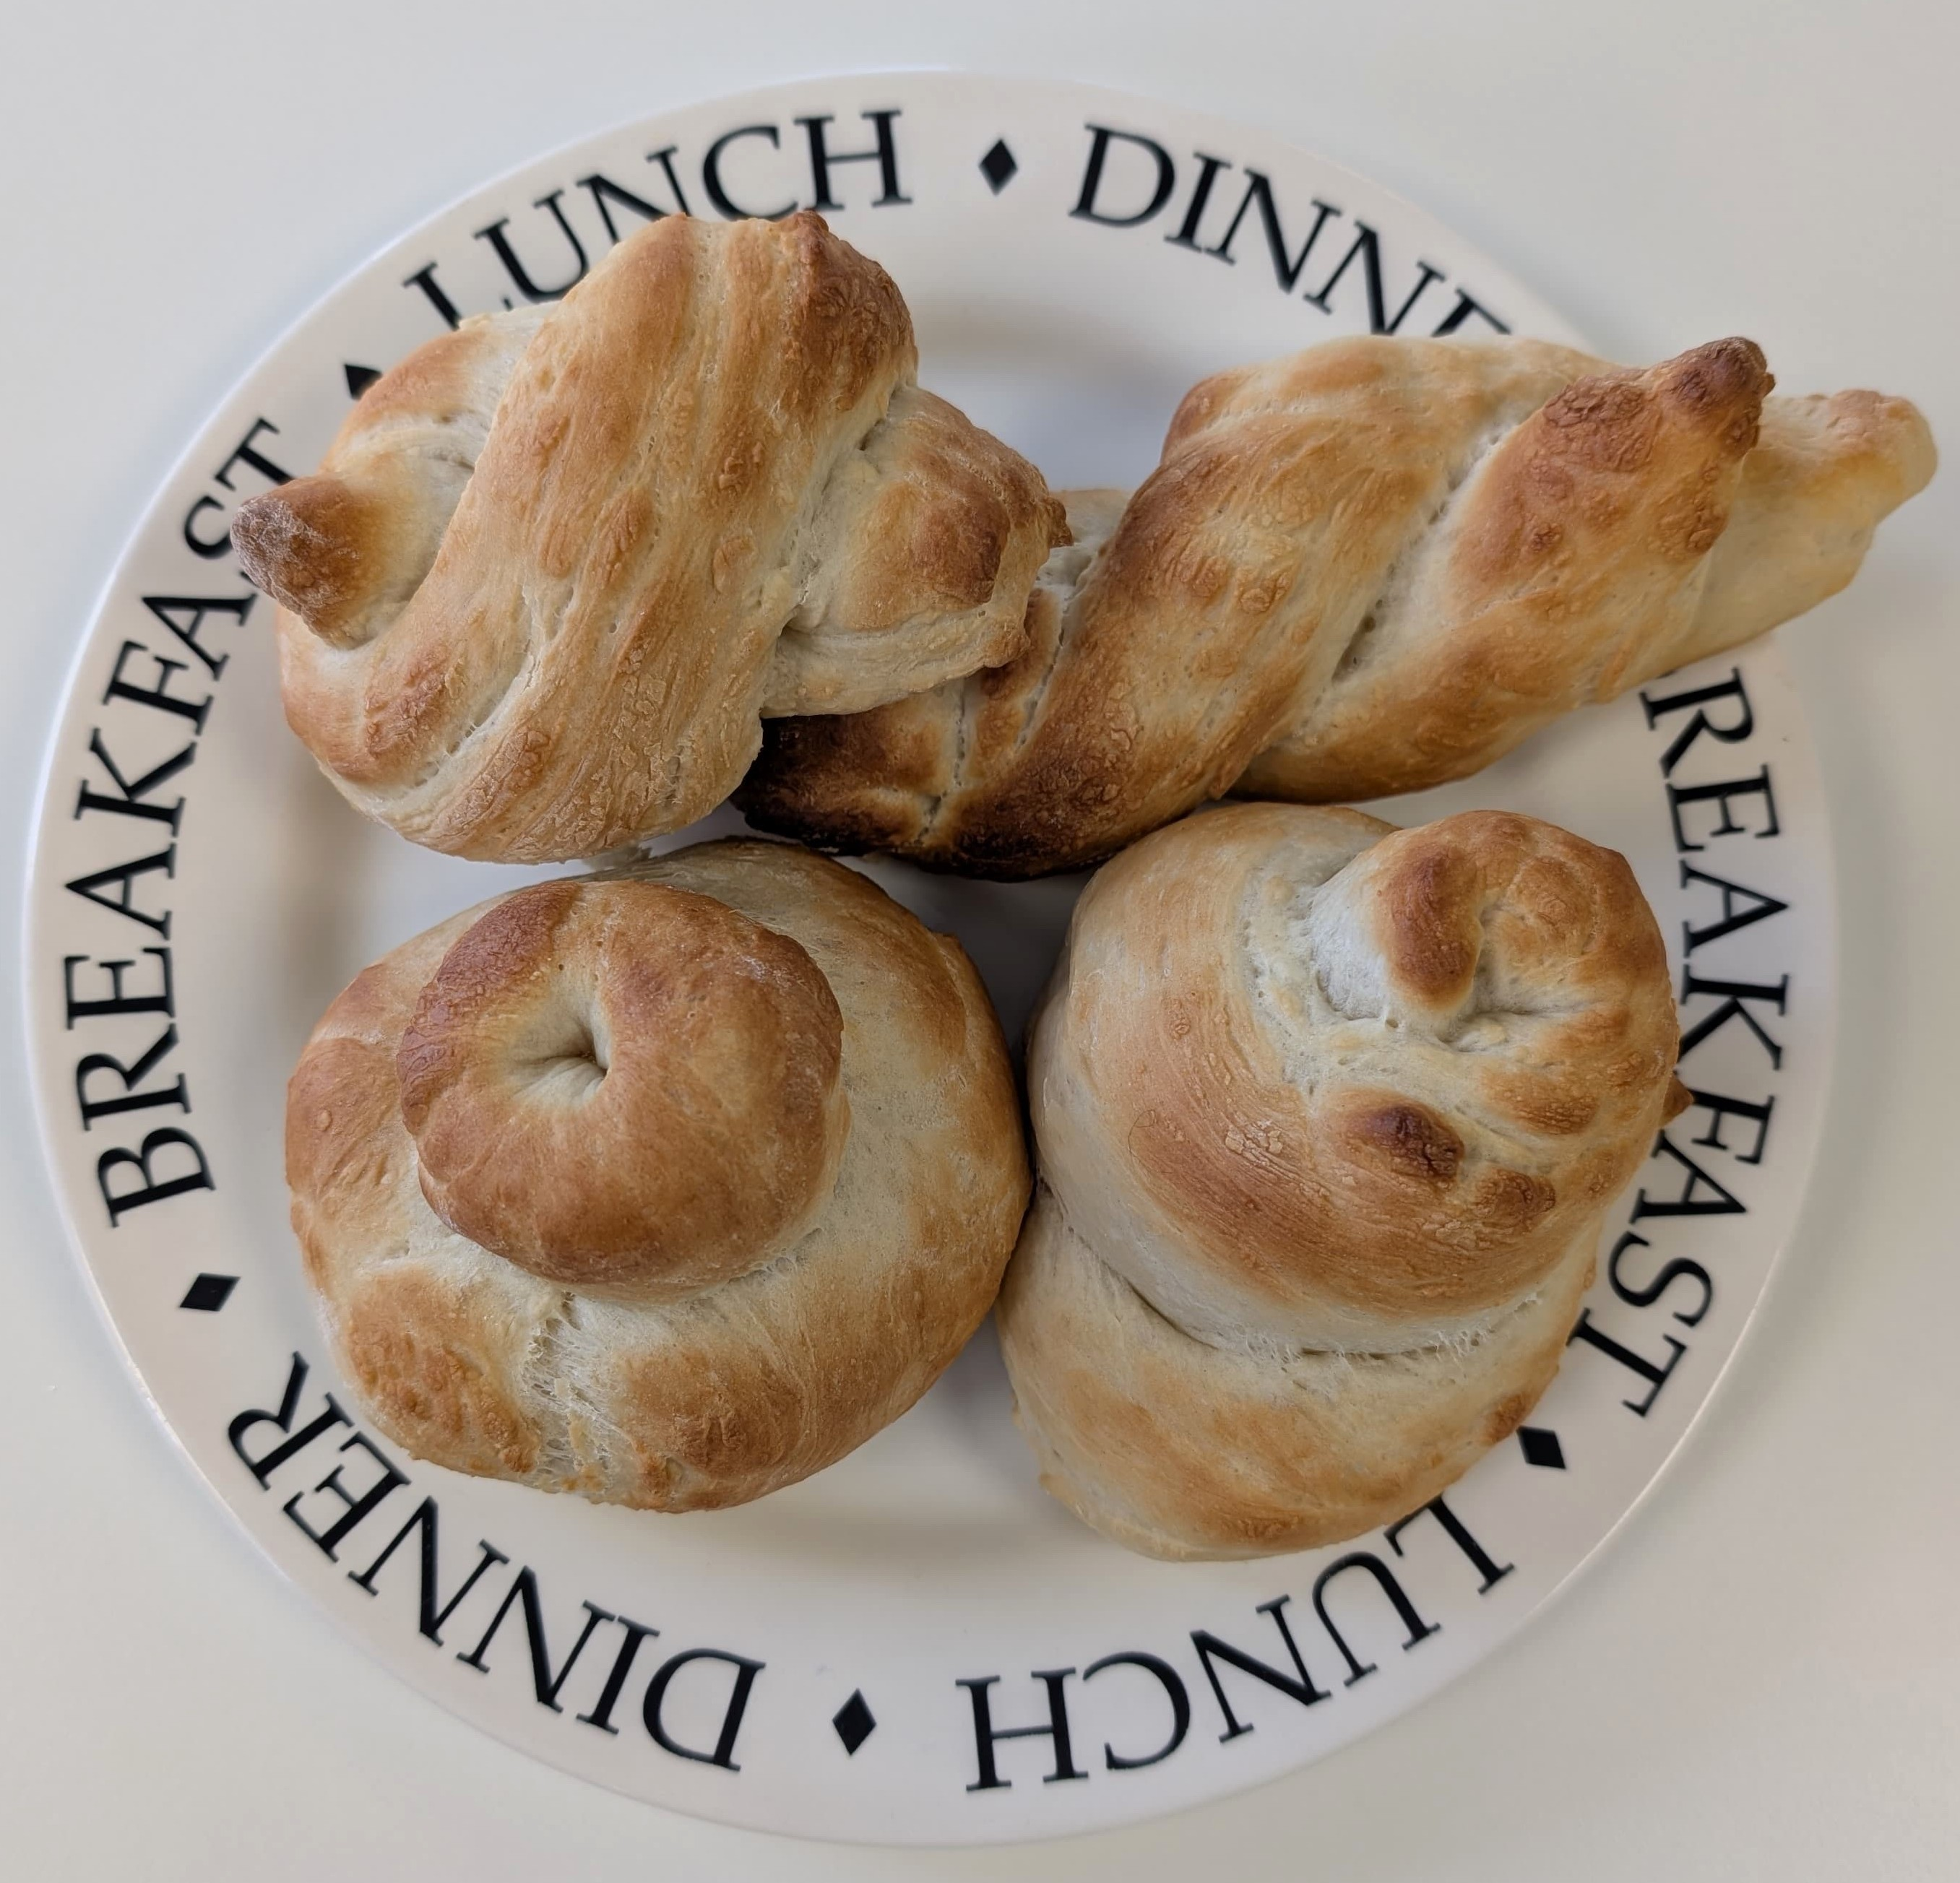
Method
1. Preheat the oven to 220ºC or gas mark 7.
2. Line the baking tray with greaseproof paper.
3. Sift together the flour and salt into the mixing bowl.
4. Stir in the yeast.
5. Make a well in the middle of the flour mixture and add the warm water gradually. Note: the water must not be too hot.
6. Mix to form a ball of soft dough.
7. Sprinkle a little flour onto a clean work surface and place the dough on the surface.
8. Knead the dough for 10 minutes.
9. Divide the dough into 4 pieces and shape into rolls of your desired shape.
10. Place the rolls on the baking tray.
11. Cover the dough and leave to prove for 30 minutes in a warm place, until they
double in size.
12. Bake for 10 - 15 minutes until golden brown.

Slide 9
Alternative “cold prove” method.
1. Line the baking tray with greaseproof paper.
3. Sift together the flour and salt into the mixing bowl.
4. Stir in the yeast.
5. Make a well in the middle of the flour mixture and add the warm water gradually.
Note: the water must not be too hot.
6. Mix to form a ball of soft dough.
7. Sprinkle a little flour onto a clean work surface and place the dough on the surface.
8. Knead the dough for 10 minutes.
9. Divide the dough into 4 pieces and shape into rolls of your desired shape.
10. Place the rolls on the baking tray.
11. Place in a COLD oven and turn up the temperature immediately.
12. Remove from oven after approximately 15 – 20 minutes and cool on a cooling rack.
13. Test for readiness by tapping the bottom. It should sound hollow.
14. Allow to cool.

Slide 10
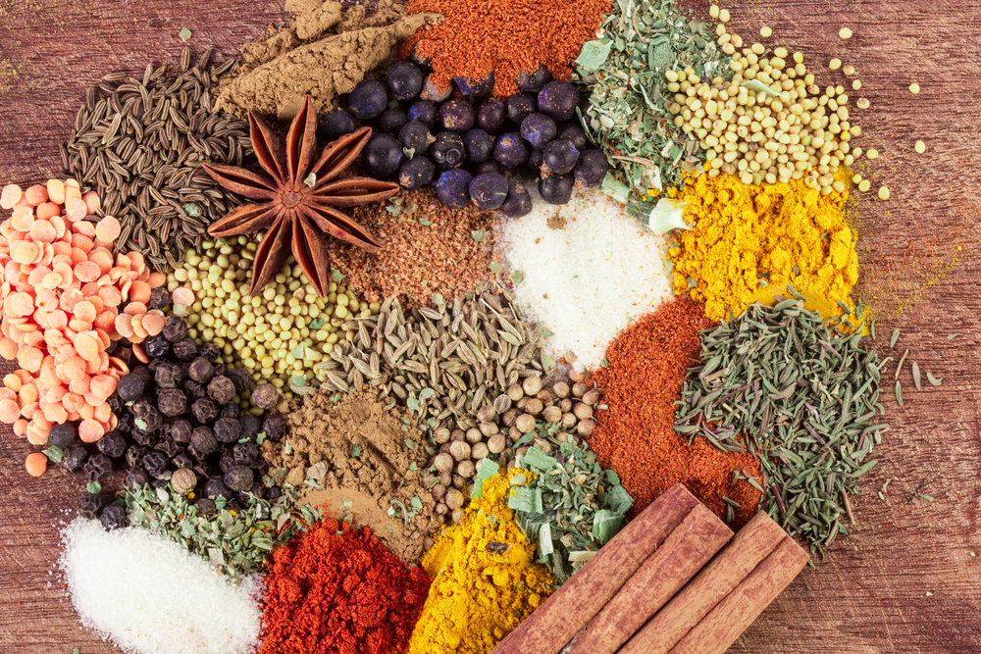
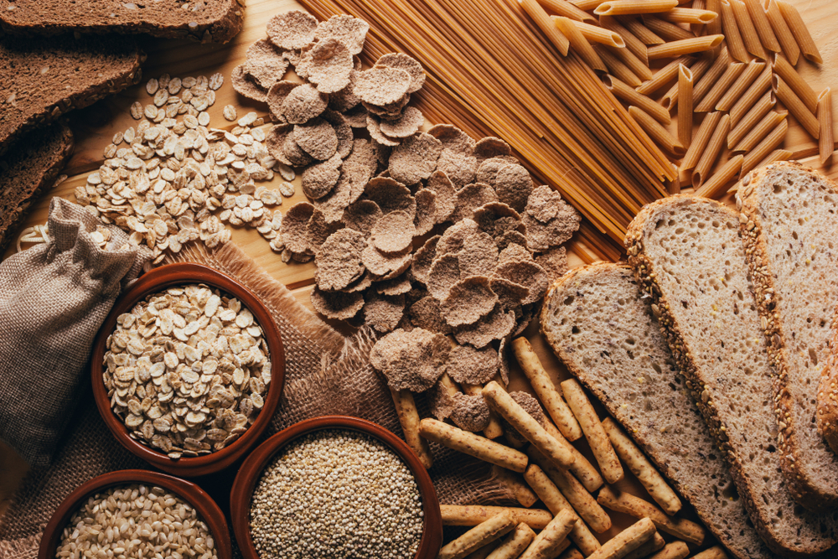
Top tips
Turn up the flavour: why not try adding 25g apple, grated cheese, dried fruit or diced garlic to the flour mixture?
Focus on fibre: decorate your bread with seeds before baking (Be ingredient aware!)

Slide 11
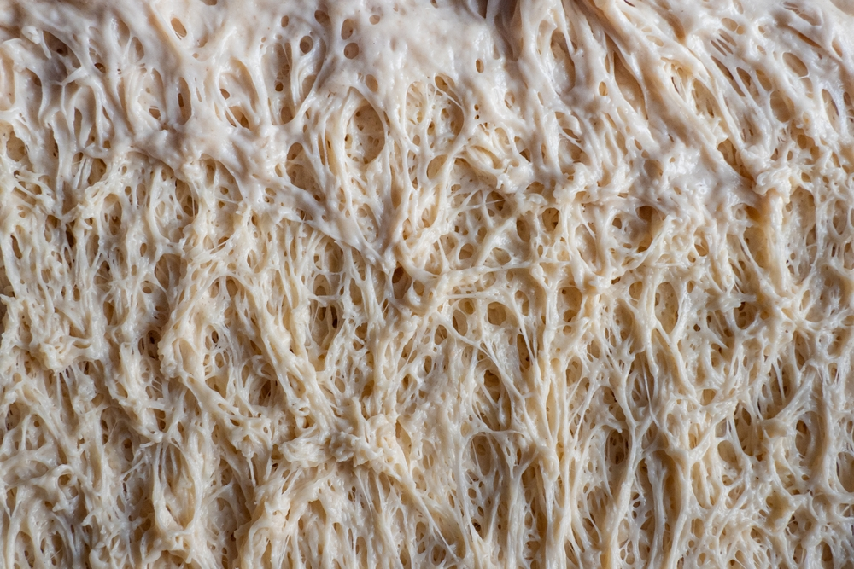
Food science
Gluten formation
Two proteins, gliadin and glutenin, found in wheat flour, form gluten when mixed with water.
Gluten is strong, elastic and forms a 3D network in dough. In the production of bread, kneading helps untangle the gluten strands and align them.
Gluten helps give structure to the bread and keeps in the gases that expand during cooking. The amount and type of protein present depends on the flour type and quality. Strong flour contains a maximum of 17% protein, plain flour 10%.
Some other flours also contain gluten, including rye and barley flours.

Slide 12



Plenary
Evaluate your bread against the success criteria below.
 |  |  |  | Comments
Well risen
Good shape
Golden colour
Firm crust

Slide 13

Example responses
 |  |  |  | Comments
Well risen |  |  |  | My bread buns were well risen; I am really pleased with them.
Good shape |  |  |  | My buns are not shaped equally; I need to spend more time on shaping them.
Golden colour |  |  |  | Most are golden in colour, but the smaller ones are much darker as they cooked quicker than the rest. I will focus on making them the same size next time.
Firm crust |  |  |  | The buns all have a firm crust and when I tapped on the bottom, they sounded hollow.

Slide 14
Want to know more?
To find out more on the science of breadmaking, go to:
https://www.foodafactoflife.org.uk/11-14-years/food-commodities-11-14-years/cereals-11-14-years/baking-bread-11-14-years/
For a bread recipe that can be made, proved and cooked within an hour or less, why not try the Quick bread bun recipe?

Slide 15
Brilliant bread
For further information, go to:
www.foodafactoflife.org.uk
This resource meets the Guidelines for producers and users of school education resources about food.

