Slide 1
Mealtimes

Slide 2
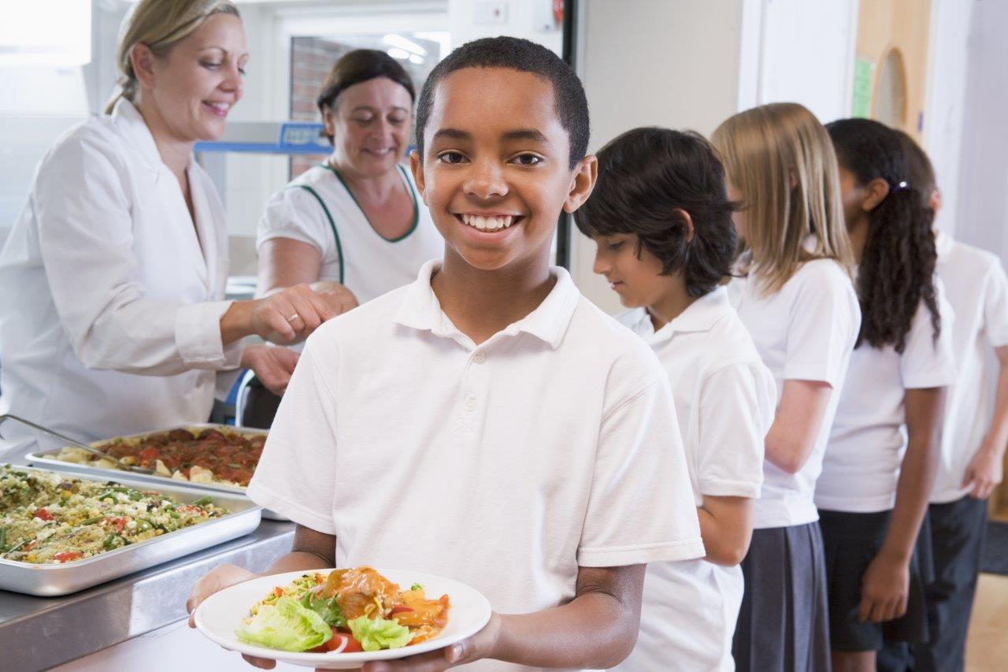
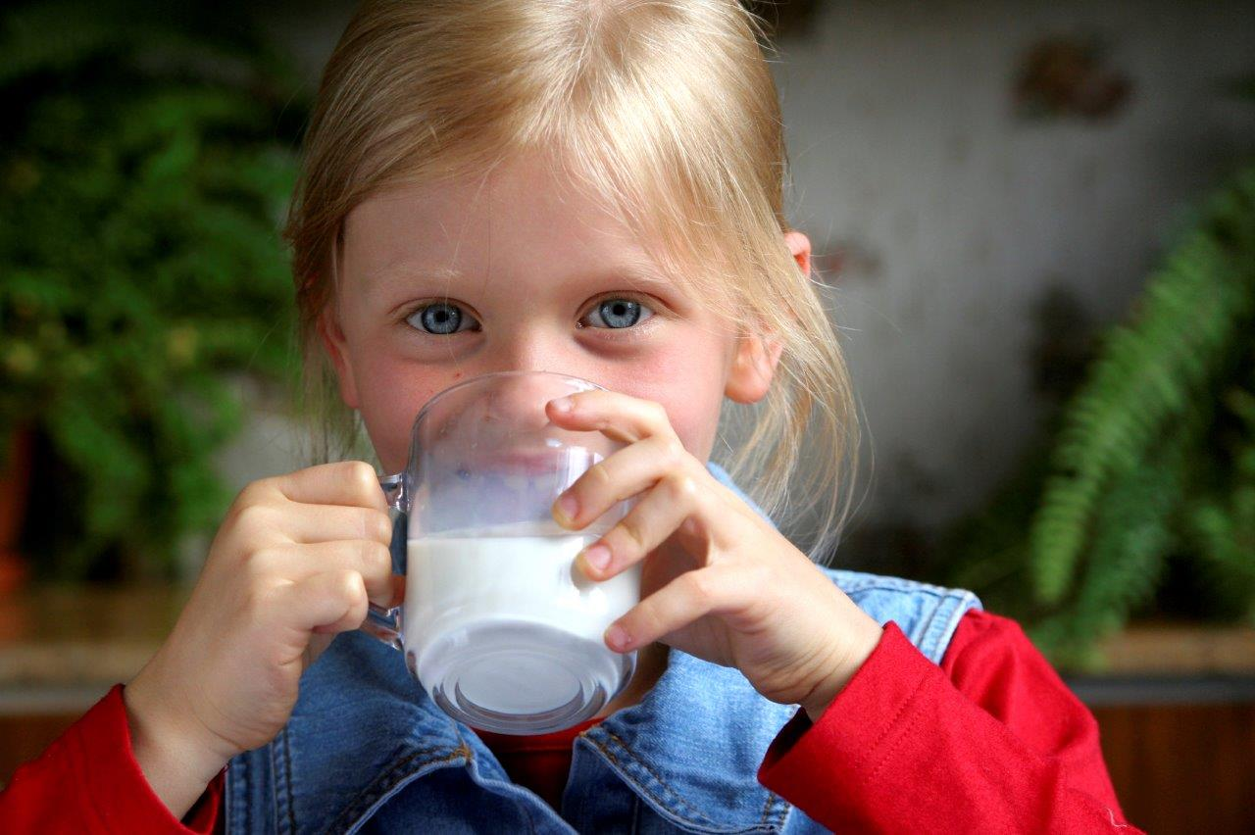
We eat food and have drinks at different times of the day.
When do you eat food during the day?
When do you have drinks during the day?

Slide 3
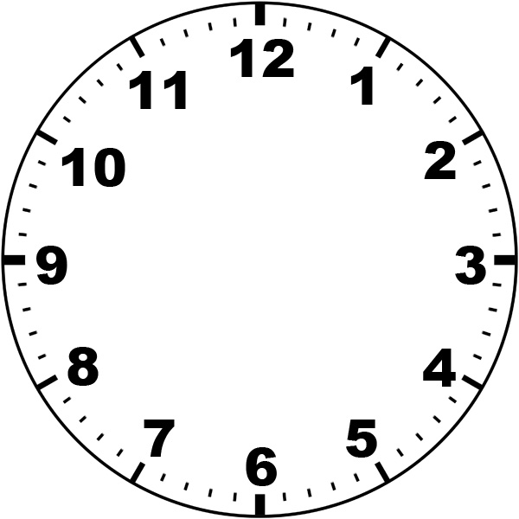
What might people eat and drink for breakfast?
What time do people have breakfast?

Slide 4
What might people eat and drink for lunch?
What time do people have lunch?

Slide 5
What might people eat and drink for their evening meal?
What time do people have their evening meal?

Slide 6
What might people eat and drink for a snack?
What time might people have a snack?

Slide 7
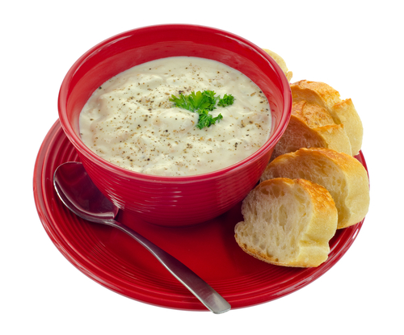
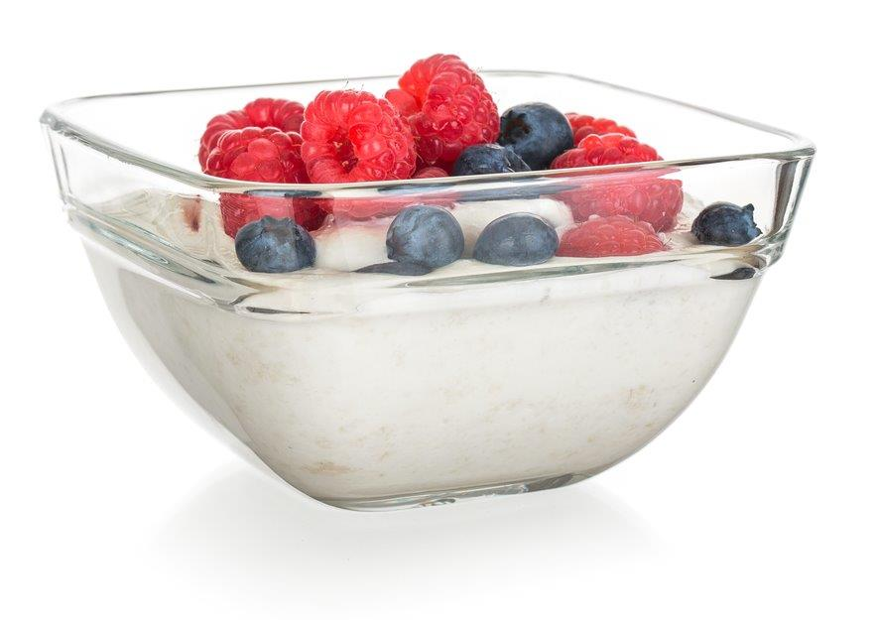
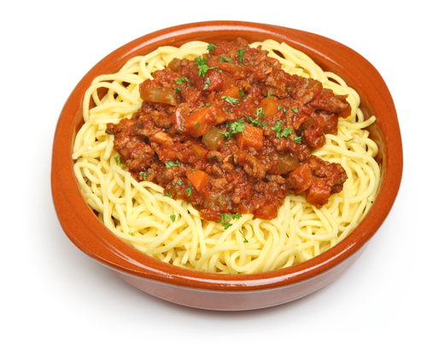
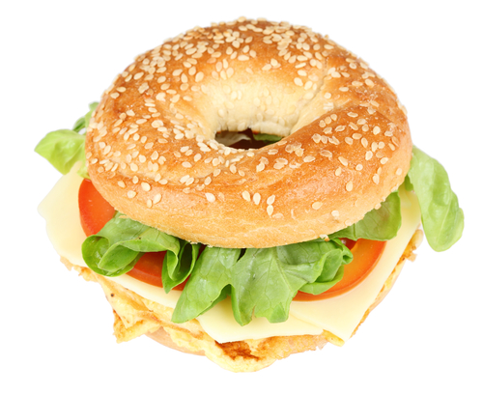
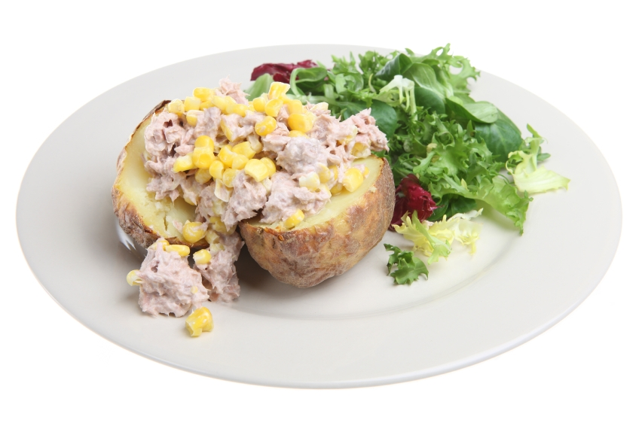
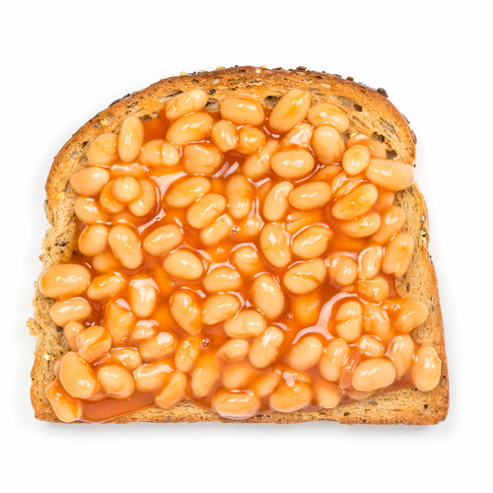
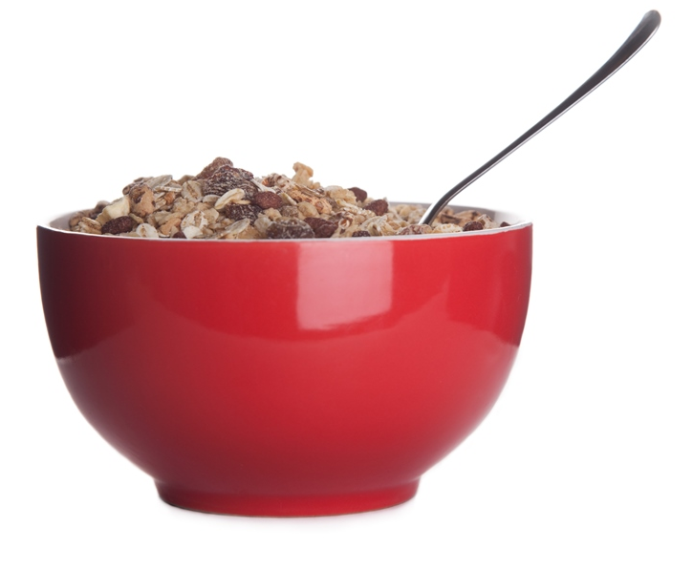
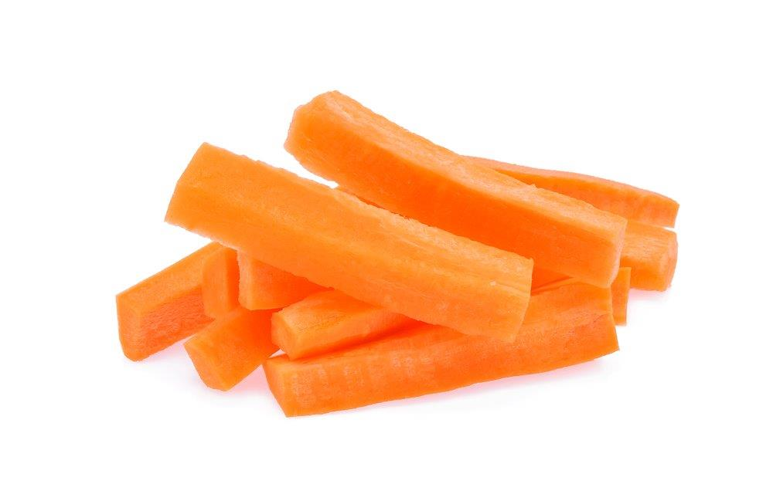
When might people eat this food?

Slide 8
Mealtimes
For further information, go to:
www.foodafactoflife.org.uk
This resource meets the Guidelines for producers and users of school education resources about food.

