Slide 1
Sustainable healthy food

Slide 2
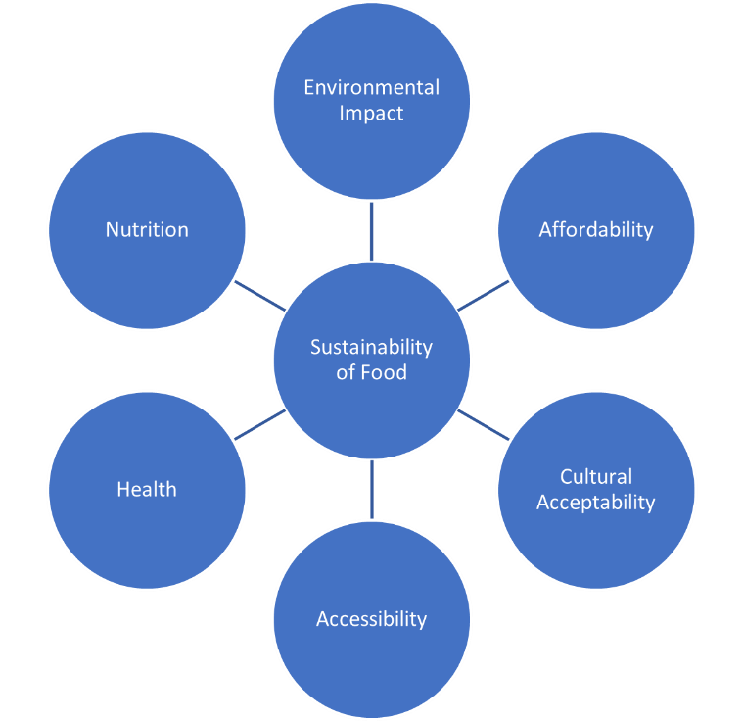
Introduction
This presentation is an introduction to sustainable, healthy food.
The diagram on the right shows the factors that make up a sustainable diet.
This presentation is aimed at children aged 7-11, and it will explore some of the factors affecting the sustainability of food.

Slide 3
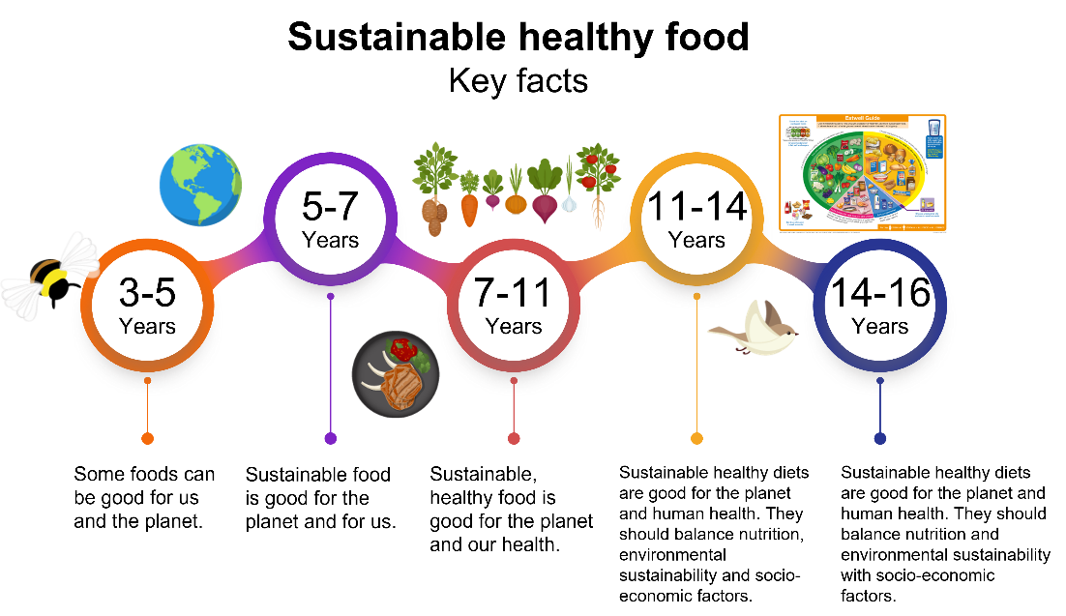
Sustainable, healthy food
Key facts
The Food – a fact of life resources covering the topic of sustainable healthy food are built around Key facts, which progress through the age phases.
See our Curriculum roadmaps to find out more about the Key facts.

Slide 4
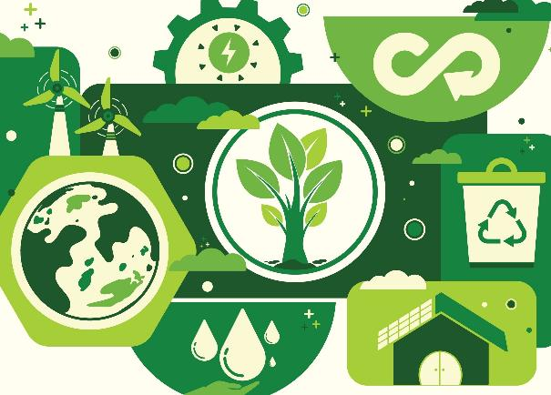
Sustainability
Sustainability is a complex topic and must consider both the planet and people.
Balance is important to consider. For example, a food might be affordable, but not nutritious or produced with care for the environment.
Another food might be produced with care for the environment and nutritious, but not be affordable or accessible.

Slide 5
Sustainable healthy food
Summarised Key fact for 7-11 years:
Sustainable, healthy food is good for the planet and our health.
Key facts:
Looking after our planet
Sustainable food is produced and processed with care for the environment.
Water, energy and land are limited resources. Wasting food also wastes these resources.
Human health
Sustainable, healthy food is nutritious and good for our health.
Affordable, accessible food
Sustainable, healthy foods are easy to access, affordable and safe to eat.
Explanatory notes:
The presentation can be used in its entirety, or you can use the hyperlinks in the titles (above) to go to the slides most relevant to your teaching and learning around sustainable healthy food.

Slide 6
Looking after our planet

Slide 7

Sustainable healthy food
Sustainable food is produced and processed with care for the environment.
Water, energy and land are limited resources. Wasting food also wastes these resources.

Slide 8
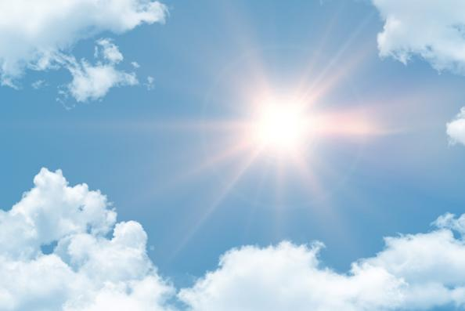
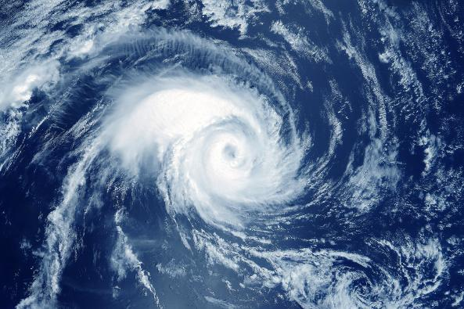
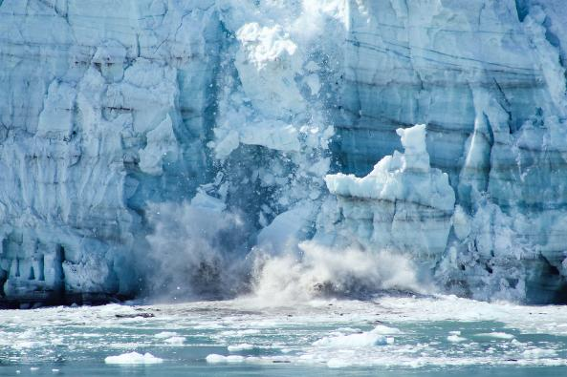
Affect of climate change
Climate change can cause extreme and unusual weather.
An increase in global temperatures.
An increase in extreme weather, such as hurricanes and flooding.
A change in the climate of an area.

Slide 9
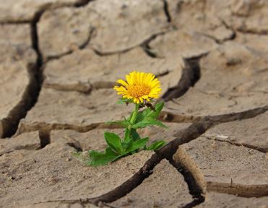
Impact of the changing environment
The changes in weather and climates around the world can affect food production and impact food security.
This can result in:
conditions changing so it can be harder to grow food;
an increase in wildfires;
the polar ice caps melting causing sea levels to rise.

Slide 10
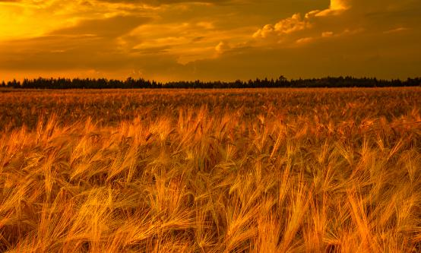
Climate change and food production
Suggest how these changing weather conditions will affect food production.
It has rained for 30 days. Fields are flooded with water. How will this affect our animals and crops?
There has been no rain for 30 days. It has been very warm and sunny. How will this affect animals and crops?
The weather has been so hot that the grass has been burnt. How will this affect the animals who eat grass?
The changing weather has caused new challenges to growing crops and rearing animals. How will this affect our food production?

Slide 11
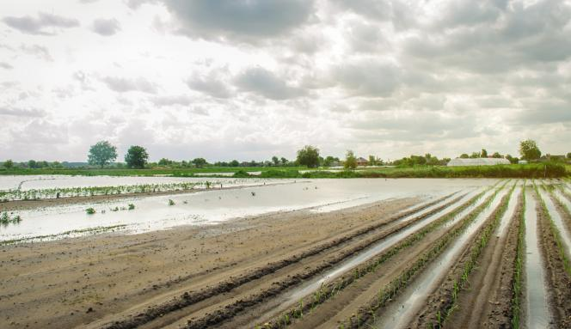
Sustainable healthy food
Example answer
It has rained for 30 days. Fields are flooded with water. How will this affect our animals and crops?
Crops cannot grow as too much water can damage them.
Animals cannot graze if the grass is underwater or ruined.
Plant roots need air and if it is too wet, they may not survive.

Slide 12
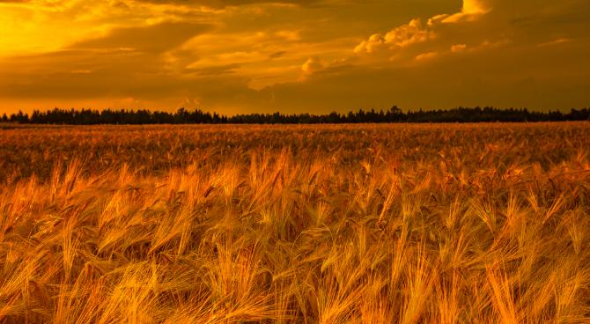
Sustainable healthy food
Example answer
The weather has been so hot that the grass has been burnt. How will this affect the animals who eat grass?
Burnt grass turns brown and dry, so animals like cows and sheep can’t eat it and lose their food source.
Farmers may need to buy food for the animals, so they don’t go hungry and keep them healthy.

Slide 13
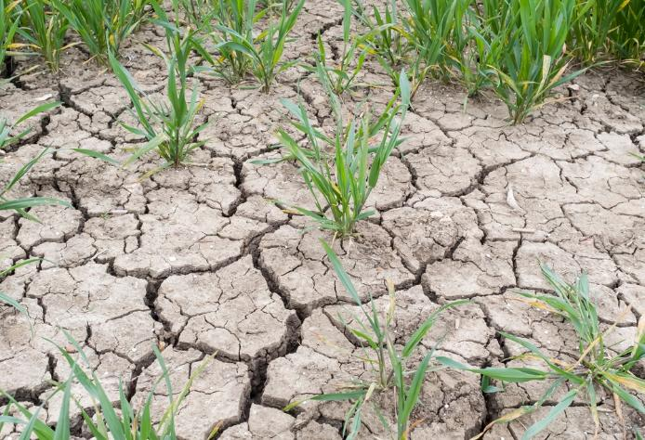
Example answer
There has been no rain for 30 days. It has been very warm and sunny. How will this affect animals and crops?
Crops need water to grow. If it is too dry, they may stop growing and die.
Less food might be available for people and animals.
Animals need water to drink, just like we do. If ponds or rivers dry up, it is harder for them to stay cool and healthy.
Grass can dry out and turn brown, animals who eat grass may struggle to find food.

Slide 14
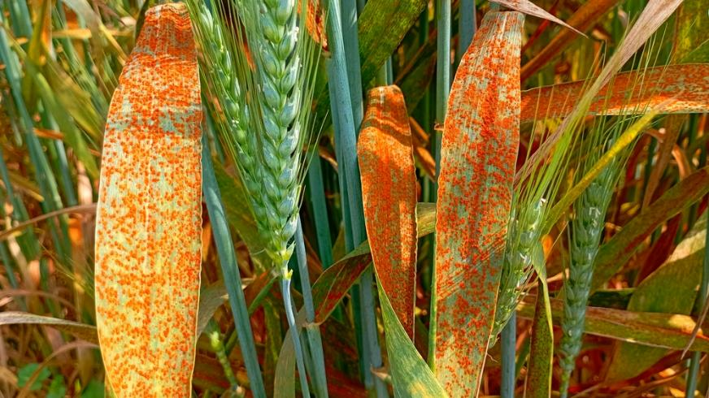
Example answer
The changing weather has caused new challenges to growing crops and rearing animals. How will this affect our food production?
Crops may get diseases or stop growing properly.
Animals that get sick can’t give us as much food.
These challenges make it harder for farmers to produce enough food for everyone.

Slide 15
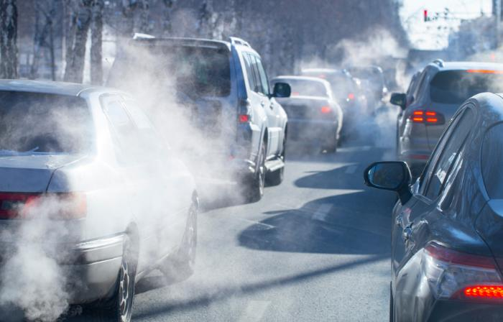
Sustainable healthy food
The greenhouse effect
Greenhouse gases are found in the air around Earth. They catch some of the Sun’s heat and keep our planet warm.
Without the greenhouse effect the Earth would be too cold for people, animals and plants to live.
Humans are making too many greenhouse gases, and this makes the Earth hotter than it should be.

Slide 16
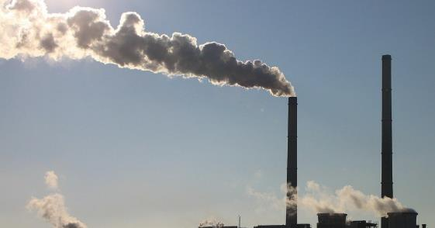
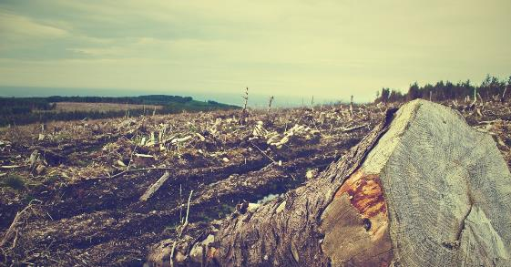
Sustainable healthy food
The greenhouse effect
Increasing the levels of greenhouse gases in our atmosphere can cause harm and puts the Earth at risk of getting too hot.
This happens in several ways, including:
burning fossil fuels like coal, oil, gas;
deforestation (cutting down trees).

Slide 17
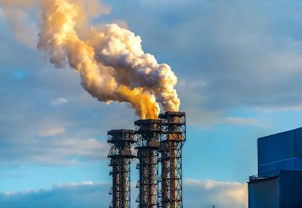
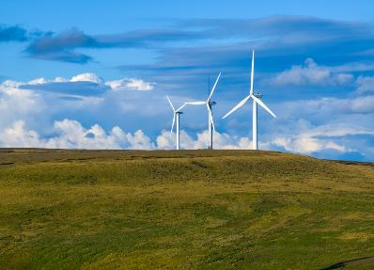
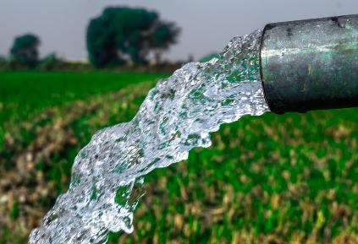
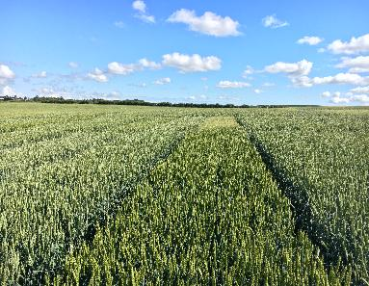
Sustainable healthy food
How can we help fight climate change?
Reduce the amount of greenhouse gases released into the atmosphere.
Use renewable energy, such as solar or wind instead of fossil fuels such as coal, oil or gas.
Store and manage water better in periods of drought or flooding.
Breed and grow crops that can survive extreme weather.

Slide 18
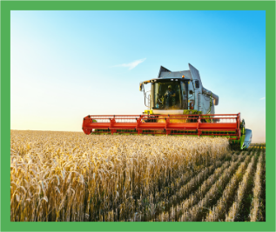
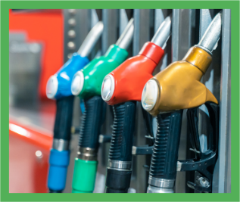
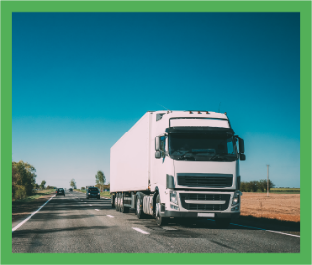
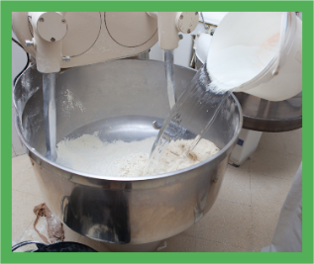
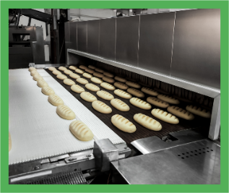
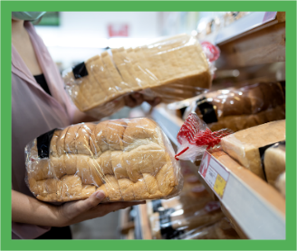
A lot goes into producing our food
Here are some of the ways land, water and energy are used to make a loaf of bread.
Land
Fuel
Transport
Explain why each of these is needed so we can have bread to eat.
Water
Oven
Packaging

Slide 19
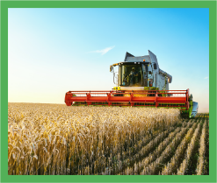


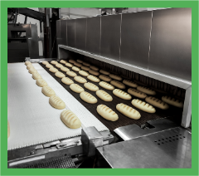


Examples
Land: to grow the wheat
Water: to mix the dough
Energy: to bake the bread in the oven
Fuel: to power the lorry
Transport: to take wheat grains to the mill
Packaging: to keep the bread fresh

Slide 20
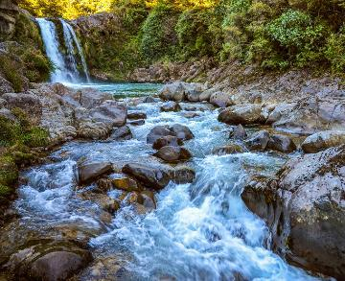
Water usage
We need freshwater to drink, grow our food, wash, cook and other parts of our daily life.
Only around 1% of the water on our planet is freshwater, so we need to use it wisely.
Our oceans are seawater, which we can’t use because it is salty.

Slide 21
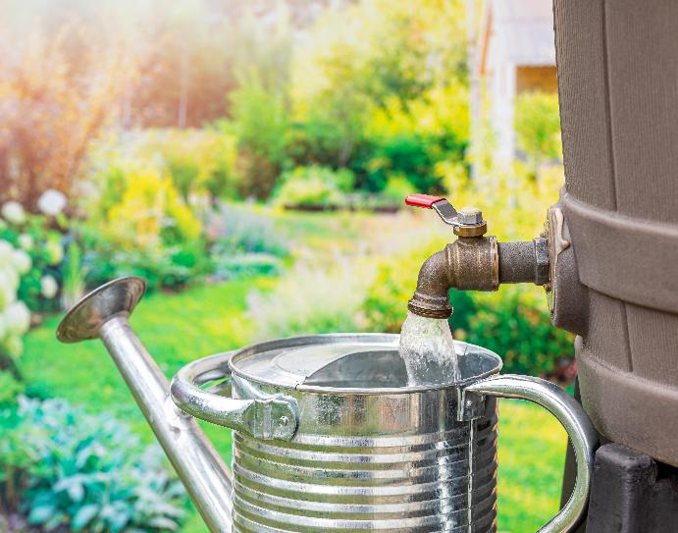
Water usage
Suggest five ways we can help save water.
Take a short shower instead of bath.
Avoid playing with sprinklers or hoses.
Make sure taps have been turned off properly when you have used them.
Use rainwater to water plants and crops.
Make sure there are no leaks in your home.

Slide 22
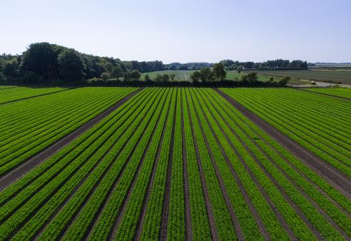
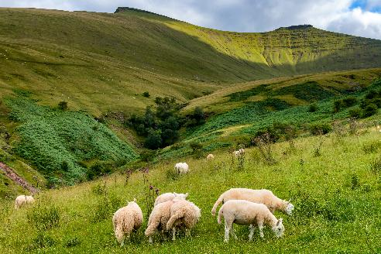
Land usage
Not all land is suitable for growing crops or rearing animals.
Flatter land is suitable for growing crops.
Some land may be very steep and would not be suitable for growing crops like wheat and vegetables, but could be used for grazing animals or growing trees.

Slide 23
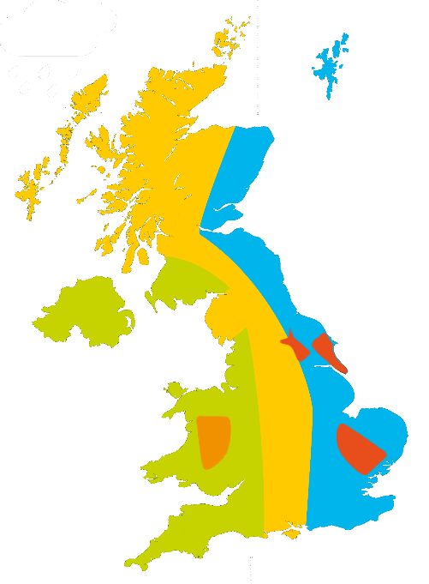
Land usage
Farmers make the most of the land by growing crops and rearing animals in different places.
This map shows where different food is farmed in the UK.
Sheep
Dairy
Mixed
Arable
Pigs

Slide 24
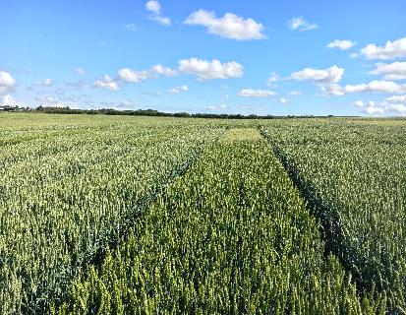
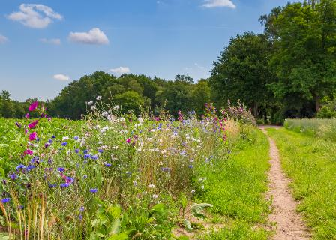
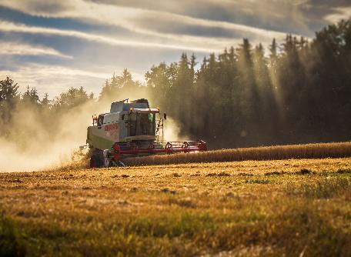
Soil health
Farmers play a big role in keeping the soil healthy. Here are some of the things they do:
Rotate crops grown, or animals reared, in a field.
Plant flowers and hedges to attract other animals or insects. Using organic fertilisers such as manure to help plants grow.
Minimise disturbance to the soil by ploughing less.

Slide 25
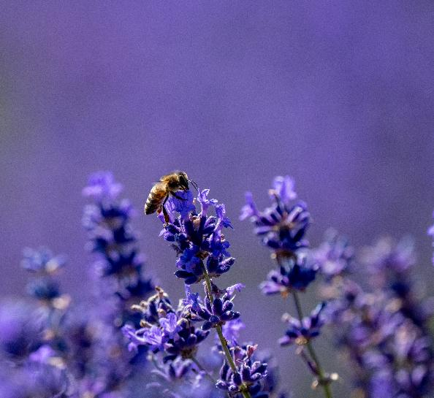
Biodiversity
Biodiversity is measured by how many different species live in an area.
One way to improve biodiversity is to attract insects and birds to live near fields.
They can help farmers by eating pests (bugs that harm plants) and by pollinating crops, which means helping plants grow fruits and seeds.

Slide 26
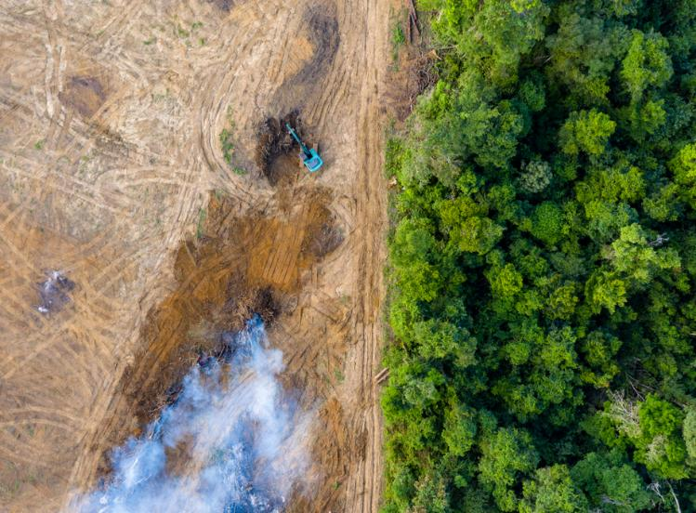
Biodiversity
Less biodiversity means fewer types of animals and plants living in a place.
If they lose their homes (habitats), it’s hard for them to survive. If they can’t survive, they might disappear forever. This is called extinction.
When one kind of animal or plant becomes extinct, it can affect others. It can change the food chain, making it harder for other animals to find food.
Low biodiversity
High biodiversity

Slide 27

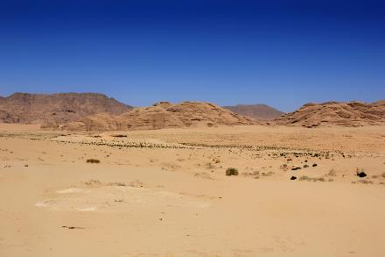
Biodiversity
Which of these habitats shows more biodiversity?
A
B
Image A shows a greater range of species, meaning it has more biodiversity.

Slide 28
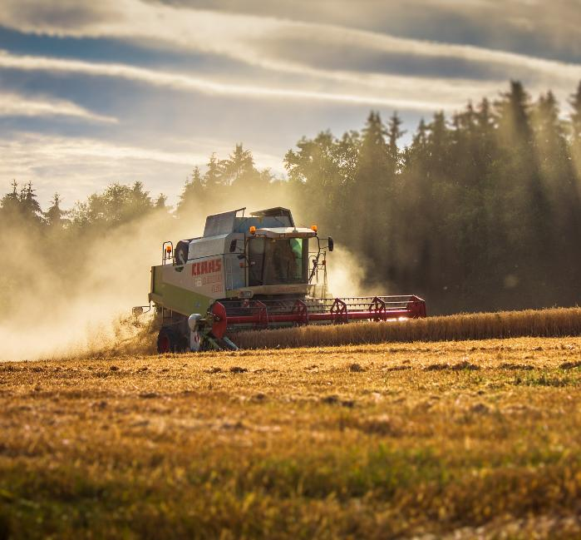
What are farmers and food producers doing?
Farmers and food producers are using more sustainable methods of farming to help protect the environment.
More sustainable farming methods include:
using natural fertilisers such as manure (animal poo);
planting hedges and trees to give animals and insects a home, to help biodiversity;
rotating crops and animals in fields to keep soil healthy and reduce the need for fertilisers.

Slide 29
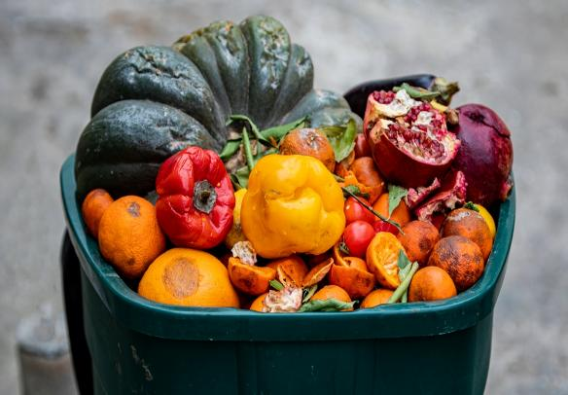
Food waste
Food loss is food that is lost before it makes it to supermarkets or shops.
Food waste is food we waste at home, in restaurants or in shops. We have all thrown away food at some time.
Make a list of the foods that you or your family have thrown away.
Why did you throw it away?
What could you have done with the food instead of wasting it?

Slide 30
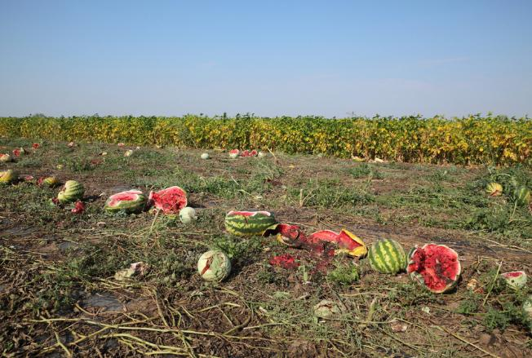
Food waste
About one third of all food is lost or wasted.
In the UK:
about 70% of food is wasted at home;
about 30% is lost on farms or in supermarkets;
the average UK household spends £470 on food that ends up in the bin every year.
Food waste also contributes to greenhouse gases being releases into the atmosphere. This plays a role in climate change and global warming.
Food waste: Amount thrown away totals 900 million tonnes - BBC News

Slide 31
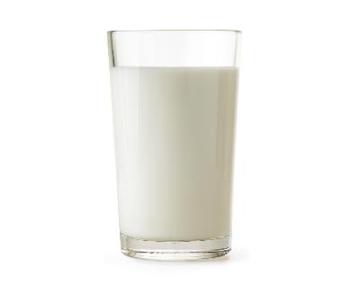
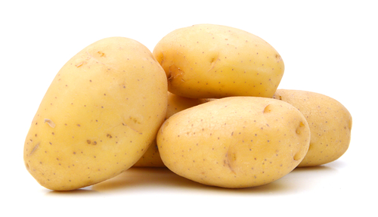
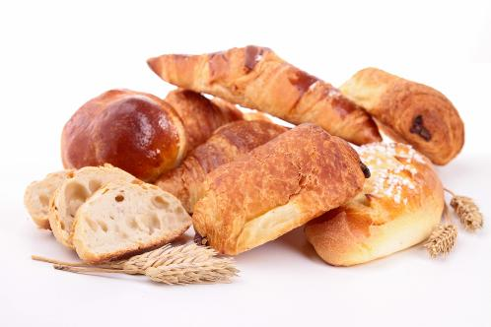
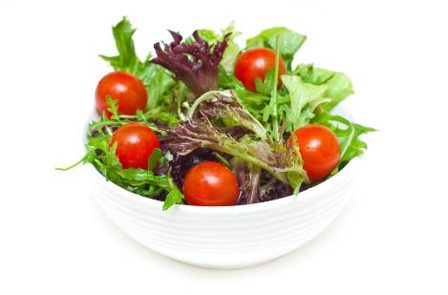
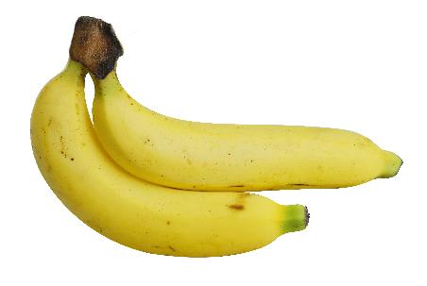
What do you think are the top 5 wasted foods in the UK?
Bread
Milk
Potatoes
Salad
Bananas
Food waste statistics

Slide 32
Memory quiz!
Name one impact of our changing environment.
Name one way that farmers can help keep soil healthy.
What percentage of food is wasted in UK homes?

Slide 33
Memory quiz!
Name one impact of our changing environment.
  There are more wildfires, the polar ice caps are melting, and weather conditions are changing, which makes it harder to grow crops.
2. Name one way the farmers can help keep soil healthy.
  Farmers can rotate crops and animals in their fields, plant flowers and hedges to attract bees and insects, plough less often to protect the soil.
3. What percentage of food is wasted in UK homes?
  70% of food waste happens in the home.

Slide 34
Human health

Slide 35
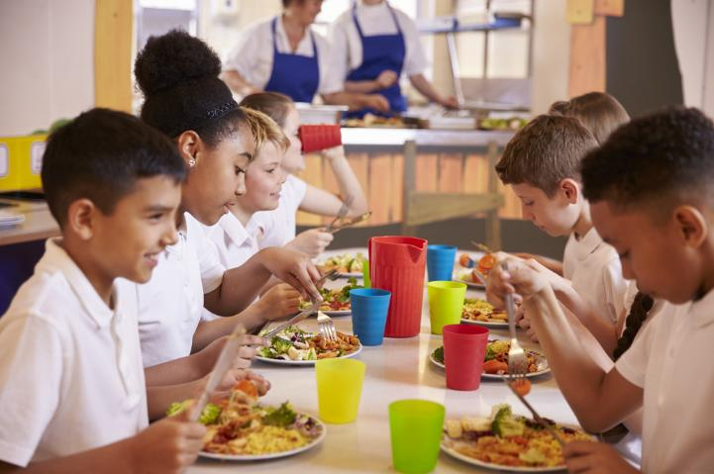
Sustainable healthy food
Sustainable, healthy food is nutritious and good for our health.

Slide 36
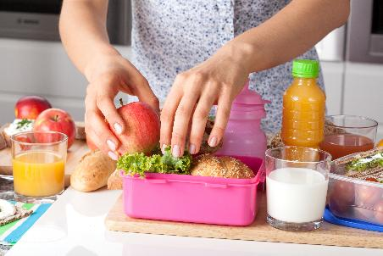
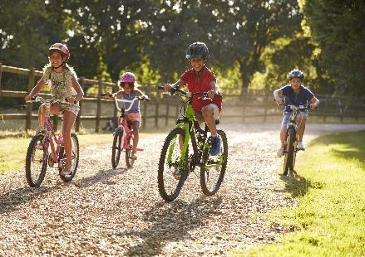
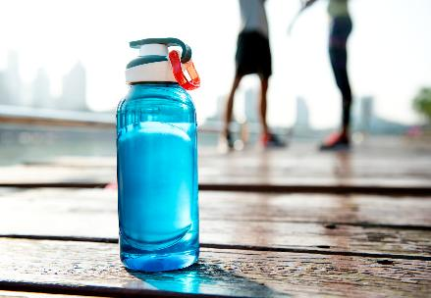
Keeping healthy
A sustainable healthy diet helps to protect our planet, but it also helps to keep us healthy.
What do we need to do to keep ourselves healthy?
Eat different types of foods. Follow the Eatwell Guide.
Be active and exercise regularly.
Drink plenty of water.

Slide 37


The Eatwell Guide
The Eatwell Guide shows which different groups of foods are needed to have a balanced, healthy diet.
People should choose a variety of different foods from each food group to help get the wide range of nutrients the body needs to stay healthy.
If everyone in the UK followed the Eatwell Guide, our diets would have a much lower environmental impact. It would ease the pressure on our limited resources of water, land and energy.

Slide 38

Nutrients
There are a wide variety of nutrients that we need to stay healthy.
The nutrients needed include protein, fat, carbohydrates, vitamins, minerals and water.
Having a varied and balanced diet that follows the Eatwell Guide helps to ensure we get the nutrients we need.

Slide 39


We need…
Foods like
Potatoes, bread, rice, pasta for carbohydrates
At least 5 portions of
Fruit and vegetables
everyday
Foods like
Beans, pulses, fish, eggs, meat for protein
Foods like
Dairy and alternatives for minerals such as calcium
Oils and spreads in small amounts as they are high in fat

Slide 40

Energy
Energy is essential for life. We need energy for growth and to be able to carry out activities.
A balance is needed between our energy intake (from what we eat and drink) and the energy we use (from physical activity).
Activities such as running, walking, cycling all use energy.

Slide 41

Fruit and vegetables
We should be eating at least 5 portions of vegetables and fruit each day.
However, in the UK, we are eating less than 5 portions of fruit and vegetables per day. On average children aged 11-18 are only eating 2.8 portions of fruit and veg daily.
Having a variety of fruit and vegetables is important because fruit and vegetables provide us with different nutrients.
National Diet and Nutrition Survey 2019 to 2023: report - GOV.UK

Slide 42

Fruit and vegetables
We can be sustainable when choosing our fruit and vegetables. Buying local produce where available, can reduce the food miles or distance the food must travel to your table.
Buying fruit and vegetables when they are in season means they are the best in terms of flavour, texture and nutrition and they are also cheaper.

Slide 43

Fibre
Fibre helps to keep our digestive system healthy and can stop us getting constipated.
Fibre adds bulk to stools by absorbing water. This makes stools softer so they can move more quickly through the gut, making them easier to pass.
In other words, fibre helps our body get rid of solid waste more easily when we go to the toilet!

Slide 44

Fibre
Fibre can be found in fruit and vegetables and in potatoes, bread, rice, pasta and other starchy carbohydrates.
86% of 4 to 10 year olds do not have enough fibre in their diet.
Age | Recommended fibre intake
2-5 | 15g per day
5-11 | 20g per day
11- 16 | 25g per day
17 and over | 30g per day

Slide 45

Beans, pulses, fish, eggs, meat and other proteins
These foods are sources of protein, vitamins and minerals.
We should eat a variety of sources of protein and try to eat more beans and pulses.
We should also aim for at least two portions of sustainably sourced fish a week, including a portion of oily fish.

Slide 46

Hydration
We need to drink plenty for lots of reasons. It helps:
keep our body the right temperature;
our brain to work properly;
us to be active.
We lose water when we go to the toilet, sweat and breathe.
We need to drink plenty to replace this lost water, so we stay hydrated.
6-8
a day

Slide 47

Hydration
All drinks give us water and can help us to stay hydrated.
We need to try and choose healthier drinks like water and reduced-fat milk.
Water is a great choice because it doesn’t contain any sugar. Make water your main drink!

Slide 48
Memory quiz!
What are three ways we can keep healthy?
What does the Eatwell Guide show us?
Why is it important to increase the amount of fibre in our diet?

Slide 49
Memory quiz!
What are three ways we can keep healthy?
  Eat different types of foods. Follow the Eatwell Guide. Be active and exercise regularly. Drink plenty of water.
2. What does the Eatwell Guide show us?
  The Eatwell Guide shows which different groups of foods are needed to have a balanced, healthy diet.
3. Why is it important to increase the amount of fibre in our diet?
  Fibre is important to keep our digestive system healthy. It can help prevent constipation and helps our body get rid of solid waste more easily when we go to the toilet.

Slide 50
Affordable, accessible food

Slide 51

Sustainable healthy food
Sustainable, healthy foods are easy to get, affordable and safe to eat.
If a food is good for the planet and healthy, but it's hard to find, too expensive, or not safe, then some people can’t get the benefits.
It’s important for everyone to be able to get healthy, sustainable food.

Slide 52

Food security
Food security means making sure everyone has enough food to eat.
This can mean:
there is enough of the right kinds of food for everyone to eat;
people have enough money to buy food and can get to places like shops or supermarkets to buy it.

Slide 53

Food insecurity
The world is changing very fast. These changes are increasing the risk of people not being able to get the food they need.
Changes that can impact the food available around the world can include:
more people being born;
new pests and crop diseases;
climate change;
wars and armed conflict;
overfishing.

Slide 54

Increasing population
There are now 8 billion people living on Earth. By 2055, it could reach 10 billion people.
The more people that live on Earth, the more pressure is on how we grow and share the food.

Slide 55

News pests and crop diseases
Climate change has caused a rise in new pests and diseases which can affect plants.
This can cause issues as it can decrease the populations of plants leading to food shortages.

Slide 56


Climate change
The Earth is getting hotter because of climate change.
This can cause big weather changes, like floods and droughts.
These can make it hard for plants and animals to live and grow.

Slide 57

Armed conflict
Fighting in different parts of the world can make it hard for people to get enough food.
Land gets damaged or taken, and farmers have to leave their farms to stay safe.
Crops and animals can get hurt, and important resources like water and tools may be lost or broken.

Slide 58

Overfishing
Modern day technology means fishers are now able to catch larger amounts of fish.
But if they catch too many (overfishing), there might not be enough fish left in the sea, and one day, they could run out.

Slide 59

Food safety
Sustainable healthy food should also be safe to eat.
Keeping food clean and storing it the right way helps stop people from getting sick.
Some countries don’t have as much safe and clean food, which makes it harder for people to stay healthy.

Slide 60

Food for everyone
Some people can't eat certain foods because of their religion, culture, allergies, or personal choice.
For example, some people eat only halal or kosher food, and some don’t eat meat or animal products.
Even if people eat differently, everyone still needs sustainable healthy food that is right for them.

Slide 61
Memory quiz!
1. What does food security mean?
2. What problems could an increasing population on Earth cause?
3. Why can wars or fighting lead to people not being able to get the food they need?

Slide 62
Memory quiz!
What does food security mean?
    Food security means that all people, always have enough food to eat.
What problems could an increasing population on Earth cause?
    By 2055, the world population is expected to have reached 10 billion. This puts pressure on our how we grow and share food, making it harder to feed everyone.
Why can wars or fighting lead to people not being able to get the food they need?
    Wars can damage land and crops, making it harder to grow food. Farmers may also have to leave their land for safety, which means less food it produced.

Slide 63
Sustainable healthy food
For further information, go to:
www.foodafactoflife.org.uk
This resource meets the Guidelines for producers and users of school education resources about food.

