Slide 1
High blood pressure

Slide 2

High blood pressure
High blood pressure is a condition that is also known as hypertension.
Having high blood pressure puts strain on your heart that can lead to your blood vessels becoming damaged, making them more at risk of heart disease.
Having a high blood pressure can also increase risk of: heart attacks; strokes; heart failure; peripheral arterial disease; aortic aneurysms; kidney disease and vascular dementia.

Slide 3
How is hypertension measured?
Blood pressure is measured by taking systolic and diastolic blood measurements.
The systolic pressure (higher number) is the force at which your heart pumps blood around your body.
The diastolic pressure (lower number) is the resistance to the blood flow in the blood vessels. They are both measured in millimetres of mercury (mmHg).
High blood pressure is considered to be 140/90mmHg or higher.
Ideal blood pressure is considered to be between 90/60mmHg and 120/80mmHg.
Low blood pressure is considered to be 90/60mmHg or lower.
NHS

Slide 4
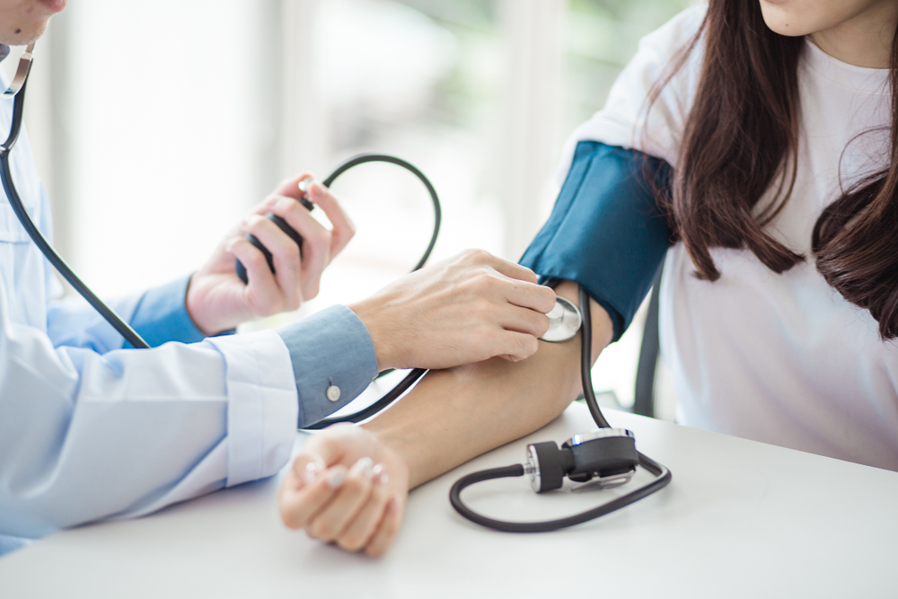
Risk factors for hypertension
There are a number of lifestyle behaviours that put you at increased risk that can be changed. These include:
smoking;
a poor diet;
excessive alcohol consumption;
lack of physical activity.
These factors contribute to the risk of obesity, type 2 diabetes, high blood pressure and high cholesterol levels, which are some of the strongest risk factors for heart disease.

Slide 5

Risk factors for hypertension
Excessive alcohol consumption
Regularly drinking more alcohol than we are recommended over a long period of time raises blood pressure, which is a risk factor for heart disease and stroke.
Lack of exercise
Not exercising regularly increases the chance of high blood pressure, higher cholesterol levels and overweight and obesity. These are all risk factors for developing heart disease.

Slide 6

Risk factors for hypertension
Smoking
The chemicals in smoke reduce the amount of oxygen your blood can carry to your heart and body; raise your heart rate and blood pressure so your heart has to work harder.
Being overweight or obese
Research shows that being overweight or obese can raise your blood cholesterol levels, increase your blood pressure and increase your risk of developing type 2 diabetes.

Slide 7
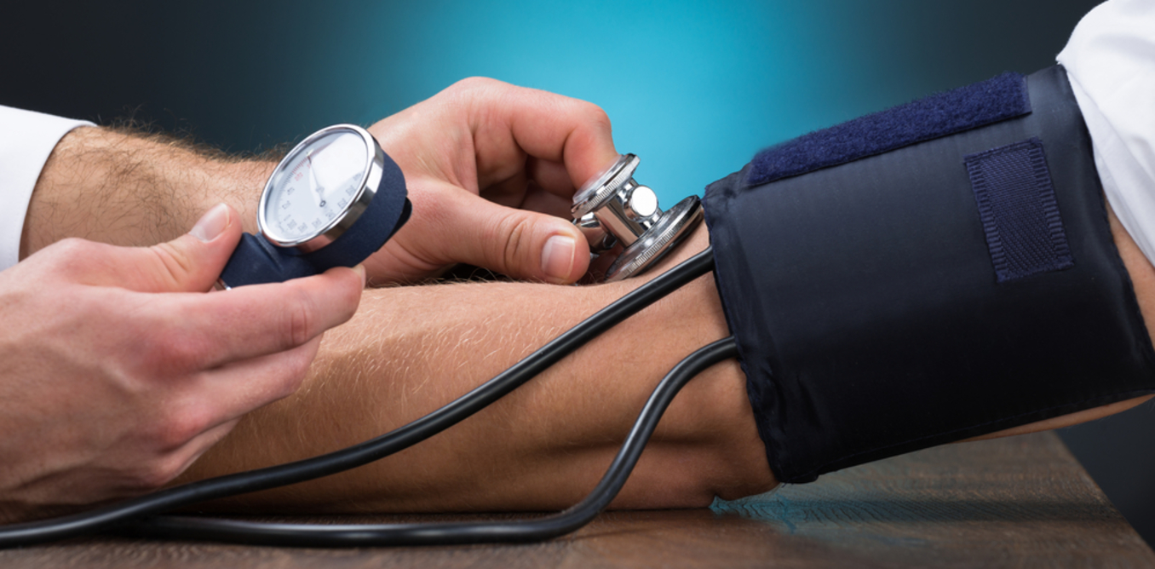
Sodium (Na)
High intakes of sodium are linked to high blood pressure (hypertension), which increases the risk of stroke and coronary heart disease.
Sodium intakes in the UK are higher than the recommended levels.
There is around 1g Sodium in 2.5g of salt.
Did you know?
It is recommended that adults have a maximum of 6g salt per day. Children under 11 years should eat less. Currently the mean intake in UK adults is 8g/day.

Slide 8

Sodium (Na)
Sodium is a component of common salt, known as sodium chloride (NaCl). Most raw foods contain very small amounts of sodium chloride (salt).
Salt is often added during the processing, preparation, preservation and serving of foods. Reductions in sodium levels in food have been happening across the UK food industry.
It is recommended to try and choose foods with lower levels of salt by checking the salt content on labels and don’t add any extra to cooking or at the table.
How can we reduce salt when preparing and cooking food?
Instead of adding salt to food, try adding pepper, herbs or spices such as mint, basil or chilli to add flavour.

Slide 9
High blood pressure
For further information, go to:
www.foodafactoflife.org.uk
This resource meets the Guidelines for producers and users of school education resources about food.

