Slide 1
Posh nosh!

Slide 2
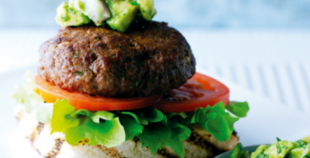
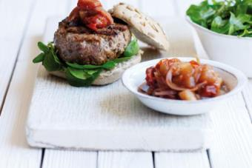
The challenge
Create a premium or luxury burger.

Slide 3
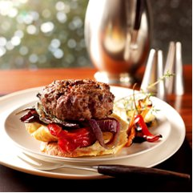
What makes a premium product?
In pairs, write down three things that make a premium product.
Did you include?
High quality ingredients.
Food provenance and quality assurance – knowing where your food comes from.
A variety of burger ingredients, breads, toppings and sides.
Good quality control – well made, shaped and cooked to perfection!

Slide 4


Food provenance
Quality assurance schemes are used by the red meat industry to assure consumers that the meat they buy is traceable, safe to eat and produced responsibly.

Slide 5
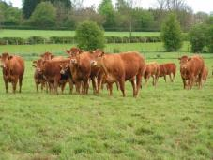
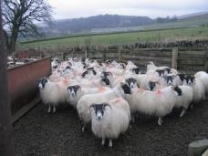
Food provenance
Task
Research The Red Tractor and Quality Standard Beef & Lamb assurance schemes.
Why do you think that manufacturers of premium products might choose to use meat produced following these assurance schemes?

Slide 6
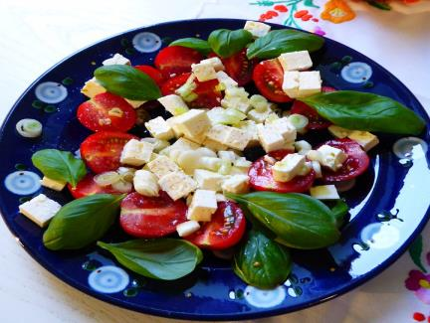
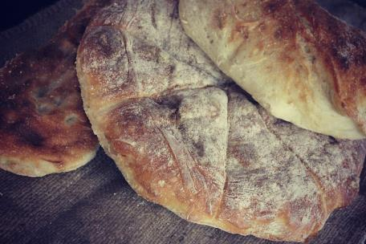

Inspiration

Slide 7
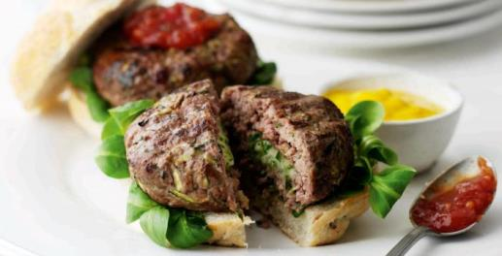
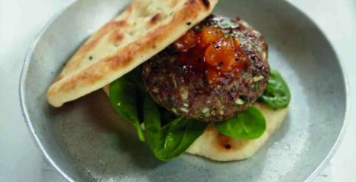
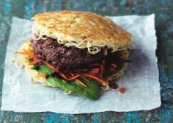
Inspiration

Slide 8
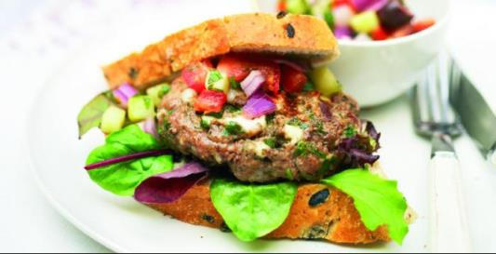
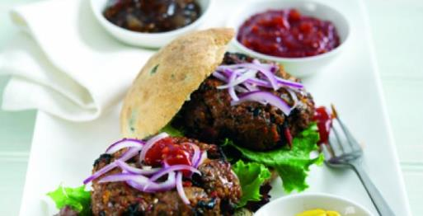
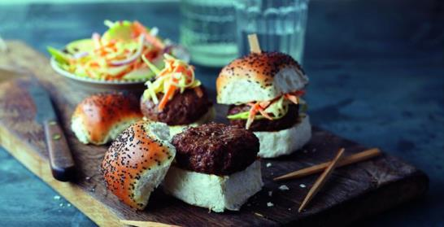
Inspiration

Slide 9

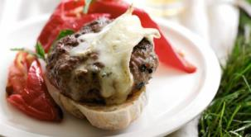
What’s on the side?
Breads, toppings and sides all make a premium product really special.
What will you serve with your burger?
Explore the different types of sides that could be added to your premium burger.
Think about appearance, textures and flavours!

Slide 10
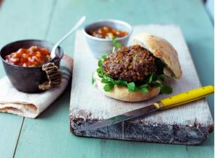
Create your burger
Step 1
Use the Gourmet Burger Builder to create your high quality premium burger.
Step 2
Make your premium burger following the recipe.
Step 3
Take a photo and share your recipe on social media.

Slide 11
Posh nosh!
For further information, go to:
www.foodafactoflife.org.uk
This resource meets the Guidelines for producers and users of school education resources about food.

