Slide 1
Social and technological changes and the impact on the food we eat

Slide 2
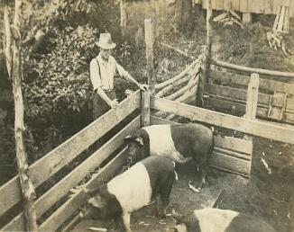
History
In the past, food was grown, prepared and cooked at home or sold by small scale producers or merchants.
For example, many people had backyard pigs which were bred to consume waste products, fertilise the land and obviously provide essential meat. Today, this is very rare and pigs are generally reared on specialist pig farms.
The same is for fruit and vegetables. In 1947 11% of fruit and vegetables were home grown but in 2015, 3.8% came from free sources, mainly gardens and allotments.
Source: 75 years of Family food

Slide 3
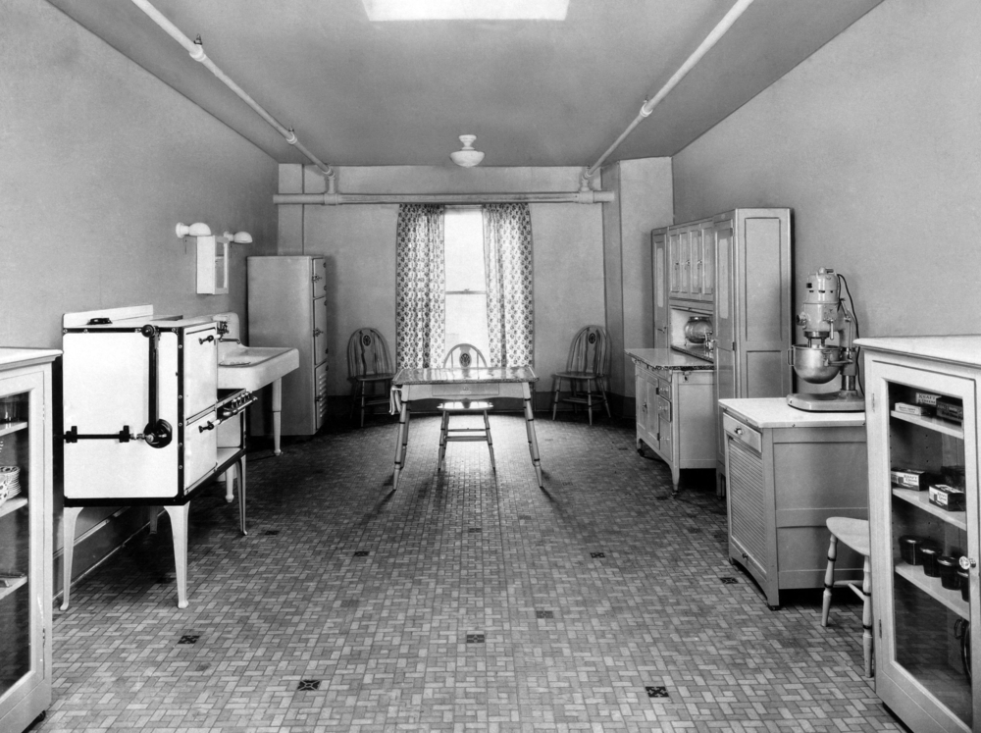
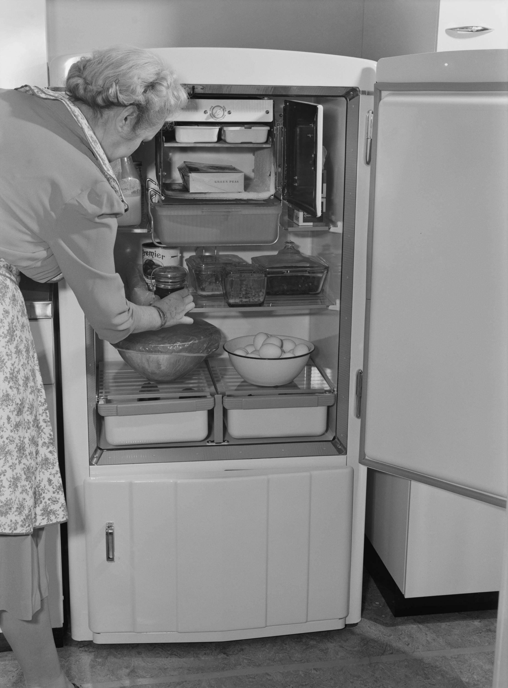
History and other developments
The industrial revolution in the 19th Century led to greater mechanisation of food production allowing for the development of new products, increased volumes of production and jobs outside of the home or local area.
The diet of most people hardly changed until the outbreak of war in 1914. Following on from this people could eat fresh fruit in winter and much food started to come packaged under brand names that soon become familiar.
The need for cooking in the home was reduced by the availability of processed food, which as well as improving convenience, also provided consumers with far greater choice.
1920s kitchen
1940s fridge

Slide 4
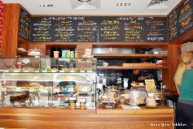
Where we buy our food
Did you know that pre-packaged sandwiches were introduced in 1980?
Today, we can buy food from a wide range of sources including:
markets;
convenience shops including those at petrol stations;
supermarkets;
on-line retailers;
farm shops and farmers markets;
cafés and coffee shops;
take-away outlets;
fast food and other restaurants.
The number of coffee outlets grew by 847% between 1993 and 1997!
Source: 75 years of Family food

Slide 5


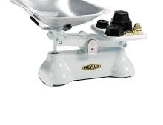
Technological changes
Most of the equipment we use in the kitchen was only invented in the last century!
According to the 75 years of Family Food:
in the early 1960’s only 33% of households owned a fridge;
In 1970 only 3% of households owned a freezer;
In 1989 only 41% of households owned a microwave.
Electric kettles – invented in 1922
or
Which sort of weighing scales do you use?

Slide 6
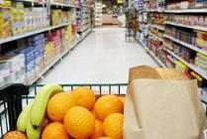

Social and economic changes
Lack of competence and confidence in the kitchen – people may choose to buy ready made, frozen or dried foods that are easy to prepare and cook and that require only basic cooking skills.
Lack of time – many people work long hours and either haven’t got the time or do not wish to spend time cooking at home.

Slide 7
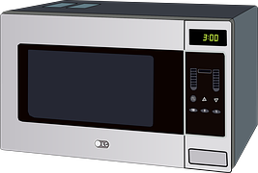

Social and economic changes
Development of ready meals – because people lack time and have labour saving equipment (such as microwaves) the amount and range of convenience foods has grown.
Smaller households – an increasing number of people now live alone and this may well affect their food choices.

Slide 8

Social and economic changes
Travel abroad - there were 70.8 million visits overseas by UK residents in 2016, which was 8% more than in 2015. People often try new foods when abroad and want to eat them again when at home. This may mean buying ingredients or cooking equipment from a specialist food shop or on-line retailer.
Social media – media, on-line blogs and forums also influence people’s food choice which may be reflected in the foods they buy and where they buy them from.
Source: Office for National Statistics

Slide 9
The impact
A wider range of ingredients and food.
Ready-made and convenience foods easily available.
Smaller/individual portions.
Greater availability of specialist food preparation and cooking equipment.
Potential health issues due to increased consumption of processed foods which can be higher in fat, salt and sugar.
Fewer people with the confidence and competence to cook at home.

Slide 10
Social and technological changes and the impact on the food we eat
For further information, go to:
www.foodafactoflife.org.uk
This resource meets the Guidelines for producers and users of school education resources about food.

