Slide 1
Malnutrition

Slide 2

Malnutrition
Meeting the body’s needs for energy and nutrients is essential for good health.
Intakes of energy and/or nutrients below or in excess of needs over time can effect health and lead to health problems.
Malnutrition is a term which covers problems of both under and over nutrition.

Slide 3
Undernutrition
Under nutrition occurs when is there is a deficiency of one or more nutrients. It may be mild or severe. Mild forms of under nutrition exist in the UK, e.g. micronutrient deficiency.
Severe under nutrition is rare in countries like the UK, but can be common in some developing countries.
The body may adapt to a short period of under nutrition. Some nutrients, such as fat-soluble vitamins, are stored in the body and can be used if the diet does not provide enough.

Slide 4
Energy
Weight loss is an obvious sign of a diet which is too low in energy.
Children who do not meet their needs for energy may stop gaining weight and stop growing.
In severe cases, a low energy intake results in starvation.
Children, especially those under 5 years of age, suffer from the effects of starvation more quickly than adults. This is because they have higher nutritional requirements in relation to their small size.

Slide 5
Energy
In severe situations when the diet provides too little energy and protein, a life threatening condition can develop. This is called protein energy malnutrition.
Kwashiorkor and Marasmus are the two most common forms of this condition.
In kwashiorkor, subcutaneous fat is usually preserved and muscle wasting occurs but is often masked by oedema (swelling from fluid retention).
Marasmus is a chronic condition of semi-starvation. In later stages, it is characterised by muscle wasting and an absence of subcutaneous fat and to which children adjust, to some extent, by reduced growth.

Slide 6

Protein and fat
The diet must provide the right combination of protein to provide all the essential amino acids, and some fat to provide the essential fatty acids.
A lack of these in the diet can cause symptoms of deficiency.
This is very rare in the UK, because people usually have an adequate energy intake.
Older people suffering from sarcopenia, the loss of skeletal muscle mass and strength as a result of ageing, or with poor appetites may benefit from consuming more protein.

Slide 7

Vitamins and minerals
Vitamins and minerals are only required in very small amounts. Vitamins and minerals each have many different functions, and as a result prolonged deficiency can affect health in many ways.
Fat soluble vitamins (A, D, E and K) and minerals are stored in the body, therefore it takes time for deficiency diseases to develop, e.g. rickets.
Water soluble vitamins (B-group and C) are not stored in the body, therefore low intakes usually lead to signs of deficiency relatively quickly, e.g. beri-beri.

Slide 8
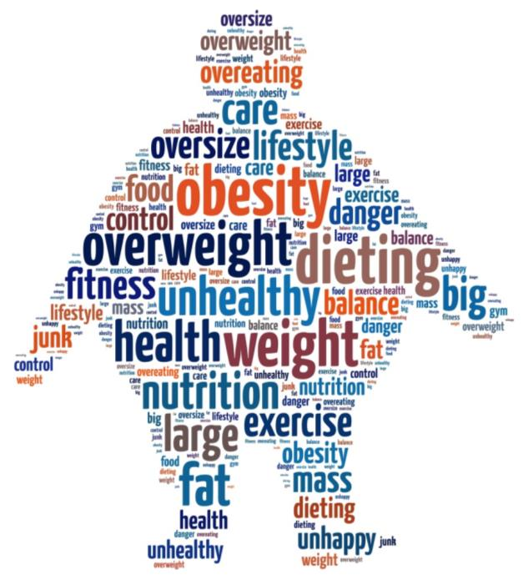
Over nutrition
Over nutrition is a problem usually associated with developed countries, such as the UK.
The most common form of over nutrition is having an energy intake in excess of needs, resulting in overweight and obesity.
Very high intakes of minerals and fat soluble vitamins (more can usually be obtained from food sources alone) can be toxic. This is because they are stored in the body, e.g. vitamin A is stored in the liver.

Slide 9
Obesity
People who are obese are more likely to suffer from:
• coronary heart disease;
• type 2 diabetes;
• gall stones;
• arthritis;
• high blood pressure;
• some types of cancers, i.e. colon, breast, kidney and stomach.

Slide 10
Health issues and weight loss
The risk of malnutrition is increased by:
increased requirements. It is more difficult to meet nutritional needs during periods of increased requirements. For example, some women have very high requirements for iron, e.g. if their menstrual losses are high, if they cannot obtain enough in their diet they may develop anaemia;
reduction in availability of food. Famine is an extreme example;
medical conditions. Some may affect food intake of the absorption of nutrients from food.

Slide 11
Health issues and weight loss
The risk of malnutrition is increased by:
restricted range of food. A diet based on a narrow range of food is more likely to lack nutrients;
income. Lack of money may make it difficult to purchase an adequate diet. Cultural practices may mean that not everyone in a family gets a fair share of the food available.

Slide 12
Health issues and weight loss
The risk of malnutrition is increased by:
other substances in food. Very high intakes of some substances, for example dietary fibre, reduce absorption of some nutrients from food;
psychological problems. Some may affect food intake;
unusual dietary habits. These may lead to over nutrition, e.g. taking toxic amounts of vitamin/mineral supplements or under nutrition e.g. having a slimming diet that does not provide sufficient nutrients.

Slide 13
Quiz- Kahoot
Open the link below on the main screen and get students to log onto kahoot.it on their tablets or smartphones. They can then enter the code (that will come up on the main screen when you start the game) and their own nickname. They can then play along with the quiz choosing the multiple choice answers that correspond with the questions on the main screen. There will then be a leaderboard of the scores after each question and at the end.
https://play.kahoot.it/#/?quizId=d30702e1-7958-4e53-acca-5fa3f0e9334c

Slide 14
Malnutrition
For further information, go to:
www.foodafactoflife.org.uk
This resource meets the Guidelines for producers and users of school education resources about food.

