Slide 1
Thai green curry
Complexity: medium

Slide 2
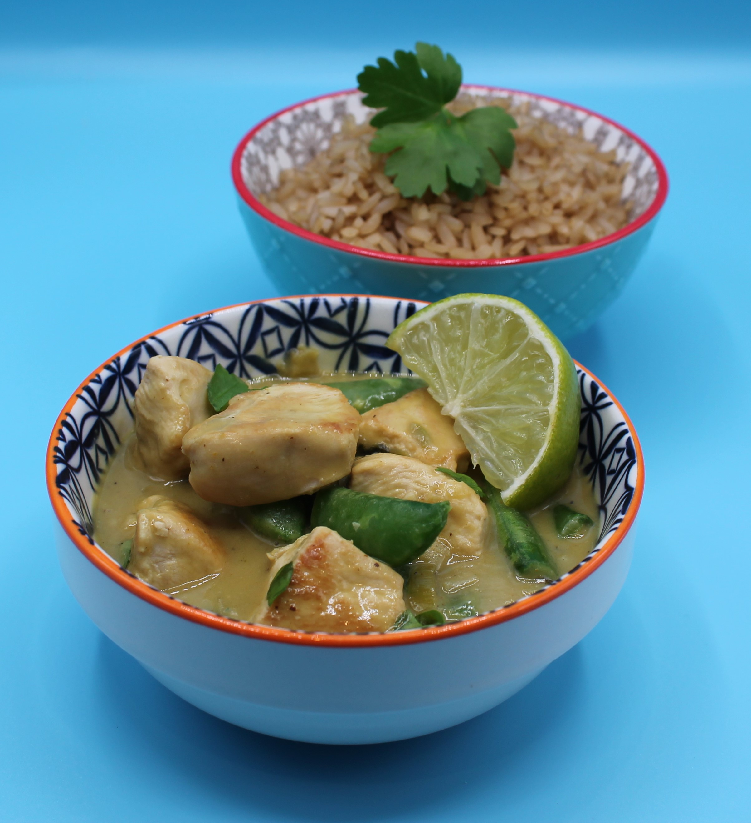
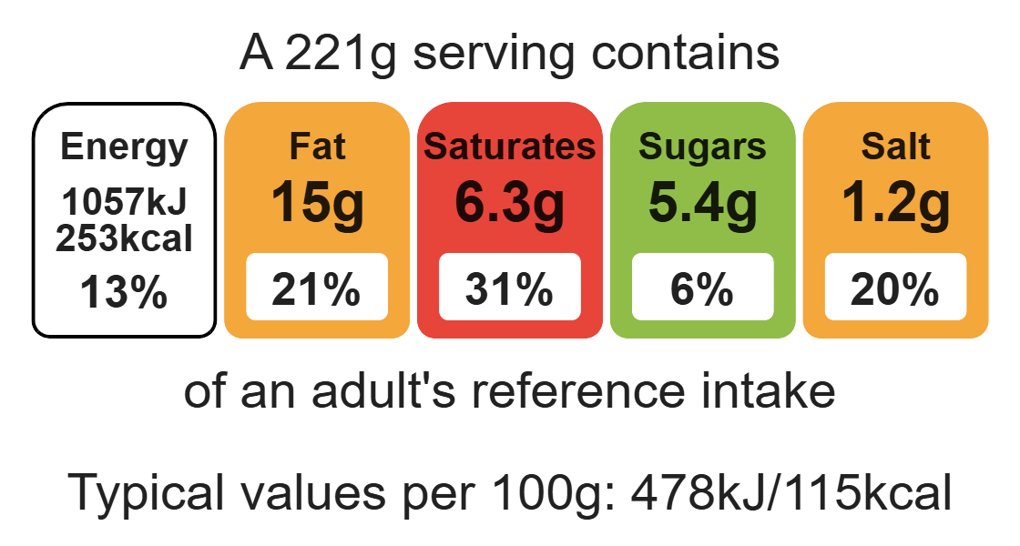
Nutritional analysis
Serves 2

Slide 3
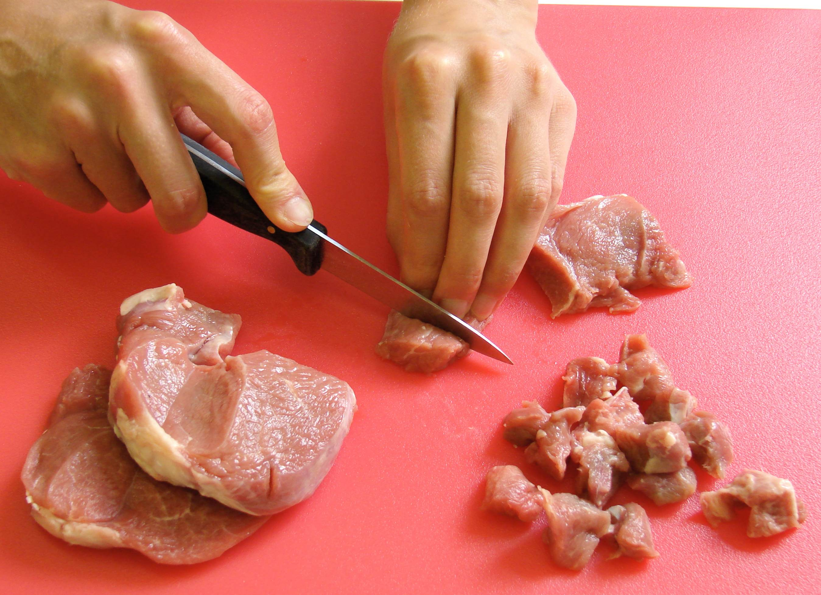
Starter activity
Explain two for hygiene and safety rules when preparing raw meat.
What is cross-contamination?
Celena is a vegetarian, what could she use to replace the chicken in the recipe?

Slide 4
Example responses
Explain two food hygiene and safety rules when preparing raw meat.
Use a red chopping board, wash hands before and after handling raw meat, wash equipment thoroughly after use.
What is cross-contamination?
Where bacteria is transferred via a vehicle e.g. equipment, hands.
Celena is a vegetarian, what could she use to replace the chicken in the recipe?
Celena could use beans or pulses, such as chickpeas, a wider variety of vegetables, or a non-meat alternative.

Slide 5
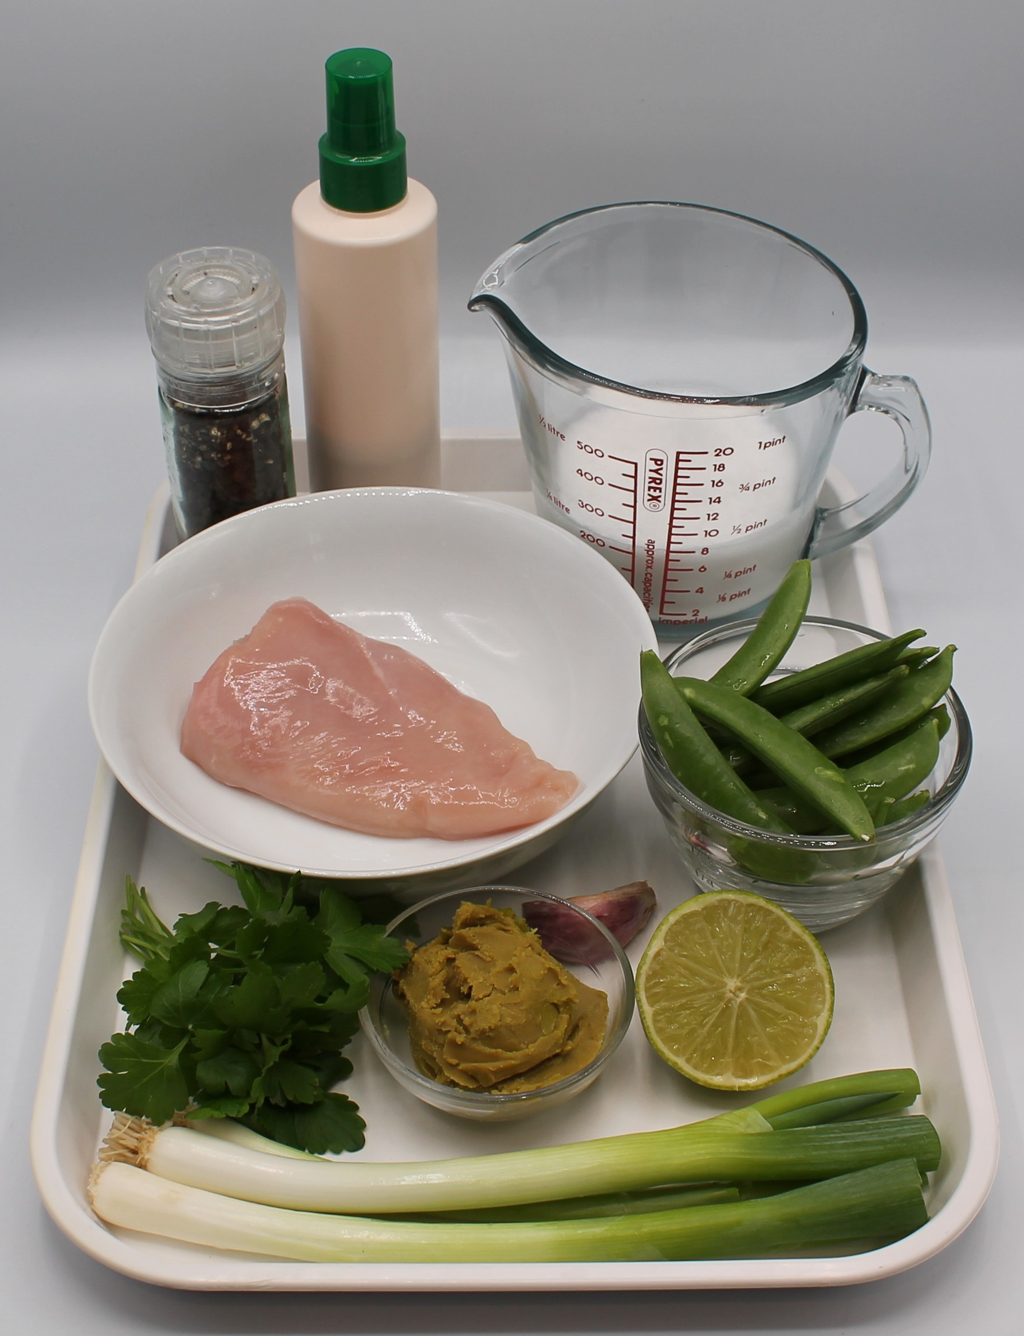

Ingredients (serves 2)
1 x 10ml spoon oil or spray oil
3 spring onions
1 clove of garlic
80g sugar snap peas
1 chicken breast
2 x 15ml Thai green curry paste
200ml reduced-fat coconut milk
½ lime
1x 15ml reduced-salt soy sauce
Small bunch of coriander
Black pepper
Check for any food allergy, intolerance, special dietary requirement or religious/cultural reasons for not handling or eating the ingredients in this recipe.

Slide 6
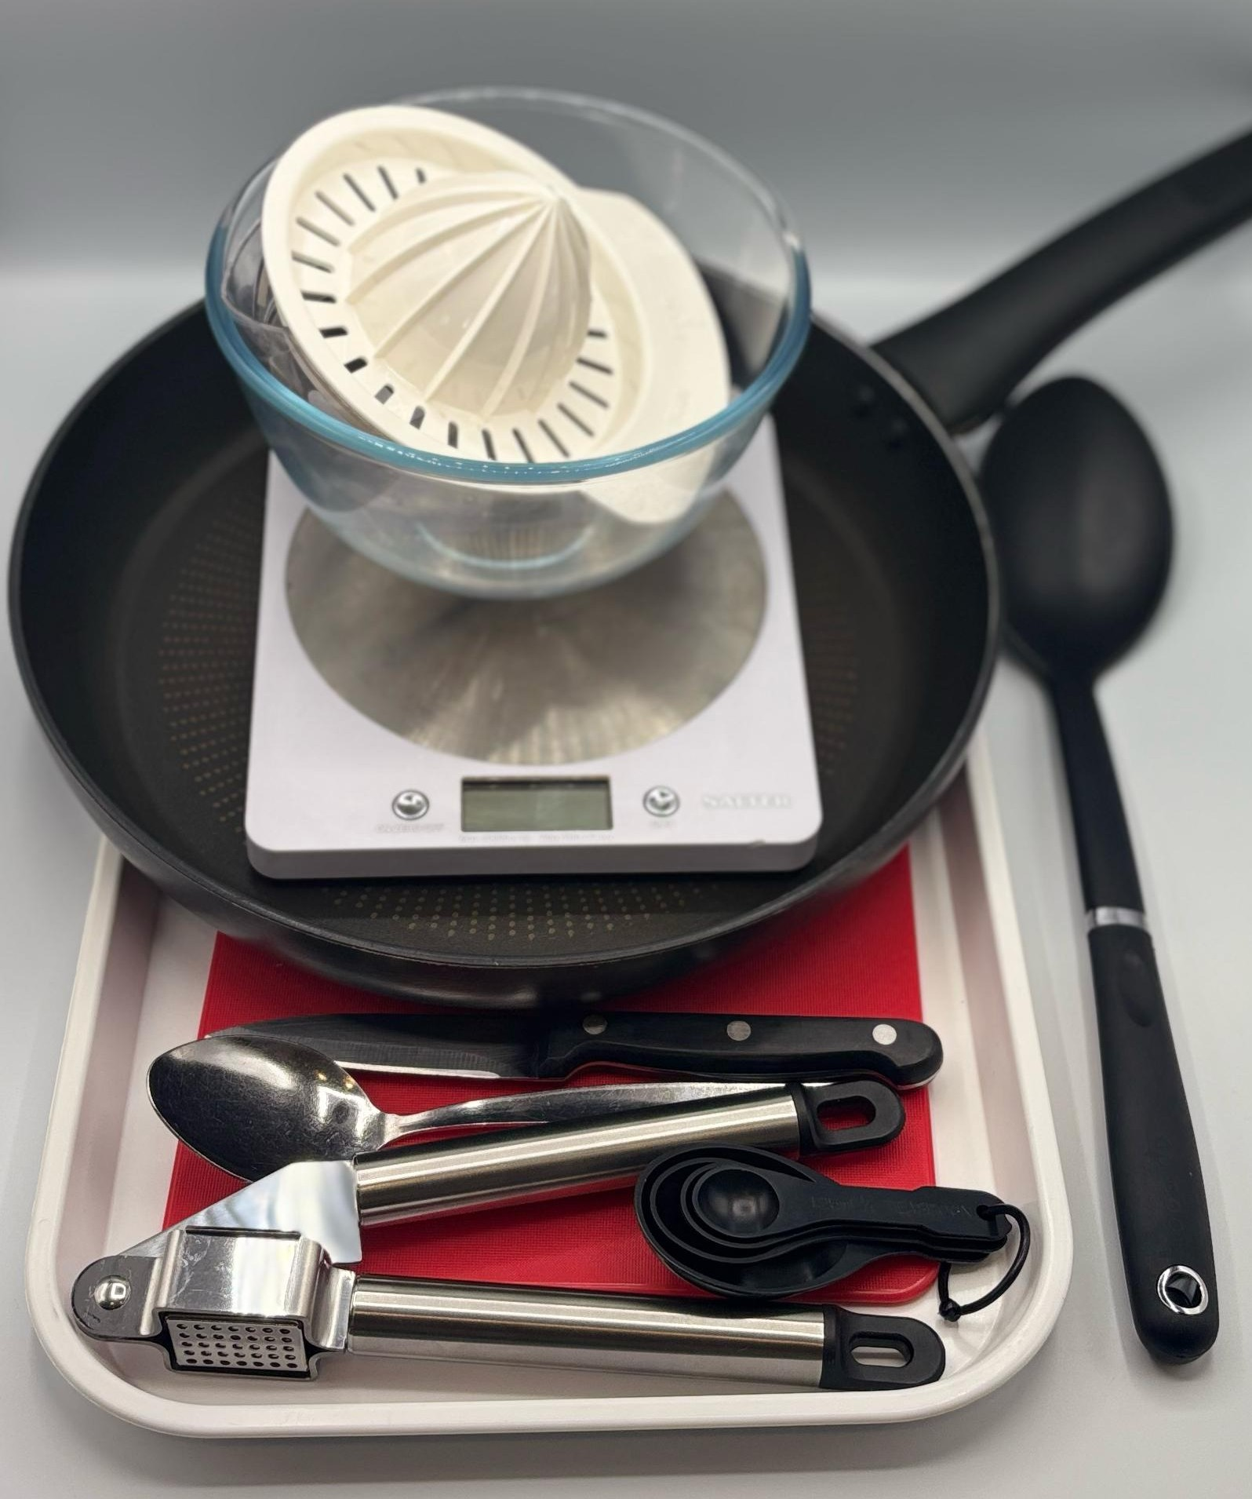
Equipment
2 chopping boards
Sharp knife
Garlic press
Frying pan
Measuring spoons
Weighing scales
Heat resistant spoon
Can opener
Juicer

Slide 7
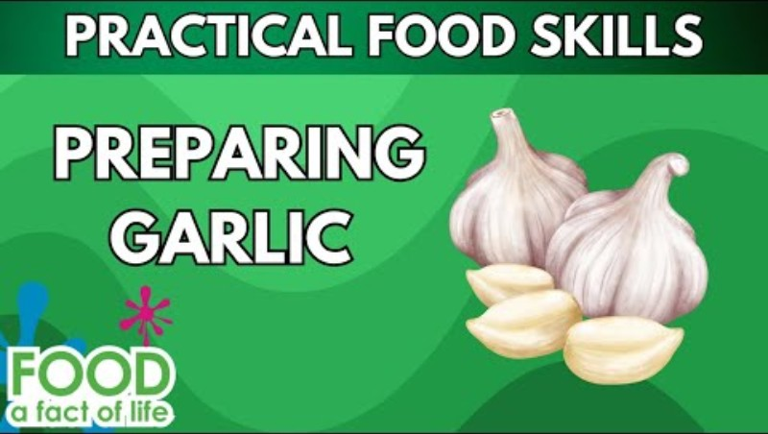
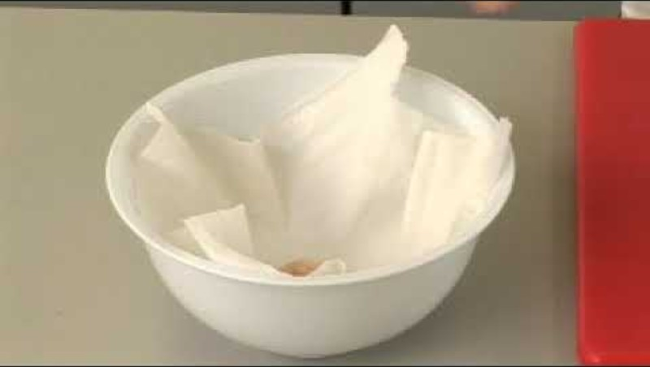
Food skills
Click below to watch how to prepare garlic
Weigh
Measure
Cut
Slice
Dice and trim
Fry and sauté
Stir and combine
Simmer and boil
Juice
Click below to watch how to prepare raw chicken

Slide 8
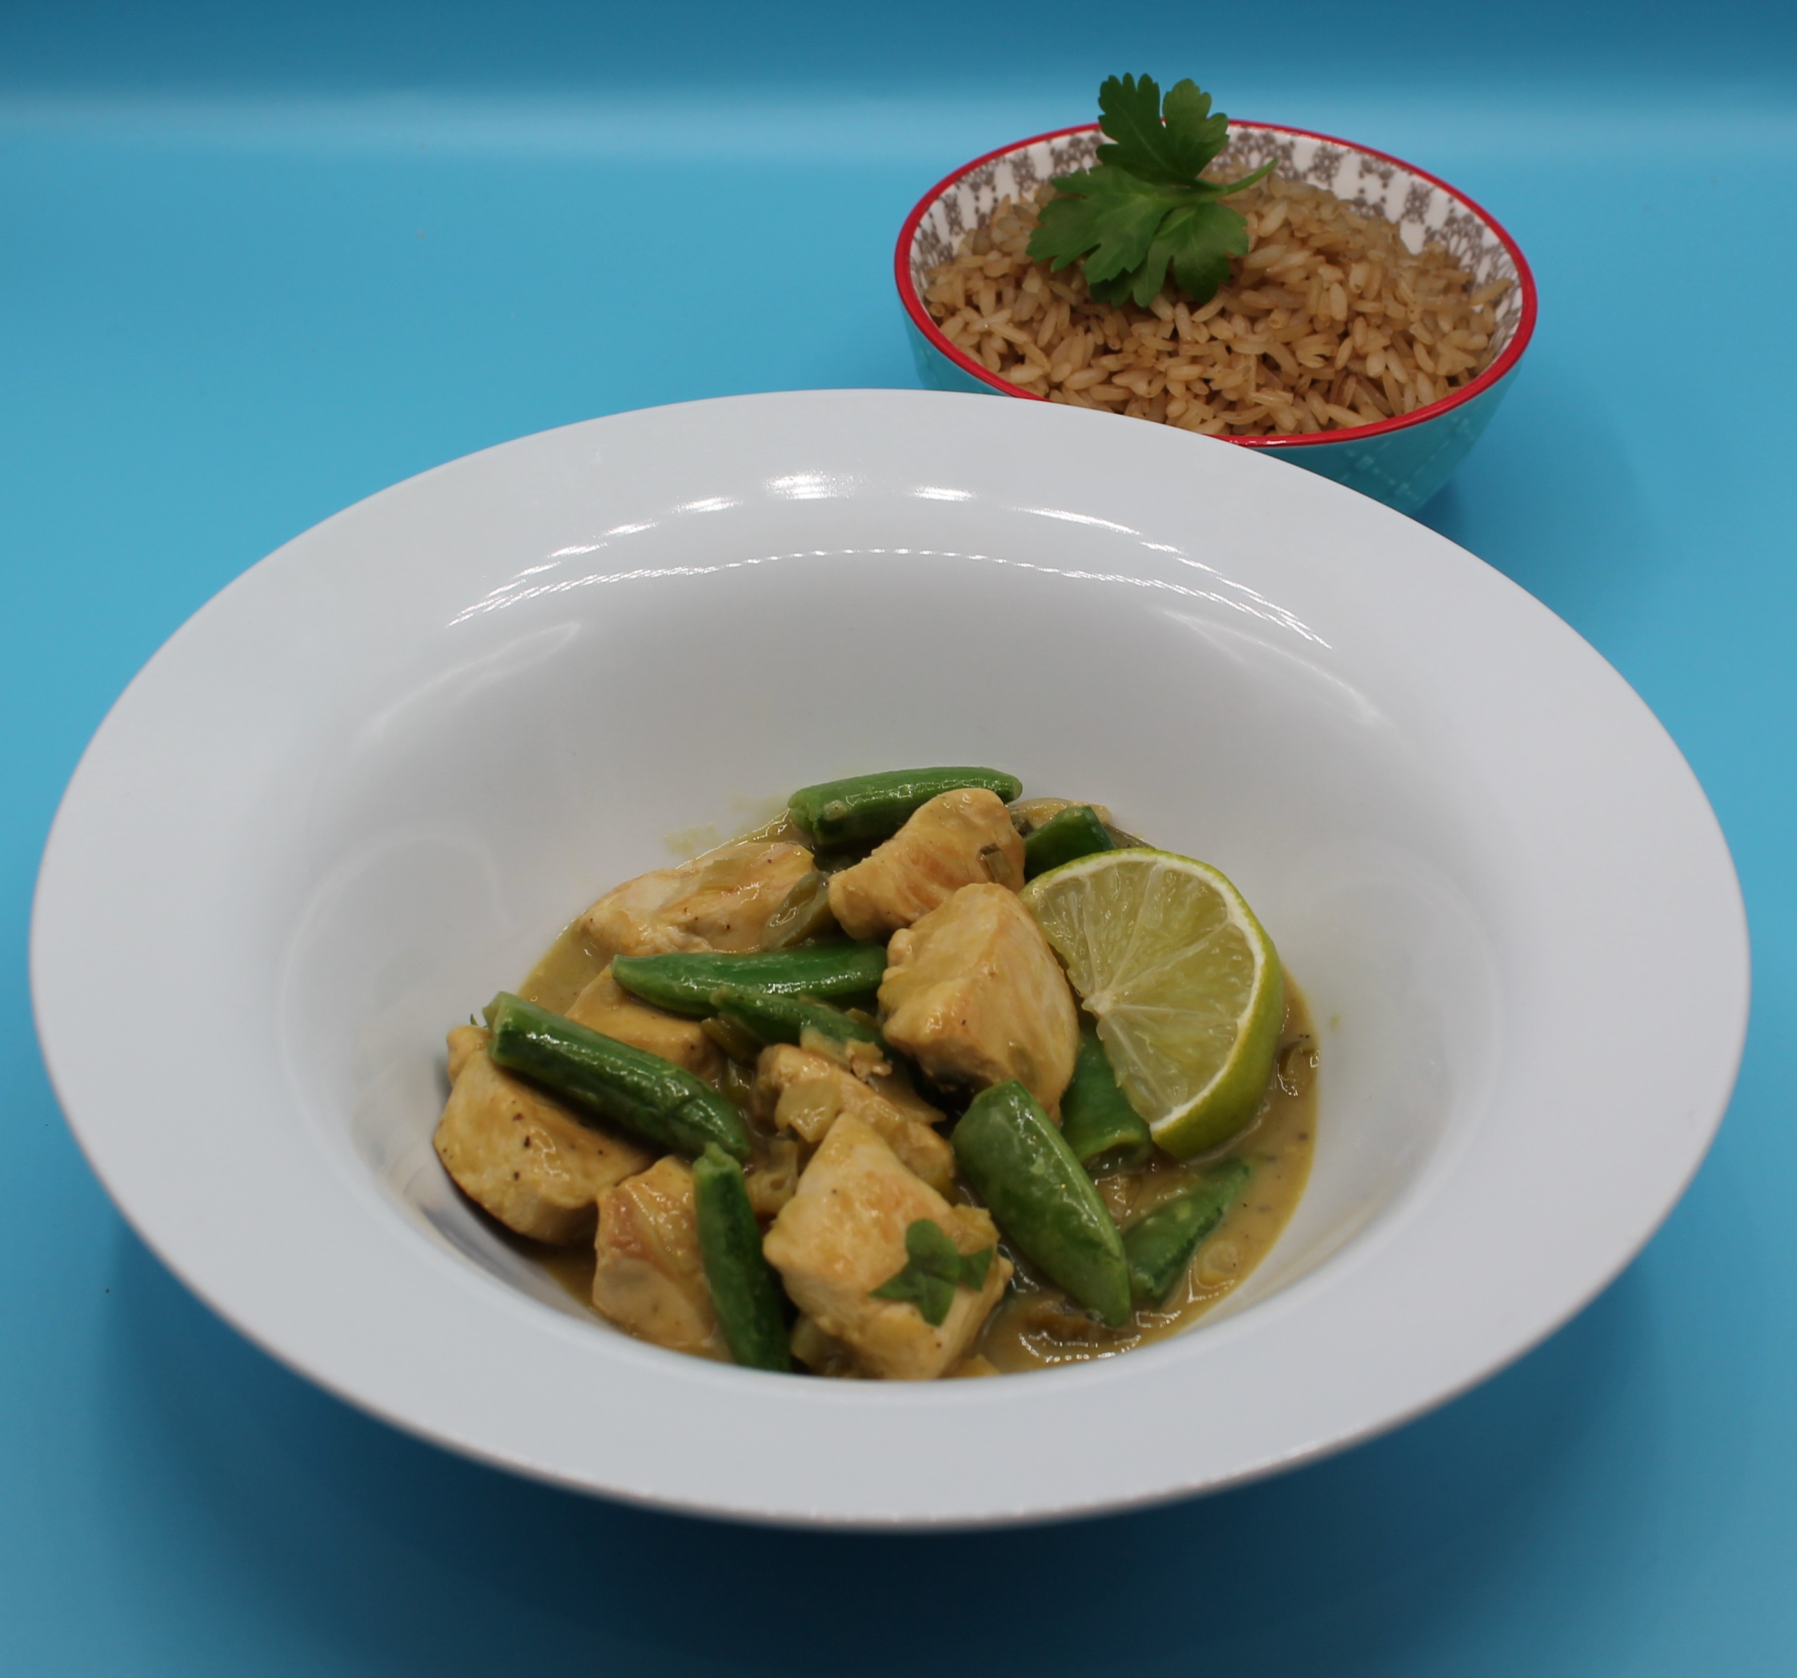
Method
Prepare the vegetables:
slice the spring onions into rings;
cut the sugar snap peas in half;
peel and crush the garlic;
roughly chop the coriander.
Using a red board, cut the chicken into small chunks. Thoroughly wash and dry your hands after touching the raw meat.

Slide 9
Method
Add the oil to the frying pan and allow to heat. Fry the chicken in
the oil for 3-4 minutes. Add the spring onions and garlic to the
pan.
When the chicken has cooked and no pink meat remains, stir in the green curry paste.
5. Pour in the coconut milk and simmer for 10 minutes.
6. Juice the lime and add to the pan.
Add the soy sauce and sugar snap peas and continue to cook for
five minutes.
8. Season with chopped fresh coriander and black pepper.

Slide 10
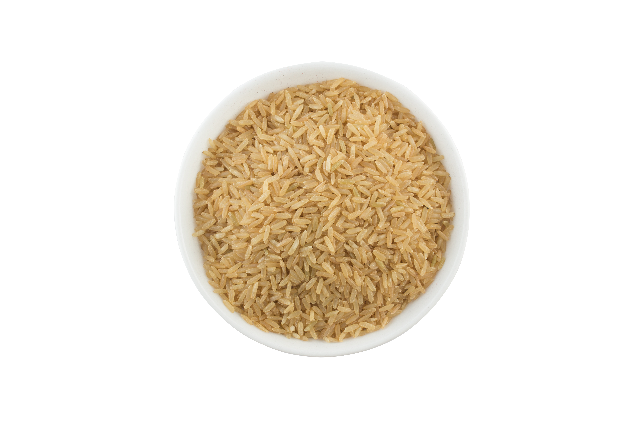
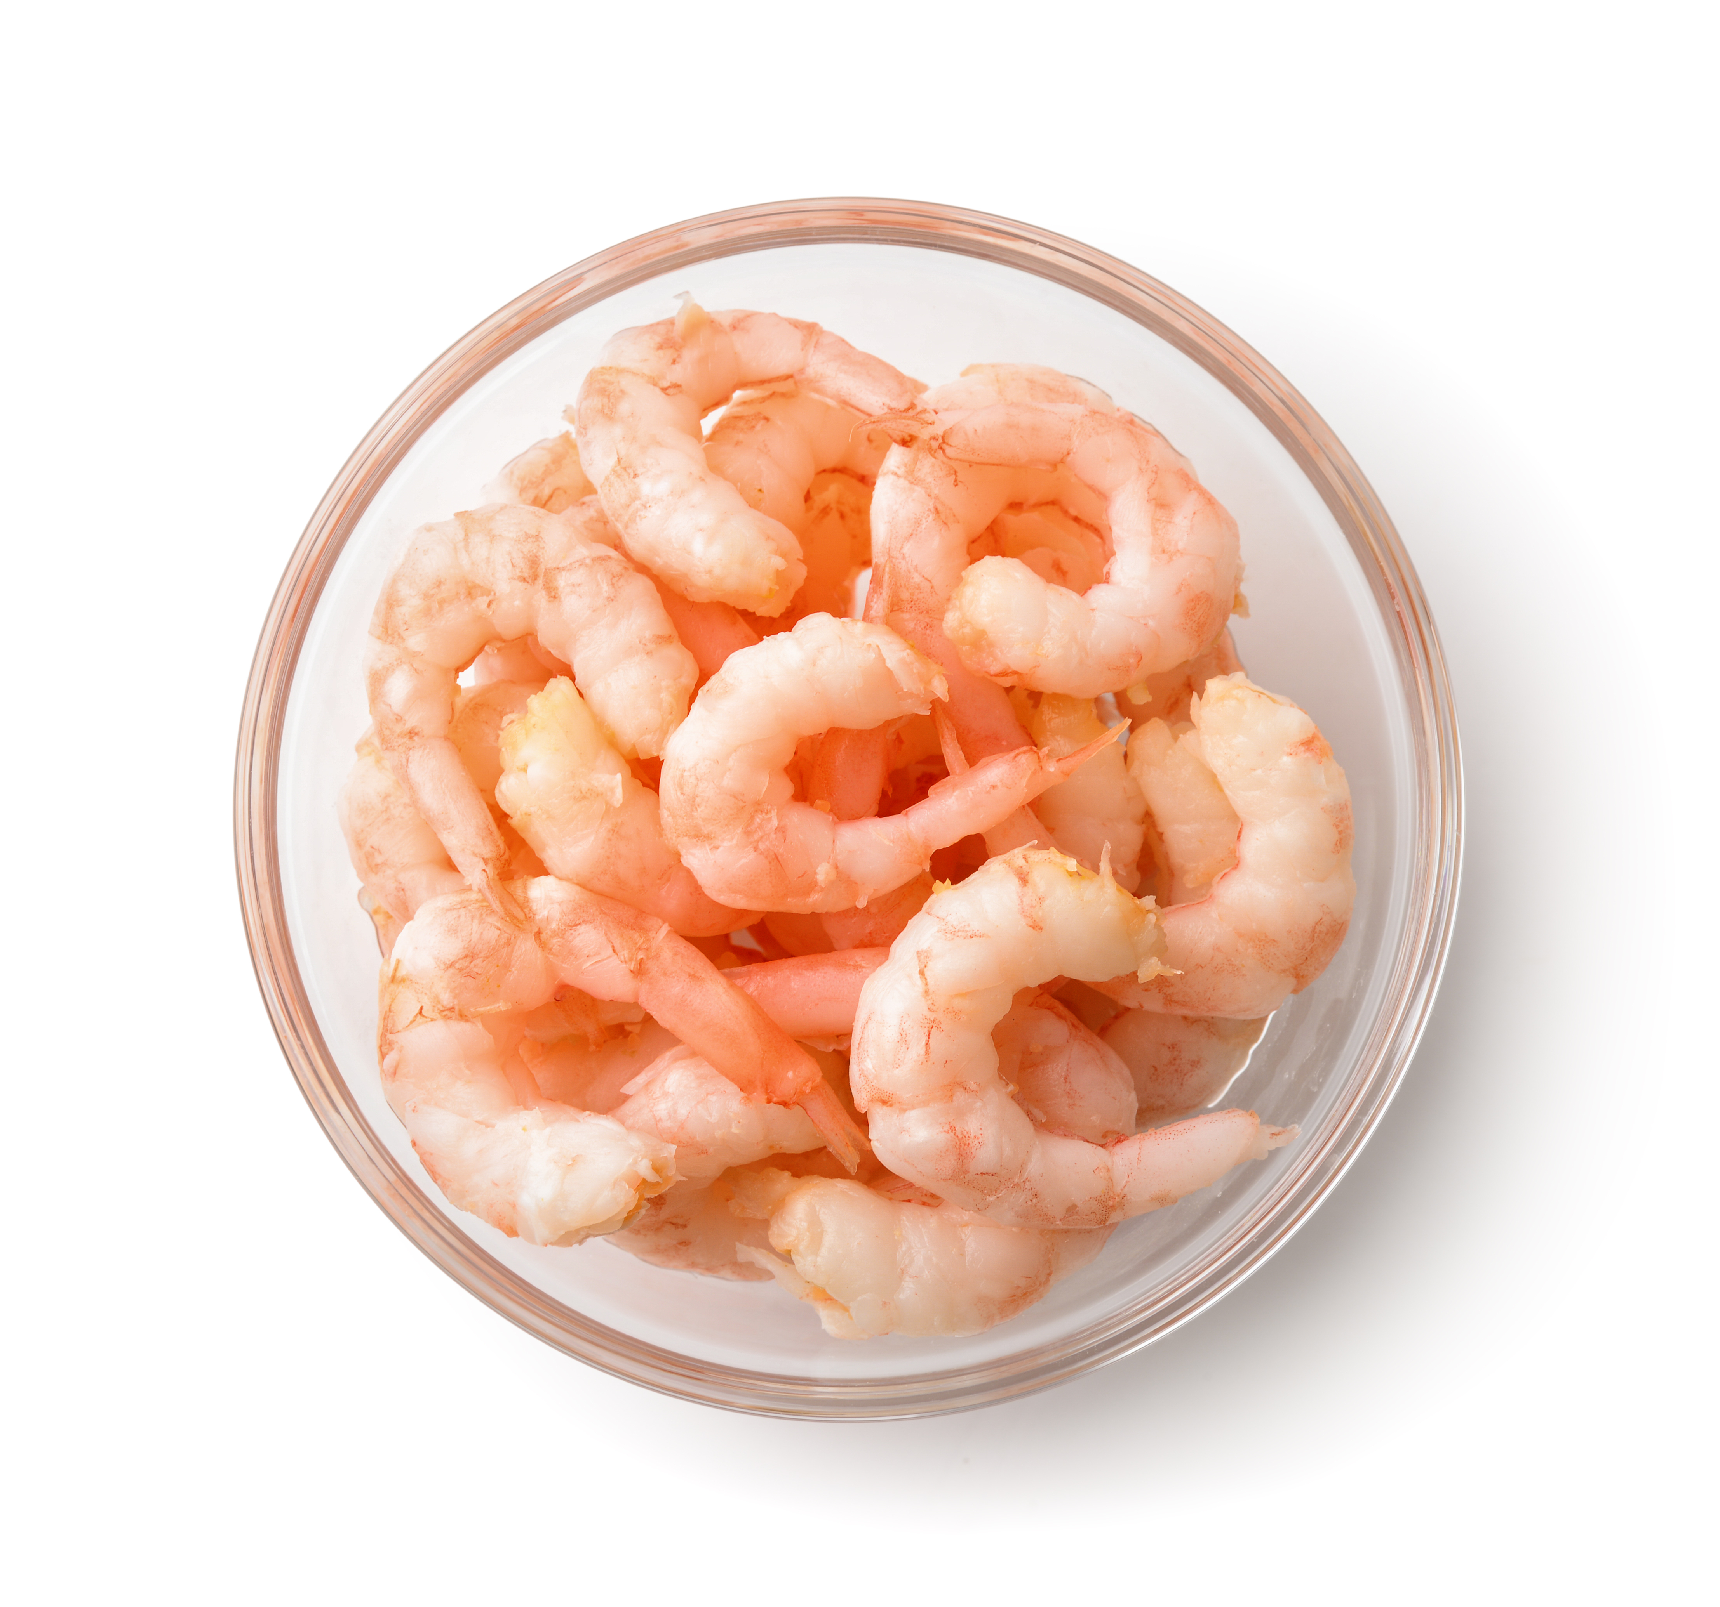
Top tips
Reduce food waste: Add leftover vegetables such as broccoli, spinach or baby corn.
Vary your protein: Swap the chicken for chickpeas, tofu, paneer, prawns or thin strips of pork.
Focus on fibre: Serve with wholegrain rice or noodles.

Slide 11
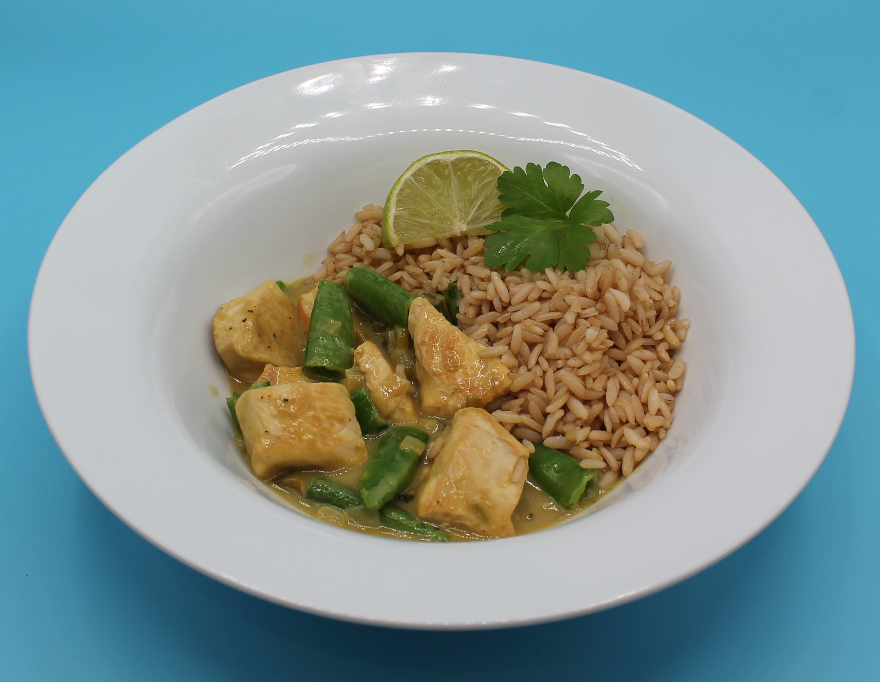
Food science
Denaturing of proteins
Denaturation is the change in structure of protein molecules. The process results in the unfolding of the protein’s structure. Factors which contribute to denaturation are heat, salts, pH and mechanical action.
When cooking the curry, the chicken denatures due to the heat, resulting in a tender texture.

Slide 12
Plenary
Evaluate five food skills and ways in which you worked.
Area | I need help |  | I can help others | Comments
Timing | ☆ ☆ ☆ ☆ ☆
Juicing | ☆ ☆ ☆ ☆ ☆
Slicing and dicing | ☆ ☆ ☆ ☆ ☆
Frying | ☆ ☆ ☆ ☆ ☆
Hygienic | ☆ ☆ ☆ ☆ ☆

Slide 13

Example responses
Evaluate five food skills and ways in which you worked.
Area | I need help |  | I can help others
Timing | ☆ ☆ ☆ ☆ ☆
Juicing | ☆ ☆ ☆ ☆ ☆
Slicing and dicing | ☆ ☆ ☆ ☆ ☆
Frying | ☆ ☆ ☆ ☆ ☆
Hygienic | ☆ ☆ ☆ ☆ ☆

Slide 14
Example responses
Evaluate five food skills and ways in which you worked.
Area | Comments
Timing | I need to work on my timings to make sure I do not over cook the veg.
Juicing | I used the juicer correctly and helped others do this.
Slicing and dicing | I was accurate with my slicing. I helped my friend and showed them the claw grip and bridge hold.
Frying | I need to practise my heat control as I had it too high.
Hygienic | I prepared my chicken safely using a red chopping board and washing my hands.

Slide 15
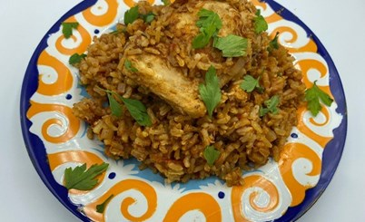
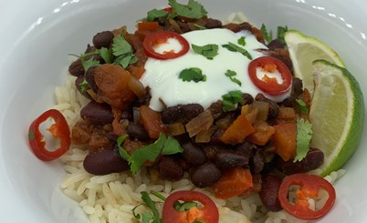
Looking for more…
Why not build a series of lessons around foods from different cultures and task your pupils to make a range of recipes using different ingredients, flavours and cooking techniques? Your pupils could make West African jollof rice with chicken, or a meat free version, Algerian meatballs, Cuban arroz con pollo, Picadillo, Vegan meat free chilli or Jerk potato and black bean curry.
More recipes from around the world and supporting resources, can be found in the 11-14 years Planning what to cook area of the Food – a fact of life website.

Slide 16
Thai green curry
For further information, go to:
www.foodafactoflife.org.uk
This resource meets the Guidelines for producers and users of school education resources about food.

