Slide 1
Apprenticeships in the food industry
17/05/23

Slide 2

Covered in today’s forum
Why an apprenticeship might suit your pupils, the benefits of following the apprenticeship route, the different levels and wide range of exciting job roles and careers.
How pupils can find out about apprenticeships available, make choices and ultimately apply.
‘On-the-job’ training – hear from employers and find out about their role in an apprenticeship.
‘Off-the-job’ training – at least 20% of an apprentice’s paid time will be dedicated to ‘off-the-job’ training provided by colleges, universities or training providers.
Apprenticeship assessment and the role of end point assessors.
Sources of further information and support.

Slide 3

What are apprenticeships?
An apprenticeship is an introduction to an occupation and is subtly different from a job with training, because it should be a comprehensive route to a productive career.
The content is defined by an occupational standard which describes the ‘knowledge, skills and behaviours’ (KSBs) needed for someone to be competent in the occupation’s duties.
The apprentice’s achievement is measured by an end-point assessment detailing the independent assessment that apprentices must take after their training.
The delivery of an apprenticeship is a partnership between the individual, their employer and (typically) an external training provider.
Gatsby – Apprentices in Work report 2021
Apprenticeships.gov.uk

Slide 4

What are apprenticeships?
An apprenticeship includes:
paid employment with holiday leave (more than 372 days or 18-60 months)*;
hands-on-experience in a sector/role of interest;
at least 20% off-the-job training (equates to 6 hours a week on average)**;
formal assessment which leads to a nationally recognised qualification (and perhaps professional body accreditation).
*Part-time options are available for most apprenticeships, but this would extend the length of time for completion
**Studying for English and maths if required is not counted in the 20% minimum for off-the-job training
Apprenticeships.gov.uk

Slide 5

Off-the-job training
Off-the-job training is delivered by subject experts and can include:
teaching theory via distance learning, blended or block release;
practical training (e.g. shadowing, mentoring, industry visits);
learning support and time to write assignments.

Slide 6
Apprenticeship levels
England, NI and Wales | Level | Equivalent
Intermediate | 2 | GCSE
Advanced | 3 | A-Level
Higher | 4,5,6 & 7 | Foundation degree and above
Degree | 6 & 7 | Batchelor’s or Master’s Degree
Scotland | Level
Foundation | SCQF Level 4/5 (3 available) SCQF Level 6 (12 available) | 5th or 6th year of school
Modern Apprenticeship |  | Aged 16 – 24 not in full time education
Graduate | Degree | Aged 16 and above
UCAS – Where can you do an apprenticeship?

Slide 7
What will an apprentice earn?
What the apprentice earns will depend on the industry, location and the level of apprenticeship they choose.
If aged between 16 and 18 or in the first year of the apprenticeship, the apprentice is entitled to the apprentice rate. (£5.28 an hour)
If the apprentice is 19 or over and has completed the first year of the apprenticeship, they are entitled to the National Minimum Wage.
18-20 - £7.49
21-22 - £10.18
23 and over - £10.42
This is the minimum an apprentice can earn but many employers offer a competitive salary.
If the apprentice is 16 to 24 and a care leaver, they will receive a £1,000 bursary payment to support them in their first year of the apprenticeship.
No student loans or tuition fees as apprenticeships are funded by the government and the employer!*
Apprenticeships.gov.uk
*Even more important now because the threshold to pay back has been lowered to 25 years and the 30 years expiration becomes 40 years (doesn’t apply to Scotland).

Slide 8
Why should your pupils consider an apprenticeship?
Widely respected and industry recognised qualification.
It’s a paid job – no student loans or tuition fees!
High quality training on offer.
1-6 years of industry experience – valuable to future roles and future employers.
Wide range of choice – subject and level.
Learning ‘on the job’ means networking opportunities, ongoing support from the employer, peer-to-peer support, social benefits, and financial perks such as discounts and paid annual leave.
91% of apprentices go on to secure employment or go on to further study after completing their training!

Slide 9

How can pupils find out more and apply?
England - Apprenticeships.gov.uk
Northern Ireland – Cafre, nidirect.gov.uk
Scotland - FDF Scotland , Apprenticeships.Scot
Wales – Careers Wales
UCAS
Institute for Apprenticeships and Technical Education
Government Find an Apprenticeship service – look out for the Disability Confident logo*
Application support (government information)
Amazing Apprenticeships
Local employers
Online employment websites
Local Colleges, e.g.
Reasehealth College
Hadlow College
Universities, e.g.
Harper Adams
Nottingham Trent
Sheffield Hallam
*Disability Confident is creating a movement of change, encouraging employers to think differently about disability and take action to improve how they recruit, retain and develop disabled people.

Slide 10


Food – a fact of life resources: Careers
Careers poster
Case studies – apprenticeship case studies coming soon!
Careers advice and opportunities webinar recordings and presentations
Careers in food resources

Slide 11
Sources of further information
Apprenticeship Diversity Champions Network – 21/22 annual report
Coronation Green Apprenticeships
Disability Rights UK – Into apprenticeships 2023
English and Maths standards at level 2 and above
Gatsby – Apprentices in Work report
Institute for Apprenticeships – Raising the standard best practice guidance, equity, diversity and inclusion
National Land Based College
Off-the-job training guide (for employers and training providers)
Tasty Careers - https://tastycareers.org.uk/apprenticeships-for-teachers
UCAS – Support for disabled people taking apprenticeships

Slide 12
Panel discussion
Employers
Paul Miles, The Booker Group
Gareth Sawbridge, Mondelez International
Apprentice – current
Kate Rose, Mondelez International
Training providers
Lucy Catley, Harper Adams University
Jeanine Read, Reaseheath College
Apprentice - past
Letitia Redfern, The Booker Group
Awarding Organisation and End Point Assessor
Jim Richardson, FDQ
If you have any questions for the panel, please type them in the chat box

Slide 13






Healthy Eating Week, 12 – 16 June 2023
Healthy Eating Week – For Everyone
Themes:
Focus on fibre
Get at least 5 A DAY
Vary your protein foods
Stay hydrated
Reduce food waste
Register for free resources and updates to help you plan and run the Week! www.healthyeatingweek.org.uk

Slide 14


Keep up to date with our free resources and training
Education News (monthly email update)
Sign up on the homepage: www.foodafactoflife.org.uk
PPD newsletter (find out about upcoming FFL training)
https://www.foodafactoflife.org.uk/professional-development/
Follow us on Twitter @Foodafactoflife
https://twitter.com/foodafactoflife
Keep in touch:
education@nutrition.org.uk
BNF news https://www.nutrition.org.uk

Slide 15
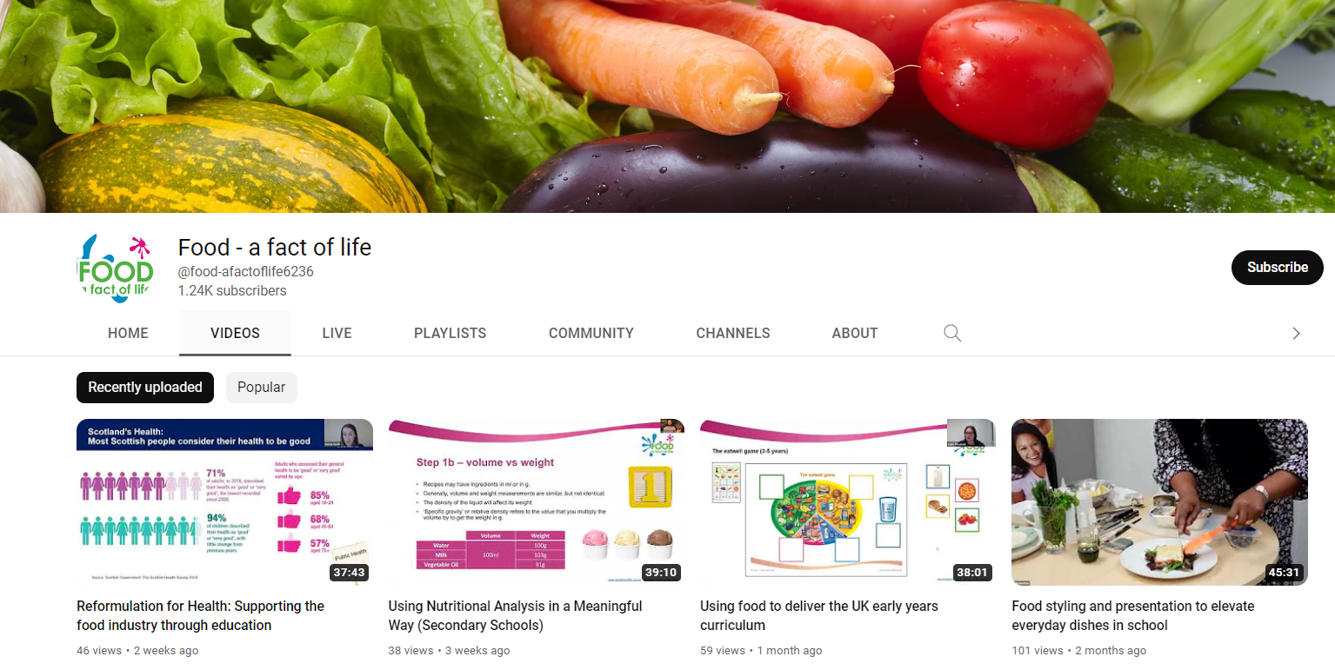
More training…
FREE online modular courses:
Functional properties of food
Sensory science
Food spoilage, hygiene and safety
Characteristics of teaching food and nutrition education (secondary)
Characteristics of teaching food and nutrition education to pupils with additional needs
FFL webinar recordings
To find out more and to book, go to https://www.foodafactoflife.org.uk/training/

Slide 16
Apprenticeships in the food industry
For further information, go to:
www.foodafactoflife.org.uk

