Slide 1
Dietary fibre

Slide 2
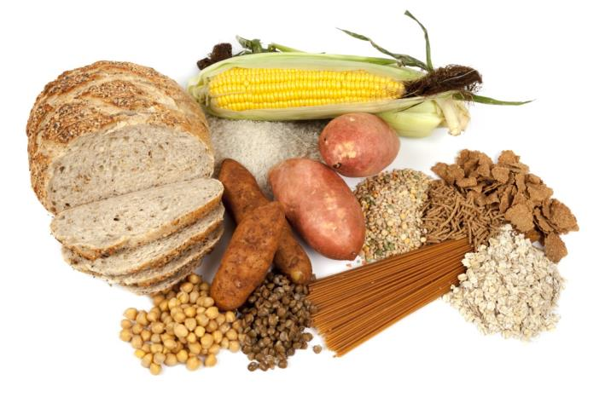
Dietary fibre
Dietary fibre is a diverse group of carbohydrate found almost exclusively in plants, including non-starch polysaccharides such as cellulose, pectin and lignin.
Unlike other types of carbohydrate, these are not absorbed in the small intestine to provide energy.
Some fibre can be fermented in the large intestine by gut bacteria, producing short chain fatty acids and gases (methane, hydrogen and carbon dioxide). Dietary fibre provides 2kcal/8kJ per gram on average.

Slide 3
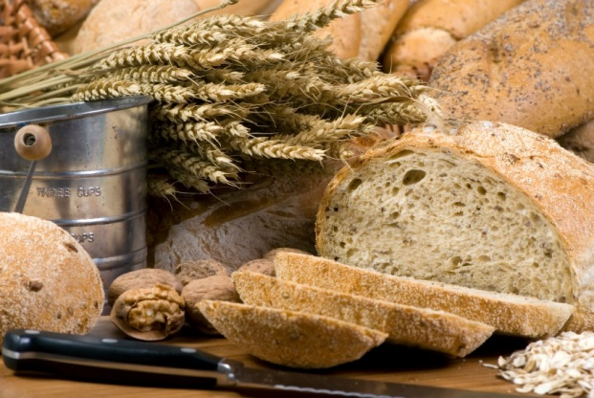
Sources of dietary fibre
Components of dietary fibre are found in different proportions in food, therefore it is important to eat a variety of fibre-containing foods.
Dietary fibre is found in:
wholegrain cereals and cereal products;
beans;
lentils;
fruit and vegetables;
nuts and seeds.

Slide 4

Fibre in the diet
Dietary fibre helps to:
reduce the risk of heart disease, diabetes and some cancers;
Help with weight control;
bulk up stools and make waste move through the digestive tract more quickly;
prevent constipation;
improve gut health.

Slide 5
How much fibre do we need?
Most people do not eat enough dietary fibre.
The recommended average intake for dietary fibre is 30g per day for adults. Children need proportionately less.
Current adult intake is around 19g per day on average, less that the recommended levels for a 5 year old.
Age (years) | Recommended intake of fibre (g/day)
2-5 years | 15 grams
5-11 years | 20 grams
11-16 years | 25 grams
17+ years | 30 grams

Slide 6

Fibre on food labels
European regulations on nutrition and health claims state that a product claiming to be a ‘source of’ fibre should contain at least 3g of dietary fibre per 100g, and for a product which contains at least 6g of dietary fibre per 100g, this can be labelled as ‘high in’ fibre.
https://ec.europa.eu/food/safety/labelling_nutrition/claims/nutrition_claims_en

Slide 7
How can fibre be increased in the diet?
Choose a high fibre breakfast cereal e.g. bran flakes, or porridge
Go for wholemeal or granary breads instead of white bread
Choose wholegrains like wholewheat pasta, bulgur wheat or brown rice
Go for potatoes with skins e.g. baked potato or boiled new potatoes
For snacks try fruit, vegetable sticks, rye crackers, oatcakes, unsalted nuts or seeds
Include plenty of vegetables with meals – either as a side dish or added to sauces, stews or curries
Add pulses like beans, lentils or chickpeas to stews, curries and salads
Have some fresh or dried fruit, or fruit canned in natural juice for dessert.

Slide 8
Dietary fibre
For further information, go to:
www.foodafactoflife.org.uk

