Slide 1
Salad

Slide 2
Teacher information
The first part of this presentation (slides 4-14) shows images of salads.
These can be shown as a presentation, or printed for group discussion or display.
The second part of the presentation (slides 16-31) takes a closer look at different types of salads and salad ingredients.

Slide 3
Salad images

Slide 4
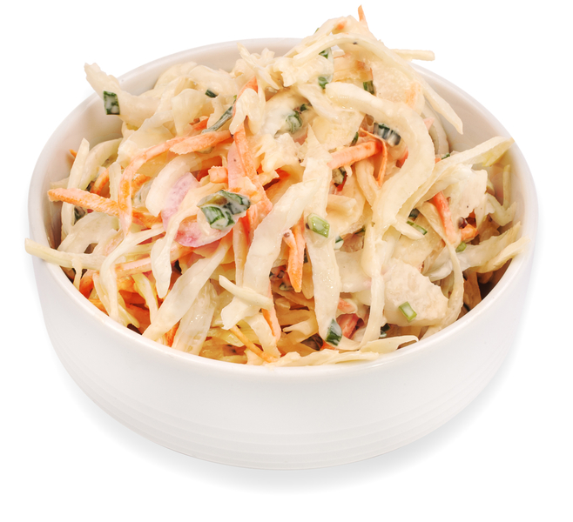
Coleslaw

Slide 5
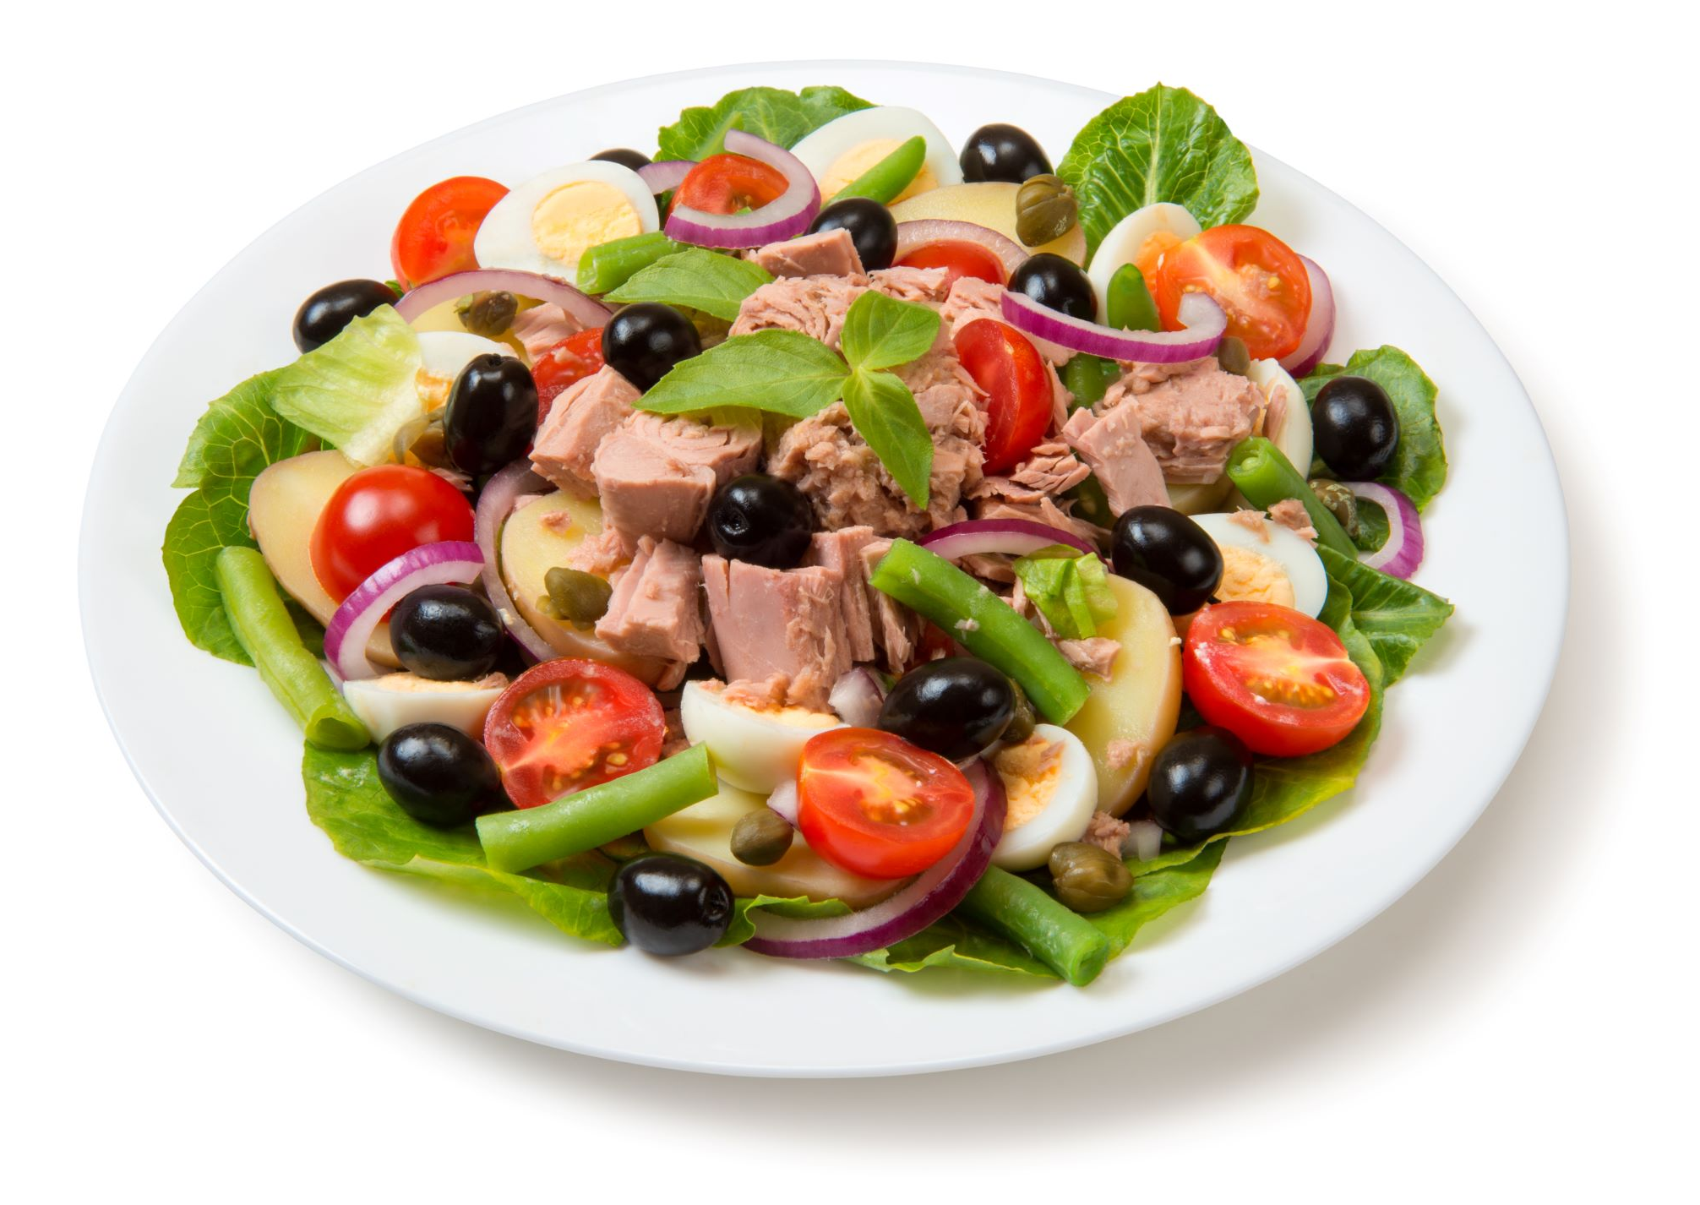
Salad niçoise

Slide 6
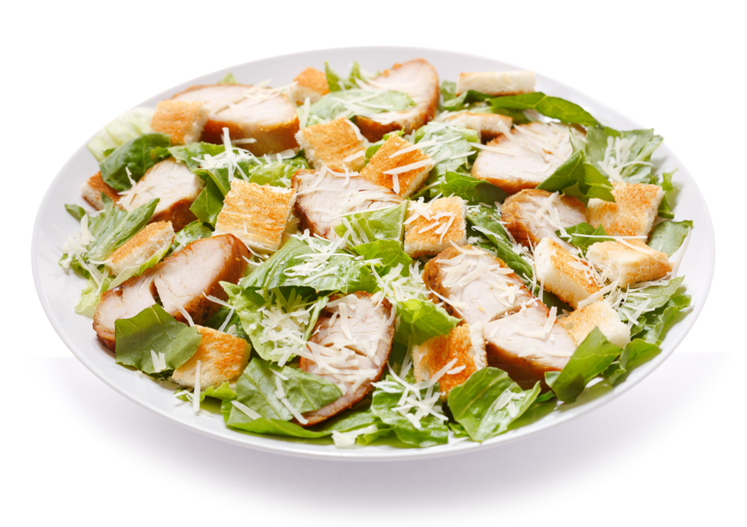
Chicken caesar salad

Slide 7
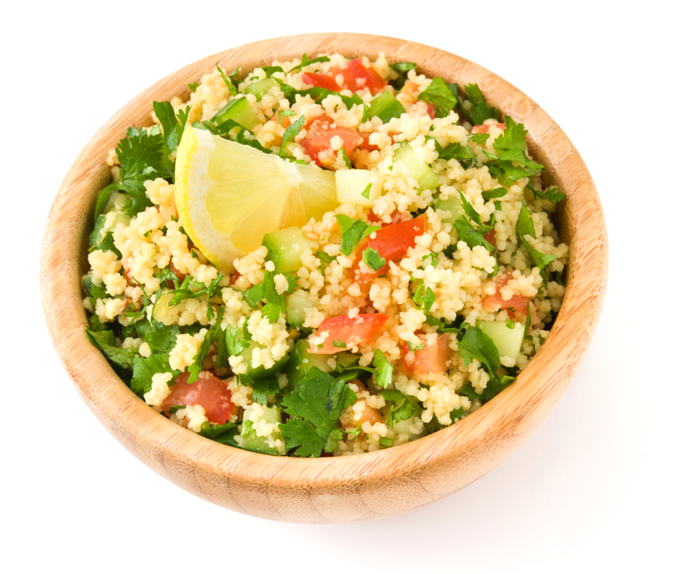
Tabbouleh salad

Slide 8
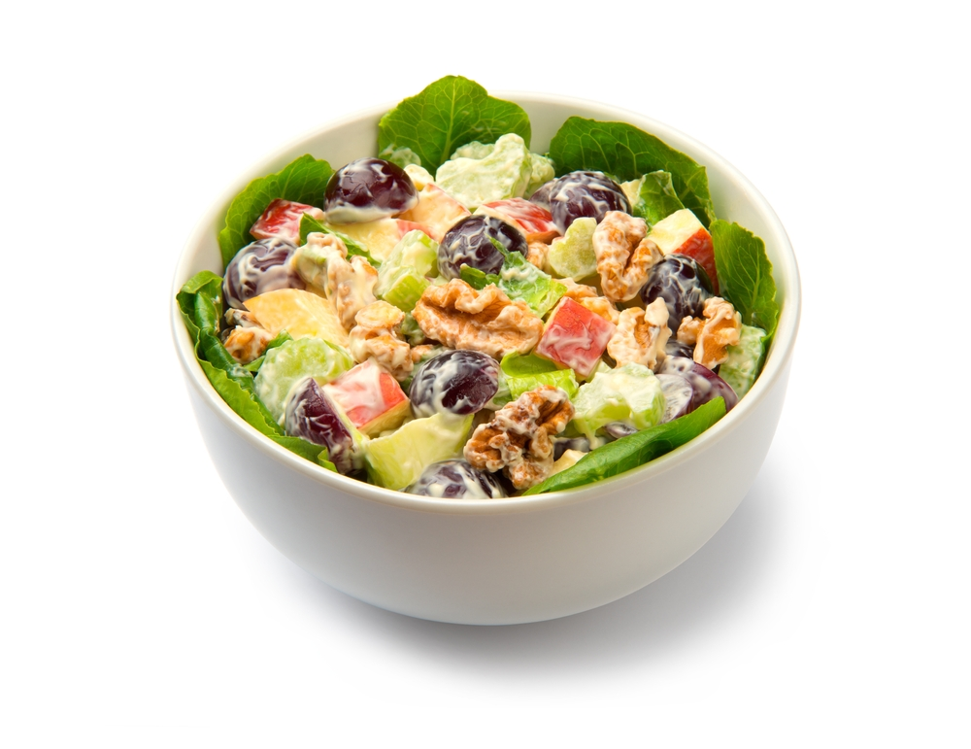
Waldorf salad

Slide 9
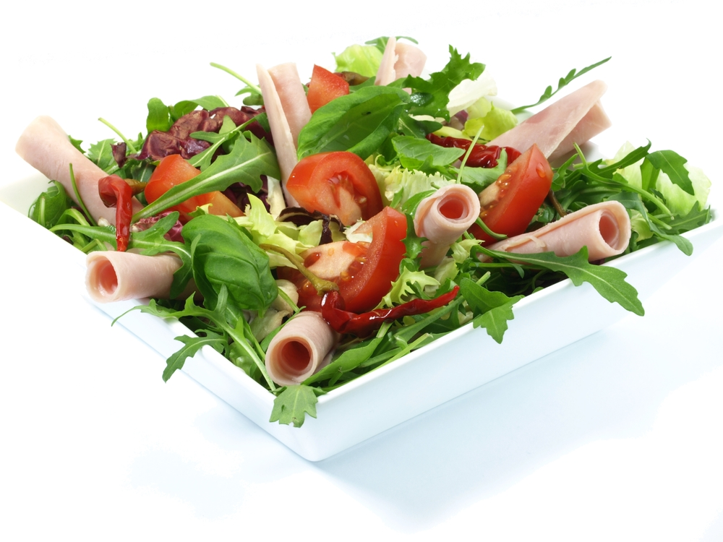
Ham salad

Slide 10
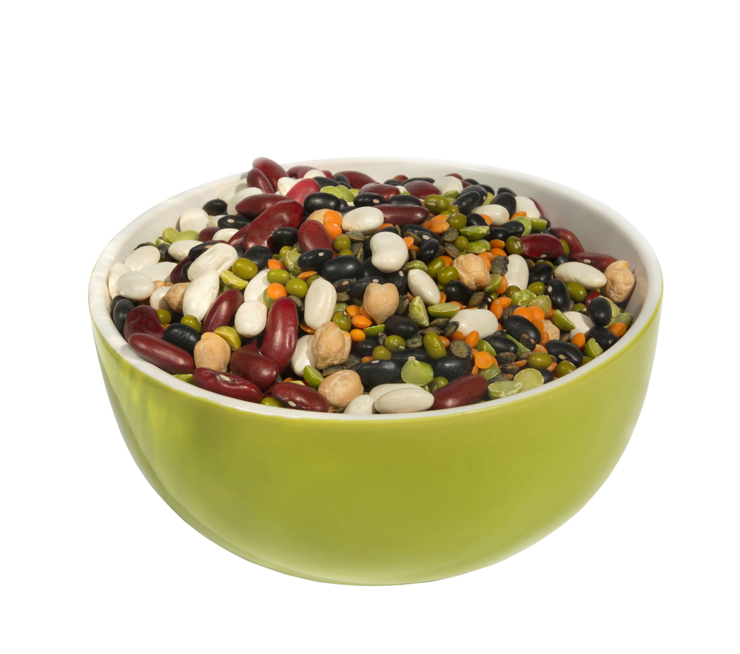
Mixed bean salad

Slide 11
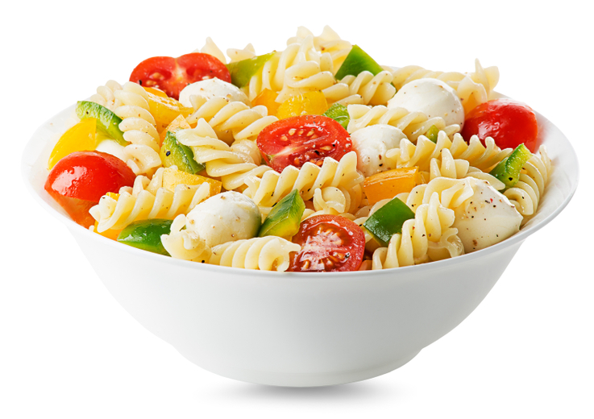
Pasta salad

Slide 12
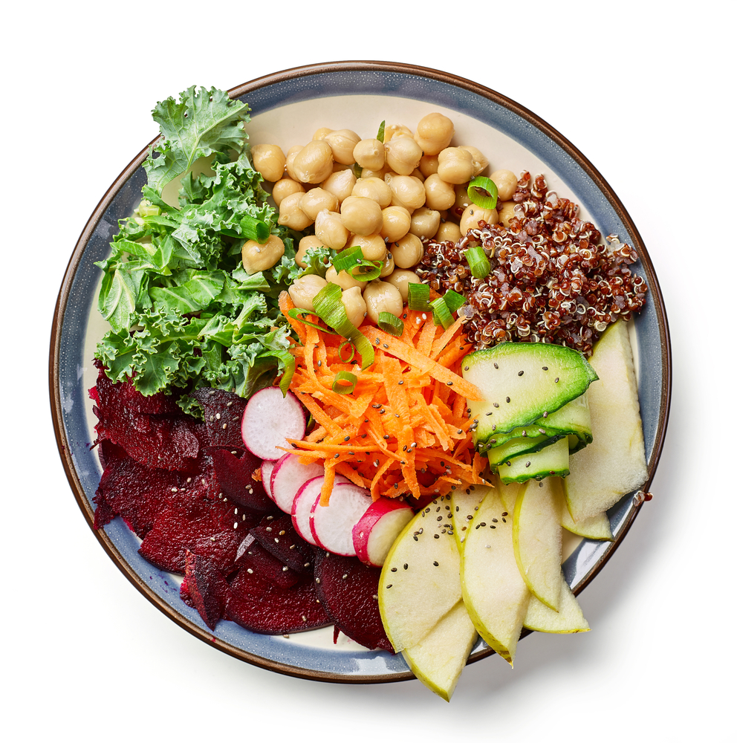
Vegan salad

Slide 13
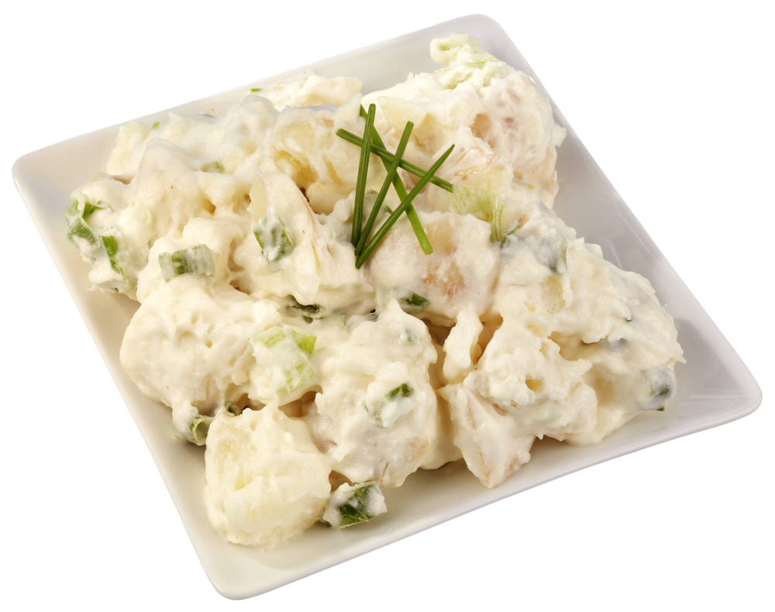
Potato salad

Slide 14
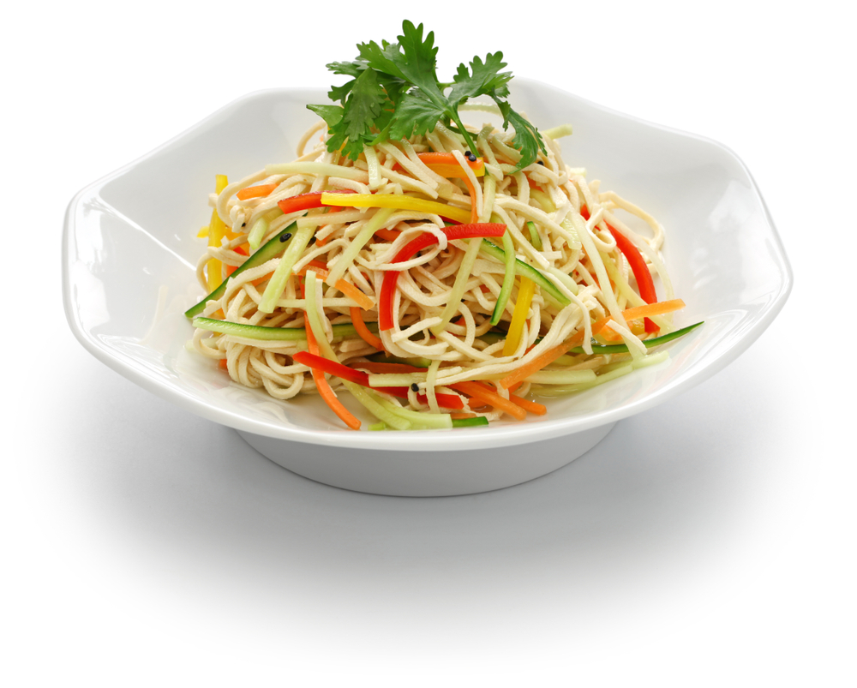
Noodle salad

Slide 15
Finding out about salad

Slide 16
Coleslaw
What ingredients can you see in this salad?
Main ingredients
Cabbage
Carrots
Mayonnaise
Herbs

Slide 17
Chicken caesar salad
Where do you think this salad originates?
Main ingredients
Chicken
Croutons
Lettuce (cos or romaine)
Parmesan

Slide 18
Tabbouleh salad
Have you tried this salad before?
Main ingredients
Bulgar wheat
Tomatoes
Parsley
Mint
Onion
Lemon juice

Slide 19
Waldorf salad
What fruit can you see in this salad?
Main ingredients
Apples
Walnuts
Celery
Grapes

Slide 20
Mixed bean salad
Can you name all the types of beans in this salad?
Main ingredients
Red kidney beans
Butter beans
Chickpeas
Black beans
Lentils (green and red)

Slide 21
Pasta salad
What ingredients can you see in this salad?
Main ingredients
Pasta
Mozzarella balls
Peppers (yellow and green)
Cherry tomatoes

Slide 22
Ham salad
How many different ingredients can you see in this salad?
Main ingredients
Lettuce
Tomatoes
Red pepper
Ham

Slide 23
Potato salad
What other ingredients would you add to this salad?
Main ingredients
Potatoes
Mayonnaise
Spring onions

Slide 24
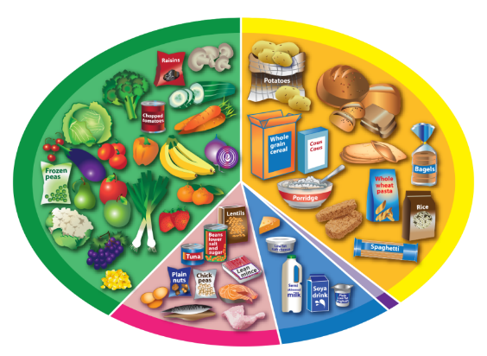
Salad niçoise
Where do each of the ingredients in this salad belong on the Eatwell Guide?
Main ingredients
Tuna
Egg
Potatoes
Green beans
Tomatoes
Onion
Black olives
Lettuce

Slide 25
Vegan salad
Can you name all these ingredients?
Main ingredients
Chickpeas
Sprouting beans
Courgette (ribbons)
Apple
Radishes
Beetroot
Lettuce

Slide 26
Noodle salad
What ingredients can you see in this salad?
Main ingredients
Noodles
Pepper
Cucumber

Slide 27
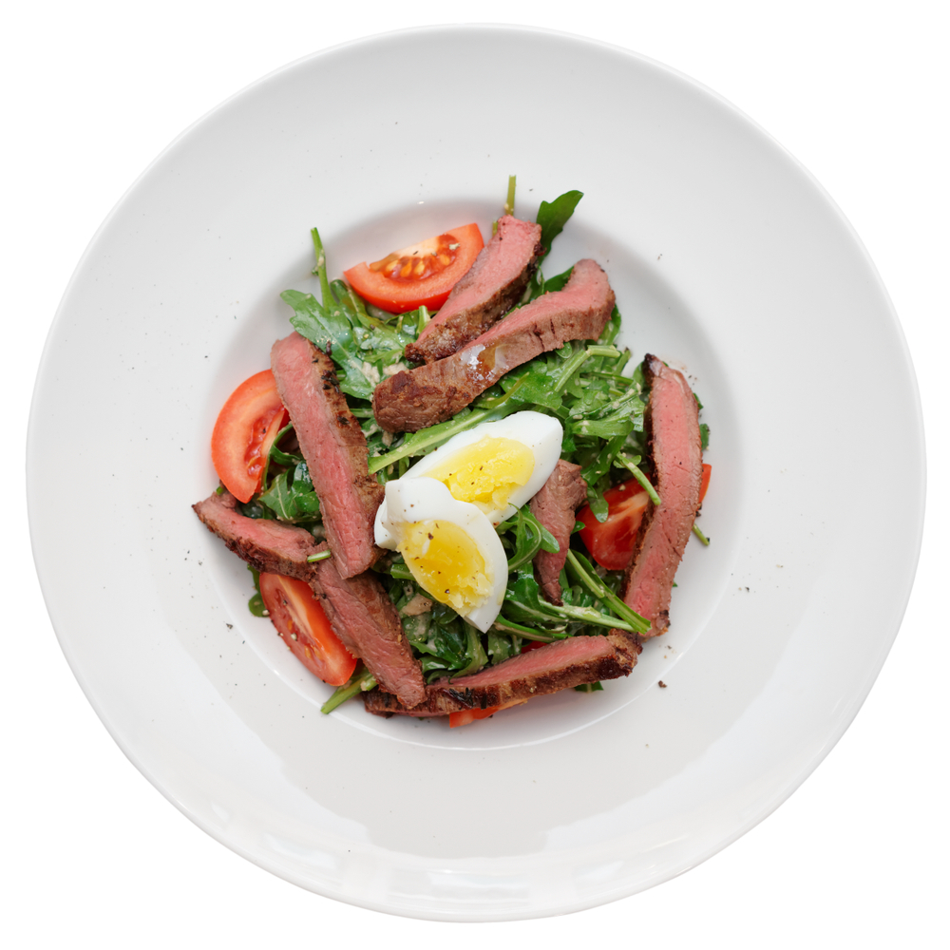
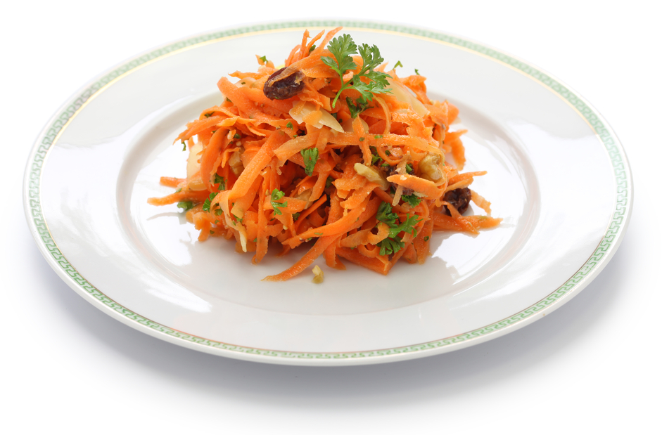
‘Use it up’ salad
Salads can be a great way to use up ingredients, or make them go further!
Ingredients
Leftover roast beef
½ boiled egg
½ tomato
A few lettuce leaves
Ingredients
½ carrot, grated
½ apple, chopped
A spoon of sultanas

Slide 28
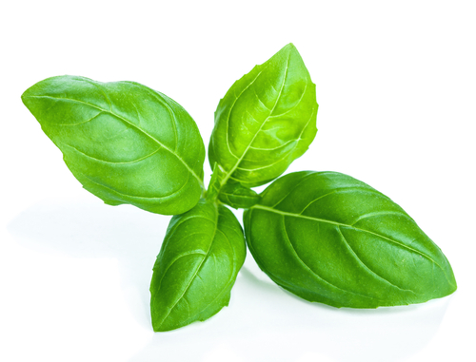

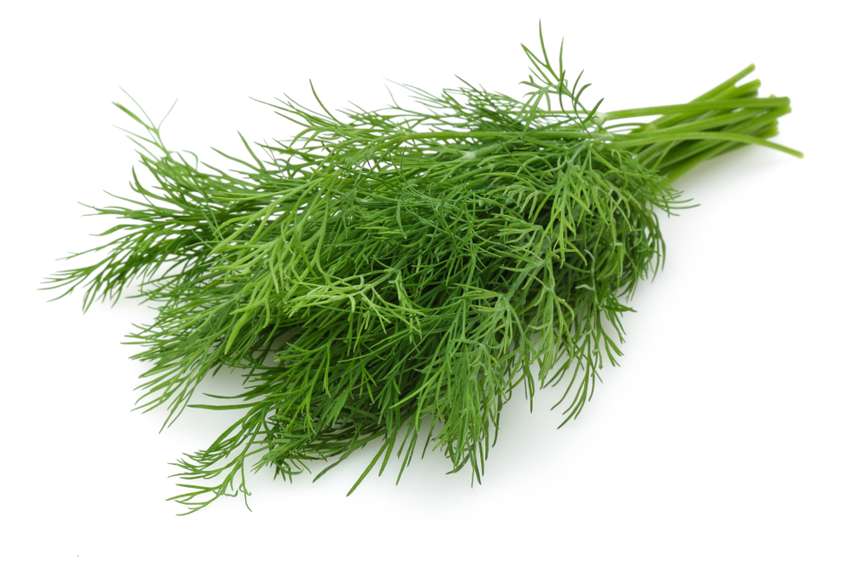
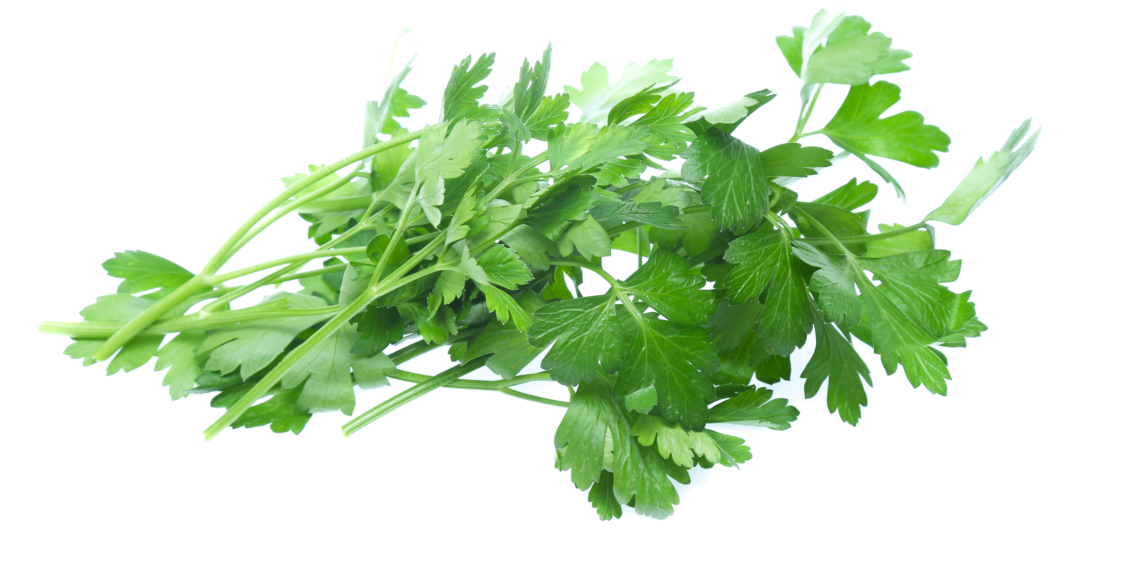
Herbs
Herbs can add flavour to salads. What are these herbs called?
Basil
Parsley
Mint
Dill
What words would you use to describe how they look?

Slide 29
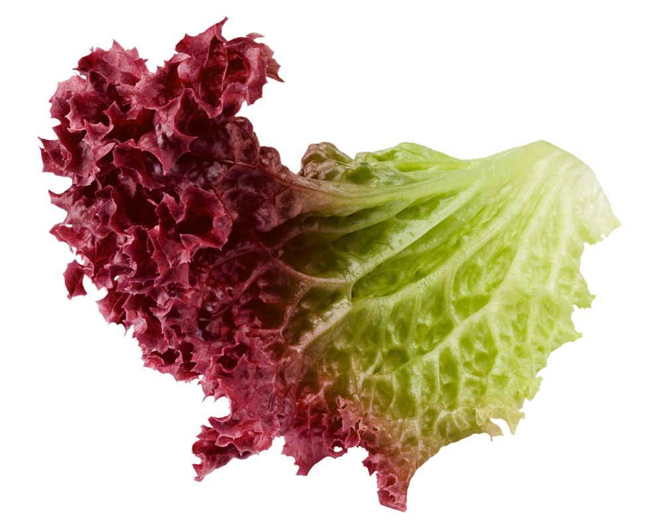
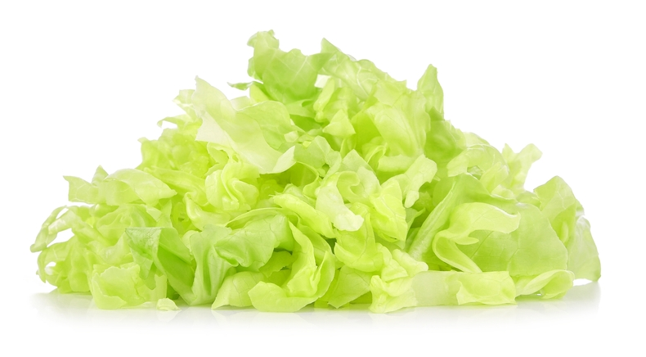
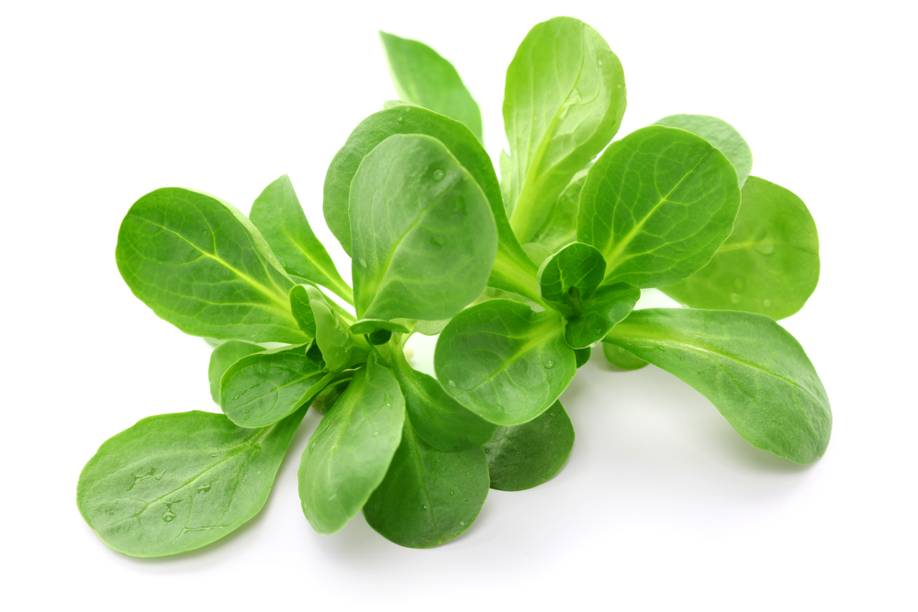
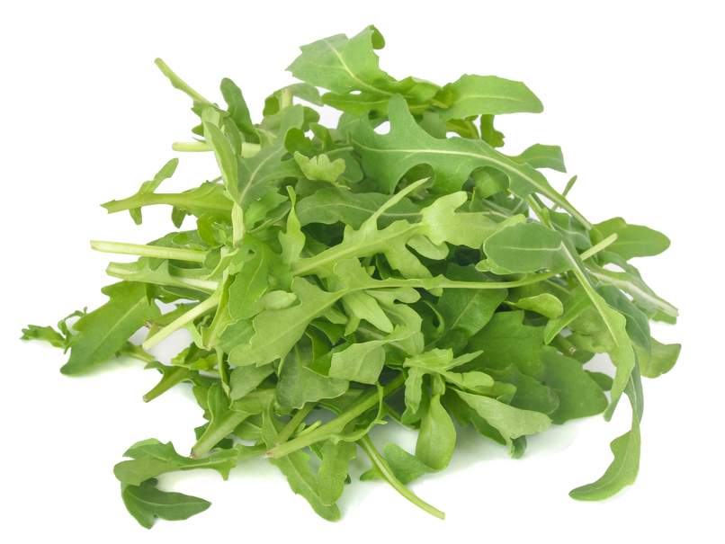
Lettuce
Different types of lettuce can be used in salads.
Lollo rosso
Iceberg
Lambs lettuce
Have you tried any of these?
Rocket

Slide 30
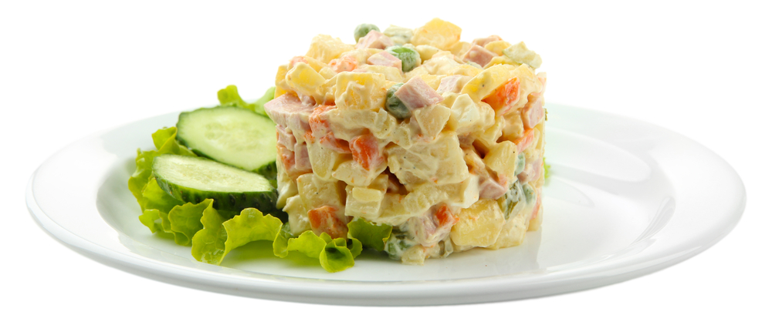
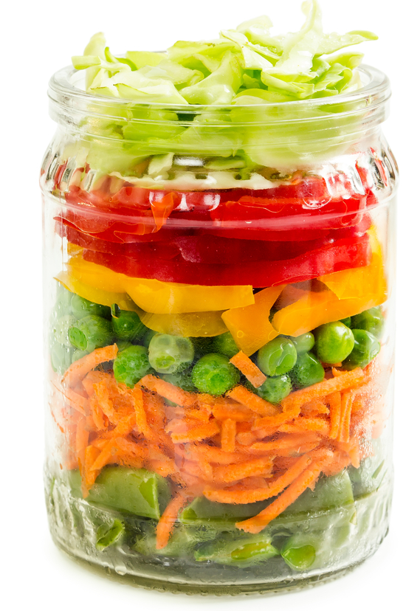
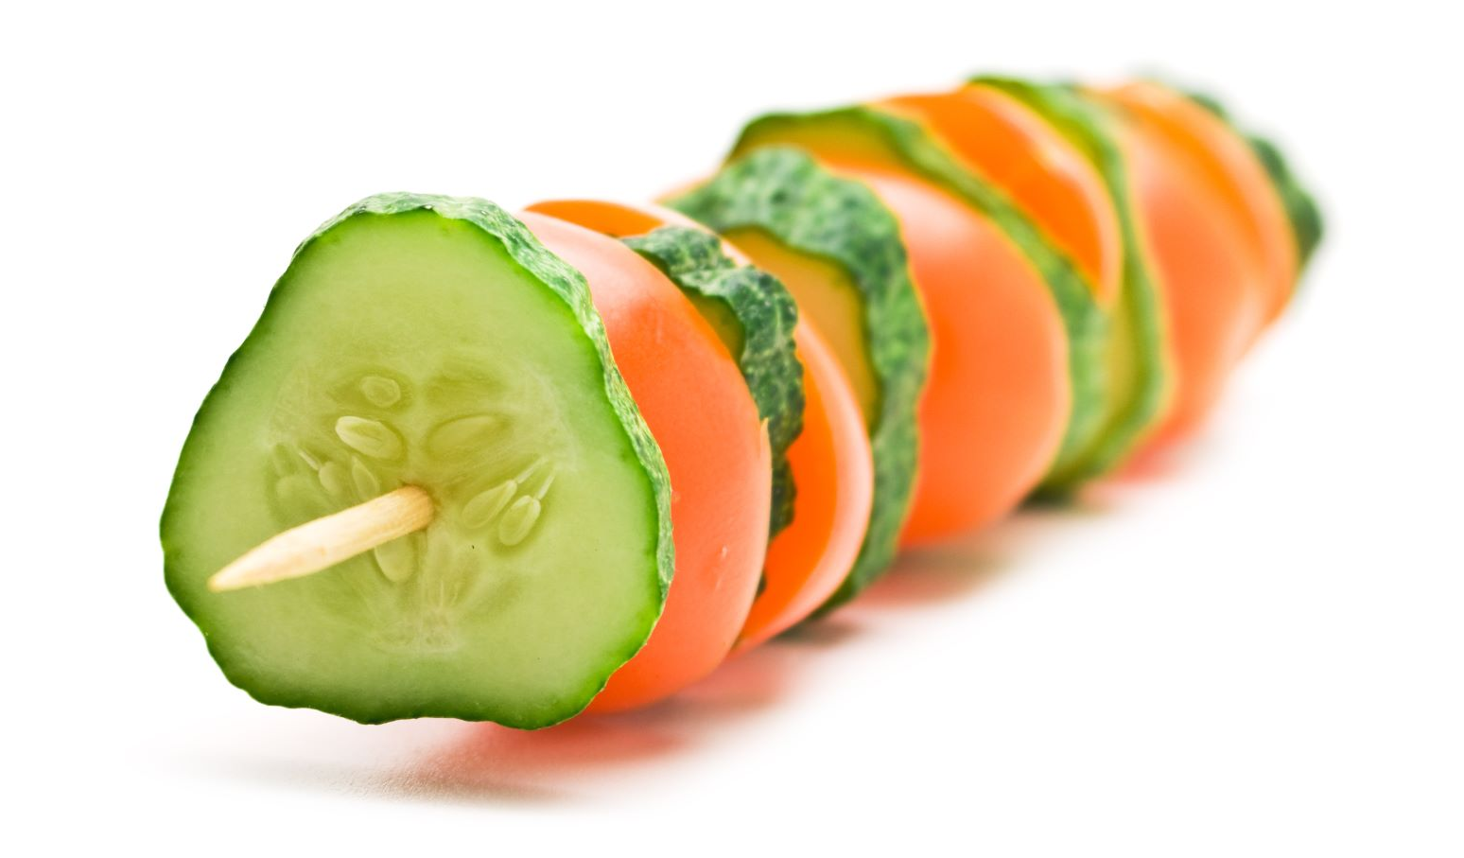
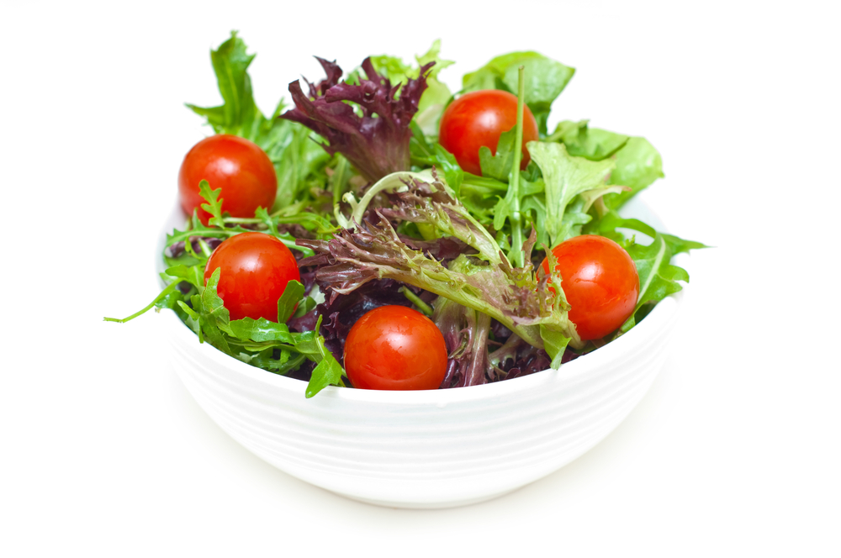
Served
Salads can be served in different ways.
As a main meal
Shaped
On a stick
As a side dish
In a jar

Slide 31
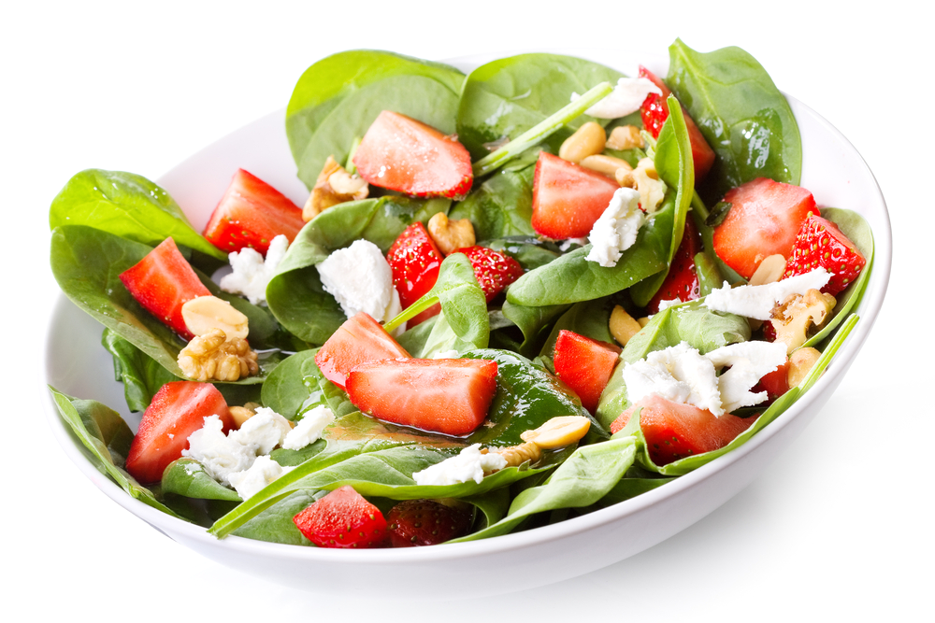
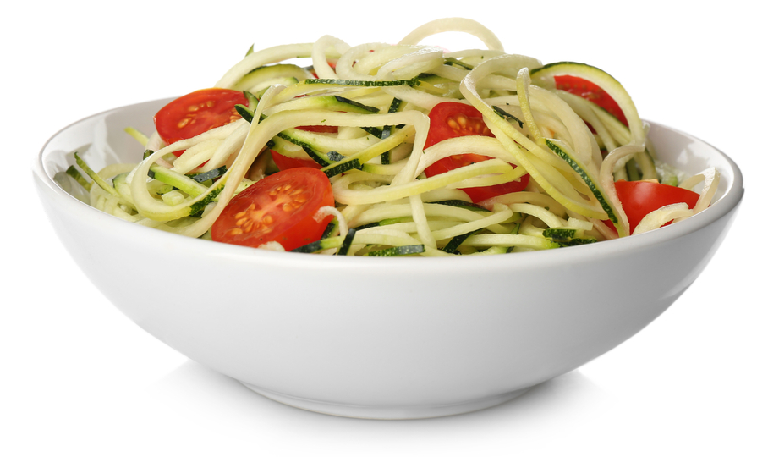
Surprising salads!
You can make a salad with almost any ingredients!
What interesting ingredients can you see in these salads?
Strawberries
Courgette spirals

Slide 32
Serve a salad
For further information, go to:
www.foodafactoflife.org.uk

