Slide 1
Factors affecting food choice

Slide 2
Healthy balanced diet
Eating the right balance of a wide range of food provides most people with the energy and nutrients that they need to stay healthy.
A healthy balanced diet, together with regular physical activity, can help people to maintain a healthy weight and may reduce their chance of developing diet related illness, such as obesity.

Slide 3
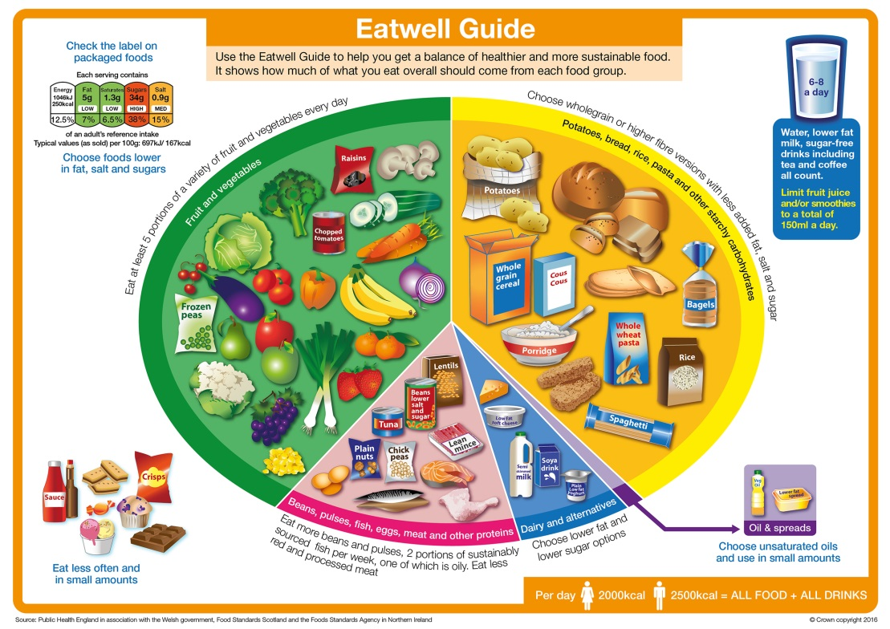
The guide for a balanced diet
All around the world people choose to eat different foods for many different reasons.
The Eatwell Guide provides guidance in the UK on how everyone can achieve a healthy varied diet.

Slide 4

Factors influencing food choice
Food choices for a balanced diet depend on many factors, such as:
individual energy and nutrient needs;
health concerns;
portion size;
cultural or religious practices;
cost;
social and economic considerations;
food availability;
food preferences;
environmental and ethical considerations;
advertising and other point of sale information.

Slide 5
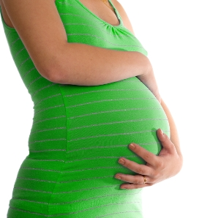
Individual energy and nutrient needs
The amount of energy, carbohydrate, fat, protein, vitamins and minerals needed differs between different age groups and between males and females.
For example, women of child-bearing age should consume extra amounts of folate and foods with added folic acid during early pregnancy to decrease the risk of foetal neural tube defects, e.g. spina bifida.
Energy needs also depend on activity levels. Athletes will have much higher energy requirements due to their high level of physical activity.

Slide 6
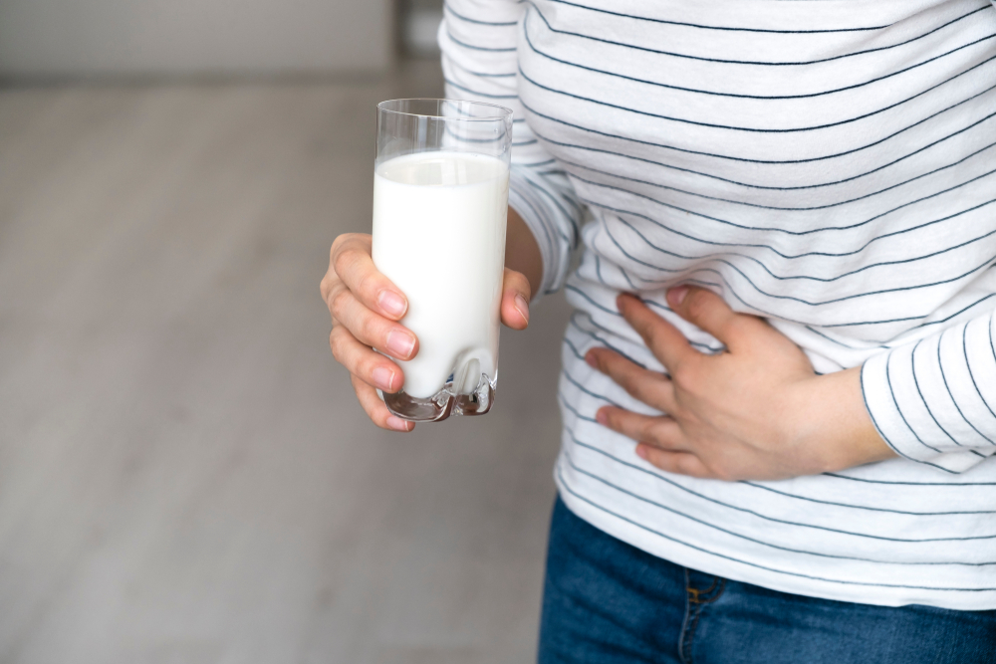
Health concerns
Diets which exclude many foods due to a person’s health concerns or for medical reasons need to be planned carefully.
For example, people who are lactose intolerant cannot eat some dairy products and so must make sure that they eat other foods which are good sources of calcium, e.g. soft edible bones in fish such as tinned salmon or sardines.
However, they can consume hard cheese, as it is low in lactose, and also yogurt in moderate amounts, because the bacteria in yogurt helps digest the lactose.

Slide 7
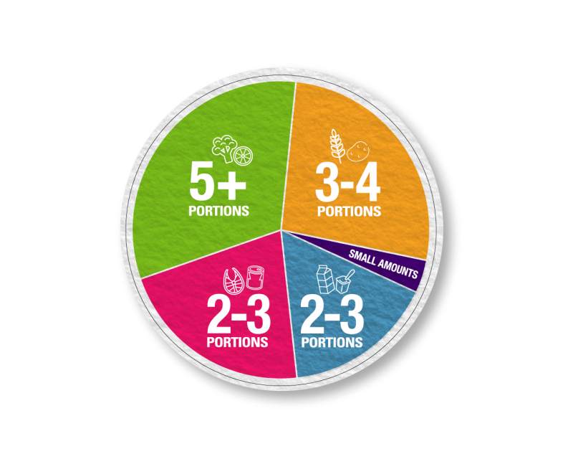
Portion size
Having a healthy, balanced diet is about getting the right types of foods and drinks in the right amounts.
This is why portion sizes are important when making food choices.
Whilst making sure portions are of the correct size is important, it is also important to make sure to follow a healthy, varied and balanced diet based on the basic principles of the Eatwell Guide.
For an average size adult female, BNF have produced some portion size guidance here.
There is also information on portion size for children as part of the school food plan here.

Slide 8
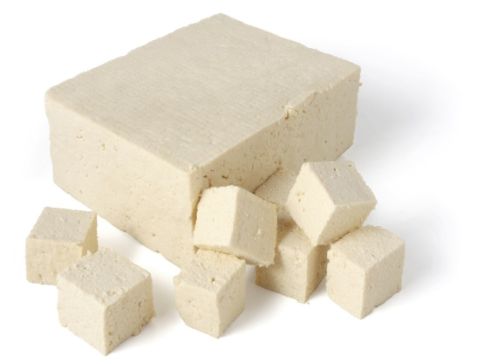
Cultural or religious practices
Ethical and religious practices, such as avoiding meat, may limit the range of food people eat.
For example, a strict Vegan will not consume any meat products. They should choose non-meat food sources which are high in protein, iron and vitamin B₁₂.

Slide 9
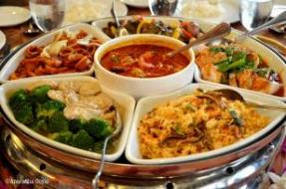
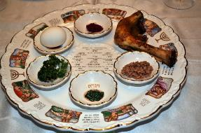
Cultural or religious practices
Religions and beliefs which have particular food restrictions or celebrations involving food include:
Christianity;
Islam;
Hinduism;
Judaism;
Sikhism;
Buddhism;
Seventh-day Adventist Church;
Rastafari Movement.

Slide 10

Cost
The cost of food and money available will influence people’s food choices.
If money is limited, people may choose to buy more basic items. Luxury items might then used for special occasions.
Food prepared at home is often cheaper than eating out, buying take-aways or ready prepared food.

Slide 11
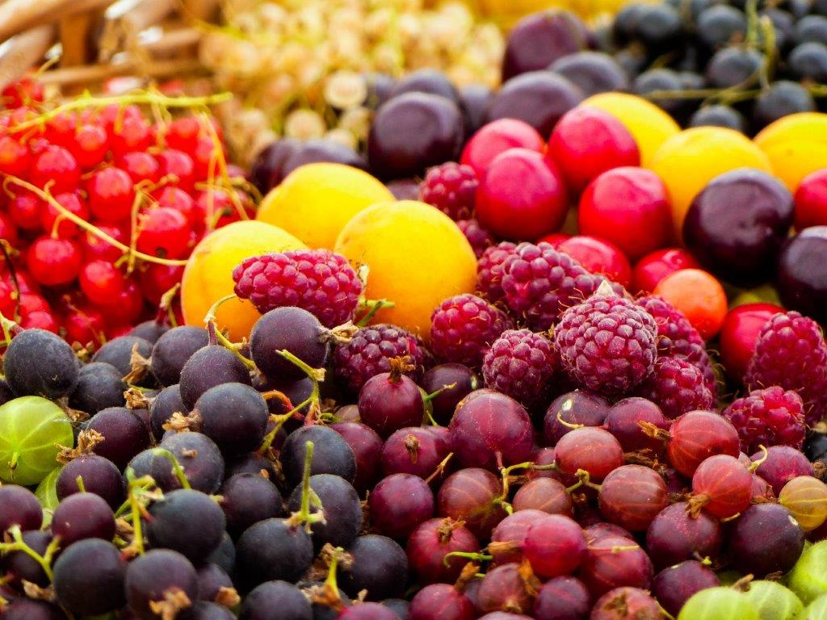
Food availability
Most food is grown in a particular season of the year, e.g. strawberries are harvested in summer. These are called ‘seasonal foods’.
Buying food when it is in season will often ensure the food price is lower.
Technology and the importation of food, however, has allowed food to be available all year round.
Frozen foods such as vegetables are a great alternative to fresh.

Slide 12
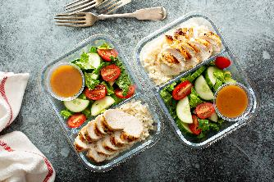
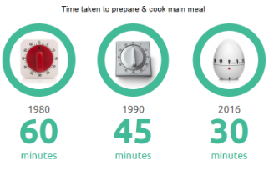
Social and economic considerations
Lack of competence and confidence in the kitchen – people may choose to buy ready made, frozen or dried food that are easy to prepare and cook and that require only basic cooking skills.
Lack of time – many people work long hours and either haven’t got the time or do not wish to spend time cooking at home.
Source: ONS/Kantar Worldpanel Usage

Slide 13
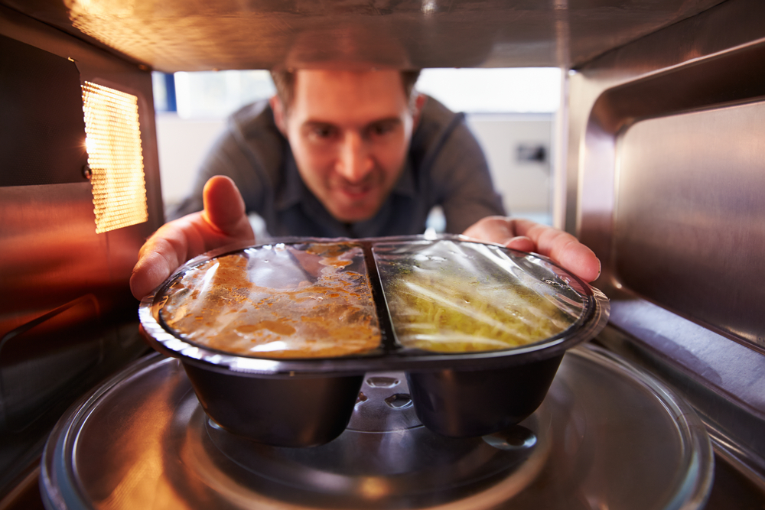

Social and economic considerations
Development of ready meals – because people lack time and have labour saving equipment (such as microwaves) the amount and range of convenience food has grown.
Smaller households – an increasing number of people now live alone and this may well affect their food choices.
In 1960, 40% of households were 1-2 people and in 2016, this had risen to 63%.
By 2027, more than a third of the population will be over 60.
Source: ONS/Kantar Worldpanel Usage

Slide 14
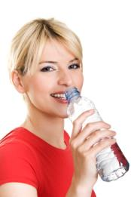
Social and economic considerations
Body image and peer pressure can both influence the food that people choose to buy, cook and eat.
A healthy balanced diet, together with regular physical activity, can help to maintain a healthy weight. Eating the right balance of a wide range of foods provides most people with the energy and nutrients that they need to stay healthy.

Slide 15


Food preferences
Not everyone likes the same food, but some foods are particularly popular or unpopular.
The taste, texture or appearance of foods can affect people in different ways.
People should choose a balanced diet with a wide range of foods they enjoy by choosing from the four food groups of The Eatwell Guide.

Slide 16
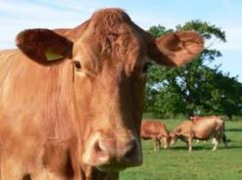
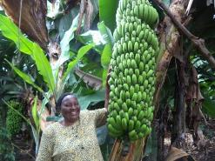
Environmental and ethical considerations
Human and animal welfare, scientific intervention in the food chain and the impact of food production on the environment can be of a high social concern for some people.

Slide 17
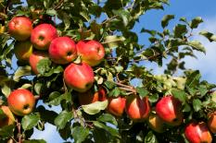

Environmental and ethical considerations
Some considerations when buying food might be:
fair trade – ensuring that farmers in less economically developed countries get a fair deal;
local foods – buying locally supports local business and farmers and some believe that food produced locally is more sustainable;
genetically modified (GM) food – scientific intervention is used to change a plant, animal or micro-organism’s genes or to insert one gene from another organism;

Slide 18
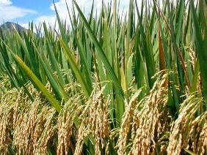
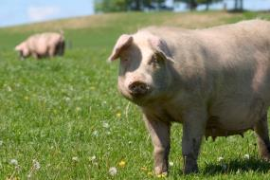
Environmental and ethical considerations
Environmental and ethical considerations continued:
organic food – food sold as ‘organic’ must come from growers, processors and importers who are registered and approved by organic certification bodies, which are shown on the food label;
free range – animals are allowed to roam freely outside: this food may be more expensive.

Slide 19
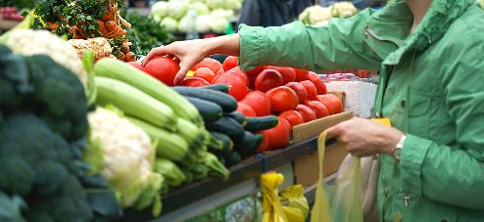
Food provenance
Food provenance means where ingredients and the foods made from them originally come from.
Many consumers want to know where their food originated.

Slide 20

Food provenance
Protected Geographical Indication (PGI)
Products which must be produced, processed or prepared within the geographical area and have a reputation, features or certain qualities attributable to that area.

Slide 21

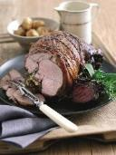
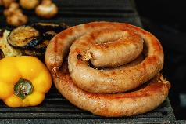
Food provenance
Protected Geographical Indication (PGI)
Two British products with PGI are:
Welsh lamb – Welsh lamb is derived from the sheep breeds of Wales and lambs are raised extensively on grassland;
traditional Cumberland Sausage - is a spiral coil shaped seasoned pork sausage. Its most distinctive feature is that, unlike other sausages, it is not linked but long and coiled.

Slide 22

Food provenance
Traditional Speciality Guaranteed (TSG)
Products which are traditional or have customary names and have a set of features which distinguish them from other similar products.
These features must not be due to the geographical area the product is produced in nor entirely based on technical advances in the method of production.

Slide 23
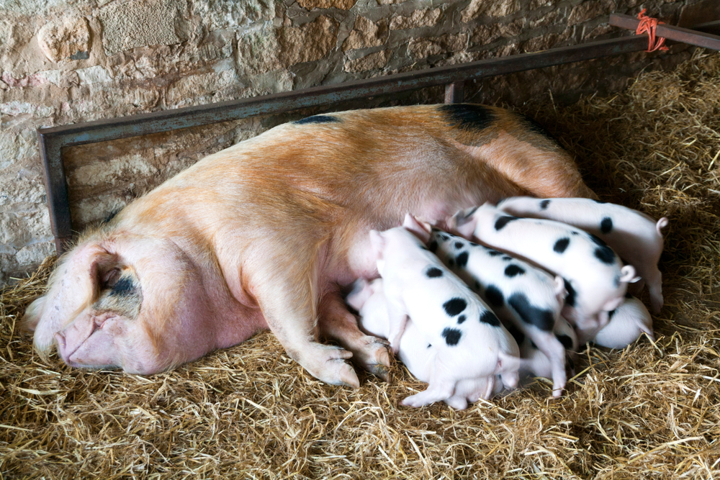
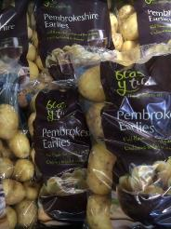
Food provenance
Traditional Speciality Guaranteed (TSG)
Two examples of British products with TSG are:
Gloucestershire Old Spots Pork - the first breed of any species in the world to be awarded TSG status;
Pembrokeshire earlies – Welsh potatoes that are harvested earlier than many other UK varieties, usually in the first week of May.

Slide 24

Food provenance
Protected Designation of Origin (PDO)
Products which are produced, processed and prepared within a particular geographical area and have a reputation, features or certain qualities attributable to that area.

Slide 25
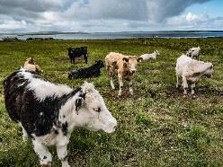
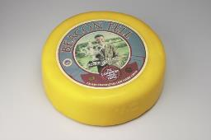
Food provenance
Protected Designation of Origin (PDO)
Two examples of British products with PDO are:
Orkney beef – a feature of Orkney Beef farming is the widespread use of Aberdeen Angus and Shorthorn cross breeding cows which give the beef its distinctive characteristics;
Beacon Fell Traditional Lancashire cheese - made exclusively in the Preston area from local milk which is pasteurised. Cylindrical shaped cheese made from the curd of two or three days. The cheese is lightly pressed for 2 days, waxed or buttered or cloth bound and is fully mature at 6 months.

Slide 26

Food assurance schemes
Red Tractor
Red Tractor assurance standards cover food safety, animal welfare, environmental protection and traceability. The Red Tractor logo tells the consumer that the food has been checked every step of the way and can be traced back to the farm source.
The Red Tractor logo appears on these products:
meat - beef, lamb, pork, chicken, turkey;
dairy - milk, cheese, cream;
cereals and flour;
fruit, vegetables and salads;
sugar.

Slide 27
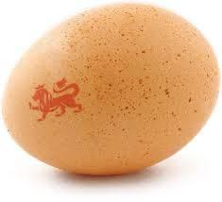
Food assurance schemes
The British Lion mark
A quality code of practice that ensures eggs have been produced to the highest standards of food safety.
The code covers the entire production chain and ensures strict food safety controls including the guarantee that all hens are vaccinated against Salmonella and a ‘passport’ system ensuring that all hens, eggs and feed are fully traceable.

Slide 28

Food assurance schemes
Northern Ireland Beef and Lamb Farm Assurance Scheme
The Northern Ireland Beef & Lamb Farm Quality Assurance Scheme was developed to give consumers assurances about the farm end of the production chain of their food.
It is about farm quality – the quality of the production methods used, the quality of care for animals which is practiced, the quality of the farm environment, and above all the quality of concern for the customer in producing beef and lamb which is wholesome, safe and free from unnatural substances.

Slide 29

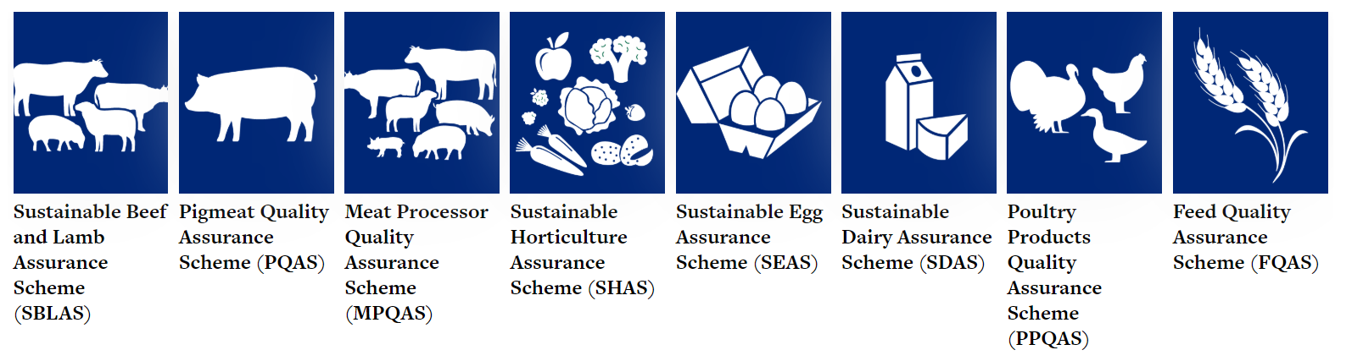
Food assurance schemes
Bord Bia Quality Assurance Schemes
In the Bord Bia Quality Assurance Schemes, all steps in the food chain from production to final packaging for sale to the consumer are Quality Assured.

Slide 30

Food assurance schemes
Marine Stewardship Council
The MSC is used to assess if a fishery is well managed and sustainable.
The Standard has three core principles:
sustainable fish stocks;
minimising environmental impact;
effective fisheries management.
The MSC logo can be used on fresh fish counters, packaged fish products and restaurant menus.

Slide 31
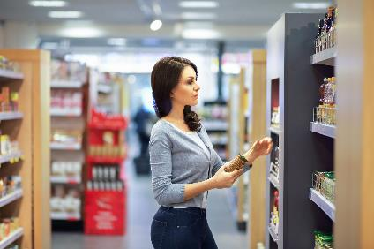
Advertising and other point of sale information
Advertisements encouraging people to choose certain foods often appear on the television, internet, radio, posters, magazines and newspapers.
Point of purchase information and product placement are strategies often used to provide information to consumers. This can assist people in making healthier choices.

Slide 32

Other sources of information
There are many sources of information to help people when making food choices:
Department of Health;
NHS Choices;
British Nutrition Foundation – www.nutrition.org.uk
supermarkets, food manufacturers, charities and other groups;
the media, i.e. internet, newspapers, radio, magazines and television programmes.
It is important that advice is clear, consistent and correct. Look for the Information Standards logo.

Slide 33
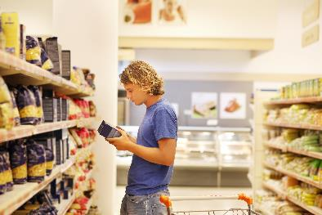
Other sources of information
Front and back of pack labels are also a good source of information to help make food choices.
Information required on the labels of pre-packed food and drink products:
name of food or drink;
list of ingredients (including additives and allergens);
weight or volume;
date mark.

Slide 34
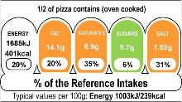
Other sources of information
Information required on the labels of pre-packed food and drink products also includes:
storage and preparation conditions;
name and address of the manufacturer, packer or seller;
country of origin and place of provenance;
nutrition information.

Slide 35
Quiz- Kahoot
Open the link below on the main screen and get students to log onto kahoot.it on their tablets or smartphones.
They can then enter the code (that will come up on the main screen when you start the game) and their own nickname.
They can then play along with the quiz choosing the multiple choice answers that correspond with the questions on the main screen. There will then be a leaderboard of the scores after each question and at the end.
https://create.kahoot.it/share/factors-affecting-food-choice/29ee069b-ed80-4226-b6e8-a0718d9f4e61

Slide 36
Factors affecting food choice
For further information, go to:
www.foodafactoflife.org.uk

