Slide 1
International food culture and tradition

Slide 2
International food culture and tradition
When considering international food culture and tradition, factors that may affect the food eaten around the world include:
food availability;
cooking equipment, methods and skills;
religion;
special occasions;
beliefs e.g. vegetarianism;
culinary practices;
traditions;
festivals.
The following slides show some examples of international food culture and tradition.

Slide 3
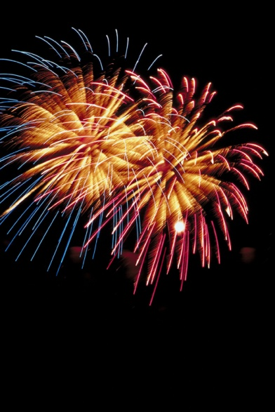
Diwali
What do you know about Diwali? What foods are consumed on Diwali? How else is Diwali celebrated?
Diwali is a five day Hindu religious festival, which is celebrated in October/November. Diwali is a major holiday in India but it is also celebrated by people in other countries where Hinduism is practised. Other religious groups such as Jains and Sikhs celebrate their own versions of the holiday.
The word Diwali means “row of lights” and Diwali is often referred to as the “festival of lights”.

Slide 4
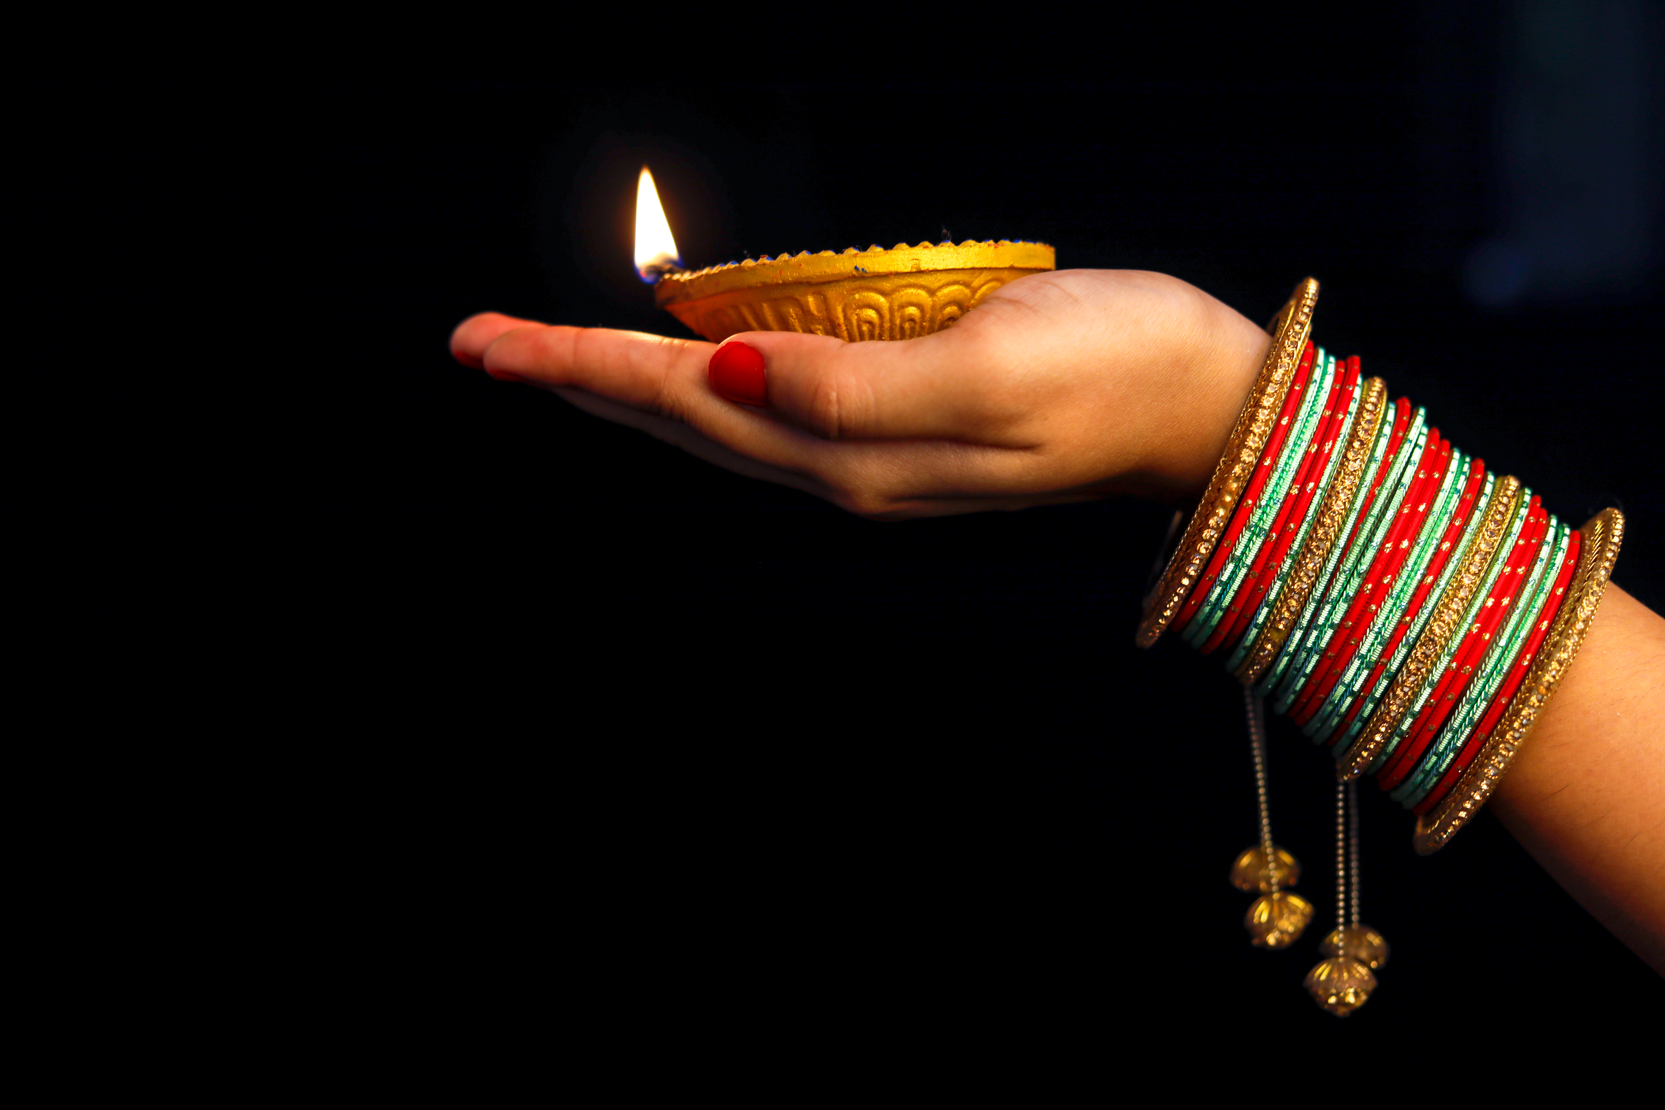
How is Diwali celebrated?
Diwali is celebrated by:
brightly decorating houses and temples;
setting off fireworks;
special religious ceremonies;
visiting friends and family to exchange gifts and food (such as mithai, dried fruit, nuts or silver serving dishes);
wearing new clothes;
gambling;
sending Diwali cards;
spring cleaning the home.

Slide 5
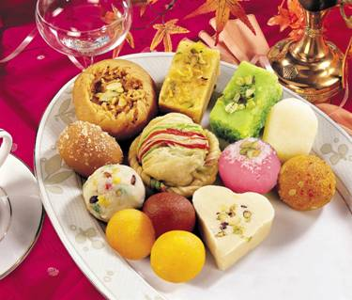
What food is eaten during Diwali?
Mithai – are a cross between snacks, dessert and confectionary. Mithai can be made from chickpea flour, rice flour, semolina, thickened condensed milk and yogurt. Sweet spices, nuts, raisins, saffron, rose water and silver/gold leaf can be added. Some mithai are eaten universally e.g. barfis, whereas some are more regional specialities e.g. moti pak.
Diwali snacks – are savoury snacks which can be made from chickpeas, rice, lentil and several other varieties of flours. They are then seasoned (e.g. with spices, sesame seeds, coconut), shaped and usually deep-fried.
Different speciality meals – are traditionally cooked on different days of the festival, and these vary further depending on region. In general, puris are accompanied by a different dal, vegetable curry, fried foods such as pakoras and a pudding on each day of the festival.

Slide 6
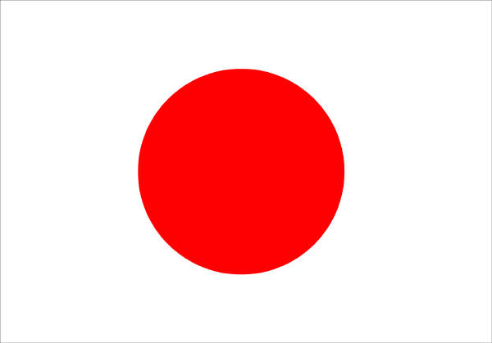
Japanese food culture
What do you know about Japanese food culture? What traditional Japanese foods can you think of? Have you tried any traditional Japanese foods?

Slide 7
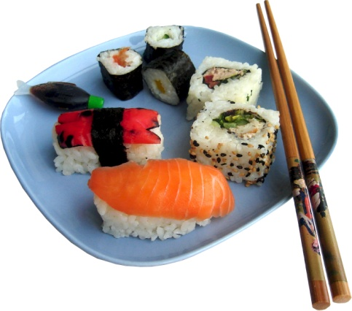
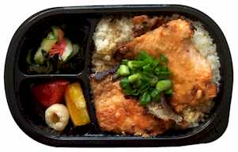
What are bento and sushi?
Japanese box lunches are known as bento. Shops sell a variety of bento which are eaten for both lunch and dinner. Many shops are take away only but some also have tables available.
Traditional sushi is a small piece of raw seafood placed on a ball of vinegared rice. Sushi is generally eaten in Japan at sushi restaurants where customers sit at the counter and call out their orders item by item to a sushi chef. There are also popular chains of ‘conveyor belt’ sushi restaurants where you grab small plates of sushi off the conveyor belt.

Slide 8
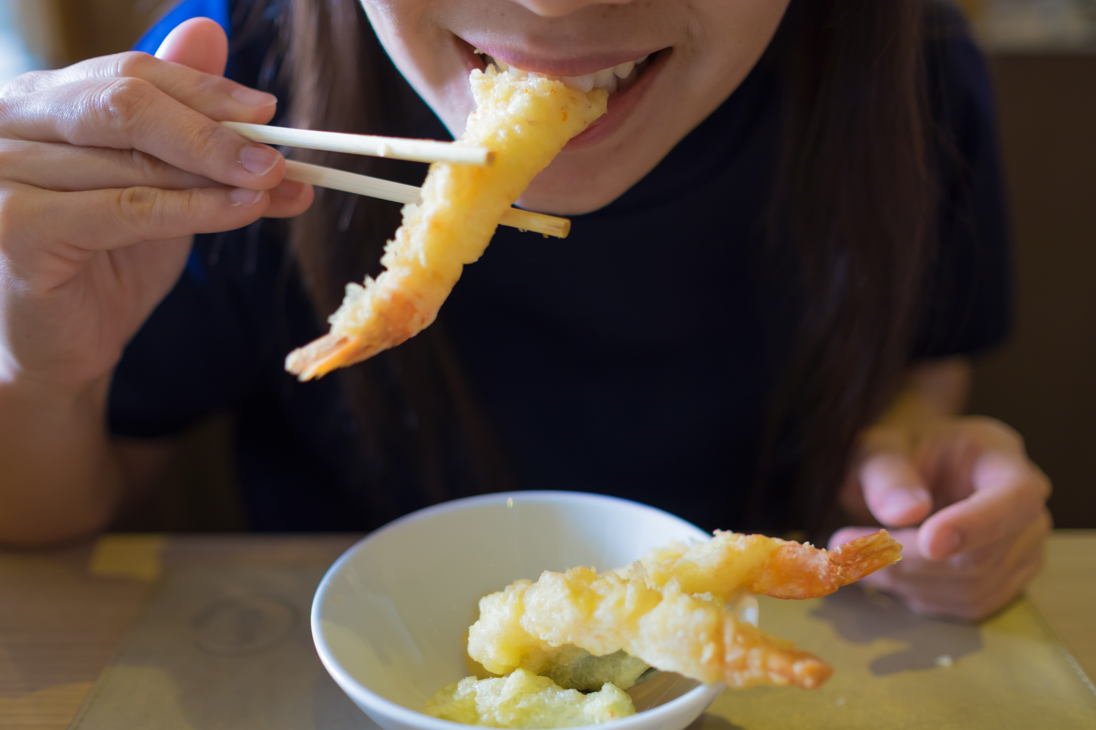
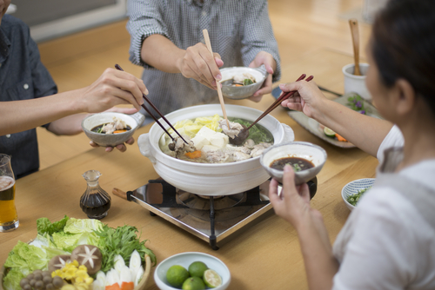
What is the eating etiquette in Japan?
In Japan food is eaten with chopsticks rather than a knife and fork. There are some rules to take into consideration when using chopsticks in Japan, for example, it is impolite to spear food with the chopsticks or wave chopsticks around above food dishes.
Soup is eaten by picking up the bowl with one hand and sipping from the edge of the bowl. Chopsticks can be used to pick up more solid ingredients from the soup (e.g. bean curd).
Noodles served on a wooden tray are picked up in bite-size portions. If noodles are served in a hot broth, picking up the noodles and lifting the bowl to sip the broth is alternated.
In Japan, slurping is a sign of a good appetite and eating with pleasure.

Slide 9
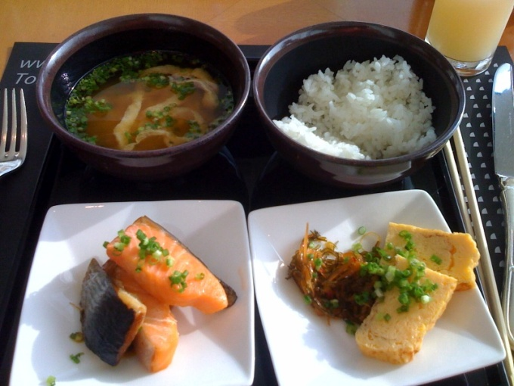
What is a traditional Japanese breakfast?
In Europe, we tend to eat foods such as breakfast cereal, bread accompanied by different spreads, cheeses and meats, yogurt and fruit for breakfast.
A traditional Japanese breakfast can include dishes such as steamed rice, miso soup, broiled or grilled fish, tamagoyaki (rolled omelette), nori (dried seaweed) and natto (fermented soy beans).

Slide 10
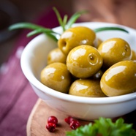
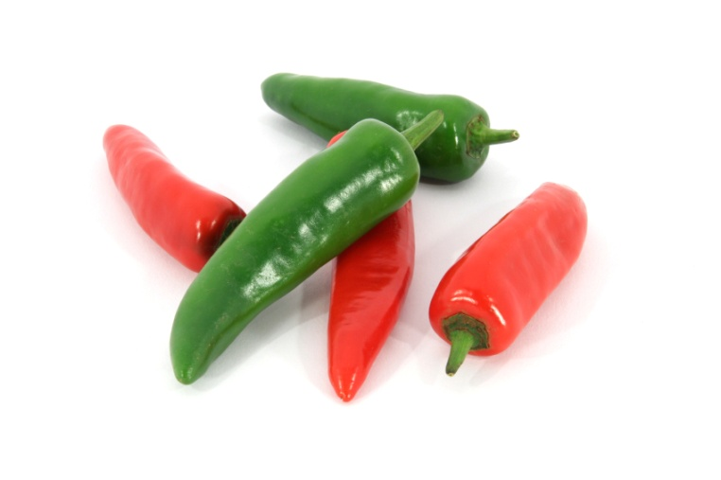
Festivals and food
Do you have any festivals in your local area celebrating a particular ingredient?
Have you celebrated any festivals by eating special foods?

Slide 11
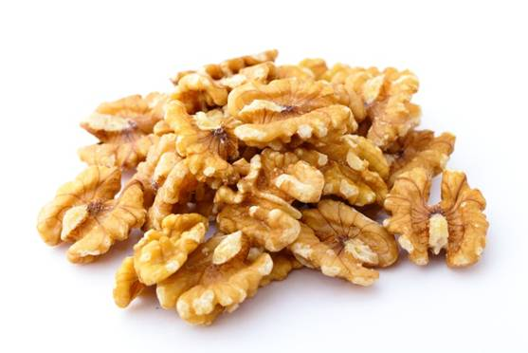
Festivals and food
Across Europe there are numerous festivals focused around a particular ingredient.
The Aritzo Chestnut and Walnut Festival, Sardinia, Italy
The mountain town of Aritzo is surrounded by chestnut and walnut groves. On the last weekend of October, the local people dedicate three days to the celebration of their harvests. Roasted chestnuts, walnuts, walnut cake and many more local specialities are on sale and songs and dances are performed by folk groups.

Slide 12
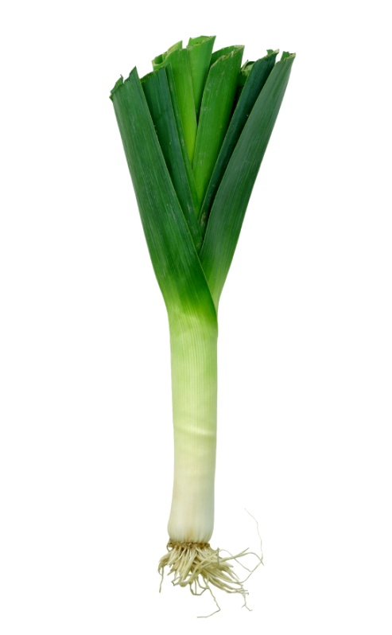
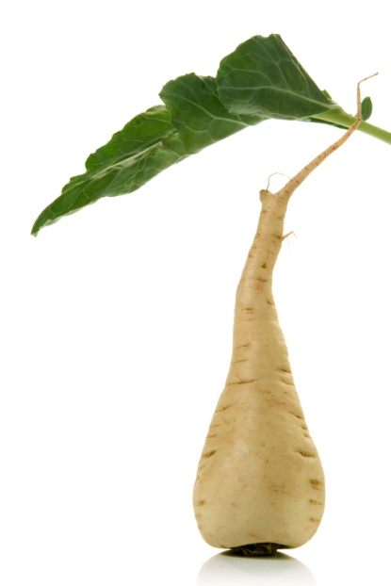
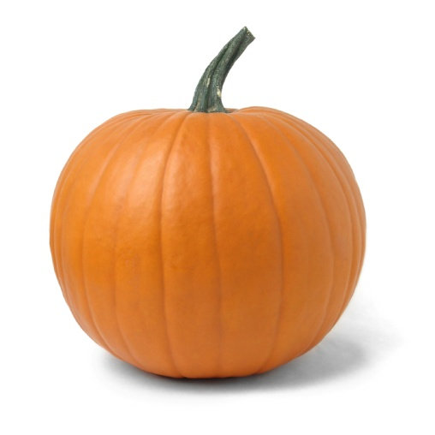
Festivals and food
Fête des Legumes Oubliés (Festival of Forgotten Vegetables), La Haye-de-Routot, France – a food festival dedicated to vegetables that were used in the past but are now forgotten such as unusual varieties of squash, leeks and parsnips.

Slide 13
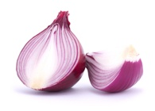
Festivals and food
Weimar Onion Market, Weimar, Germany
Weimer holds an annual onion market in October each year. It was first recorded in 1653 as a one day market. The market is now a three day event and the number of visitors is given as 350,000 annually.
Traditions include the first slice of Onion cake with the queen of the Onion Market and farmers selling braids of plaited together onions decorated with dried flowers of yellow, white or lilac. Foods on sale include onion soups, stews, breads and tarts.

Slide 14
International food culture and tradition
For further information, go to:
www.foodafactoflife.org.uk

