Slide 1
Resource management

Slide 2

Managing resources
It is important that consumers know how to manage their resources effectively when choosing, shopping for, preparing and storing food.
The resources include:
time;
energy;
money.

Slide 3
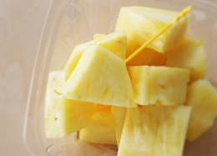

Choosing food
To make good use of time, energy, and money when choosing food consider the following:
Meal planning – thinking ahead will reduce the number and amount of time needed for shopping;
Ingredients – try and choose ingredients that will save time and money;
Seasonality – choose seasonal and local foods;
Value for money – compare the cost of fresh and pre-prepared ingredients/foods, e.g. sliced, chilled pineapple verses a whole fruit or a jar of pasta sauce verses fresh.

Slide 4

Shopping for food
To make good use of time, energy, and money when shopping for food consider the following:
compare prices – use a price comparison website, compare the same or a very similar product from different companies or visit different shops to compare prices;
make use of special offers on foods that you buy regularly;
write a shopping list or use an app and keep to it;
make a comparison between buying in bulk (large quantities) against single unit price;
work out ‘special offers’ carefully – do they really save money?

Slide 5
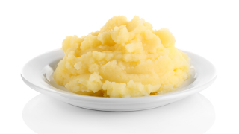

Food preparation
To make good use of time, energy, and money when preparing food consider the following:
make good use of leftover food, e.g. mashed potatoes can be used to make fish cakes the next day;
ready meals and convenience foods may be useful occasionally but can be expensive, cook from scratch;
make good use of fuel – use energy efficient appliances and make good use of oven space;
try and use energy efficient methods of cooking.

Slide 6

Resource management
Discuss how to manage these resources effectively for people on low income:
What are some of the key considerations for managing:
time;
energy;
money?
Population groups that may be included:
students;
retired, older adults;
unemployed.
What other groups can you think of?
What practical ideas can you think of that might help one or more of the groups to plan, shop and prepare food on a limited budget?

Slide 7

Discuss how to manage these resources effectively for people living on their own:
What are some of the key considerations for managing:
time;
energy;
money?
Population groups that may be included:
young single person;
widow/widower;
retired, elderly person.
What other groups can you think of?
What practical ideas can you think of that might help one or more of the groups to plan, shop and prepare food?

Slide 8

Discuss how to manage these resources effectively for families with children:
What are some of the key considerations for managing:
time;
energy;
money?
Make a list of factors that might have to be taken into account, e.g. after school activities, working patterns.
What practical ideas can you think of that might help families with children to plan, shop and prepare food?

Slide 9
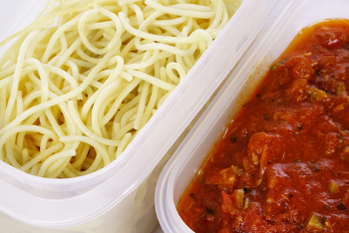
Reduce food waste
Every year in the UK, seven to ten million tons of food are wasted.
It is thought that approximately 50% of the food wasted is still edible.
The cost of food waste is significant – estimates show that it costs an average family £700 per year.
Source: Love Food Hate Waste

Slide 10
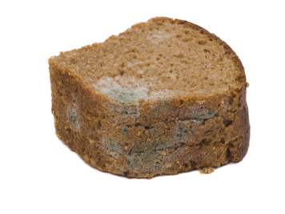
Reasons for food waste
There are many reasons why food is wasted, some of the most common items that are wasted:
Bread and bread products:
consumers do not understand ‘best before’ dates and bread is thrown away while still edible;
the bread has been stored incorrectly and has dried out and gone hard;
the bread has been stored too long (beyond ‘best before’ date) and has gone mouldy.

Slide 11

Reasons for food waste
Fruit and vegetables:
consumers do not store the produce correctly;
large pack size or multi-buys encourage consumers to buy more than they need;
consumers are not aware of the benefits of some packaging extending the shelf life of the product.
Starchy foods:
consumers cook too much, e.g. pasta/rice – portion size too big;
Leftovers are thrown away.

Slide 12
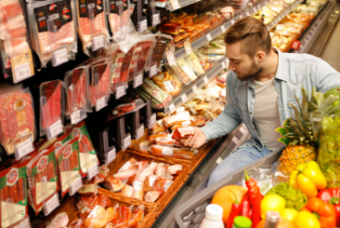
Reasons for food waste
Meat, chicken, fish:
consumers buy too much in advance;
food ‘goes off’ before cooking due to incorrect storage.
Fizzy drinks:
the ‘fizz’ is lost when bottles are opened a few times;
larger bottles can be cheaper than small.
Milk:
milk can go ‘off’ if stored incorrectly;
too much milk is poured with cereals or in drinks.

Slide 13
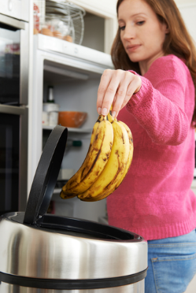
Reducing food waste
Reducing the amount of food consumers waste not only has financial benefits but also environmental benefits.
When food waste goes to landfill, it rots and during the process methane gas is produced. Methane is a greenhouse gas and contributes to global warming.
Consumers should use food waste bins wherever possible.
Reducing waste is a priority for both the economy and the environment. The UK is making progress but still has a long way to go.
Ethically it is challenging too – despite the amount of food wasted there are an increasing number of people who are in food poverty and rely on food banks.

Slide 14
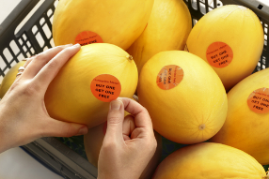
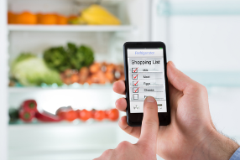
Reducing food waste
There are many ways in which consumers can help reduce food waste when buying food, eating out and eating at home.
Common causes of food waste when shopping include:
buying multi-pack items that may not get used – share the cost and goods with a friend/family;
impulse shopping – write a list and stick to it;
tempting offers – work out if they really are a good deal e.g. BOGOF;
confusion over date labels – be familiar with what they mean. Chose the food with the longest date.

Slide 15
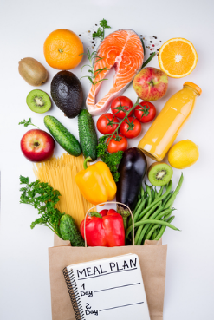
Common causes of food waste
Common causes of food waste when preparing and cooking food at
home include:
no forward planning – plan meals in advance and make a list;
cooking too much – use portion guides and calculators when cooking;
limited cooking skills – get to know recipes that can be modified to use foods that you have available;
left-over food is not used – be creative with leftover food to save waste and money;
food is stored incorrectly – make sure perishable food is stored at the correct temperature. Make good use of the freezer.

Slide 16


Methods of paying for food
Cash:
quick and efficient, no interest is charged;
may be safety concerns about carrying large quantities of cash;
consumers cannot pay for online purchases with cash.
Debit card:
no interest charged (providing the account is not overdrawn);
money is taken straight from consumers account;
no limit on payment, can be easy for consumers to overspend;
contactless cards use an embedded chip for payments up to £30, they are quick to process but may not be enough for a food shop;
some consumers may have security concerns.

Slide 17

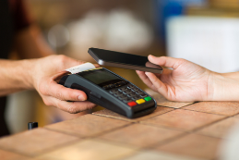
Methods of paying for food
Credit cards:
money is borrowed from the provider allowing payments to be spread over a period of time giving flexibility to the consumer;
high rates of interest are charged if not fully paid off;
no limit on payment, can be easy for consumers to overspend.
Phone/watch payment system:
contactless payments can be set up on certain mobile phones and watches, quick and easy to process;
no limit on payment, can be easy for consumers to overspend;
may not be accepted in all locations;
some consumers may have security concerns.

Slide 18
Resource management
For further information, go to:
www.foodafactoflife.org.uk

