Slide 1
Being an effective consumer

Slide 2

What is a consumer?
Consumers can be defined as “a person who purchases goods and services for personal use”.
It is therefore likely that many people are consumers on a daily basis.
On your way to school you may use the bus and then buy a snack at break time – you are a consumer.
To be an effective consumer the person will:
know their rights and responsibilities;
know how to get advice on issues;
know how to complain effectively.

Slide 3

What are the barriers to being an effective consumer?
Access: consumers may have physical barriers that affect their access as a consumer. For example:
consumers with hearing or sight impairment, learning difficulties or mobility issues may find access difficult in some environments;
lack of accessible parking spaces or public transport can restrict access to services and shops;
loud noise or dim lighting can make it difficult for consumers to find the information they need e.g. reading labels;
it may be difficult for a consumer in a wheelchair to access high shelves in a supermarket.

Slide 4
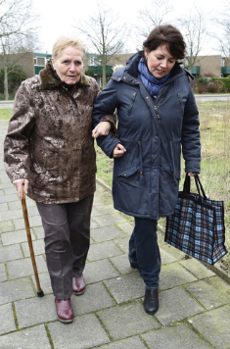
What are the barriers to being an effective consumer?
Age: there are three main challenges depending on the age of the consumer. For example:
financial access: not having enough money to buy food and transport (low income) can affect many different age groups for different reasons, e.g. a young unemployed person, or an elderly person living alone;
physical access: for some consumers not being able to access shops easily is a problem, e.g. not having suitable transport to get to shops;
access to information: the lack of ability to understand product information/labels or how to access help or complain e.g. younger consumers are less likely to complain about poor service/goods.

Slide 5

What are the barriers to being an effective consumer?
Ethnicity: cultural differences and language may affect consumers ability to access and understand information and their rights and responsibilities. For example:
consumers from other countries may not be aware of or understand consumer legislation that is there to protect them;
not having access to familiar foods and products can be challenging for consumers;
consumers may feel socially isolated when shopping or accessing services.

Slide 6

What are the barriers to being an effective consumer?
Knowledge: the laws that are there to support consumers can be complex and some may find them difficult to understand. For example:
consumer rights are complicated so it may be challenging for people with learning difficulties or limited numeracy/literacy skills to access;
the age of the consumer can also be a factor; younger and older (55+) consumers may be less well informed;
consumers living on a low income may also find it more difficult to access appropriate information.

Slide 7

What are the barriers to being an effective consumer?
Resources: consumers may be affected by lack of resources such as money, time and location. For example:
low income or lack of access to money or credit will affect how consumers shop or access services for the products they need;
consumers may have limited time to research or find information, e.g. they may be carers, work long hours or work away from home;
their location (where they live) may make it difficult for consumers to shop e.g. there may be little or no public transport in rural areas.

Slide 8

Shopping options for consumers
Consumers have a wide range of options when shopping for food. There are advantages and disadvantages for them all, it is therefore important for consumers to decide which is the most suitable for them.
Shopping options include:
independent grocery shops;
supermarkets;
markets;
farm shops;
online shopping;
shopping apps.

Slide 9

Independent grocery shop
Advantages:
closer to home – often in residential areas;
more personal service;
stock more local food products;
offer smaller quantities, reducing waste;
Disadvantages:
may be more expensive;
more limited choice/range of products;
less turnover of stock;
access/parking may be limited.

Slide 10
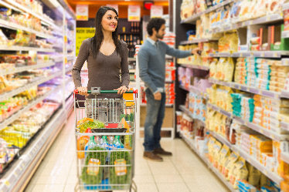
Supermarket
Advantages:
wide range of brands/products available;
own brand/’value’ brands can be less expensive;
money saving offers and promotions;
longer opening hours – some 24 hours;
wide range of services/facilities e.g. dry cleaning;
economy of scale – sell more products for less;
usually easy access and parking.

Slide 11
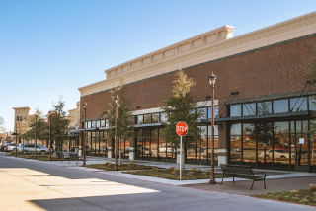
Supermarket
Disadvantages:
consumers may overspend, make impulse purchases;
purchase ‘special offers’ when not really needed;
less local/regional produce;
can be very busy and noisy;
if situated ‘out of town’ can be difficult to access without a car;
more impersonal.

Slide 12

Markets
Advantages:
local produce available, including specialities to the area;
may be less expensive than shops;
more interaction with people, more sociable.
Disadvantages:
often only open on specific days;
can be dependent on the weather conditions;
information such as labelling, may not be available;
may be more limited in the range of services/products available.

Slide 13
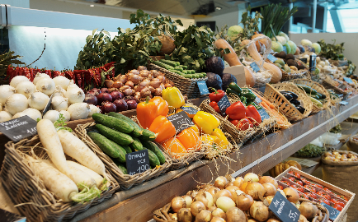
Farm shops/markets
Advantages:
sell local produce direct to the consumer;
may support local growers/producers.
Disadvantages:
can be more expensive than supermarkets;
may not have as a wide a range as larger shops;
limited opening times/hours;
may be less accessible, rural locations.

Slide 14
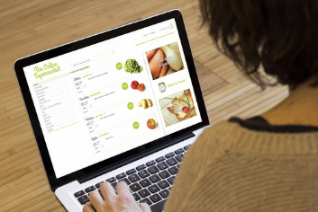
Online shopping
Advantages:
wide range of products available;
can be accessed at all times;
shopping process can be done at home and delivered.
Disadvantages:
consumer cannot see/handle the items before they buy;
the sell-by dates may be short;
there may be a delivery charge;
less sociable, consumer has no contact with producer/seller;
security concerns with online payment.

Slide 15
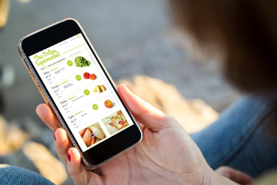
Shopping apps.
Advantages:
easy to find products using search or scanner;
shopping list can be created and managed flexibly;
consumers can make cost comparisons across shops;
app allows consumers to set price alerts, find the best offers;
saving suggestions and cash back vouchers;
synchs the shopping list to the consumers account.
Disadvantages:
consumers do not experience the food e.g. smell, texture;
difficult to check dates/freshness of the food.

Slide 16

Consumer protection
Trading Standards Scotland (TSS) is the national team for trading standards in Scotland.
The role of the TSS is the local government service that works to protect consumers and support legitimate business.
Trading Standards Scotland have a statutory obligation to:
enforce fair trading;
combat illegal trading;
monitor product safety;
address under-age sales;
verify weights and measures.
More information: Trading Standards Scotland

Slide 17
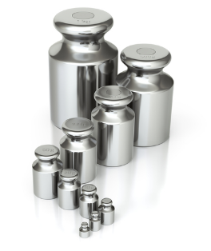
Trading Standards Scotland
Weights and measures:
Inspectors check to make sure food measured by weight or volume is being accurately measured. The weight of the food product written on the label must match the weight of the food.
Claims or complaints around issues of weight or volume measurements are investigated.
TSS are responsible for checking the calibration and accuracy of equipment used in food production premises to weigh and measure food and drink.
Any business found selling inaccurate quantities can be prosecuted in a criminal court.

Slide 18
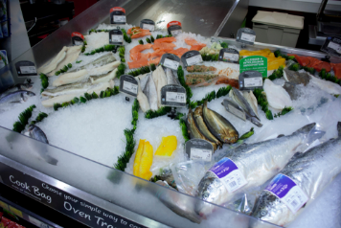
Trading Standards Scotland
Pricing and false misleading instructions:
TSS have the responsibility of checking pricing in shops selling food and investigating any disputes or problems.
TTS can offer advice and guidance on pricing labels.
Shops must show the price per unit on a food product label, this makes it much easier for consumers to compare prices.
Shops must give genuine and fair prices and must not mislead the consumer.
All products that are sold must be labelled and described accurately.

Slide 19
Trading Standards Scotland
TSS protects consumers by:
investigating complaints and handling disputes;
inspecting food retailers, checking calibration, record keeping and labelling;
educating retailers and consumers on legislation;
seizing counterfeit goods from rogue traders;
collecting evidence to use in prosecution.

Slide 20

Shopping choice
Discuss the shopping choices that could be made by the following people:
A university student living in shared accommodation with a limited income and access to public transport.
A young working adult, working long hours in a city office; uses public transport only.
A family of three children, both parents working full time, busy after school/work; living in a rural area with car but no public transport.
An older adult living alone with weekly domestic help; limited access to transport.

Slide 21
Being an effective consumer
For further information, go to:
www.foodafactoflife.org.uk

