Slide 1


Overcoming challenges with engaging children on the autistic spectrum in food lessons
7 May 2019

Slide 2

Overcoming challenges with engaging children on the autistic spectrum in food lessons
Peter Imray
www.peterimray.co.uk
peter.imray@hotmail.co.uk
Notes:
2
Inclusive classroom practice
• Strategies and approaches
• Materials and resources
• Understanding and managing behaviour
• Sensory issues
• Transition

Slide 3
Why do you think children, young people and adults with autism might have problems with food activities/food lessons?
Answer in the chat box

Slide 4
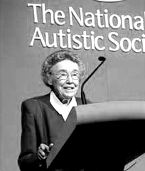
The Triad of Impairments (Wing and Gould, 1979)
Language and Communication.
Social Interaction.
Flexibility of thought and acceptance of change.

Slide 5
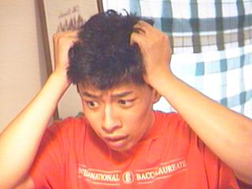
Possible/probable difficulties with communication
The person may have a very concrete understanding of language.
‘What you say’ is what is understood.
No account is taken of nuance, context and alternative (commonly understood) meanings.
Autism may be the only condition where language and communication are developed independently.
Notes:
What does ‘good for me’ mean?

Slide 6

Possible/probable difficulties with Social Interaction
A person with an ASD will have problems in understanding social behaviour and will have (sometimes extreme) difficulties in interacting effectively with others.
Some may not wish to engage with others at all.

Slide 7
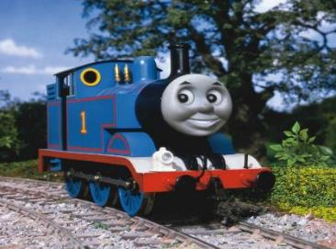
Possible/probable difficulties with Flexibility of Thought
Unlikely to cope well with changes to routine or timetables.
May engage in very rigid rituals which prevent the development of relationship skills.
May only be interested in own special interests.
Limited or no appreciation of the feelings of others.
Lack of awareness of the motives of other people.

Slide 8
Sensory processing difficulties.
The fourth impairment?

Slide 9
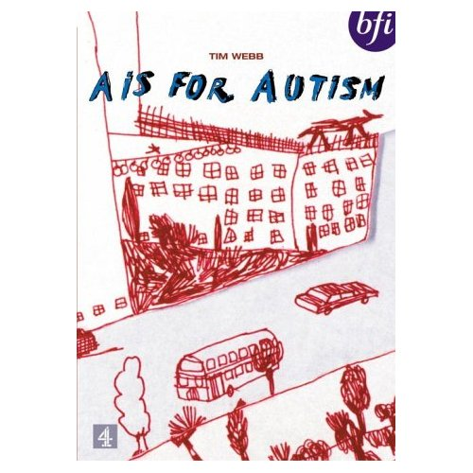
A is for Autism

Slide 10
Summary
Autistic Spectrum Disorders occur in early childhood as a result of a neurological disorder which affects development in the following areas:
Social Communication
Social Interaction
Flexibility of Thought
Sensory Processing
There is no known cure.

Slide 11
Sensory processing
Difficulties processing and integrating the seven senses.
Most of those on the spectrum will suffer from hypersensitivity - being over sensitive or intolerant to a sensory experience.
Some may suffer from hyposensitivity - being under sensitive to, or unable to get enough of, a sensory experience. Some people with autism report experiencing great pleasure as a result of their different sensitivities.

Slide 12
Tactile system
Sense of touch.
Receptors in the skin all over the body and of course on the tongue and in the mouth.
Degree of touch, pressure, vibration, temperature and pain.
Contributes to body awareness and motor planning.
It is both protective and discriminatory with these two elements working closely together.

Slide 13
Oversensitivity leads to low tolerance thresholds
People who are oversensitive tend to operate under high levels of anxiety.
They are often in a hyper aroused state with “fight, fright or flight” reactions.
Some will seek out certain sensations as a coping strategy, for example:
Bumping into objects, bouncing, squeezing between pillows and furniture
Humming and making noises
Rocking or rhythmic motions.
Notes:
Provides proprioceptive input which is calming or organising.
Rocking and rhythmic motions are movements that are calming or organising for the child.
Allows the child to screen out irritating or unexpected noises.

Slide 14
The oversensitive person
Tactile – might avoid messy activities so that cooking could be a problem. May have difficulties being close to other people.
Auditory – might be distracted by noise, easily startled, covers ears, distressed with certain sounds.
Visual – might dislike bright lights, especially strip lighting, sunny days. Might dislike foodstuffs touching each other on the plate.
Oral – might not be able to tolerate certain food textures or putting things in the mouth like a toothbrush for example.
Olfactory – might dislike some strong smells.

Slide 15
How to help the oversensitive person
Treat their difficulties as a real phobia. Ignore or downplay them at your peril!
Respect the person’s need to limit unfamiliar or uncomfortable input.
Pay attention to variables in our control such as people, the time of the day, the environment.
Operate a ‘less is more’ policy of change so that a small success is much better than a big failure.

Slide 16
How to help the oversensitive person
Use a basic and simple reward strategy - you can have A if you do a tiny bit of B.
Gradually build up over a period of time and don’t rush things.
Accept that the person may have bad days when they’re not able to tolerate change.
Gradually broaden the sensory processing range by introducing acceptable rituals or routines.

Slide 17
References and Reading
Ayres A J, Erwin P and Mailloux Z (2004). Love Jean. Inspiration for Families Living with Dysfunction of Sensory Integration. California. Crestport Press.
Bogdashina O. (2003) Sensory Perceptual Issues in Autism and Asperger Syndrome. London. Jessica Kingsley.
Grandin T & Scariano M (1986) Emergence labelled autistic. New York. Warner books.
Haddon M (2004). The Curious Incident of the Dog in the Night-Time. London. Vintage.
Smith Myles B, Tapscott Cook K, Miller N, Rinner L and Robbins L (2004) Asperger Syndrome and Sensory Issues: Practical Solutions for Making Sense of the World. Asperger Syndrome and Sensory Issues: Practical Solutions for Making Sense of the World. Autism Asperger Publishing Company.
Wing L and Gould J (1979) Severe impairments of social interaction and associated abnormalities in children: epidemiology and classification. Journal of Autism and Developmental Disorders.

Slide 18

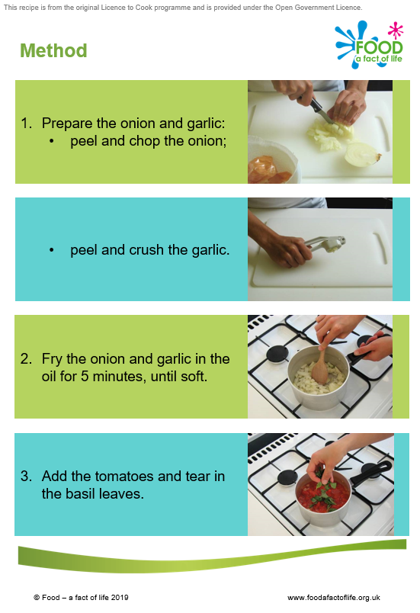
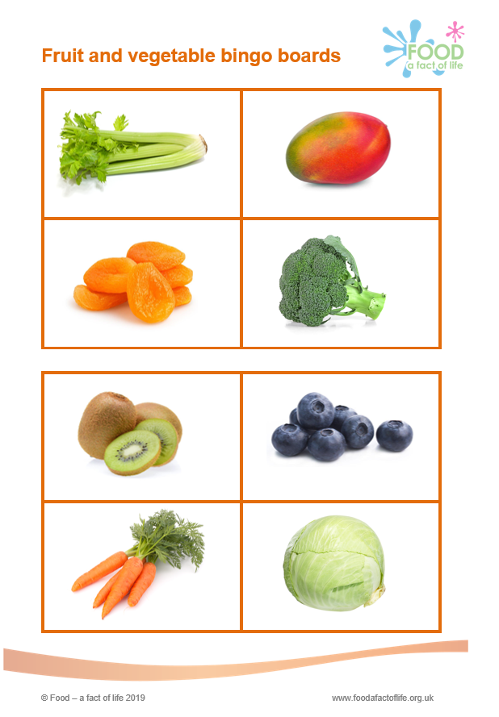
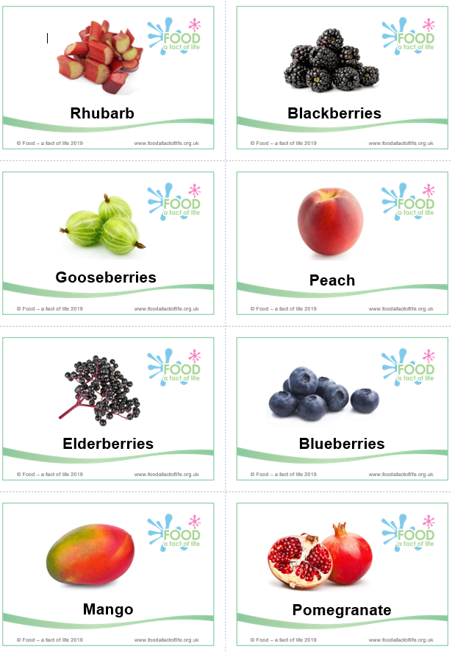
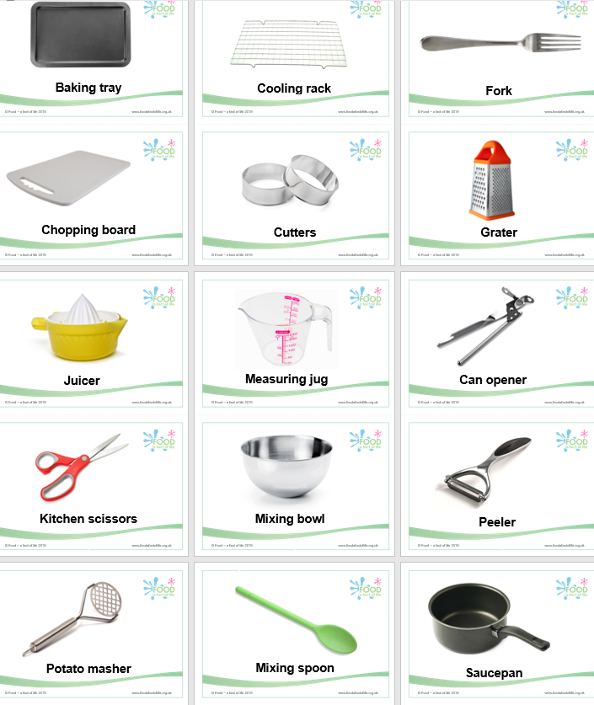
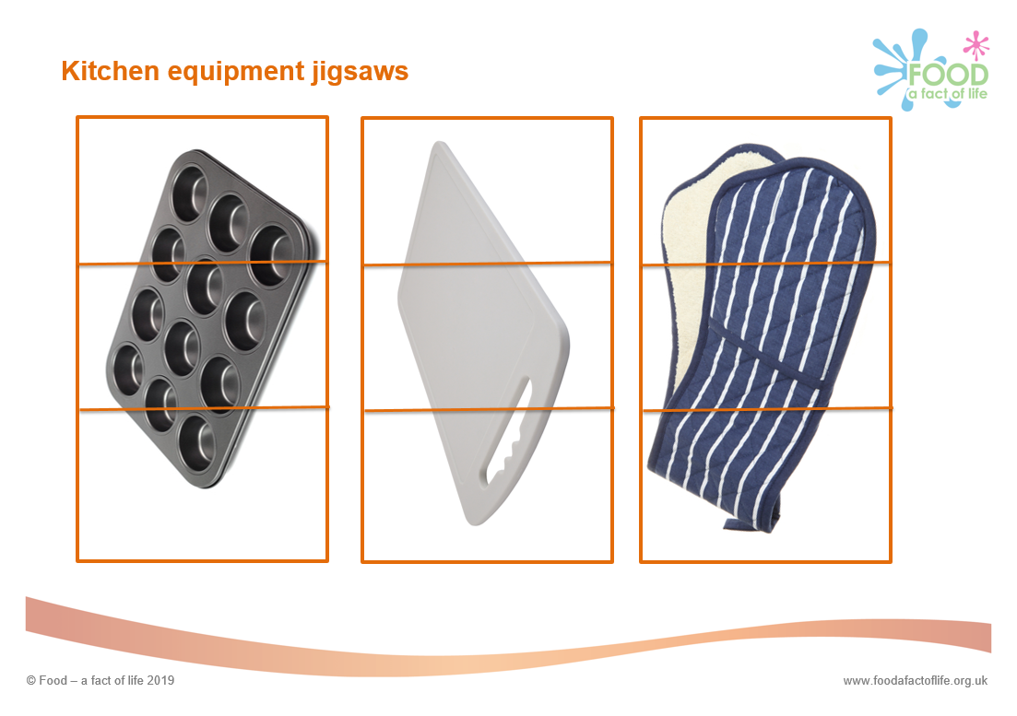
Food – a fact of life resources
A variety of resources are available on the Food – a fact of life website to support pupils with special needs, including:
food cards;
equipment cards;
food labels;
step-by-step picture
recipes.
www.foodafactoflife.org.uk

Slide 19
For further information, go to:
www.foodafactoflife.org.uk

