Slide 1

Food science in action
28 March 2019

Slide 2
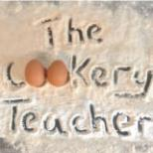
Food science in action
Barbara Monks
www.thecookeryteacher.com
Thursday 28 March 2019

Slide 3
Food Science in action
What will be covered?
Why is it important to know about the functions of ingredients?
What is protein denaturation and why and how does it happen?
Different ways to demonstrate and show denaturation in practical activities including food science investigations.
Links to Food – a fact of life resources
Suggestions for further reading and sources of information.

Slide 4
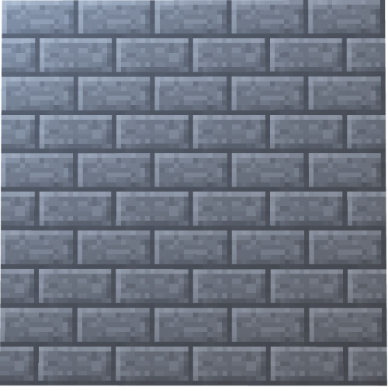
Why is it important to know about the functions of ingredients?
Requirement of the National Curriculum 2014
Progressive learning
KS3: knowing about a characteristics of a variety of ingredients when applying heat
Studying a range of commodities
Preparation for KS4
How ingredients work
Food Science
Ingredient knowledge
Seasonality
Provenance
Cooking skills
and competence
Mainly savoury dishes
User / Purpose
Nutrition & Health (Eatwell)

Slide 5



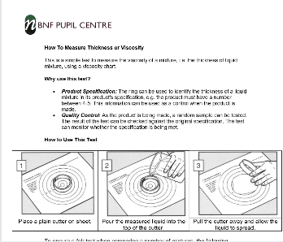
Knowledge of the function of ingredients
GCSE specification for KS4
• understanding of the working characteristics, functional and chemical properties of ingredients to achieve a particular result
• carbohydrates – gelatinisation, dextrinisation , caramelisation
• fats/oils – shortening, aeration, plasticity and emulsification
Proteins – denaturation, coagulation, foam formation and gluten
NEA 1 Food Investigation needs
GCSE or alternative

Slide 6
Functions of ingredients
Food preparation
Nutritional & health
Food science
Practical
lesson
Food Choice / provenance
Food
Safety

Slide 7
Functions of ingredients
Skills, application of heat or cold,
Combining and mixing, processes
Food preparation
Nutritional & health
Food science
Modifying recipes
Adapting meals
Delivering nutrition
Practical
lesson
Working properties, characteristics, effect of heat, acid and combinations
Sustainable, local, seasonal
Food Choice / provenance
Food
Safety
Perishable, non-perishable, shelf life, microbes

Slide 8
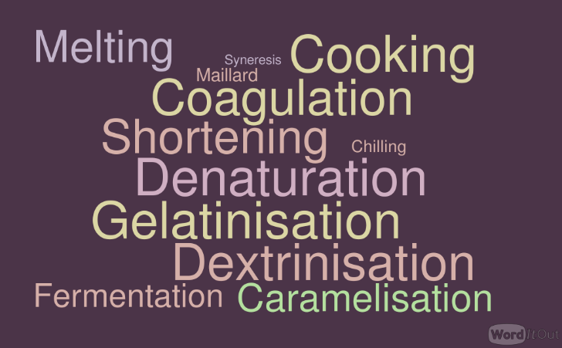
What is protein denaturation and why and how does it happen?

Slide 9


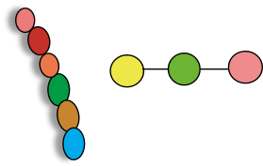



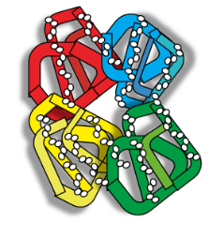


Structures of protein molecules
Peptide bonds or links
Secondary structure
Coiled
Amino acids
Primary structure
Quaternary structure
Globular linked proteins such as
Haemoglobin
Tertiary structure
3 dimensional
H-H

Slide 10
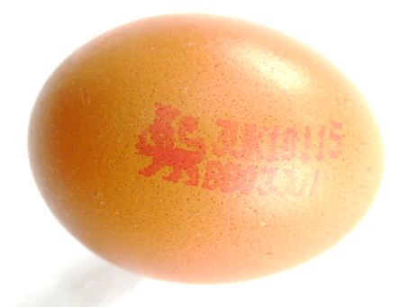
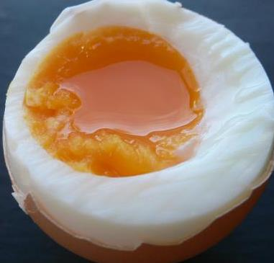
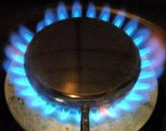
Protein denaturation in egg - coagulation

Slide 11
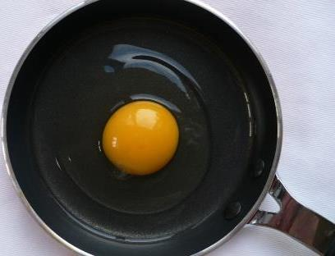
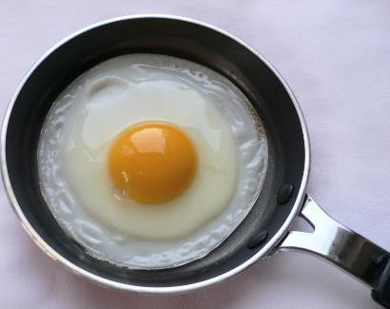
Egg observation and starting investigations
Research:
Eggs
Effect of heat on eggs
Define the term ‘coagulation’
Practical:
Investigate 3 different ways to coagulate eggs.
Take temperature whenever possible
What heat transfer methods did you use?
What changes occurred and why?
Make links to meals that are based on coagulated egg protein?

Slide 12
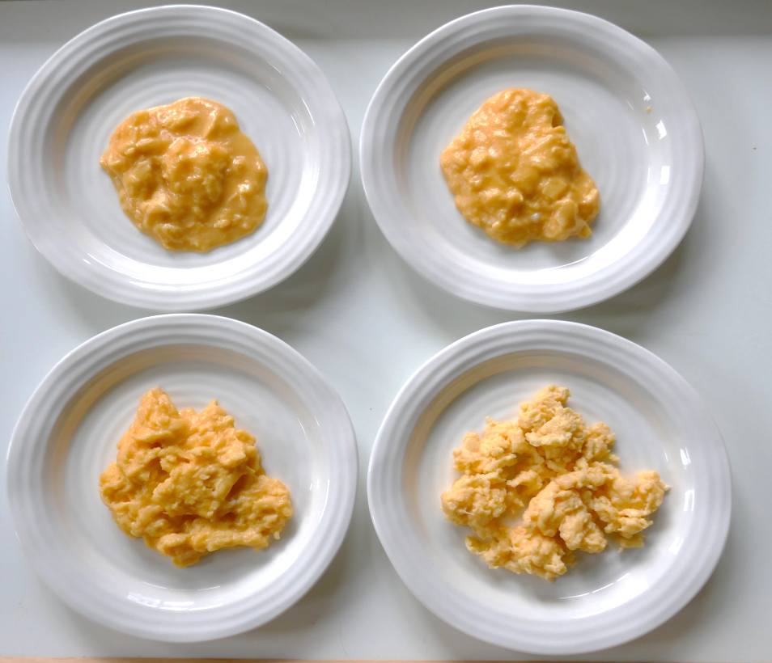
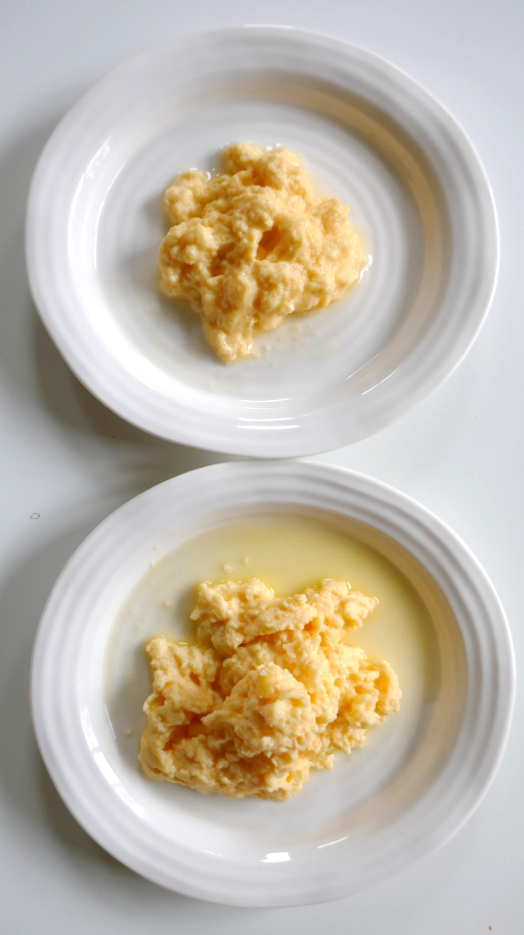
The denaturation process
Scrambled egg with milk
Lightly scrambled
Soft scramble
syneresis
Firm scramble
Over cooked scramble

Slide 13
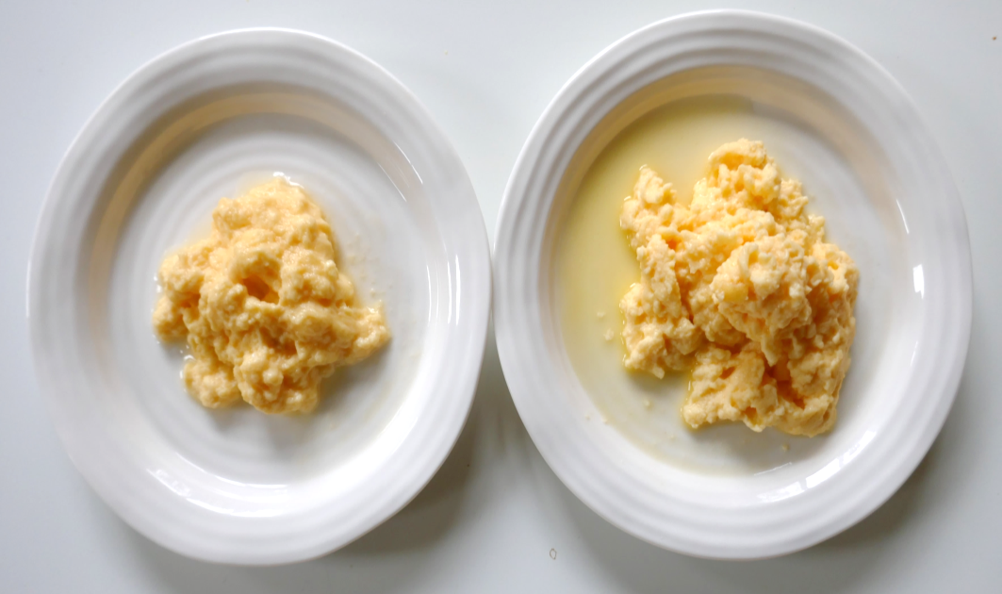
Over-coagulation
Scrambled egg with milk
Denatured protein firstly become more digestible as proteins unfold during cooking
Gradually proteins denature more and become tougher, less digestible
Protein loses functionality in being able to hold a set
Syneresis may occur
syneresis

Slide 14
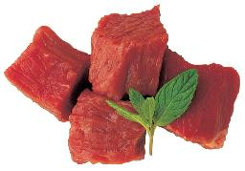
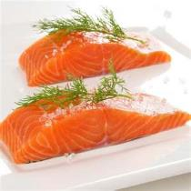
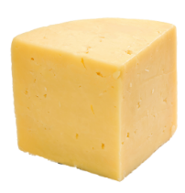
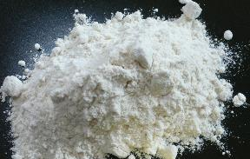

Where else do we see protein denaturation?
Meat cookery
Fish cookery
Cheese cookery
Wheat Flour in baking
Aquafaba

Slide 15
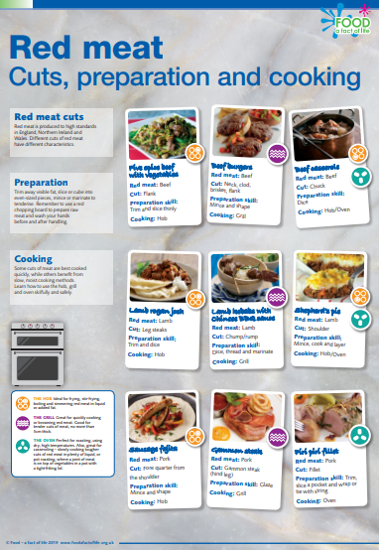
Red meat denaturation
Heat transfer to meat will denature proteins
Tenderisation makes meat proteins easier to digest
Generally slow, moist heat renders tough meat tender in methods such as casserole, stew and gently simmer
Rapid heat such as stir-fry, grill and shallow fry are best for smaller thinner portions of meat
https://www.foodafactoflife.org.uk/11-14-years/food-commodities/meat/posters/

Slide 16
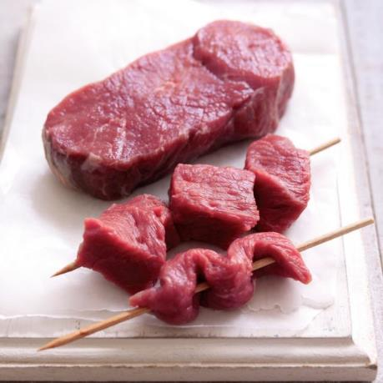
Meat protein denaturation
Meat loses about 30% of its weight during cooking as the proteins denature
Shrinkage of meat on cooking is noticeable
Juices are released
Meat proteins change in colour
Surface colours change

Slide 17
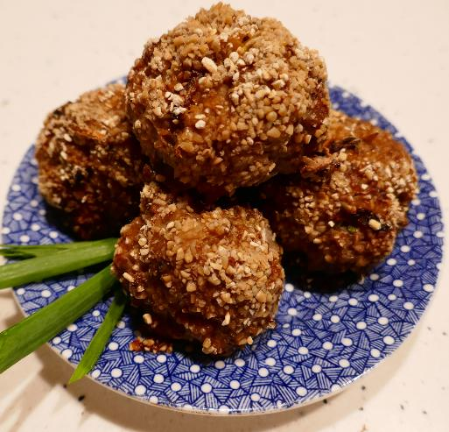
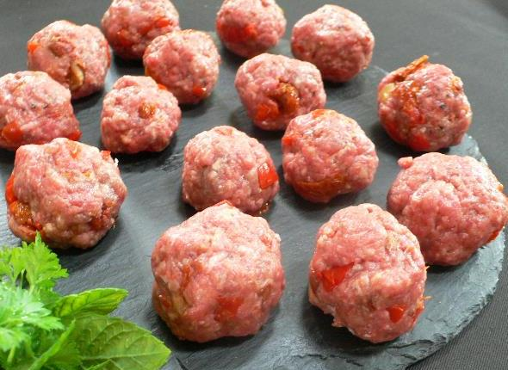
Proteins denature when cooked

Slide 18
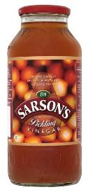
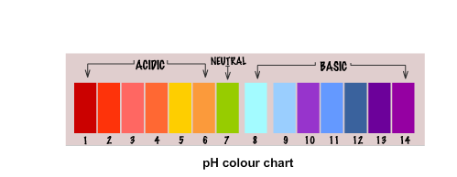
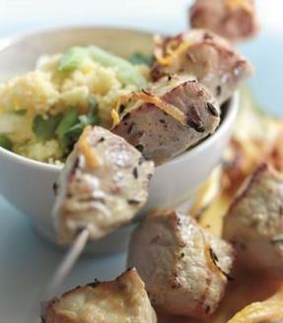
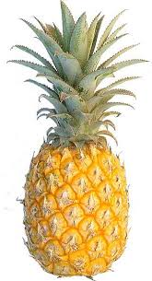
Marinades denature proteins
Marinades contain ingredients with functionality:
Acidic ingredients
contain free hydrogen ions that make them active
Acid ingredients in marinades will denature meat proteins to make meat more tender and other ingredients in the marinade will impart flavour
Enzymatic ingredients provide active enzymes that denature protein
Bromelain is an enzyme in fresh pineapple

Slide 19
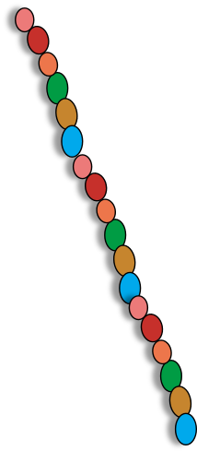

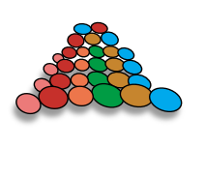
How does a protease work?
Protein enzymes are called
‘proteases’
Protease ready for action in a marinade
Proteases fold up to form specific shapes
Proteases are made up from amino acids in a set sequence

Slide 20
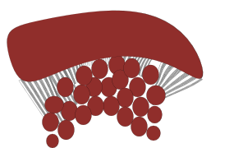
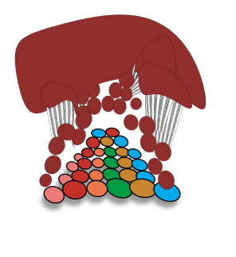
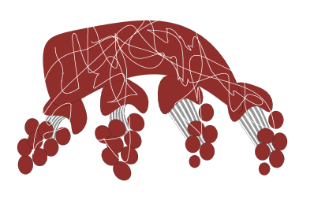
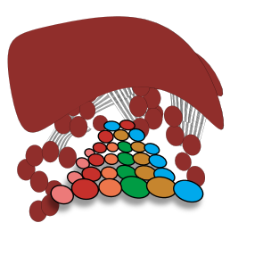
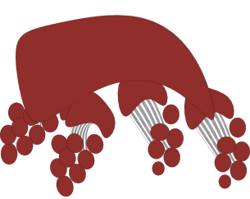


How an enzyme works in a meat marinade
Meat Cubes
Meat cubes in marinade
Tenderised meat cube
Enzymes change the texture of protein in meat
Meat becomes more tender and absorbs some of the marinade giving flavour and colour
1
2
Enzyme reacts with meat cube
3
Enzyme in marinade

Slide 21
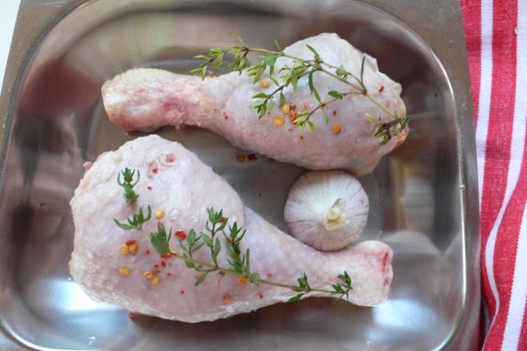
Denaturation of poultry
Popular choice to demonstrate skills
Proteins denature during cooking
Colour changes
Texture changes

Slide 22
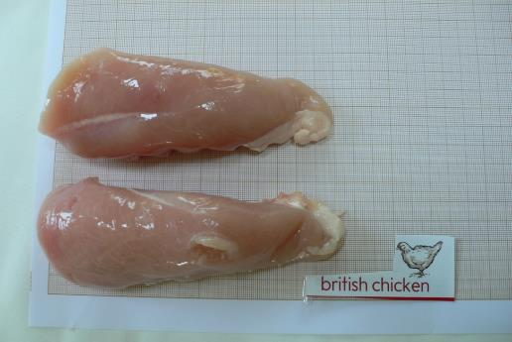
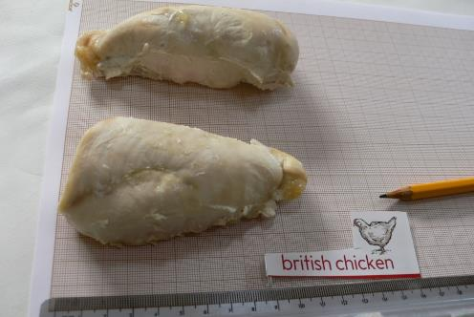
Look for changes from raw to cooked
Before cooking
After cooking

Slide 23
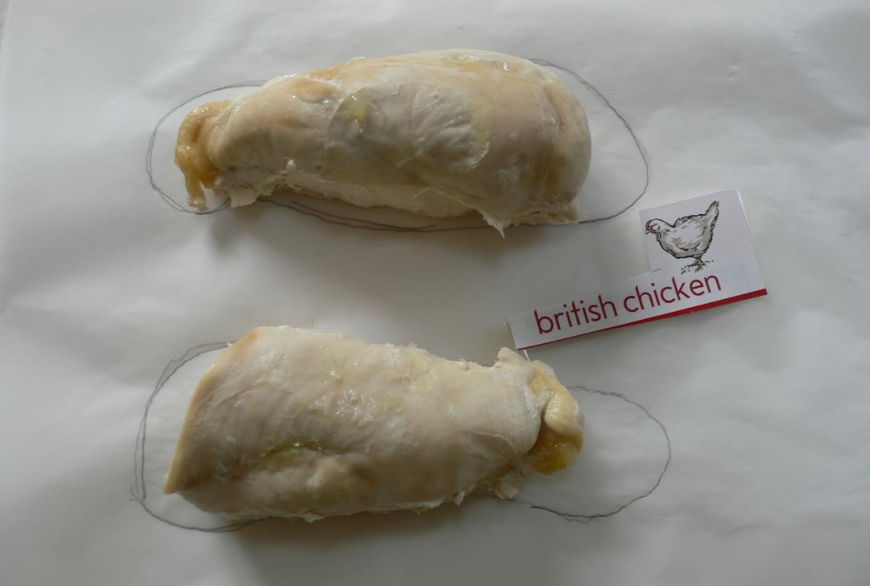
What do you notice?

Slide 24
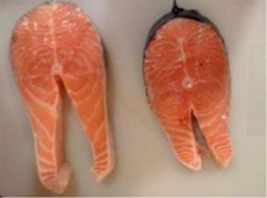
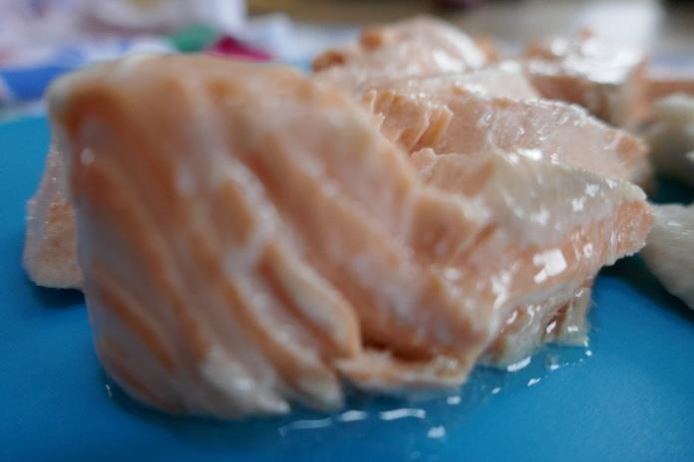
Fish protein denaturation
Fish muscle protein is easily denatured by heat and by acid
Marinades work well on fish portions
A wide range of cooking methods can render fish proteins tender

Slide 25
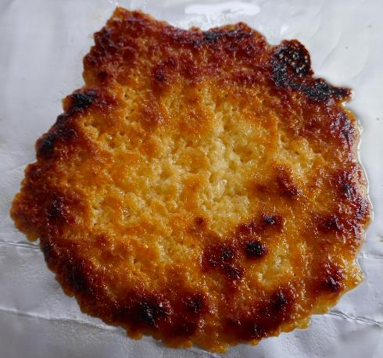
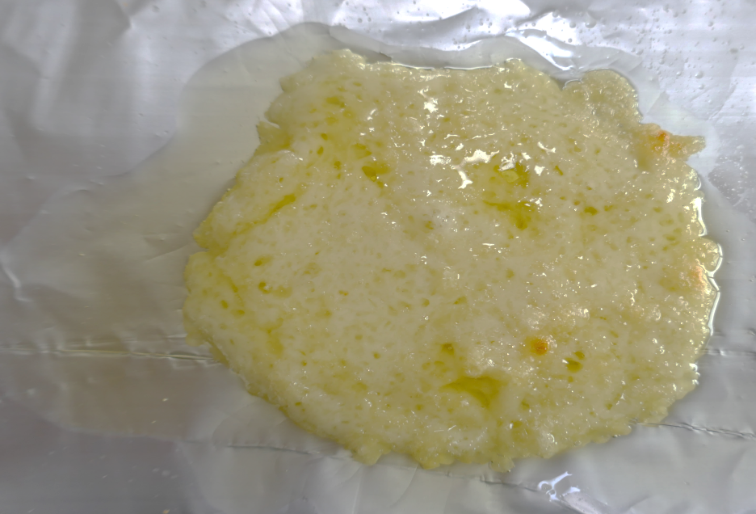
Cheese protein denaturation
Heat applied to hard cheese

Slide 26
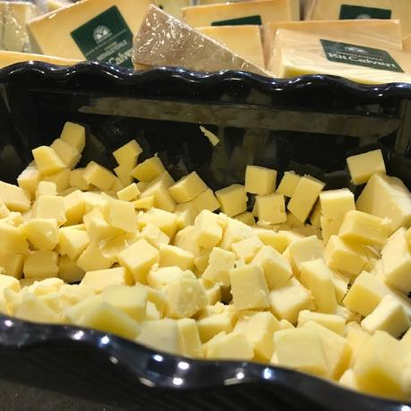
Cheese is denatured milk protein
Cheese is made by curdling proteins
Casein a protein in milk that denatures by coagulation to produce cheese
Paneer cheese is made using ACID from lemon juice to curdle the milk
Most cheeses use rennet, an active enzyme named chymosin, is added to the milk after a starter bacteria.
Rennet speeds up the coagulation of casein and produces a stronger curd at a lower acidity, which is important for some types of cheese.

Slide 27
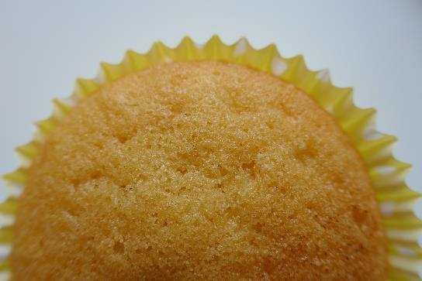
Wheat flour in baked goods
Wheat flour contains proteins glutenin and gliadin
Together these form gluten in when liquid is added to form a dough or cake mix
Heat denatures gluten to form rigid structures that hold the risen and cooked shapes of many products such as breads, pastries, biscuits and scones

Slide 28
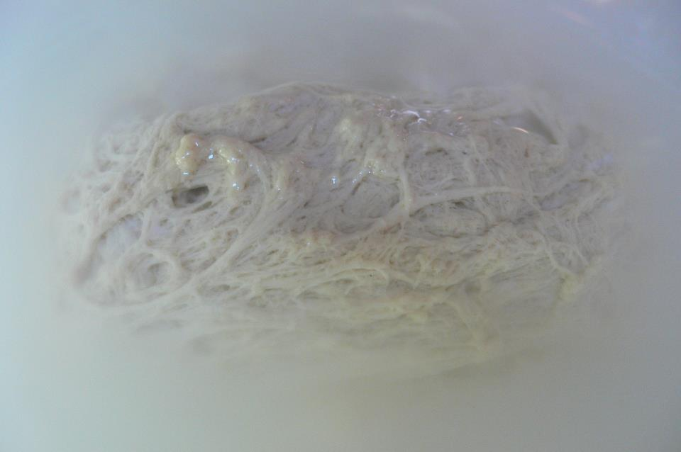
Washing away the starch from a dough helps you see the grey colour of the gluten.

Slide 29
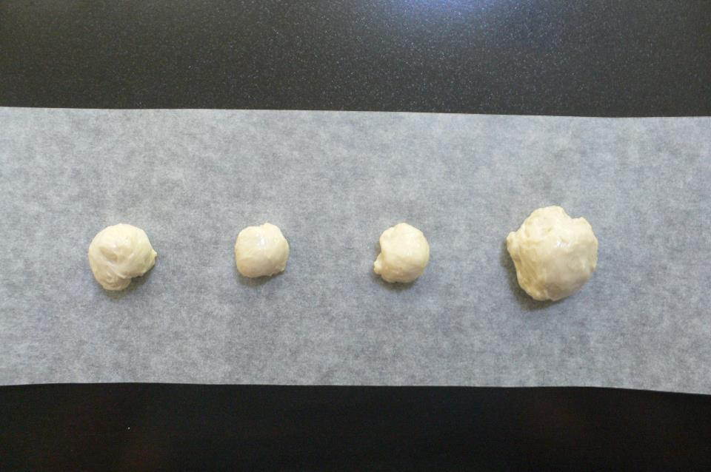
These tiny balls of gluten , the size of your little fingernail, are ready to be cooked.

Slide 30
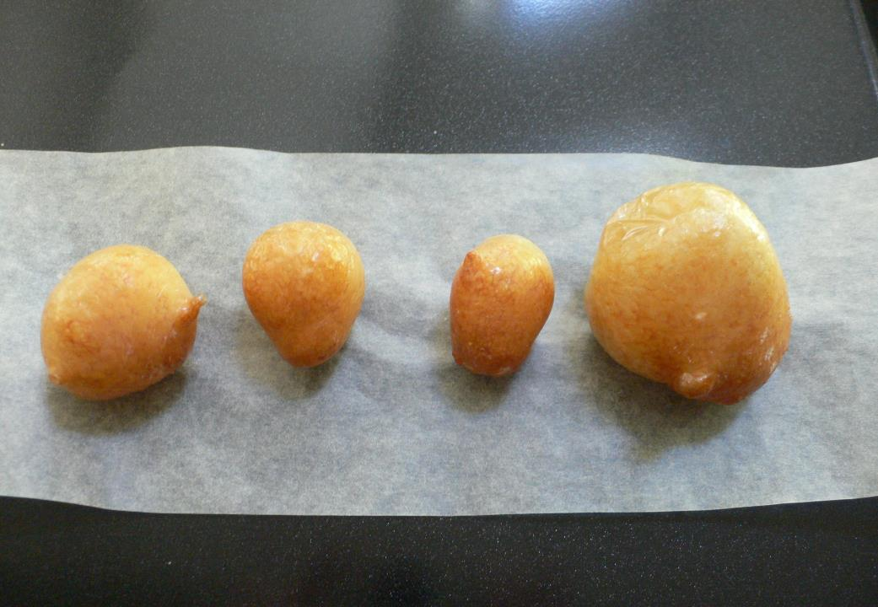
Cook the gluten in a hot oven for about 8 – 10 minutes. Smell it and feel it.

Slide 31
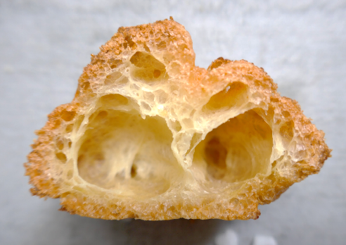
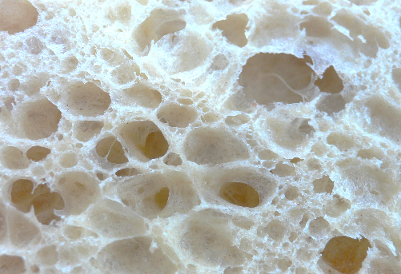
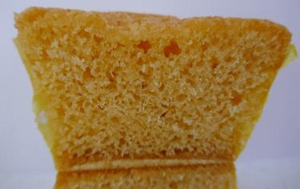
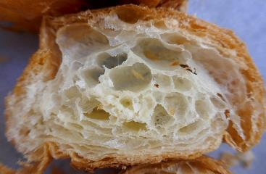

Structural characteristics of gluten
Choux pastry
White bread
Creamed cake
Puff pastry
Croissant

Slide 32

Whisking egg white protein
Egg proteins form a structure
Globular protein unravels
Proteins reform cross links
Air is trapped – Foam is formed
Proteins denatured by agitation
Further denatured by heat
Texture changes occur

Slide 33


Aquafaba – chickpea protein
Aquafaba, or bean water, is the cooking liquid from chickpeas and other legumes
Naturally full of proteins and saponin (surface active agents)
Can be whipped up like egg white.
Useful for vegan meringues, mayonnaise and so on.

Slide 34



Bean water can function as egg replacer
Whisked bean water with sugar
Whisked bean water
Meringues made with beanwater

Slide 35





Resources
www.thecookeryteacher.com
Every recipe has
‘Cooks Know How’
www.foodafactoflife.org.uk
You can access all the webinars on the new website
Be sure to sign up for Food - a fact of life newsletter – so much information
Websites:
www.sciencelearn.org
www.epicurious.com
IFST https://www.ifst.org/lovefoodlovescience
BOOKS: Use the range of textbooks and revision guides
https://winterfood-science-tutorials123.eventbrite.co.uk

Slide 36





Further information and resources
https://www.foodafactoflife.org.uk/11-14-years/cooking/ingredients/

Slide 37
For further information, go to:
www.foodafactoflife.org.uk

