Slide 1

Schemes of Work and lesson planning
5 February 2019

Slide 2
Schemes of Work and lesson plans
Roy Ballam
British Nutrition Foundation

Slide 3

Objectives
Using the National Curriculum in England as an example, Roy will explain the importance of planning Schemes of Work and lessons that meet curriculum requirements, demonstrate progression and allow for differentiation, but also enable stretch and challenge. From curriculum statements to classroom practice – mapping the learning journey.
Identifying progression from 5 to 14 years.
Developing a Scheme of Work and lesson plans.
Different pedagogical approaches (including Bloom’s Taxonomy).
Links to Food – a fact of life resources.
Suggestions for further reading and sources of information.

Slide 4

Russian dolls

Slide 5
From curriculum to classroom
Curriculum >
Key Stage >
Knowledge and skills
Progression
Year >
Prior learning and experiences
Splitting content over years of teaching, ensuring progression
SoW >
Lessons >
Aims for the year and learning outcomes
Effective lessons
Show progress
Differentiation
In the classroom >
Evaluate
Feedback

Slide 6


Helicopter view

Slide 7
Cooking and nutrition – top line progression
Key stage 1 Pupils should be taught to: | Key stage 2 Pupils should be taught to: | Key stage 3 Pupils should be taught to:
use the basic principles of a healthy and varied diet to prepare dishes. | understand and apply the basic principles of a healthy and varied diet. | understand and apply the principles of nutrition and health.
 | prepare and cook a variety of predominantly savoury dishes using a range of cooking techniques. | cook a repertoire of predominantly savoury dishes so that they are able to feed themselves and others a healthy and varied diet. become competent in a range of cooking techniques
understand where food comes from. | understand seasonality, and know where and how a variety of ingredients are grown, reared, caught and processed. | understand the source, seasonality and characteristics of a broad range of ingredients.

Slide 8

Unpack the curriculum
What do these statements mean over time?
What knowledge and skills should be included?
What are the key building blocks (concepts)?
Is there an emphasis on certain concepts, do these change over the Years?
How is progression shown? (Once key concepts are established?)

Slide 9
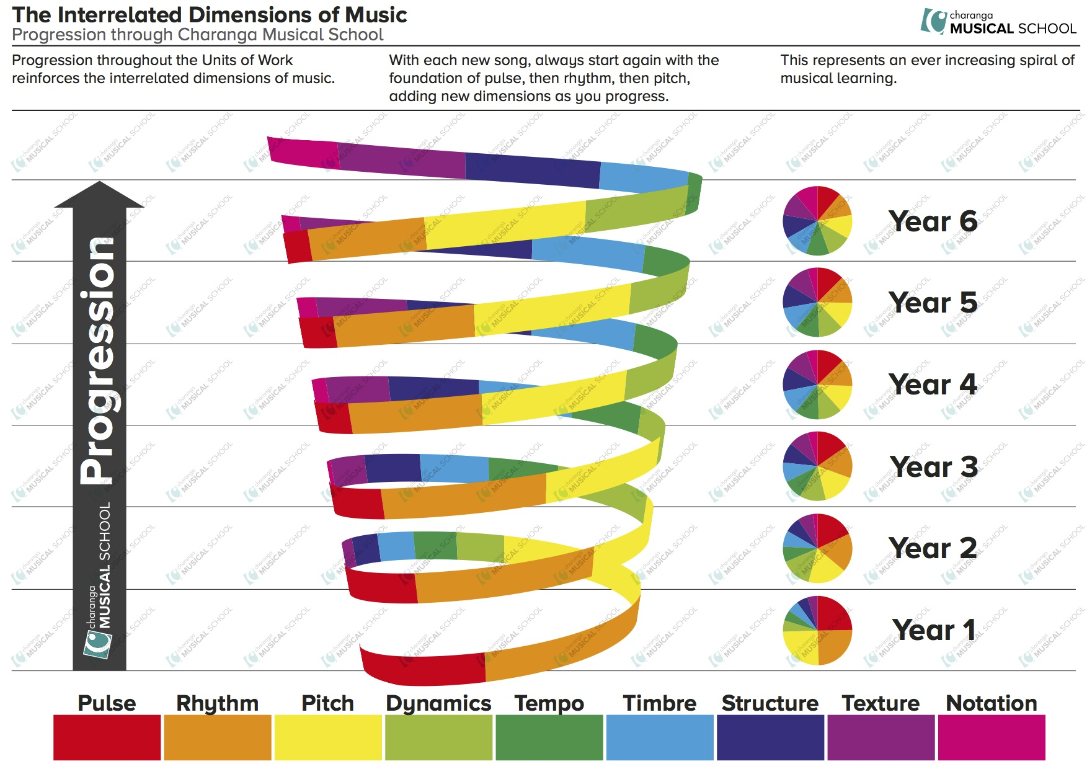
What are the food building blocks?
Healthy eating
Cooking
Food provenance
Food safety
Consumer awareness
Food commodities
Food science
Sensory work
Other?

Slide 10

Haven’t we done this before?
Key stage 3 Pupils should be taught to:
understand and apply the principles of nutrition and health.
cook a repertoire of predominantly savoury dishes so that they are able to feed themselves and others a healthy and varied diet. become competent in a range of cooking techniques.
understand the source, seasonality and characteristics of a broad range of ingredients.
Year 7
Year 8
Year 9
Extend
Year 7
Year 8
Consolidate
Year 9
Year 7
Introduce
Year 8
Year 9

Slide 11

Scheme of Work (Key Stages ….)
Consider the learning that must take place over each of the Key Stages.
Are there other elements you need to include, e.g. competences, food safety and hygiene?
Can the learning be easily broken into the Years?
What differentiates each Year?
How can you build on previous relevant knowledge from Year to Year?
Consider the amount of practical work required.
Do you need to consider school formats/expectations?
How much detail do you need to provide?
Is pupil voice considered?
Have you considered your knowledge and skills?

Slide 12
Key concepts: where food comes from
Pupils should be taught to:
understand where food comes from;
understand seasonality, and know where and how a variety of ingredients are grown, reared, caught and processed;
understand the source, seasonality and characteristics of a broad range of ingredients.
Consequences of choice (seasons and source)
Quality, standards and types of production
Food production and processing (different food)
Food origins / The seasons
Plants and animals

Slide 13
Key concepts: healthy eating
Pupils should be taught to:
use the basic principles of a healthy and varied diet to prepare dishes.
understand and apply the basic principles of a healthy and varied diet.
understand and apply the principles of nutrition and health.
Dietary needs and health (ages and stages, special diets)
Energy and nutrients (source, function and amount)
The eatwell guide and 8 top tips for healthy eating
5 A DAY
Food and drinks

Slide 14
Key concepts: cooking
Pupils should be taught to:
use the basic principles of a healthy and varied diet to prepare dishes;
prepare and cook a variety of predominantly savoury dishes using a range of cooking techniques;
cook a repertoire of predominantly savoury dishes so that they are able to feed themselves and others a healthy and varied diet; become competent in a range of cooking techniques.
Food skills (basic …. extend … practice … become proficient)
Equipment (basic … extend … cooker … electrical tools … practice … become proficient)
Recipe choice to support learning objectives
Accuracy and precision … Safety & hygiene > Complexity > Combination of skills …
Eatwell Guide … Savoury … Variety and cuisines … Creativity … People

Slide 15
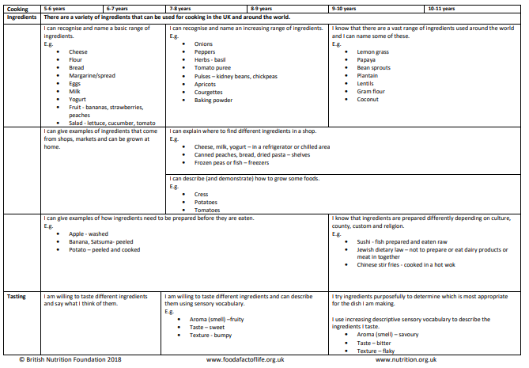
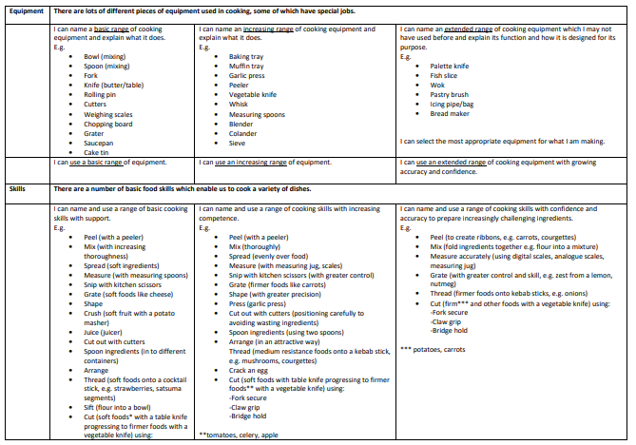
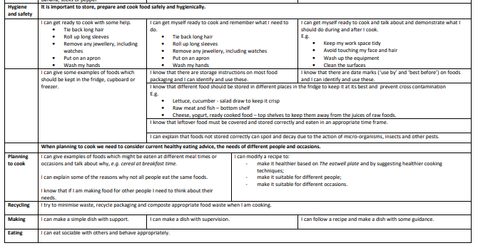
Progression of food skills

Slide 16
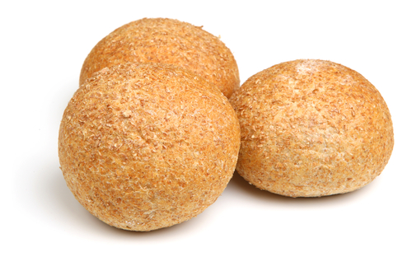
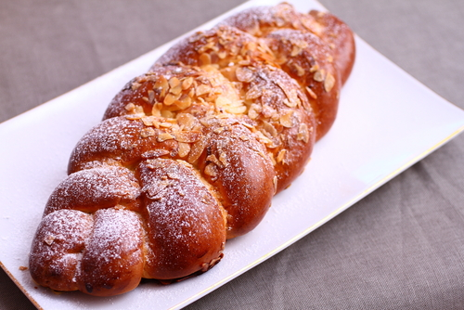
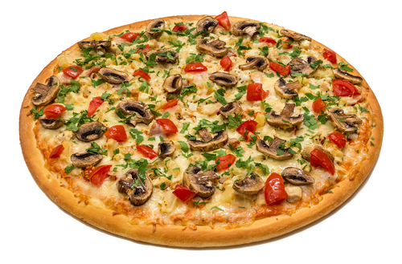
Progression of food skills
Bread rolls
Weighing & measuring
Mixing
Kneading
Shaping
Baking
Fruit plait
As before, plus …
Adding dried fruit
Mixing in spice
Plaiting
Glazing
Pizza / Calzone
As before, plus …
Sauce making
Vegetable preparation
Decorating
Grating
?

Slide 17
Theme for a Year?
Familiar
Less familiar
Help to focus and put into context?
For example …
All about me (the pupil / individual)
Friends and family (different occasions)
Others, dietary restrictions or concerns (Out of home)

Slide 18
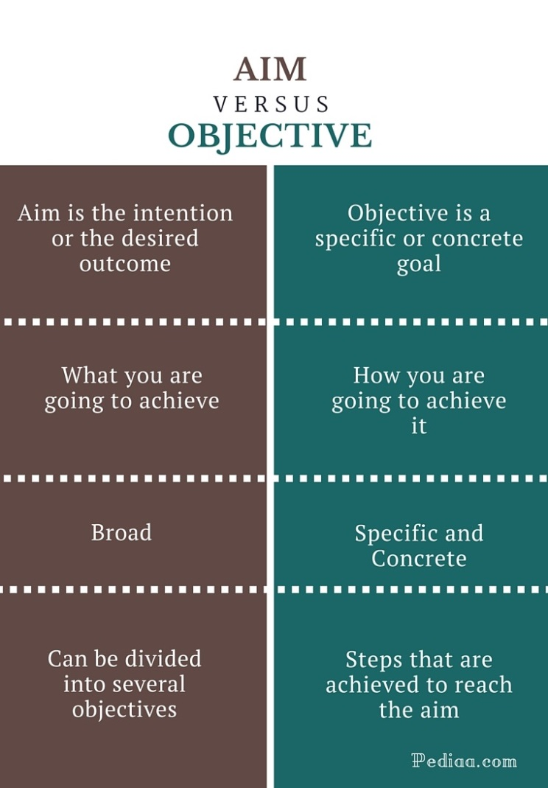
SoW – What’s in it?
Key Stage and Year Group
Time allocation, e.g. 18 hours
Introduction: main theme/rationale for Year
Aims: what will pupils be able to do? Broad terms. Apply knowledge to make informed decisions … Develop practical skills …
Learning outcomes: statements that define measurable outcomes. List The Eatwell Guide food groups; adapt and follow recipes ; describe and apply food hygiene messages

Slide 19

SoW – What’s in it?
Prior learning, e.g. build on early years, Key Stage 1 or 2
Resources
Risk assessment
Differentiated learning outcomes
All pupils will: Carry out 10 hours practical cooking, making a range of basic dishes.
Most pupils should: Carry out with skill and accuracy 10 hours practical cooking, making a range of dishes.
Some pupils could: Independently, with skill and accuracy carry out 10 hours practical cooking, making a range of dishes.
Curriculum coverage, e.g. D&T (C&N), English, maths, science and other areas

Slide 20
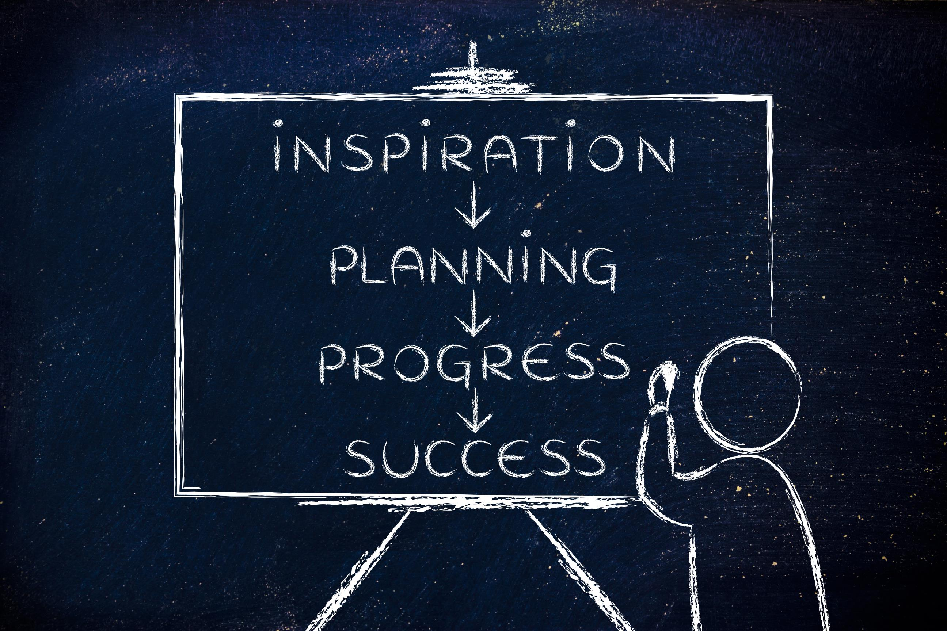
Lesson plans
Consider lessons as part of the bigger plan (SoW).
How many lessons? Consider sequence of lessons. How do they build? Do they recap/consolidate?
Pedagogy – teaching and learning styles.
Look at flow of lessons over the Year – does it meet the SoW?
What happens if pupils miss a lesson?
Ratio of ‘theory’ to ‘practical’ to achieve desired learning.
Assessment?

Slide 21
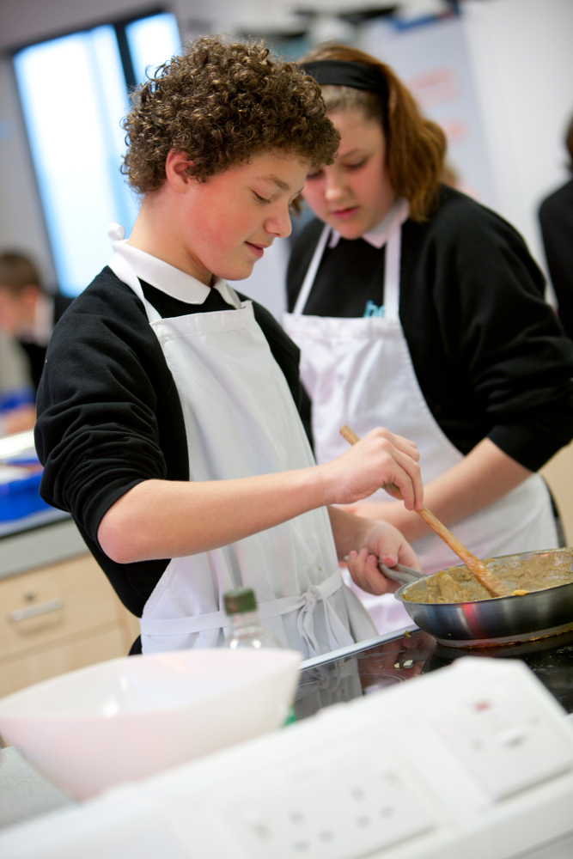
Practical lessons
How do we decide on what pupils make?
Focus on SoW and Learning outcomes/objectives.
Does it support progression? (Food skills chart)
Consider appropriateness of recipe for Year group / lesson. (For example, knowledge of room & procedures, motor skills, use of cooker, sharp equipment, accuracy, time management …)
What skills and knowledge is the recipe providing? Opportunities.
Does it support the drive for predominately savoury recipes, as well as the principles of a healthy, varied diet?

Slide 22


Effective pedagogy approaches?
Effective pedagogies give serious consideration to pupil voice.
Effective pedagogies depend on behaviour (what teachers do), knowledge and understanding (what teachers know) and beliefs (why teachers act as they do).
Effective pedagogies involve clear thinking about longer term learning outcomes, as well as short-term goals.
Effective pedagogies build on pupils’ prior learning and experience.
Effective pedagogies involve scaffolding pupil learning.
https://assets.publishing.service.gov.uk/government/uploads/system/uploads/attachment_data/file/329746/what-makes-great-pedagogy-nine-claims-from-research.pdf

Slide 23


Effective pedagogy approaches?
6. Effective pedagogies involve a range of techniques, including whole-class and structured group work, guided learning and individual activity.
7. Effective pedagogies focus on developing higher order thinking and metacognition, and make good use of dialogue and questioning in order to do so.
8. Effective pedagogies embed assessment for learning.
9. Effective pedagogies are inclusive and take the diverse needs of a range of learners, as well as matters of student equity, into account.
https://assets.publishing.service.gov.uk/government/uploads/system/uploads/attachment_data/file/329746/what-makes-great-pedagogy-nine-claims-from-research.pdf

Slide 24
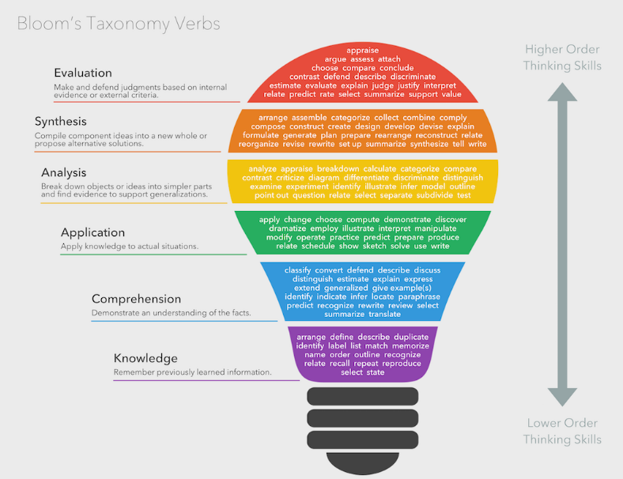

Slide 25
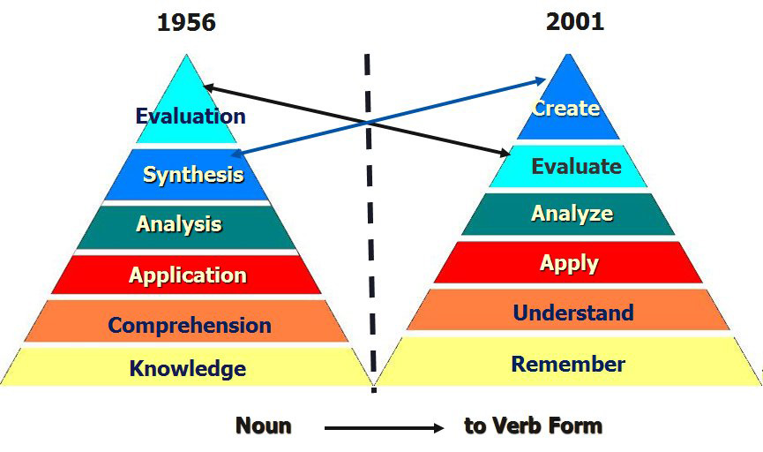

Slide 26
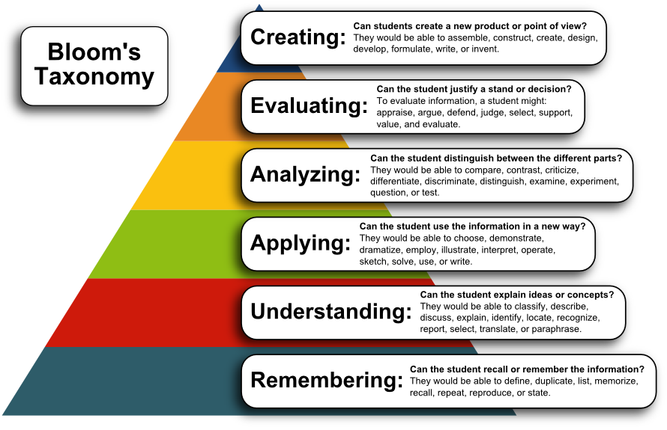

Slide 27
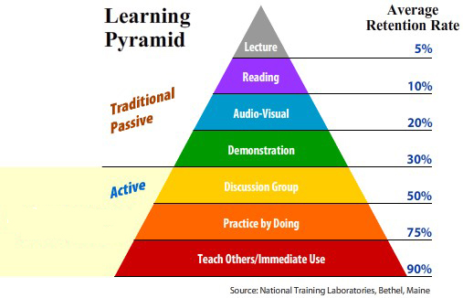

Slide 28
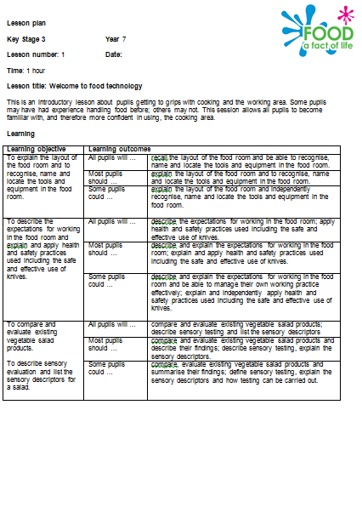
Lesson plans – structure
Key Stage / Year Group
Lesson number
Time available, e.g. 60 mins
Lesson title
Learning objectives (differentiated?)
All pupils will …
Most pupils should …
Some pupils could …

Slide 29
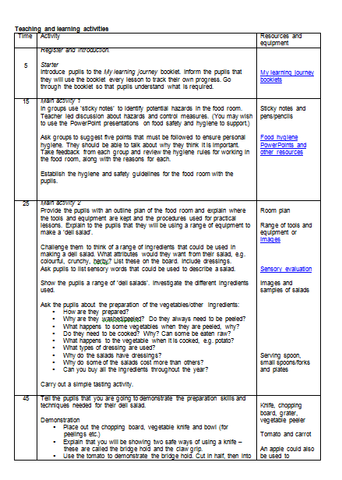
Lesson plans – structure
Lesson overview
Time – key timings throughout the lesson
Activity – main teaching and learning; key tasks; key questions; hazards;
Resources and equipment – hyper links to worksheets/presentations/recipes, equipment needed for lesson.
Homework
Extension activity

Slide 30
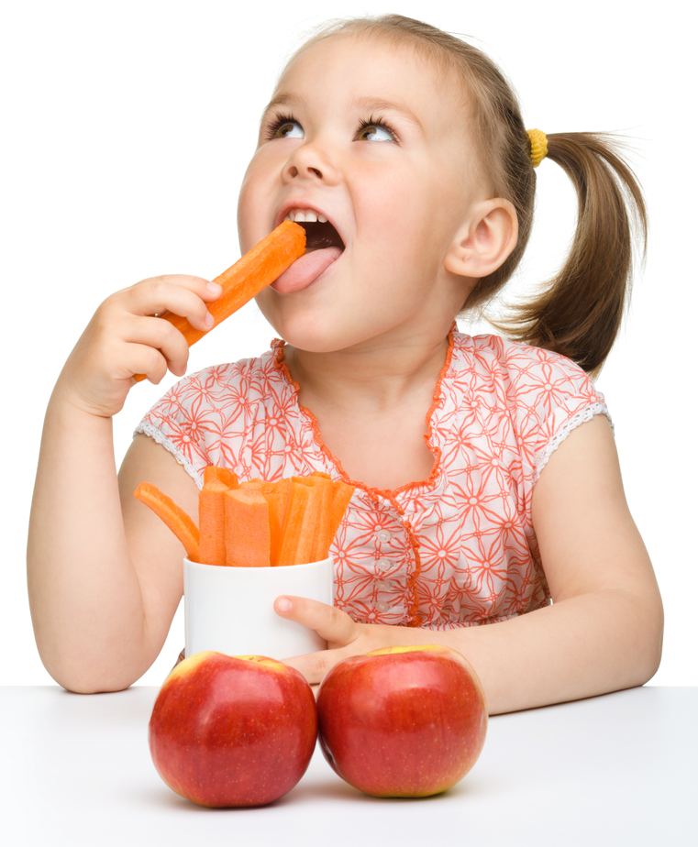
Summary
Map out key concepts (food building blocks), supporting progression.
Schemes of Work and lesson planning – create, use, evaluate, update …
Practical work – focus on learning objectives, not recipes.
Be aware of pedagogical approaches – consider your skills and knowledge, teaching environment and learning styles.
Look at examples from organisations and other schools – but make it your own (your school may have a format it prefers).

Slide 31
Sources of further information
National Curriculum https://www.gov.uk/government/collections/national-curriculum
Competences https://www.nutrition.org.uk/foodinschools/competences.html
Food – a fact of life (FFL – primary progression)
http://archive.foodafactoflife.org.uk/attachments/24aaa70d-ad1b-40d3df656705.pdf
FFL SoW and Lessons
https://www.foodafactoflife.org.uk/5-7-years/activity-packs/schemes-of-work/
http://www.foodafactoflife.org.uk/11-14-years/schemes-of-work/
Licence To Cook materials http://www.foodafactoflife.org.uk/11-14-years/cooking/licence-to-cook/
Teacher Toolkit (5 min lesson plans) https://www.teachertoolkit.co.uk/5minplan/
D&T Association (progression frameworks) https://www.data.org.uk/for-education/curriculum/dt-national-curriculum-for-england-2014/

Slide 32
For further information, go to:
www.foodafactoflife.org.uk

