Slide 1
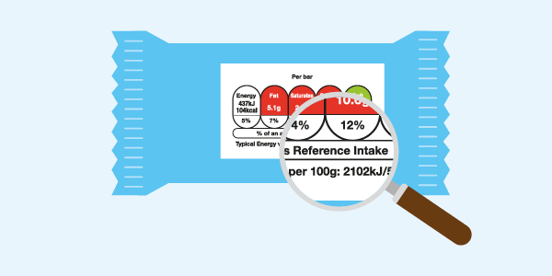
Food labelling – understanding front of pack nutrition labelling
23 January 2019

Slide 2

Food labelling – understanding front of pack nutrition labelling
Hannah Skeggs Anutr – Nutrition & Scientific Affairs Manager
Wednesday 23rd January 2019
© IGD 2019

Slide 3

Agenda
Discover the best ways to talk about front-of-pack nutrition labels
1
Are labels mandatory or important?
2
What does consumer research show?
3
How can we teach comprehension of FOP labelling?
4
Further reading and resources
© IGD 2018
Page 3

Slide 4

Who are IGD?
IGD is a research and training charity which sits at the heart of the food and grocery industry
We collaborate with industry to encourage healthier eating across the UK
We believe we are uniquely placed to enable healthier diets across the nation….
© IGD 2017
Page 4
Notes:
4

Slide 5
Nutrition information on pack – Background

Slide 6
A brief history of food labels in the UK
2005
IGD reviewed and extended the 1998 GDAs & published best practice guidance
2012
New EU regulation on Food Information to Consumers was published
1998
Guideline Daily Amounts were developed
1979
EU General Labelling Directive
1991
Experts & COMA set Dietary Reference Values
2004
The government called for clearer food labelling to reduce obesity
2007
EU consumer policy strategy stated consumers need access to clear, consistent, evidence based nutrition information

Slide 7
Nutrition information on pack – the rules

Slide 8
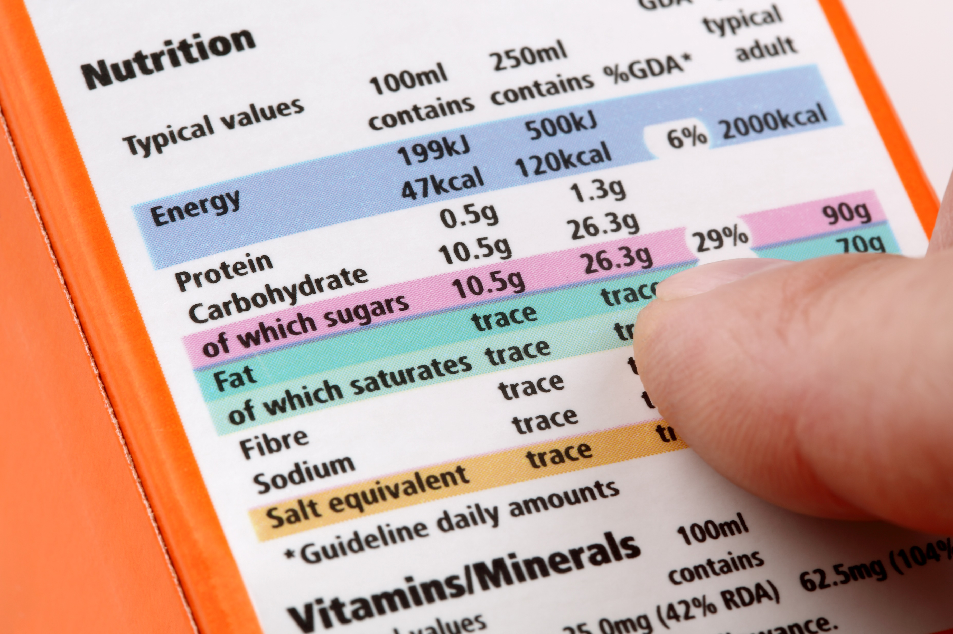
Food information to consumers regulation
Information required by the Regulation (on the labels of pre-packed food and drink products):
Name of food or drink
List of ingredients (including additives and allergens)
Weight or volume
Date mark
Storage and preparation conditions
Name and address of the manufacturer, packer or seller
Country of origin and place of provenance
Nutrition information
Notes:
8

Slide 9

What about Front of Pack labelling?
FOP Nutrition Labelling or ‘traffic light’ labelling is voluntary in the UK and was introduced in 2013
It is present on
2/3
packaged food and drink products
(DoH, 2018)
Notes:
9

Slide 10
IGD’s consumer research and outcomes

Slide 11




Consumer Research
Desk based research
Instore interviews and eye-tracking
Focus groups & message testing
Shopper surveys and comprehension testing
We have INVOLVED OVER 7,700 CONSUMERS IN OUR RESEARCH SO FAR…

Slide 12
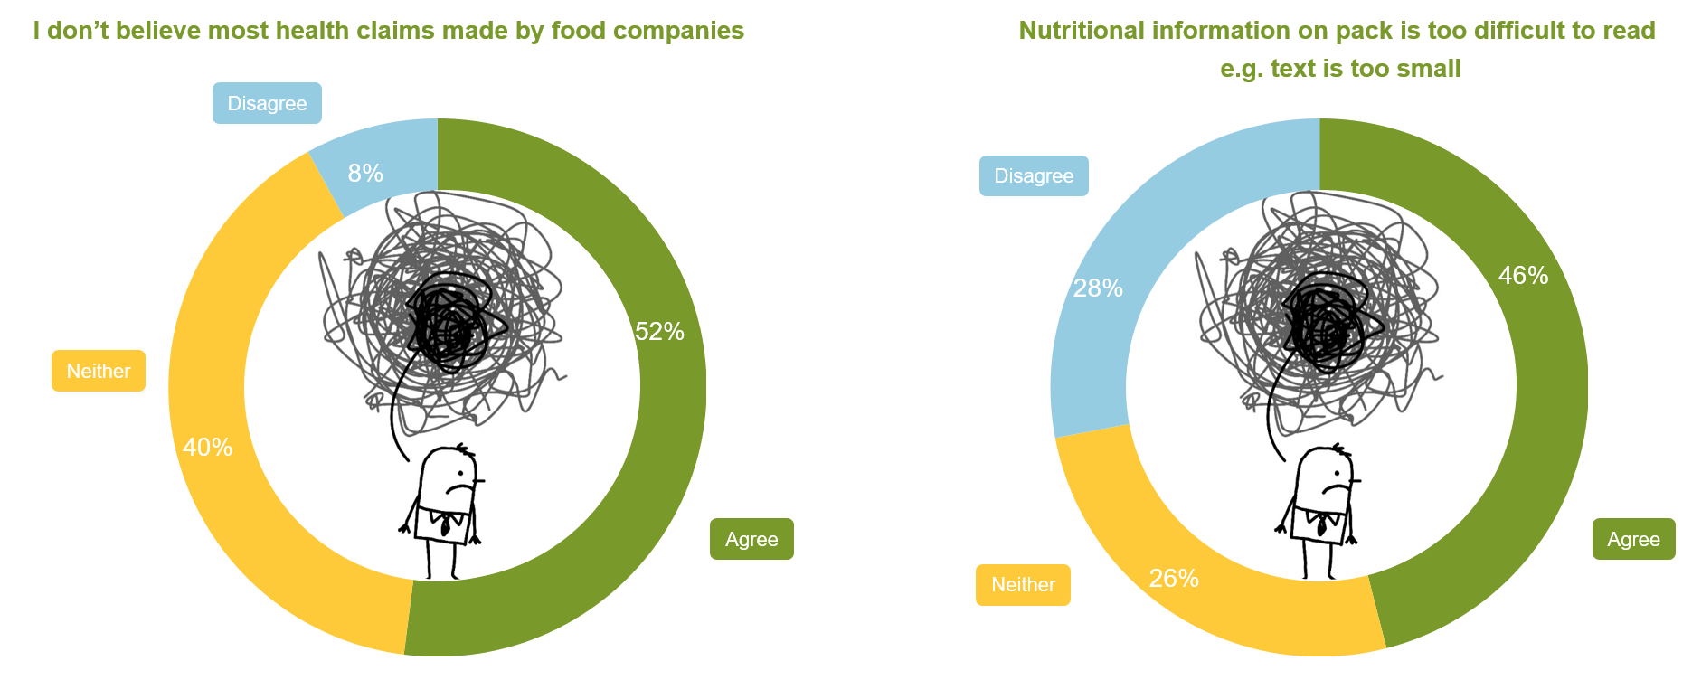
Shoppers confused and sceptical about labelling
Base: 1,721 British grocery shoppers, Apr’17
Notes:
12

Slide 13
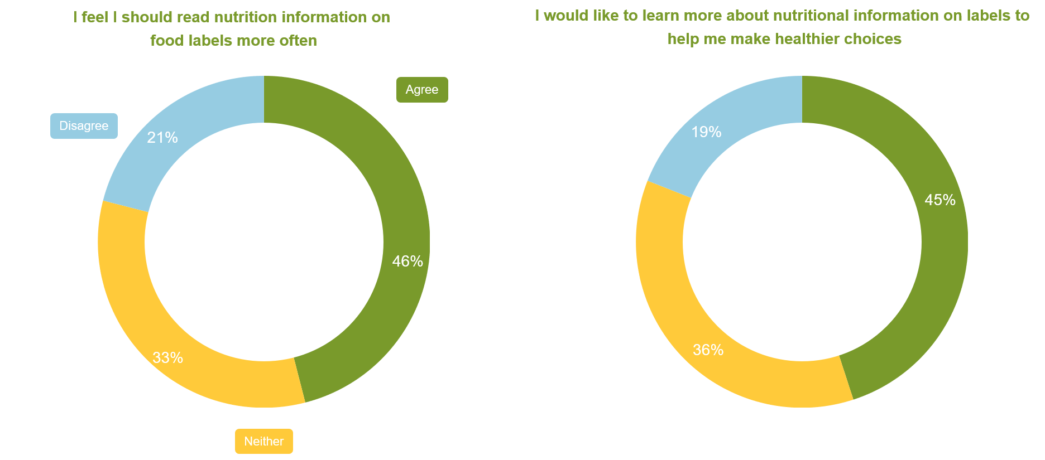
However, there is appetite to use nutrition labels more
Base: 1,727 British grocery shoppers, May’17
Notes:
13

Slide 14
What’s helpful about current labelling?
Which of the following pieces of information, on the front of food/drink packages, do you find most helpful when determining if a product is a healthy choice?
Base: 1,727 British grocery shoppers, May’17
Notes:
14

Slide 15
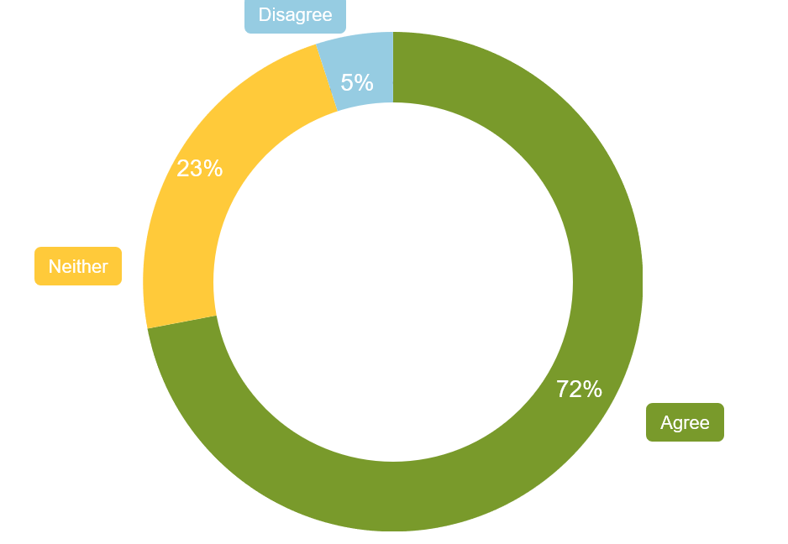
Majority of shoppers looking for consistency
72% of shoppers agree with the following statement:
It would be easier to understand food labels if they were consistently displayed across all products
Notes:
15

Slide 16
Around half claim to have looked at nutritional labels in last three months
Source: IGD ShopperViata, Interim results, November 2018
Notes:
16

Slide 17
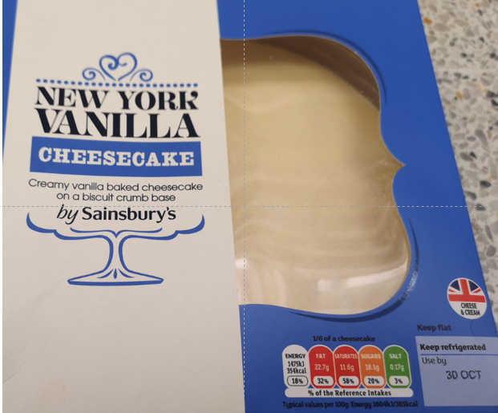
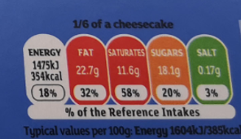
1 in 4 are not understanding portion size labelling
Please look at the image of the cheesecake below, using the information provided, how many recommended servings are there in the pack?
Source: IGD ShopperViata, Interim results, November 2018
Notes:
17

Slide 18
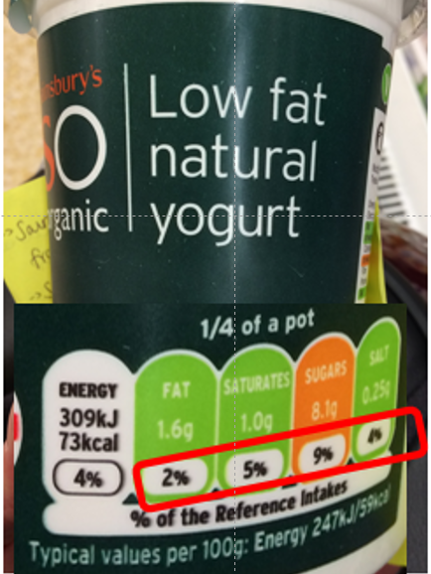
6 in 10 are not fully understanding reference intakes
Please look at this product. What are the % on front of pack showing?
Source: IGD ShopperViata, Interim results, November 2018
Notes:
18

Slide 19
Messages to improve comprehension of food labels

Slide 20
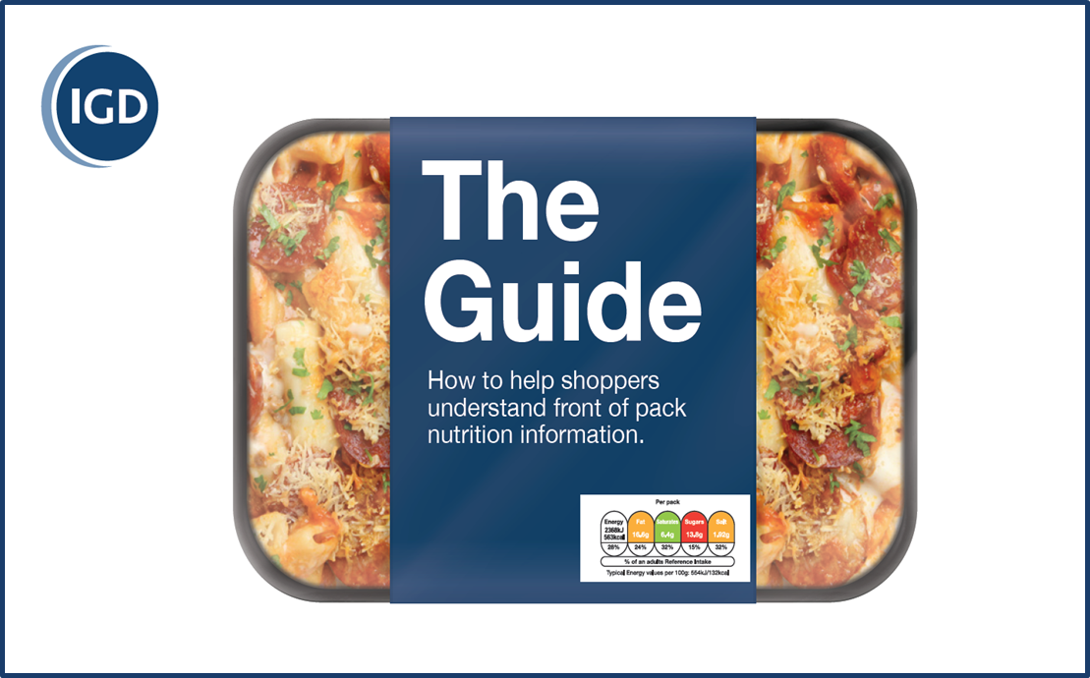
Tackling confusion through education
Set of explanatory messages to help tackle biggest areas of consumers confusion:
Portion size
Energy/calories
Reference Intake
Colour coding
Worked with:
Marketing agencies, research agency, behaviour change experts and nutritionists
Consulted with: Industry, NGOs, HCPs and Government

Slide 21
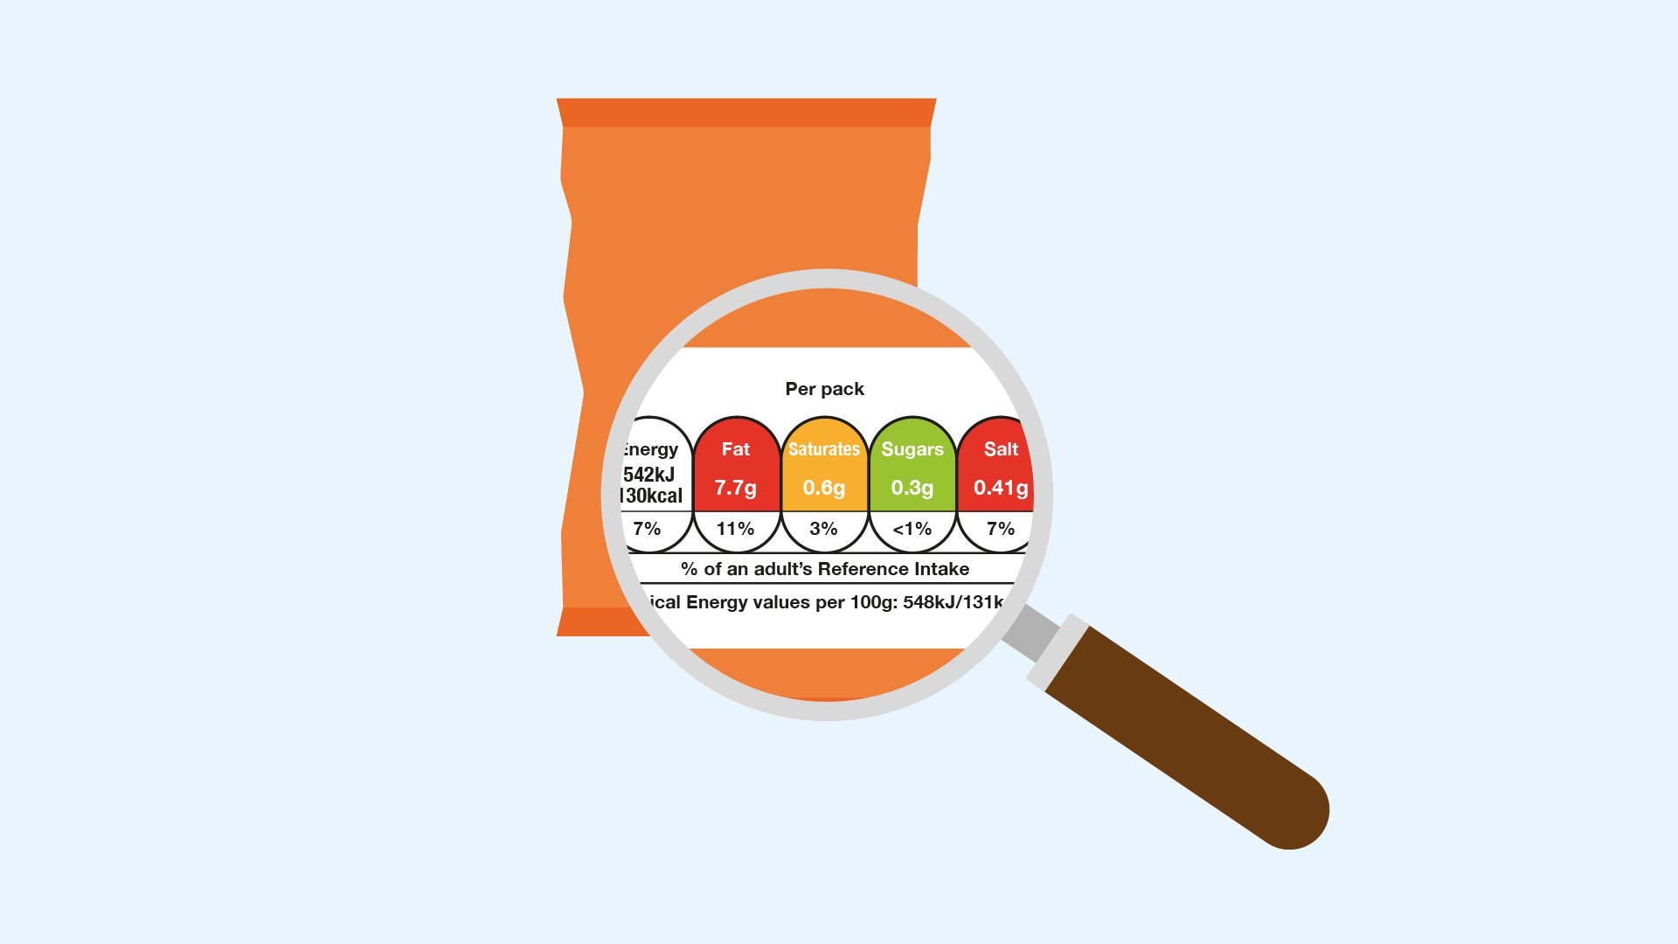
Know your label
Checking the nutrition label is a good way to compare products, make healthier choices and eat a balanced diet
© IGD 2019
Page 21

Slide 22
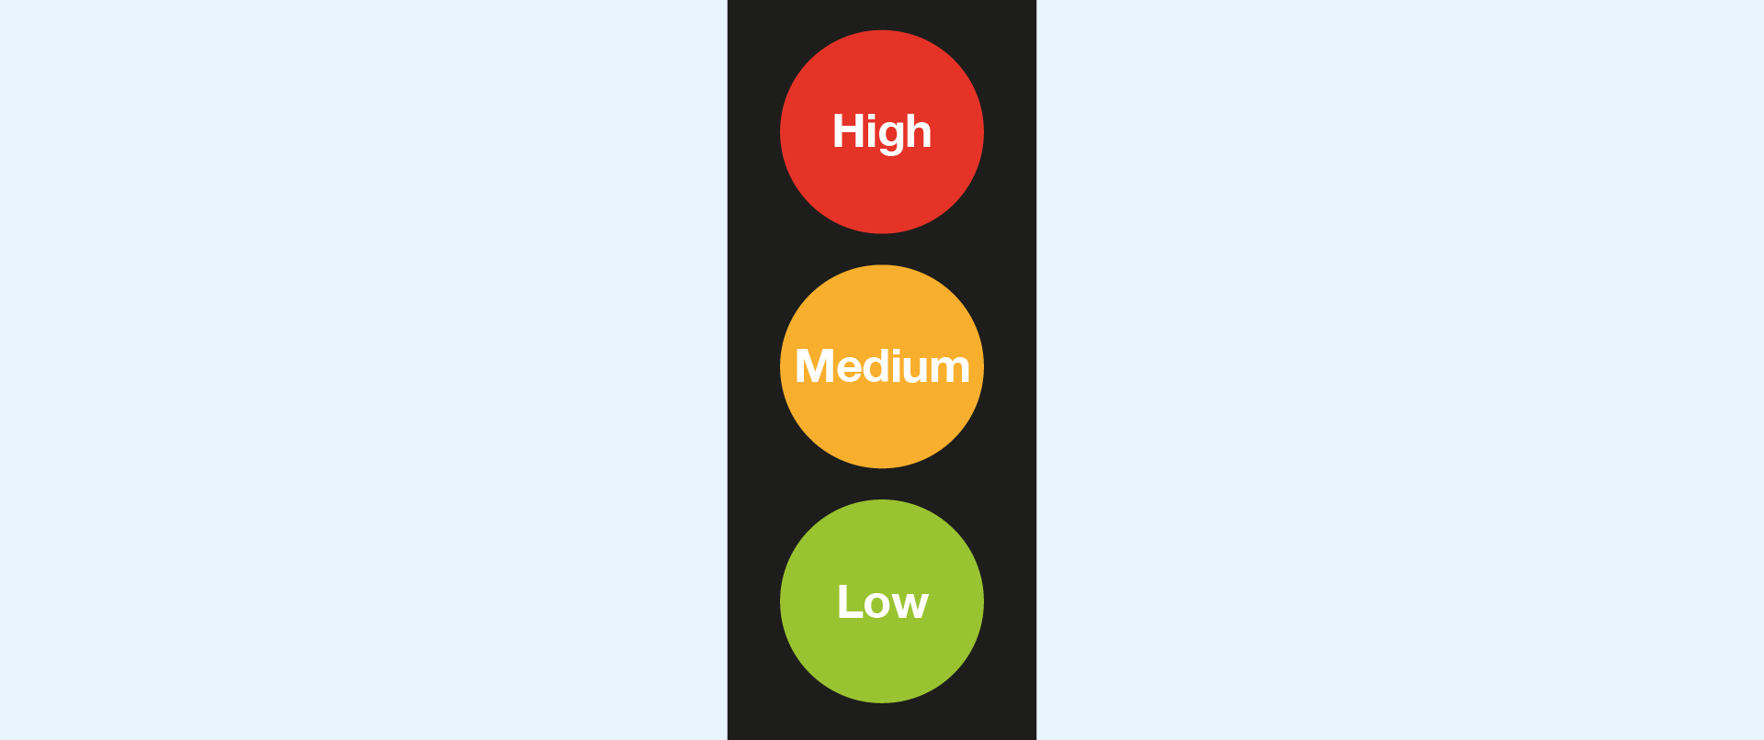
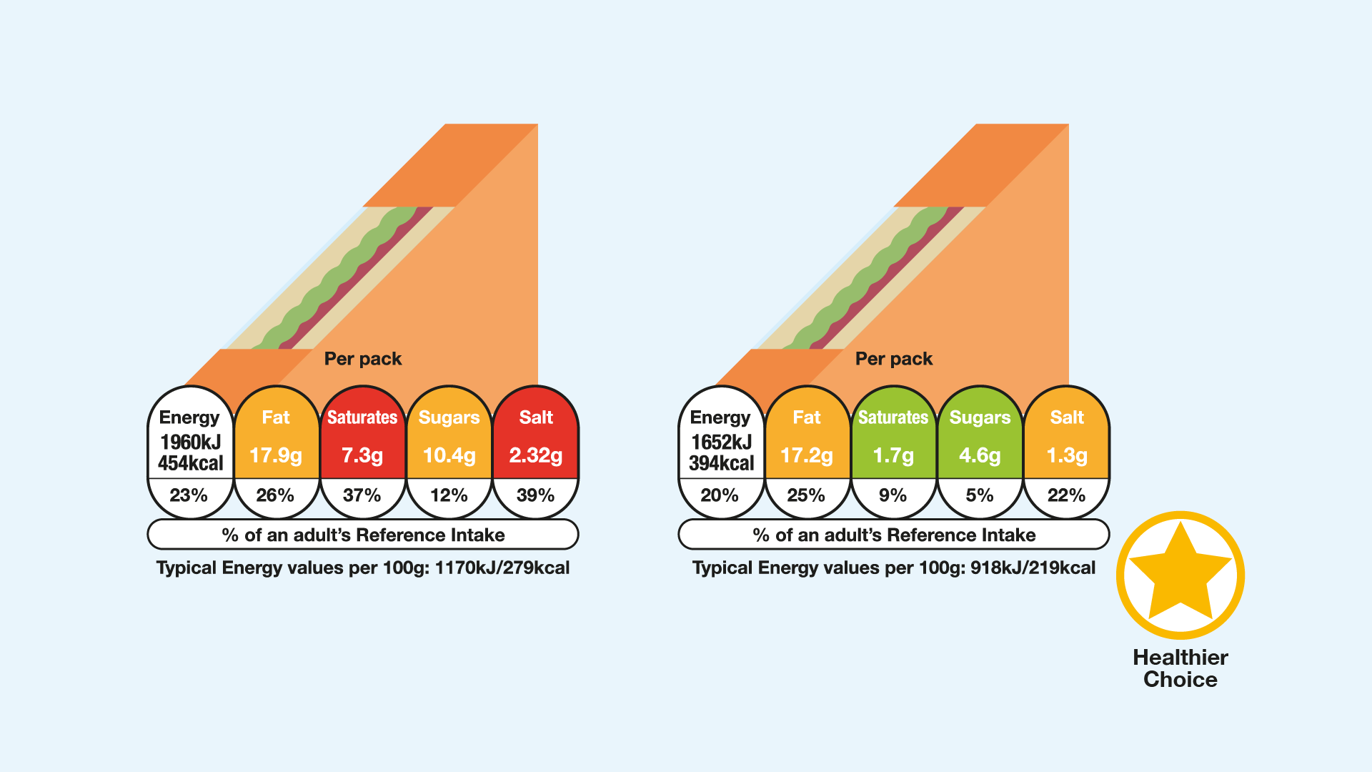
Know your colours
The red, amber and green colours show at a glance whether a product is high, medium or low for fat, saturates, sugars or salt.
Use the colour coding to compare two products. If one sandwich has less red and more green than another, it’s the healthier choice.
© IGD 2019
Page 22

Slide 23
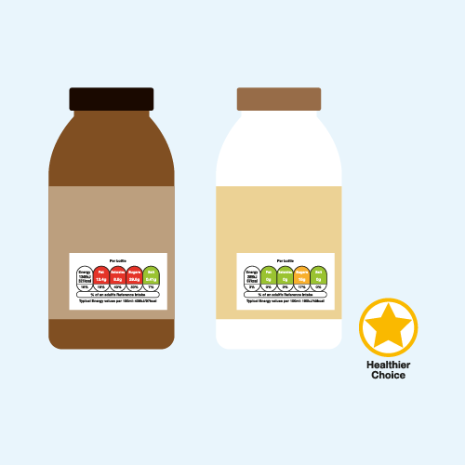
Want to know more?
Notes:
For a healthier choice choose products with more greens and fewer reds.
You don’t have to avoid all foods with a red colour on the nutrition label but eating fewer reds and less often can help you achieve a healthier diet.
A food could be high (red) in sugars but low (green) in fat, for example, so look out for the overall balance in your diet.
If two products have the same colour coding on the nutrition label, look at the numbers to compare in more detail.
The colour coding for fat, saturates, sugars and salt on nutrition labels is set by the Department of Health.

Slide 24
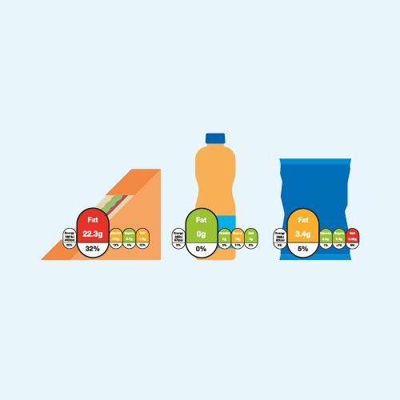
Notes:
You don’t have to avoid all foods with a red colour on the nutrition label but eating fewer reds and less often can help you achieve a healthier diet.
A food could be high (red) in sugars but low (green) in fat, for example, so look out for the overall balance in your diet.
If two products have the same colour coding on the nutrition label, look at the numbers to compare in more detail.
The colour coding for fat, saturates, sugars and salt on nutrition labels is set by the Department of Health.

Slide 25
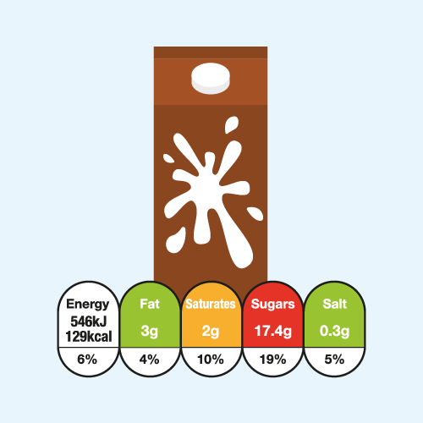
Notes:
A food could be high (red) in sugars but low (green) in fat, for example, so look out for the overall balance in your diet.
If two products have the same colour coding on the nutrition label, look at the numbers to compare in more detail.
The colour coding for fat, saturates, sugars and salt on nutrition labels is set by the Department of Health.

Slide 26
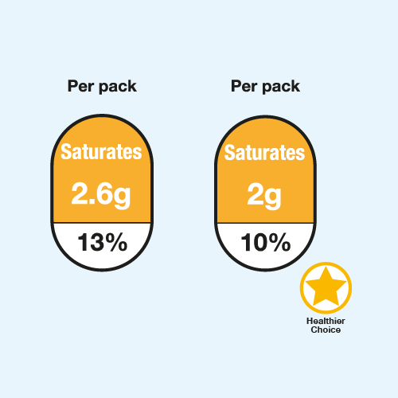
Notes:
If two products have the same colour coding on the nutrition label, look at the numbers to compare in more detail.
The colour coding for fat, saturates, sugars and salt on nutrition labels is set by the Department of Health.

Slide 27
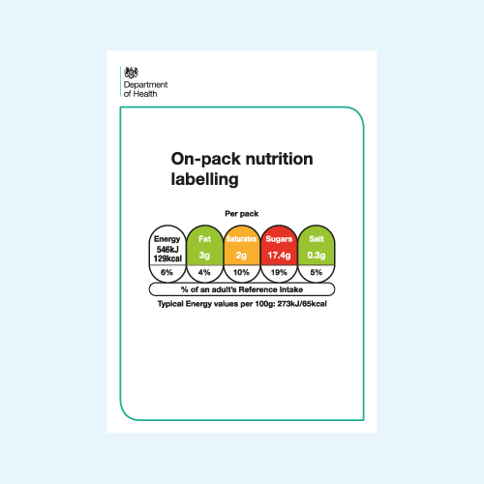
Notes:
The colour coding for fat, saturates, sugars and salt on nutrition labels is set by the Department of Health.

Slide 28
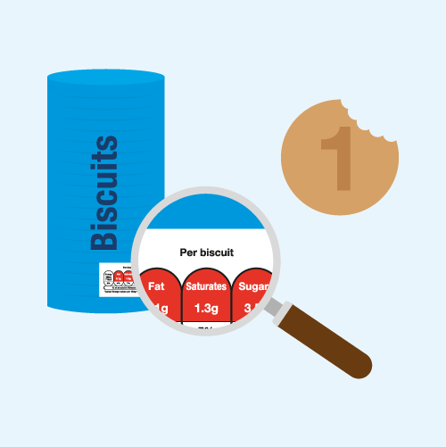
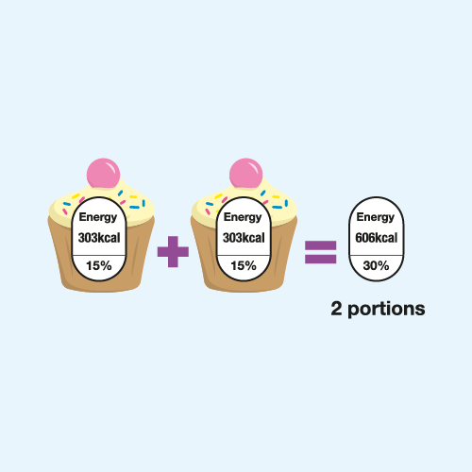
Know your portions
Check the pack for the portion size, this is what the numbers on the nutrition label are based on
If you are eating more or less than the portion size shown, you need to adjust the numbers shown on the
nutrition label
© IGD 2019
Page 28

Slide 29
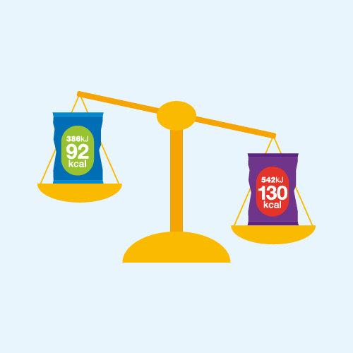
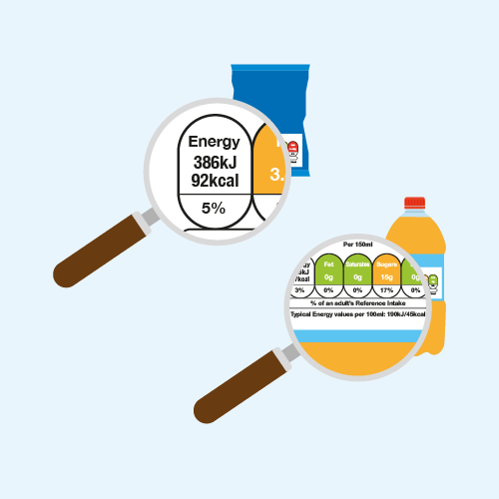
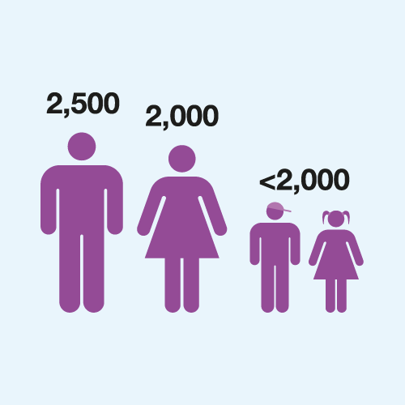
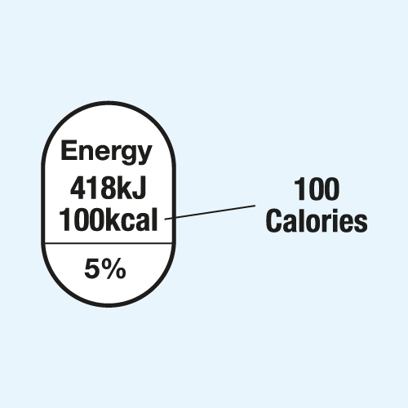
Know your calories
To make the choice that is right for you, use the calorie information to compare products.
Check the pack for the number of calories there are in a portion and 100g of a food or 100ml of drink.
The average woman needs 2,000 calories per day, the average man 2,500 and children fewer than 2,000 depending on their age.
You’ll usually see two values on labels, kcal and kJ, but look out for kcal or calories.
© IGD 2019
Page 29

Slide 30
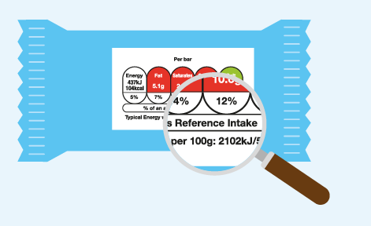
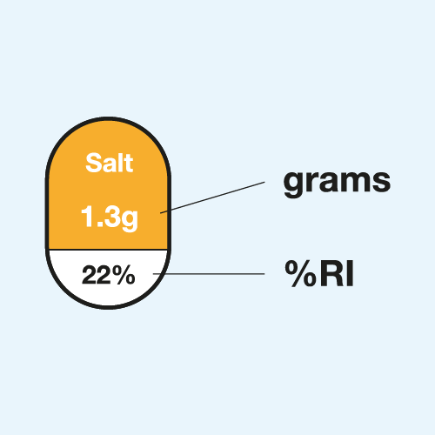
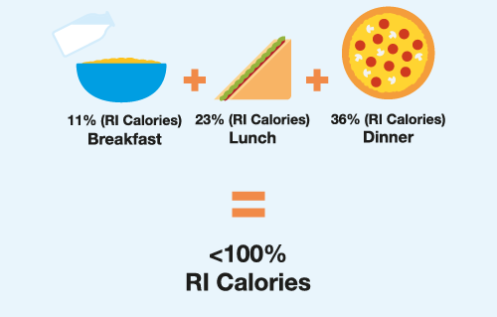
Know your daily allowance
Reference Intake (RI) has replaced the term Guideline Daily Amount or GDA.
The numbers on the label show you how many calories and how much fat, saturates, sugars and salt a portion of food or drink contains, both in number of grams and as a share (%) of your daily allowance (RI).
Aim to stay below 100% of your daily allowance (RI) for calories, fat, saturates, sugars and salt when you add up everything you consume in a day.
© IGD 2019
Page 30

Slide 31
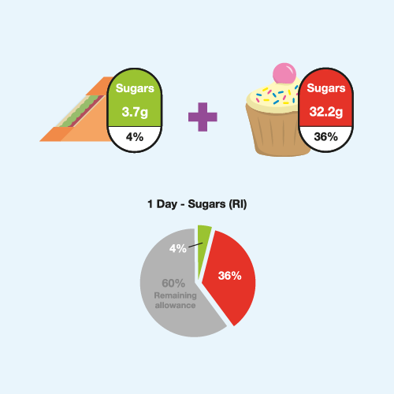

Know your daily allowance
Use the percentages on the nutrition label to track whether you’re under or over your daily allowance (known as a Reference Intake or RI).
The daily allowances (RI) are recommended by an independent panel of scientific experts and endorsed by the Department of Health.
© IGD 2019
Page 31

Slide 32















Message adopters
Duncan Selbie, Chief Executive, Public Health England, said:
“Better nutritional information is a foundation of healthier food and drink choices.
It’s great to see so many household names sign up to the IGD guide and commit to providing clear and consistent information to consumers. I hope it encourages others to follow suit."

Slide 33
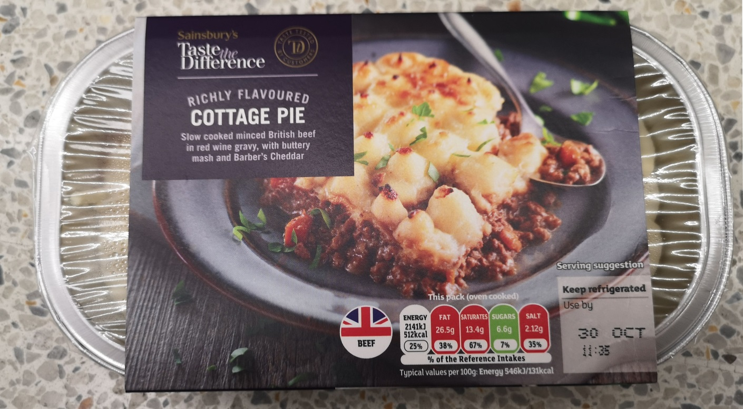
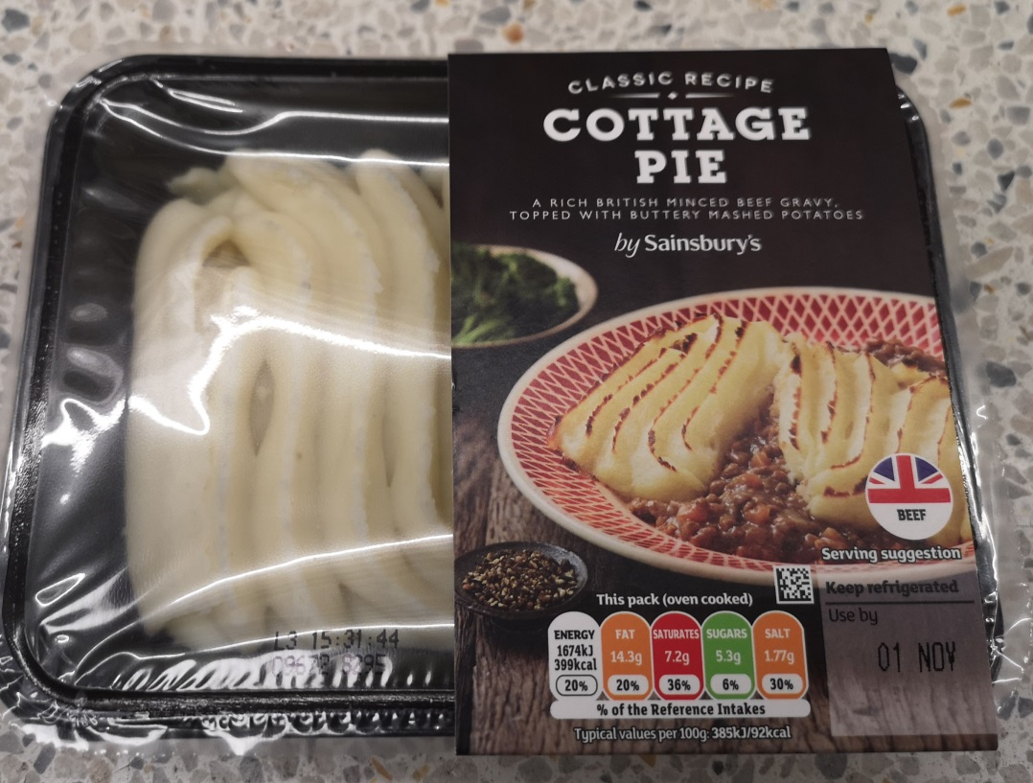


Let’s try…
A
B
Notes:
Ok so let’s give that a try!
Here we have 2 cottage pies showing front of pack labelling.
Using the message area - type in A or B for the following questions.
Which pie has the least salt? …….B
Which pie has the highest saturated fat content? ……A

Slide 34
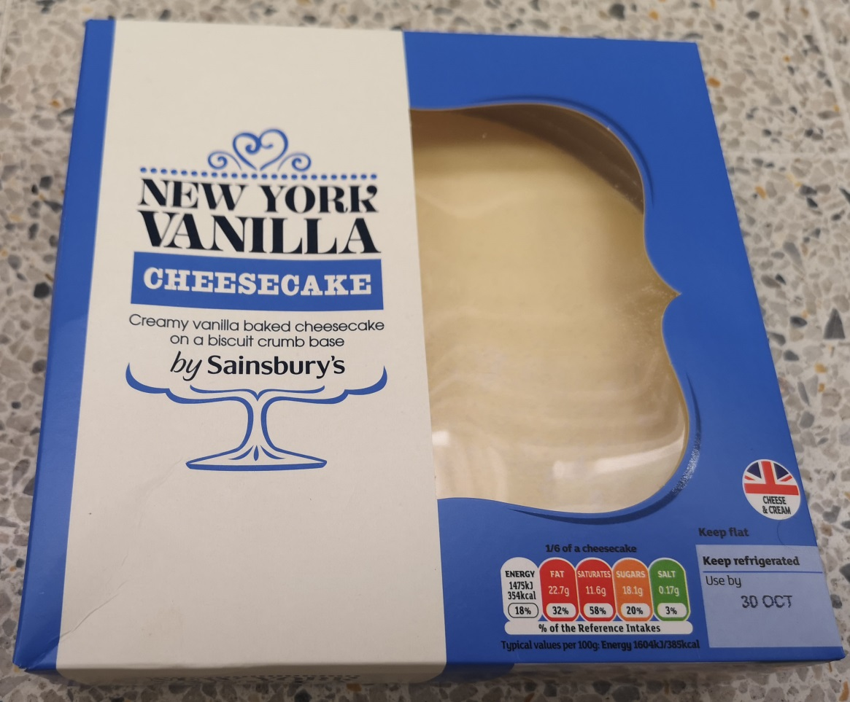
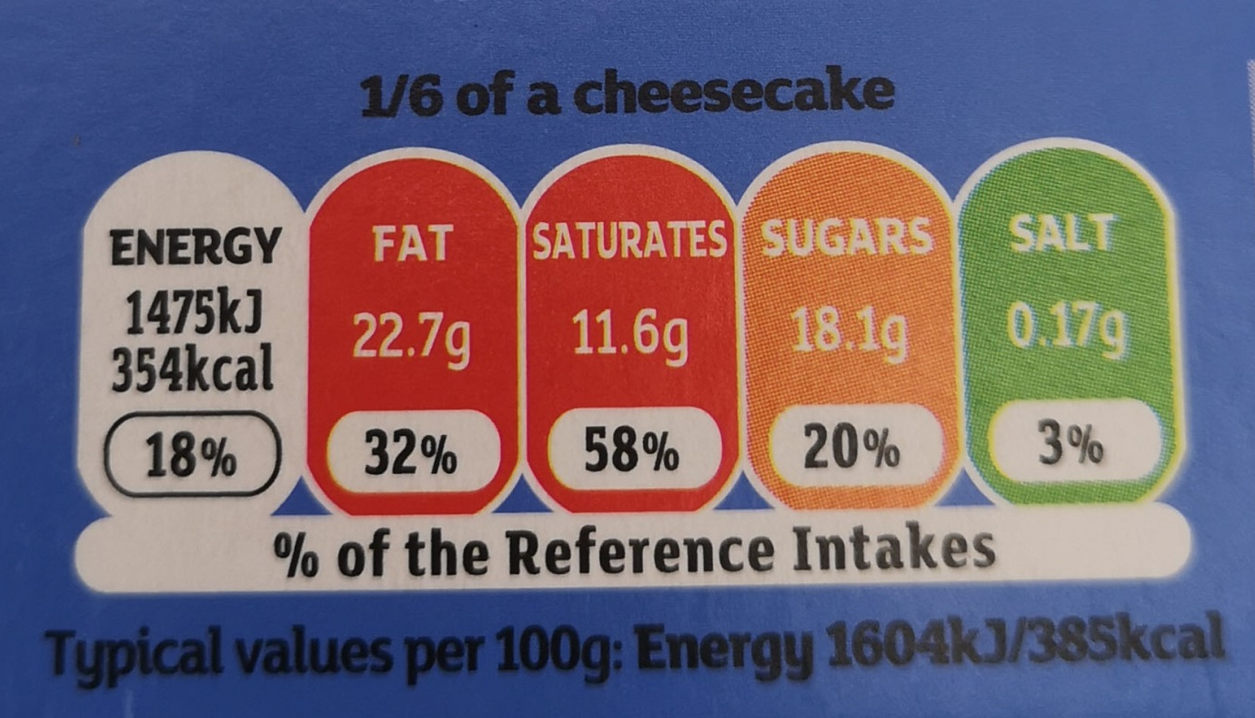
Let’s try…
Notes:
How many portions are there in this Cheesecake?.......6
How much of an adults reference intake for sugar is in one serving? …..20%

Slide 35


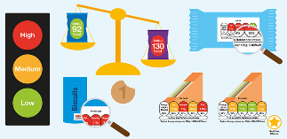

Nutrition labelling guides
Help people better understand and use front of pack nutrition labels
The guide for food and drink organisations
The guide for educators and healthcare professionals
Messaging toolkit
2. Improve the consistency of the presentation of front of pack nutrition labels
Technical best practice guide for the presentation of Front of Pack labels
Page 35
Notes:
35

Slide 36
Conclusions
Health is a key driver to purchase and we need to empower shoppers to make informed choices
1
Shoppers want to use nutrition information but are confused by it
2
Simple messaging and consistency could improve comprehension
3
The food and grocery industry are rolling out IGDs messaging and best practice
4
More needs to be done to drive behaviour change and you can help!
© IGD 2018
Page 36
Notes:
36

Slide 37

Further reading
For further insights and information on labelling visit www.igd.com/healthyeating
We can help you meet Gatsby Benchmarks & link the curriculum to careers www.igd.com/educatorhub
IGD run free, food science summer schools with four universities in July – these are for year 12 students www.igd.com/summerschools

Slide 38
Food – a fact of life resources and further reading
Resources
Presentations, classroom activities, quizzes and pupil worksheets to enhance teaching and learning about food labels can be found on the Food – a fact of life website.
www.foodafactoflife.org.uk
Have you tried Explore food?
BNF’s free nutritional analysis tool for schools with supporting information and resources.
http://explorefood.foodafactoflife.org.uk/
Further reading
Food Standards Scotland (FSS)
Food Standards Agency (FSA) England, Wales and Northern Ireland
British Nutrition Foundation (BNF)

Slide 39
Any Questions?
Thank you for listening
Email: Hannah.Skeggs@igd.com
Website
www.igd.com/healthyeating
Email
healthyeating@igd.com
Twitter
@IGD_health
Notes:
39

