Slide 1
The Eatwell Guide Alex White, British Nutrition Foundation 10 January 2019

Slide 2
What will be covered?
The Eatwell Guide – overview and context.
Food groups and key messages.
Main nutrients provided in each food group.
How the recommendations from the Guide can be applied.
Links to Food – a fact of life resources, including an interactive activity.
Suggestions for further reading and sources of information.

Slide 3



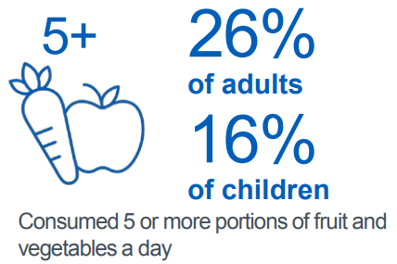
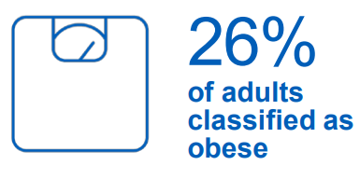

Context
Low intakes of some vitamins and minerals.
Low intake of AOAC fibre.
1 in 5 children starts school overweight or obese.
By the time children leave primary school, 1 in 3 overweight or obese.
Excess consumption of Free sugars, salt, saturated fat and energy.

Slide 4
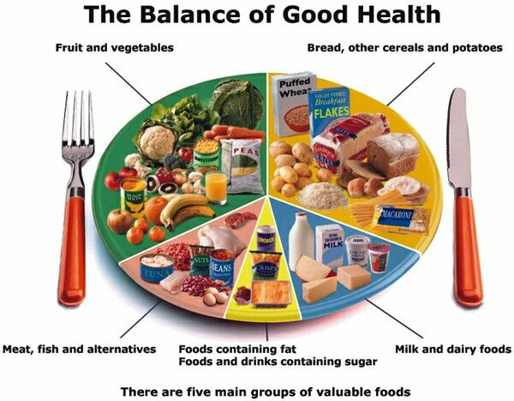
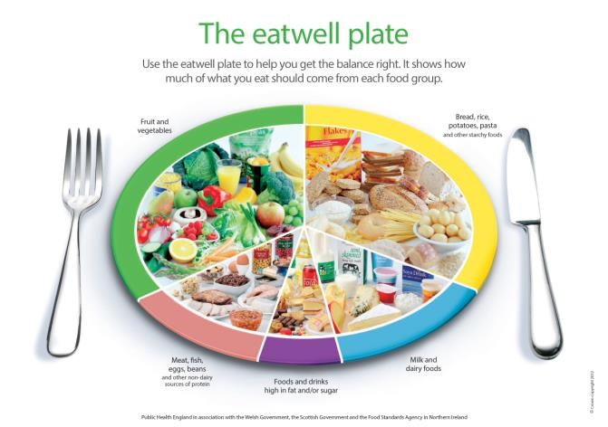
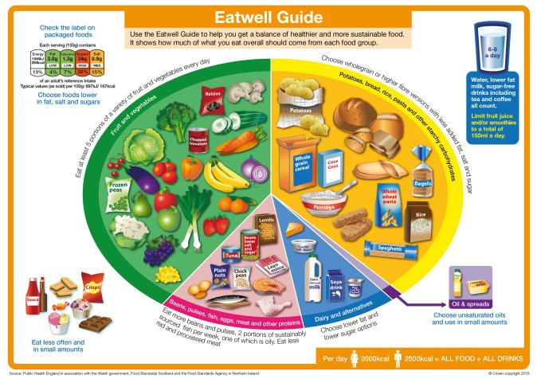
The progression of food based models
1994
2007
2016

Slide 5

The Eatwell Guide
Notes:
The UK’s healthy eating model.
Shows the proportions in which different food groups are needed in order to have a well-balanced and healthy diet.
We should choose a variety of different foods from each group.
The proportions shown represent food intake over a day or a week, not necessary each meal time.

Slide 6

Who does the Eatwell Guide apply to?
Notes:
The Eatwell Guide is suitable for most of the general population in the UK, regardless of weight, dietary preferences, ethnic origin, religious or cultural beliefs.
The Eatwell Guide does not apply to children under the age of 2, as their nutritional needs are different.
Children aged between 2 and 5 should gradually begin to follow the proportions illustrated in the Eatwell Guide.
People with medical conditions may need to seek advice from their GP or health professional about their diet.

Slide 7
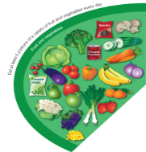
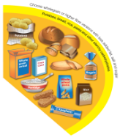
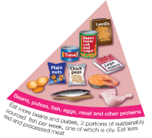
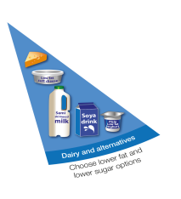

The Eatwell Guide – main groups
Fruit and vegetables
Potatoes, bread, rice, pasta and other starchy carbohydrates
Beans, pulses, fish, eggs, meat and other proteins
Dairy and alternatives
Oil and spreads

Slide 8



















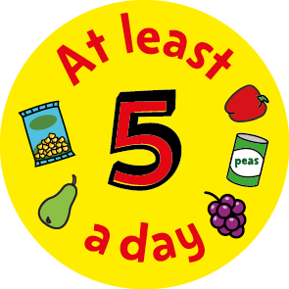




Fruit and vegetables
Key nutrients provided: sources of minerals and vitamins, and also an important source of fibre.
Eat at least 5 portions of a variety of fruit and vegetables every day
Notes:
Fruit and vegetables should make up just over a third of the food we eat each day.
Aim to eat at least five portions of a variety of fruit and vegetables each day.
Choose from fresh, frozen, canned, dried or juiced.
A portion is 80g or any of these:
1 apple, banana, pear, orange or other similar-size fruit;
3 heaped tablespoons of vegetables;
a dessert bowl of salad;
30g of dried fruit (counts as a maximum of one portion a day);
150ml glass of fruit juice or smoothie (counts as a maximum of one portion a day).
The new advice is to limit consumption of fruit juice and smoothies together to a total of 150ml (one portion) per day and to consume with meals to reduce the risk of tooth decay.

Slide 9











Potatoes, bread, rice, pasta and other starchy carbohydrates
Key nutrients provided: important source of fibre, especially in the case of wholegrains. Also a source of some vitamins and minerals.
Base meals on potatoes, bread, rice, pasta or other starchy carbohydrates; choosing wholegrain versions where possible
Notes:
Starchy food should make up just over a third of the food we eat.
Choose higher-fibre, wholegrain varieties when you can by purchasing wholewheat pasta, brown rice, or simply leaving the skins on potatoes.
Base your meals around starchy carbohydrate foods:
• start the day with a wholegrain breakfast cereal - choose one lower in salt and sugars;
• have a sandwich for lunch;
• round off the day with potatoes, pasta or rice as a base for your evening meal.
Why choose wholegrain?
Wholegrain food contains more fibre than white or refined starchy food, and often more of other nutrients. We also digest wholegrain food more slowly so it can help us feel full for longer.
Wholegrain food includes:
wholemeal and wholegrain bread, pitta and chapatti;
wholewheat pasta;
brown rice;
wholegrain breakfast cereals and whole oats.

Slide 10








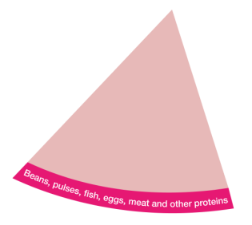

Beans, pulses, fish, eggs, meat and other proteins
Key nutrients provided: sources of protein, vitamins and minerals. Beans and pulses are also high in fibre, protein and vitamins and minerals and are naturally low in fat.
Eat some beans, pulses, fish, eggs, meat and other proteins (including 2 portions of fish every week, one of which should be oily)
Notes:
These foods are sources of protein, vitamins and minerals, so it is important to eat some foods from this group.
Beans, peas and lentils (which are all types of pulses, sometimes called ‘legumes’) are good alternatives to meat because they’re naturally very low in fat, and they’re high in fibre, protein and vitamins and minerals. Other vegetable-based sources of protein include tofu, bean curd and mycoprotein.
Aim for at least two portions (2 x 140g) of fish a week, including a portion of oily fish. Most people should be eating more fish, but there are recommended limits for oily fish, crab and some types of white fish.
Some types of meat are high in fat, particularly saturated fat. So when you’re buying meat, remember that the type of cut or meat product you choose, and how you cook it, can make a big difference.
To cut down on fat:
choose lean cuts of meat and go for leaner mince;
cut the fat off of meat and the skin off of chicken;
try to grill meat and fish instead of frying;
have a boiled or poached egg instead of fried.
If you eat more than 90g of red or processed meat per day, try to cut down to no more than 70g per day. The term processed meat includes sausages, bacon, cured meats and reformed meat products.

Slide 11


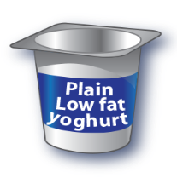

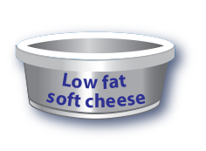
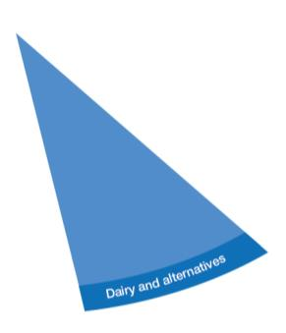
Dairy and alternatives
Key nutrients provided: sources of protein and vitamins, and are also a source of calcium, which helps to keep our bones strong, and iodine.
Have some dairy or dairy alternatives (such as soya drinks); choosing lower fat and lower sugar options.
Notes:
Try to have some milk and dairy food (or dairy alternatives) such as cheese, yoghurt and fromage frais.
These are good sources of protein and vitamins, and they’re also an important source of calcium, which helps to keep our bones strong.
Some dairy food can be high in fat and saturated fat, but there are plenty of lower-fat options to choose from.
Go for lower fat and lower sugar products where possible. For example, try - 1% fat milk which contains about half the fat of semi-skimmed milk without a noticeable change in taste or texture; - reduced fat cheese which is also widely available;
- have a smaller amount of the full-fat varieties less often;
- going for unsweetened, calcium-fortified versions when buying dairy alternatives.

Slide 12


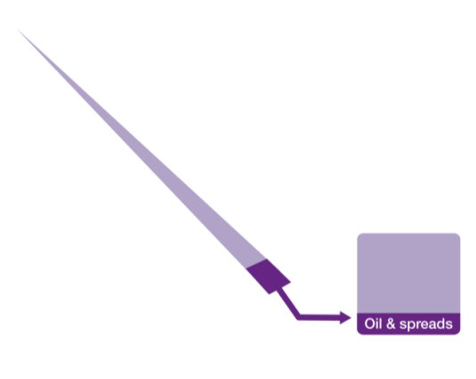
Oil and spreads
Key nutrients provided: unsaturated fats. Swapping to polyunsaturated fats (from saturated fats) helps to reduce cholesterol in the blood and reduce risk of CVD.
Choose unsaturated oils and spreads and eat in small amounts.
Notes:
Although some fat in the diet is essential, generally we are eating too much saturated fat and need to reduce our consumption.
Unsaturated fats are healthier fats that are usually from plant sources and in liquid form as oil, for example vegetable oil, rapeseed oil and olive oil.
Swapping to unsaturated fats will help to reduce cholesterol in the blood, therefore it is important to get most of our fat from unsaturated oils.
Choosing lower fat spreads, as opposed to butter, is a good way to reduce your saturated fat intake.
Remember that all types of fat are high in energy and should be limited in the diet.

Slide 13
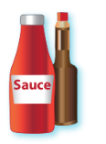









Foods high in fat, salt and sugars
Throughout the UK we consume excess amounts of:
Saturated fat;
Salt;
and Free Sugars.
If consuming foods and drinks high in fat, salt or sugar have these less often and in small amounts.
Notes:
This includes products such as chocolate, cakes, biscuits, sugars sweetened soft drinks, butter and ice cream.
These foods are not needed in the diet. If they are included, have infrequently and in small amounts.
If you consume these foods and drinks often, try to limit their consumption so you have them less often and in smaller amounts. Food and drinks high in fat and sugar contain lots of energy, particularly when you have large servings.
Check the label and avoid foods which are high in fat, salt and sugar!

Slide 14
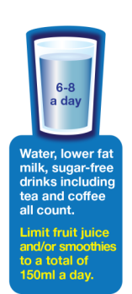



Drink 6-8 cups/glasses of fluid a day
Notes:
Aim to drink 6-8 glasses of fluid every day.
Water, lower fat milk and sugar-free drinks including tea and coffee all count.
Fruit juice and smoothies also count towards your fluid consumption, although they are a source of free sugars and so you should limit consumption to no more than a combined total of 150ml per day.
Sugary drinks are one of the main contributors to excess sugar consumption amongst children and adults in the UK.
Swap sugary soft drinks for diet, sugar-free or no added sugar varieties to reduce your sugar intake in a simple step.

Slide 15
Energy

Slide 16
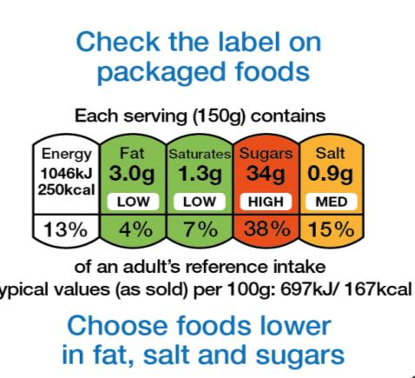

Labelling

Slide 17

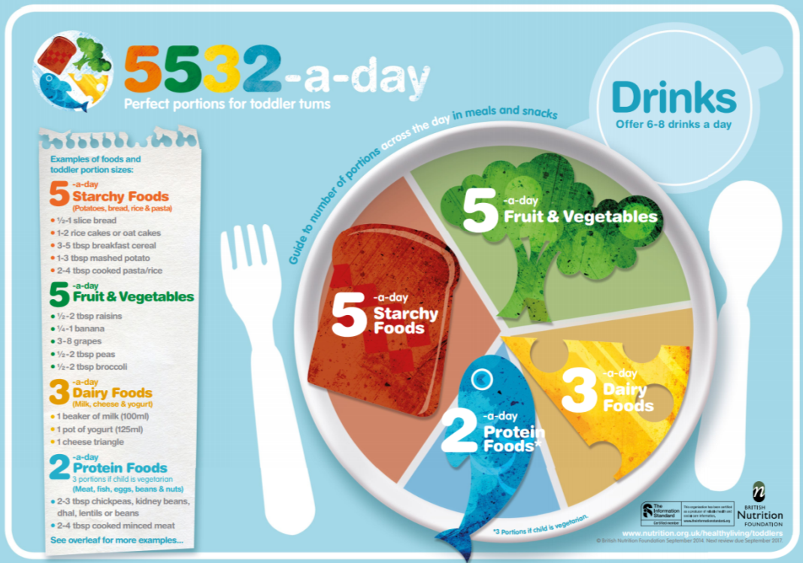
What about for children 1-3 years?
Starchy foods x 5-a-day
Fruit & vegetables x 5-a-day
Dairy foods x 3-a-day
Protein foods x 2-a-day*
=5532-a-day!
*3 portions if child is vegetarian.

Slide 18



What about people who are vegetarian or vegan?

Slide 19



What about people with different dietary needs?

Slide 20
Further information
Reading
Public Health England (PHE)
Food Standards Scotland (FSS)
Food Standards Agency (FSA) NI
Public Health Wales
British Nutrition Foundation (BNF)
Scientific Advisory Committee on Nutrition (SACN)
Resources
The Eatwell Challenge
Eatwell Guide videos
Eatwell Guide Kahoot quizzes
Eatwell Guide presentation and worksheets
Eatwell Guide posters

Slide 21
For further information, go to:
www.foodafactoflife.org.uk

