Slide 1


Feeding of infants and children, focusing on behavioural aspects
22 May 2019

Slide 2

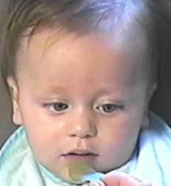

Feeding infants and children
-learning to like vegetables
Marion M Hetherington
Professor of Biopsychology

Slide 3
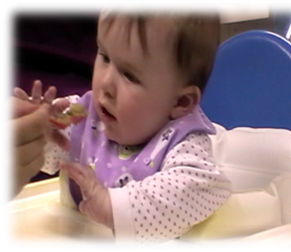
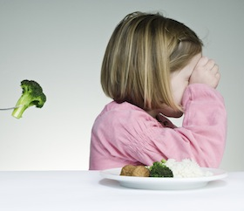
Overview
Campaigns to increase vegetable intakes in children raise awareness but don’t change behaviour
Infants are born wise to flavours!
So why don’t children like vegetables?
Behavioural strategies used to encourage children to eat more vegetables

Slide 4

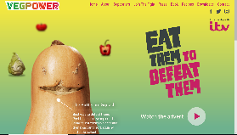
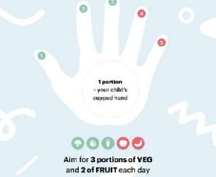
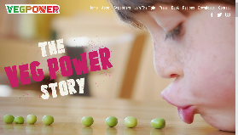

Campaigns to encourage children to eat more veg
Raise awareness
Knowledge – behavior gap

Slide 5

Health benefits of consuming fruits and vegetables
F&V protect against cancer, heart disease, type II diabetes, cognitive decline
Phytochemicals such as phenolic acids, flavonoids, organosulfur compounds, and carotenoids have antioxidant and tumour suppressant effects
β-carotene- and vitamin C-rich F&V are associated with a lower CHD risk (Bhupathiraju et al 2013);
Vegetables more protective than fruit, benefits of 7+ portions per day reported (Oyebode et al 2014, J Epid Comm Health)
Quantity rather than variety of F&V linked to lower risk of CHD (Bhupathiraju et al 2013)

Slide 6

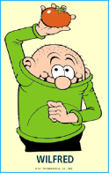


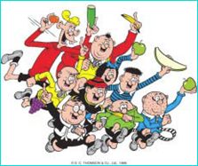
Learning to like vegetables – at school
Too late to learn?
21 school based studies (meta-analysis)
24,000 children
Improvement of 0.25 portions of daily fruit and vegetable intake (excluding fruit juice)
Of this, vegetables accounted for 0.07 portions!!
Interventions selectively improve fruit not vegetable intake
Evans et al (2012) AJCN

Slide 7


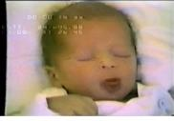
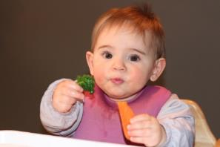
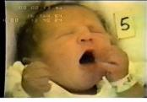
Infants are born wise
univore
Learning through
experience
innate
capacities
omnivore

Slide 8
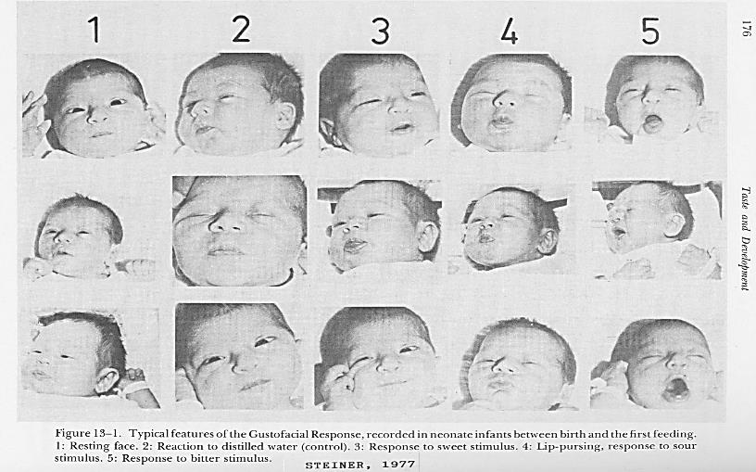
FIRST TASTES
rest water sweet sour bitter

Slide 10
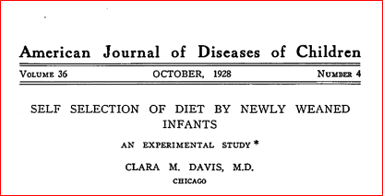
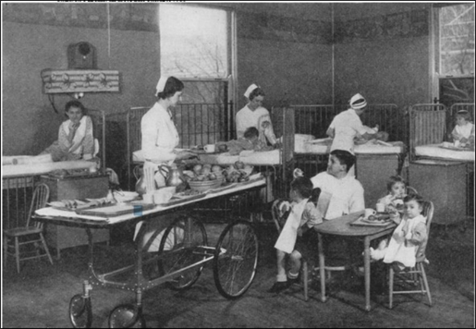
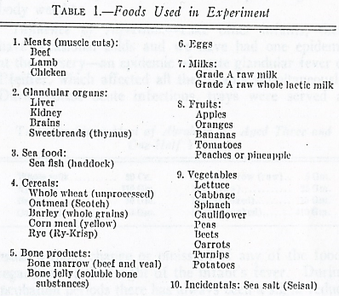
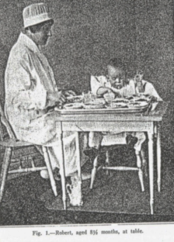
Self selection of diets by newly weaned infants
(n = 15; Davis, 1928, 1939)
No combined foods like soup or custard or bread; “pure” foods – raw and cooked

Slide 11
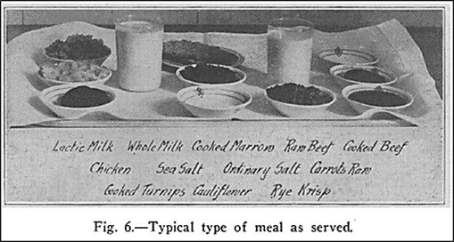
Food choice of 1 yr old infant (Davis, 1928)
7am breakfast
60 cc milk
21 g raw apple
100 g cooked apple
100 cc orange juice
67 g cooked wheat
15 g cooked barley
16 g cooked liver
50 g cooked sweetbreads
5pm supper
120 cc milk
21 g bone jelly
19 g fish
1 cooked egg
55 g banana
60 g orange segments
10 g raw oats
56 g cooked oats
Not just sweet or favoured foods and drinks but wide variety
“Each infant in the beginning chose some foods which… he spat out. Later on this did not happen.”

Slide 12
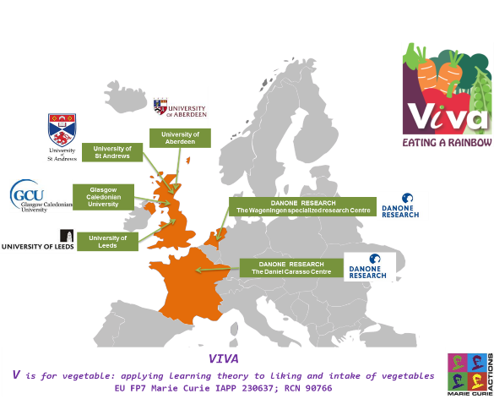
Step by step veg first approach to complementary feeding
Interviews with French mothers indicated their desire to establish “the foundations of taste”
We developed a trial to test one strategy
Mothers were randomised to intervention or control
Intervention infants received 12 d of vegetables added to breast or formula then 12 days added to baby rice
Control infants received just milk then cereal
Average age of taste introduction was 5.5 m

Slide 13




Step by step complementary feeding with vegetables
Day Number | 1 | 2 | 3 | 4 | 5 | 6 | 7 | 8 | 9 | 10 | 11 | 12 | 13 | 14 | 15 | 16 | 17 | 18 | 19 | 20 | 21 | 22 | 23 | 24 | 25 | 26 | 27 | 28 | 29 | 30 | 31 | 32 | 33 | 34 | 35
Phase | Milk: 12 days X1 a day |  |  |  |  |  |  |  |  |  |  |  | Baby Rice: 12 days X2 a day |  |  |  |  |  |  |  |  |  |  |  | Purees: 11 days X1 a day
Control Group | Plain milk: usual quantity |  |  |  |  |  |  |  |  |  |  |  | Plain Baby Rice : max~77g |  |  |  |  |  |  |  |  |  |  |  | Vegetable puree : max~260g
 |  |  |  |  |  |  |  |  |  |  |  |  |  |  |  |  |  |  |  |  |  |  |  |  | Ca | GB | Sp | Br | Ca | GB | Sp | Br | Ca | GB | Pa
Intervention Group | Flavoured milk : max ~50g |  |  |  |  |  |  |  |  |  |  |  | Flavoured Baby Rice :max~72g |  |  |  |  |  |  |  |  |  |  |  | Vegetable puree : max~260g
 | Ca | GB | Sp | Br | Ca | GB | Sp | Br | Ca | GB | Sp | Br | Ca | GB | Sp | Br | Ca | GB | Sp | Br | Ca | GB | Sp | Br | Ca | GB | Sp | Br | Ca | GB | Sp | Br | Ca | GB | Pa
Intervention group (n = 18): receive vegetables on daily rotation
Control group(n = 18): receive no vegetables until Day 25
when all infants receive vegetables

Slide 14
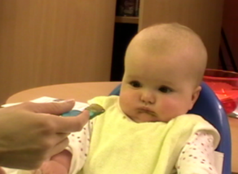
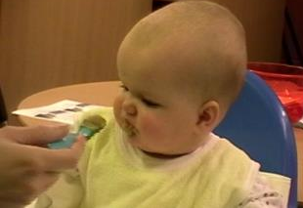
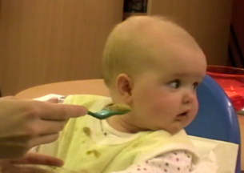
Measurements
Mothers fed their baby pure vegetable and asked to stop when they had observed 3 consecutive refusals
Mothers were given training in how to identify refusals
Liking was rated
Facial and behavioural responses were filmed
Intake was weighed

Slide 15









One spoon sequence
Ready for Spoon offer
Beginning spoon offered
END
New spoon offered

Slide 16
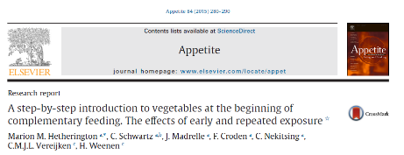
Intake and pace of eating

Slide 17
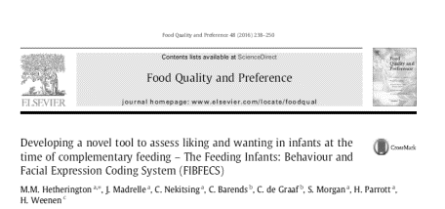
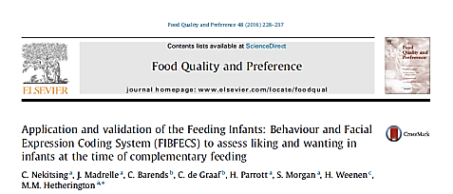
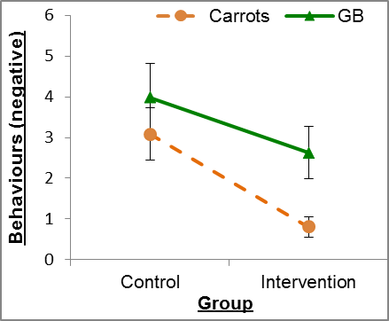
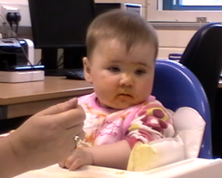
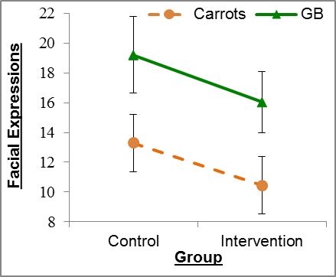
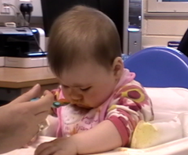

Slide 18

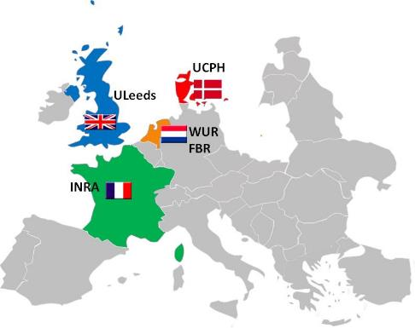

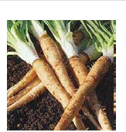
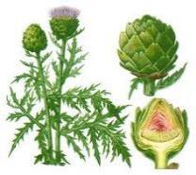
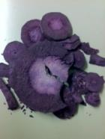
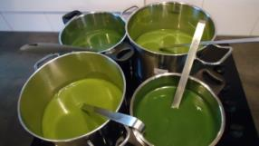
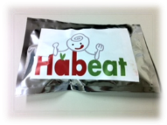
Learning by experience up to 3 yr
Individual differences in learning
  Maternal feeding practices e.g. pressuring
  Maternal characteristics e.g. BMI
  Children’s eating traits e.g. food fussiness

Slide 19


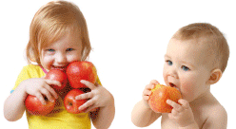
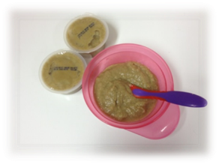
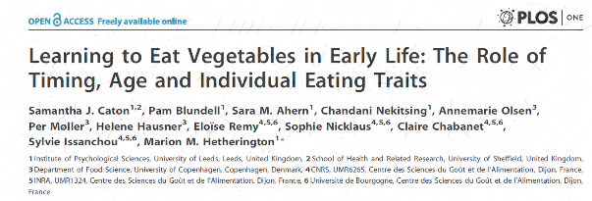
Learning by experience up to 3 yr
UCPH
ULeeds
INRA

Slide 20
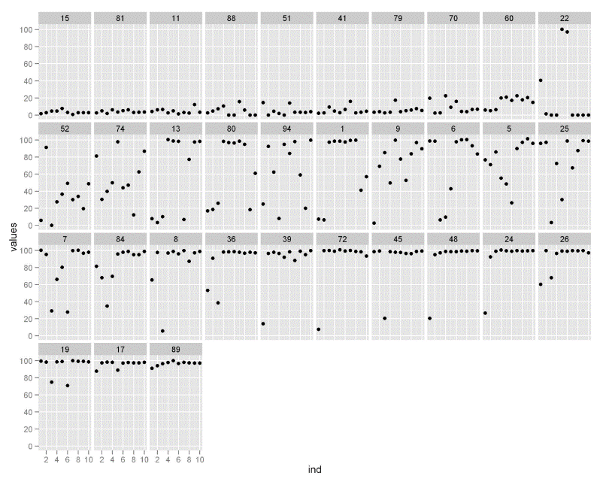
Individual eating patterns (artichoke)

Slide 21
Predictors of eating patterns
 | Learners | Non-eaters | Plate-clearers | Others
N | 133 | 69 | 70 | 60
Intercept*** | 35.4 (41.5) | 5.9 (7.8) | 118.9 (36.4) | 76.3 (50.7)
Slope*** | 17.2 (11.8) | 0.2 (1.5) | 3.0 (5.2) | 1.8 (10.6)
Age (months) *** | 20.0 (9.4) | 26.7 (6.9) | 12.4 (8.0) | 15.1(9.5)
BMI zscore | 0.44 (1.23) | 0.5 (0.93) | 0.38 (1.32) | -0.03 (1.19)
EF | 4.1 (0.6) | 4.0 (0.69) | 4.2 (0.6) | 4.1 (0.6)
SR *** | 2.8 (0.9) | 3.2 (0.5) | 2.0 (0.8) | 2.4 (0.9)
FF *** | 2.7 (0.7) | 3.0 (0.6) | 2.0 (0.8) | 2.2 (0.7)
FR | 2.5 (0.7) | 2.5 (0.8) | 2.0 (0.8) | 2.2 (0.7)
BF total | 20.8 (14.4) | 22.0 (13.3) | 19.7 (16.8) | 23.7 (28.4)
Weaning age (weeks) | 20.7 (4.6) | 21.0 (5.2) | 21.7 (4.0) | 22.0 (3.9)
*** statistically significant effect of eater category p < 0.001

Slide 22
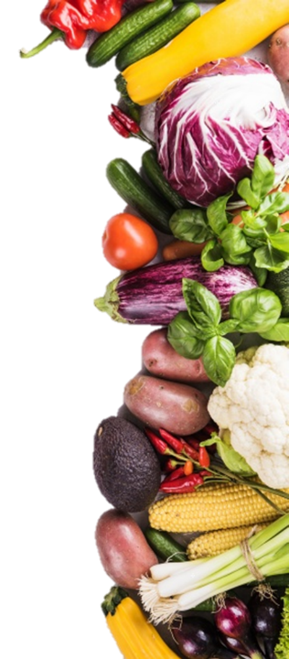
Introduction
Most children do not eat enough vegetables
(WHO, 2010)
Many are unwilling to taste new vegetable
(Cooke et al 2003)
Nutrition education widely used - but small effects
(DeCosta et al., 2017)
Children are taught about the familiar vegetables
Does it matter?

Slide 23


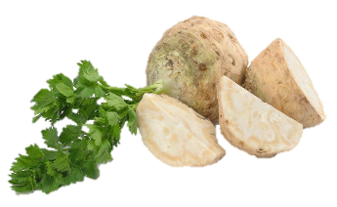
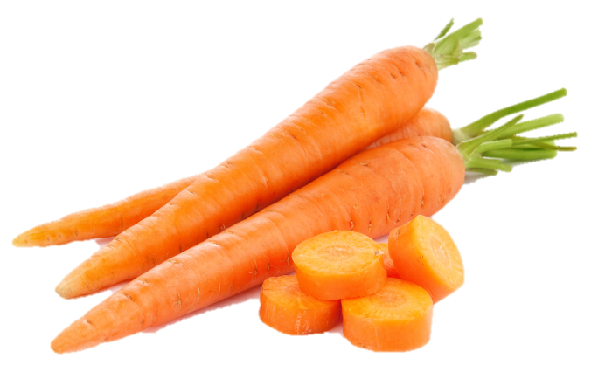
Research questions
Target Storybook
Do storybooks featuring a novel veg increase intake?
Sensory Learning
Does sensory learning with the novel vegetable increase intake?
Study registration: ClinicalTrials.gov NCT03400566

Slide 24
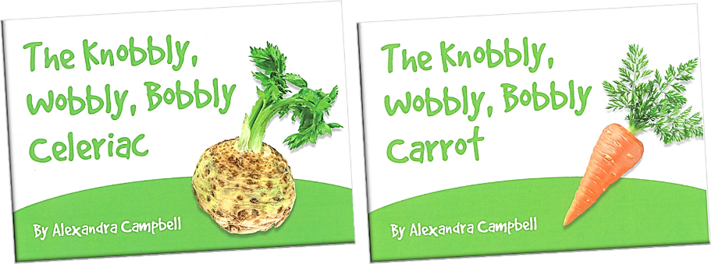

Intervention narratives: identical books
© PhunkyFoods 2017

Slide 25
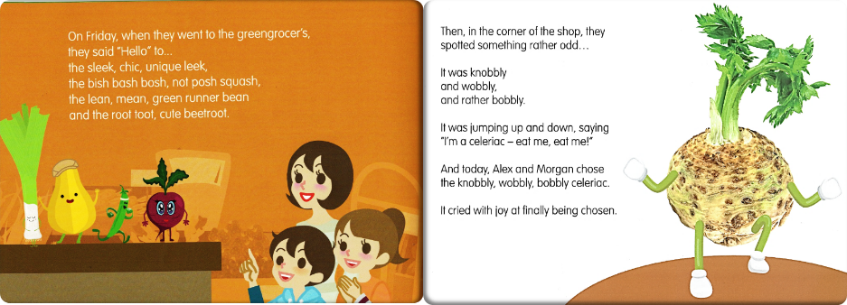
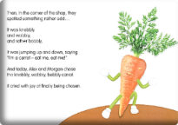
Narratives: the storyline
Alex and Morgan visit the greengrocer with their mum from Monday to Friday. They choose a different vegetable everyday for their tea. Finally they pick and eat celeriac/ carrot!
© PhunkyFoods 2017

Slide 26
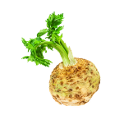
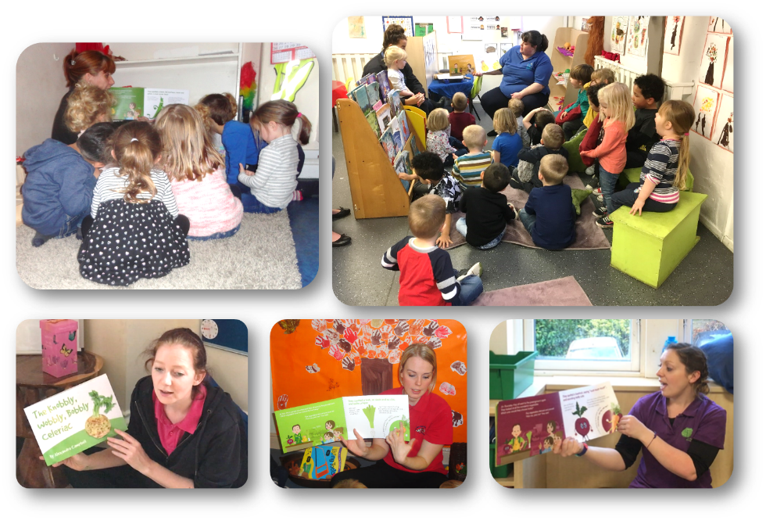
Story time in the nurseries

Slide 27
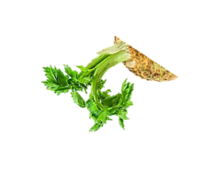
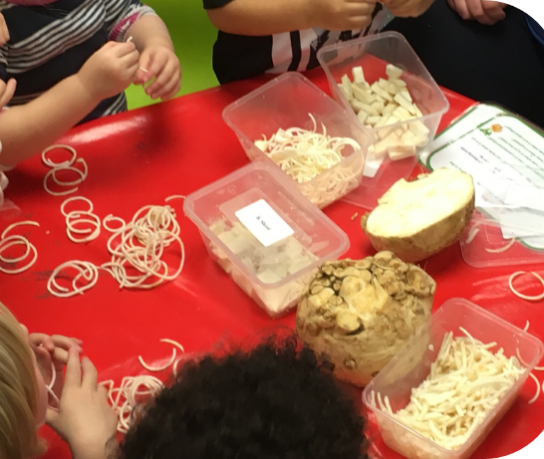
Intervention sensory: vegetable forms
Whole
Half
Sliced
Sticks
Spiralized
Grated

Slide 28



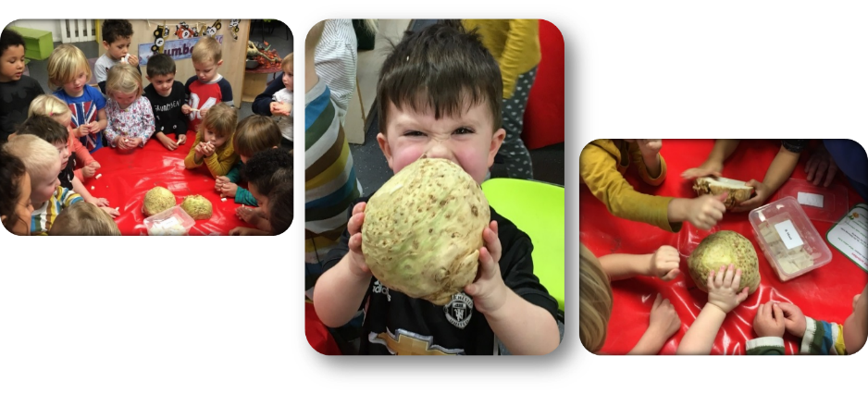
Non-taste sensory activities
Listen
See
Smell
Touch

Slide 29
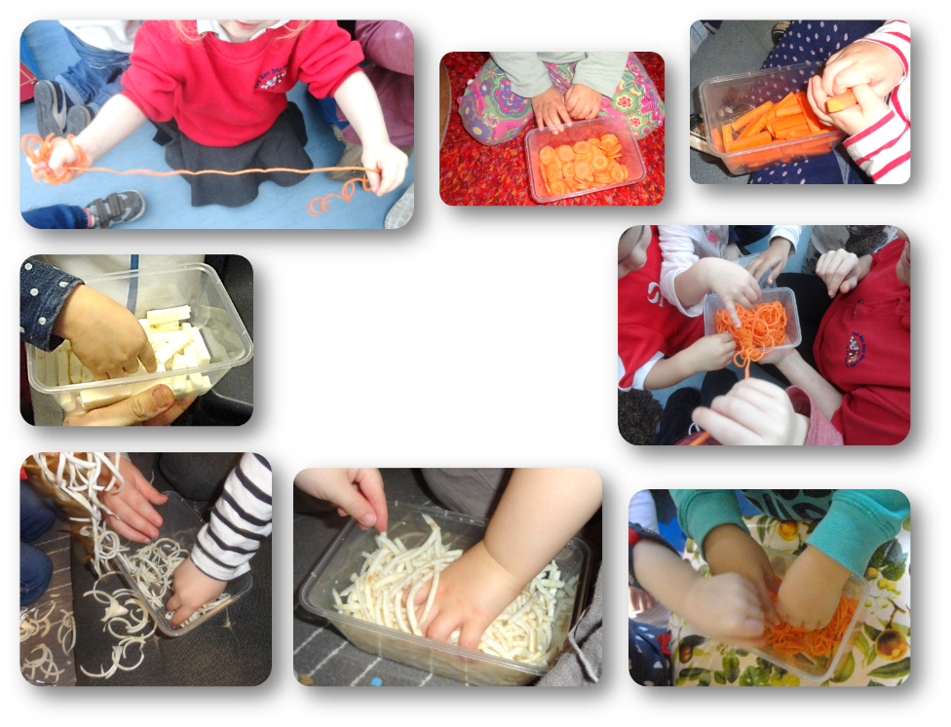
Sensory activity ‘hands on’

Slide 30


Celeriac tasting

Slide 31


Pre and post celeriac intake by condition

Slide 32


Children who did not eat celeriac at pre-test
54% (n = 145) did not eat the celeriac at baseline (≤ 0.5g)
Significant effect of narrative plus sensory regardless of vegetable type

Slide 33

Storybooks and sensory play
Books encourage familiarity
Sensory play encourages willingness to try
The books must be congruent with the vegetable to be effective
Any sensory play seems to help children to taste a little of the vegetable

Slide 34


Conclusions
Infants dislike bitter from birth
Vegetables advocated as a first food during complementary feeding
Children learn to accept vegetables best with TASTE exposure
Storybooks encourage awareness and willingness to taste
Sensory play reduces fear of new foods and encourages exploration and acceptance

Slide 35






Food – a fact of life resources
A variety of resources are available on the Food – a fact of life website to support teaching and learning about vegetables:
10 x food based sessions;
learn with stories;
where food comes from cards;
vegetable cards;
fruit and vegetable bingo.
www.foodafactoflife.org.uk

Slide 36

Further sources of information
Encouraging children to eat vegetables https://www.nutrition.org.uk/healthyliving/toddlers/eatveg.html
Introducing solid foods
https://www.nutrition.org.uk/healthyliving/nutrition4baby/complementaryfeeding.html
5532 a-day - perfect portions for toddler tums!
https://www.nutrition.org.uk/healthyliving/toddlers/5532aday.html
Feeding toddlers and pre-school children
https://www.nutrition.org.uk/healthyliving/lifestages/feeding-your-toddlerpre-school-child.html
Children – nutrition and diet information https://www.nutrition.org.uk/healthyliving/lifestages/children.html

Slide 37
For further information, go to:
www.foodafactoflife.org.uk

