Slide 1

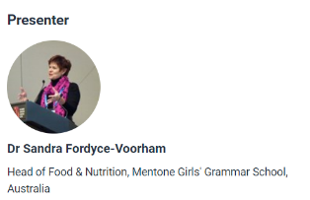

‘Food literacy’ versus ‘Food skills’
26 June 2019

Slide 2

‘FOOD LITERACY’ VERSUS ‘FOOD SKILLS’…
WHAT EXACTLY IS THE SAMENESS?
Sandra Fordyce-Voorham
PhD, MEd, BEd (Home Economics)
Head of Food & Nutrition
Mentone Girls’ Grammar School
Melbourne, Australia
sfordyce@mentonegirls.vic.edu.au
Food Skills Australia

Slide 3
Introduction to presentation
The emergence of food literacy over the last decade
Food literacy versus food skills – what is the ‘sameness’?
Food literacy (declarative-knowledge) vs Food skills (procedural- hands-on)
What food literacy/skills should be taught?
The need for an evidence-based model to design and evaluate our skill-based programs
Links to Food – a fact of life resources are hot linked throughout this webinar presentation
Suggestions for further reading and sources of information
http://www.foodskillsaustralia.com.au/resource/food-literacy-versus-food-skills-what-is-the-sameness/
Notes:
How are food literacy skills different or similar to food skills?

Slide 4
Transitions of definitions of ‘Food Literacy’
Food literacy is…
‘the ability of consumers to understand and act upon the food labelling and nutritional information they need to prepare tasty and nutritious meals for themselves and their families’ Fordyce-Voorham S, 2010.
‘a collection of inter-related knowledge, skills and behaviours required to plan, manage, select, prepare and eat food to meet needs and determine intake’ Vidgen H & Gallegos, 2012.
‘the knowledge, skills and capacity to source, prepare, cook and
share food in a sustainable manner to promote a healthy and balanced lifestyle. Food literacy is also about individuals understanding the role that food plays in communities and cultures’ (Home Economics Victoria, 2013)
Food literacy competencies presented as a framework – that encompasses all of the above plus sustainability and wellbeing Slater J, Falkenburg T, Rutherford J, Colatruglio S. 2018
Notes:
Evolution of terminology

Slide 5
Use of the term “food literacy” in the literature between 1990-2012
Vidgen (2014)
Notes:
Food literacy is a term that has recently emerged in the literature.

Slide 6
Who are (some of the) players?
From Denmark reported in the International Journal of Home Economics: Jette Benn (2014) (Published in IJHE Vol 7 No 1 2014) Food, nutrition or cooking literacy—a review of concepts and competencies regarding food education
From Hong Kong: Wai Ling Theresa Lai-Yeung (2011) (Published in the Asia-Pacific Journal of Clinical Nutrition 2011;20 (1):87-94) Nutrition education for adolescents: Principals’ views
From Australia :
Ronto R, Ball L, Pendergast D and Harris N. (2016) Food Literacy at Secondary Schools in Australia
Helen Vidgen & Danielle Gallegos (2014) (Published in Appetite 76 2014 50–59) Defining food literacy and its components
Helen Vidgen & Danielle Gallegos (2012) Defining food literacy, its components, development and relationship to food intake : A case study of young people and disadvantage.
Sandra Fordyce-Voorham (2010) The identification of food skills in skill-based healthy eating programs
From Canada
Sarah Colatruglio & Joyce Slater Food literacy: Bridging the Gap between Food, Nutrition and Wellbeing
Slater J, Falkenberg T, Colatruglio S, Rutherford J. (2016) Critical Food Literacy Competencies for Young Adults
From Scotland and Australia
Professor Donna Pendergast (Griffiths University, Qld) and Yvonne Dewhurst (University of Aberdeen) (Published in the International Journal of Home Economics Volume 5 No 2 2012)
Home Economics and Food Literacy: An International Investigation
From New Zealand
Teresa O’Sullivan (Otago University) Measuring Food Literacy (2015)

Slide 7
Food Literacy, Sustainability and Well-Being
Slater J, Falkenburg T, Rutherford J, Colatruglio S. 2018
Notes:
PDF available in later slide

Slide 8
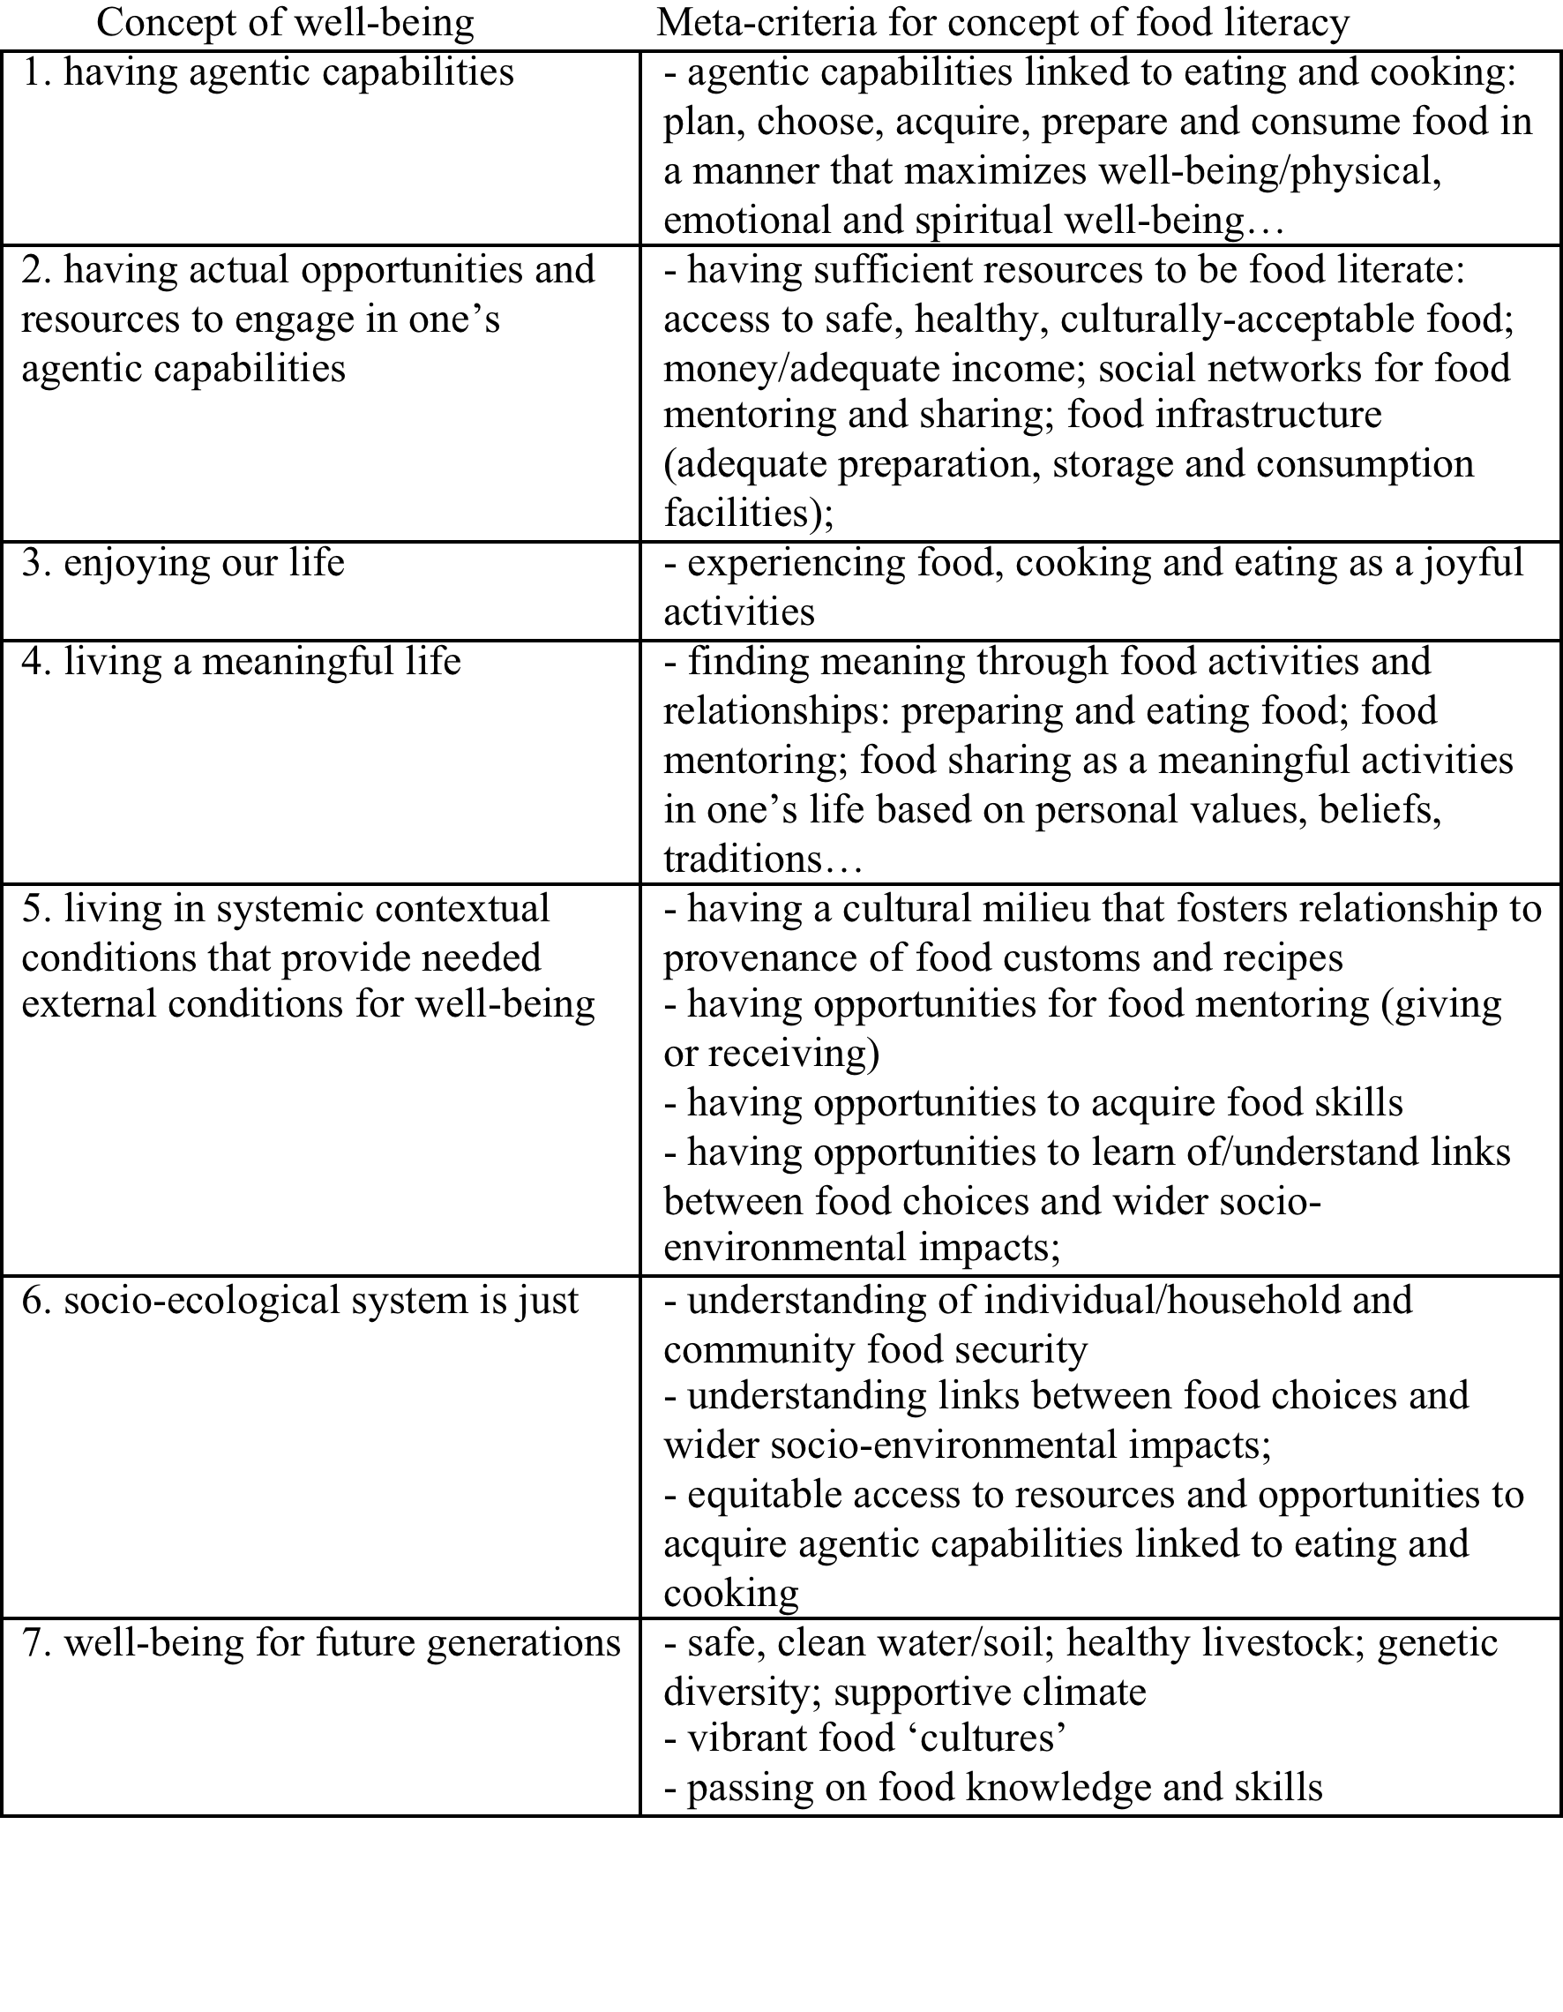
Food Literacy and Well-Being
Falconberg 2014

Slide 9
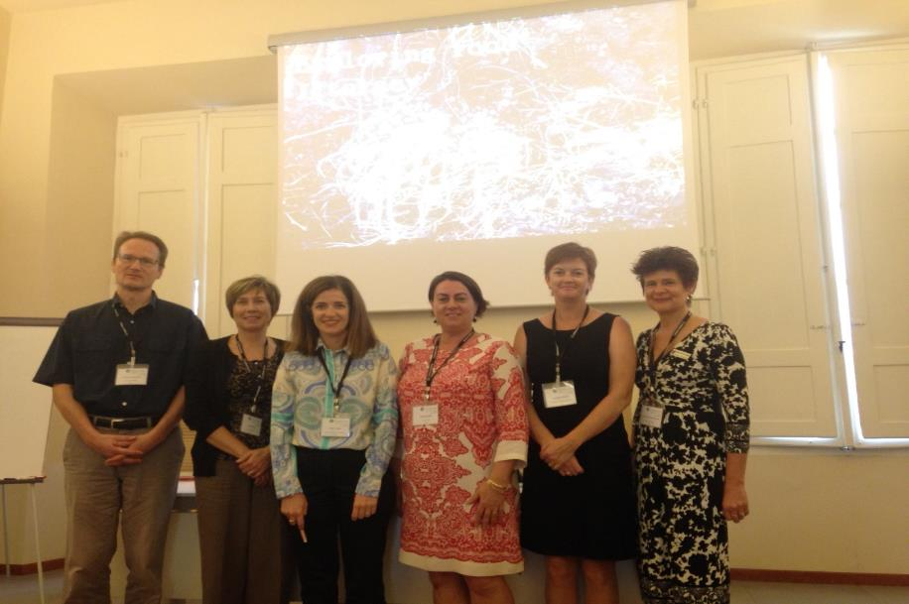
Food Studies Conference- Prato 2014
Title: Exploring Food Literacy…
From L to R: Thomas Falkenberg, Joyce Slater, Helen Vidgen, Andrea Begley, Danielle Gallegos, Sandra Fordyce-Voorham

Slide 10
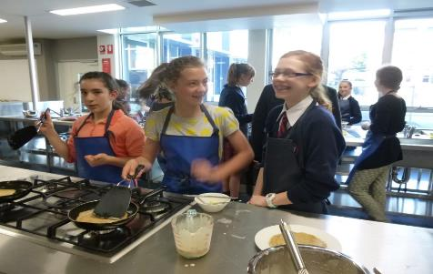
Who are the players in schools?
Food and nutrition teachers are in-house food experts
teach young people the food skills that they need to live healthy and independent lives
- most confine teaching to the procedural food skills (preparation and cooking of healthy meal and snacks)
“WE’RE NOT JUST COOKING PANCAKES”
Notes:
Home economics teachers’ are the in-school food experts However, due mainly to the time constraints of the crowded school curriculum (and the sometimes marginalisation of home economics having to compete with non life skills subjects) most teachers confine their teaching to the procedural food skills, that is; the preparation and cooking of healthy meal and snacks.

Slide 11
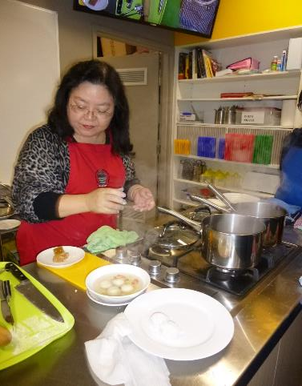
Procedural Skills – the ‘hands-on’ skills
How shall we cook tonight’s dinner?

Slide 12
Procedural Skills – the ‘hands-on’ skills
FOOD LITERACY
Is the ability to..
3. Preparation
3.1 Make a good tasting meal from whatever food is available. This includes being able to prepare commonly available foods, efficiently use common pieces of kitchen equipment and having a sufficient repertoire of skills to adapt recipes (written or unwritten) to experiment with food and ingredients.
‘Clean as you go’ and clean after the meal is prepared
3.2 Apply basic principles of
safe food hygiene and handling.
4. Eating
4.1 Understand food has an impact on personal wellbeing.
4.2 Demonstrate self-awareness of the need to personally balance food intake. This includes knowing foods to include for good health, foods to restrict for good health, and appropriate portion size and frequency.
4.3 Join in and eat in a social way.
4.4 Evaluation – what would I do differently next time?
Helen Vidgen
Notes:
4.1 and 4.2 – declarative skills

Slide 13
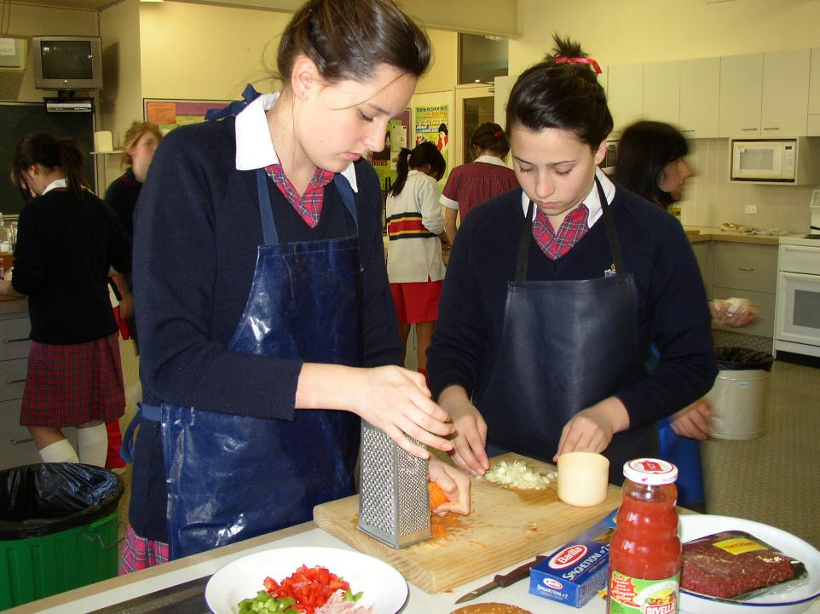
PROCEDURAL SKILLS
IN ACTION

Slide 14
Food (literacy) skills content of a skill-based program
The twelve essential food (life) skills content include:
Consumer knowledge, information and skills- where food comes from
Hygiene and Safety knowledge and skills
Meal knowledge and skills- food planning
Nutritional Health knowledge
Cookery Methods knowledge
Equipment knowledge (kitchen tools and small and large appliances)
Food exposure knowledge (restaurant, market visits, guest speakers)
Seasonal Produce knowledge (when fruits and vegetables are in season)
Troubleshooting knowledge (how to anticipate and rectify culinary ‘disasters’)
Sources information (where information obtained; cookbooks, Internet, food magazines, television, markets, supermarkets)
Terminology information (culinary terms and techniques defined and described)
Skills acquisition (knife skills, meal preparation and cooking competencies)
Fordyce-Voorham (2010)
Notes:
Be strategic – match the recipes to incorporate the skills. Choose recipes that cover several essential skills to accommodate short-term programs
The Hyperlinks are directly linked to relevant section of the FFL website

Slide 15
Definition of Food Literacy in context with declarative skills
Declarative (Reynolds J, 2000) skills focus on the context in which that meal is constructed: the suitability of the meal occasion, decisions and resources required to complete the meal to a level considered satisfactory to the food preparer and for the other individuals consuming the meal.
They include the food literacy skills which refers to an individual’s ability to make effective consumer decisions such as weighing-up the monetary versus the time-saving costs of purchasing convenience foods (Lang & Caraher, 2001).

Slide 16
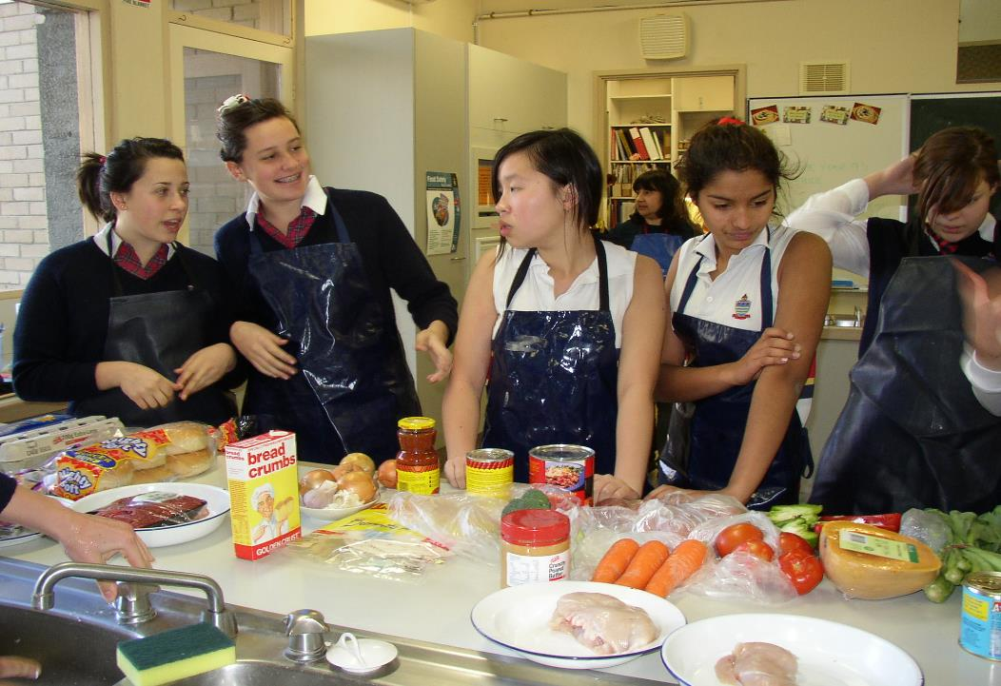
DECLARATIVE SKILLS IN ACTION

Slide 17
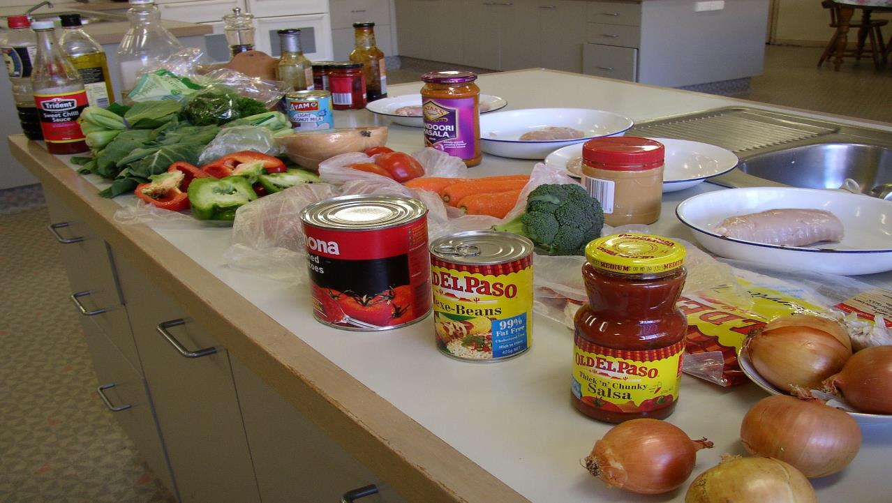
WHAT’S IN MY PANTRY? REFRIGERATOR?

Slide 18
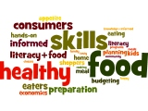
Declarative Skills – the thinking skills
What shall we have for dinner tonight?
Two-stage process skill of designing and planning of healthy meals to suit the dietary and sensory (likes and dislikes) needs of family members and friends consuming those meals.
Notes:
2 stage process – Helen’s 1. Planning and Management and 2

Slide 19
Declarative Skills – the thinking skills
1. Planning
and Management
1.1 Prioritise money and time for food.
1.2 Plan food intake (formally and informally) so that food can be regularly accessed through some source, irrespective of changes in circumstances or environment.
1.3 Make feasible food decisions which balance food needs (e.g. nutrition, taste,
hunger) with available resources (e.g. time, money, skills, equipment).
2. Selection
2.1 Access food through multiple sources and the know advantages and disadvantages of these sources.
2.2 Determine what is in a food product, where it came from, how to store it and use it.
2.3 Judge the quality of food.
FOOD LITERACY
Is the ability to..
Helen Vidgen
Notes:
What does food literacy include
What would be the difficulties in measuring these items
How close was I to what you wrote down

Slide 20

DECISION MAKING PROCESS
1. PLANNING AND INVESTIGATING (Declarative skill) considers
- number, age, food intolerances likes & dislikes of diners
resources of skills, time, energy, money, equipment, recipes, access to food
2. IDENTIFYING AND WEIGHING ALTERNATIVES (Declarative skill) considers
Assessing meal choices
3. TAKING ACTION (Procedural skill)
Preparing and making the meal
4. EVALUATING (Declarative skill)
What would I do differently next time?
Notes:
Declarative skills- food literacy
Procedural skills- hands-on food preparation and cooking

Slide 21
The need to evaluate food skills programs
Teachers lack time and access to databases to evaluate their food skills programs
I teach Year 8, with a real emphasis on safety & hygiene, food handling & cooking skills in one theory lesson and one cooking lesson, per week. The constraints of the timetable is a significantly limiting factor with the school allocating semester elective subjects across many year levels, only giving the students a limited view of the breadth of this subject. Teacher, Melbourne. 08/09/14
Rely on researchers to promote and endorse their work
Notes:
How do we know our programs work?
How do we know what the essential food skills are? And how do we decide what skills to teach if our programs are short?
We know we have plenty of anecdotal evidence as students come back to tell us..
Answer- my research identified the skills – followed up with over 300 teachers to validate.
Current research is condensing the essential skills into 10 week short programs that match with the national Australian curriculum

Slide 22
Food Literacy Model for Schools
Figure 1 A food literacy model for schools (Fordyce-Voorham, 2015)

Slide 23
Description of Food Literacy Model
Basic level – described as the operational dimension (Renwick K, 2013), the food tasks performed at this level focus on the individual and their interactions with food.
Examples include:
an individual’s food likes and dislikes,
access to different food varieties (fresh and processed) and amount of food,
basic knowledge of the origins of food,
the chemical (nutritional) and sensory (aesthetic) properties and analysis of food in relation to their health.
Notes:
an individual’s food likes and dislikes, access to different varieties (fresh and processed) and amount of food, basic knowledge of the origins of food (‘Paddock to Plate’), the chemical (nutritional) and sensory (aesthetic) properties of food in relation to their health.

Slide 24
Description of Food Literacy Model
Intermediate level – described as the cultural dimension (Renwick K, 2013), the food tasks performed at this level involve the individual interacting with people (family, teachers, students and local shopping vendors) in their near environment
Examples include:
- family food likes and dislikes including cultural variations
- food decisions: “gate-keeping” of food
- availability of, and access to food in the home
- availability of, and access to food in the community
Notes:
Intermediate level – described as the cultural dimension (Renwick K, 2013), the food tasks performed at this level involve the individual interacting with people (family, teachers, students and local shopping vendors) in their near environment (Micro-Meso system).
Examples include: family food likes and dislikes, food decisions (“gate-keeping” of food – who and what influences the food planned, purchased, stored, prepared and consumed in the home and school), availability of, and access to food in the home (farmyard, backyard and balcony gardens and domestic food production of eggs and preservation of home-grown fruits, nuts and vegetables) and community (supermarkets, strip shopping fresh food vendors such as butchers, greengrocers, bakeries, roadside stalls and farmers’ markets)

Slide 25
Description of Food Literacy Model
Advanced level – described as the critical dimension (Renwick K, 2013), the food tasks performed at this level involve the individual interacting with the social environment (media, culture, society, technology) and making ethical decisions about food including sustainability
Examples include:
social (including television, digital and print media and technology) and
cultural factors influencing and modifying individual and family food decisions and choices. Decisions to use smart foods
Notes:
Examples include: social (including television, digital and print media and technology) and cultural factors influencing and modifying individual and family food decisions and choices.

Slide 26
Putting it together
Or where do we go from here?...
Both terms ‘food skills’ and ‘food literacy’ interrelate
Recommended to inform the design and delivery of sustainable and evidence-based food education programs
Suggestions for further reading - evaluation of food skills/literacy program to support your teaching in schools- Fordyce-Voorham (2018) and Slater J et al (2016)
Notes:
Hot links to journal article and document to help underpin your programs

Slide 27
For further information, go to:
www.foodafactoflife.org.uk

