Slide 1

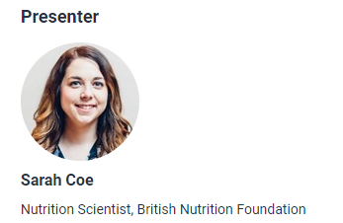
The Quality Calorie concept – because a healthy diet is about both quality and quantity
4 July 2019

Slide 2
The Quality Calorie (QC) concept
Because a healthy diet is about both quality and quantity
Sarah Coe
4 July 2019
Food – a fact of life webinar

Slide 3
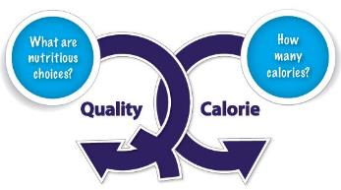
Good nutrition is more than calories
Obesity is a major public health issue, but are calories the only nutritional issue we should be thinking about?
In this webinar, we will explore why for our health we need to think about more than just calories and to consider foods that provide vitamins, minerals, fibre and healthier fats, and how we hope the QC concept may help to do this.

Slide 4
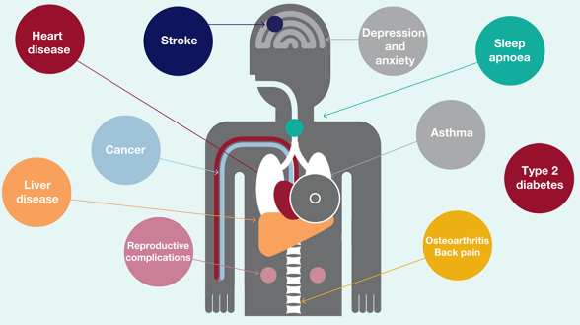
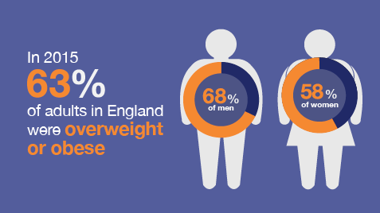
We are rightly concerned about obesity!
“We spend more each year on the treatment of obesity and diabetes than we do on the police, fire service and judicial system combined”
PHE 2017/2018

Slide 5




Childhood obesity
1 in 5 children starts school overweight or obese
By the time children leave primary school, 1 in 3 overweight or obese
Children living in deprived areas are twice as likely to be obese
Obese children are more likely to become obese adults and have a higher risk of morbidity, disability and premature mortality in adulthood
EYN Partnership 2016

Slide 6
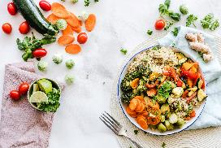
Healthier dietary patterns
We know that on average we are consuming too many calories – 200-300 calories in excess per day. Being aware of the calories we eat and drink can help with weight management. But intakes of micronutrients and fibre are very important for good health.
Healthier dietary patterns include: plenty of fruit, vegetables and wholegrains, good sustainable protein sources (e.g. pulses), good sources of healthy fats (e.g. nuts, seeds and oily fish) and healthy hydration (lower sugary drinks, not excess alcohol)
Reduced risk of heart disease and strokes
Lowering of blood pressure
Reduction of blood cholesterol
Reduced risk of some cancers
Reduced risk of type 2 diabetes
Better cognitive health
But are we eating like this in the UK?

Slide 7



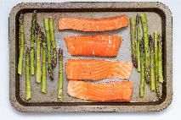

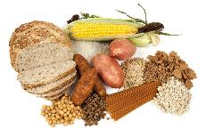
Snapshot of the UK diet
TOO MUCH
NOT ENOUGH
5 A Day well recognised but we are still not meeting this
Average fruit & veg intake in teenagers similar to toddlers!
(168 vs. 170g/d)
Why is quality of calories important as well as quantity?
Poor dietary choices reflected in poor nutrient intake

Slide 8
Vitamins and minerals – evidence of low intakes in the UK?
UK National Diet and Nutrition Survey (NDNS) - % males & females of different ages with intakes of micronutrients below lower reference nutrient intake (LRNI)
 | 11-18 years |  | 19-64 years
 | Male | Female | Male | Female
Calcium^{ⱡ} | 11 | 22 | 7 | 11
Folate^{ⱡ ⱡ} | 2 | 15 | 3 | 5
Iodine^{ⱡ} | 14 | 27 | 9 | 15
Iron^{ⱡ} | 12 | 54 | 2 | 27
Potassium^{ⱡ} | 18 | 38 | 11 | 23
Zinc^{ⱡ} | 18 | 27 | 7 | 8
^{ⱡ} food sources only ^{ⱡ ⱡ} food sources and supplements
Intakes below the LRNI are inadequate for most individuals
Some DRVS (e.g. potassium, zinc) based on limited data health impact of intakes below LRNI is unclear

Slide 9
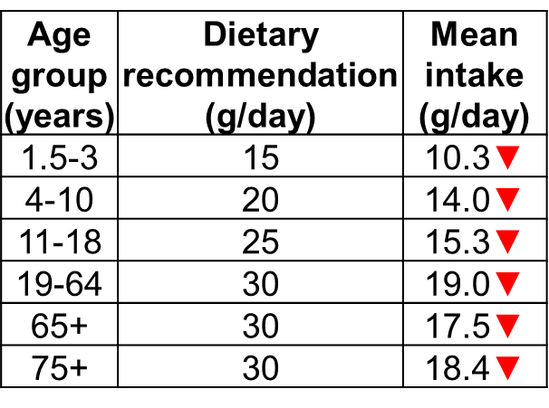

Fibre – forgotten?
The government has increased the recommendation for fibre intake to 30g/day for adults and 15-30g/day for children
Dietary fibre can reduce risk of heart disease, type 2 diabetes and some cancers, and is important for digestive health.
18% adults & 15% children
no wholegrain consumption
SACN 2015, Bates et al. 2014

Slide 10

How do we combine concepts of
calories and nutrient quality?

Slide 11
The ‘Quality Calorie’ (QC) concept
It is important to reduce calories to tackle obesity BUT we need to think about the nutrient quality and
‘Make every calorie count’
But how can we encourage consumers to do this - to make better choices for nutritional quality?
Could thinking about QC help?
Small, simple swaps that can be made every day to improve the nutritional quality of our diets, for the same or fewer calories
It’s NOT about deprivation, its about making positive QC choices!

Slide 12

The QC - because it’s more than just the numbers!
If we only think about calories…
  What about oily fish?
  What about wholegrains?
  What about sources of healthy fat? (e.g. nuts and seeds, rapeseed oil, avocado)
  What about salt?
Notes:
If we only think about calories as numbers, then we might choose to avoid foods that are relatively high in calories but also have a high nutritional value like …. – all of which can be included as part of healthy dietary patterns.
We might also forget about nutrients such as salt, which doesn’t contribute calories to the diet but is important to consider in terms of its effects on health

Slide 13
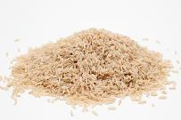
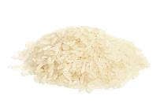


The QC - because it’s more than just the numbers!
Foods with a similar calorie content can be different in terms of the nutrients they provide.
instead of
Fibre
Fibre
instead of
Free sugars
Saturated fat

Slide 14
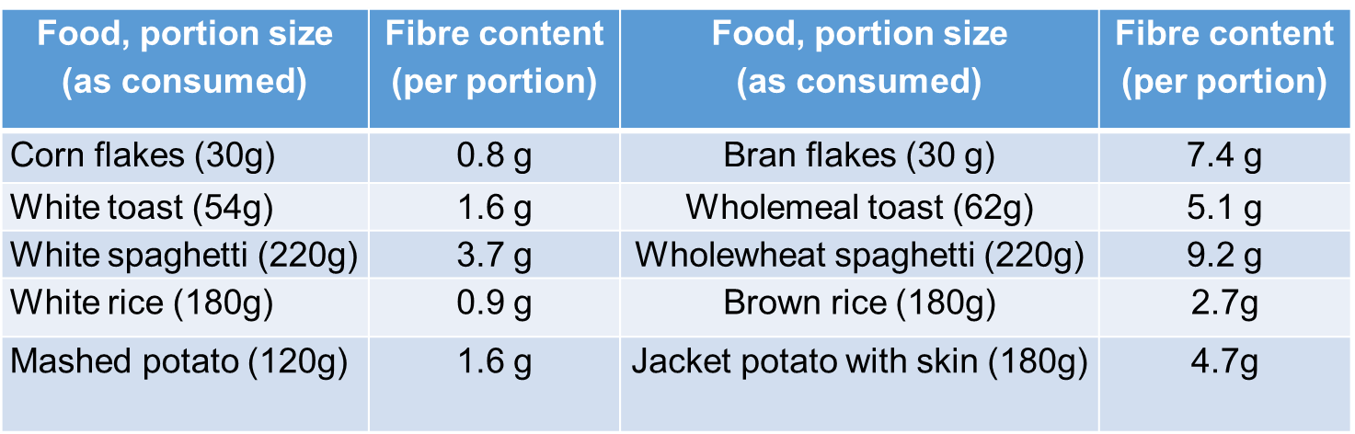
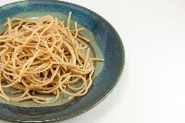

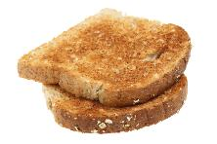
The QC – swapping for fibre and more!
B vitamins
Vitamin E
Protein
Selenium
Fibre-containing foods (fruit and veg, wholegrains, pulses, nuts, seeds) are the basis of a healthy, balanced diet.

Slide 15
How can everyday meals, snacks and drinks be QC’d?
What’s your QC?
Why not QC today?
How QC is that?

Slide 16

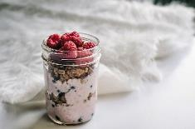
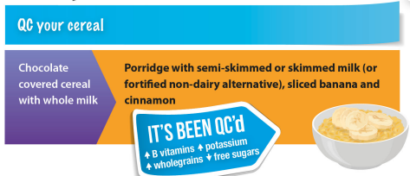

QC your breakfast

Slide 17
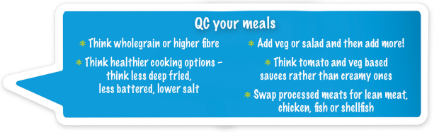

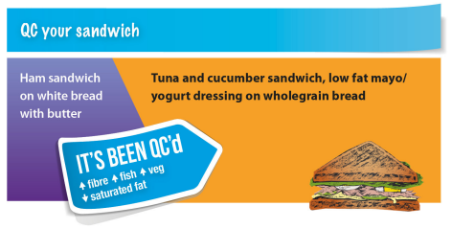
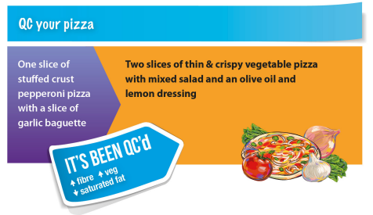
QC your meal

Slide 18
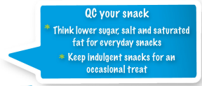

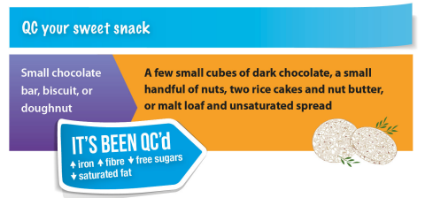
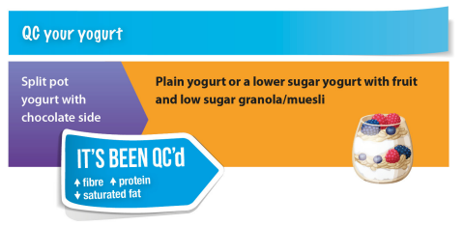
QC your snack

Slide 19



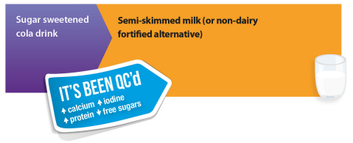

QC your drink
*Fruit juice and smoothies combined should be limited to one small glass a day

Slide 20
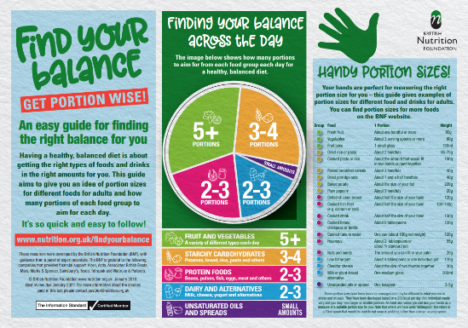
The QC – portion size is important too
Remember to QC in moderation
There are simple ways that people looking to manage their weight can do this; for example, keep the number of nuts to a handful or use a spoon to measure out oils.
‘Find your Balance’
http://bit.ly/BNFfindyourbalance

Slide 21

QC on a budget:
Nutrient intakes and household income
Latest UK dietary surveys show that lower income households are more likely to have:
Fruit and vegetables Sugar-sweetened drinks
Fibre Free sugars (not children)
Nutritional status and intake for some
micronutrients (e.g. folate)
Bates et al. 2019

Slide 22

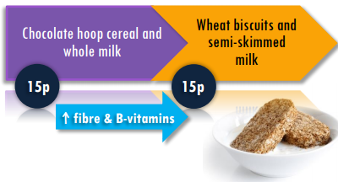
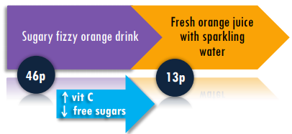
QC on a budget
Healthier diets can be more expensive so it’s important to consider costs. The issue of healthy eating and deprivation is serious, complex and multifactorial.
‘QC on a budget’ of course can’t solve this, but we hope it provides some helpful tips when money is tight
Breakfast
Drinks

Slide 23
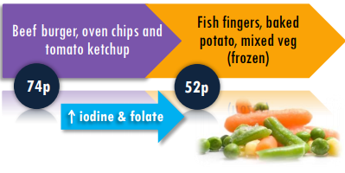
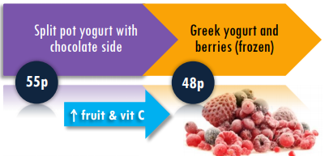
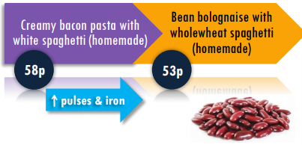
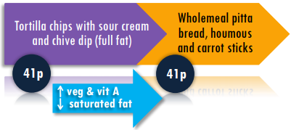
QC on a budget
Meals
Snacks
Use frozen fruit and veg – cheaper and less waste
Top Tip: add canned beans to dishes

Slide 24
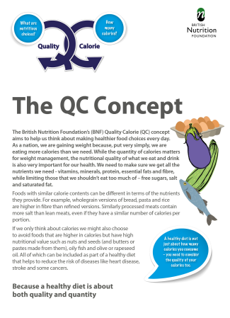
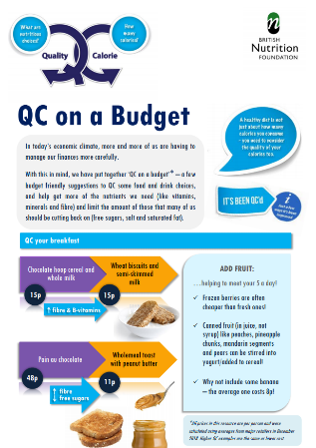
The resources
https://www.nutrition.org.uk/healthyliving/helpingyoueatwell/qualitycalorie.html

Slide 25

Acknowledgement
For further information, go to: www.nutrition.org.uk
Why not follow us on Twitter? @BNFEvents @Foodafactoflife

Slide 26
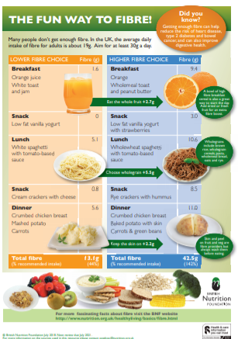
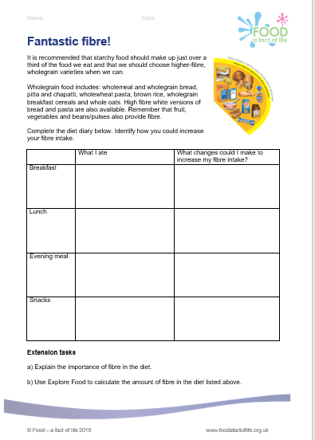
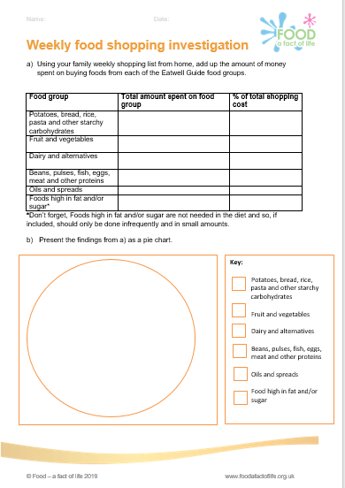
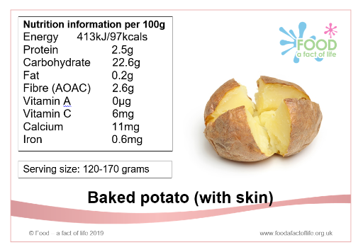
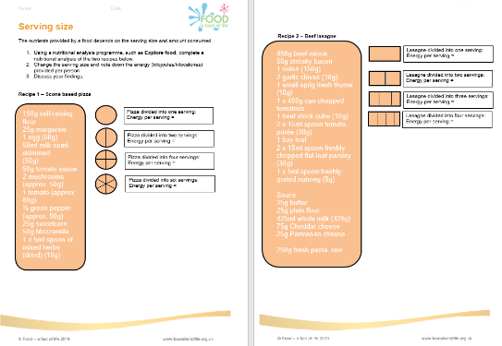
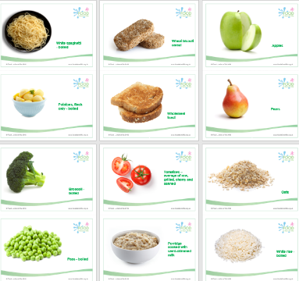
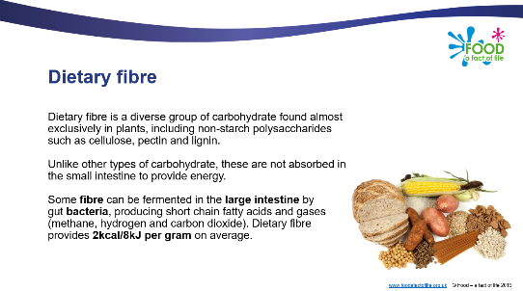
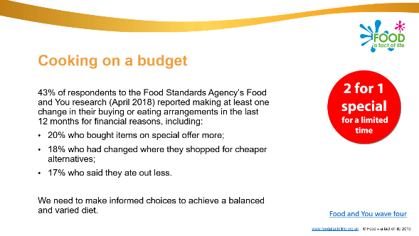
Food – a fact of life resources

Slide 27
The Quality Calorie concept – because a healthy diet is about both quality and quantity
For further information, go to:
www.foodafactoflife.org.uk

