Slide 1

Food security, provenance and quality in the UK
3 April 2019

Slide 2
Food security, provenance and quality in the UK
Where does food come from and why?
David Swales
Head of Strategic Insight, AHDB

Slide 3


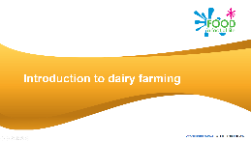
Who are AHDB?
The Agriculture and Horticulture Development Board (AHDB) is a statutory levy board, funded by farmers, growers and others in the supply chain and managed as an independent organisation.
AHDB supports 6 sectors of the agriculture industry: beef and lamb, cereals and oilseeds, dairy, horticulture, pork and potatoes.
In exchange for the levy, AHDB provides guidance and support to farmers and growers. We are in partnership with the British Nutrition Foundation to bring you the Food – a fact of life education programme.

Slide 4
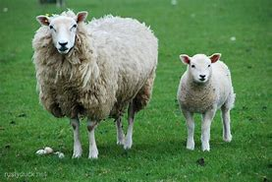
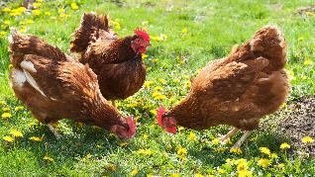
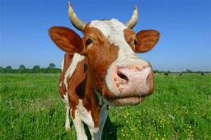
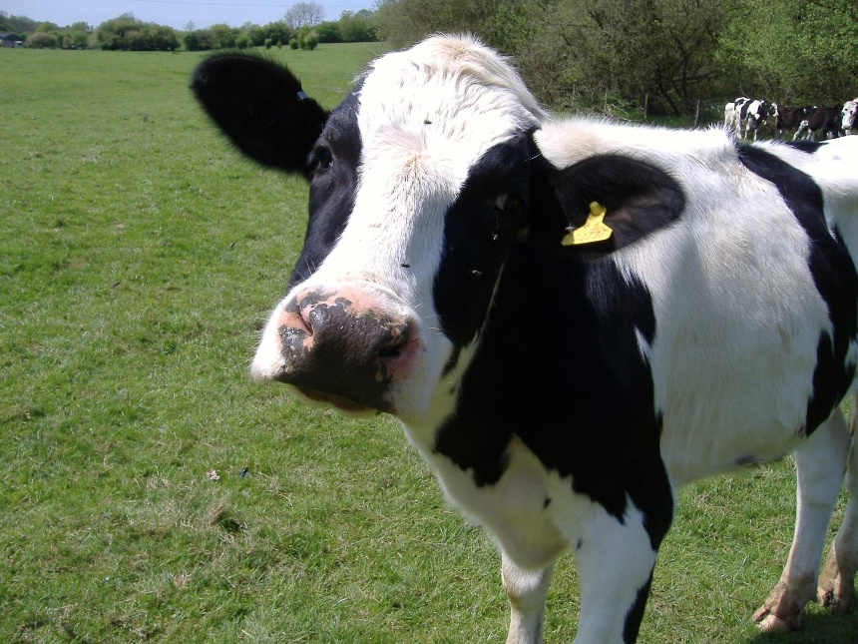
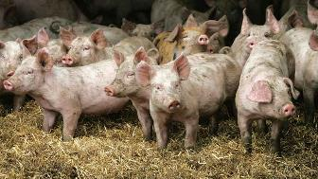
The UK is not self-sufficient for producing food
Farming cover 12.5 million hectares – 72% of land in the UK
Total labour force = 474 thousand
Only 60% self-sufficient for food
10 million cattle
81%
182 million birds
90%
35 million sheep
101%
2 million dairy herds
80%
5 million pigs
61%
Source: Agriculture in the UK 2017, livestock numbers with self-sufficiency %

Slide 5
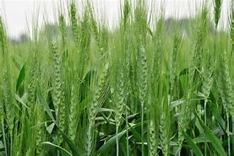
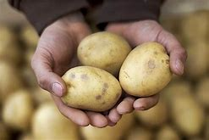
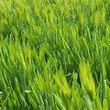
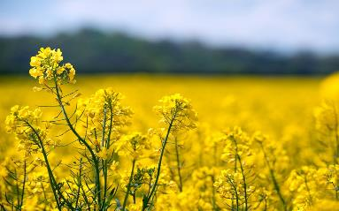
Area of arable and cropping in the UK, with self sufficiency %
145 thousand hectares potatoes
74%
1.8 million hectares wheat
92%
1.2 million hectares barley
115%
562 thousand hectares oilseed rape
91%
Source: Agriculture in the UK 2017

Slide 6
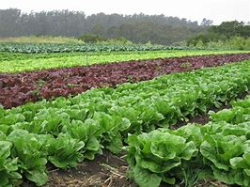
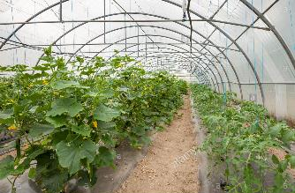
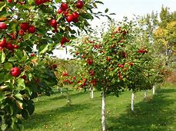
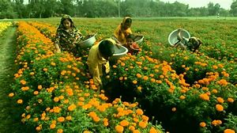
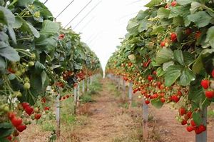
Area of horticulture crops grown in the UK, with self sufficiency %
3 thousand hectares of glasshouse
crops
117 thousand hectares of vegetables
57%
24 thousand hectares of orchard fruit
13 thousand hectares of outdoor plants and flowers
11 thousand
hectares of soft
fruit and wine
grapes
16%
Source: Agriculture in the UK 2017

Slide 7
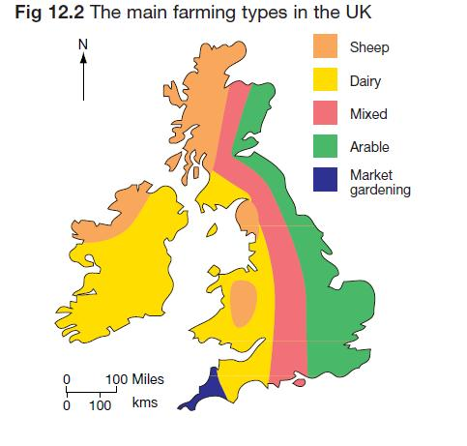

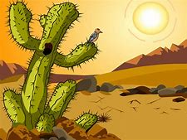


Predominant farm types

Slide 8



Why don’t we produce more?
117 thousand hectares of vegetables
11 thousand
hectares of soft
fruit and wine
grapes
13 thousand hectares of outdoor plants and flowers
Climate
Economics
Seasonal

Slide 9
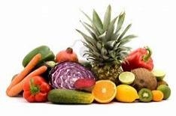
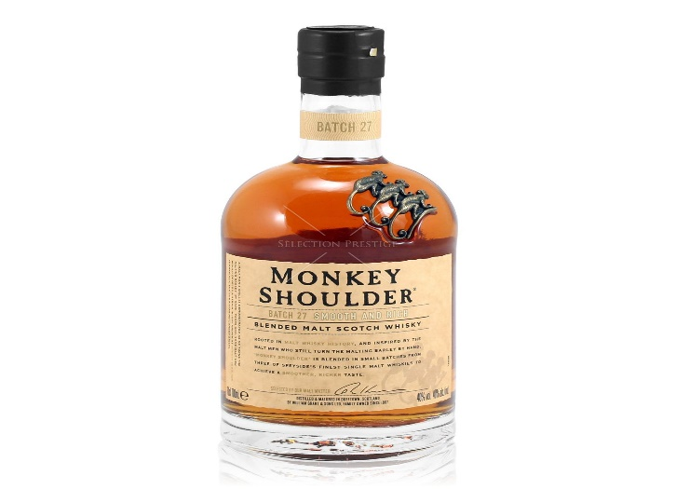

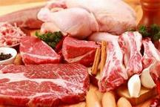
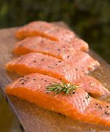
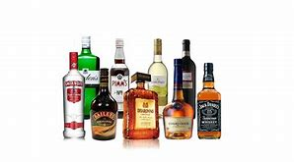

UK agricultural trade
Fresh fruit and vegetables
Whisky
Top Imported Products
Top Exported Products
Meat
Salmon
Beverages
Sources: AHDB/HMRC
Beer

Slide 10
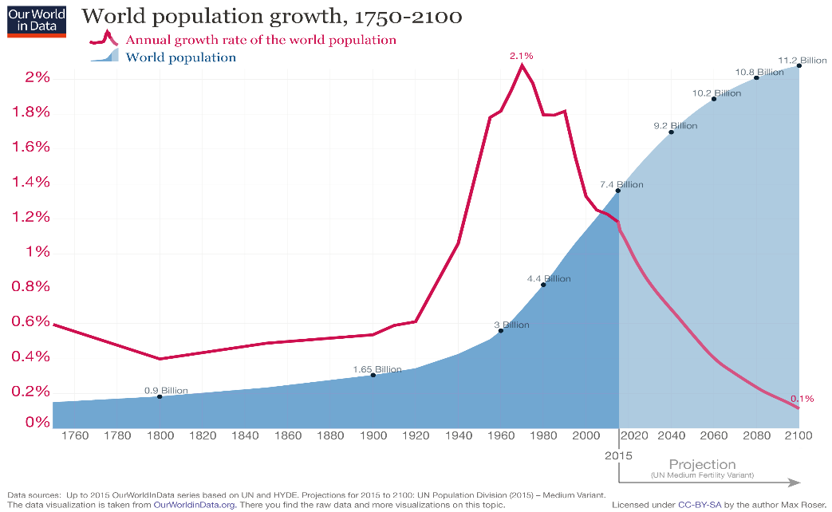
Do we need to be more self-sufficient?
- World population growth

Slide 11
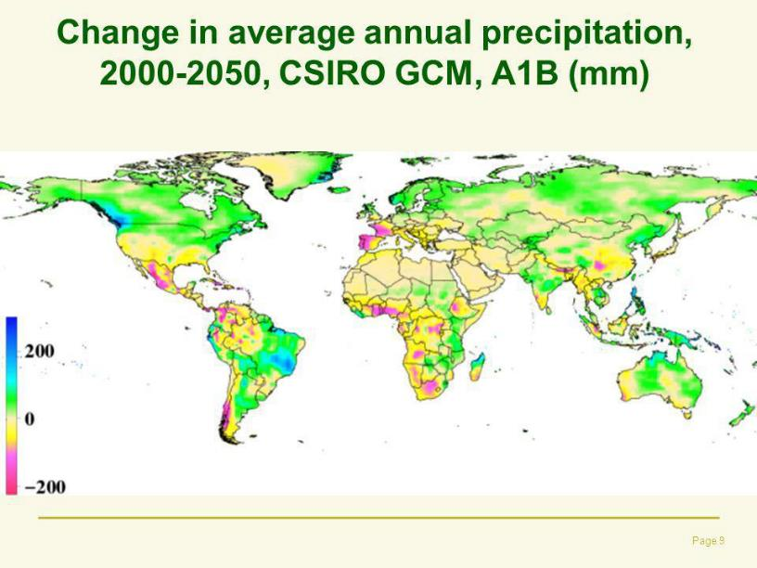
Climate change
Source: Foresight Report

Slide 12
But would shoppers back British?

Slide 13
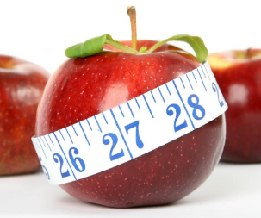

Consumer priorities when grocery shopping
£
Price and promotions
Quality
Pack size
Three of the top attributes consumers say are important in their purchase decision
Source: IGD ShopperVista Category benchmark research, 2017, base 3,400 UK supermarket shoppers

Slide 14


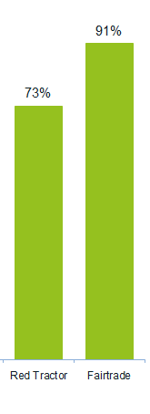
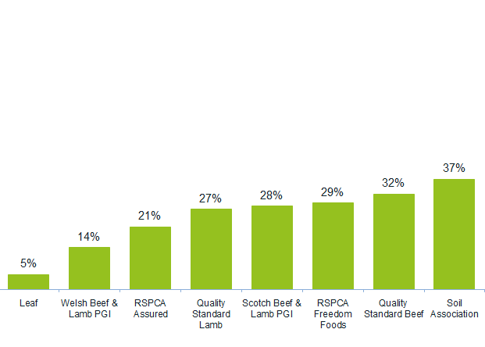








Quality label awareness
AHDB/ YouGov tracker.Q Have you seen this mark before?

Slide 15
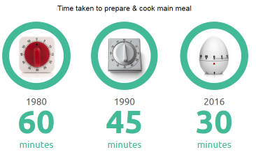
Continued drive for convenience
Time taken to cook and prepare main meals is reducing
Search for quicker convenient meals
Meals plans and products that fit well with this have proved popular
Market has seen of convenience themed products hitting the market
Source: ONS/Kantar Worldpanel Usage

Slide 16
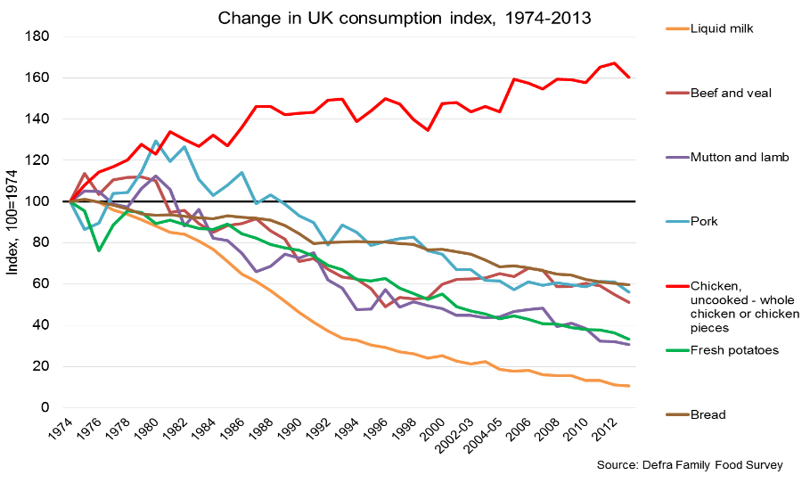
Long-term changes in consumer behaviour are impacting on our industry

Slide 17

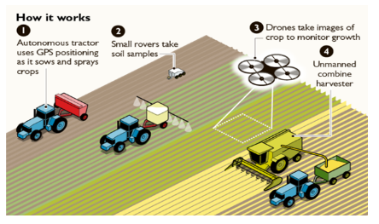
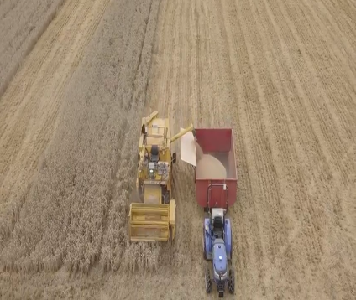
Is technology the answer? eg. Automation - hands free hectare
They are automated machines growing arable crop remotely, without operators in the driving seats or agronomists on the ground.
In a world-first, members of Harper Adams University engineering staff, are attempting to grow and harvest a hectare of cereal crops; all without stepping a foot into the field.
Reduces labour costs and time.

Slide 18
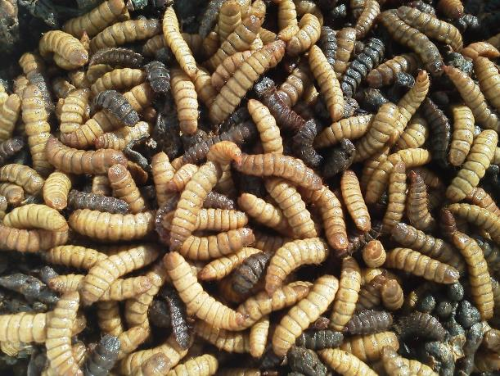
Eg. Sustainable protein from insects
Entocycle are a UK based company looking to supply insect protein, as alternative to Soya and fish meal, to the livestock and aquaculture markets.
Feeding of food waste, such as brewers grains, to Black soldier fly larvae to produce high protein body mass in 14 days.
Insects are 45-65% protein, and are processed into flour ready for distribution
Protein flour combined with other products by the feed industry.

Slide 19


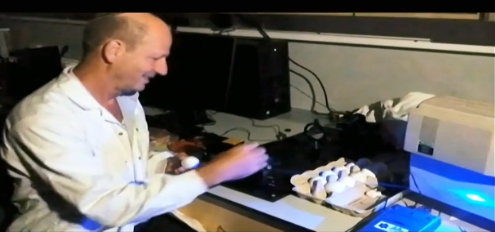
Eg. Biotechnology - EggXYt
EggXYt is developing a technology that enables sex detection of chick embryos immediately after the eggs are laid.
They edit the chicks gene so that only the male chicks carry a bio-marker, which can be detected by the SexXYt machine.
SexXYt only allows female eggs to be incubated. The male eggs are separated by the yellow colour when entering the machine and are sent to the secondary market instead.

Slide 20
Summary
The UK is dependent on food imports to maintain our food security.
There are good reasons for importing food such as climate, economics and seasonality.
Consumers are key, with most seeing price as the key driver for product choice. As consumer requirements change this has an impact on agriculture and the wider supply chain.
Global population growth and climate change and massive challenges for agriculture.

Slide 21
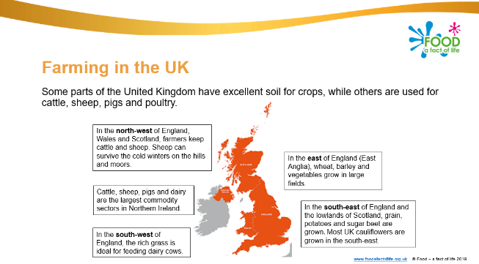
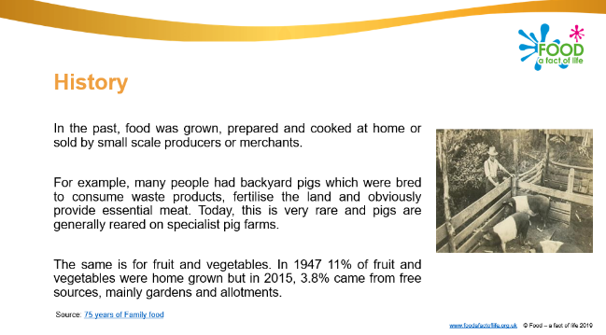
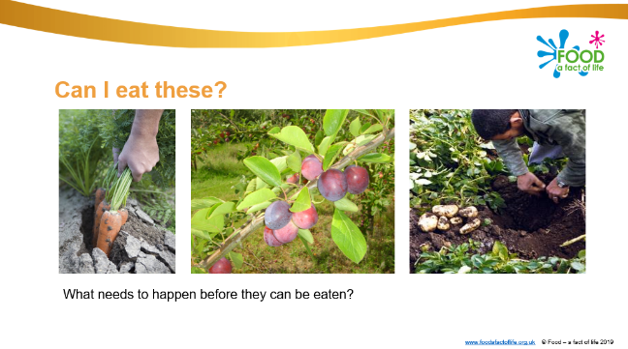
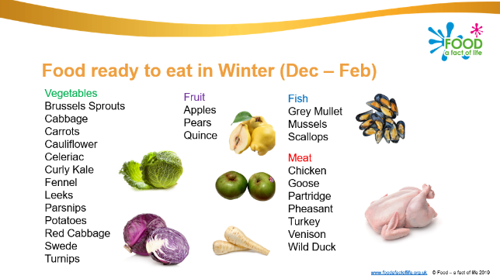
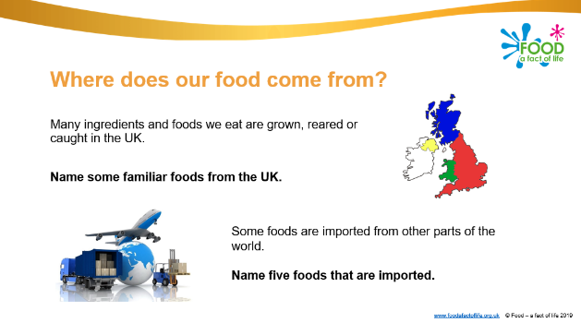
Further resources - Where food comes from
Food origins
Farming and processing
Food availability
https://www.foodafactoflife.org.uk/11-14-years/where-food-comes-from/

Slide 22
For further information, go to:
www.foodafactoflife.org.uk

