Slide 1
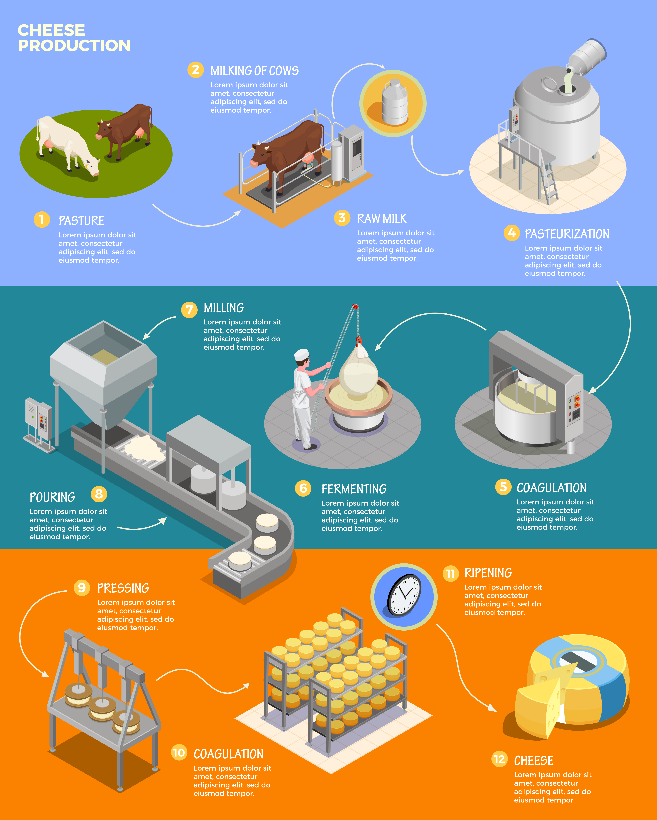
Background to cheese making
Cheese is defined as a product intended for sale for human consumption, obtained by coagulating and/or combining milk products.
Coagulation separates the milk into solid curds and liquid whey.
Most cheese is made from the curds (a notable exception being some types of ricotta).
Coagulation results from the denaturing of casein proteins in the milk.
This is commonly achieved with the help of lactic acid bacteria and the enzyme rennet, though other methods of coagulation are also possible.
In this session, we’ll be using lemon juice and heat as an alternative to rennet.

Slide 2
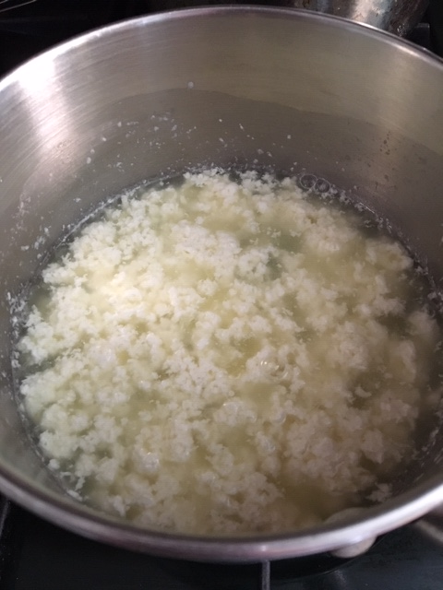
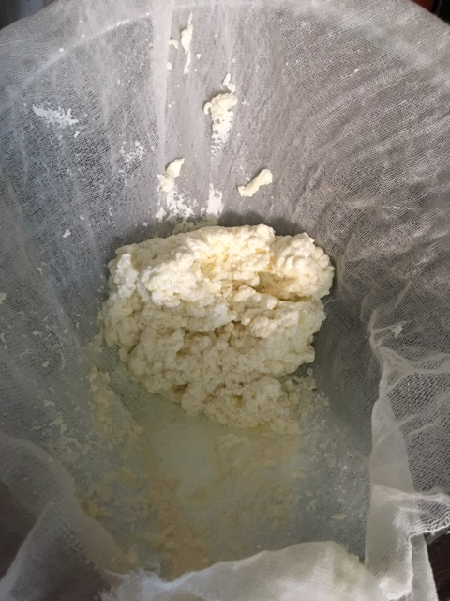
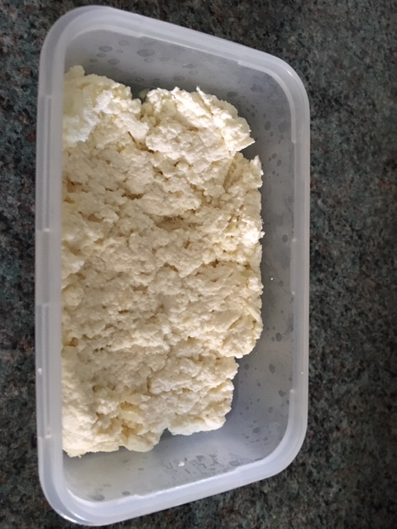
Making a soft cheese
Ingredients:
500ml whole milk
1 large lemon (approx.
50ml juice)
Method:
Juice the lemon.
Slowly heat the milk and stir in the lemon juice when the milk reaches 37°C.
Remove from the heat at about 50°C and allow to cool for 5-10 minutes.
Strain the milk through the muslin cloth, which is in the sieve over a bowl.
Wrap the cloth over the cheese and gently press to help remove the whey.
Place the cheese into a small container to help form its shape.
Put the cheese into the fridge to chill.
Equipment:
Chopping board
Knife
Juice squeezer
Saucepan
Measuring jug
Digital food probe
Muslin cloth
Sieve
Bowl
Small container

Slide 3


The science behind your cheese
Casein proteins are not readily coagulated by heat. However at pH <4.6 they begin to coagulate, which is why the lemon juice is added. Heating raises the effective pH to around 5.2.
Most cheeses use lactic acid bacteria to generate the low pH and also use the enzyme rennet.
Coagulation results in what is essentially a gel; the coagulated casein proteins surround globules of milk fat.
The gel is then set by the chilling process.
Whey proteins also coagulate at temperatures above 72°C. That means that this cheese will also contain whey proteins.
In regular cheese production, temperatures do not normally exceed about 37°C, which is the temperature rennet works best at.

Slide 4

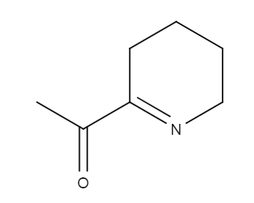
Optional extra: the science of toast
Toast makes a quick and tasty accompaniment to the soft cheese.
When bread is heated in the toaster, three main reactions give it it’s brown and ‘toasty’ characteristics.
Dextrinisation results from the dry heating of starch. The exposed starch on the surface of the bread is broken down by heat, producing shorter-chained dextrins, also brown in colour.
Caramelisation occurs to a small degree, with sugars present in the bread being broken down by heat and forming molecules with a caramel flavour and colour.
The Maillard reaction is a complex reaction between amino acids found in protein and reducing sugars*. It results in a wide variety of usually brown-coloured end-products which often have distinctive, pleasant aromas and tastes.
*Reducing sugars are sugars with an
aldehyde or ketone group, which can
react with amino acids. These sugars can react
with other components of the food (e.g. amino acids)
to change the colour, taste and aroma of the food.
Notes:
6-Acetyl-2,3,4,5-tetrahydropyridine

