Slide 1

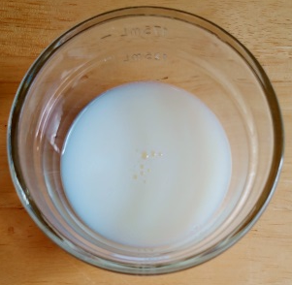
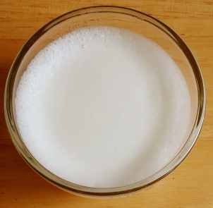
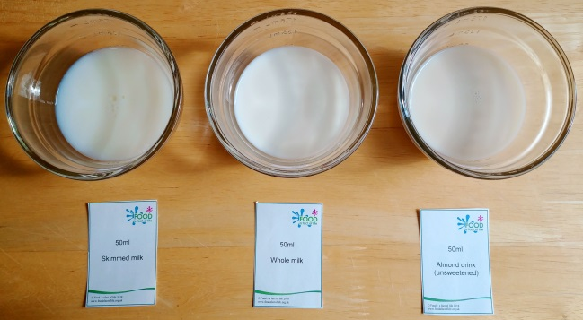
Milk foam information sheet
What are foams?
A foam is formed when air or another gas is trapped within a liquid or solid.
For a foam to be successful it must remain stable. An unstable foam quickly collapses and becomes unusable.
Many foods are foams, including meringue, whipped cream, cakes and even bread!
A milk foam is created by frothing milk, allowing air to be trapped by the liquid.
Milk contains proteins. These proteins are normally tightly folded, but when the milk is frothed enough they can ‘denature’ and change their shape.
They can then bond together in a network. This network surrounds the air bubbles and makes the foam stronger.
When fat is present, it can disrupt the protein network and burst the fragile air bubbles.
In some products, stabilisers and emulsifiers are added, which can help to keep the foam stable.
Below is a before and after example of a milk foam.
Before
After
Milk foam experiment
You will need:
skimmed milk, whole milk
and a dairy alternative;
three small clear bowls or cups;
hand-held milk frother;
timer;
measuring jug.
Method:
Measure 50ml of the milks and dairy alternative and pour into the bowls or cups. Label clearly.
Using the milk frother, froth the liquid for 20 seconds.
What has happened? Write down your observations.
Taste the foam. Write down your observations.
Check the foam again after two and then 10 minutes. What has happened to the foam?
Questions
Which foam was the most stable?
Why do you think that is?
What might be making the least stable foam unstable?
Why might a dairy alternative have a stable foam, even if it has a low protein content?
An example of the experiment set up
© Food – a fact of life 2019
www.foodafactoflife.org.uk

