Slide 1
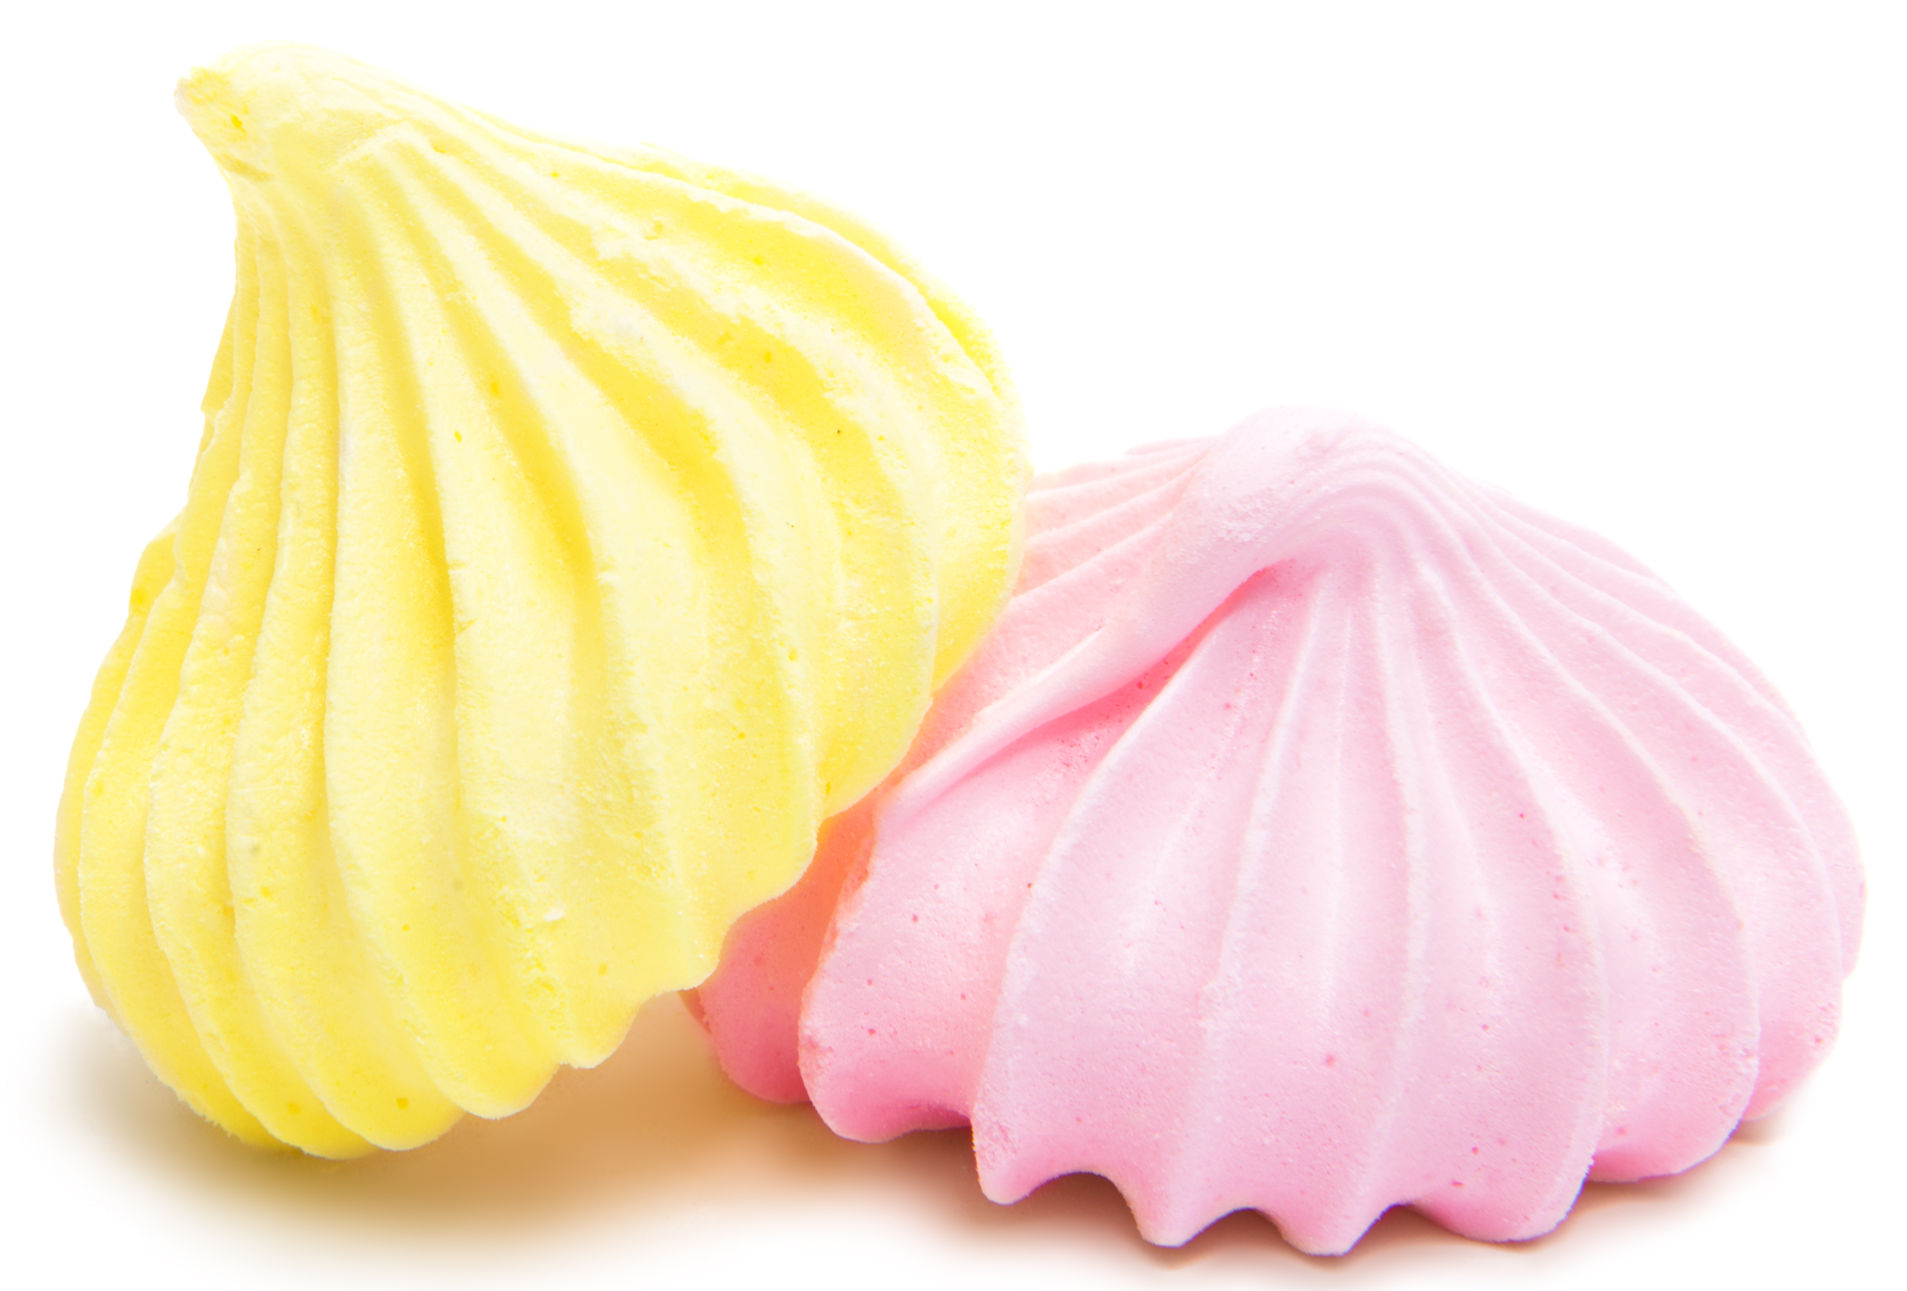
What are foams?
A foam is formed when a gas (usually air) is suspended in either a liquid or solid matrix.
There are a number of different ways foams can form, but the desired result remains the same: Incorporate air into the liquid or solid.
Most foams are unstable when they form. This means that over time, they tend to collapse.
This occurs for a number of reasons, including:
Liquid surrounding the air bubbles draining away due to gravity. This causes air bubbles to rupture.
Other components of the food interfering with the foam. For example, when fat from egg yolks is accidentally incorporated into egg whites, the foam will form poorly and collapse quickly.

Slide 2

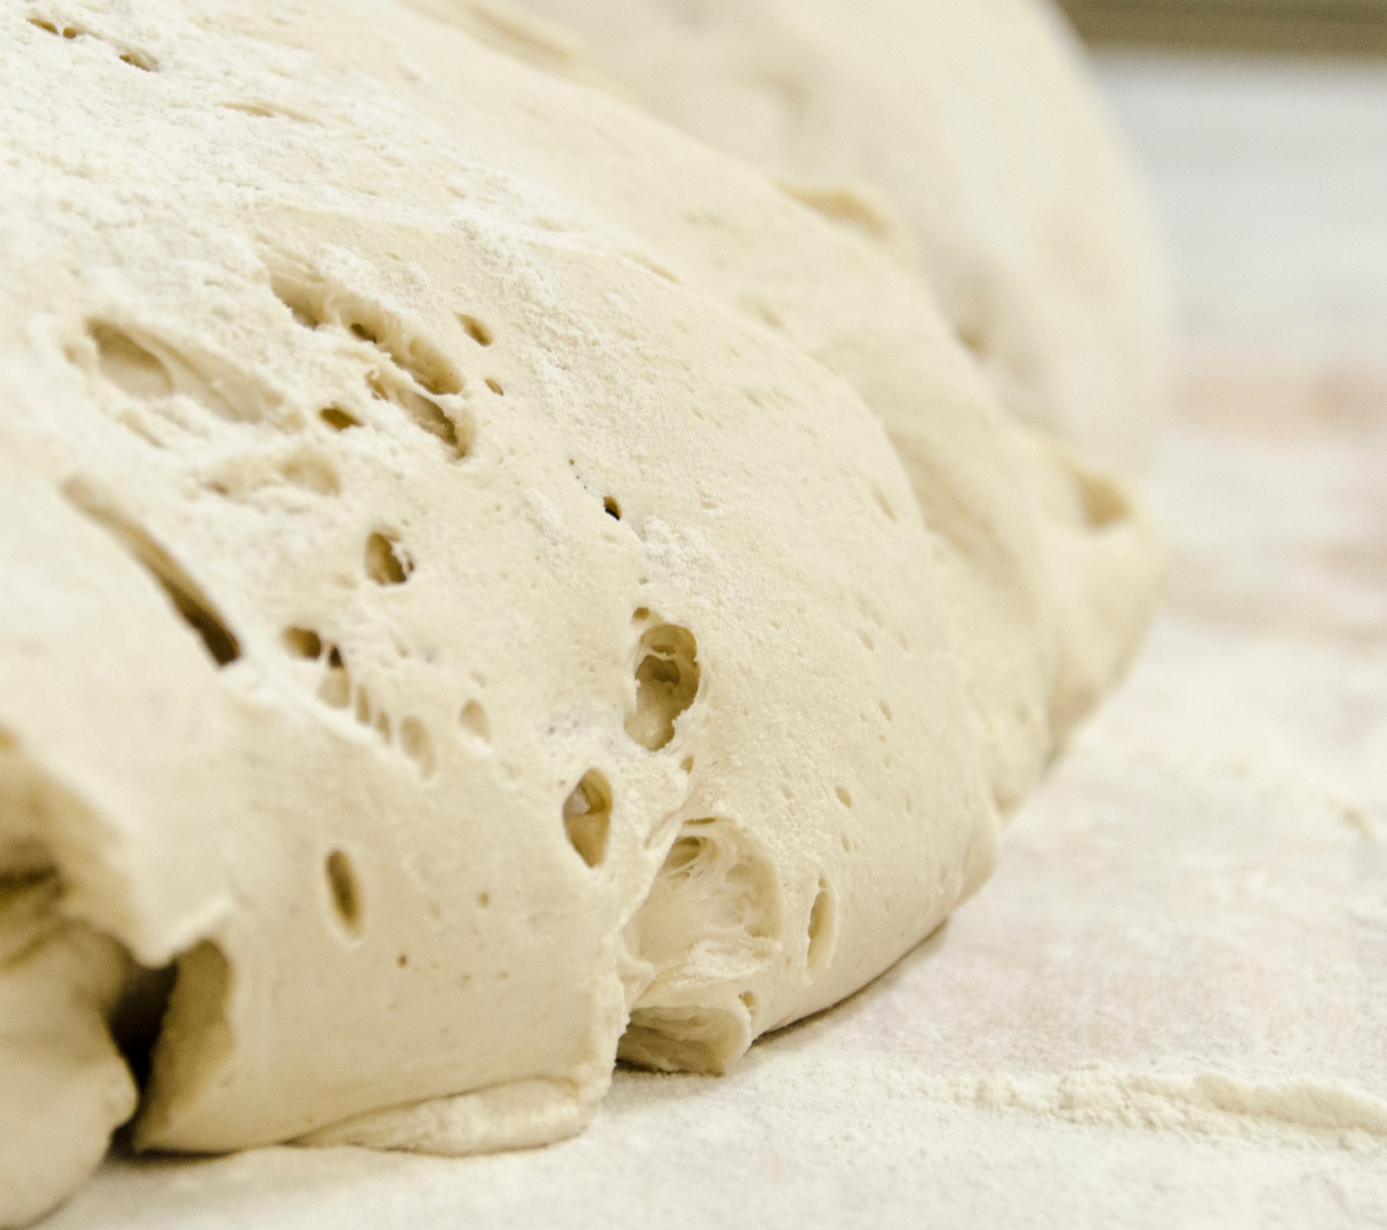
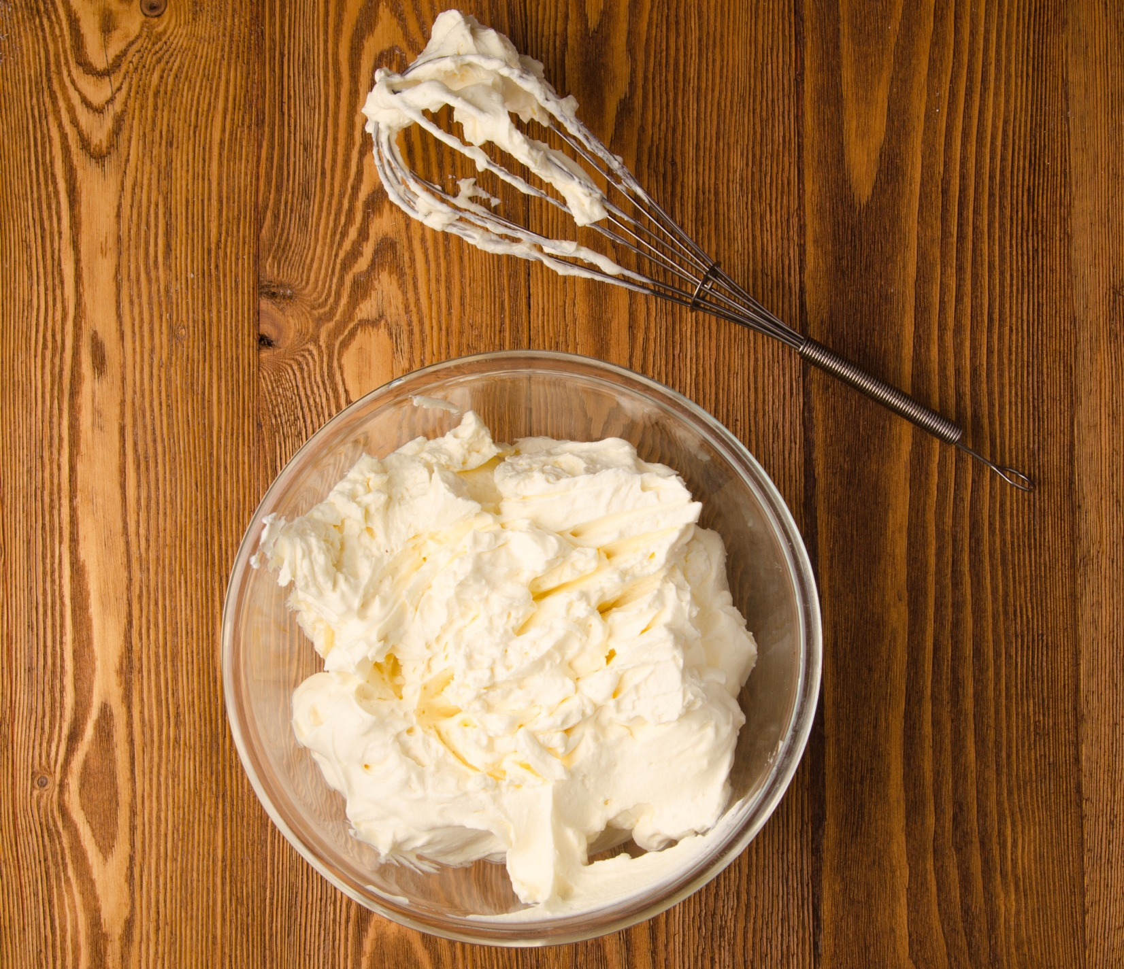
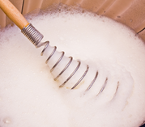
Common culinary foams
Bread is a solid foam that is formed due to yeast which produce CO₂. Baking the bread makes the foam stable.
The foam can collapse if bread is left to rise for too long, as the bubbles of CO₂ coalesce (join together), thinning the supporting structure.
Whipped cream is formed by mechanical action (i.e. whipping). It relies on fat to be stable.
Cream needs to have a high fat percentage and be chilled to whip properly. This is because the fat needs to be in a more solid state for the foam to be stable.
Egg white foams are also formed by mechanical action, which denatures the proteins.
When denatured, the proteins form a network, trapping air in-between.
These foams can be stabilised by cooking (e.g. meringues).

Slide 3
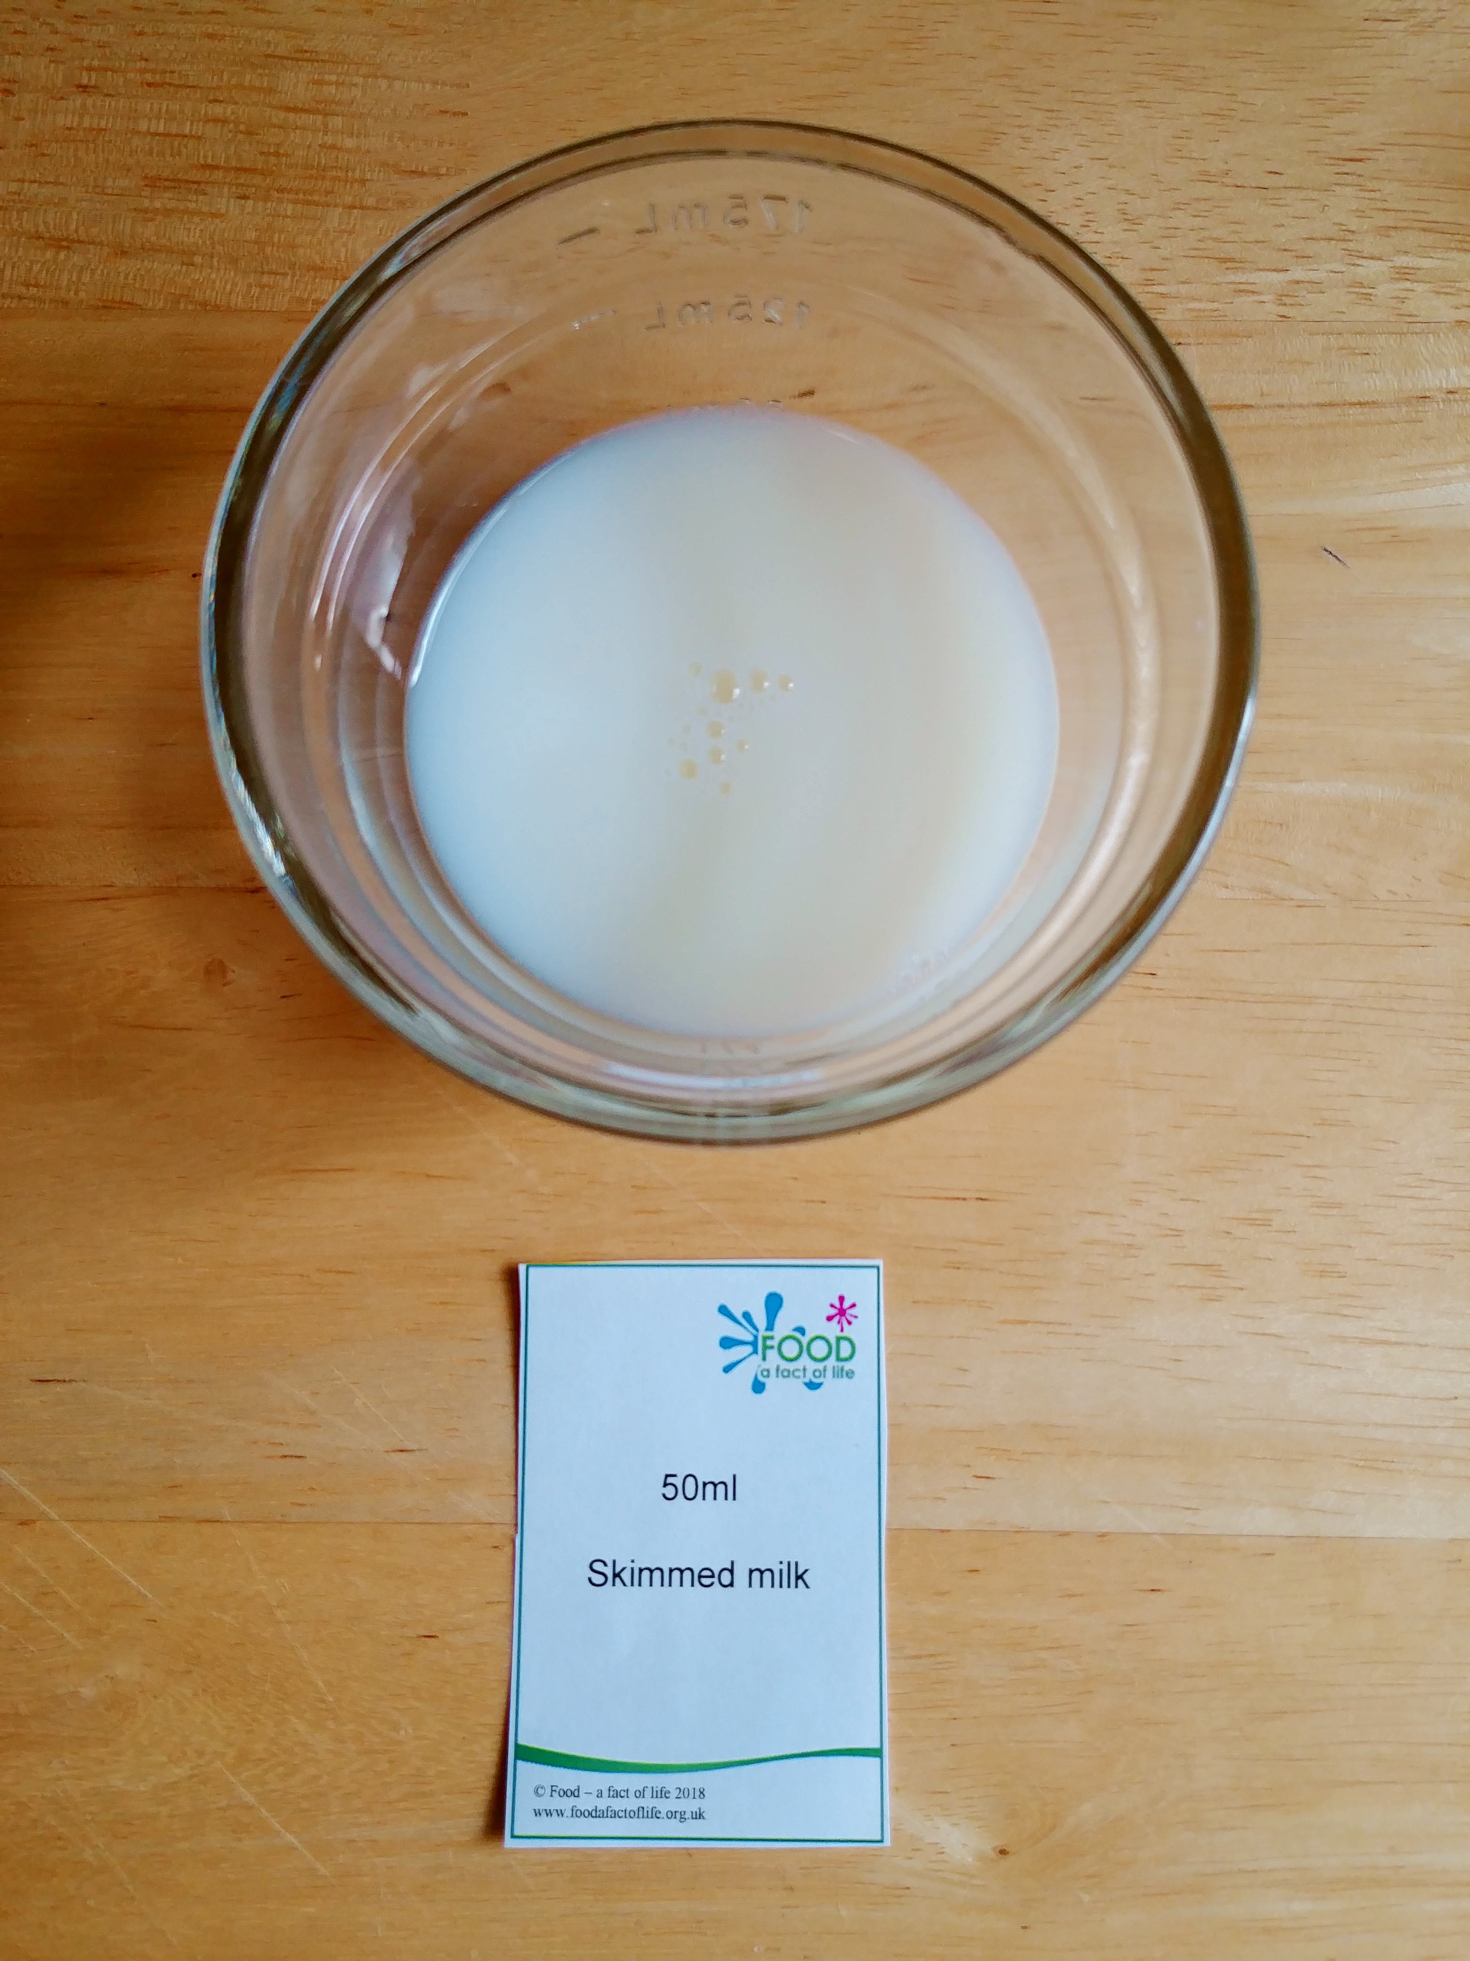
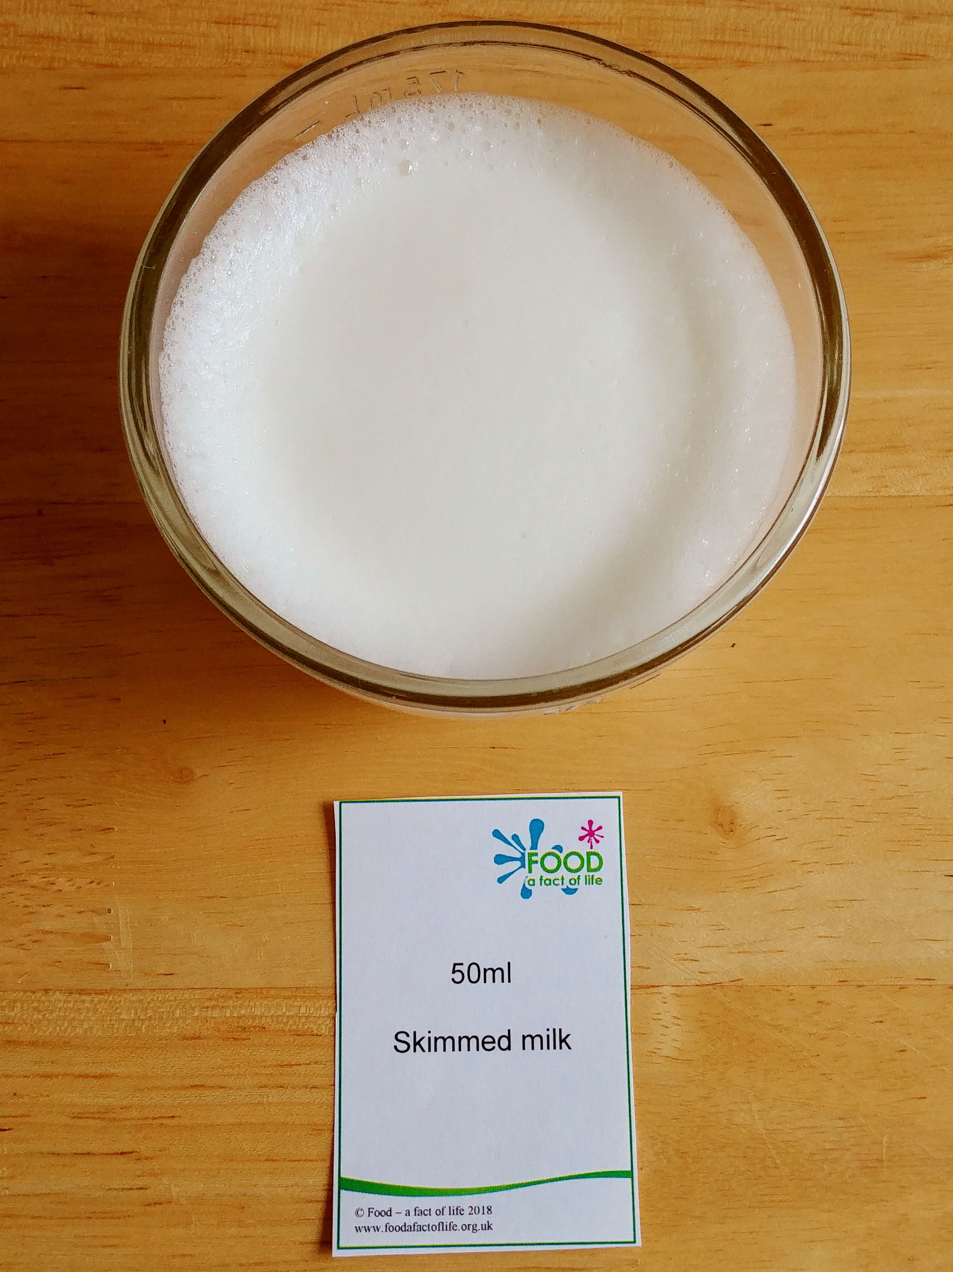
Milk frothing experiment
You will need:
skimmed milk, whole milk
and a dairy alternative;
three small clear bowls or cups;
hand-held milk frother;
timer;
measuring jug.
Instructions:
Measure 50ml of the milks and dairy alternative and pour into the bowls or cups. Label clearly.
Using the milk frother, froth the liquid for 20 seconds.
Ask pupils to look at and taste the foam, then write down their observations.
Check the foam again after two and then 10 minutes. Ask your pupils to write down their observations. What has happened to each foam?
Questions:
Which foam appears to be the most stable?
How do the foams look different?
Why do you think some foams were more stable than others?
Before
After

Slide 4

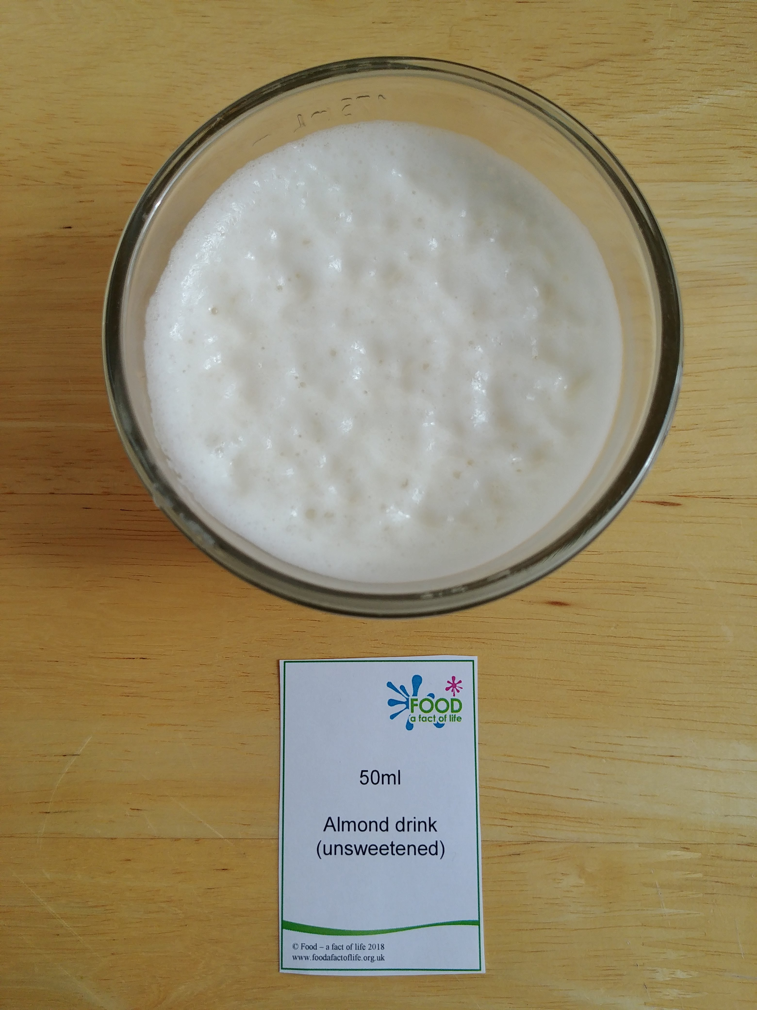
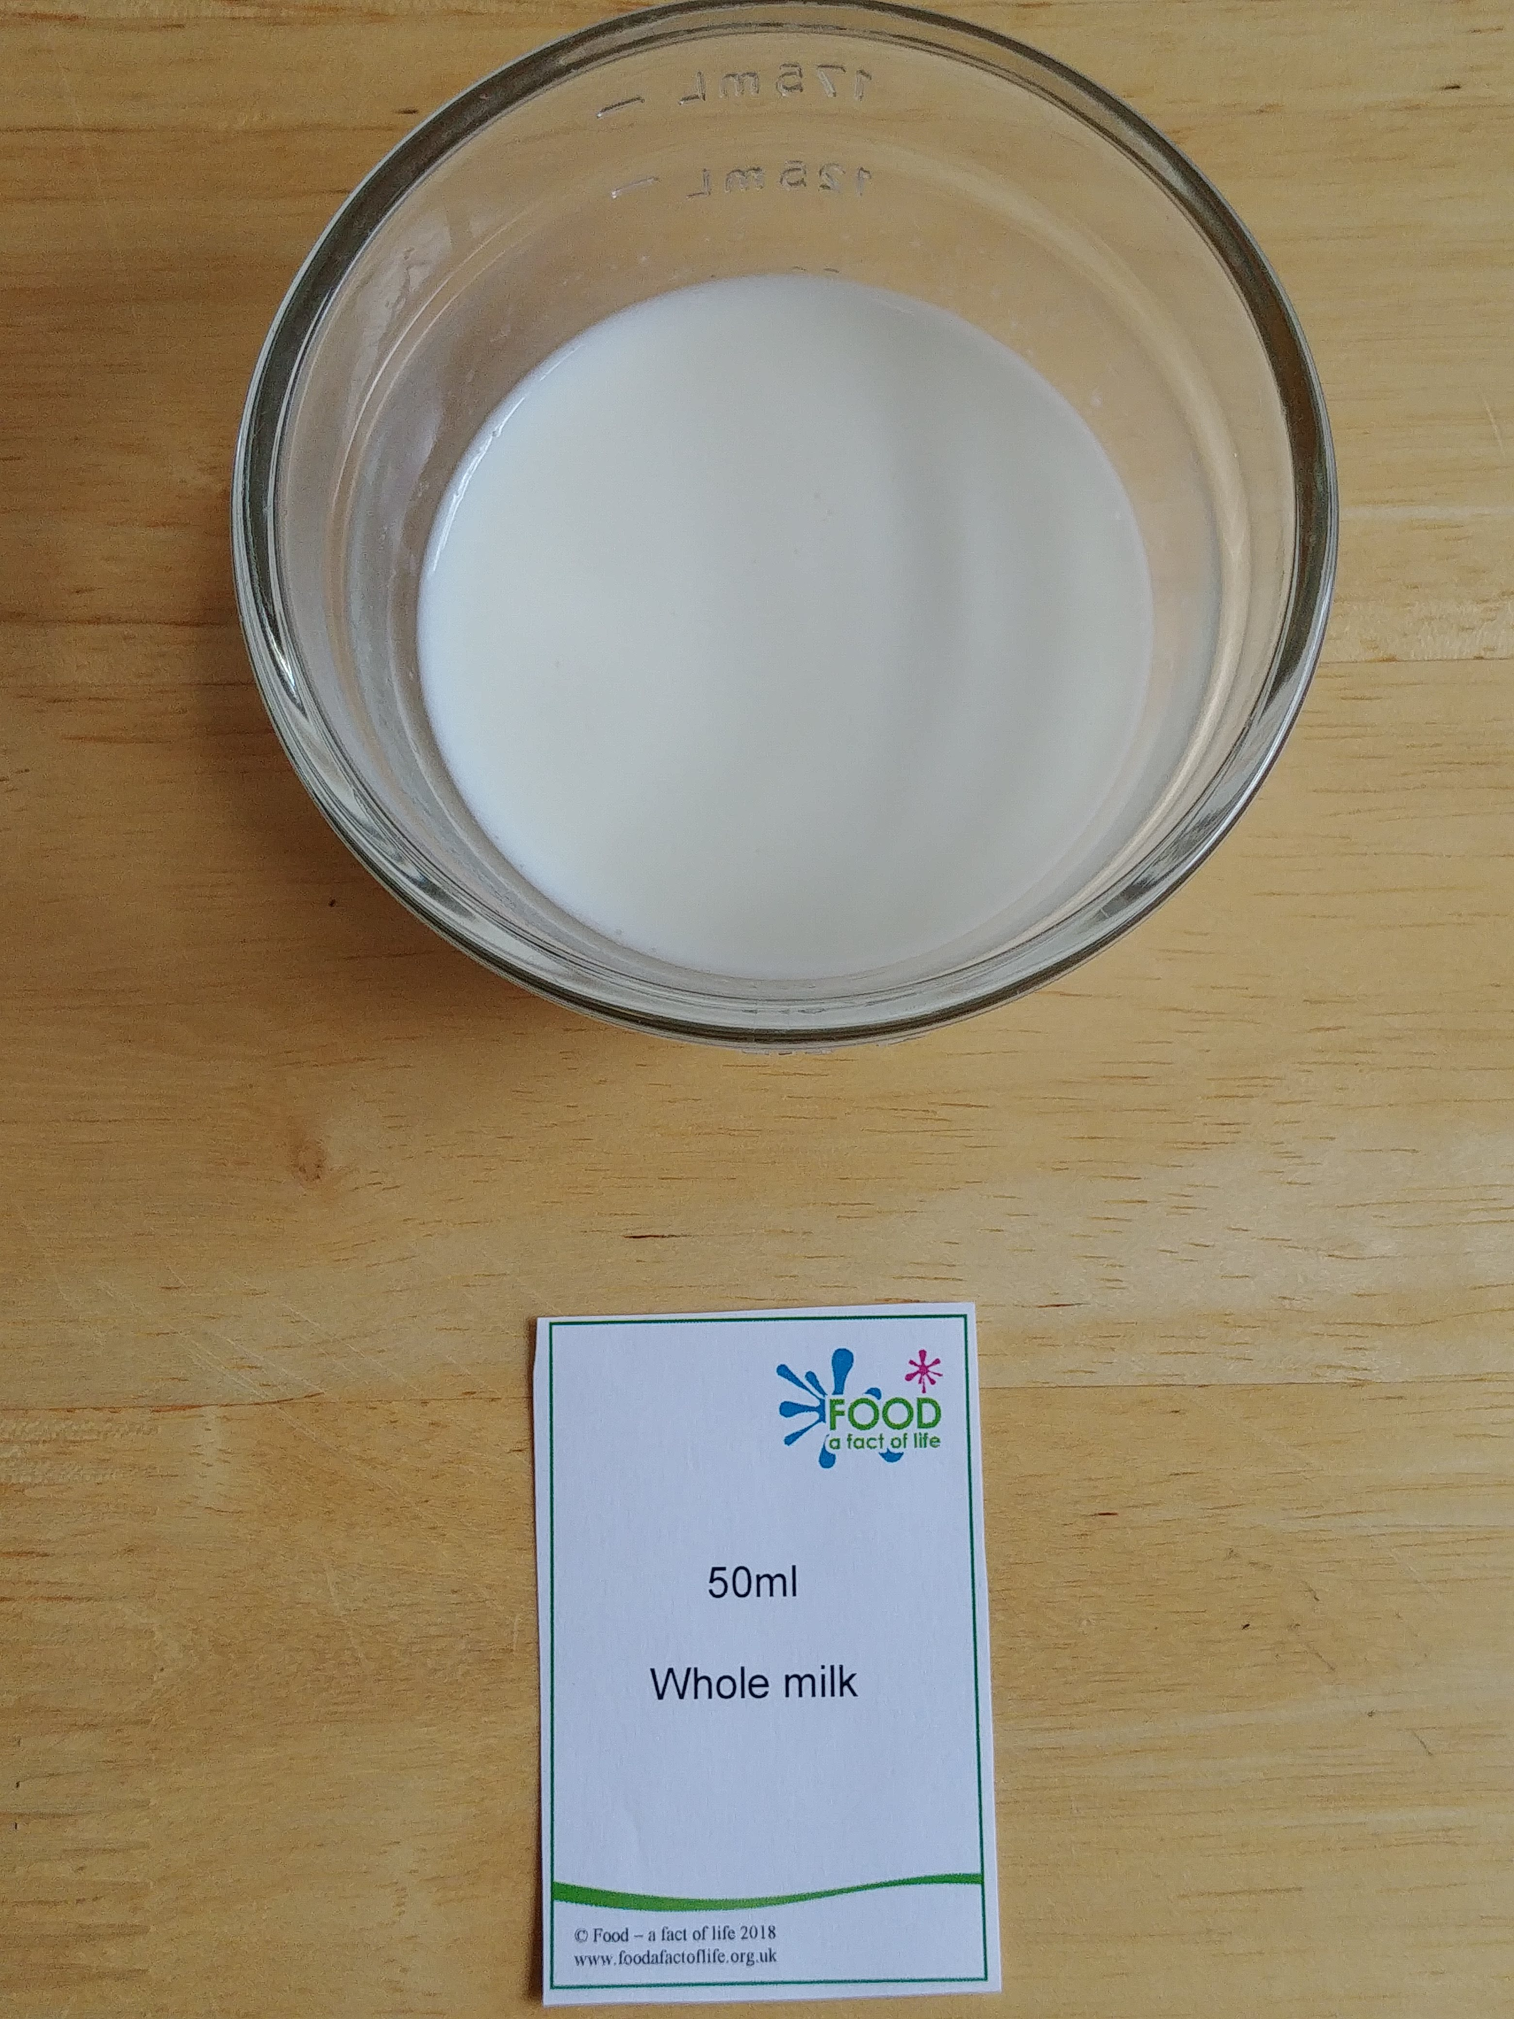
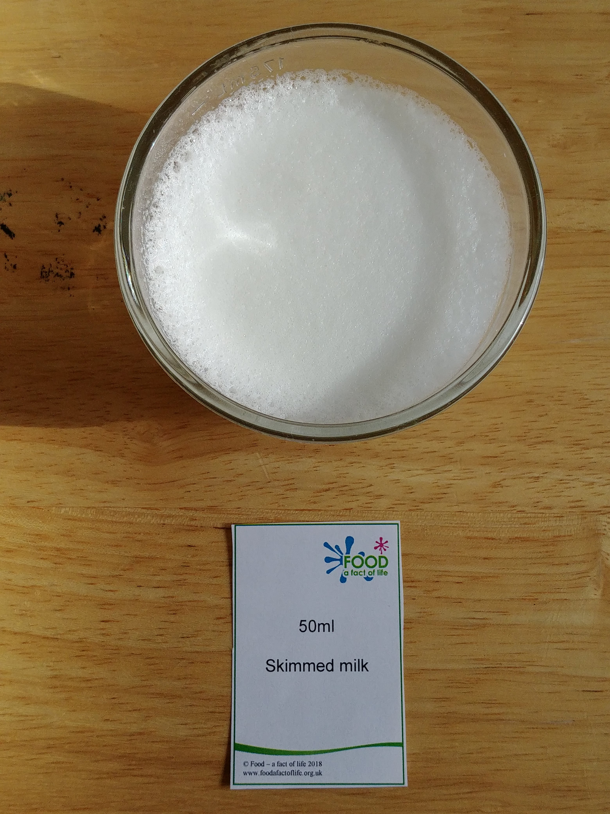
What can the experiment tell us?
Almond
The milk foam experiment is an example of a foam that is stabilised by a protein network.
When the milk is frothed, the casein and whey proteins are denatured and bond to each other, forming a network that helps to hold the foam together.
When fat is present, it can disrupt the protein network and burst the fragile air bubbles. This is why the whole milk foam collapses much faster than the skimmed milk foam.
Dairy alternatives tend to have quite low amounts of protein, and more fat than skimmed milk. However, they also usually contain stabilisers and emulsifiers (including lecithin, carrageenan, and locust bean gum). These help to support the foam when it is formed. Other dairy alternatives may contain different additives, meaning they behave differently.
Whole
Skimmed

Slide 5

Milk frothing as a food investigation
The milk frothing experiment could be an example of a simple and relatively inexpensive food investigation.
We know that in general, a higher fat content disrupts the protein network, preventing foams from forming or causing them to collapse.
An example of a hypothesis might be:
“My hypothesis is that the less fat a milk or dairy alternative has, the more stable its foam will be.”
Would the pupil be able to accept this hypothesis, having done the experiment?
How would they be able to explain and present their results?
What sensory tests could they use to describe the attributes of the foam?

