Slide 1
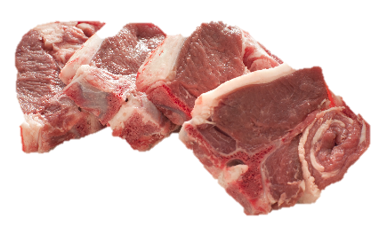
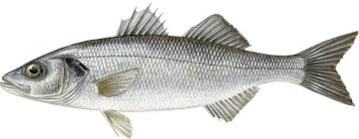
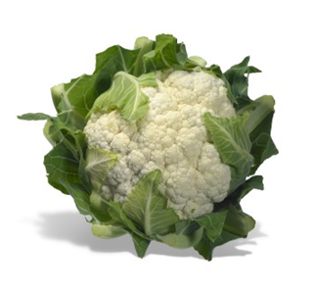
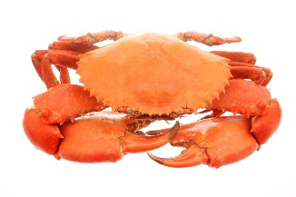
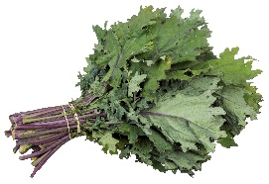
Food ready to eat in spring (March - May)
Fruit
Gooseberries
Rhubarb
Fish
Crab
Haddock
John Dory
Lobster
Mackerel
Monkfish
Prawns
Sea Bass
Sea Salmon
Trout
Turbot
Vegetables
Asparagus
Carrots
Cauliflowers
Celeriac
Curly Kale
Purple Sprouting Broccoli
Spinach
Spring Greens
Watercress
Meat
Beef
Chicken
Spring Lamb

Slide 2
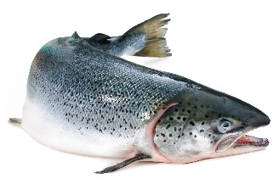
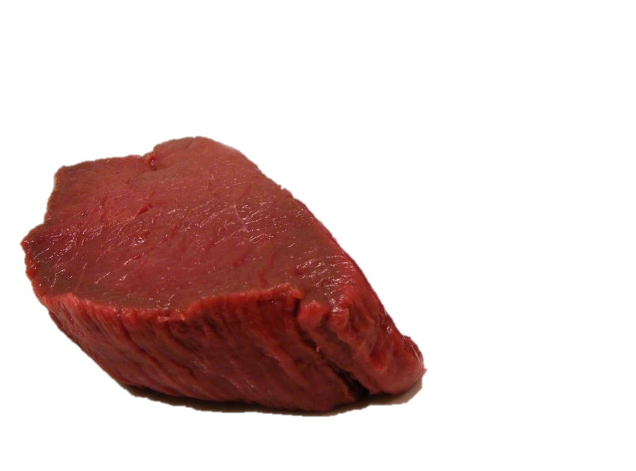
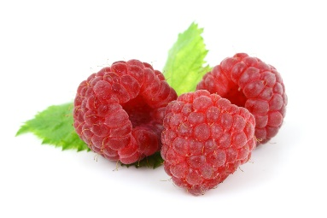
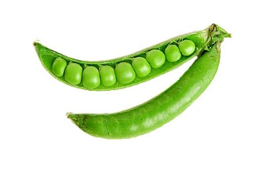
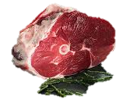
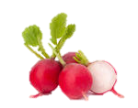
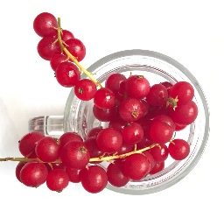
Food ready to eat in Summer (June-Sept)
Fruit
Blueberries
Currants – black, white and red
Greengages
Loganberries
Plums
Raspberries
Strawberries
Tayberries
Fish
Crab
Pilchards
Wild Salmon
Vegetables
Broad Beans
Courgettes
Fennel
Fresh Peas and green Beans
Lettuce and salad leaves
New potatoes
Radishes
Runner Beans
Tomatoes
Meat
Beef
Chicken
Lamb
Pork
Saltmarsh Lamb
Venison

Slide 3
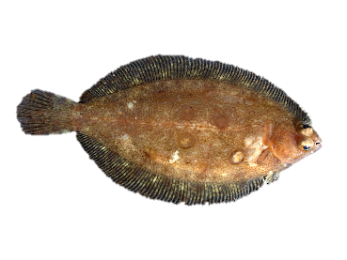
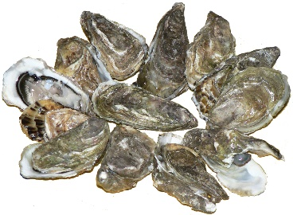
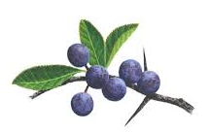
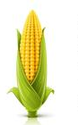
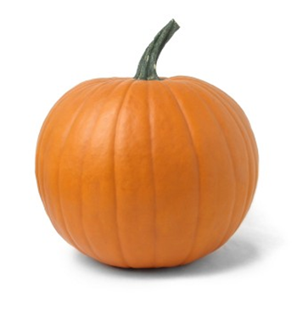
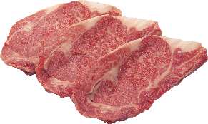
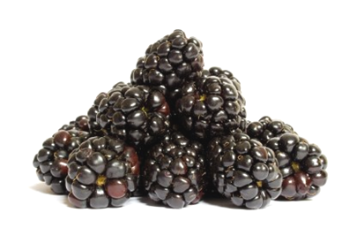
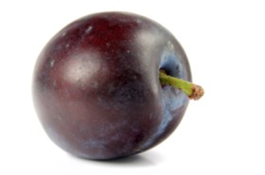
Food ready to eat in autumn (Oct - Nov)
Vegetables
Field Mushrooms
Lettuce
Marrow
Potatoes
Pumpkin
Rocket
Squashes
Sweetcorn
Watercress
Fruit
Apples
Blackberries
Damsons
Elderberries
Pears
Plums
Sloes
Fish
Brill
Dabs
Dover Sole
Flounders
Oysters
Skate
Meat
Chicken
Grouse
Heather-fed Lamb
Pork
Venison

Slide 4
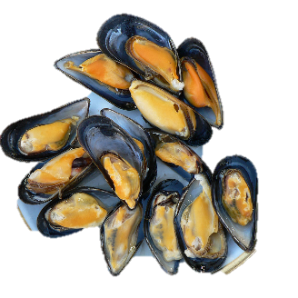
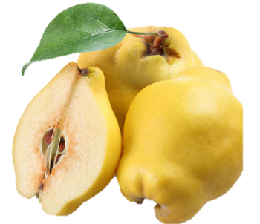
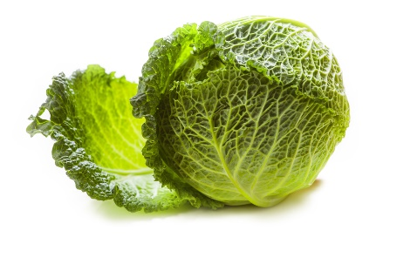
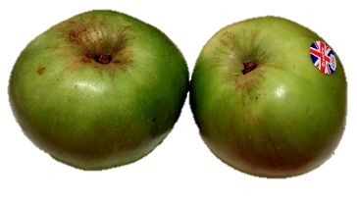
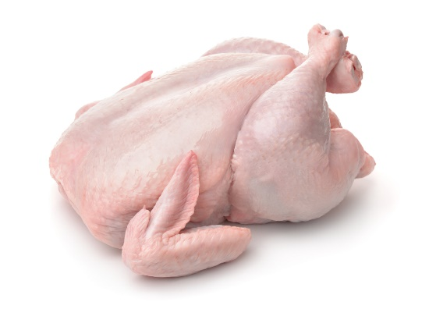
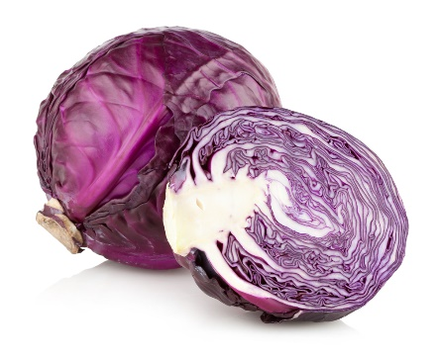
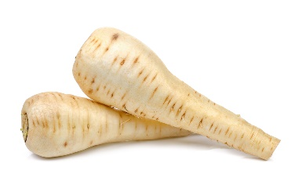
Food ready to eat in Winter (Dec – Feb)
Vegetables
Brussels Sprouts
Cabbage
Carrots
Cauliflower
Celeriac
Curly Kale
Fennel
Leeks
Parsnips
Potatoes
Red Cabbage
Swede
Turnips
Fruit
Apples
Pears
Quince
Fish
Grey Mullet
Mussels
Scallops
Meat
Chicken
Goose
Partridge
Pheasant
Turkey
Venison
Wild Duck

