Slide 1
Food labelling

Slide 2
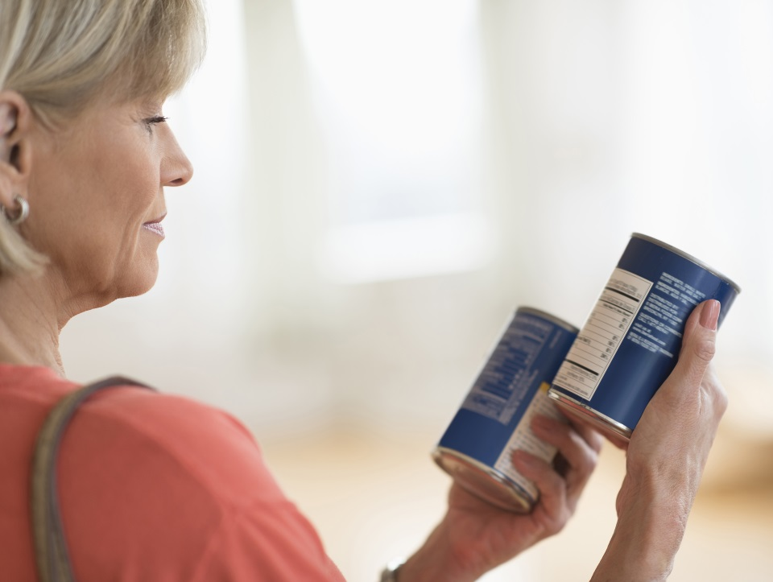
Introduction
Information is provided on food and drink packaging to help consumers choose between different products, brands and flavours.
There is a legal requirement to provide some information on food labels.
The laws regarding food labelling that apply in the UK are based on the European Union’s (EU) community legislation. This will remain the case for the foreseeable future whilst negotiations with the EU take place.

Slide 3
History of food labels in the UK
2007
EU consumer policy strategy stated consumers need access to clear, consistent, evidence based nutrition information
1979
EU General Labelling Directive
1998
Guideline Daily Amounts were developed
2004
The government called for clearer food labelling to reduce obesity
2012
New EU regulation on Food Information to Consumers was published
1991
Experts & COMA set Dietary Reference Values

Slide 4
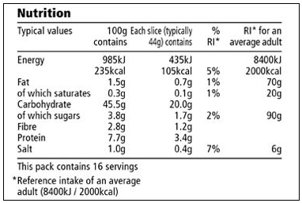
Information required by the Food Information Regulation (on the labels of pre-packed food and drink products):
Name of food or drink
List of ingredients (including additives and allergens)
Weight or volume
Date mark
Storage and preparation conditions
Name and address of the manufacturer, packer or seller
Country of origin and place of provenance
Nutrition information
Additional information may also be provided, such as cooking instructions or serving suggestions.

Slide 5

Name of food
Some food has made-up names, e.g. Bites for savoury snacks, which give no information about what is in them or how they have been processed. In such cases, a description of the food must be given so that it is neither ambiguous nor misleading.
If the food has been processed in some way, the process must be included in the title, e.g. dried apricots, salted peanuts, smoked mackerel.
The name must also describe the differences between apparently similar products. For example, a ‘fruit yogurt’ must be flavoured using real fruit, whereas a ‘fruit flavoured yogurt’ can be flavoured using artificial flavourings.

Slide 6
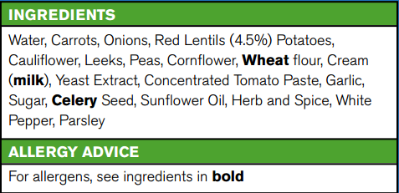
List of ingredients
The list of ingredients should include all the ingredients (including water and food additives), in descending order of weight, according to the amounts that were used to make the food.
Allergens need to be highlighted. Allergens can be highlighted as bold, underlined, in italics or highlighted.
The ingredients must be listed in the language relevant to the country where the food is being sold.

Slide 7
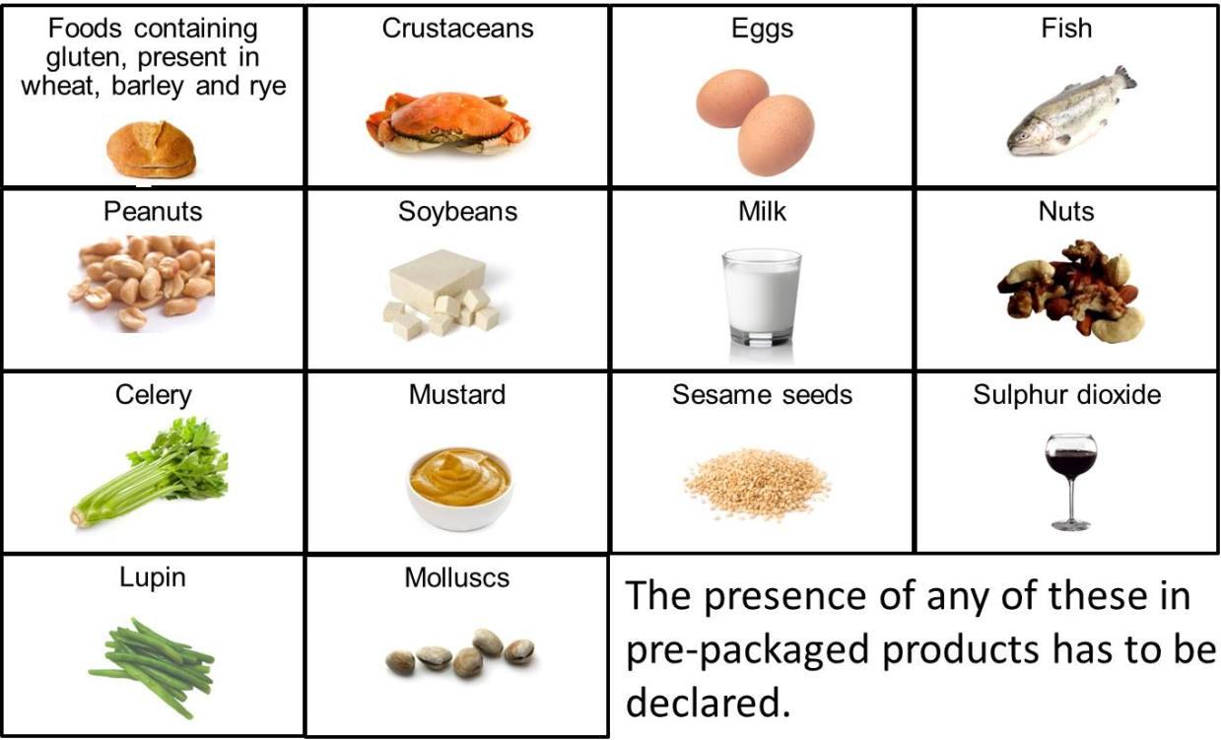
The most common allergens are present in:

Slide 8
Allergen information
By law, food, drink and ingredients that are known to contain allergens are required to be highlighted on the ingredients list.
If there is a chance that a food may also contain minute amounts of allergen because it is produced on the same line or in the same factory as other products that contain ingredients known to cause allergy, an additional voluntary statement with the word ‘also’ may follow, for example:
Also, not suitable for customers with peanut allergy
Also, may contain soya and egg
May also contain nuts

Slide 9
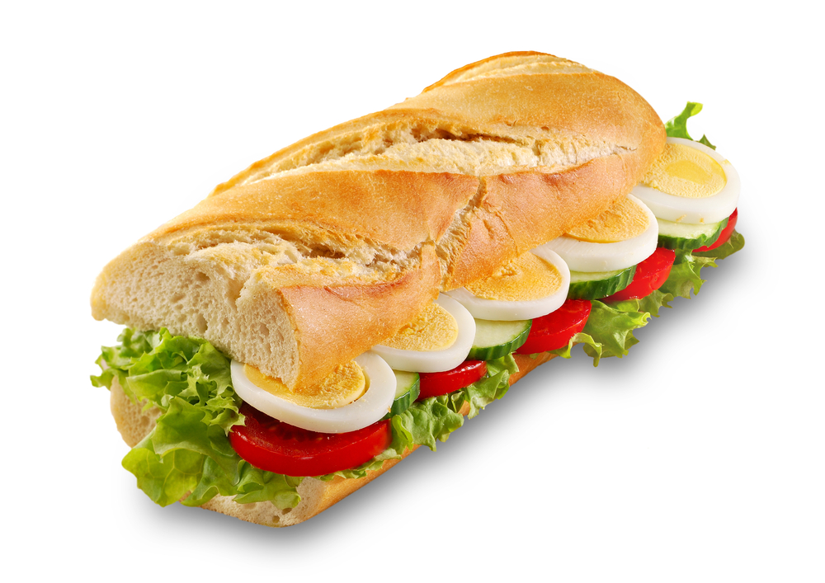
New allergen labelling Law
The government will introduce legislation mandating full ingredient labelling for food prepared for direct sale which will come into force by summer 2021.
The Law is known as Natasha’s Law, after Natasha Ednan-Laperouse who died after suffering an allergic reaction to a baguette.
The new legislation will tighten the rules by requiring food that is prepared for direct sale to carry a full list of ingredients.
Natasha’s Law, Gov.UK

Slide 10
Additives
Additives are added to ensure safety, increase shelf life or improve the taste, texture or appearance of food.
Additives need to be approved before they can be used. Additives are given an ‘E number’ to show that they have been rigorously tested for safety and have been approved for use in food by the European Commission.
Food additives must be shown clearly in the list of ingredients on food labels, either by the additive’s name or E number.

Slide 11
Weight or volume
The net weight or volume of a product must be within a few grams or millilitres of the quantity stated on the label. If the product weighs less than 5g or 5ml, the weight need not be stated; however, this does not apply to spices and herbs.
The symbol ‘e’ is used to show that the weight complies with the EU requirement for weight under the ‘average system’, i.e. the average pack is at least the weight declared.
For solid food that are sold in a liquid (e.g. canned tuna in brine), the drained (net) weight of the food should be included on the packaging.

Slide 12
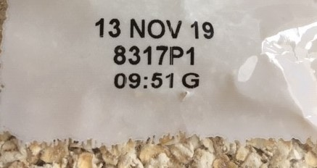
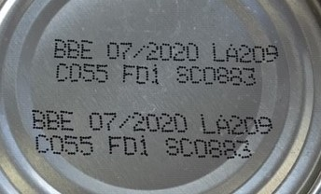
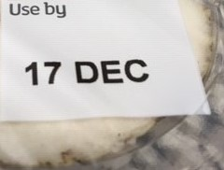
Date marks
There are two different date marks that appear on food labels:
‘Use-by’ - found on perishable food, e.g. milk, meat, fish. Food are not safe to eat after this date.
‘Best before’ - found on a wide range of food including frozen, dried and canned food. ‘Best before’ dates are about quality, not safety, and are reliant on the food being stored according to the instructions on the label.

Slide 13
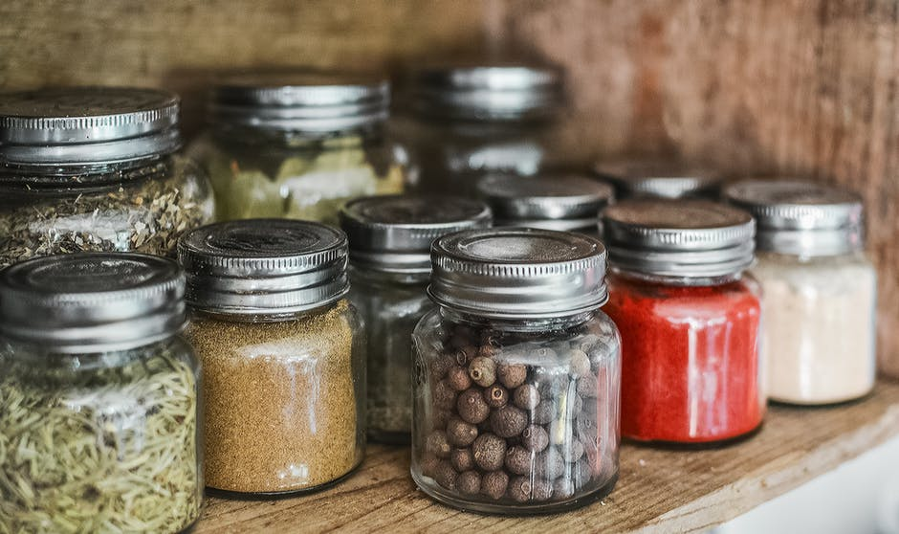
Storage and preparation conditions
In cases where food require special storage conditions and/or conditions of use, these must be clearly indicated.
When necessary, instructions on how to prepare and cook the food must also be given on the label.

Slide 14
Country of origin and place of provenance
The label must display clearly where the food has come from if it would be misleading not to show it. It has also become mandatory to show origin information for most fresh and frozen meat.
The origin of the main ingredients will have to be given if different from where the final product is made.

Slide 15
Back of pack (BoP) nutrition labelling
Back-of-pack nutrition labelling is a legal requirement for pre-packed products, with specific rules on the nutrients that can be included and the order they are listed.
This is to help people compare food so they can make healthier choices and to be aware when they are choosing food (or drink) that are high in calories, saturated fat, sugars or salt.

Slide 16
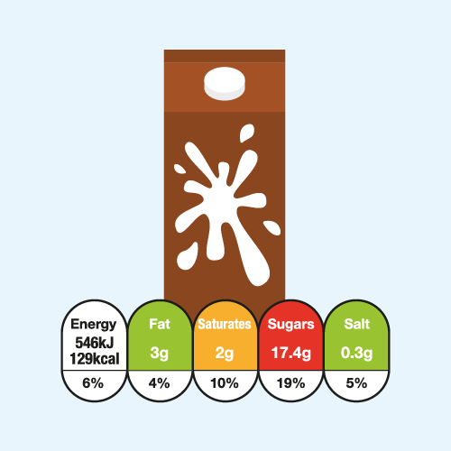
Front-of-pack nutrition labelling
In the UK, most of the major supermarkets and many food manufacturers voluntarily display nutritional information on the front of pre-packaged food and drinks.
The government’s recommended format is red, amber, green colour-coding and percentage Reference Intakes. This is often known as ‘traffic light labelling’.
FOP Nutrition Labelling or ‘traffic light’ labelling is voluntary in the UK and was introduced in 2013. In 2018, it was found on 2/3rds packaged food and drink products.

Slide 17
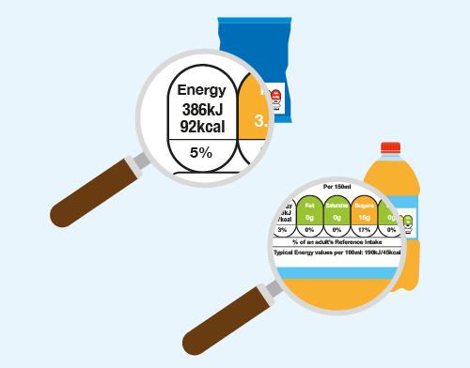
Reference Intakes
Reference Intakes are not targets for individuals to consume, but a guideline or benchmark to help people make dietary choices and balance their daily intake.
Usually, the values for adult women are used for food labels. This is because Reference Intakes have been developed for the nutrients often consumed in excess, they represent levels that should not be exceeded on a regular basis.
To discourage excess consumption, the values for women are typically used as these are slightly lower than those for men.

Slide 18
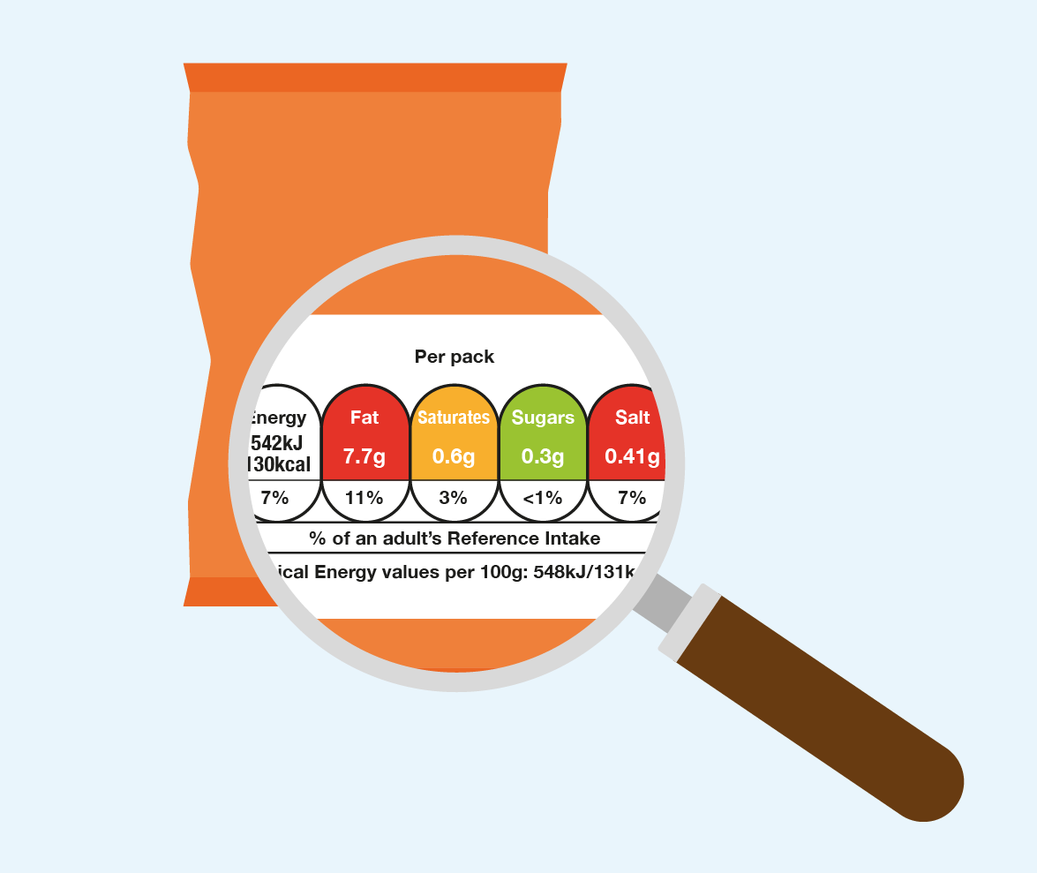
Front of pack labelling – UK
The key principles of front of pack labelling are:
Provision of energy in kJ and kcal per 100g/ml and per specified portion;
Provision of the amount (g) of fat, saturated fat, total sugars and salt per specified portion;
Provision of meaningful, recognisable portion information;
% RI based on the amount of each nutrient and energy value in a portion of the food;
Colour coding of the nutrient content (may also use the descriptors “high”, “medium” or “low”).

Slide 19
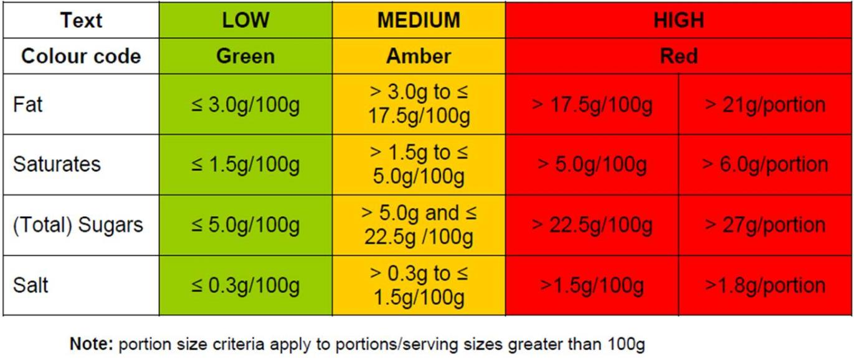
Traffic light labelling
The criteria for red, amber and green colour-coding of food are;

Slide 20
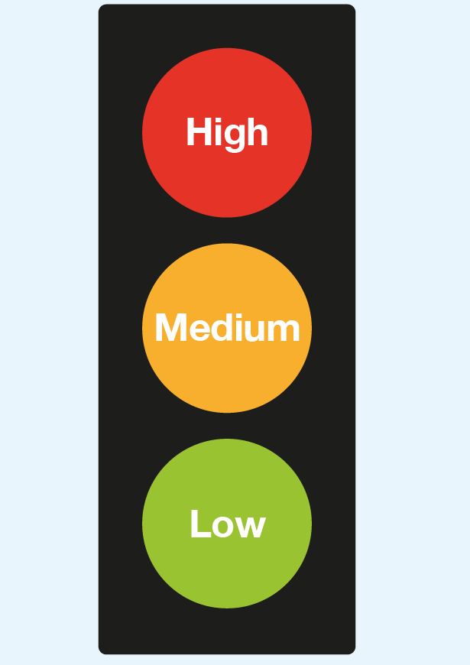
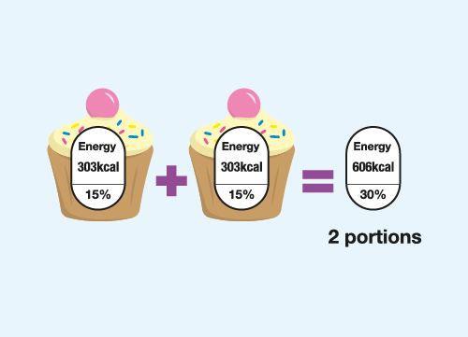
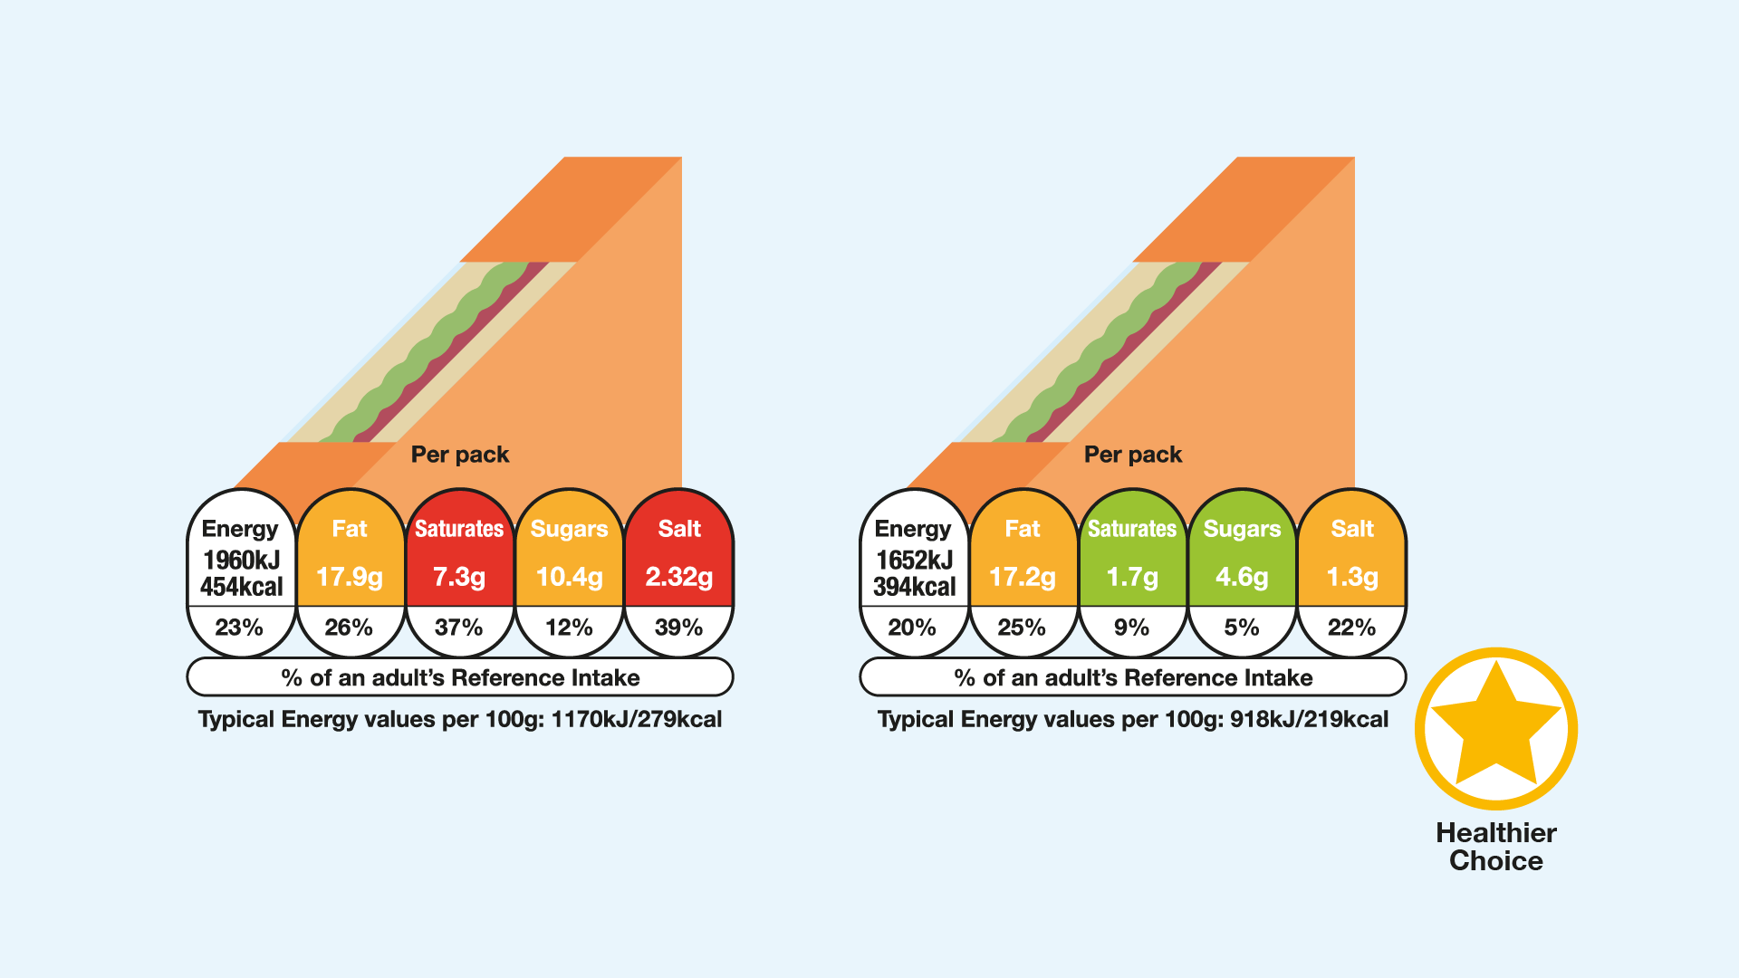
Traffic light labelling
The red, amber and green colours show at a glance whether a product is high, medium or low for fat, saturates, sugars or salt.
The colour coding can be used to compare two products.
The portion size is given on the pack and if a consumer is eating more or less than the portion size shown, then the numbers shown on the label need to be adjusted accordingly.

Slide 21
Quiz- Kahoot
Open the link below on the main screen and get students to log onto kahoot.it on their tablets or smartphones.
They can then enter the code (that will come up on the main screen when you start the game) and their own nickname.
They can then play along with the quiz choosing the multiple choice answers that correspond with the questions on the main screen. There will then be a leaderboard of the scores after each question and at the end.
https://play.kahoot.it/#/?quizId=b8ce66f4-f419-49e0-9704-8f2ae255c704

Slide 22
Food labelling
For further information, go to:
www.foodafactoflife.org.uk

