Slide 1
The economy of food

Slide 2
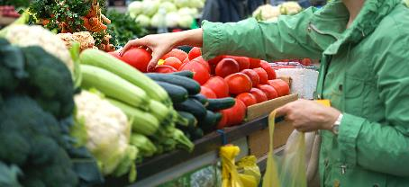
Factors affecting food choice
All around the world, people choose to eat different food for many different reasons.
One very important factor for most people is the cost of the food.
Knowing about food and where it comes from can help keep cost down.

Slide 3

Cooking on a budget
There are many things that we can do to spend money wisely on food.
In 2016/17 the amount the average UK household spent on food and drink purchases was £26.34 per person per week. This figure excludes eating and drinking out, and alcoholic drinks.
Source: Family Food Survey 2016/17

Slide 4
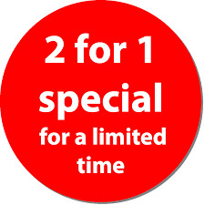
Cooking on a budget
43% of respondents to the Food Standards Agency’s Food and You research (April 2018) reported making at least one change in their buying or eating arrangements in the last 12 months for financial reasons, including:
20% who bought items on special offer more;
18% who had changed where they shopped for cheaper alternatives;
17% who said they ate out less.
We need to make informed choices to achieve a balanced and varied diet.
Food and You wave four

Slide 5
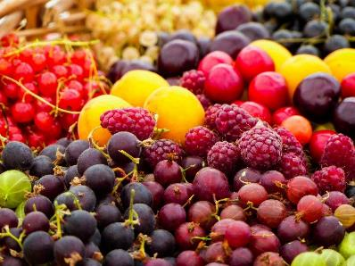
Eat the seasons
Buying and eating food that is in season means that it:
is fresh;
has the best flavour, texture and colour;
has optimum nutritional value.
Seasonal food is readily available which usually means it is cheaper to buy.
If the food has been grown or reared locally, travelling and storage costs are reduced.

Slide 6
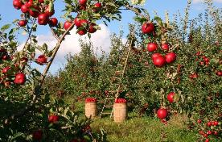
Eat the seasons
Using food in season is easy to do:
use seasonal ingredients to change the flavour and texture of recipes;
combine seasonal fresh fruit and vegetables in main meals as they are often cheaper.
Name two examples of food currently in season.
Remember that it is not just fruit and vegetables that are seasonal – meat and fish can be too!

Slide 7
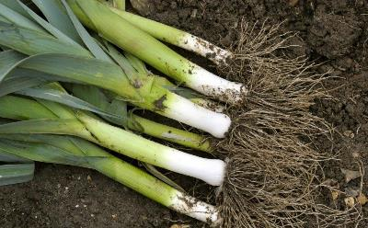
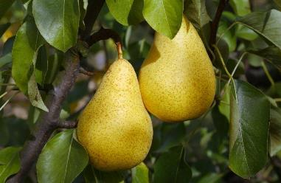
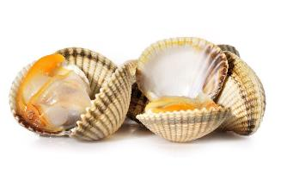
Eat the seasons
Leeks: October - May
Cockles: September - April
Pears: mid August - October

Slide 8
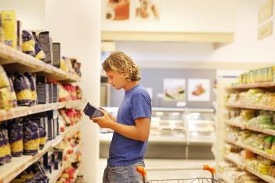
Stock up
When you go shopping see what’s on special offer and stock up on food with a long shelf-life.
Check the price difference between value brands and premium products.
Check out the price per 100g or per 100ml when choosing food.

Slide 9
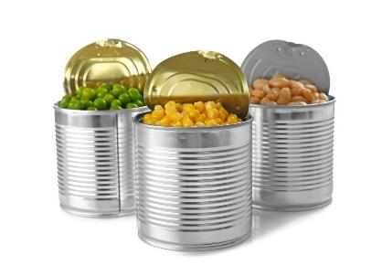
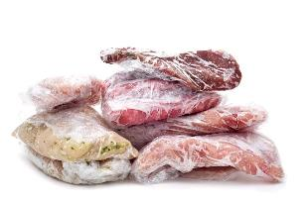
Stock up
Check the frozen and canned vegetable section and buy items that are cheaper so you always have a variety in the freezer and the cupboard.
Bulk buy meat and fish and freeze in smaller portions until you are ready to use them.

Slide 10
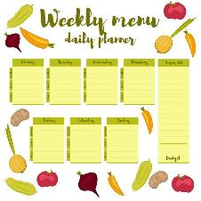
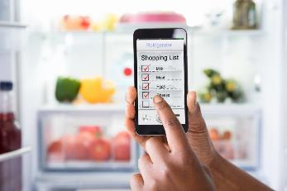
Shop smart
Take time to plan your meals and then compile a shopping list of everything you need.
Products such as canned tomatoes, beans, pulses, rice, pasta, oatmeal and barley are lower cost items. They can be used to bulk up meals and make them go further.

Slide 11
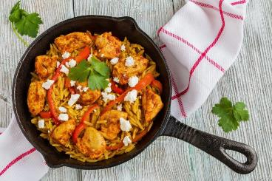
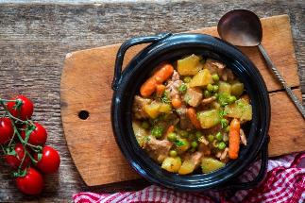
One pot cooking
Save time, heat energy and washing up by cooking ‘one-pot’ meals.
Cheaper cuts of meat can be cooked slowly for a tasty economical meal.
Add root vegetables to make casseroles go further.

Slide 12
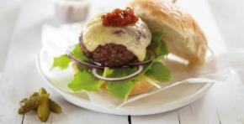
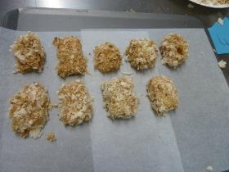
Fake-aways!
Instead of getting a take-away or having fast food delivered, why not make your own ‘fake-away’?
Burgers, kebabs, chicken nuggets and chips, and curries are all dishes you can make at home for far less money.
Aso, home-made versions of take-away dishes often contain far less salt, fat and sugar and taste just as delicious!

Slide 13
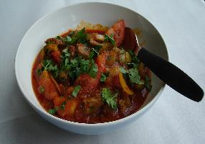
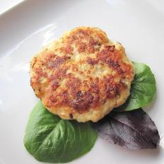
What’s left?
Using leftovers is a great way to save money and reduce food waste.
Use leftover cooked meat in a curry or risotto.
Leftover potatoes could be used to make fishcakes.
Suggest one other idea for using up leftovers.

Slide 14
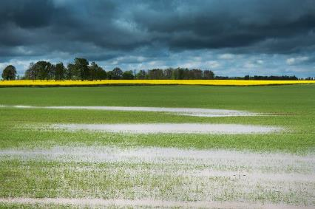
Why do food prices change?
Food prices can and do change throughout the year. This may be due to a variety of reasons:
climate and weather patterns;
agricultural costs increase;
fuel prices go up;
consumer demand;
seasonality.
Suggest other things that might cause the prices of food to rise or fall.

Slide 15
Food prices
Food prices can and do change throughout the year and over time. This may be due to a variety of reasons:
climate and weather patterns;
crop failure;
crop disease;
seasonality;
consumer demand;
agricultural costs increase;
fuel prices go up;
increased use of bio fuels.
What can cause food prices to change?
Discuss your thoughts with the person next to you.

Slide 16
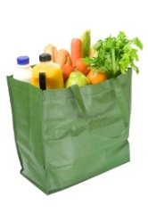
Reducing the amount spent on food
Whilst the cost of food and non-alcoholic beverages has fallen in real terms in recent years, food remains the largest item of household expenditure for some households.
Name three different strategies that could be used to reduce the amount of money spent on food.
Discuss with the rest of the class.
Family Food 2016/17 expenditure
Food Statistics Pocketbook

Slide 17
Strategies
The following strategies could be used to reduce the amount spent on food:
replace branded items with cheaper, non branded (e.g. supermarket own, economy) items;
shop at different places (e.g. discount supermarkets, markets);
compare prices and shop around to find the cheapest items;
try different cooking methods that work well with cheaper cuts of meat, e.g. stewing or casseroling;
grow own food (e.g. growing vegetables in the garden);
buy items from reduced food aisles (e.g. wait until end of day when food is marked down, buy foods which are at/almost at their use by date);
purchase different types of food (e.g. canned vegetables or pulses);
reduce the total amount of food purchased.

Slide 18




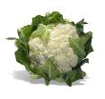

Food price and food choice
When food prices increase and our budget remains the same, we may have a more limited food choice. What different food choices would you make?
For example:
Swapping from fresh fruit and vegetables
To canned and frozen fruit and vegetables

Slide 19
The economy of food
For further information, go to:
www.foodafactoflife.org.uk

