Slide 1
Hydration and activity!

Slide 2
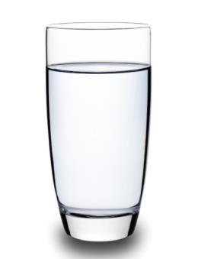
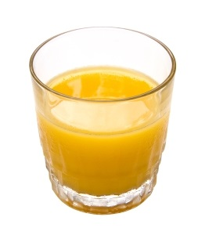
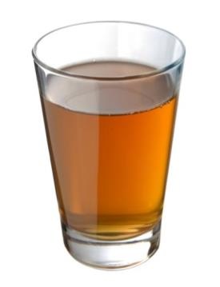
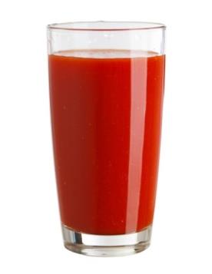
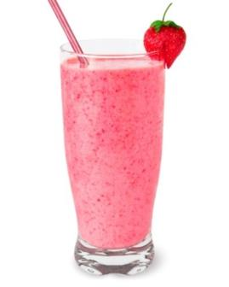
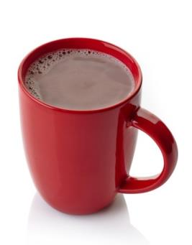
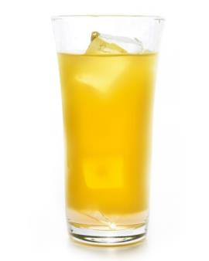
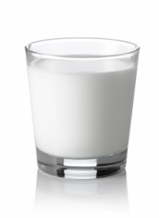
What do you like to drink?

Slide 3
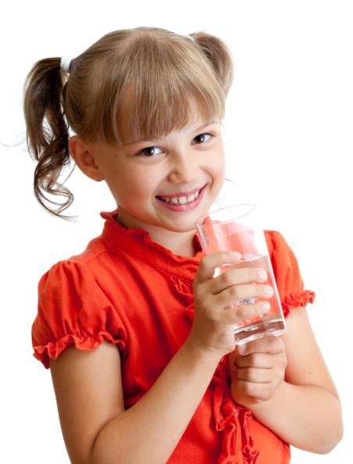
Why do we need to have drinks?
Water makes up about two-thirds of the weight of a healthy body!
Lost water needs replacing so we stay healthy.
Where does the water go?
Notes:
Q – what fraction makes up the rest of the body?
Q – where does the water go? (breathe, sweat, urine)

Slide 4
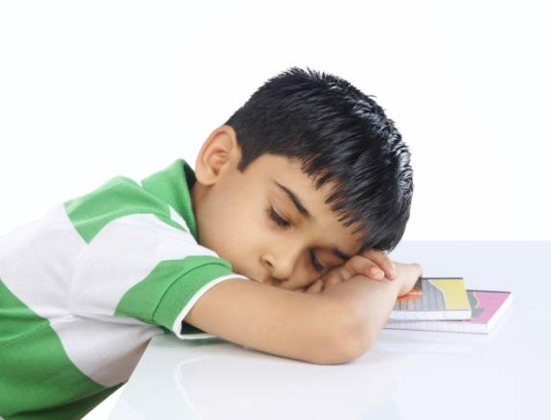
What happens if we don’t drink enough?
We can become dehydrated and might…
feel tired;
get a headache;
find it hard to concentrate.

Slide 5
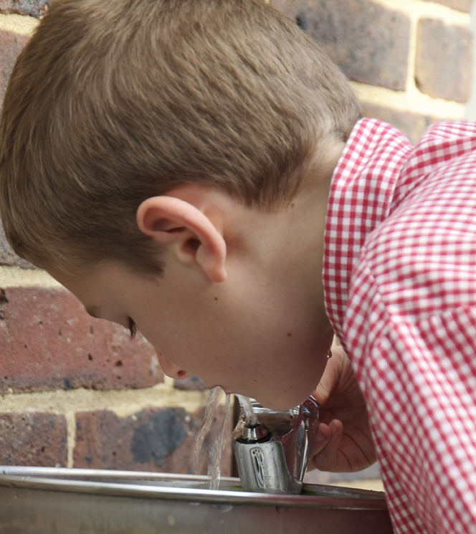
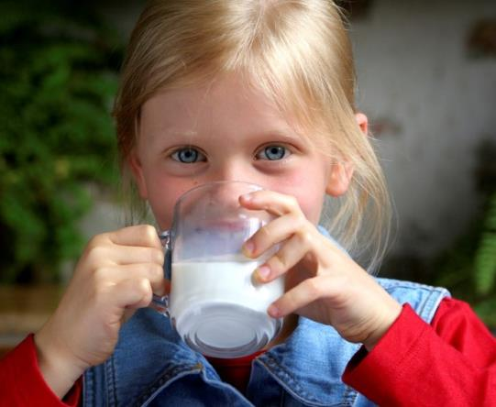
How can we stay hydrated?
Have 6-8 drinks every day!

Slide 6
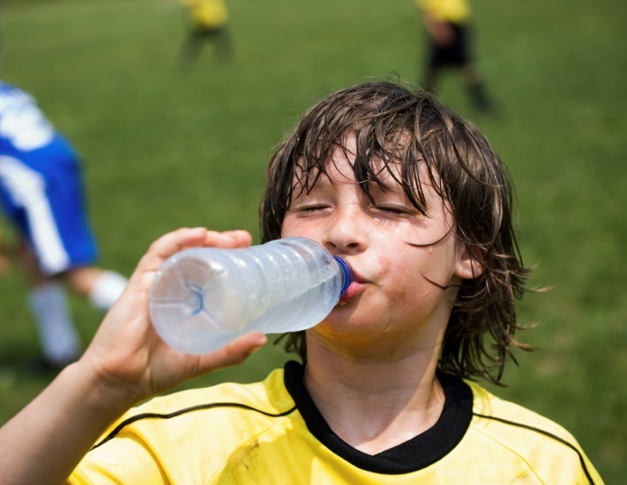
Is it always 6-8 drinks?
You need to drink more if it is hot or you
are being active.
Why?

Slide 7
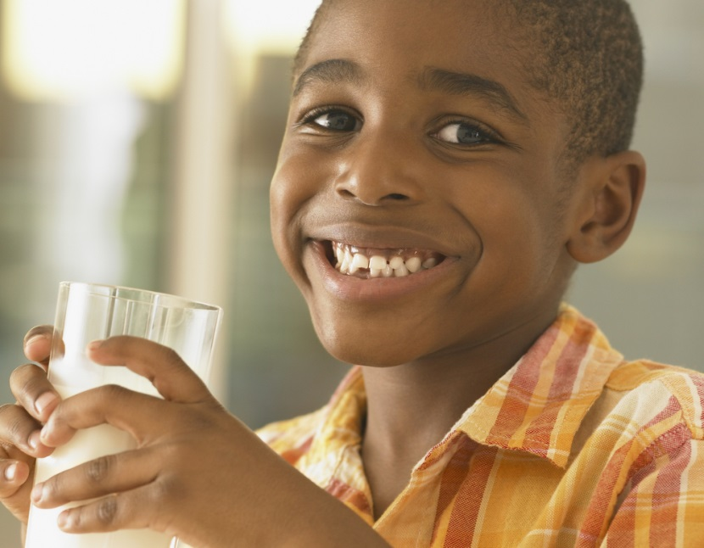
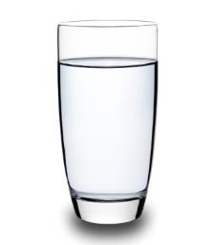
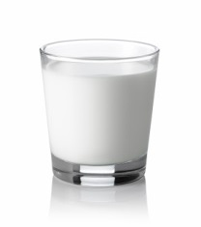
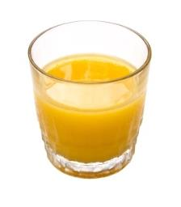
What drinks should we have?
All drinks can count!
Good choices are…

Slide 8
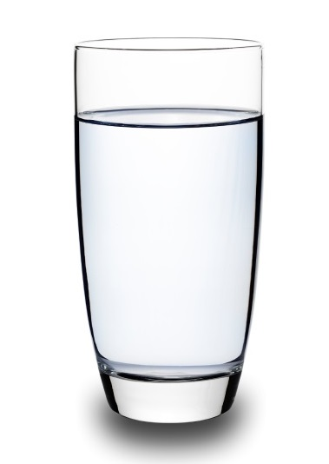
Why water?
It is easily available!
It hydrates without harming teeth.

Slide 9
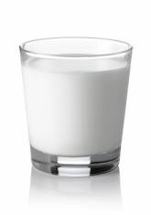
Why milk?
It provides calcium!
What does calcium do?
It provides vitamins and other minerals.

Slide 10
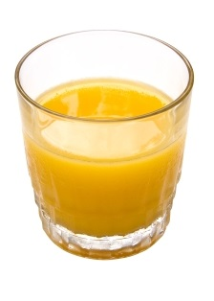
Why juice?
It counts as one portion towards your 5 A DAY!
Just 150ml once a day –with a meal!
It provides vitamins and other minerals.

Slide 11
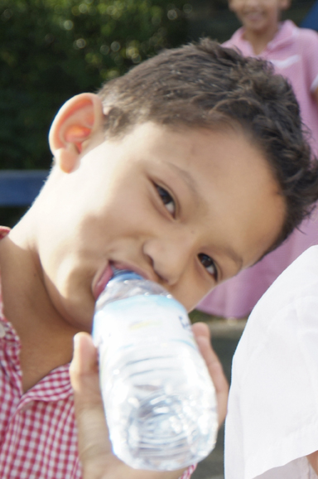
How can we make sure we have enough to drink?
Have drink with each meal…
Breakfast
Lunch
Evening meal
Have a drink …
At break time
During lessons
After school
A little while before you go to bed

Slide 12
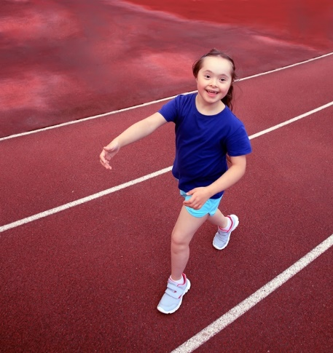
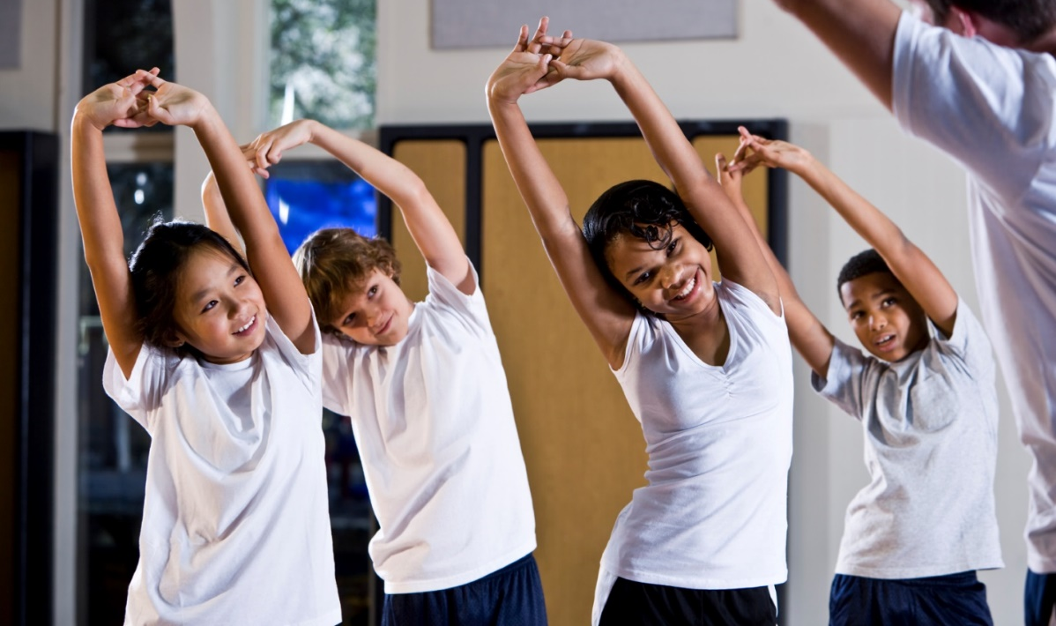
Activity
Move more, be active!

Slide 13
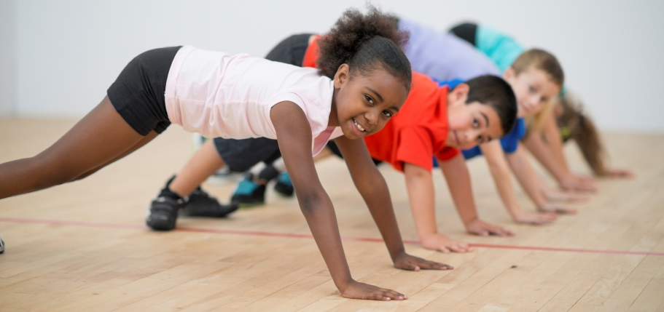
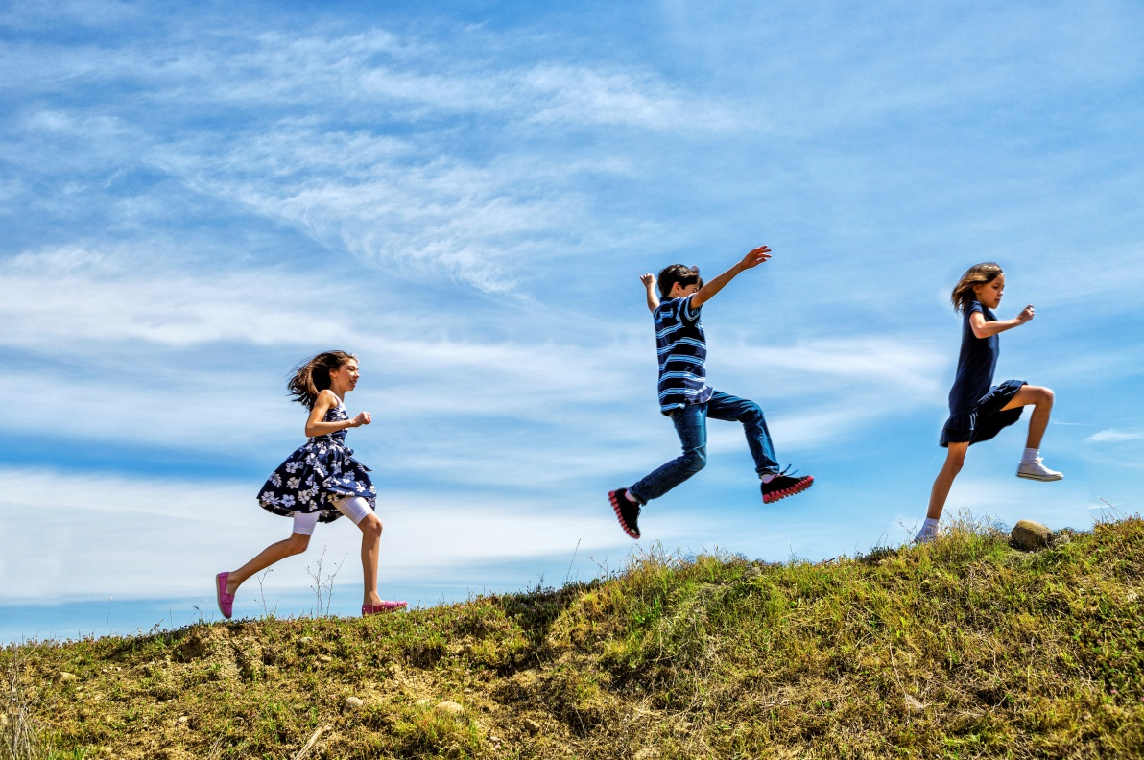
Why do we need to be active?
To help us to have…
strong bones;
strong muscles;
a healthy heart.
Being active can also…
help us to feel happy;
help us make new friends;
provide new experiences!

Slide 14
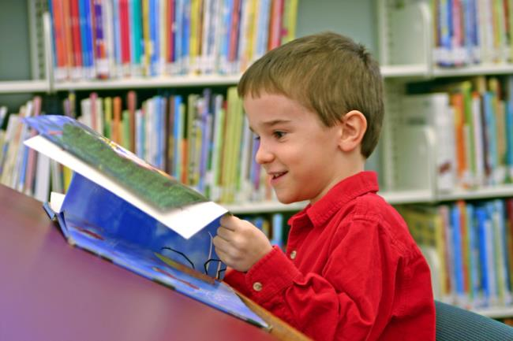
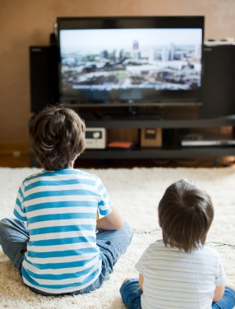
Sit less
When are you not active?
Reading
Watching TV

Slide 15
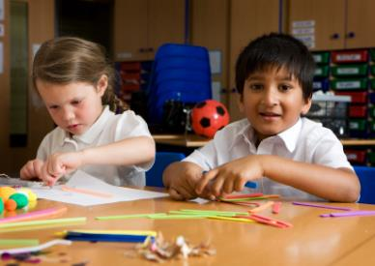
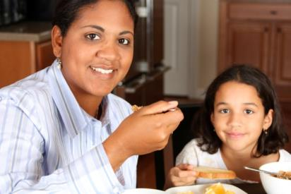
Sit less
Sometimes it is important to sit.
When do you think this is?
Working at school
Eating a meal

Slide 16
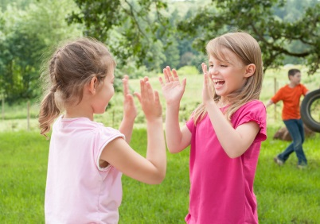
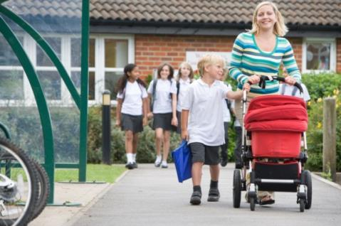
Move more
What is moving more?
Playing games
Walking to school
Moving more means being active every day.

Slide 17
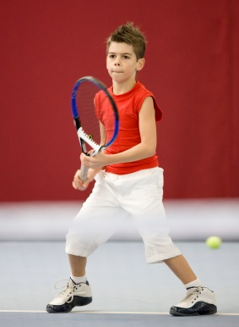
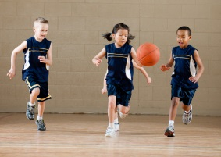
Be active for 60 minutes a day
What would count towards your 60 minutes a day?
Playing tennis
Playing team games

Slide 18

Be active
What makes you feel like this?
How does being active feel?
You…
You…
Your…
feel warmer
breathe harder
heart beats faster

Slide 19
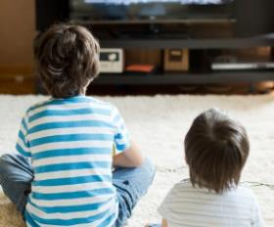
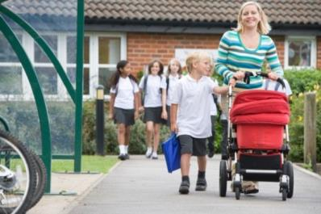
Every day…
Sit less
Move more
Be active for at least 60 minutes
What could you do to be more active?

Slide 20
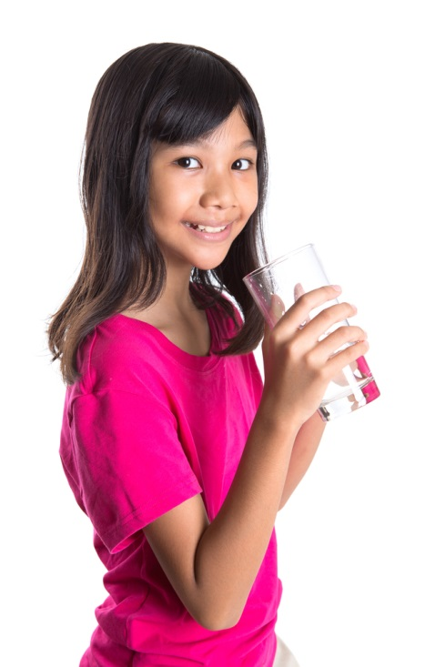
Stay active and hydrated!
Remember…
have 6-8 drinks everyday;
have more if it is hot;
have more if you are active;
be active for 60 minutes every day!

Slide 21
Hydration and activity
For further information, go to:
www.foodafactoflife.org.uk
This resource meets the Guidelines for producers and users of school education resources about food.

