Slide 1
British and international cuisine

Slide 2
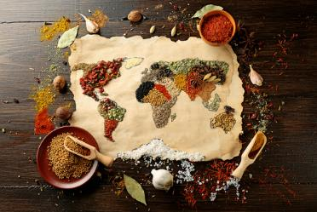
What does cuisine mean?
The term cuisine means a style or method of cooking that is characteristic of a country or region. It is often associated with geographical regions and cultures.
Cuisines evolve over time and are influenced by many different factors.
Often a traditional style of cooking is based around the ingredients that are grown and reared, or available, locally.
Other factors include:
preparation and cooking methods;
the use of specific tools and equipment;
service and presentation of food.

Slide 3
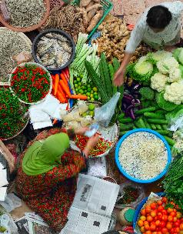
Factors that influence cuisine
There are many factors that will influence the type of food that is prepared and served in different countries. These include:
Religious and cultural beliefs will influence the selection, preparation and cooking of ingredients.
The geography and climate of the country or region will determine food that can be produced and therefore used in the cuisine of the area.
The economy – the amount of money available for people to buy food will influence the choice, preparation and cooking of ingredients.
The availability of food will have a direct influence on the cuisine of an area or country.

Slide 4
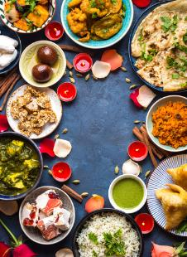
Religious and cultural beliefs
Religion plays an important role in the choice of food, its preparation and service.
It can have a significant impact on the diet of the population. Many religions and cultures have dietary laws which state the rules and give advice about food which should not be eaten.
There may also be specific rules about the preparation, cooking and eating of certain food.
World religions and cultures that have specific dietary laws include:
Buddhism, Hinduism, Islam, Judaism, Rastafarianism, Sikhism.

Slide 5
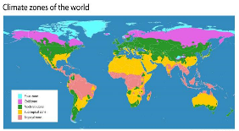

Geography and climate
Local weather and changing climate patterns can have an effect on the type and amount of food produced, e.g. drought, extreme storms, flooding, gales/cyclones. These extreme weather conditions can affect food security.
Climate and terrain will determine the types of food that can be grown, reared or caught successfully. For example:
Wheat and barley are found in temperate climates like the UK, Europe, parts of Asia and North America.
Rice is a crop of the wet tropics while sorghum can survive in very hot, dry conditions.

Slide 6

Economy
The wealth of a country will have an influence on the availability of food and diet of the people.
In some countries the population may have less money available to purchase food. This may restrict their diet to foods such as staple crops which are grown locally.
In wealthier countries there will be a greater and more accessible choice of food. This may provide the population with more variety but not necessarily a healthier diet.

Slide 7

Availability
Availability of food maybe related to:
Seasonality: the food may only be available at certain times of the year, unless it is imported, so eating seasonally can reduce the miles food has to travel;
Access: the consumer may find it difficult to access food, e.g. this may be due to lack of transport, physical disability, lack of money. Ingredients required to prepare and cook dishes from different cuisines may not be readily available;
Variety: in some urban areas the variety of fresh food available in the shops maybe limited – this is sometimes called a ‘food desert’.

Slide 8
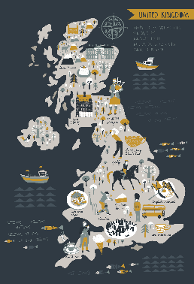
Food in the United Kingdom
The four countries of the United Kingdom have their own distinctive cuisines using local and regional ingredients.
In countries around the world, people eat a wide variety of different cuisines. This has been influenced by travel, the immigration of people from different countries and the availability of less familiar ingredients.
People are keen to try new foods and ways of preparing and cooking them.
The UK diet is often considered to be multi-cultural with different cuisines regularly included in the diet.
Fusion food is also popular, this is a form of cooking that combines contrasting culinary traditions or techniques into a single dish.

Slide 9

England
Some English foods and dishes are found throughout the country. Others are found in specific areas and are known as regional foods.
Religious festivals and other traditional celebrations influence the foods that are served. For example, pancakes on Shrove Tuesday.
There is an increased interest in local and regional food. Consumers can buy produce from farm shops, farmers markets and local allotment shops.
Food festivals are also popular promoting the use of local foods.

Slide 10


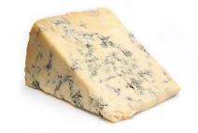



Name these examples of food from England
1 | Cornish Pasty
2 | Stilton
3 | Yorkshire Pudding
4 | Bakewell tart
5 | Cumberland sausage
6 | Eccles cakes
1
2
3
4
5
6

Slide 11
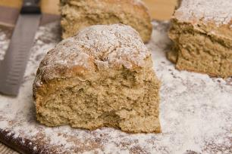
Northern Ireland
The cuisine from Northern Ireland has been influenced by its farming heritage, in particular potatoes and bread.
There is a wide variety of speciality ingredients and dishes from the country. These include:
colcannon: mashed potato and cabbage;
soda bread: soft bread made with baking soda instead of yeast;
Irish stew: made with lamb or beef, potatoes, carrots, onion in a gravy;
boxty: a potato cake made with cooked mashed and grated raw potato;
dulse: a seaweed snack food.

Slide 12
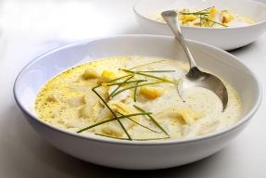
Scotland
Scotland produces a many ingredients including a wide variety of fish and shellfish, meat, fruit and vegetables. Traditional ingredients include: Aberdeen Angus beef, oats and barley, berry fruits, haggis, root vegetables, salmon, mussels and scallops.
Speciality dishes include:
porridge: oats cooked in milk or water, sugar or salt can be added;
cullen skink: a thick soup made with smoked haddock, potato, onion;
cranachan: a mixture of double cream, whisky, honey and fresh raspberries, with toasted oatmeal;
neeps and tatties: mashed root vegetables and potatoes.

Slide 13
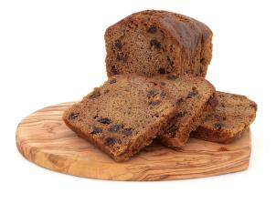
Wales
Welsh cuisine is historically based around the food produced for workers in rural areas, such as farmers and fishermen and more industrial areas in coal mining and other industries.
Traditional ingredients include Welsh lamb and beef, fish and seafood, Caerphilly cheese, leeks, potatoes, laver (seaweed).
Speciality dishes include:
Glamorgan sausage: vegetarian, made with Caerphilly cheese, leeks, mustard and breadcrumbs;
bara Brith: spiced loaf made with fruits soaked in tea;
cawl: a lamb or beef broth with potatoes and vegetables.

Slide 14
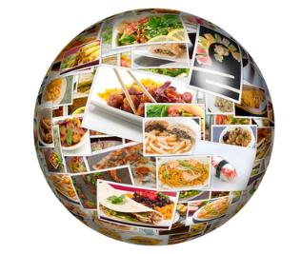
International cuisine
There are many hundreds of cuisines around the world, all having their own influences and traditions.
A term known as ‘Global cuisine’ is also becoming popular. This means a local, regional or national cuisine that has spread around the world, its food is served worldwide.
Examples of this are Chinese, Indian and Japanese food which can be found in many parts of the world.
The following are examples of different cuisines from around the world.

Slide 15
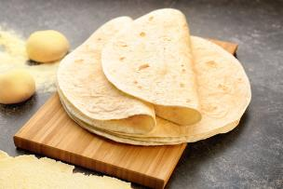
Mexican cuisine
The staple foods of Mexico include corn, beans, squash and chillies. Corn is used to make masa, a dough that is then turned into tortillas and tamales, whereas beans and corn feature prominently in many dishes.
Herbs and spices, particularly chilies are used in many dishes creating strong, earthy flavours.
Mexico’s six regions vary considerably in cuisine due to key differences in geography, climate and ethnic makeup.
Specialty dishes include refried beans, enchilada, mole (traditional sauces), pozole (a traditional soup or stew), salsa.

Slide 16
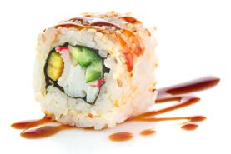
Japanese Cuisine
Japanese cuisine offers a wide range of regional and seasonal dishes.
For over 2000 years, rice has been the most important food in Japanese cuisine. Whilst rice consumption is slowly decreasing it remains one of the most important ingredients in Japanese cooking.
Sushi is the most famous Japanese dish outside of Japan, and one of the most popular dishes inside Japan, as well.
Hundreds of different fish, shellfish and other seafood are used in the Japanese cuisine. They are prepared and eaten in many different ways, such as raw, dried, boiled, grilled, deep fried or steamed.
Noodle dishes are very popular in Japan and are served both hot and cold depending on the season.

Slide 17
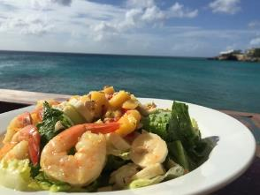
Caribbean cuisine
Caribbean cuisine is a fusion of African, Creole, Cajun, European, Latin American, East/North Indian, Middle Eastern, and Chinese. These traditions were brought from many different countries when they came to the Caribbean.
Popular ingredients in many Caribbean dishes include rice, plantains, beans, cassava, peppers, chickpeas, tomatoes, sweet potatoes, coconut and poultry, pork or fish.
A unique blend of fresh herbs and spices, many grown on the islands give a distinctive flavour and aroma to many dishes.

Slide 18
British and international cuisine
For further information, go to:
www.foodafactoflife.org.uk
This resource meets the Guidelines for producers and users of school education resources about food.

