Slide 1
Food education in primary curricula across the UK
Claire Theobald, Education Services Manager Ewen Trafford, Nutrition Education Officer

Slide 2
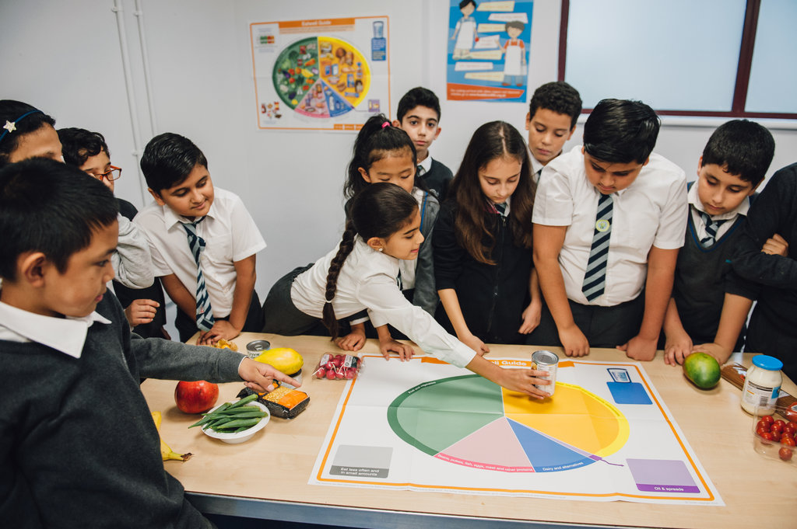
This session will cover:
Where food education fits in primary curricula across the UK
Why food and nutrition education is so important
What primary school children should be taught
Resources that can support

Slide 3
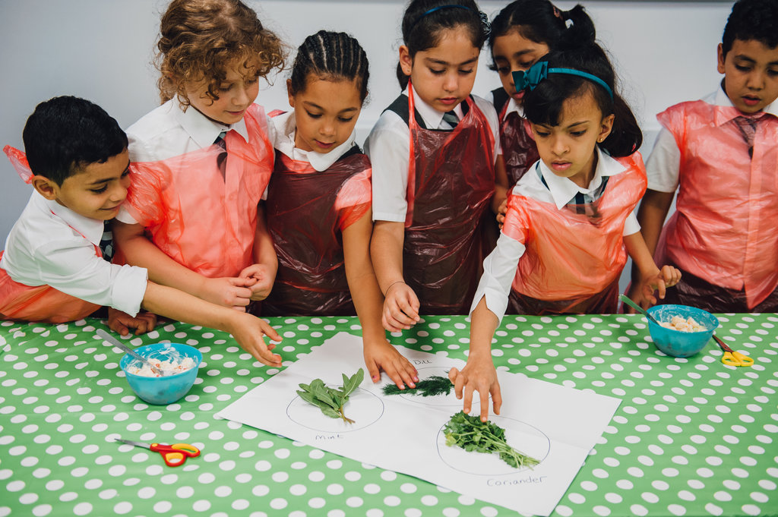
Where food education fits in primary curricula across the UK

Slide 4
Health and personal development
Healthy eating!
Country | Curriculum area/subject | Learning
England | Personal, social, health and economic (PSHE) education - RSE and Health Education | Healthy diet, nutrition, plan and prepare meals, poor diet and risks associated
Northern Ireland | Personal Development and Mutual Understanding (PDMU) | Keeping healthy and well - healthy eating, hygiene, safety
Scotland | Health and wellbeing | Healthy eating, applying healthy eating advice, energy, nutritional needs at different life stages, hygiene and safety
Wales | Health and Well-being | Balanced diet, nutrition, choices Plan and prepare basic meals
Notes:
Materials – construction, textiles, ingredients

Slide 5
Technologies and science
Cooking!
Country | Curriculum area/subject | Learning
England | Design and technology Cooking and nutrition Science | Design, Make, Evaluate - with different materials, e.g. food Apply healthy eating, prepare and cook Diet, digestion, nutrients
Northern Ireland | The World Around Us - Science and technology | Materials – properties, changes (heating/cooling), joining and assembling, tools
Scotland | Technologies | Tasting, food preparation, cooking, problem solving
Wales | Science and technology | Design, solve problems, use tools and equipment safely, combine component parts, materials and processes Properties of materials, environment
Notes:
Materials – construction, textiles, ingredients

Slide 6
Various areas/subjects
Where food comes from!
Country | Curriculum area/subject | Learning
England | Cooking and nutrition | Where food comes from, seasonality, how ingredients are grown, reared, caught and processed
Northern Ireland | Personal Development and Mutual Understanding (PDMU) | Food and culture
Scotland | Health and wellbeing | Where food comes from, food journeys (source to consumer), seasonality, local availability, sustainability Food labels, advertising and media, food and culture
Wales
Notes:
Materials – construction, textiles, ingredients

Slide 7

Food – a fact of life covers…
Healthy eating | Cooking | Where food come from
Eatwell Guide Applying healthy eating Energy balance (energy ‘in’ and ‘out’) Nutrients (carbohydrate, protein, fat, vitamins, minerals) Digestion | Hygiene (getting ready to cook, using equipment) Safety (using kitchen equipment ‘tools’) Food skills – making (‘cut’, ‘assemble’, ‘techniques’) Ingredients (‘materials’) Planning (‘design’) Tasting (review, evaluate) | Plant or animal origin Grown, reared, caught Seasonality Processing, e.g. cheese, bread
Notes:
Materials – construction, textiles, ingredients

Slide 8
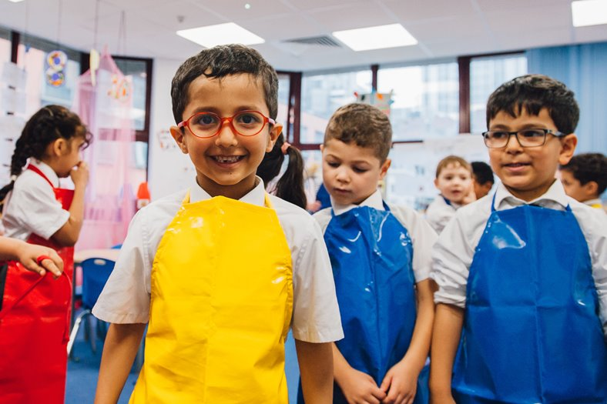
Why food and nutrition education is so important

Slide 9
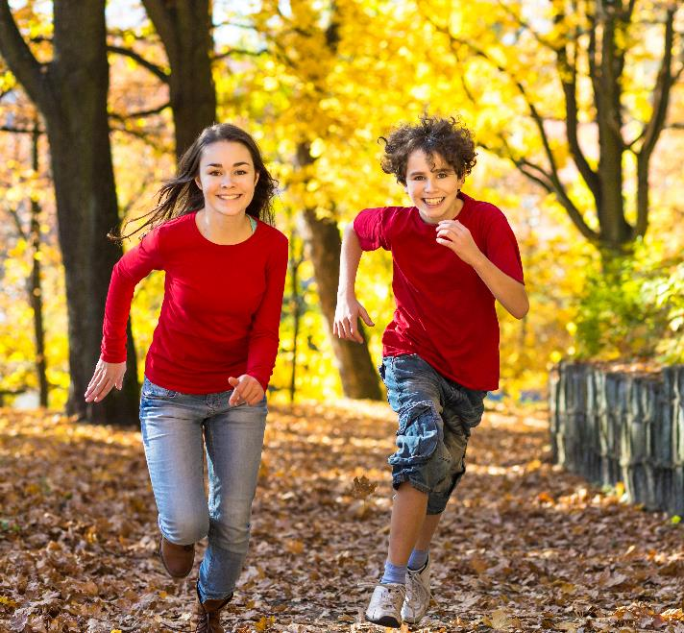
Importance of nutrition during childhood and adolescence
Needed to support:
rapid growth;
bone development;
muscle development;
cognitive development.
British Nutrition Foundation – Teenagers
Lowe, Morton and Reichelt, 2020
Notes:
There is an acceleration of physical and mental development during the teenage years, leading to increased nutrient requirements
There is also an increased distinction between certain nutrients that boys and girls may need more of as they get older (e.g. boys may require more zinc, selenium and girls more iron)
However, we know that many markers of health status in teenagers are of concern and we also know that the dietary quality of teenagers tends to be poor.

Slide 10
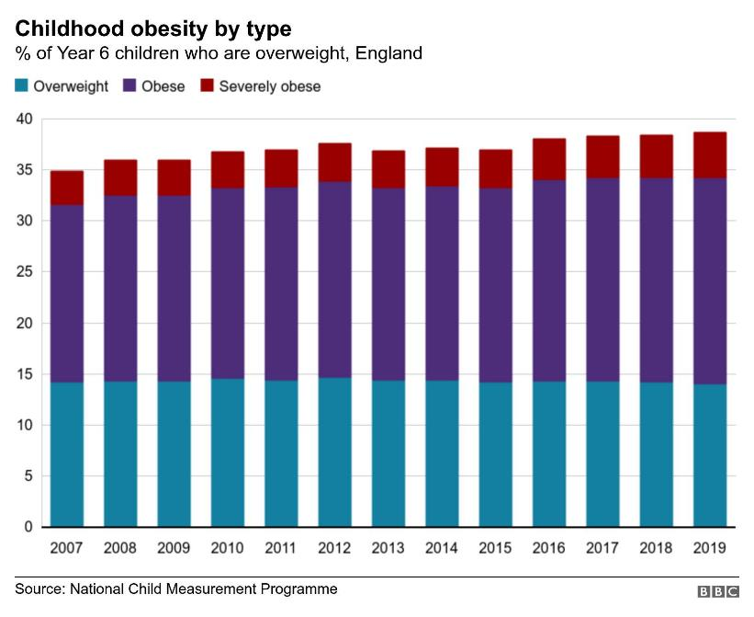
Health status in children and young people
Overweight, Obesity and Physical Activity
1 in 5
obese by year 6
Fewer than 50%
meeting recommended activity guidelines
Statistics on Obesity, Physical Activity and Diet, England, 2020
National Child Measurement Programme
Notes:
1 in 5 by year 6 and this percentage continues to rise as children get older. Between the ages of 13 and 15, 36% of all children in England are overweight or obese. We can also see from this graph that the total overweight, obese and severely obese by age 11 has continued to steadily rise with time.
Guidelines – children and young people (5 to 18) should aim to be physically active for at least 60 minutes per day across the week.
Fewer than 50% of children and young people meet the recommended activity guidelines, compared to 67% of adults. We do know that boys are, on average, a little bit more physically active than girls as well.
When we factor in for deprivation, more deprived children have a much higher rate of obesity and as they get older this gap increases (Children in England by year 6 27.5% obese in most deprived areas vs 11.9% in least deprived) – NCMP 2019/20
Obesity in childhood tracks into adulthood

Slide 11
Health status in young people
Government response
Sugary drinks consumed vs free sugar intake
Public Health England*
Sugar reduction
Salt reduction
Calorie reduction
Childhood Obesity Plan
Advertising restrictions
Soft Drinks Industry Levy
Free sugar intake
Dental health
*Superseded by the Office for Health Improvement and Disparities
Notes:
Government has attempted to enact measures to deal with overweight and obesity, plus other health issues such as salt.
Children are an increasing focus of the government’s obesity plan.
For example, rules to introduce a 9pm watershed for foods high in fat, salt and sugar is due to come into force next year
Other legislation includes rules around promotions of HFSS foods in stores.
An example of a broadly successful measure is the SDIL.

Slide 12



Health status in children
Intake of key foods
18%
<15g
2g*
getting 5-A-Day
fibre per day
avg. oily fish eaten per day
Overall dietary quality in UK children and adolescents is poor
This suggests that childhood and adolescence is a key time to make targeted changes
Health Survey for England, 2019
NHS, 2021
Wimpenny et al., 2018
*data for 11-18 year olds
Notes:
Only 12% getting 5-A-DAY and 4% getting enough fibre.
Both of these are an issue in the adult population too, but worse in teenagers.
Two portions of fish a week, one of which is oily is the general recommendation for oily fish
Children under the age of 16 should avoid eating any shark, swordfish or marlin. This is because the levels of mercury in these fish can affect a child's nervous system.
You can give boys up to 4 portions of oily fish a week, but it is best to give girls no more than 2 portions a week. This is because the low levels of pollutants that oily fish contain can build up in the body and may harm an unborn baby during a future pregnancy.
Research suggests that the overall dietary quality in UK adolescents is poor and not diverse. This is a period of change and therefore it is challenging to intervene but this is an important period for development.

Slide 13
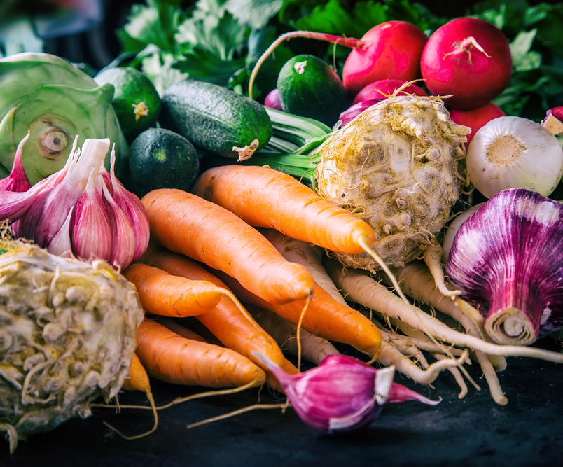
Vitamins and Minerals
During childhood and adolescence, requirements for nutrients are high, due to rapid growth and development.
Reference Nutrient Intakes and Lower Reference Nutrient Intakes are set for vitamins and minerals.
These help to indicate how many people are at risk of deficiency.
Notes:
The EAR is the estimated average requirement for a nutrient in a population, determined by research into that nutrient
The RNI for a nutrient is the level at which 97.5% of a population group will have sufficient status.
The LRNI is the level at which 97.5% of a population group would be deficient
Identifying the LRNI for key nutrients can give an indication of how many teenagers are at high risk of deficiency

Slide 14
Vitamins and minerals (11-18 years)
Vitamin or Mineral | % Boys below LRNI | % Girls below LRNI
Iron | 11% | 49%
Calcium | 14% | 16%
Zinc | 20% | 16%
Iodine | 19% | 28%
Vitamin A | 18% | 18%
Riboflavin (B₂) | 13% | 22%
NDNS: results from years 9 to 11 (2016 to 2017 and 2018 to 2019)
Notes:
For example, these are nutrients where we know these age groups are below this amount and are important:
Iron - 49% of girls below LRNI (high iron requirements during this period, particularly due to menstruation, plus lower intakes than boys)
Iron can be found in meat (particularly red meat) but also in green, leafy vegetables. However, the iron in leafy vegetables is less bioavailable
Calcium – important for bone, tissue and dental health
Calcium can be found in dairy products but also green, leafy vegetables such as kale and broccoli (in lower amounts). Many dairy alternatives and juices are also fortified with calcium to boost intake.
Zinc – supports growth and development and the immune system. Zinc is not stored in the body, so regular intake is important.
Zinc can be found primarily in seafood and meat and fortified cereals but in some nuts, seeds and beans at lower levels.
Iodine – Important for proper skeletal development, nervous systems and hormone production
Iodine can be found primarily in dairy, eggs and seafood. Seaweed can have high levels of iodine, however in some species of seaweed this can be dangerously high.
Vitamin A – supports growth and development
Vitamin A can be found in two forms – retinol (from animals) and beta-carotene (from plants). Retinol is more readily available.
Retinol is typically found in meat and in high amounts in liver, but too much retinol can lead to toxicity – so caution should be taken when eating liver.
Beta-carotene is found in high quantities in sweet potato, spinach and carrots – there is far less risk of toxicity with high intakes of beta-carotene
Riboflavin (B2) – Energy production, growth and development
Riboflavin can be found in red meat and dairy but also in lower amounts in nuts and mushrooms. Most cereals are fortified with riboflavin.
Despite the evidence that magnesium, potassium and selenium intakes are below the LRNI in a substantial proportion of the UK population, particularly in older children and adults, the health implications of this are unclear as the DRVs for these minerals are based on limited data. This means that caution should be used when assessing adequacy of intake using the LRNI for these nutrients - just say that intakes also below LRNI in x% for Mg, Se and K but implications (if any) unknown
Bear in mind that these are the percentage below the LRNI, where 97.5% would be deficient. Even if everyone reached the EAR, 50% would still have suboptimal status
Take home message – balanced diet

Slide 15
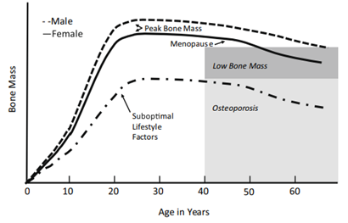


Key consideration – bone mass
Calcium
+
Vitamin D
Weaver et al., 2016
NHS, 2020
Notes:
Vitamin D – no LRNI but median intakes below 20% for both groups. 19% have low blood vitamin D <25nmol/l
Vitamin D is generated by UV light on the skin. In the diet it can be found in oily fish and dairy – mushrooms may be specially treated with UV light to produce it. However, dietary sources alone are typically not enough
We are now all recommended to take vitamin D supplements – the whole population has an issue with this, not just teenagers!
‘Vitamin D helps regulate the amount of calcium and phosphate in the body.
These nutrients are needed to keep bones, teeth and muscles healthy.
A lack of vitamin D can lead to bone deformities such as rickets in children, and bone pain caused by a condition called osteomalacia in adults.’ - NHS
Early accumulation of bone mass important in order that decline not be overly detrimental – suboptimal lifestyle factors (also including other factors than just these 2) increase risk of osteoporosis.
Risk is higher in women – 16% below LRNI for calcium and 19% suboptimal blood vitamin D levels

Slide 16
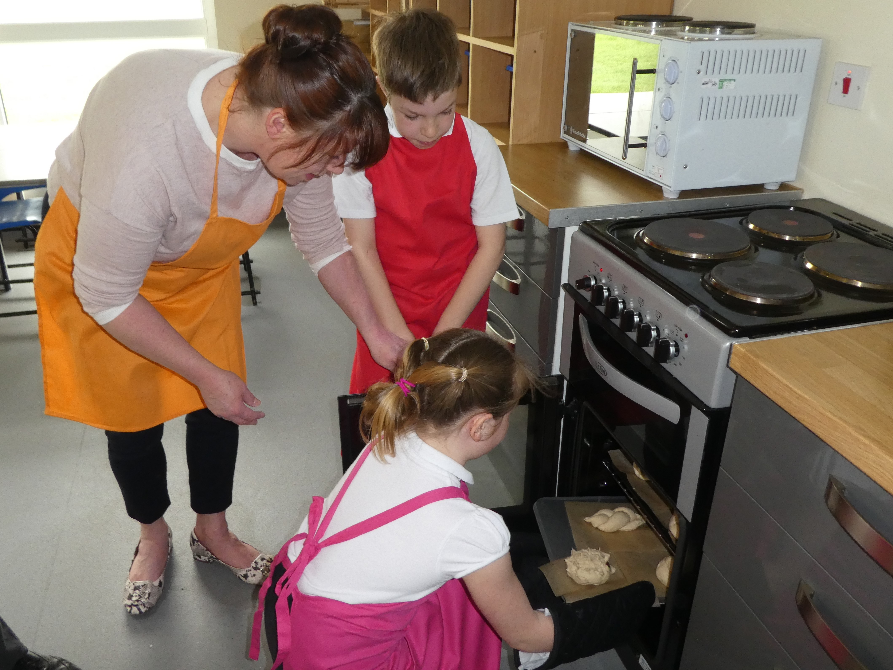
What primary school children should be taught

Slide 17
Food – a fact of life covers… (recap)
Healthy eating | Cooking | Where food come from
Eatwell Guide Applying healthy eating Energy balance (energy ‘in’ and ‘out’) Nutrients (carbohydrate, protein, fat, vitamins, minerals) Digestion | Hygiene (getting ready to cook, using equipment) Safety (using kitchen equipment ‘tools’) Food skills – making (‘cut’, ‘assemble’, ‘techniques’) Ingredients (‘materials’) Planning (‘design’) Tasting (review, evaluate) | Plant or animal origin Grown, reared, caught Seasonality Processing, e.g. cheese, bread
Notes:
Materials – construction, textiles, ingredients

Slide 18
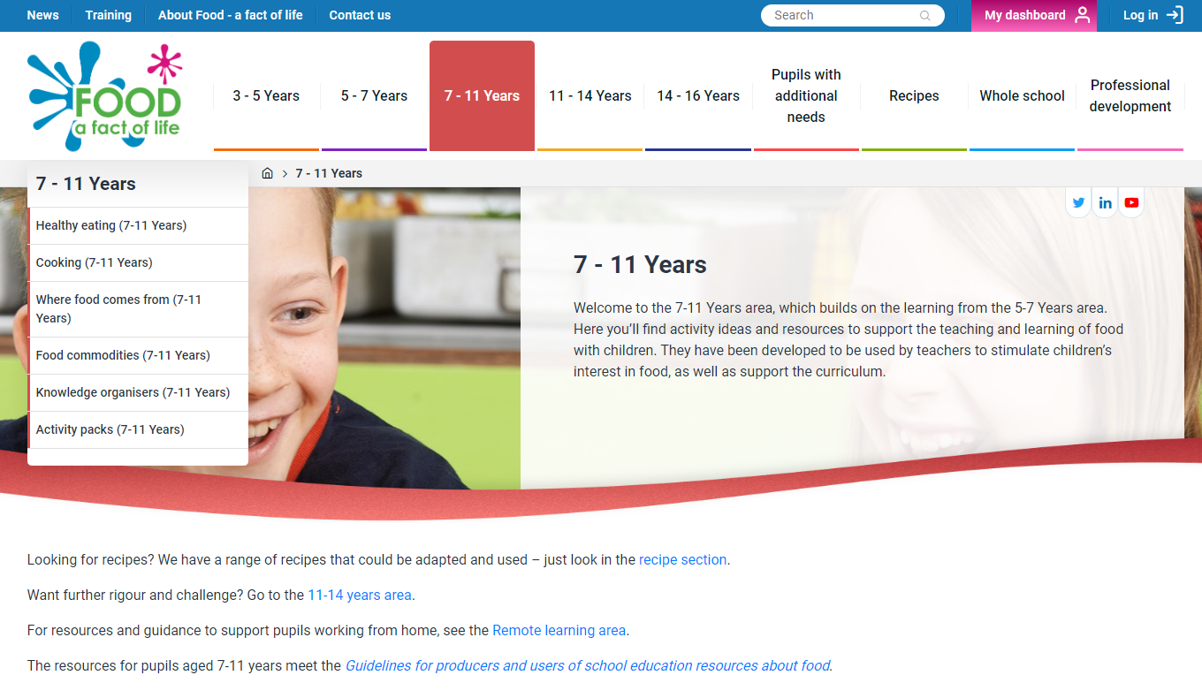
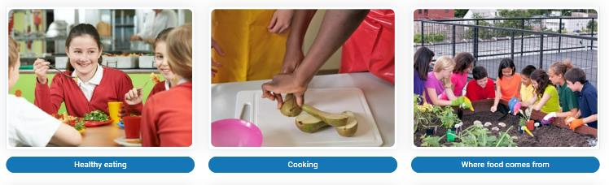
Food – a fact of life
Free resources for teaching young people aged 3-16 years about where food comes from, cooking and healthy eating.
www.foodafactoflife.org.uk

Slide 19
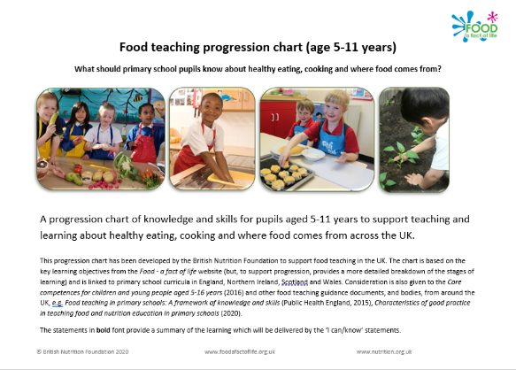
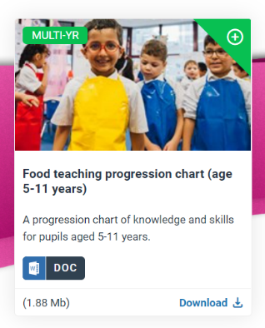
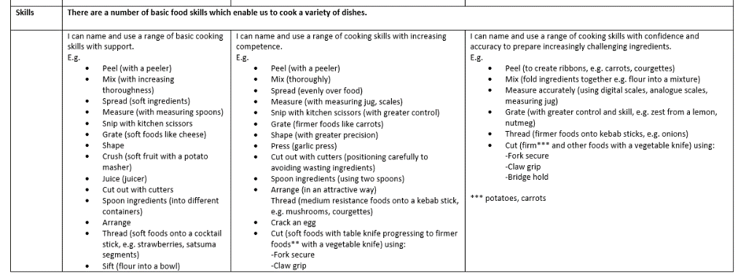
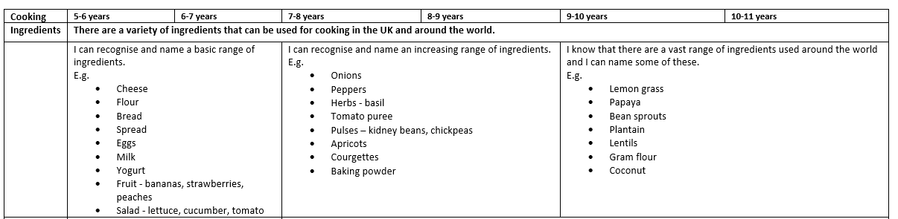
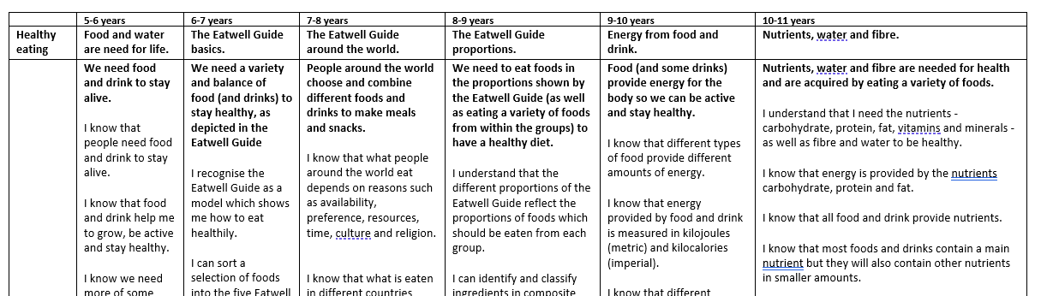
Progression chart
https://www.foodafactoflife.org.uk/professional-development/ppd-toolkit/primary/food-teaching-progression-5-11-years/

Slide 20

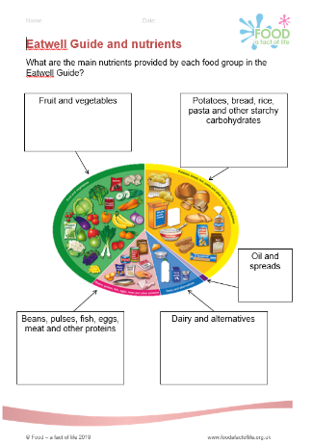
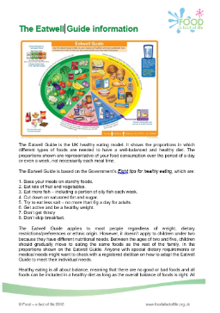
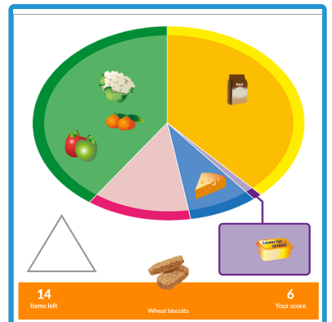
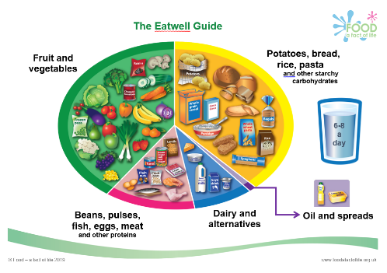
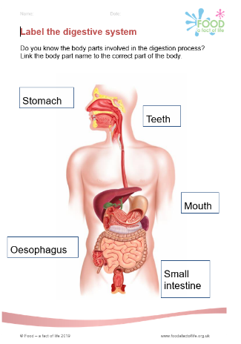
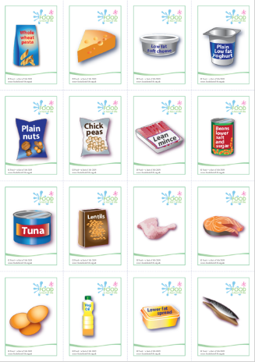
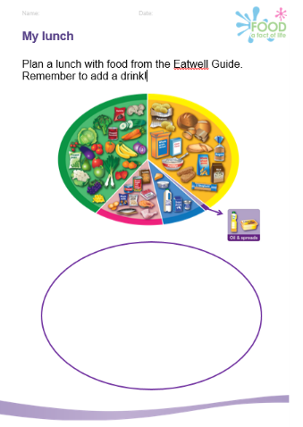
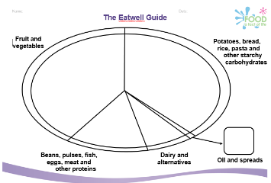
Resources to support healthy eating
Healthy eating guide
Posters
Interactive Eatwell activity
Eatwell Guide card games
And more!

Slide 21





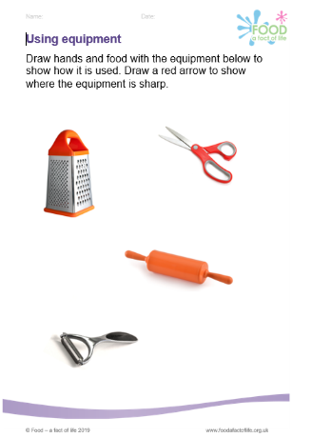
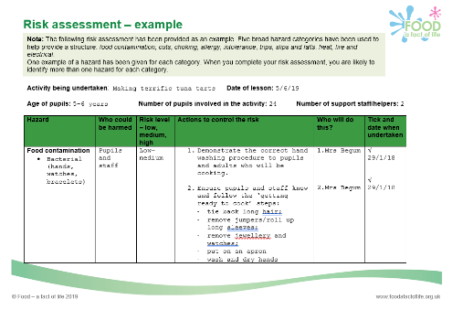

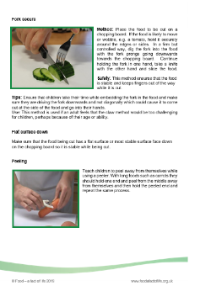

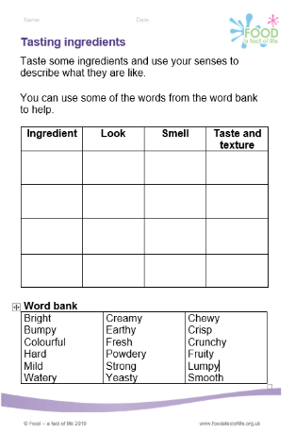

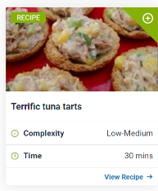

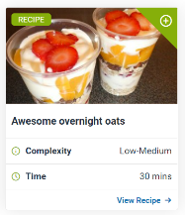
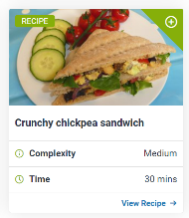
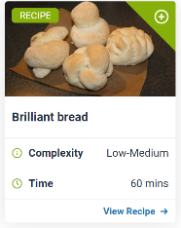
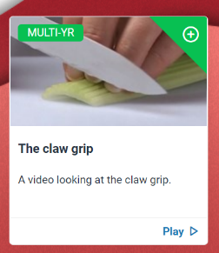


Resources to support cooking
Activity sheets
Cards – ingredients, equipment, sensory vocabulary
Guides – food skills, setting up a cooking session
Videos – food skills and recipes
Risk assessment
And more!

Slide 22
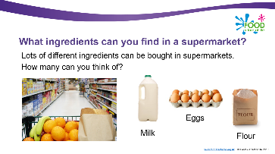
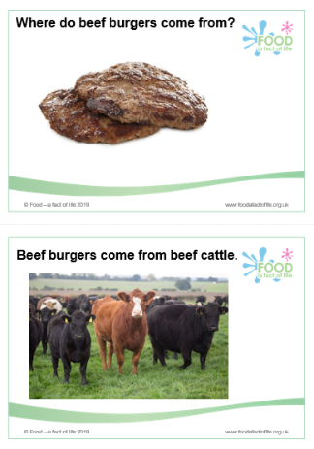
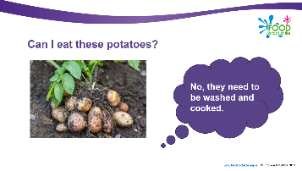

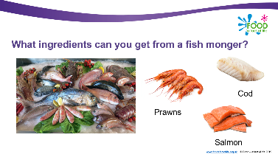
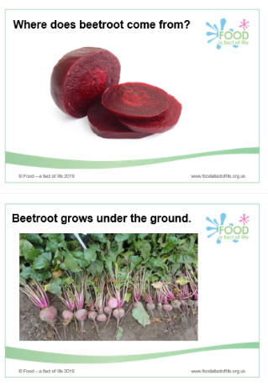
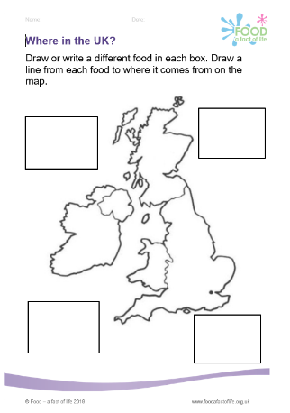
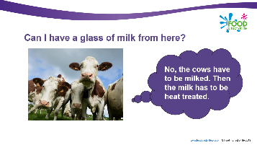
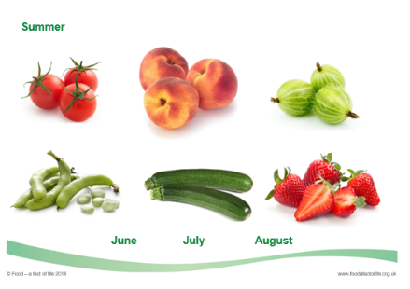
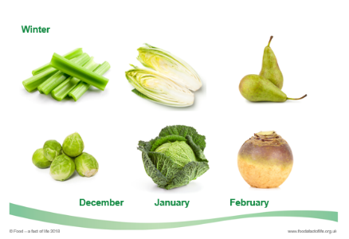
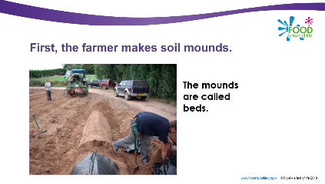
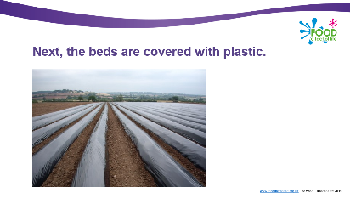
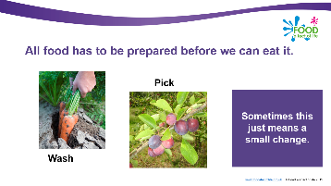
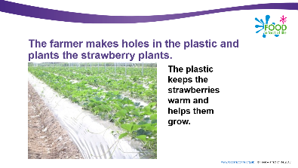
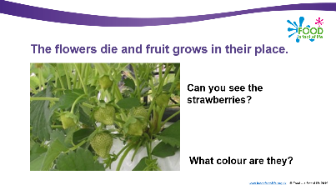
Resources to support where food comes from

Slide 23
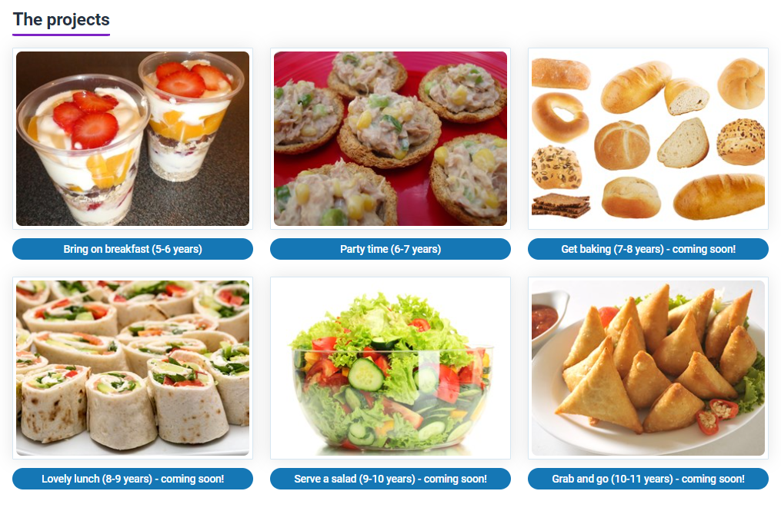
Primary food projects – coming soon!
Six food projects to support a progressive approach to teaching and learning about healthy eating, cooking and where food comes from.
Each project includes:
Overview, objectives and curriculum links;
six lesson plans;
links to supporting resources on Food – a fact of life – worksheets, recipes, presentations.
Primary projects (area link)

Slide 24
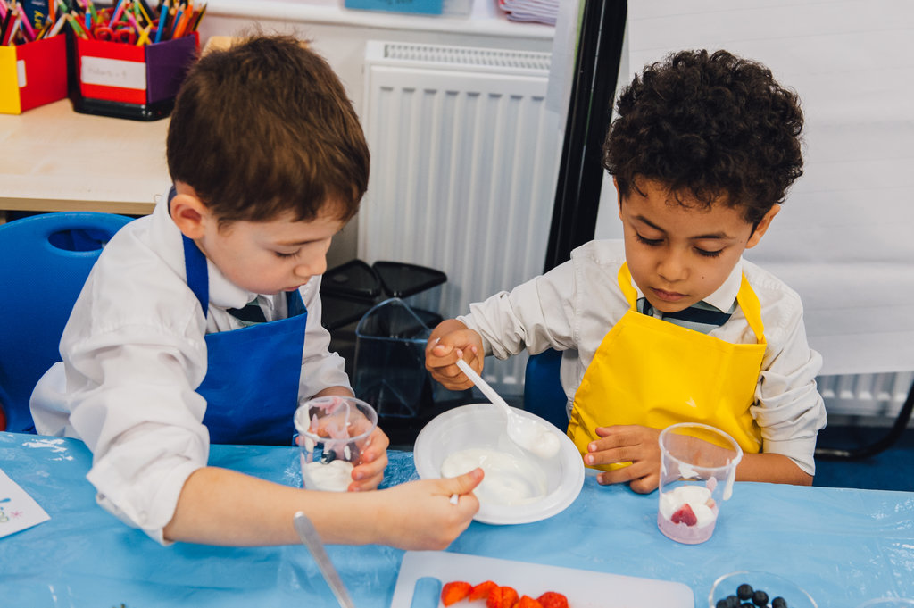
Resources that can support (cross-curricular/ interdisciplinary)

Slide 25
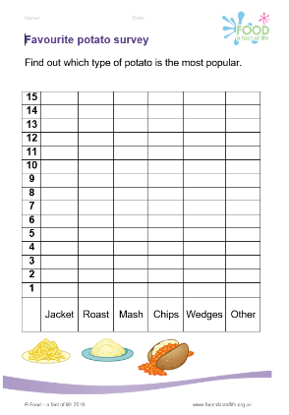
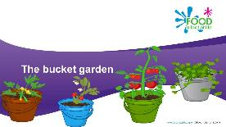




Learn with stories...
Six food themed, cross curricular stories that support literacy and numeracy.
The bucket garden
www.foodafactoflife.org.uk Search in the age tab (5-7 or 7-11) > Activity packs > Learn with stories

Slide 26








Fibre pack
To find these resources: 7 - 11 Years > Activity pack > Fibre activity pack Simple nutritional analysis tool (on Food – a fact of life), Explore Food

Slide 27








Victorians
Supports
Learning about food in Victorian times – eating, shopping cooking
Seasonal food
Preserving food
Comparing Victorian and modern-day diets
Includes
Teachers’ guide, presentation, activity sheets and a recipe
To find these resources: 7-11 Years > Activity packs > Victorians

Slide 28








Space
Supports
Nutrition and human health
Comparing food on earth to food in space (requirements)
Physical activity
Preserving food, e.g. dehydrating
Includes
Teachers guide, presentation, activity sheets, game
To find these resources: 7-11 Years > Activity packs > Space

Slide 29


Keep up to date with our free resources and training
Education News (monthly email update)
Sign up on the homepage: www.foodafactoflife.org.uk
Follow us on Twitter @Foodafactoflife
https://twitter.com/foodafactoflife
Keep in touch: education@nutrition.org.uk

Slide 30
Thank you

