Slide 1
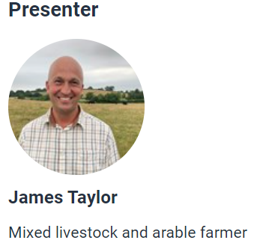
Sustainable farming in practice: the natural world and the importance of sustainability in context
Welcome!
The webinar will start at 4.30pm
Let us know who you are – type your name and organisation in the chat box.
Set your chat box to everyone.

Slide 2
What we will be covering
James' mixed farming system and his sustainable farming practices.
The three pillars of sustainability and the importance of them when producing food.
Seasonal activities that take place on James’ farm.
Links to Food – a fact of life resources about where food comes from.
Sustainability and climate change: a strategy for the education and children’s services systems
Food and nutrition, particularly at GCSE level, has been identified as providing opportunities for pupils to be taught about the environment and sustainability in context.

Slide 3
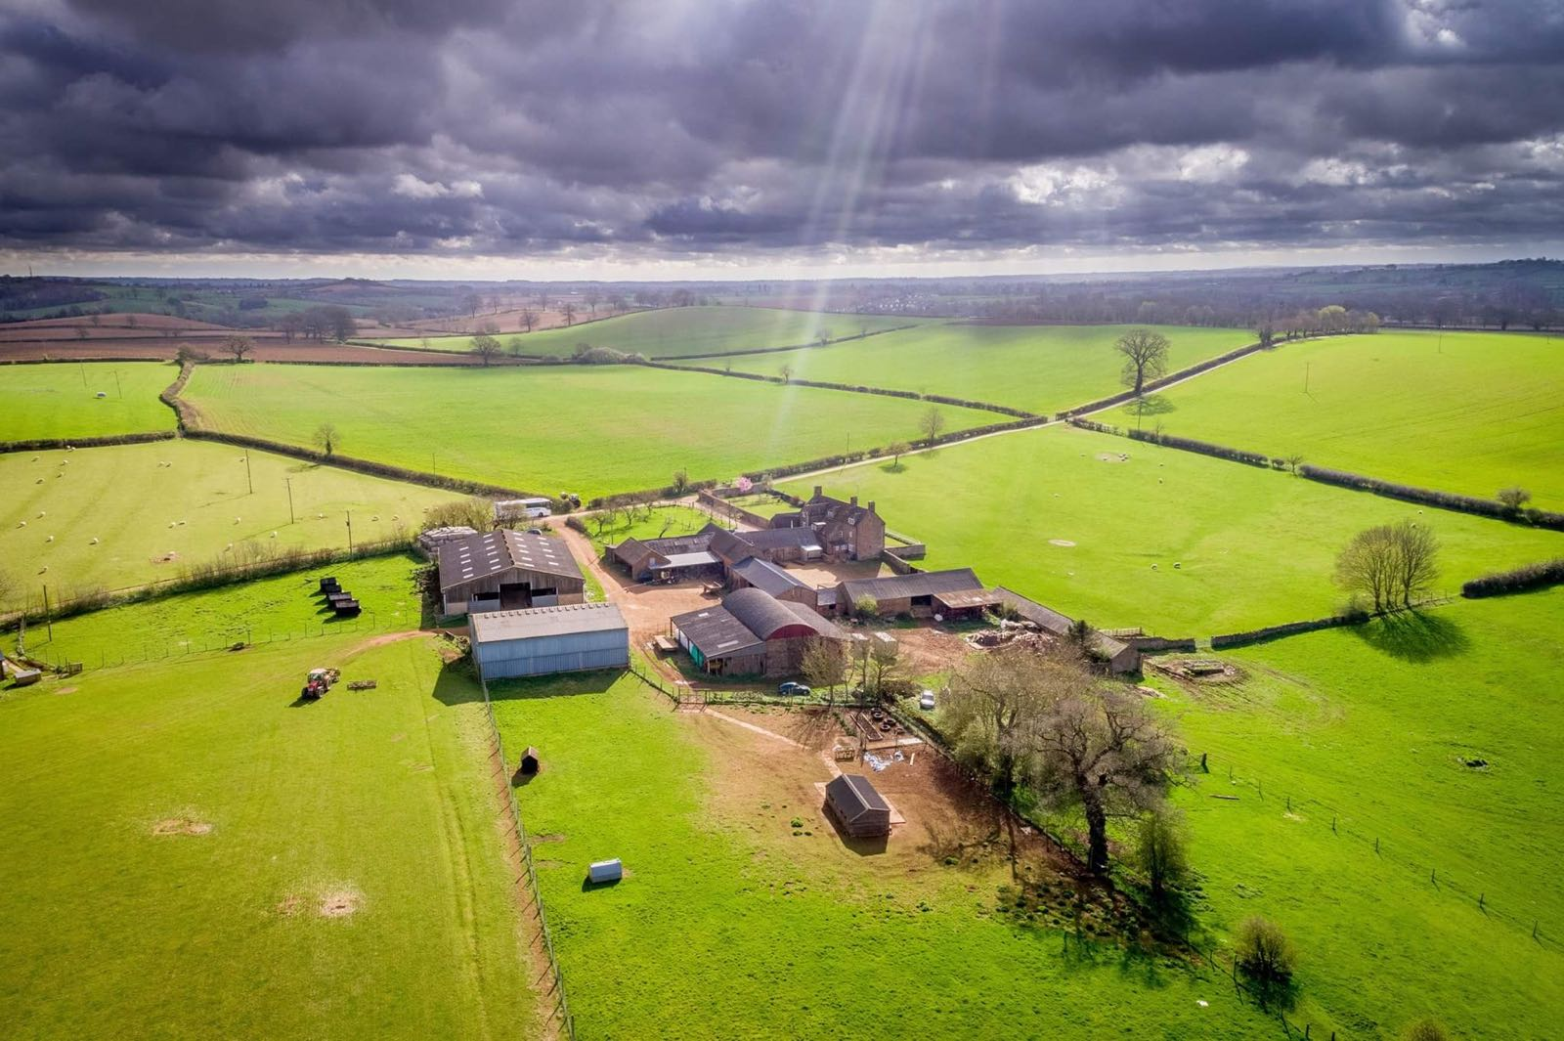
Broughton Grounds Farm

Slide 4
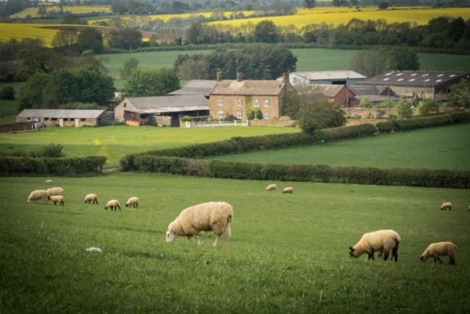
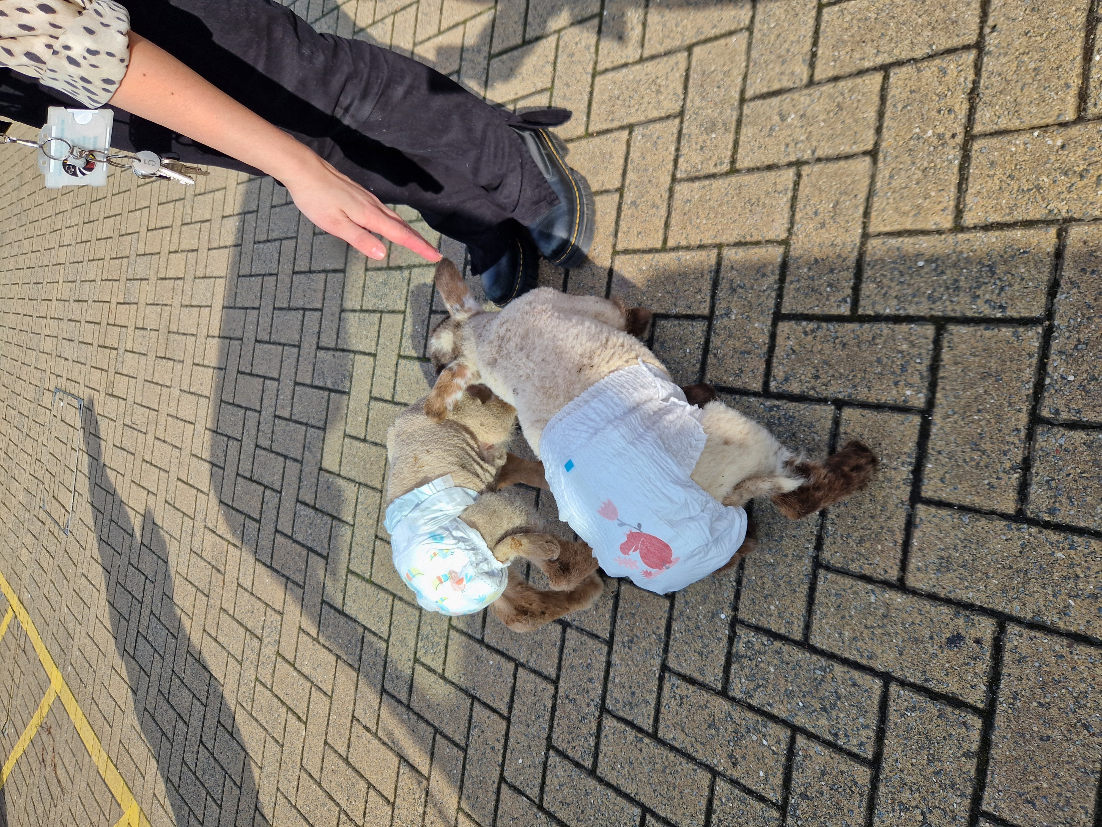
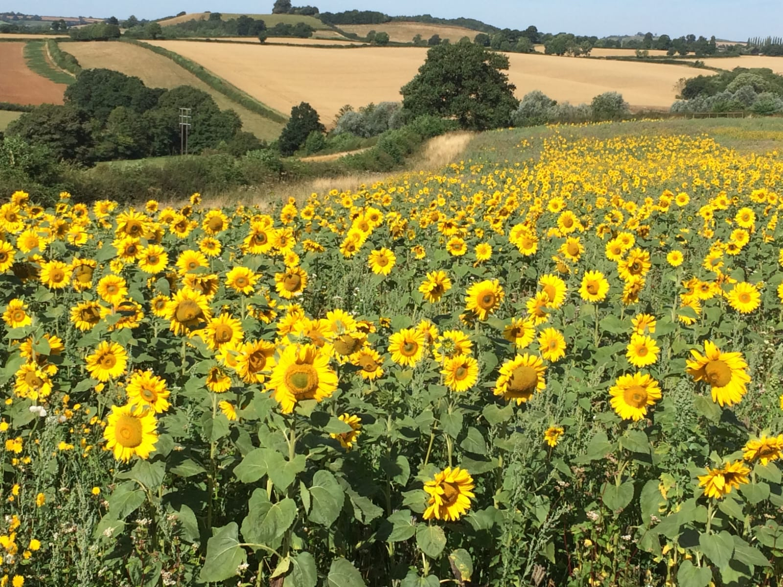
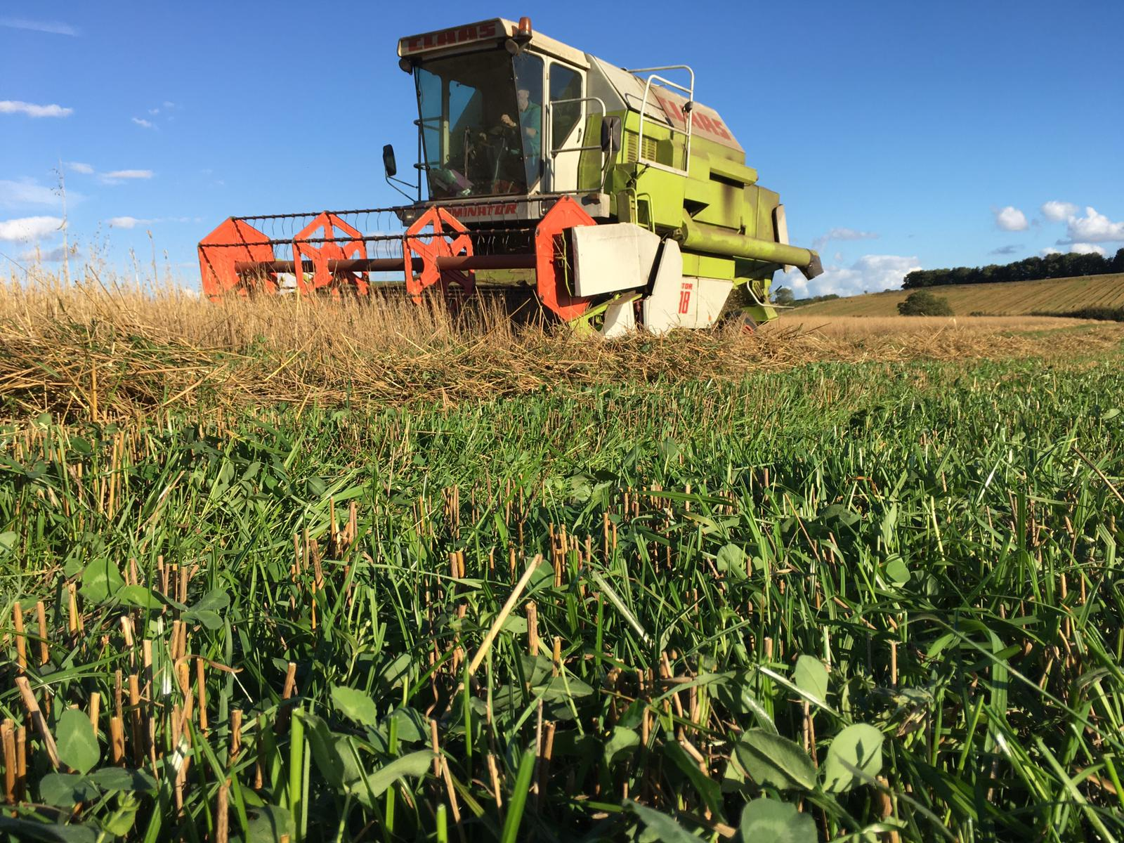
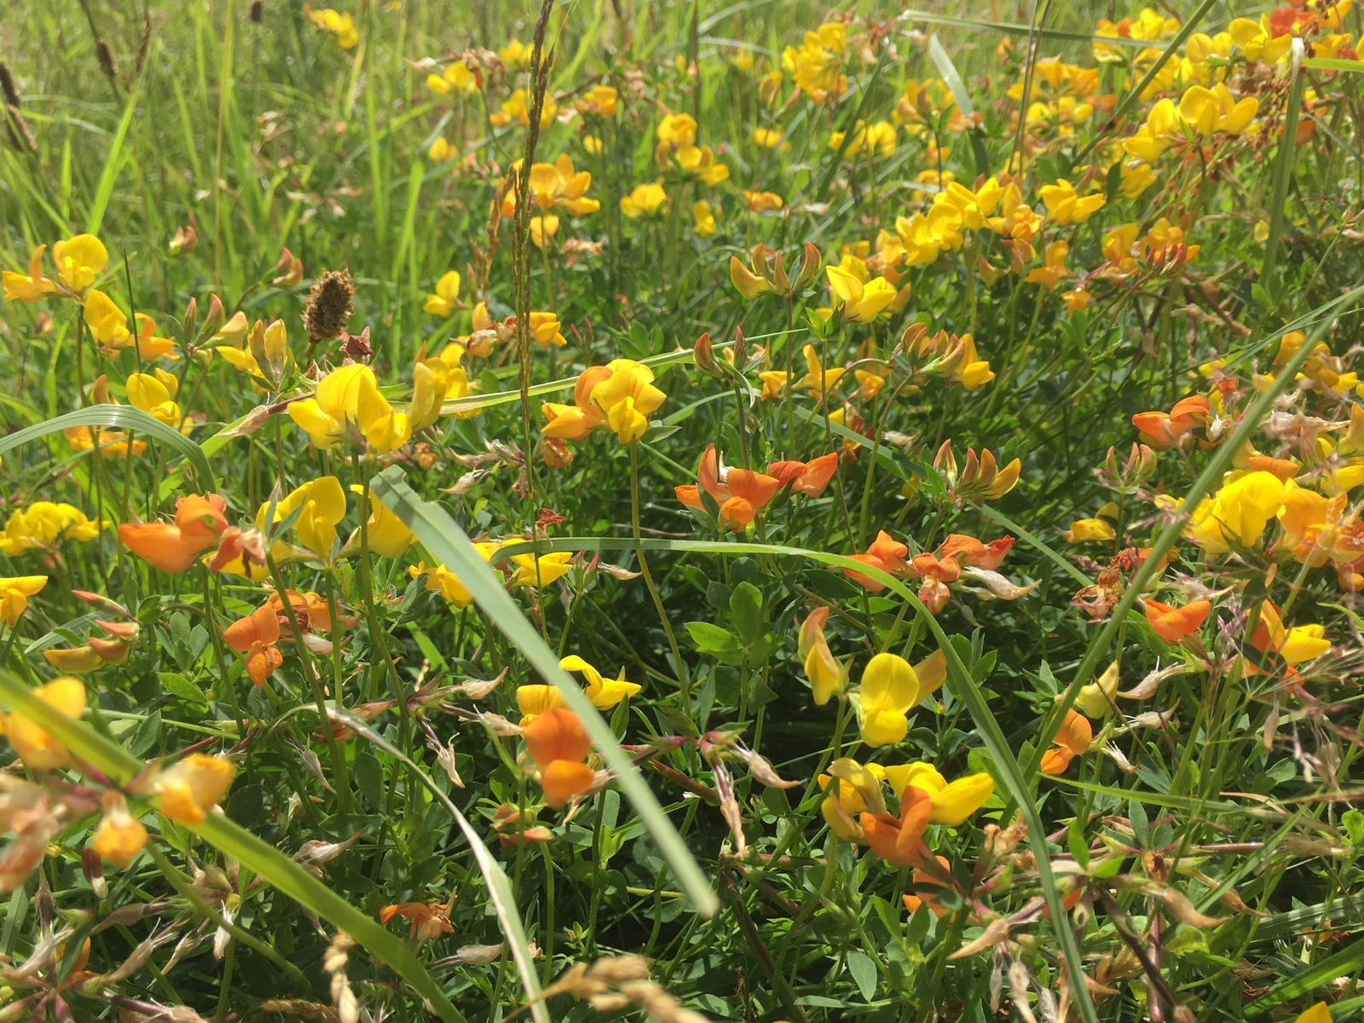
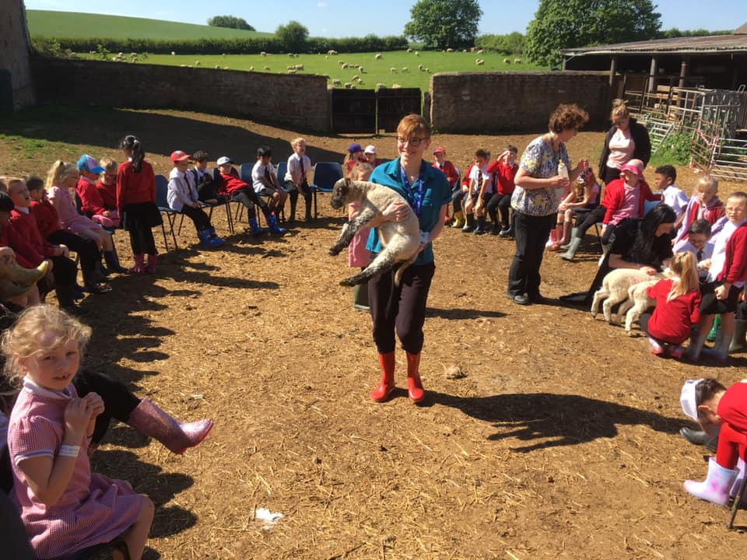
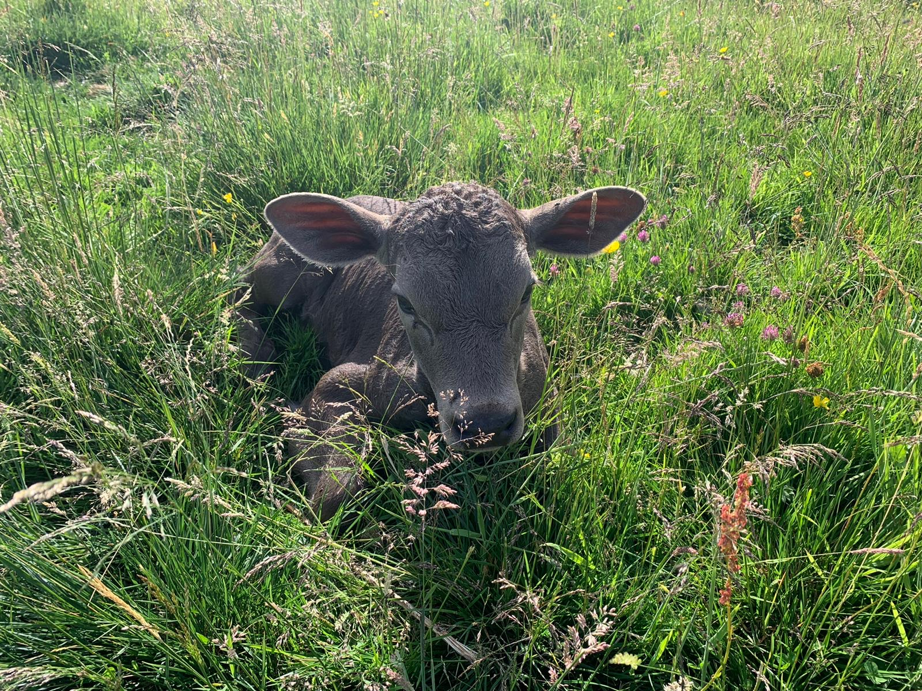
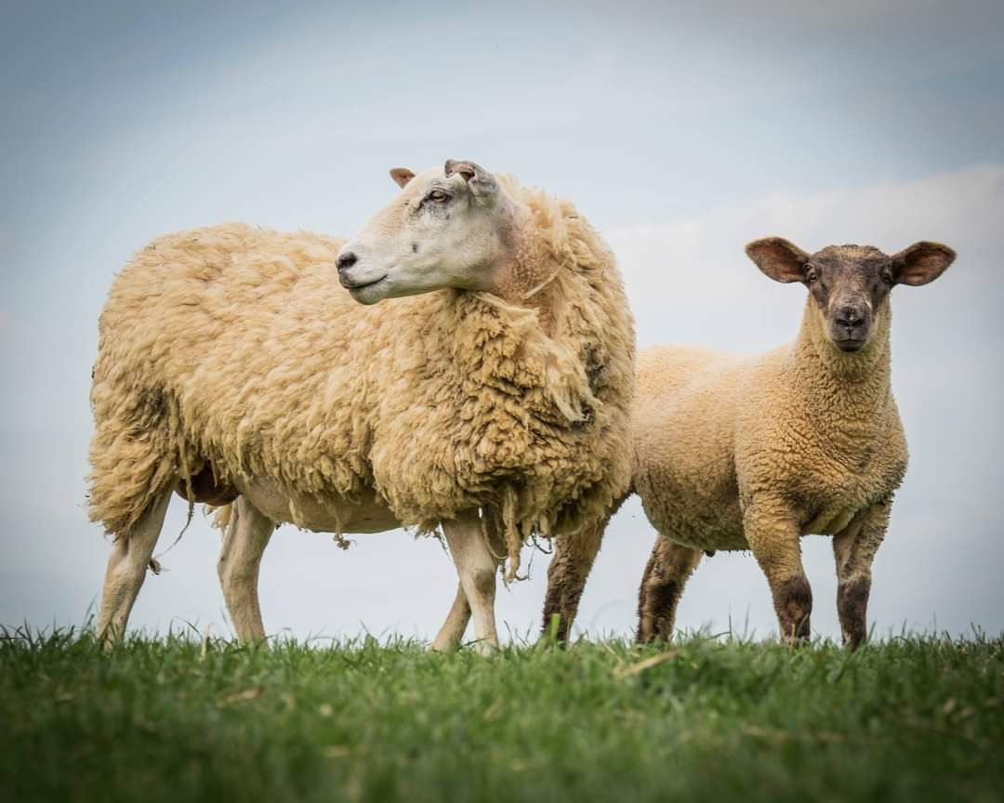
Mixed livestock and arable production systems – what does sustainability look like in practice?

Slide 5

Broughton Grounds Farm
400 acre / 162 ha tenanted farm, risk-averse, see our role as stewards.
Arable land in 6 yr rotation (wheat, barley, turnips, clover).
500 ewes, 90 cattle, 400 hens and about two million bees!
One integrated system, not isolated enterprises.
Varied habitats which we strive to protect / enhance.

Slide 6
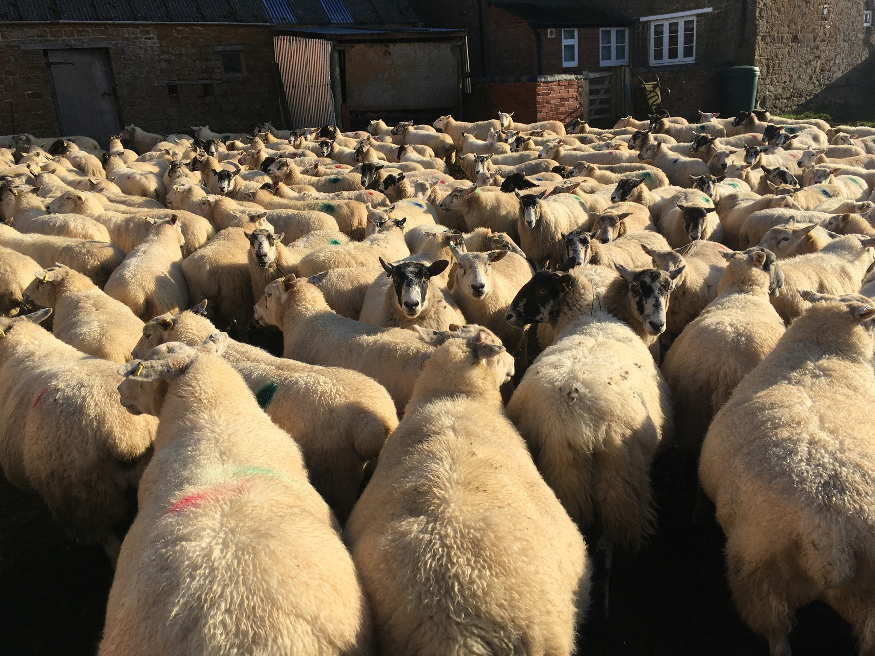
What makes a farming system sustainable?
Resilience i.e. system’s ability to withstand challenges.
Mixed system can build resilience.
Environmental, social and financial pillars.
Each has challenges at the moment!

Slide 7
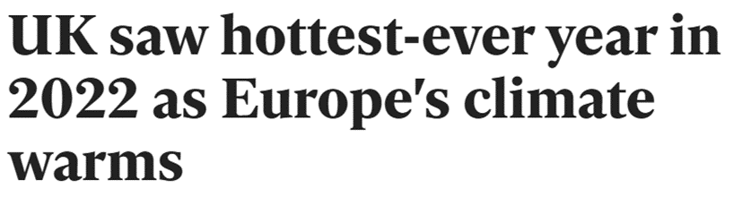
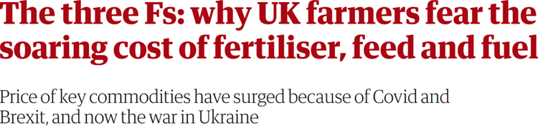

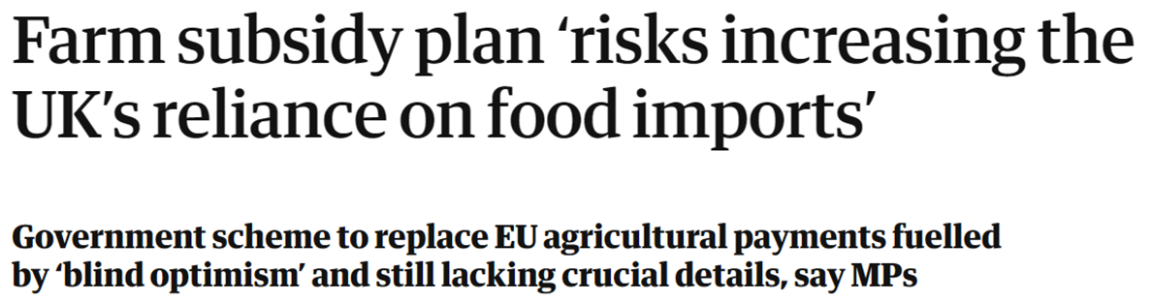
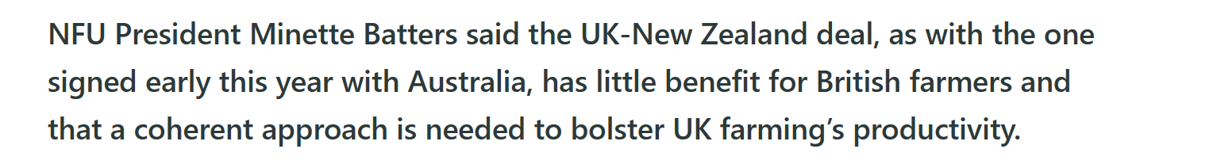

Slide 8
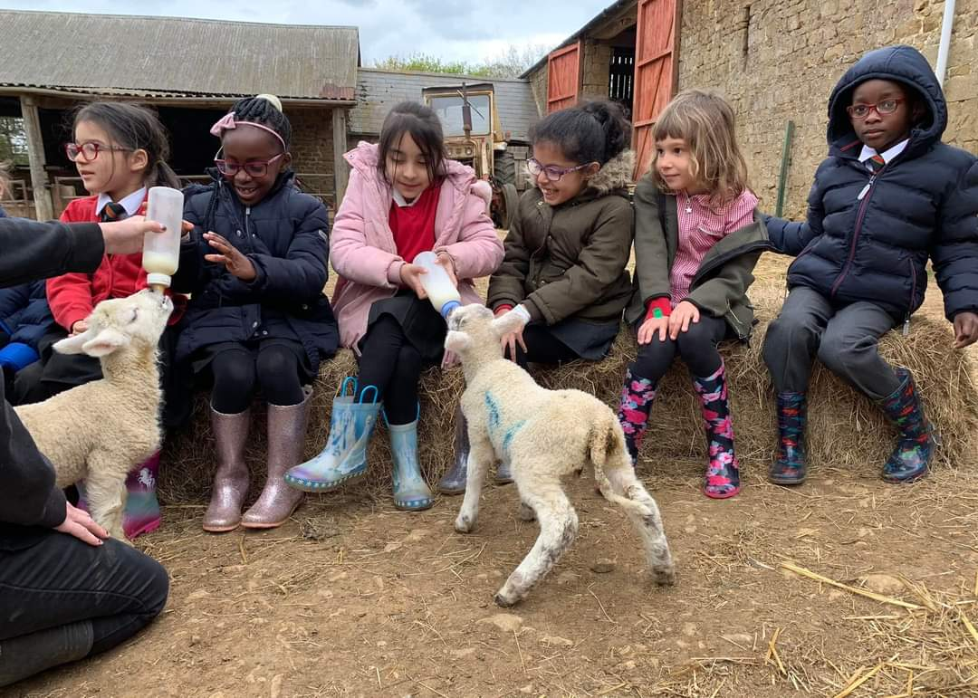
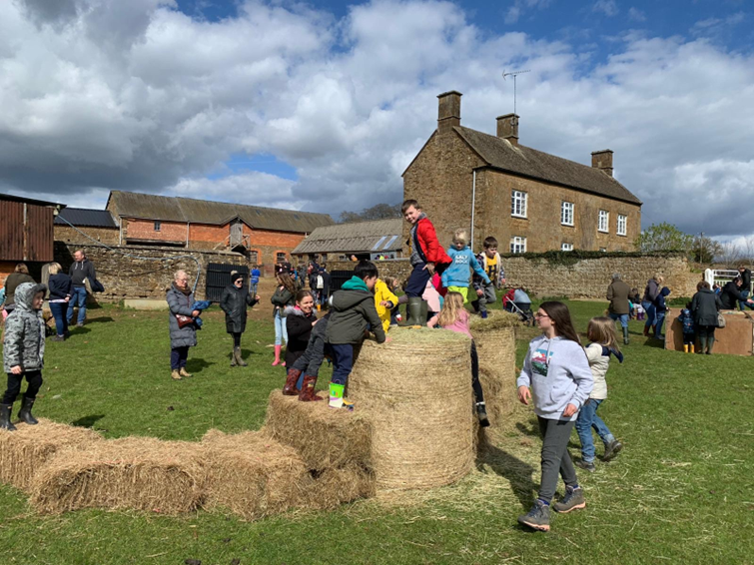
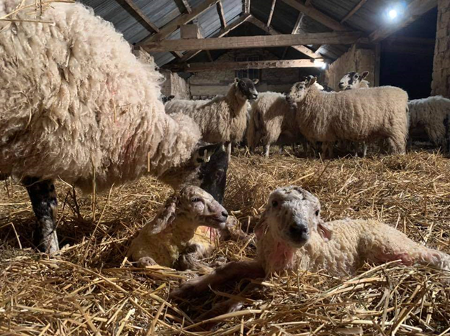
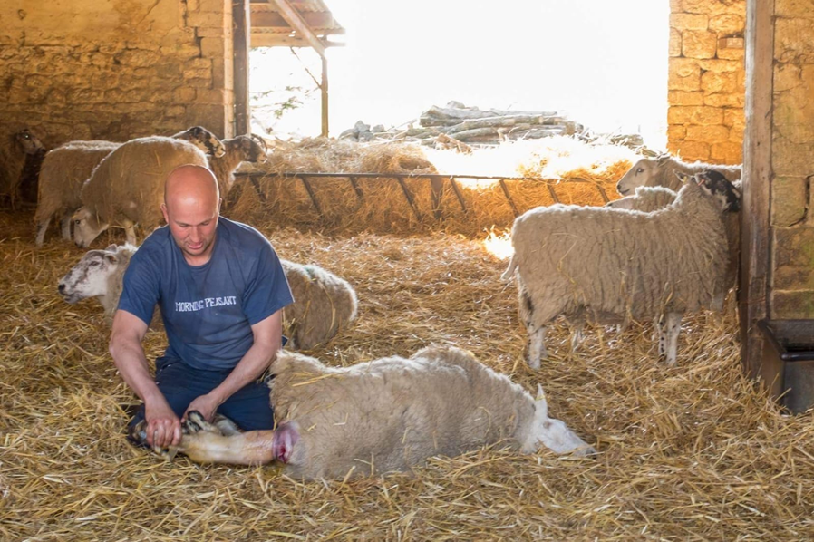
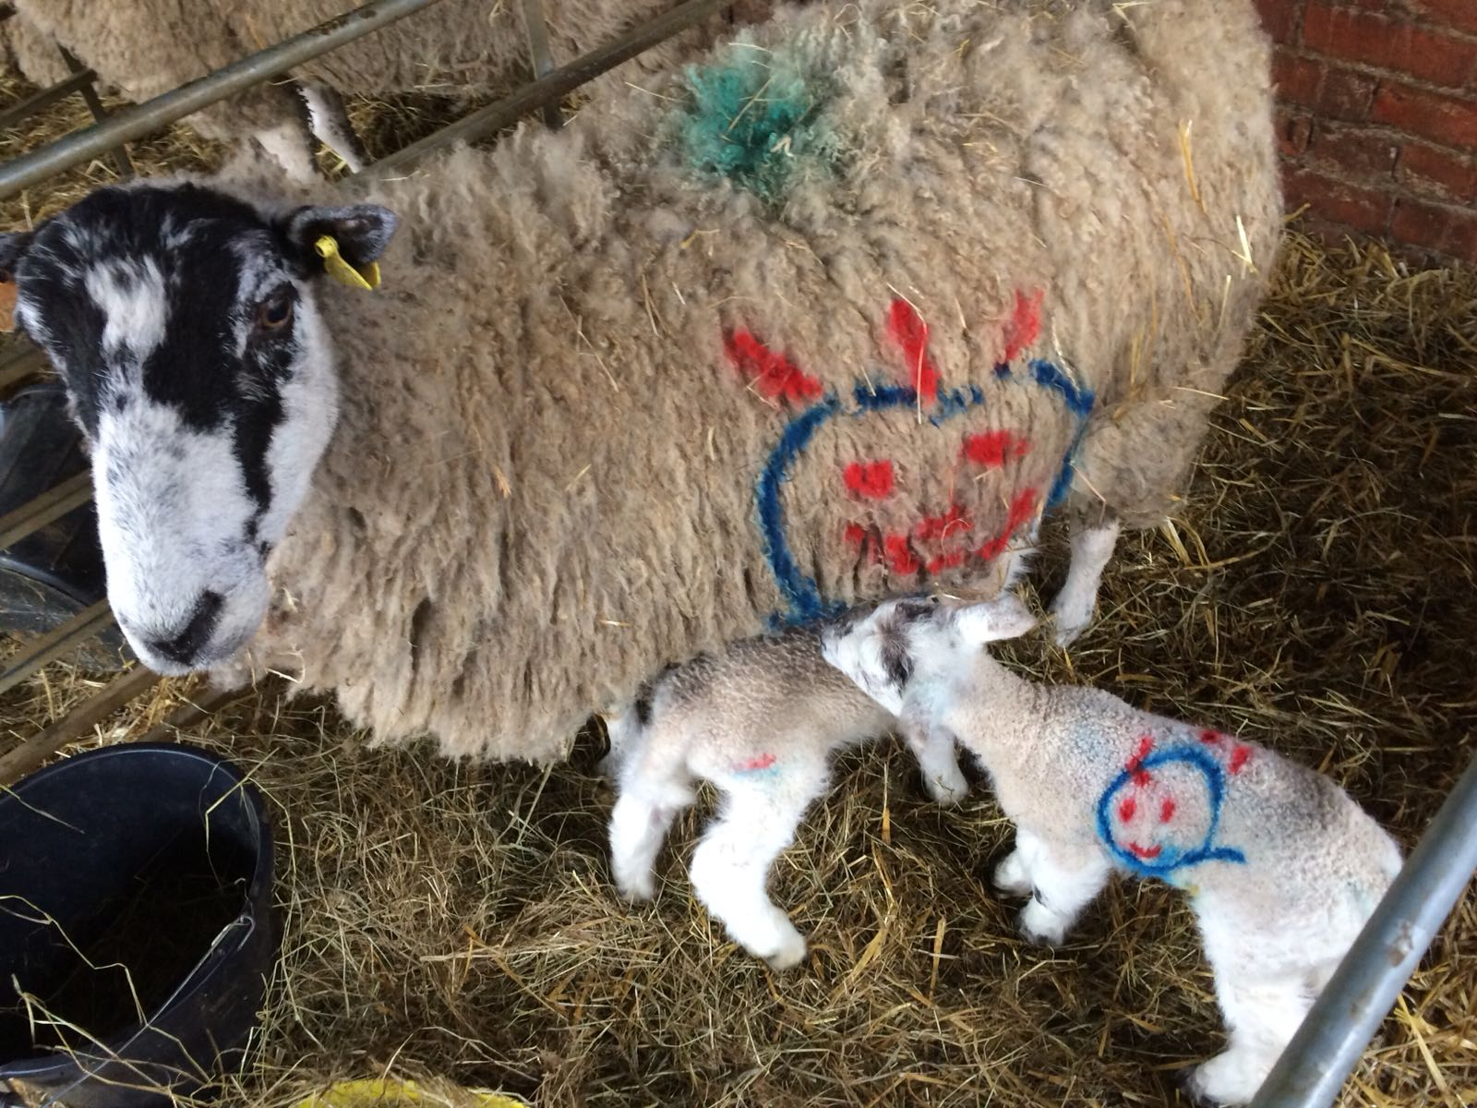
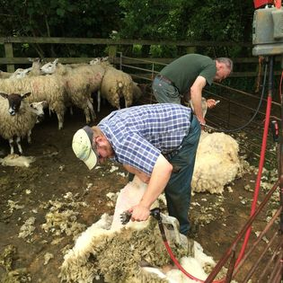
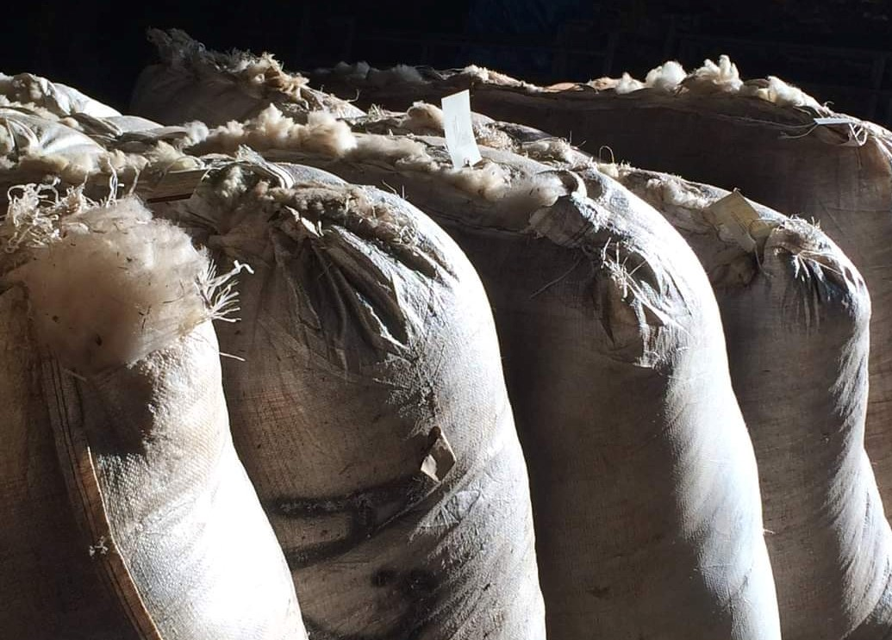
Spring … lambing, planting and feeding cereals, swallows return, school visits and open day, shearing

Slide 9
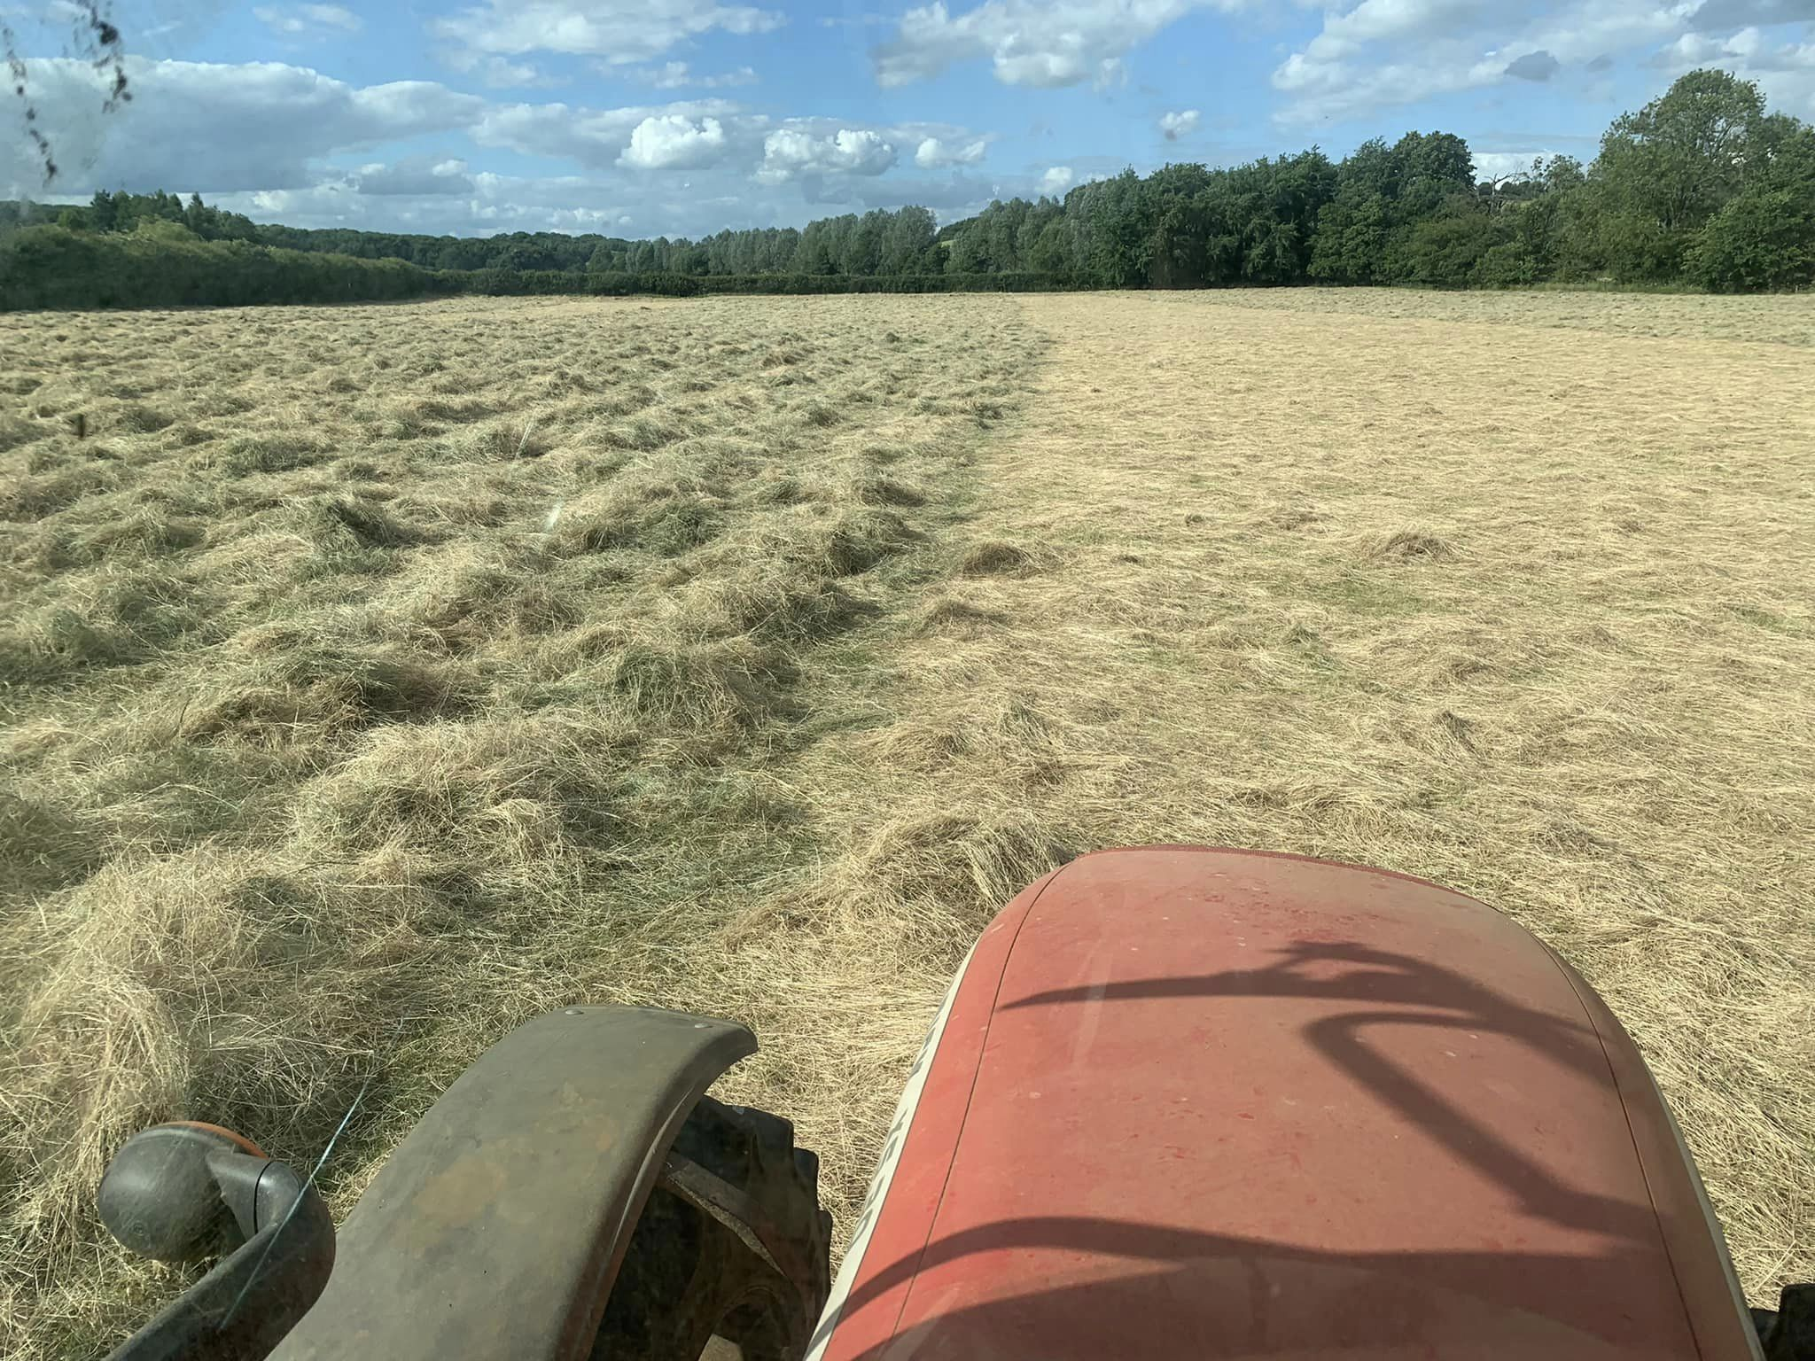
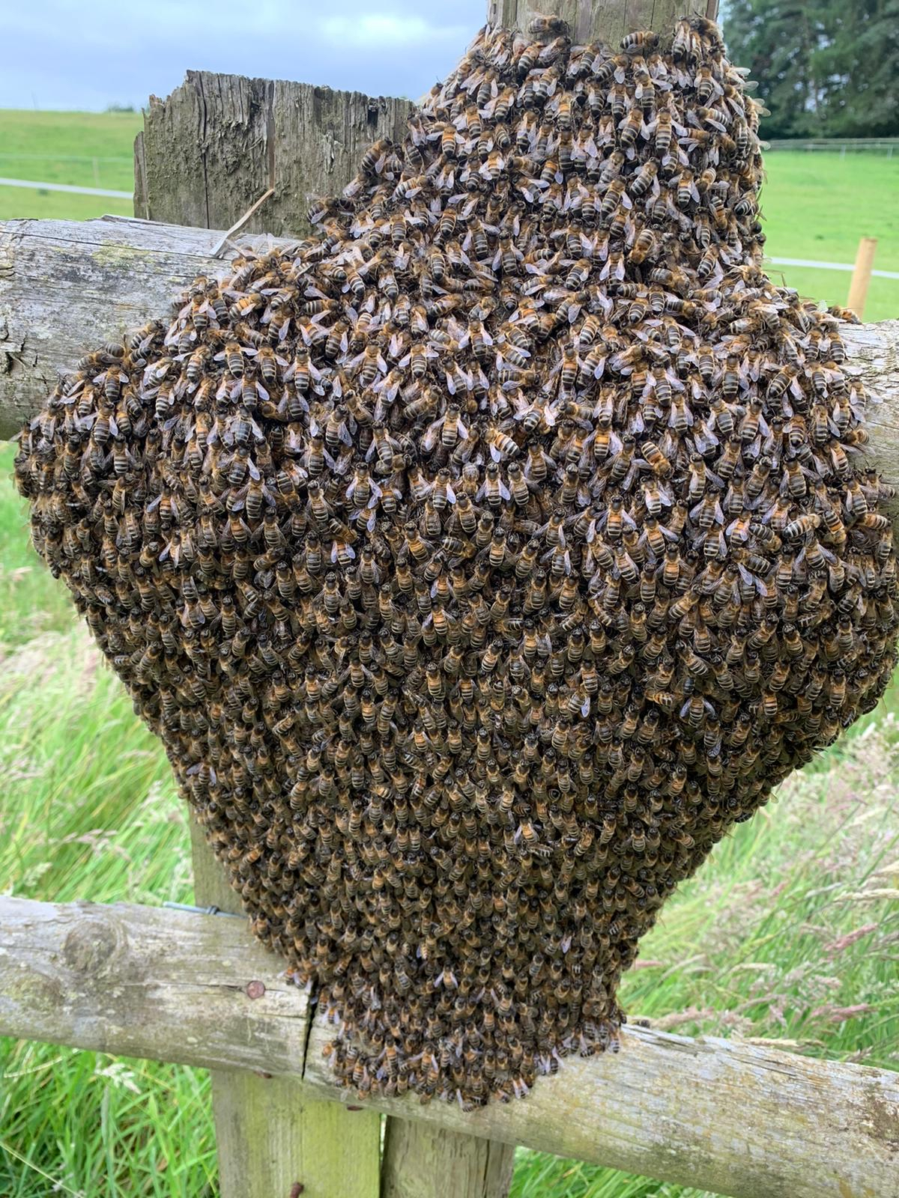
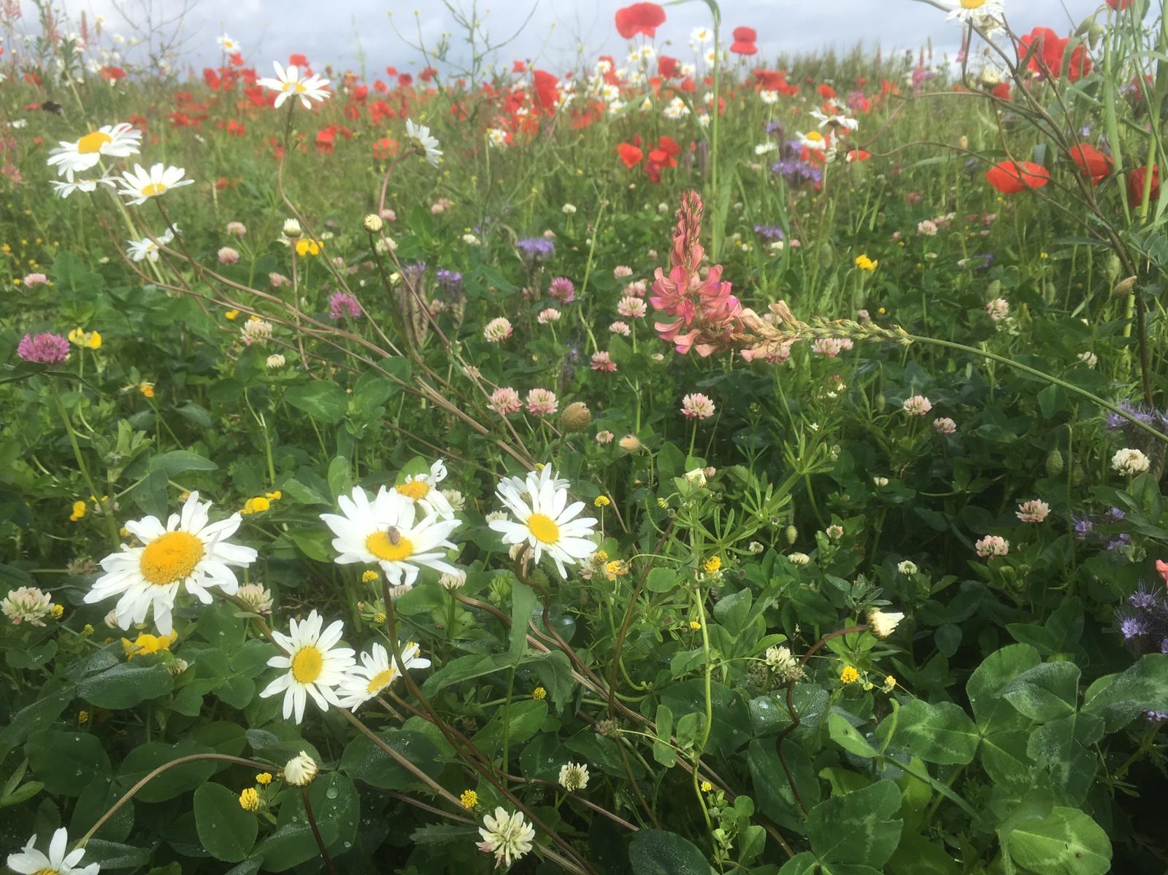
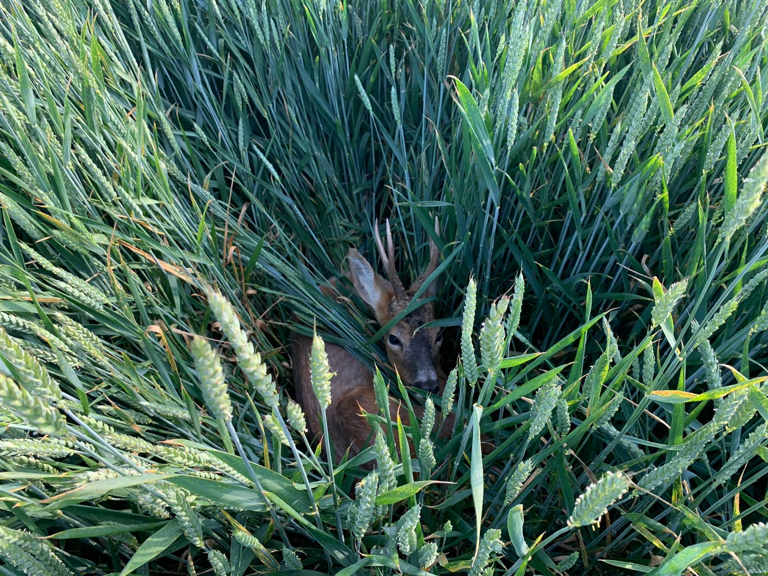
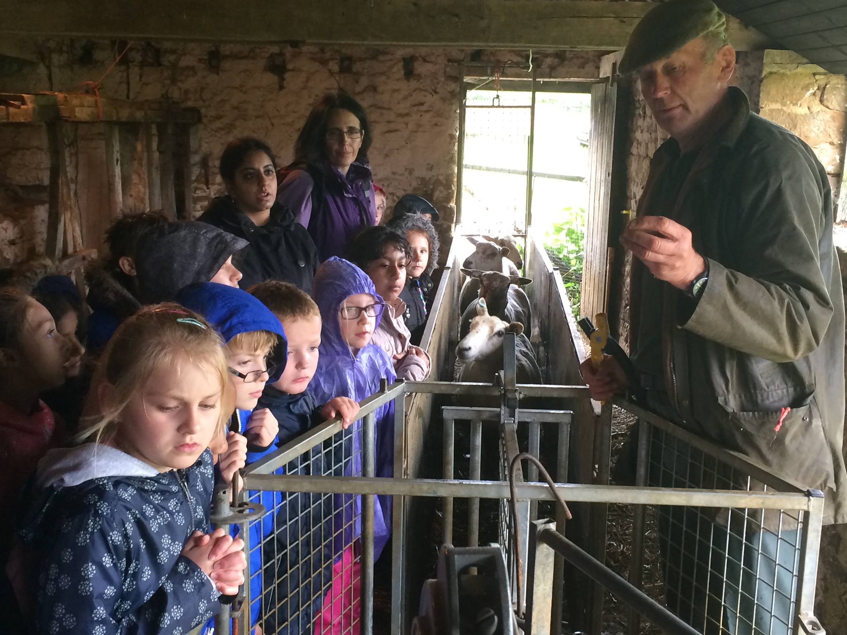
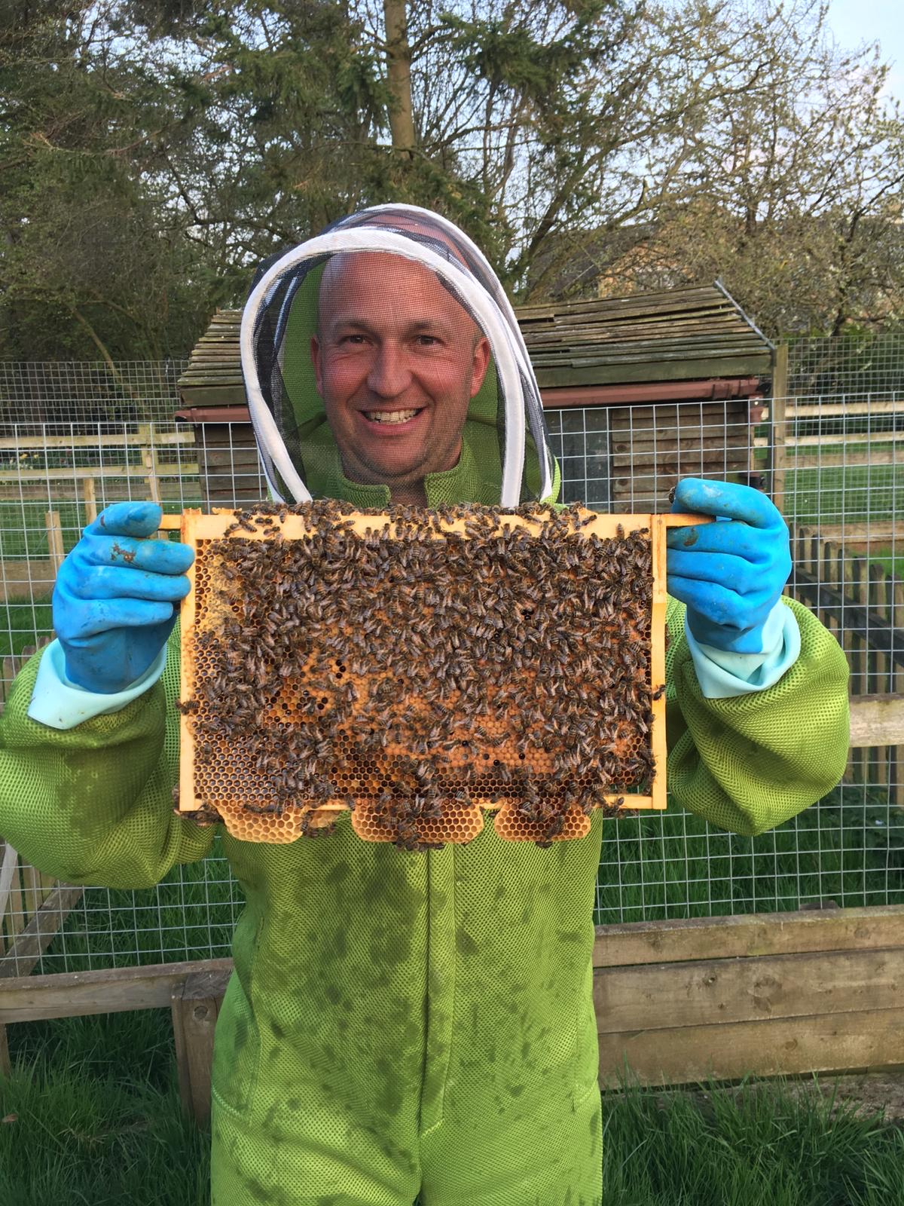
Summer … hay-making, shepherding, bee-keeping, harvest, hoping for just the right amount of rain!

Slide 10
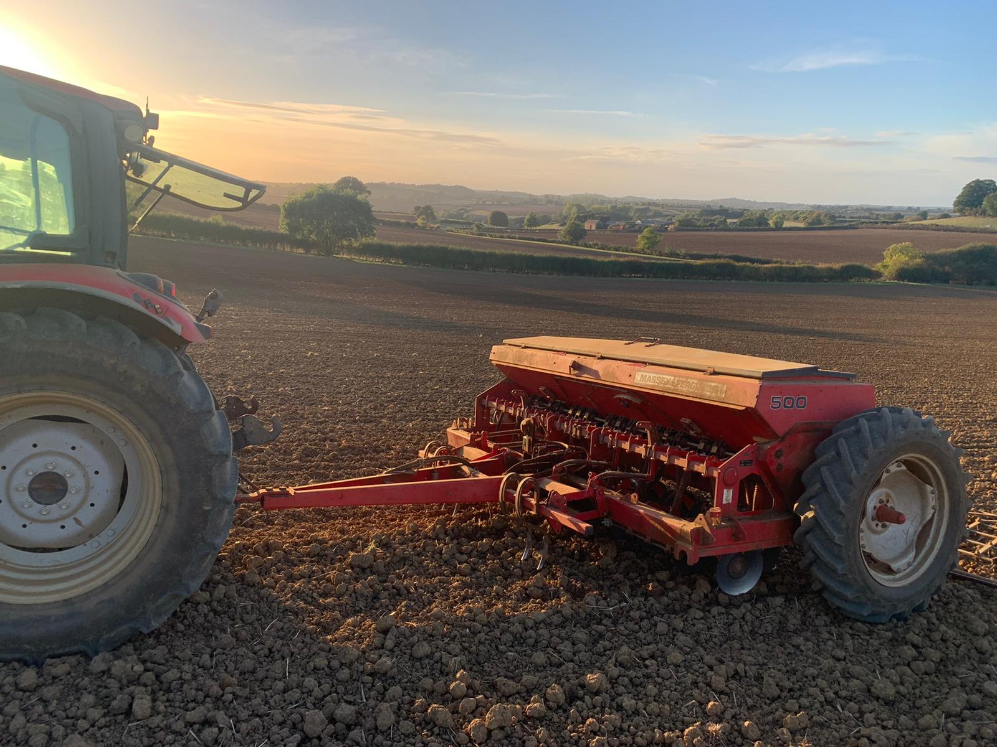
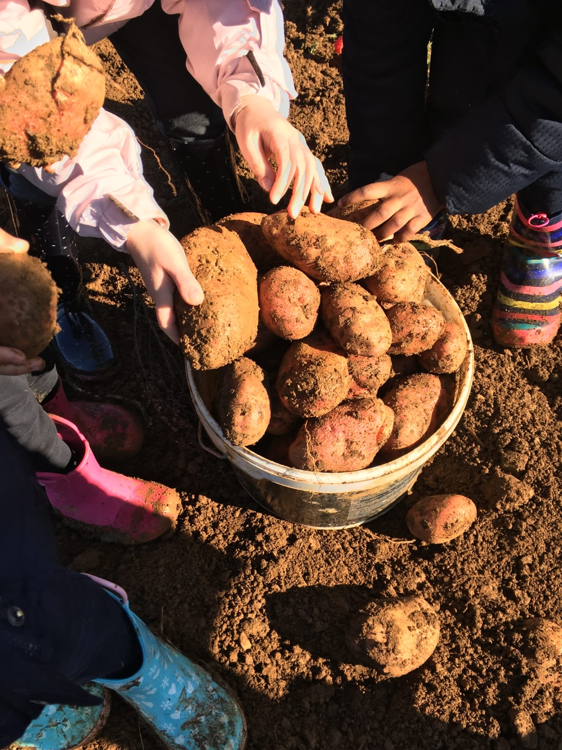
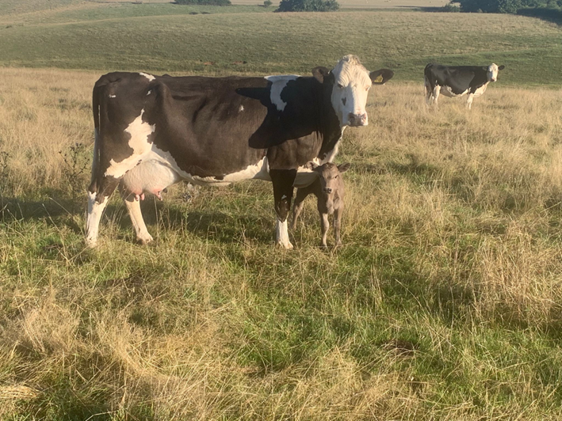
Autumn … harvest continues, planting cereals, rams get busy, cows calving, visits!

Slide 11
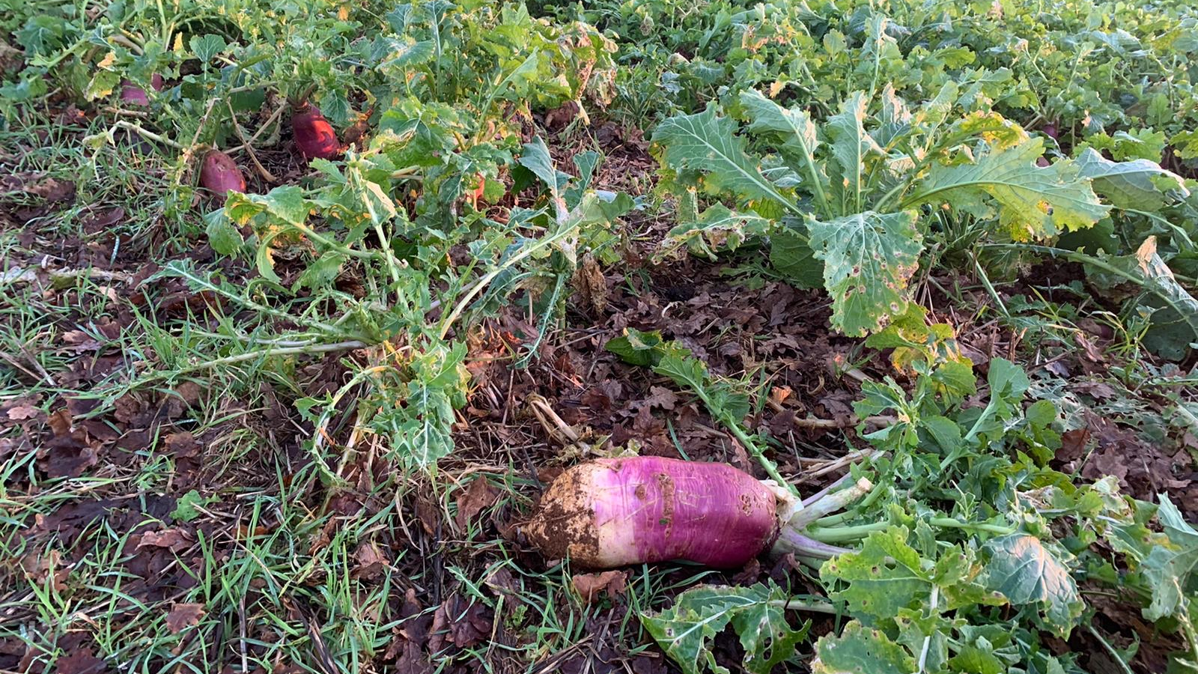
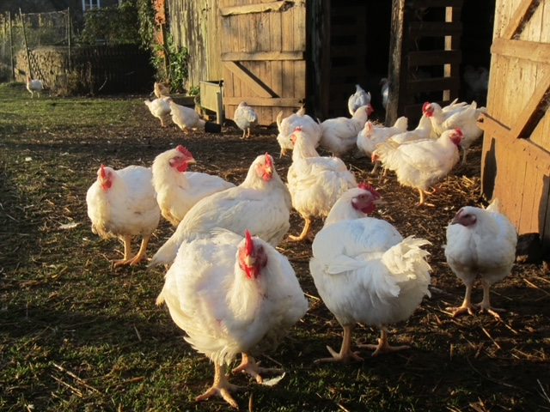
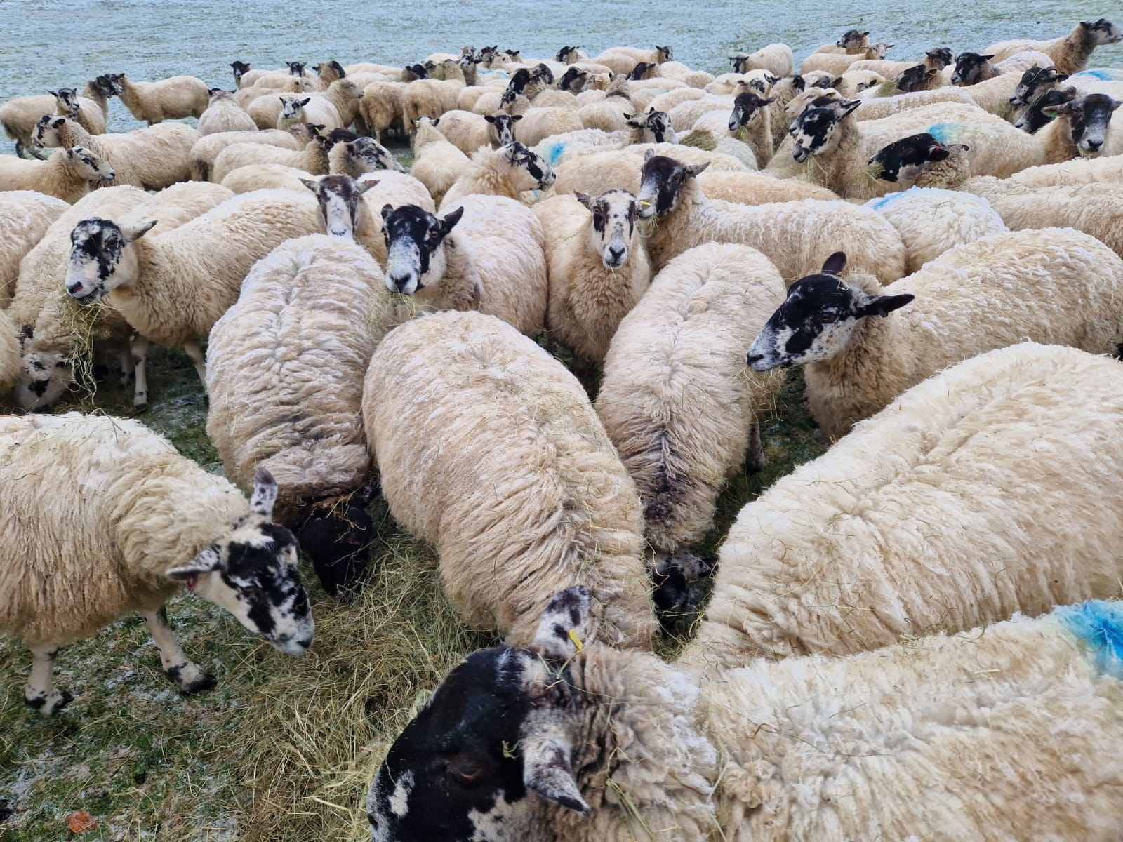
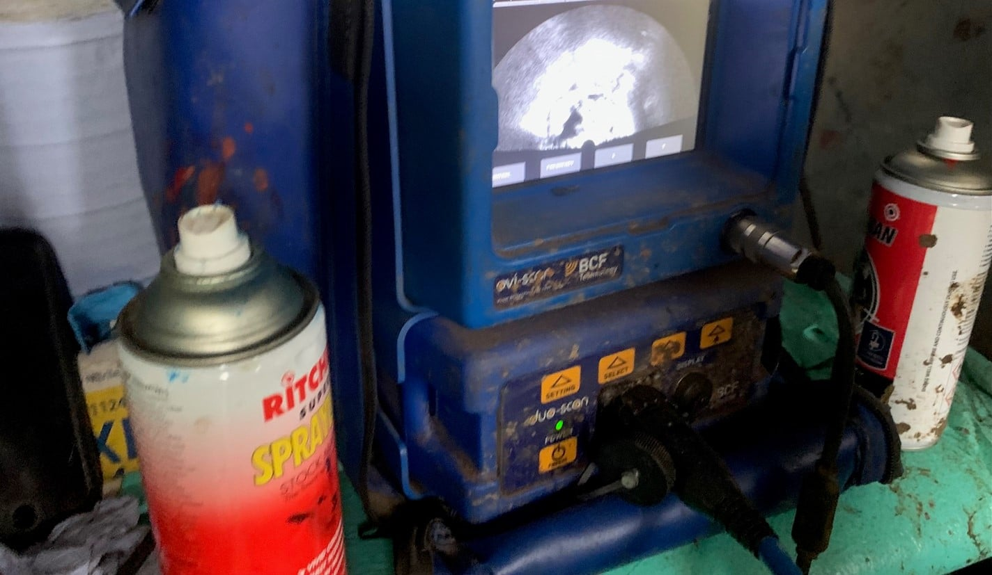
Winter … house cattle, Christmas poultry, maintenance, turnips

Slide 12
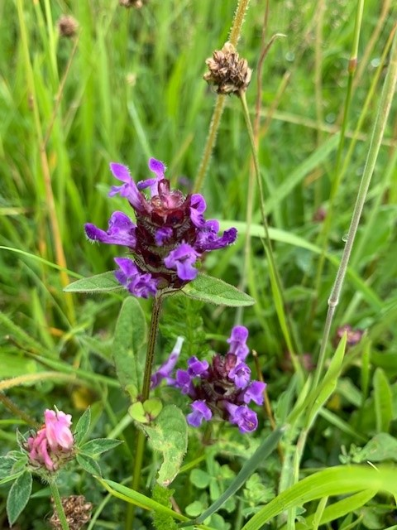
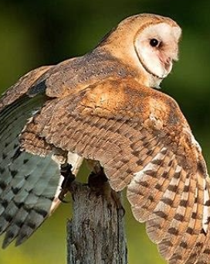
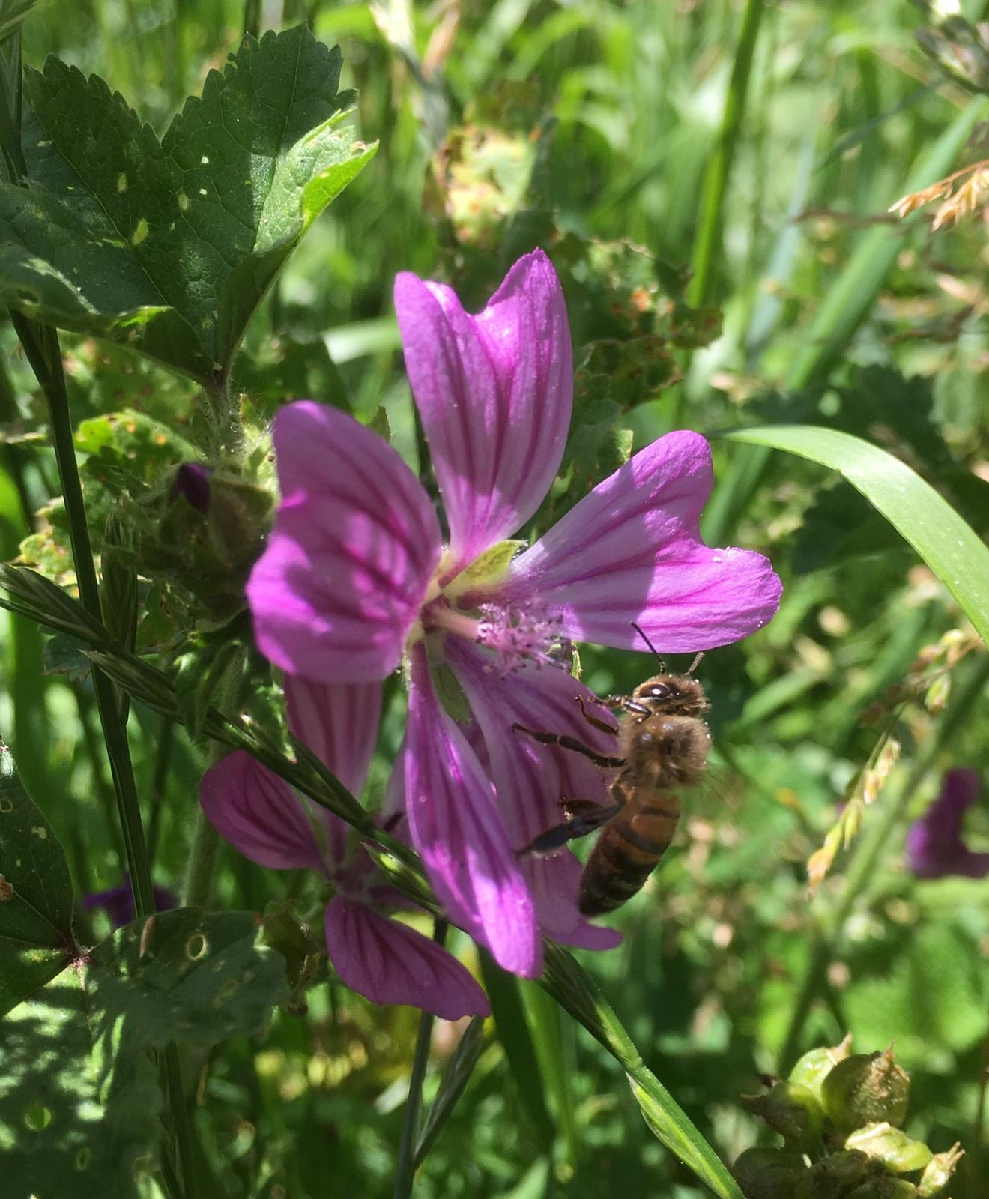
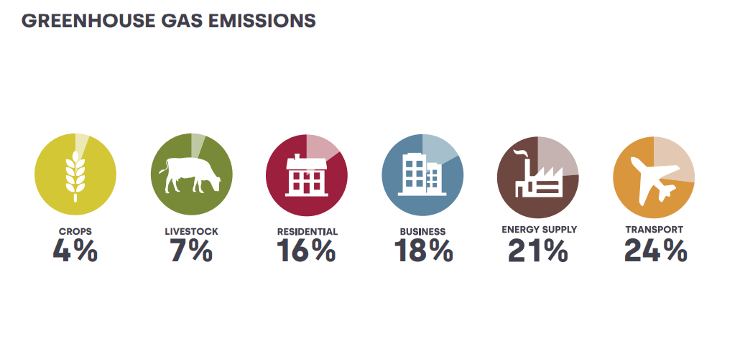
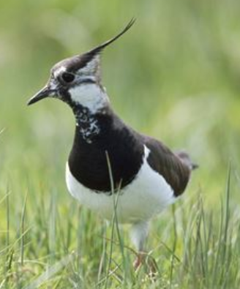
Environment

Slide 13
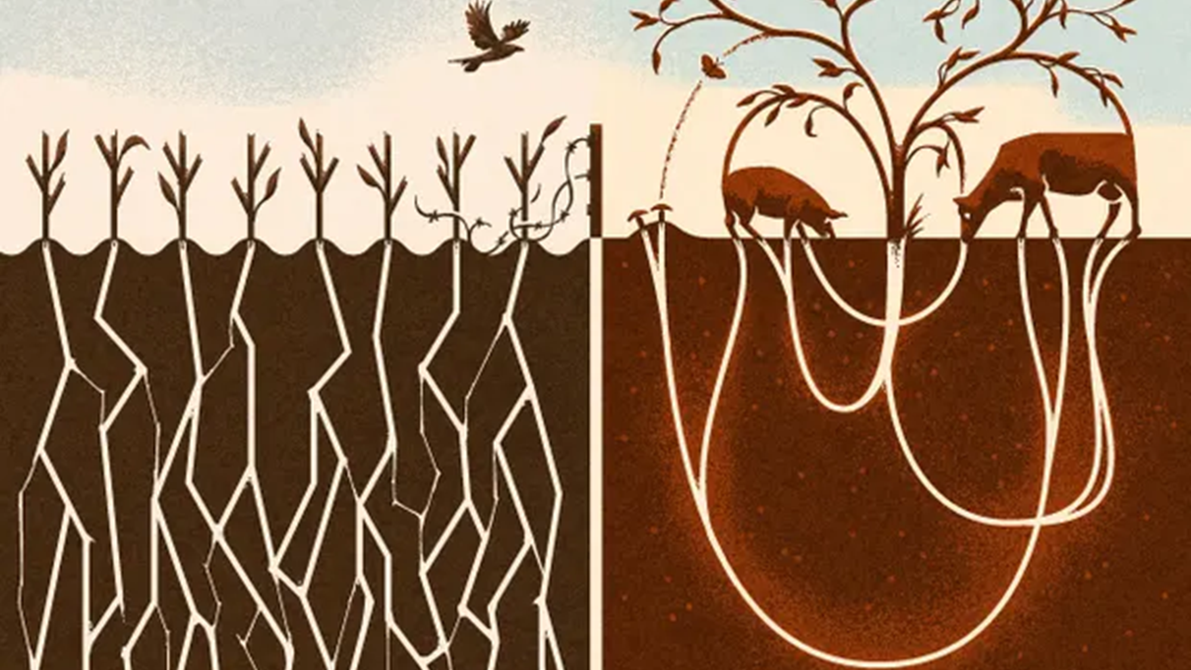
Environment
Very high soil organic matter (9.9% – 13%)
Moderate NPK fertiliser use
Grazing helps enhance biodiversity – 135 grassland species in one field
Improving genetics to enhance efficiency and work towards net zero

Slide 14
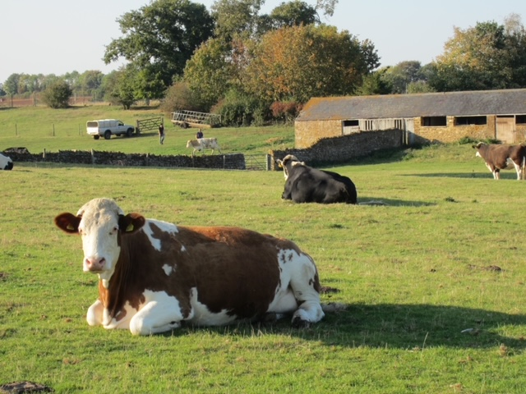
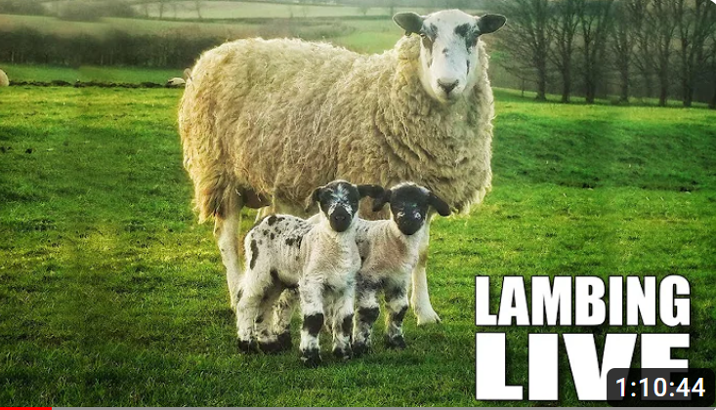
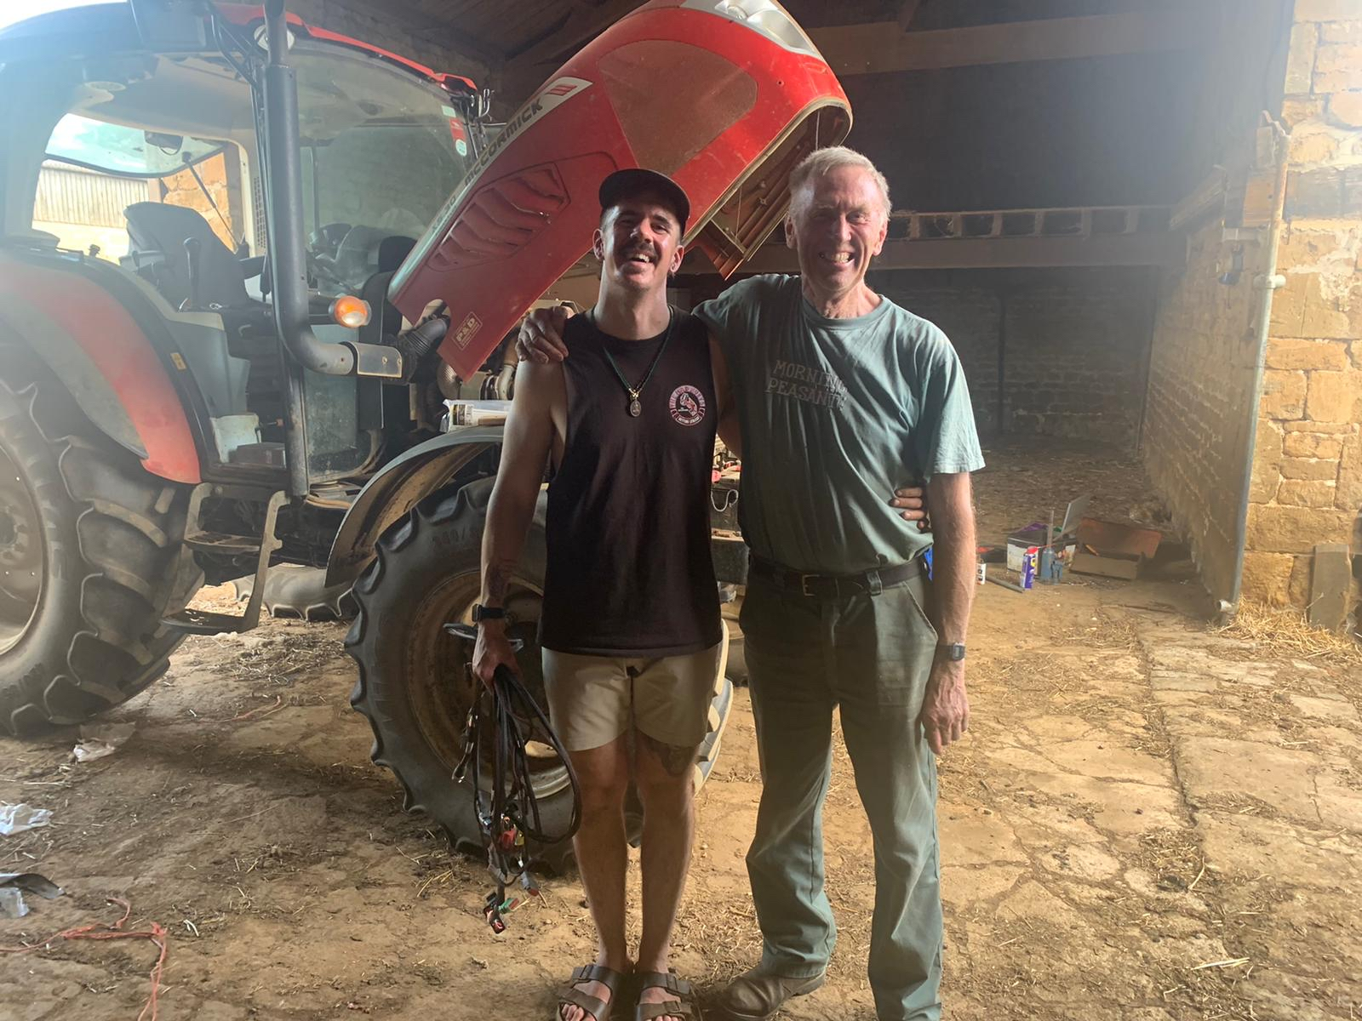
Social
Mixed farming helps keep people on the land
We give young people an opportunity to develop a career in agriculture
Farming can be isolating / stressful
Care farming before we knew what it was!

Slide 15
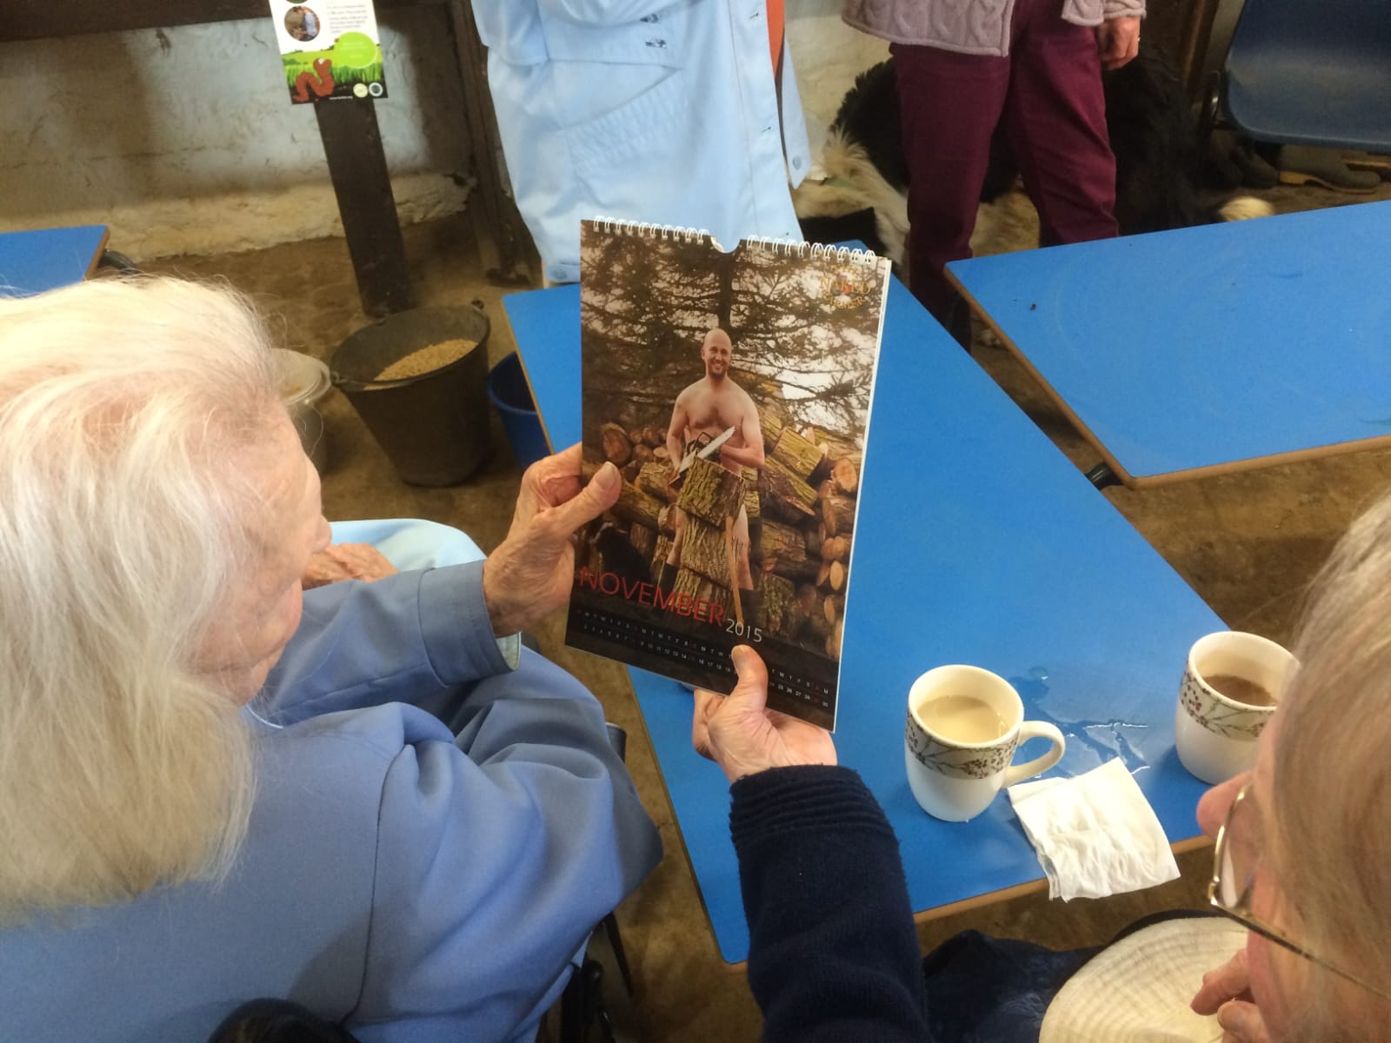
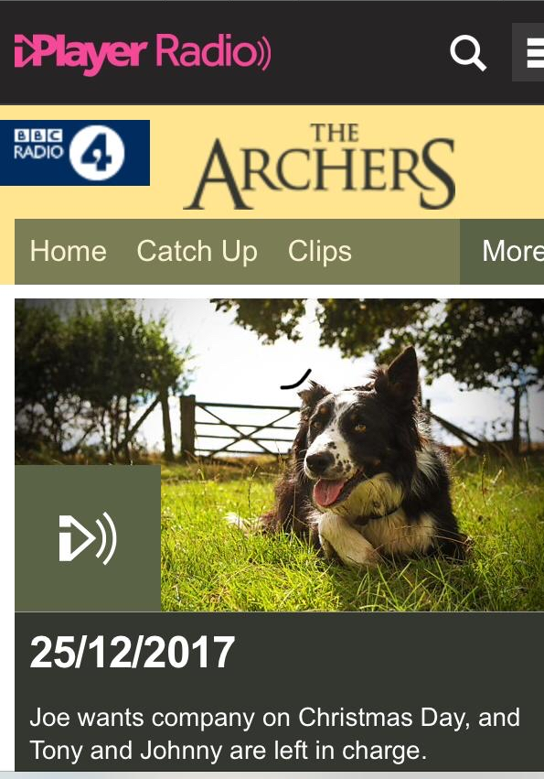
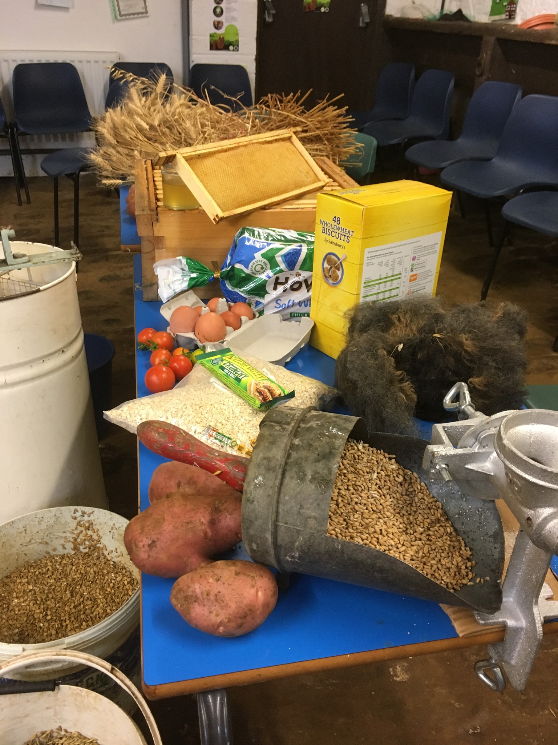
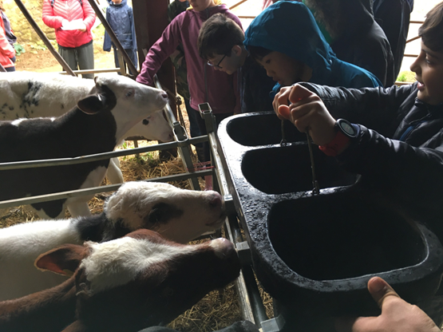
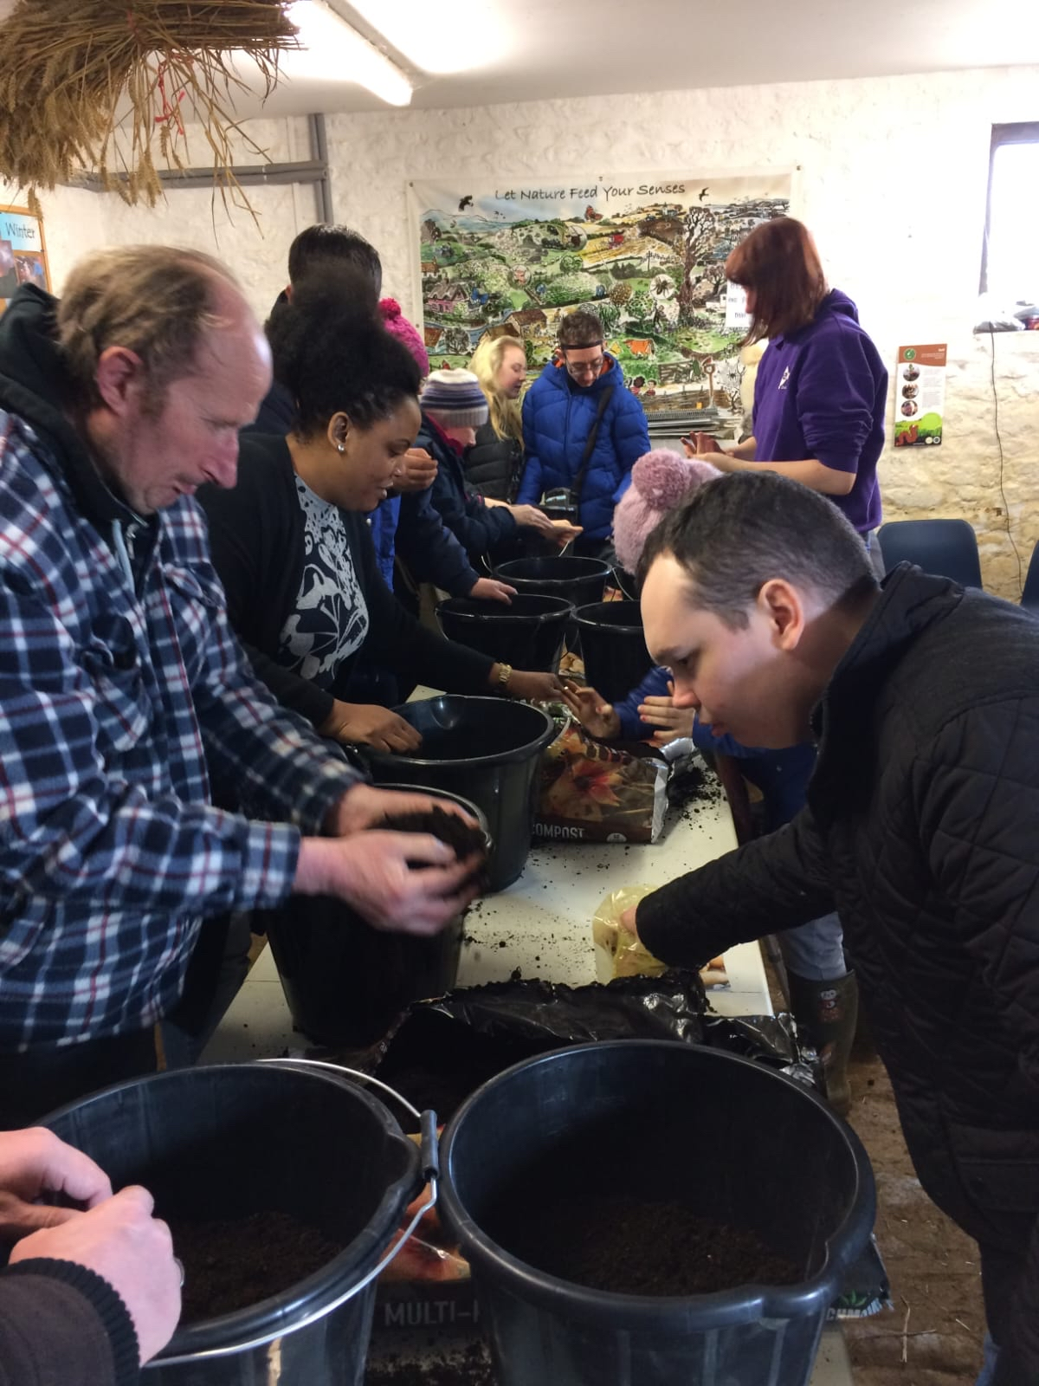
Social

Slide 16
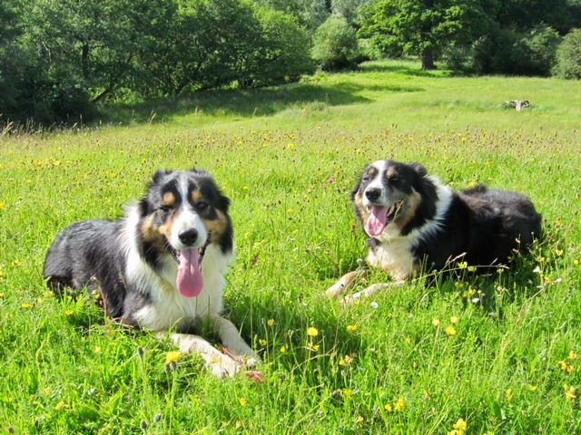

Financial

Slide 17
Financial
Commodity | HSBC 2023 projected production cost | Market price January 2023
Feed Wheat (tonne) | £232 | £220
Lamb (kg) | £2.24 | £2.40
Beef (kg) | £2.58 | £2.60

Slide 18


Slide 19
Broughton Ground’s SWOT
Strengths are habitats, spreading risk, keeping nutrients in the system, family labour, social offer
Weakness is finding the off switch!
Opportunity is getting closer to consumers
Threats are over simplification of environmental issues, price volatility, removal of safety net

Slide 20




Food – a fact of life resources
Knowledge organisers
Where food comes from resources
Food commodities resources, including growing and food production videos
Challenge activities:
Grow the seasons – 5-7 years
Life on a farm – 7-11 years
Eat your way round the UK – 11-14 years
Journey of your meal – 14-16 years
Posters
www.foodafactoflife.org.uk

Slide 21

Webinar recording
Today’s webinar is the second in a series of webinars to enhance teaching and learning about where food comes from.
The first webinar took place on Wednesday 28 February and focused on Bringing where food comes from to life in primary and secondary schools. A recording of the webinar can be found in the FFL professional development area.

Slide 22

More training…
FREE online modular courses:
Functional properties of food
Sensory science
Food spoilage, hygiene and safety
Teaching food and nutrition in primary schools (England, Northern Ireland, Scotland and Wales)
Characteristics of teaching food and nutrition education – primary, secondary and pupils with additional needs
FFL webinar recordings
To find out more and to book, go to https://www.foodafactoflife.org.uk/training/
Further webinars and virtual practical workshops will be announced soon. If there is a particular topic that we should focus on, let us know!

Slide 23


Keep up to date with our free resources and training
Education News (monthly email update)
Sign up on the homepage: www.foodafactoflife.org.uk
PPD newsletter (find out about upcoming FFL training)
https://www.foodafactoflife.org.uk/professional-development/
Follow us on Twitter @Foodafactoflife
https://twitter.com/foodafactoflife
Keep in touch:
education@nutrition.org.uk
BNF news https://www.nutrition.org.uk

Slide 24
Sustainable farming in practice: the natural world and the importance of sustainability in context
For further information, go to:
www.foodafactoflife.org.uk
education@nutrition.org.uk

