Slide 1
Food safety and the law

Slide 2
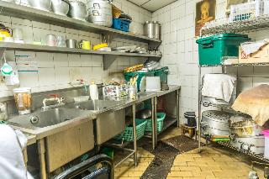
Food safety law
Owners and managers of food businesses are responsible for ensuring that food prepared, cooked and sold is safe to eat and that they comply with food safety law.
Food safety laws are designed to protect consumers from illness and harm.
If a legal offence is committed, the case will be tried in the magistrates or crown courts.

Slide 3
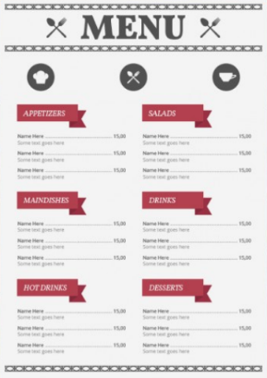
The Food Safety Act 1990
The Food Safety Act 1990 (amended) provides the framework for food legislation in Great Britain and covers the movement and sale of food. It applies to all types of food businesses.
The main aims of the Act are:
to ensure that all food meets consumers’ expectations in terms of nature, substance and quality and is not misleadingly presented;
to provide legal powers and specify offences in relation to public health and consumers’ interest.
Food Standards Agency (FSA) - general food law

Slide 4

The Food Safety Act 1990
To comply with the Act, food businesses:
  must not include anything in food, remove anything from food or treat food in any way which means it would be damaging to the health of people eating it, e.g. if a preservative was removed from a food, it could shorten the shelf life, allow bacteria to multiply and make it harmful to eat.

Slide 5
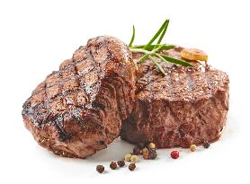
The Food Safety Act 1990
To comply with the Act, food businesses:
must ensure that the food served or sold is of the nature, substance or quality which consumers would expect, for example:
nature - coley rather than cod;
substance - contains foreign material, including glass or packaging;
quality – mouldy cheese or stale bread or substitution of a lower quality food, e.g. rump steak instead of sirloin or fillet.
must ensure that the food is labelled, advertised and presented in a way that is not false or misleading, e.g. photos on menus that do not look like the dishes served to customers.

Slide 6

The Food Safety Order 1991 (Northern Ireland)
The Food Safety (Northern Ireland) Order 1991 is wide-ranging legislation on food safety and consumer protection in relation to food throughout Northern Ireland and is similar to the Food Safety Act 1990.
The Order does not cover hygiene, for which there is separate legislation, or food prepared in the home for domestic purposes.
It does, however, cover food prepared by child minders in their homes for other people’s children and activities such as preparation of food in canteens, clubs, schools, hospitals, institutions and district councils.
Food Safety key regulations

Slide 7
Due Diligence
The Food Safety Act introduced the defence of ‘Due Diligence’ which is a defence under the law if legal action is taken against a business. In order to claim ‘Due Diligence’ the business must prove that it has done everything possible to ensure the safety of food. This could include:
ensuring staff are trained to the standard required to do their job safely and effectively;
purchasing food from reputable suppliers;
effective stock and temperature control;
effective and thorough cleaning;
pest control;
comprehensive record keeping, including Hazard Analysis Critical Control Point, monitoring records, pest control and cleaning schedules.

Slide 8
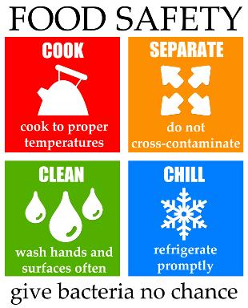
Food Safety (General Food Hygiene) Regulations
The Regulations focus strongly on how to identify and control food safety risks at each stage of the process of preparing and selling food. They apply to all types of food businesses - from a burger van to a Michelin starred restaurant, from a community hall where food is prepared, to a vending machine.
Suppliers and producers of products of animal origin, such as dairies, meat processors, or wholesale fish markets should follow the Regulations relevant to their food product or trade.
Food Safety (General Food Hygiene) Regulations
The Food Hygiene Regulations (Northern Ireland) 2006

Slide 9

Food Safety (General Food Hygiene) Regulations
Under the Regulations, a proprietor of a food business must ensure that:
the preparation, processing, manufacturing, packaging, storing, transportation, distribution, handling and offering for sale or supply, of food are carried out in a hygienic way.
In order to do this, the Regulations emphasise the need to control risks. They say that a business must:
identify all steps in activities that are critical to food safety;
ensure adequate safety controls are in place, maintained and reviewed.
Legislation.gov.uk

Slide 10

Food Safety (General Food Hygiene) Regulations
The Regulations also cover the following aspects of food safety:
the rooms where food is prepared;
movable or temporary premises;
transport;
equipment;
food waste;
water supply;
personal hygiene;
protection from contamination;
training.

Slide 11

Hazard Analysis Critical Control Point (HACCP)
HACCP stands for Hazard Analysis Critical Control Point. It is a health and safety system that food businesses must follow the principles of by law. The principles of HACCP help to reduce the risk of danger to consumers.
The origins of HACCP stretch all the way back to the 1940s, where procedures were put in place to produce artillery shells. However, HACCP as we know it today was conceived in the 1960s and was used to safeguard production of foods made for NASA to be sent into space.
These days, HACCP is widely regarded as the international standard for assessing risk in food businesses.

Slide 12
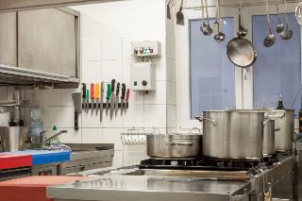
The principles of an HACCP system
The principles of HACCP are:
identify the hazard, e.g. bacterial, physical, chemical or allergens;
identify the critical control points, e.g. time and temperatures for storing and cooking meat;
establish critical limits, e.g. store high risk foods below 8°C (legal cold temperature);
implement control measures and monitor them, e.g. ensure fridges are kept below 8°C and record twice a day;

Slide 13
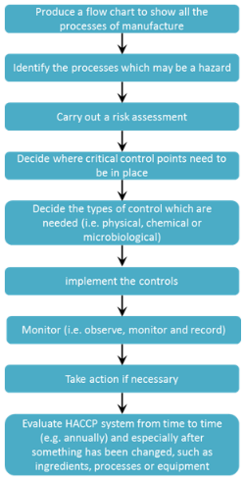
The principles of an HACCP system (continued)
The principles of HACCP are:
establish corrective actions, e.g. if the fridge temperature rises above 8°C, report to the supervisor and arrange an engineer;
verification – to prove the HACCP system is working;
ensure thorough records and documentation are kept, maintained and reviewed when necessary.

Slide 14
Hazard Analysis Critical Control Point (HACCP) in practice
When serving food in a cafe, for example, checks must be in place:
when the food is delivered (e.g. is the temperature correct, is the integrity of the packaging maintained);
when the food is stored on site (e.g. is it being stored in the correct environment, such as a fridge or freezer);
when the food is prepared (e.g. is handler hygiene correct, is the food being prepared in a safe manner, has the kitchen been properly cleaned beforehand);
when the food is cooked (e.g. has the food been heated to the correct core temperature); and
when the food is held before being served (e.g. is the food being held at 63°C or above, has the food been left out for too long).

Slide 15
Food labelling regulations
Information required by the Food Information Regulation (on the labels of pre-packed food and drink products):
Name of food or drink
List of ingredients (including additives and allergens)
Weight or volume
Date mark
Storage and preparation conditions
Name and address of the manufacturer, packer or seller
Country of origin and place of provenance
Nutrition information
To sell food and drink products, the label must be:
clear and easy to read;
permanent;
easy to understand;
easily visible;
not misleading.
Further information about Food Information Regulations across England, Northern Ireland, Scotland and Wales can be found in the FSA’s Food Information Regulation guidance document.
FSA Food labelling and packaging

Slide 16

Food labelling regulations
In a catering business, or a shop where food is sold loose or packaged for sale, the following is only required:
the name of the food;
if any of the ingredients have been irradiated, or have come from genetically modified sources;
warnings if the food contains certain ingredients, e.g. raw milk or sweeteners;
any food additive added;
allergen information.
FSA Food labelling and packaging

Slide 17
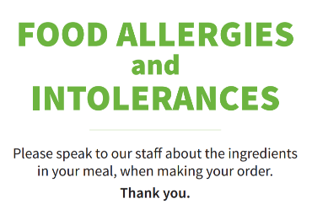
Managing food allergen information
It is a legal requirement for food businesses to provide accurate information about the allergenic ingredients used in the food and drink they serve.
Currently, for meals served in a restaurant, allergen information can be provided:
in writing, e.g. an allergen chart, on a menu or chalkboard;
orally to the customer (this must be verified in writing).
Safer food, better business for caterers (FSA)

Slide 18
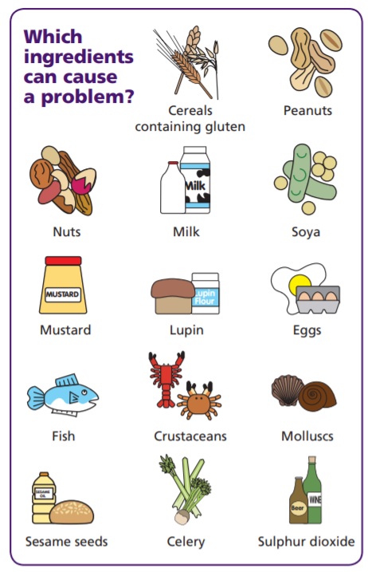
Managing food allergen information
Staff must know where allergen information can be found (e.g. recipe sheets, food labels) and be able to handle allergen information requests.
If someone asks if a dish contains a certain food, this must include all the allergenic ingredients in the dish (and what they contain).
Allergen information must be accurate, consistent and up-to date.
If food is offered in the form of a buffet, allergen information for each separate food item must be provided. Not just for the buffet as a whole.
Allergen guidance for food businesses (FSA)
Think allergy (FSA)
Allergen information for loose foods (FSA)
Safer food, better business for caterers (FSA)

Slide 19
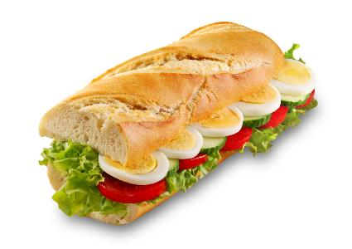
Natasha’s Law
The government introduced new legislation in 2019 mandating full ingredient labelling for food prepared for direct sale. For example, a packaged sandwich or salad made by staff and placed on the shelf for purchase.
The Law is known as ‘Natasha’s Law’, after Natasha Ednan-Laperouse who died after suffering an allergic reaction to a baguette.
'Natasha’s Law' (Gov.UK)

Slide 20
What are the main legal responsibilities of food handlers?
Food handler’s main responsibilities are:
follow good personal hygiene practices;
keep themselves and their workplace clean;
wear suitable clean, washable protective clothing;
protect food from contamination;
restrict the time that high risk foods are left at danger zone temperatures;
keep hot food hot, at 63°c or hotter;
keep cold food cold, at below 8°C;
tell their employer if they have symptoms of a food borne illness.

Slide 21

What are the main legal responsibilities of food handlers? (continued)
Food handler’s main responsibilities are:
carry out their part in hazard analysis (HACCP);
follow instructions and rules at work;
report all food hazards, faults and suspicions of contamination;
co-operate with environmental health practitioners/officers and food inspectors.
Non-food handlers, e.g. cleaning staff, also have a duty to ensure safe food.

Slide 22
Environmental Health Practitioners
The role of an Environmental Health Practitioner* (EHP) is to ensure that food is safe and is what it is says it is.
EHPs work in the public, private and charity sectors developing food policy, providing advice and enforcing food law.
A business that prepares or serves food must be registered with their local authority. EHPs will visit food businesses to ensure that the food produced is safe. The frequency of inspection visits will depend on the perceived risk of the business, e.g. a restaurant will be regarded as higher risk than a shop selling packaged food, so will be inspected more frequently.
*Environmental Health Practitioners are also sometimes known as Environmental Health officers (EHO)
Chartered Institute of Environmental Health

Slide 23

The responsibilities of an EHP
EHPs give advice and guidance to food businesses as well as ensuring that they comply with the law to protect the health of the public.
Along with giving advice and guidance, EHPs also:
inspect food premises;
enforce legislation covering food;
investigate outbreaks of food-borne diseases and possible offences.

Slide 24
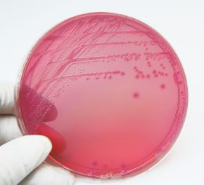
Powers of EHPs
EHPs have the power to:
gain entry to food businesses at reasonable hours without advance notice;
inspect food, equipment and the premises;
detain or seize suspect foods and request for them to be condemned (destroyed) by a justice of the peace;
collect samples and evidence, e.g. swabs from surfaces or equipment, photographs or documentation.

Slide 25
Powers of EHPs
If during an inspection, an EHP is concerned about the cleanliness or safety of a piece of equipment, considers a procedure dangerous or is worried about the business or premises as a whole, they can:
serve an improvement notice which gives the food business 21 days in which to rectify a problem, e.g. replace cracked or missing wall tiles or repair a damaged work surface;
serve an emergency prohibition order which can close down part or the whole of a food business if there is an imminent risk to health;
take companies to court for breaking food safety laws.

Slide 26

Consumer protection across England and Wales
National Trading Standards was set up in 2012 by the Government for consumer protection in England and Wales.
National Trading Standards is responsible for gathering important intelligence from around the country to combat rogue traders and tackle priorities.
These priorities include mass marketing and internet scams (2019) and other enforcement issues that go beyond local authority boundaries.
National Trading Standards is different to the support provided by local trading standards services.
Consumers can get advice from their local Trading Standards office or the Citizens Advice consumer helpline (Welsh–speaking advisers available).

Slide 27
Local trading standards across the UK
Most legislation is enforced by Local Authority Trading Standards (England and Wales), Trading Standards Service (Northern Ireland) and Trading Standards Scotland. These organisations’ roles include:
enforcing consumer protection laws;
providing advice;
investigating complaints.
There are three areas that are related to consumers and food:
weights and measures;
pricing;
false or misleading descriptions.

Slide 28
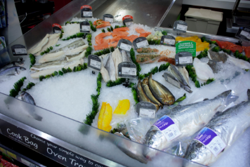
Local trading standards – pricing and false/ misleading instructions
Trading Standards (England),TSS (NI) and TSS (Scotland) have the responsibility of checking pricing in shops selling food and investigating any disputes or problems. They can also offer advice and guidance on pricing labels.
Standards state that:
shops must show the price per unit on a food product label, this makes it much easier for consumers to compare prices;
shops must give genuine and fair prices and must not mislead the consumer;
all products that are sold must be labelled and described accurately.

Slide 29
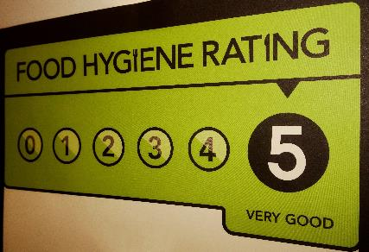

Food Hygiene Rating Scheme
The scheme helps consumers choose where to eat out or shop for food by giving clear information about the businesses’ hygiene standards. The scheme is run by the Food Standards agency in partnership with local authorities in England, Wales and Northern Ireland.
The scheme is set out in law in Wales and Northern Ireland, but display of the rating sticker is voluntary in England.
In Scotland, food outlets must have a food hygiene inspection undertaken by the Local Authority. Following this inspection, the food outlet will be given a Food Hygiene Information Scheme (FHIS) rating based on their inspection results. Some businesses may choose not to display their rating on their website or premises, but all ratings are displayed on the Food Standards Scotland website.
Food hygiene rating scheme
Food hygiene information scheme

Slide 30
Food safety and the law
For further information, go to:
www.foodafactoflife.org.uk
This resource meets the Guidelines for producers and users of school education resources about food.

