Slide 1
Enzymes and the caramelisation of onions

Slide 2
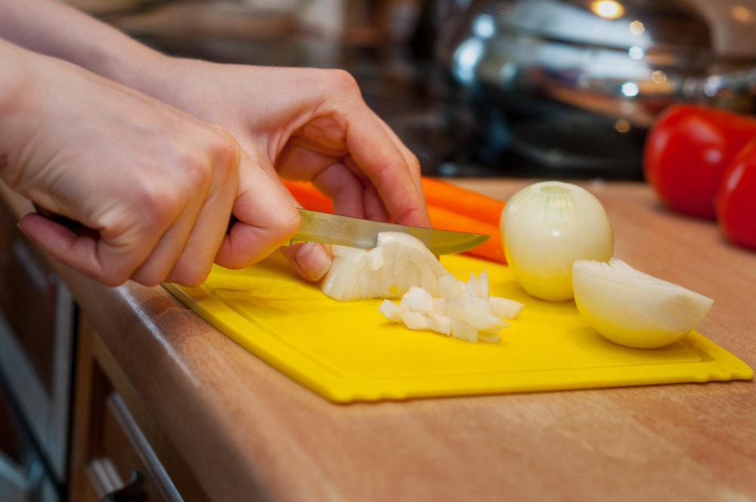
Starter
Describe a raw onion.
Think of the texture, smell, colour and flavour.

Slide 3
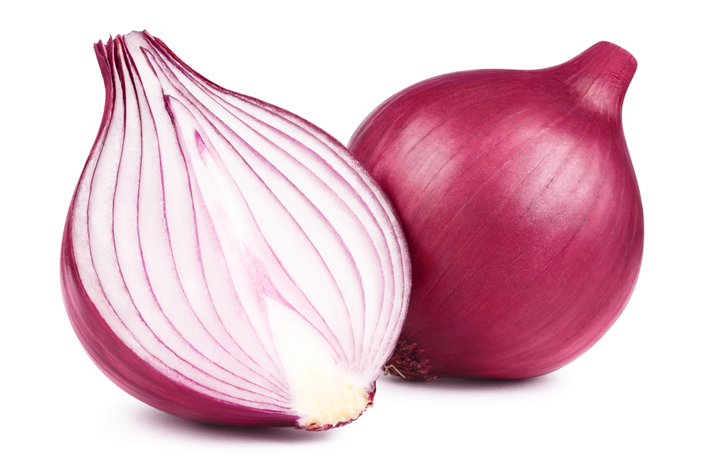
Onion chemistry
The enzyme in onions is called allinase which:
makes your eyes water
becomes active when cells are cut open.
If you boil onions or heat them the enzymes are destroyed.
Onions have large cells containing water.
What are enzymes and how are they destroyed?

Slide 4
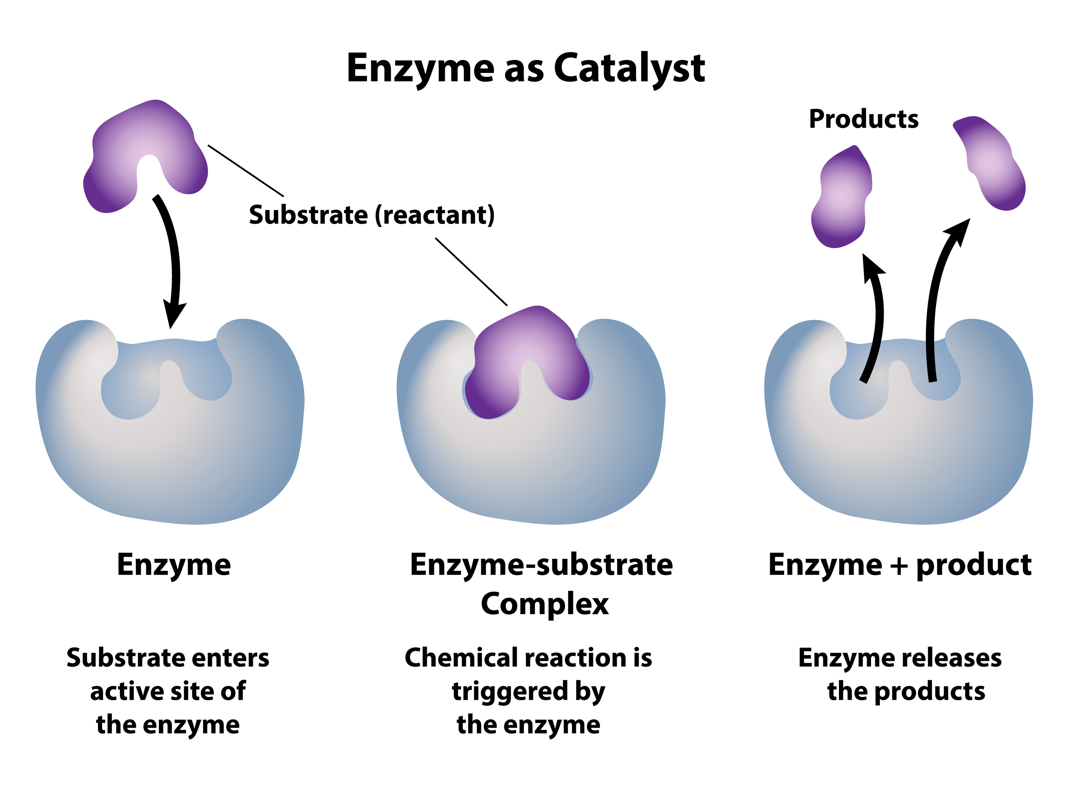
What is an enzyme?
Enzymes are proteins that can break large nutrient (food) molecules into smaller ones.
For an enzyme to work, the enzyme and the substrate come together to form an enzyme-substrate complex.
Substrate means what the enzyme is working on.

Slide 5
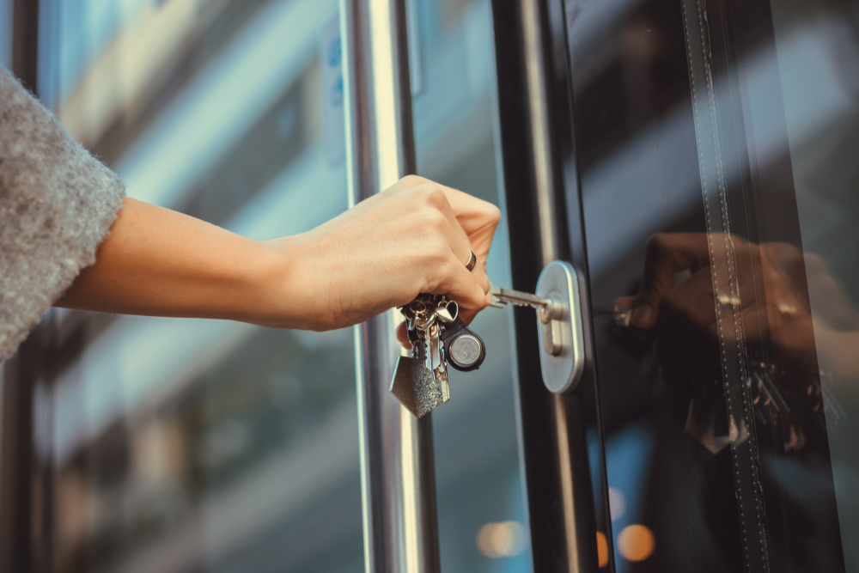
Lock and key model
We call this the lock and key model, as the enzyme and substrate come together requiring an exact fit like a lock and key.

Slide 6
Enzymes
Draw a cartoon picture to explain the important features of enzymes and how the work.
Show the substrate and the enzyme forming an enzyme-substrate complex and this triggering the chemical reaction.
Make sure to label your diagram. You can use the picture to support.

Slide 7
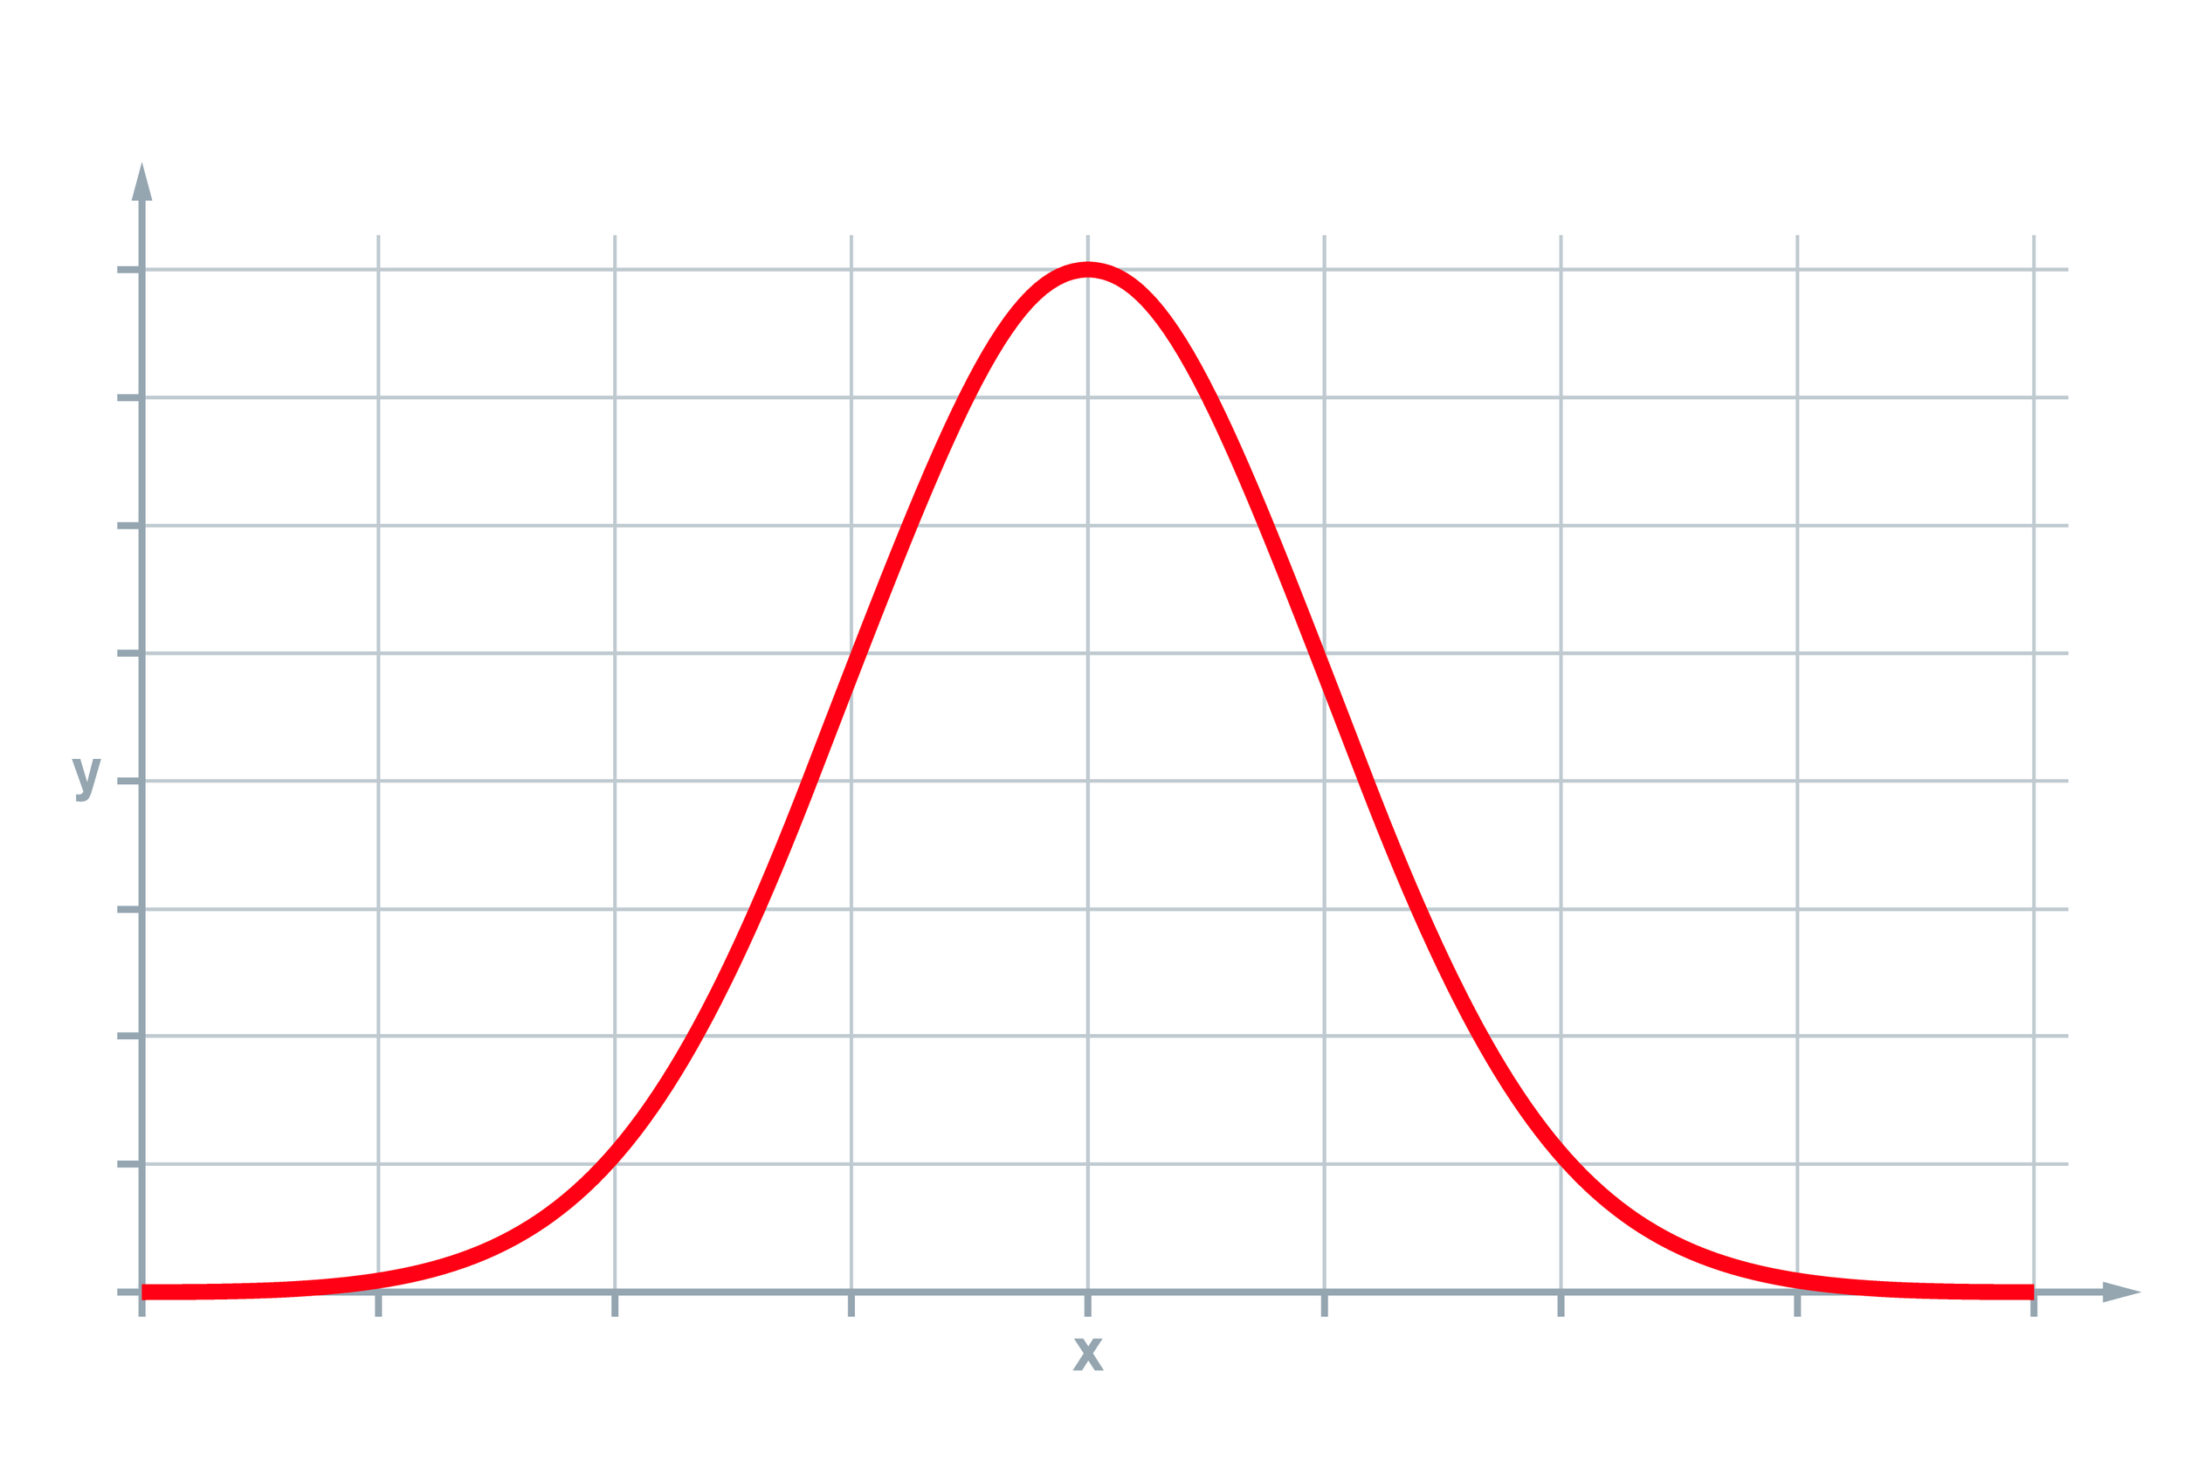
Enzymes and denaturing
Optimum temperature
Enzymes are catalysts – they speed up digestion and are not used up.
Like most chemical reactions, increasing temperature increases the rate of an enzyme reaction but only to a certain point – about 40°C for most enzymes. The temperature the enzyme works best at is called the optimum temperature.
Above 40 °C the long amino acid chains begin to unwind, the 3D structure is lost and the shape of the active site changes. The substrate will no longer fit and bind and the enzyme is denatured.
Rate of reaction
Temperature

Slide 8
Enzymes and denaturing
1. What is the term for when the substrate has joined with the enzyme?
2. Describe what is meant by the ‘lock and key’ idea with relation to enzymes.
3. Why do you think this idea was named the lock and key theory?

Slide 9
Fill in the gaps
Initially increasing temperature _______ the rate of reaction. Above ______ most enzymes become _________. This means the __________ of the _________ ________ changes and the substrate no longer _________.
increases
active site
denatured
shape
40°C
fits
Extension: Describe why, at lower temperatures, the rate of reaction decreases.

Slide 10
Investigation: caramelisation of onions
When onions are caramelised, one of the big changes is that enzymes are denatured (or broken down).
The enzyme in onions is called allinase which is destroyed when you heat the onion.

Slide 11
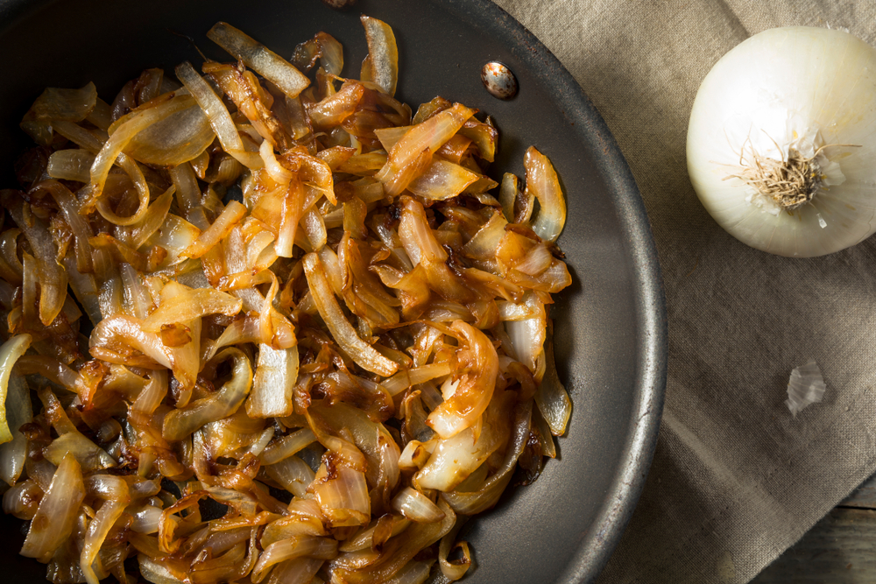
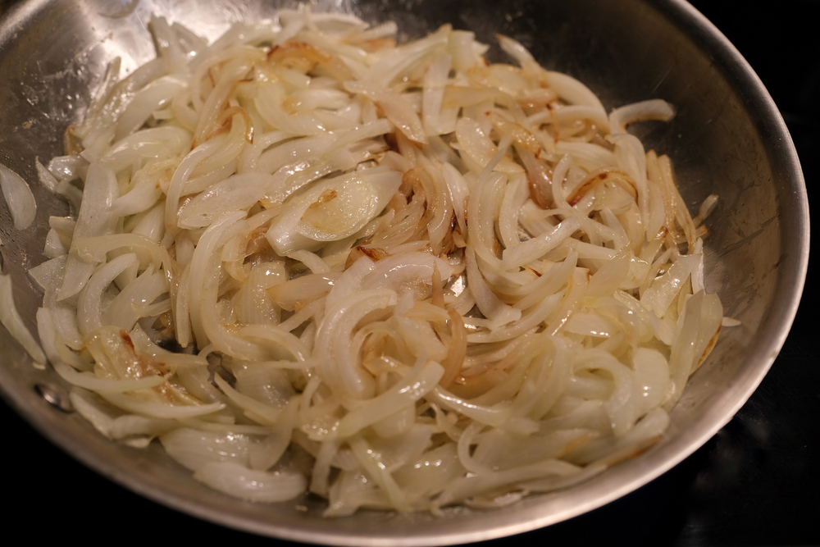
Caramelisation of onions

Slide 12
Investigation: Caramelisation of onions
Equipment
Weighing scales
Chopping board
Vegetable knife
Teaspoon
Frying pan
Spatula for stirring
Matching bowls for serving
Food probe
Ingredients
Brown onion
Ghee or oil
Caster sugar
Sodium bicarbonate

Slide 13
Investigation: Caramelisation of onions
Onions are naturally sweet.
Slow cooking breaks down the natural sugars in the onions and they become sweeter.
Caramelisation occurs as a result of the simple cooking of sugar.
In many recipes the onions are initially sweetened by caramelisation to improve flavour and colour in the dish.
Extension task – research kilocalories and carbohydrates in the onion family.

Slide 14
Investigation: Caramelisation of onions
Method:
Weigh the onion then remove skin and reweigh.
Peel and slice onion into measured slices.
Weigh sliced onions.
Melt ghee or oil and fry gently – time caramelisation.
Use food probe to check temperatures as onions caramelise.
Compare to sugar boiling scales.
Test pH of mixture.
Variables:
Onions and ghee/oil
Onions, ghee/oil and 10g caster sugar
Onions, ghee/oil and 10ml balsamic vinegar

Slide 15
Investigation: Caramelisation of onions
Additional variables to try:
Add ½ tsp teaspoon bicarbonate soda – makes the pH more alkaline and speeds up browning
Soak the sliced onions in water, drain, dry and fry
Use different frying fats: rapeseed oil, olive oil, dripping
Add 10g of plain flour, or cornflour to the onions
Add 10g apple juice or 1 tsp caster sugar
Vary the onions – red onion, shallots, leeks.
Variables:
Onions and ghee/oil
Onions, ghee/oil and 10g caster sugar
Onions, ghee/oil and 10ml balsamic vinegar

Slide 16
Investigation: Caramelisation of onions
Data to collect:
Weight of raw onion
Weight of onion pre cooking
Weight of onion caramelised
Comparison of colour of onions against a benchmark range (photograph)
Accurate small measurements of 10g sugar etc
Sensory analysis – raw / caramelised onions
Recipes that incorporate caramelisation of onion.

Slide 17
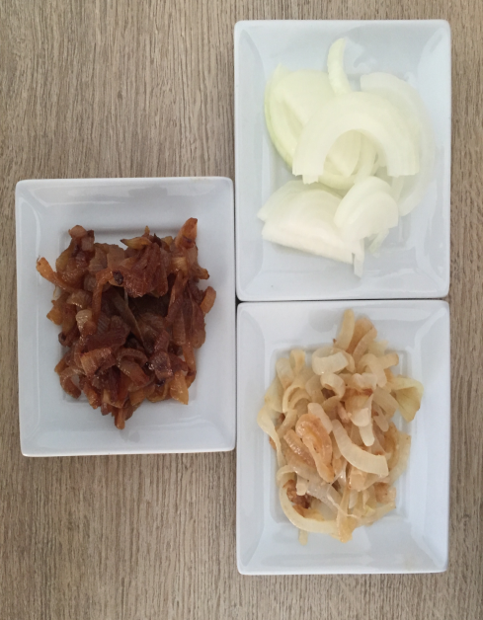
Benchmark of onion colourations as they brown
White / speckled brown/ golden /dark golden / rich dark golden / rich brown
The Cookery Teacher

Slide 18
5 scientific stages when onions are browned
1 Evaporation
When onions are heated the first thing that happens is that the water evaporates and steam is seen and heard - it sizzles out of the onion cells. Around 75% of an onion is formed from water.
As the water is forced out the cellular structure of the onion softens.

Slide 19
5 scientific stages when onions are browned
Enzymes
  Allinase is the enzyme which causes irritation to our eyes and makes us cry when chopping raw onions.
  During cooking the temperature increases and the enzyme is destroyed.
  Other enzymes are released from the cells and mix together.

Slide 20
5 scientific stages when onions are browned
3 Browning
  Evaporation enables the temperature of the onions to increase to 110⁰C.
  Sugars oxidise and compounds are formed.
  You begin to see the onion go brown.

Slide 21
5 scientific stages when onions are browned
Sweetening
  Sweetness increases as the sugars breakdown.
  Disaccharides turn to monosaccharides.
  Fructose is sweeter than sucrose therefore the onion becomes sweeter in taste.

Slide 22
5 scientific stages when onions are browned
5 Maillard reaction
  Maillard reactions occur when proteins and carbohydrates combine through heating.
  Sugars, proteins and enzymes work together to produce the ‘golden’ and sweeter attributes of Maillard reactions.
  Slow gentle cooking of onions is key to optimal caramelisation and flavour development.

Slide 23
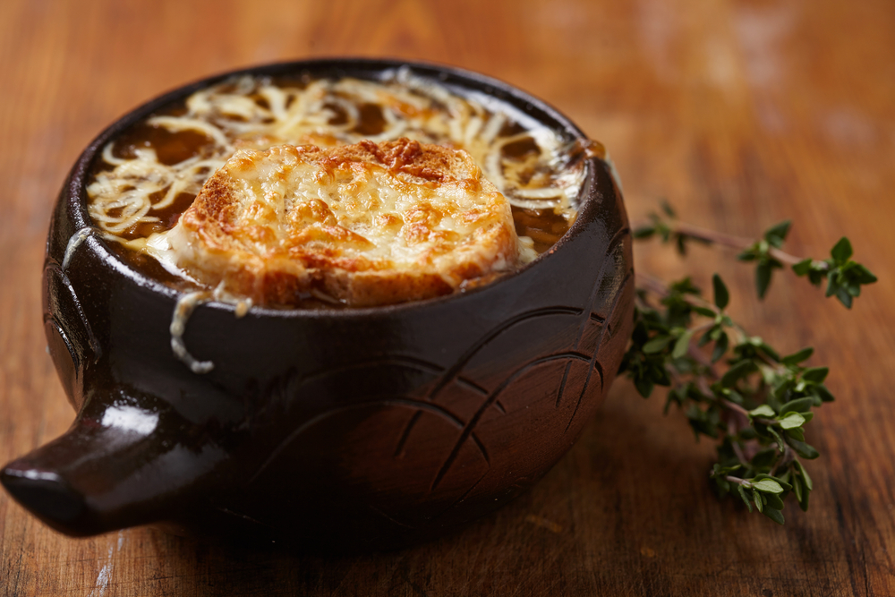
French Onion Soup
Method:
Caramelise onions
Add to rich beef stock
Thicken very slightly with potato starch or cornflour
Check seasoning
Add French bread slices
Add grated Gruyère cheese
Grill and serve.

Slide 24
Key words
Key word​ | Meaning​
Caramelisation | The chemical change of heated sucrose (table sugar) to caramel, which produces flavour and browning. Caramelisation is a type of non-enzymic browning reaction.
Enzymes | Proteins that regulate chemical reactions, e.g., rennin in cheese production.
Denaturation | A change in the structure of protein molecules, resulting in their unfolding, e.g., whisking egg white to make meringues.

Slide 25
Teachers’ guide

Slide 26
Extra information for teachers
The following slides contain extra information for teachers to support the teaching and learning around this topic area.
This may be useful as background reading, or you may wish to extend the learning for students by using this information in the lesson.

Slide 27
Enzymes
Enzymes are biological catalysts – they speed up chemical reactions.
Enzymes are large protein molecules that have a complex 3D shape.

Slide 28
Enzymes
The shape of the enzyme is vital for the enzyme to function. The long chains of amino acids are folded to produce a molecule with an active site that has a unique shape so it can only bind to a specific substrate molecule.
The substrate – the molecule or molecules taking part in the chemical reaction – fits into the active site. Once bound to the active site, the chemical reaction takes place.

Slide 29
Enzymes – lock and key
The lock and key theory is a simple model of how enzymes work.
The substrate of the reaction to be catalysed fits into the active site of the enzyme. You can think of it like a lock and key. Once it is in place, the enzyme and the substrate bind together. The reaction then takes place rapidly and the products are released from the surface of the enzyme.
Remember that enzymes can join small molecules together as well as break up large ones. There are other, more complex models of how enzymes work but they are all based on the lock and key theory.

Slide 30
Enzymes – lock and key
Most of your enzymes work inside the cells of your body, controlling the rate of the chemical reactions. Your digestive enzymes are different. They work outside your cells.
They are produced by specialised cells in glands (such as your salivary glands and your pancreas), and in the lining of your digestive system. The enzymes then pass out of these cells into the digestive system itself, where they come into contact with food molecule.

Slide 31
Enzymes – denaturing
If enzymes are exposed to extremes of pH or high temperatures the shape of their active site may change. If this happens then the substrate will no longer fit into the enzymes.
This means the key will no longer fit the lock. We say that the enzyme has been denatured – denaturation is a permanent change.

Slide 32
Enzymes in digestion
Enzyme | Nutrient it breaks down | Sites of production | Sites of action
Carbohydrase | Carbohydrate to sugar/glucose | Salivary glands Pancreas | Mouth Small intestine
Protease | Proteins to amino acids | Stomach Pancreas Small intestine | Stomach Small intestine
Lipase | Lipids to fatty acids and glycerol | Pancreas Small intestine | Small intestine

Slide 33
Caramelisation of onions
For further information, go to:
www.foodafactoflife.org.uk
This science pack is one of a series of resources produced for the pHood Futures project, supported by the Royal Society of Chemistry.
Presentation produced with the support of The Cookery Teacher
This resource meets the Guidelines for producers and users of school education resources about food.

