Slide 1
Denaturation & Coagulation

Slide 2
Introduction
Denaturation and coagulation are two processes that occur in protein.
Denaturation is useful in food preparation for example:
whisking eggs;
marinating a piece of meat where the acid tenderises the meat before cooking;
making sour cream and yoghurt.
Coagulation is used in food preparation for example:
raw eggs being cooked e.g. boiled or scrambled as part of a dish;
making a quiche, where the eggs coagulate and set;
meringue (denaturation for beating the eggs, coagulation for cooking the egg product)
cooking meats, and the process of making cheese.

Slide 3
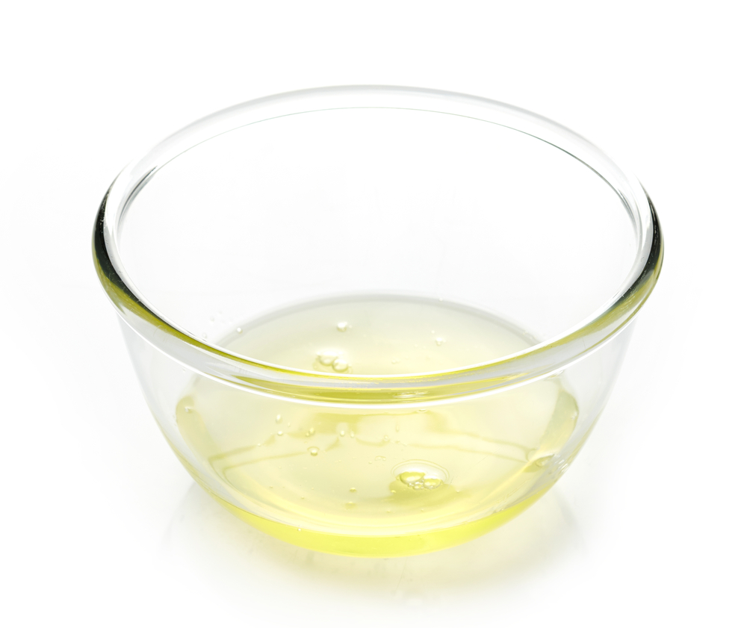
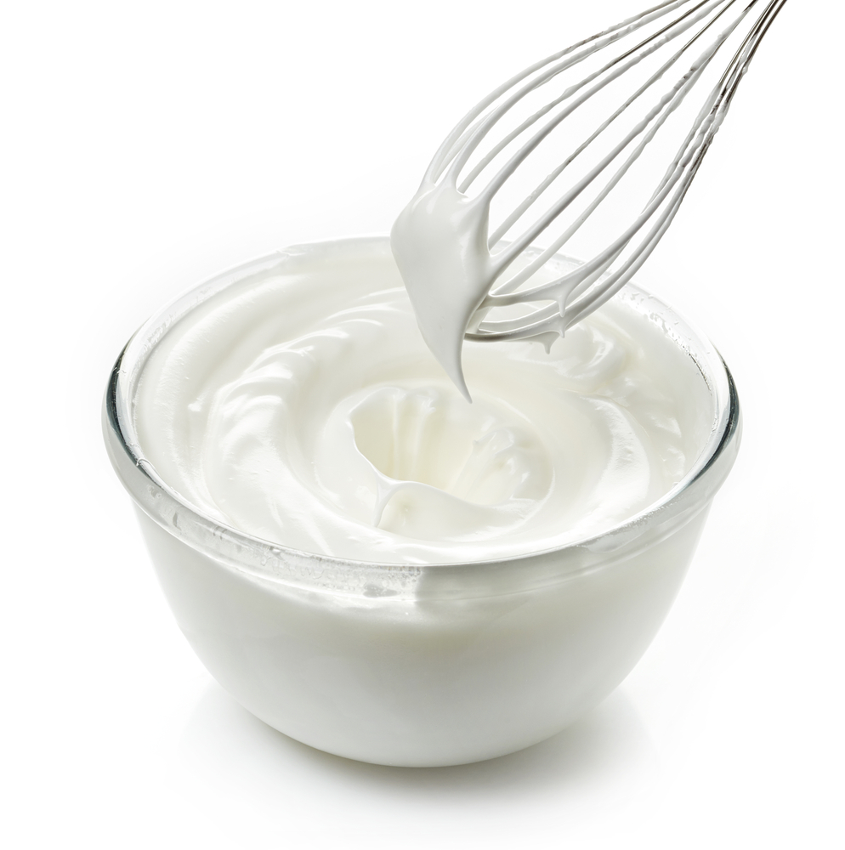
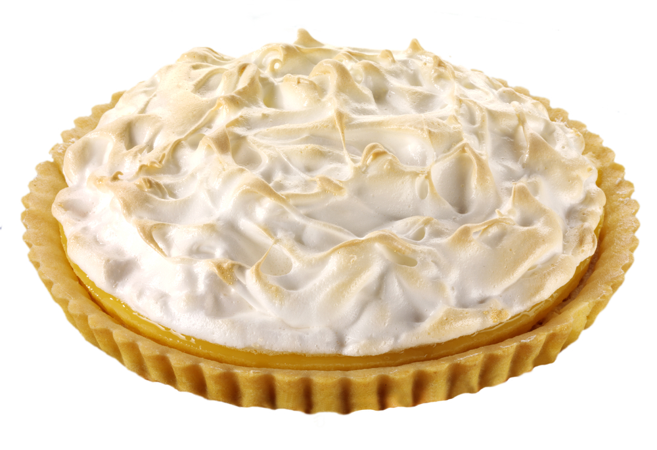
Examples of denaturation and coagulation
Raw egg white
Egg white whisked - denaturation
Egg white cooked - coagulation

Slide 4
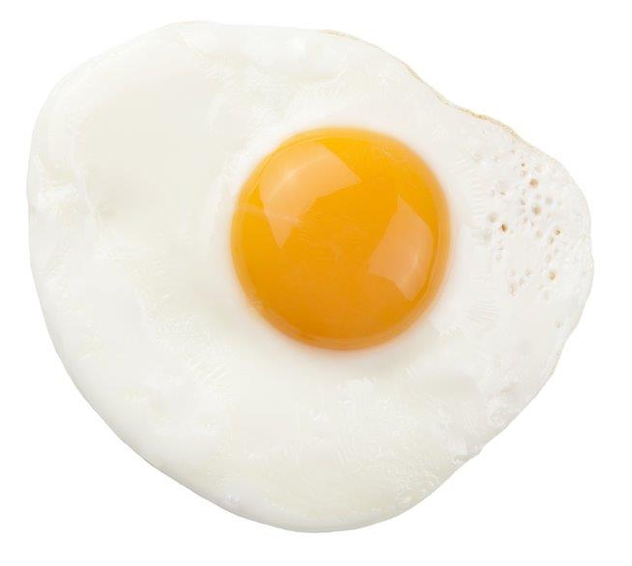
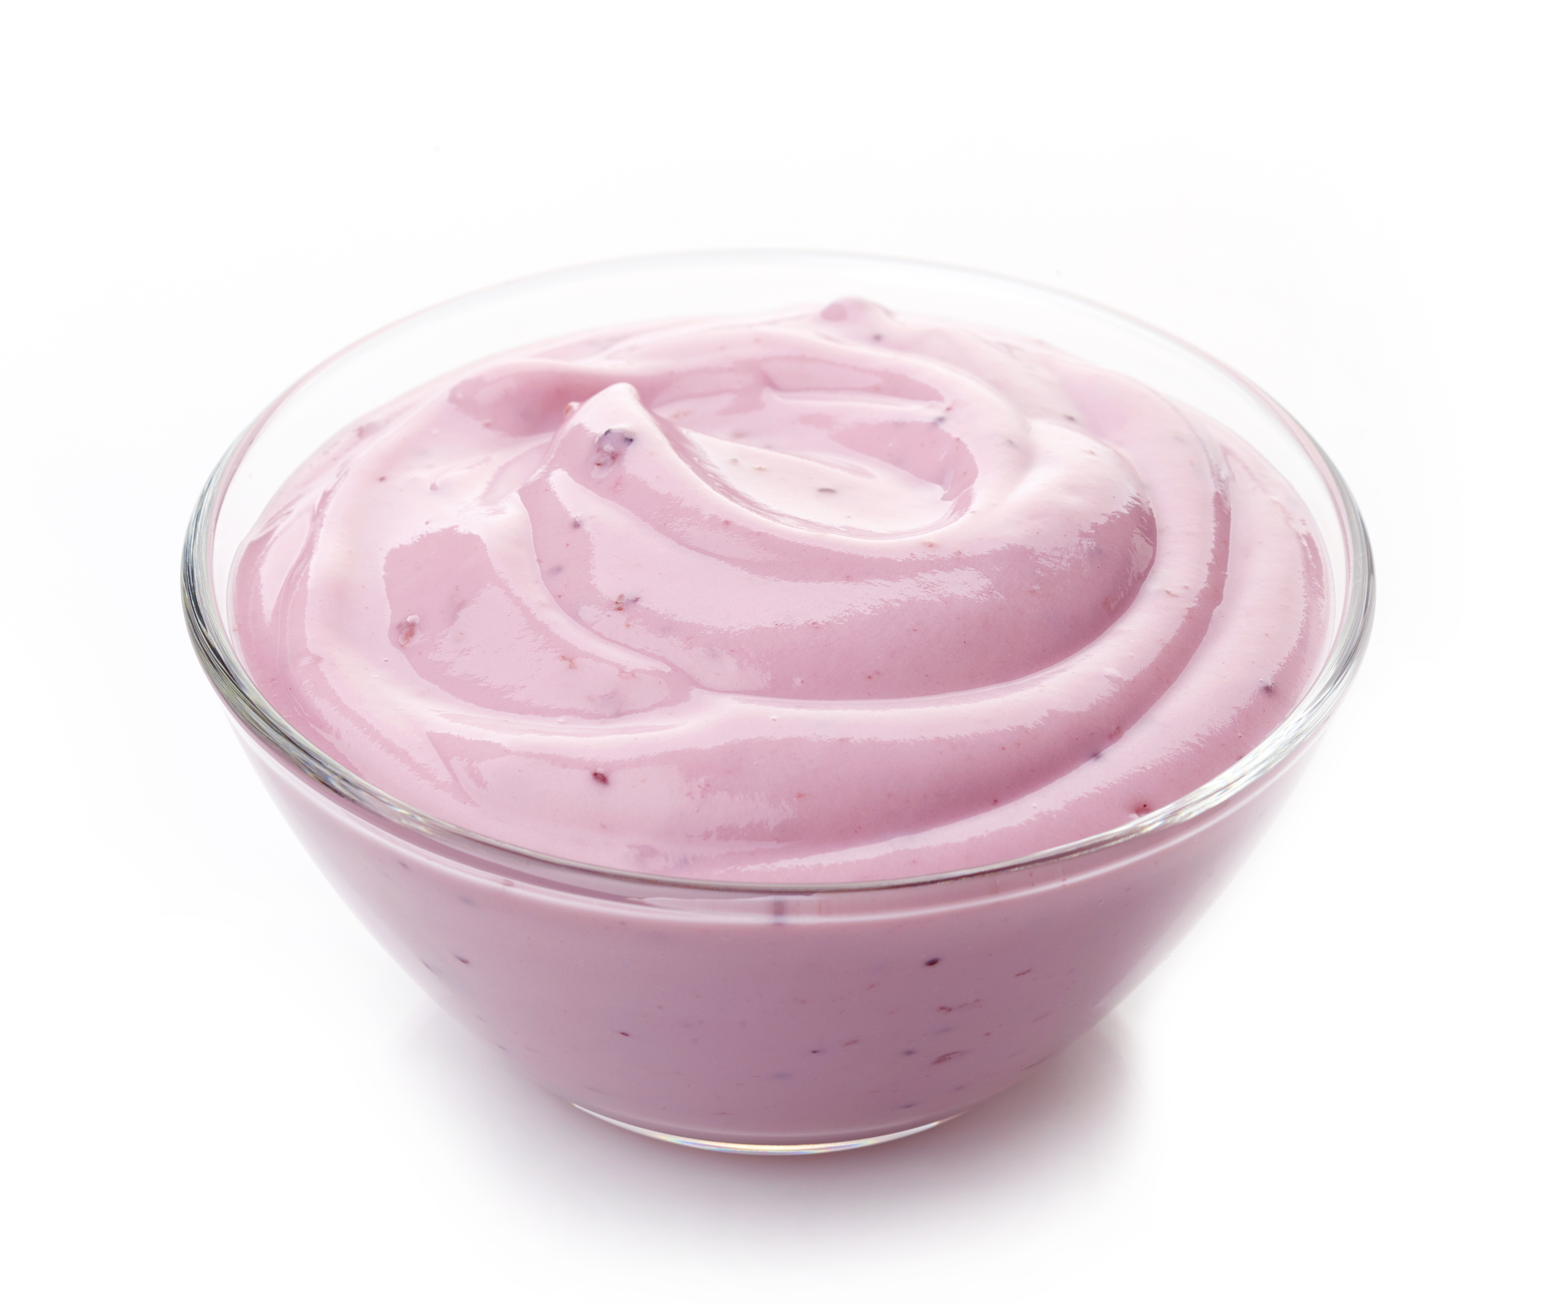
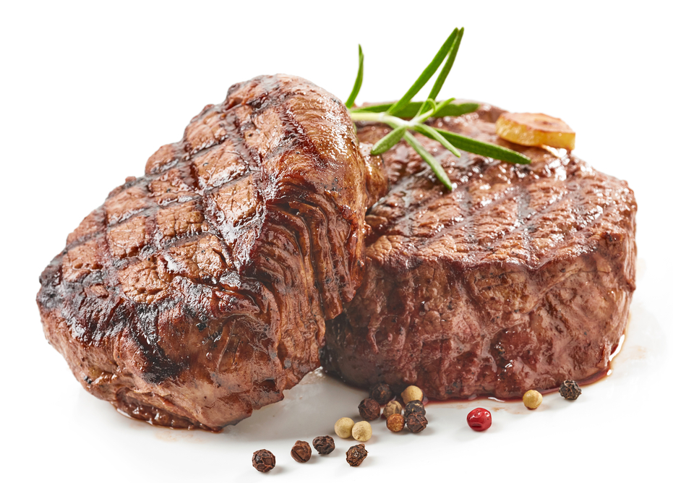
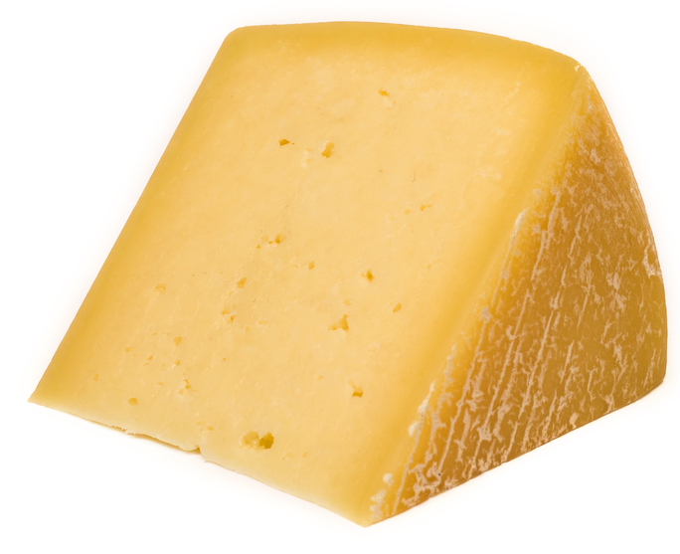
Examples of denaturation and coagulation
What do these examples show?
Coagulation of proteins through heat (frying)
Coagulation of egg proteins through heat (frying)
Coagulation of milk proteins by acid-producing bacteria
(low pH)
Coagulation of milk proteins through addition of acid and enzymes (in rennet)

Slide 5
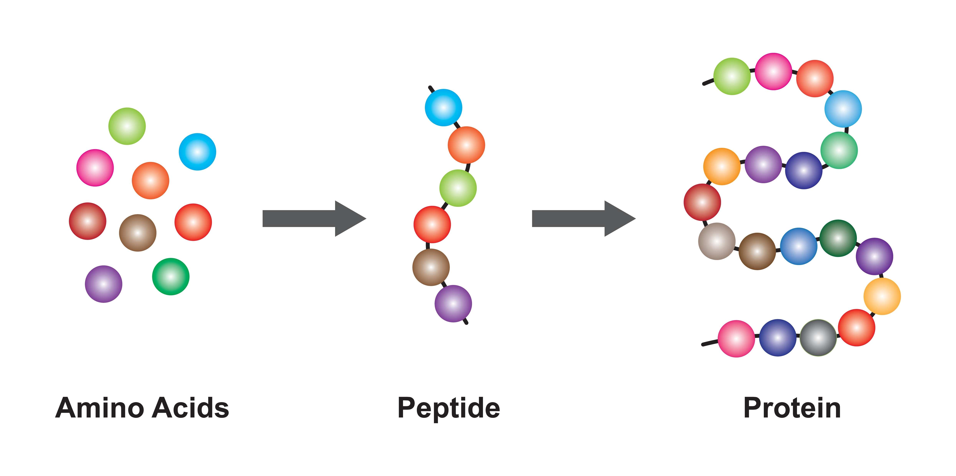
Protein structure
All proteins are built from amino acids in long three-dimensional chains of molecules.
As amino acid groups join they form larger molecules called peptides.
As more amino acids react with peptides very big, complex chains of amino acids are formed called polypeptides.
These polypeptides combine and fold in twisted and branched chains to form protein.
Chemical bonds hold a bundle of chains together to stop them unfolding.

Slide 6
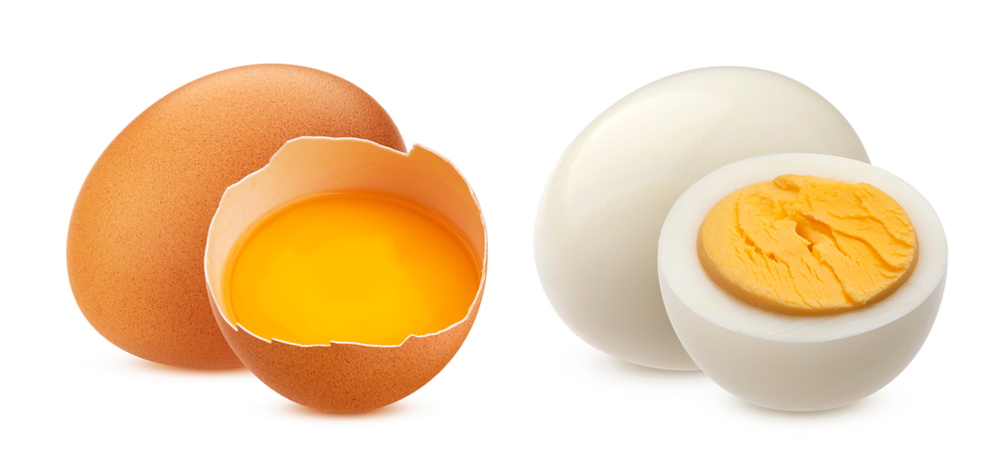
Denaturation
Denaturation is the change in structure of protein molecules.
The chemical bonds are broken allowing the bundles to change shape or unfold.
Proteins denature (change shape) and then coagulate (set).
Denaturation can be caused by:
heat (e.g. boiling an egg);
acids (e.g. marinating meat, adding lemon juice to milk/cream);
mechanical action (e.g. whisking eggs) to form a foam.

Slide 7
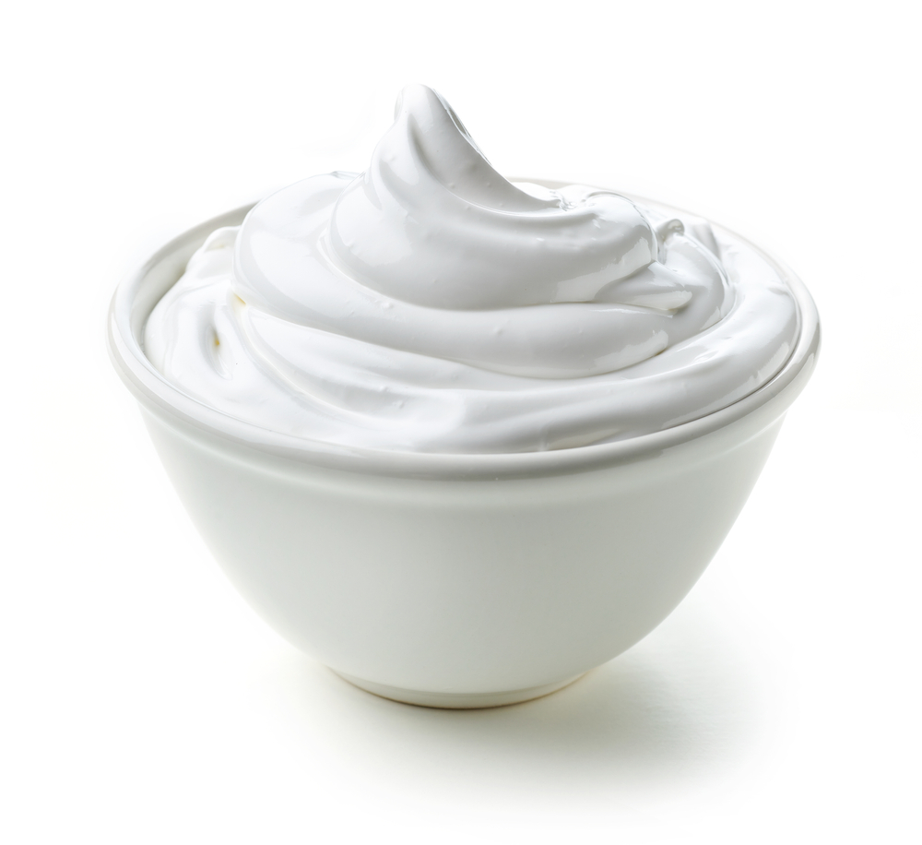
Reversing denaturation
Denaturation is a partially reversible change.
For example, when egg white is whisked (mechanical action) it incorporates air to form a foam.
If the foam is left to stand, it will collapse back into liquid egg white.
However, as denaturation is only partially reversible, trying to make a new foam from a collapsed one will not work well.

Slide 8
Coagulation
Coagulation follows denaturation.
The denatured (unfolded) protein chains bind together to form a stable network.
This change is irreversible. For example, a solid, cooked egg cannot return to a liquid, uncooked egg.
Another example is heating milk. You may have noticed that when you heat milk to just below boiling point, a skin forms. The proteins cannot be turned back into their liquid form.

Slide 9
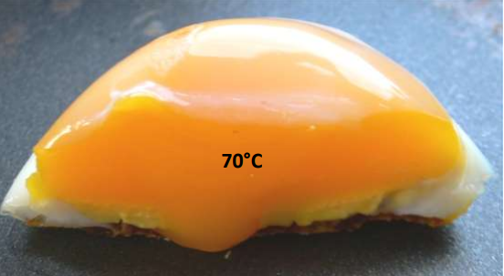
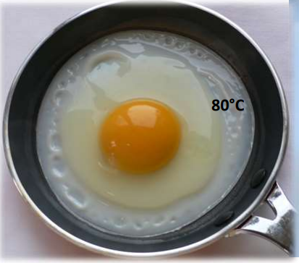
Temperature
Coagulation is affected by the cooking temperature. The longer an egg is cooked the more solid it becomes.
Egg white changes from a clear, transparent liquid to a white, opaque colour at around 60°C
Egg yolk thickens at about 65°C and coagulates at 70°C
If eggs are overcooked the white becomes tough and rubbery and the yolk becomes crumbly.
Excess heat or over cooking causes the proteins to clump together and shrink and water separates (syneresis) from the egg.
Photographs courtesy of Barbara Monks @ https://thecookeryteacher.com/

Slide 10
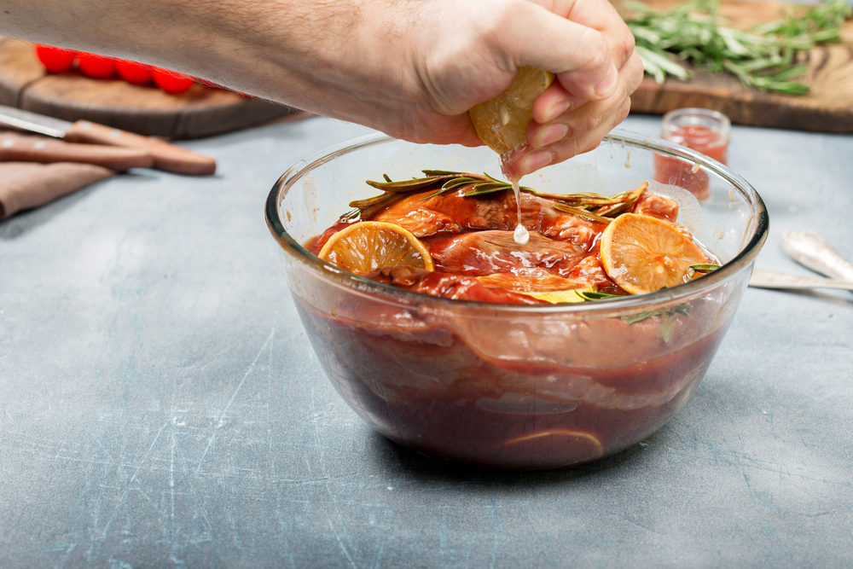
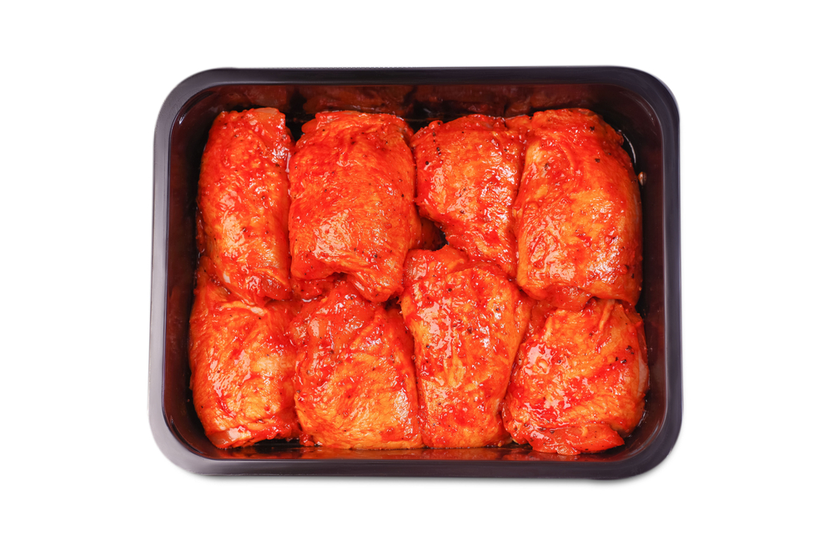
Tenderising meat - denaturation
Meat is made up of muscle fibres and connective tissue. The aim of tenderising is either to break down or soften the muscle and connective tissue. The protein is denatured.
This can be done by chemical tenderisation. Marinades are used to tenderise the meat and add flavour.
Marinades may use enzymes to tenderise the meat e.g. bromelain in pineapple.
Marinades also use acids to denature the proteins e.g. lemon juice, vinegar or tomatoes.
Meat should not be left in acid-based tenderisers for a long time as it will become over-soft, tough and dry.

Slide 11
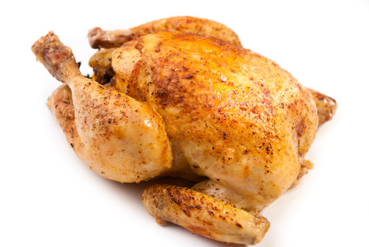
Cooking and resting meat
When meat is cooked, the proteins coagulate. This changes the texture and flavour of the meat.
Meat needs to be cooked for the right amount of time – if it is cooked for too long, too much coagulation can occur and make the meat tough and dry.
When proteins in meat coagulate, they squeeze out some of the liquid.
This is why resting meat is important. The slight cooling of the meat allows the coagulated proteins to relax and reabsorb some of the water – keeping the meat juicy!

Slide 12
Cheese making
Coagulation is an important step in cheese making.
Rennet (which contains the enzyme rennin) is added to milk. The protein casein coagulates, producing curds (solid) and whey (liquid).
Because the curds have coagulated into a solid, they can be easily separated from the whey and be processed into cheese.
The whey can also be used for other useful purposes, such as making butter, or removing the lactose and using it for animal feed.

Slide 13
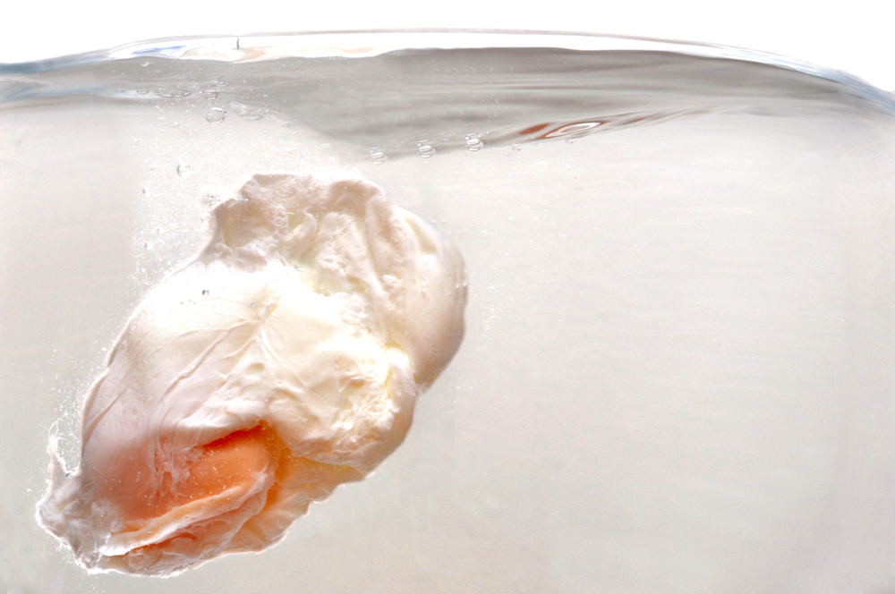
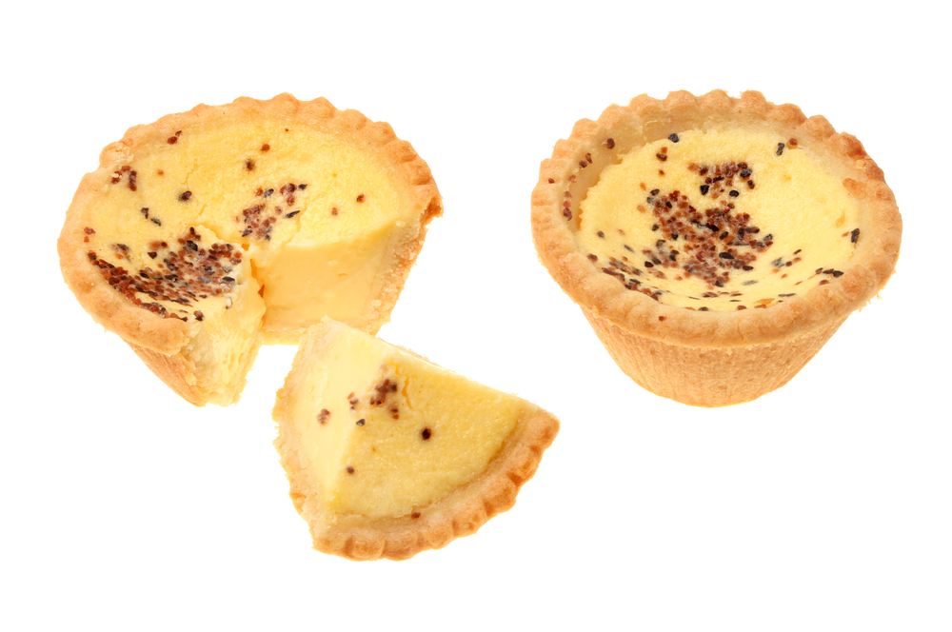
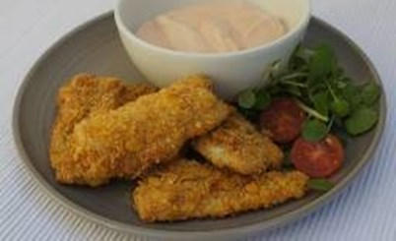
Applying the science
Lemon and herb coley goujons
Why is lemon juice added when poaching an egg?
The coagulation of egg protein is used to thicken custards, sauces and soups.
Beaten egg is used to coat the fish before cooking. The coagulation of the egg holds the breadcrumbs together making a protective coating.
Adding an acid like lemon juice or vinegar will speed up the denaturation of protein.

Slide 14
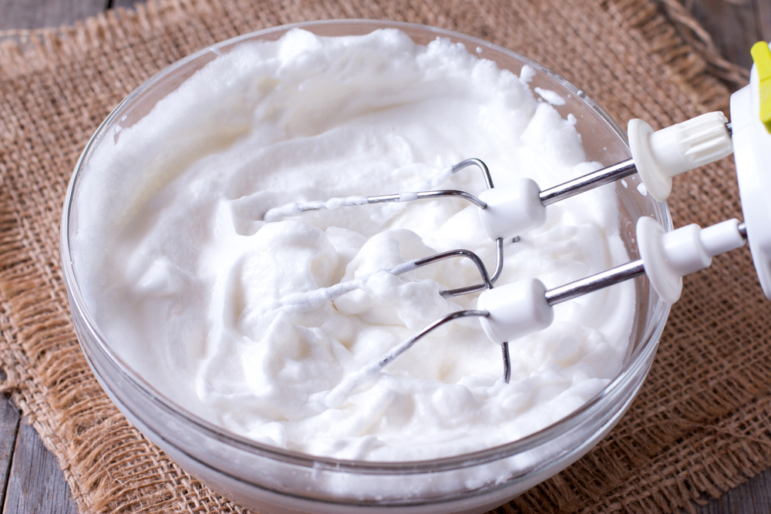
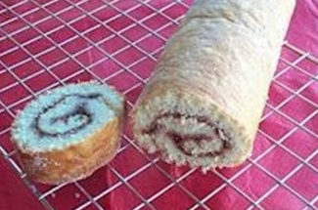
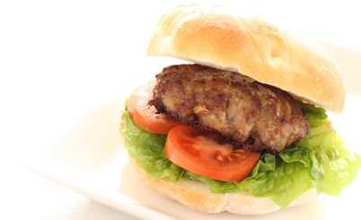
Applying the science
Swiss roll
Homemade burgers
Eggs bind (hold together) mixtures. When the mixture is cooked the egg proteins coagulate holding the food together.
As egg white is whisked air is trapped in the mixture. The proteins are unraveled (denatured) to make a foam. The action of beating or whisking creates enough heat to slightly coagulate the protein. This makes the foam more stable.
This is used to make whisked sponges (e.g. Swiss roll), mousses and souffles.

Slide 15
Key words
Key word | Meaning
amino acid | The units from which proteins are constructed. There are nine ‘essential’ or ‘indispensable’ amino acids, which can only be obtained through the diet.
casein | A protein commonly found in milk.
coagulation | The irreversible denaturation of protein molecules, e.g., when liquid egg turns to solid during cooking.
curds | A solid product formed during cheesemaking, through coagulation.
denaturation | A change in the structure of protein molecules, resulting in their unfolding, e.g., whisking egg white to make meringues.
enzyme | Proteins that regulate chemical reactions, e.g., rennin in cheese production.
foam | A colloid which has a gas dispersed in either a liquid, e.g., beaten egg white, or a solid, e.g., cake.

Slide 16
Key words
Key word | Meaning
lactose | A sugar present in milk. Lactose is a disaccharide (galactose in chemical combination with glucose)
peptide | A molecule made of at least two amino acids, joined together.
polypeptide | Many amino acids joined together.
protein | A component of food that is made up of amino acids. There are many diverse types of protein with a range of functions, including enzymes that catalyse reactions and structural proteins that make up the tissues in our body.
rennet | A mixture of enzymes used in cheese production. Makes the milk ‘curdle’ by denaturing the protein casein.
rennin | Sometimes called chymosin. An enzyme that coagulates milk proteins. Found in rennet and used in cheese production.
whey | The liquid remaining after the curds have been separated from milk.

Slide 17
Teachers’ guide

Slide 18
Teaching about denaturation and coagulation:
Explain the basic structure of protein
Define denaturation and explain that is usually reversible
Define coagulation and explain that it is irreversible
Use examples to illustrate the above. For example, cooking eggs, whisking egg white*, cooking and resting meat, or making cheese
Give examples of recipes that demonstrate the above
Carry out investigations/experiments that demonstrate denaturation and coagulation
*Teachers’ note: refer to the foams pack for more information

Slide 19
Coagulation - investigating functional properties
Example:
Investigate the changes that occur when eggs are used to set mixtures/recipes and to explain scientifically what happens.
Discuss with the pupils:
Key and command words.
The principles of a food investigation.
How to plan and carry out a food investigation.
The process/method that will be used.

Slide 20
Denaturation – an overview
The following information is based on excerpts from the British Nutrition Foundation’s
Functional Properties of Food course.
Denaturation is the change in structure of proteins, which may alter their function. Various factors can contribute to denaturation, including heat, salts*, pH changes and mechanical action (e.g. whisking).
*Teachers’ note: In cooking, this is most commonly table salt (sodium chloride).

Slide 21
Denaturation/coagulation - pros
Denaturation may become irreversible, such as in the frying of an egg. This is because new bonds have formed between the unfolded peptides, preventing them from returning to their original shape.
The cooking of eggs requires protein denaturation, as the heat causes the proteins to denature and form a solid network (this is known as coagulation), leading to a desirable end product that is both nicer to eat and easier to digest.

Slide 22
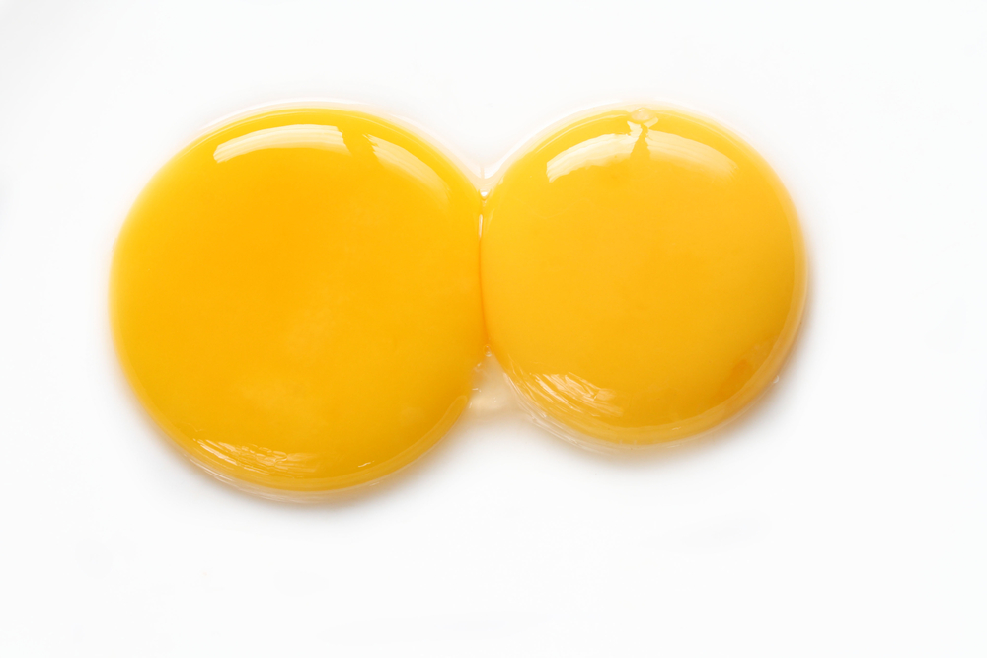
Denaturation/coagulation - cons
On the other hand, attempting to store egg yolks in a freezer can cause proteins to denature and clump together, forming a lumpy, undesirable end product when thawed.
Sometimes denaturation can be a delicate balance. Many caterers use bulk pasteurised egg, which has been heated gently to kill Salmonella bacteria. However, if the heating is too severe the proteins will denature and the egg is no longer suitable for baking.

Slide 23
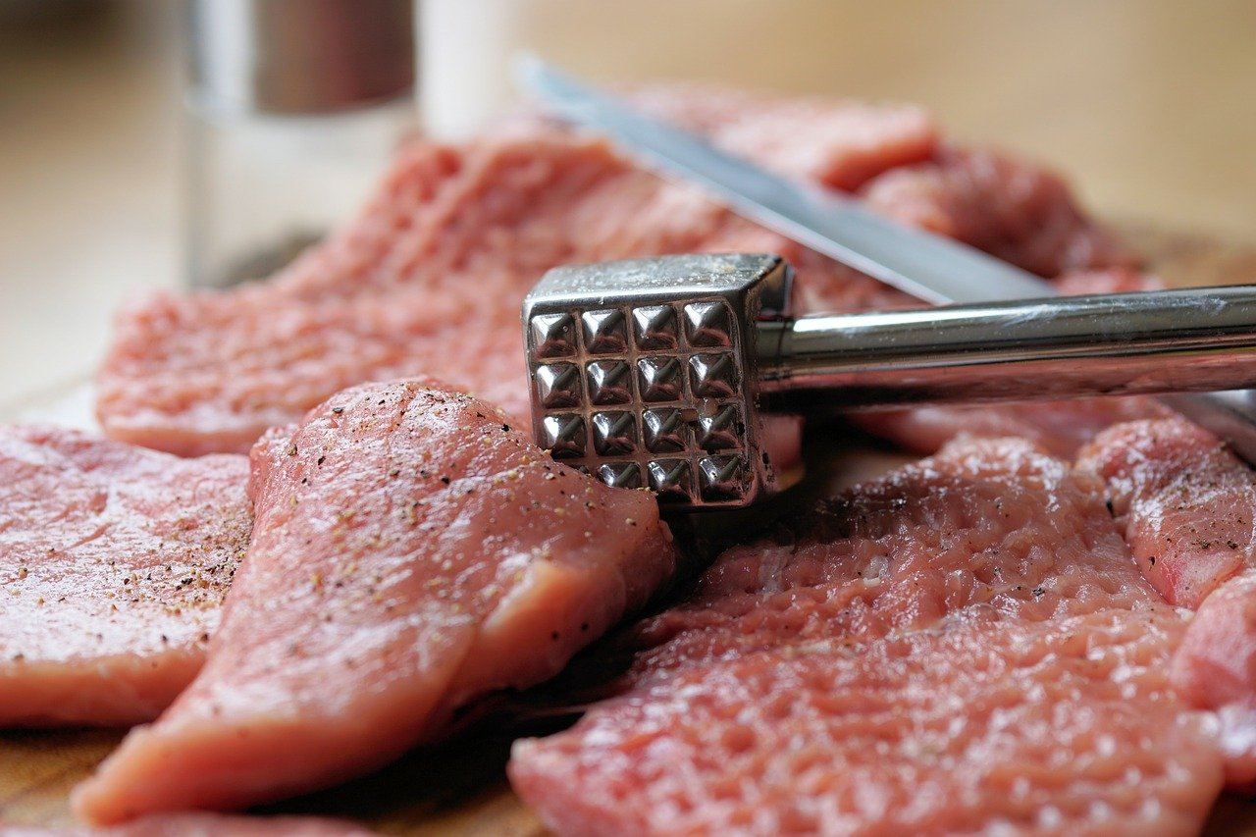
Tenderising meat - mechanical
The aim of tenderising is either to break down or soften the muscle and connective tissue. The protein is denatured.
Tenderising allows for tougher cuts of meat to become softened and therefore easier to eat.
This can be done by mechanical or chemical tenderisation.
A meat hammer may be used to mechanically tenderise meat. This disrupts the structure by separating and reducing the length of the fibres to improve the tenderness.

Slide 24
Tenderising meat - chemical
Marinades may use enzymes to tenderise meat e.g., bromelain in pineapple, papin in papaya and ficin in fresh figs.
Marinades also use acids to denature the proteins e.g. lemon juice, vinegar or tomatoes.
Meat should not be left in acid-based tenderisers for a long time as it will become over-soft, tough and dry.

Slide 25
Coagulation – cooking meat
When meat is cooked, proteins coagulate, and lose their ability to ‘hold on’ to water.
This is why overcooked meat tends to be very dry. It is also why meat should usually be rested after cooking.
This allows a partial (but not total) reversal of some of the protein denaturation, allowing some of the moisture to be held by the meat, rather than being lost during slicing.

Slide 26
Coagulation – examples
Other examples of coagulation in action are:
yogurt production, which involves partial coagulation of milk proteins;
thickening of sauces with beaten egg;
binding ingredients together (e.g. fish cakes, reformed meats);
providing a coating for products (e.g. scotch eggs).

Slide 27
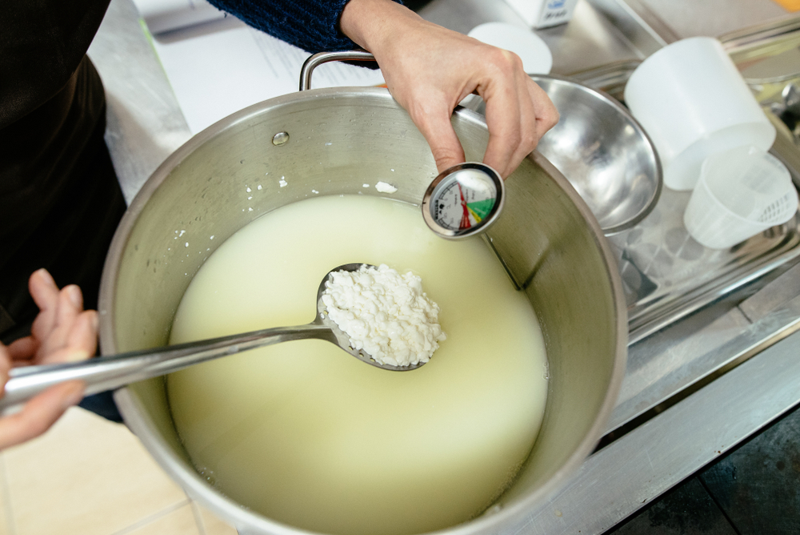
Cheese making - activities
Pupils, individually or in groups, could:
Learn about cheese production with the cheese production worksheet.
Make a simple soft cheese.
Learn about the functions of proteins in food, and complete the accompanying worksheet.
Cheese making masterclass with Quicke’s Dairy video.
Making Mozzarella – Quicke’s demonstration video.
More cheese making resources can be found here.
Make two of our new Eastern European recipes, twarog and gzik!
Teachers will need to decide on the level of complexity of the tasks chosen, depending on age, stage and need, and considering progression.

Slide 28
Further supporting resources
Food – a fact of life
A worksheet looking at acid denaturing
A worksheet looking at coagulation
A worksheet looking at protein foams
Bind information sheet
Food functions poster
Investigations:
An activity and worksheet looking at ingredients that set
An activity and worksheet looking at egg proteins
Teachers will need to decide on the level of complexity of the tasks chosen, depending on age, stage and need, and considering progression.

Slide 29
Further supporting resources
Food science of marinades presentation
What happens when meat is cooked?
What happens when meat is cooked? (teachers’ notes)
What makes meat tender?
Resources around food science can be found here: 11-14 years, 14-16 years
Further information, support and resources around functional characteristics of ingredients can be found here 11-14 and 14-16.
Ingredients - functional characteristics Knowledge Organiser 11-14
Teachers will need to decide on the level of complexity of the tasks chosen, depending on age, stage and need, and considering progression.

Slide 30
Further support resources
External resources
IFST – protein
IFST – protein coagulation experiment
IFST – stability of egg white foams experiment
IFST – foam formation
IFST – protein: acid denaturation
Coagulation film - AQA GCSE Food Preparation and Nutrition
The effect of cooking on food: Eggs – Eduqas resource

Slide 31

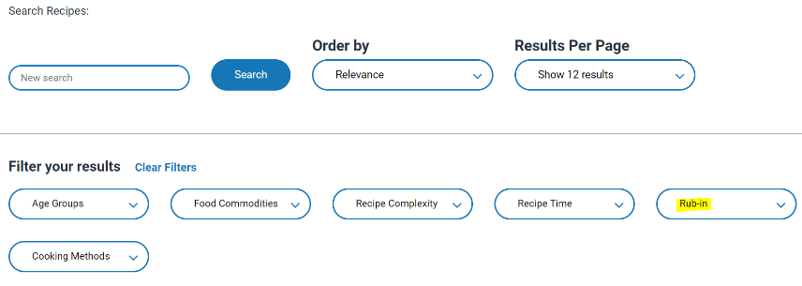
Denaturation and coagulation - recipes
The recipes below are useful ways to showcase the process of coagulation:
Easy veg frittatas
Scrambled omelette with cherry tomatoes
Quiche
Honeyed lamb shoulder
Individual lamb wellingtons
Lemon and herb coley goujons
Parmesan chicken nuggets
Oatcakes and scrambled eggs
Go to the recipes section and filter Food Skills for more recipes.
For the egg-based recipes, discuss how the coagulation of the egg forms a solid product that is held together. For the meat recipes, discuss the cooking time for the ideal amount of coagulation and why the meat should be rested.

Slide 32
Coagulation – recipes continued
Sausage and tomato frittata
Brunch packed omelette
Black bean and red pepper shakshuka
Perico
Swiss roll
Homemade burgers
Red lentil bake
Moussaka stuffed aubergine, topped with cheesy souffle sauce
Peach gateau

Slide 33
Denaturation and coagulation
For further information, go to:
www.foodafactoflife.org.uk
This food science pack is one of a series of resources produced for the pHood Futures project, supported by the Royal Society of Chemistry.
This resource meets the Guidelines for producers and users of school education resources about food.

