Slide 1
Pizza toast
Complexity: medium - high

Slide 2
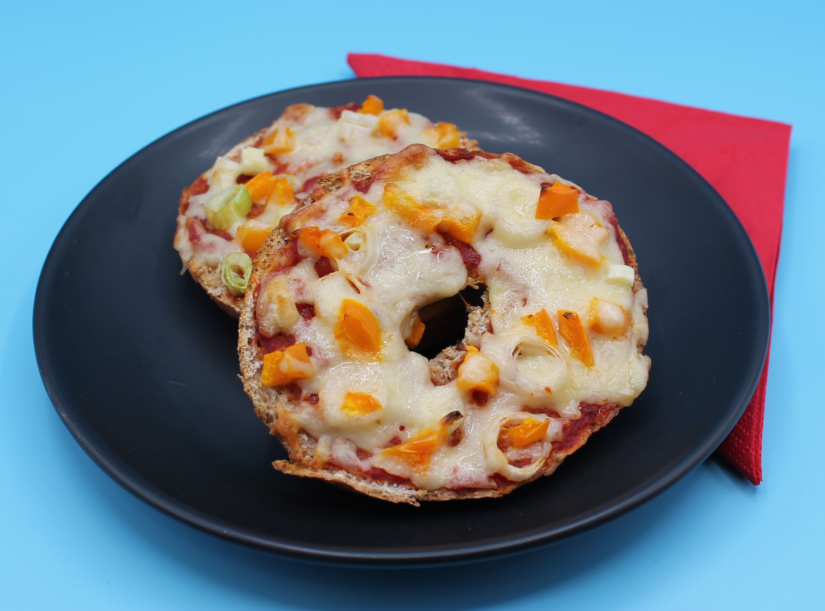
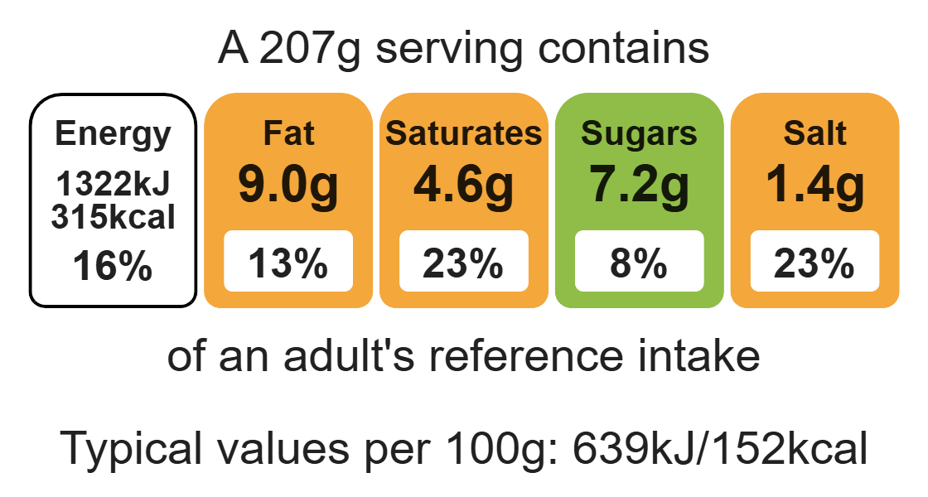
Nutritional analysis
Serves 1

Slide 3
Starter activity
Name three toppings that could be used on a pizza toast.
Name two different types of cheese which could be used.
Name the method of heat transfer used by the grill.

Slide 4
Example responses
Name three toppings that could be used on a pizza toast?
Peppers, sweetcorn, ham, pepperoni, red onion, tomatoes, artichoke.
2. Name two different types of cheese which could be used?
Cheddar, mozzarella, halloumi.
3. Name the method of heat transfer used by the grill.
Radiation.

Slide 5
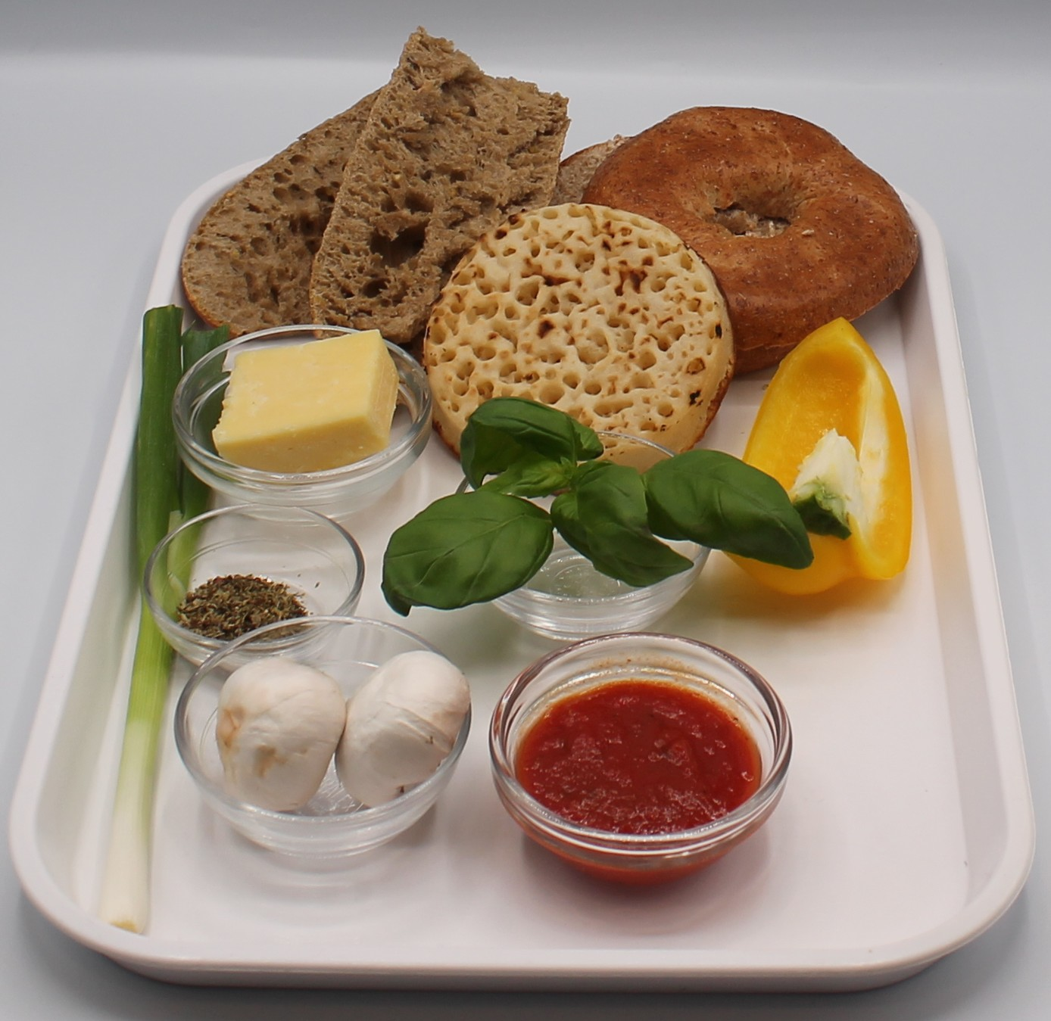

Ingredients (serves 1)
½ pepper
1 spring onion
2 mushrooms
30g reduced-fat hard cheese, e.g. cheddar, Edam, Gruyere
2 slices wholemeal bread, bagel, piece of French stick sliced in half, or a crumpet
2 x 15ml spoons tomato pizza sauce or passata
½ x 5ml spoon mixed herbs
Check for any food allergy, intolerance, special dietary requirement or religious/cultural reasons for not handling or eating the ingredients in this recipe.

Slide 6
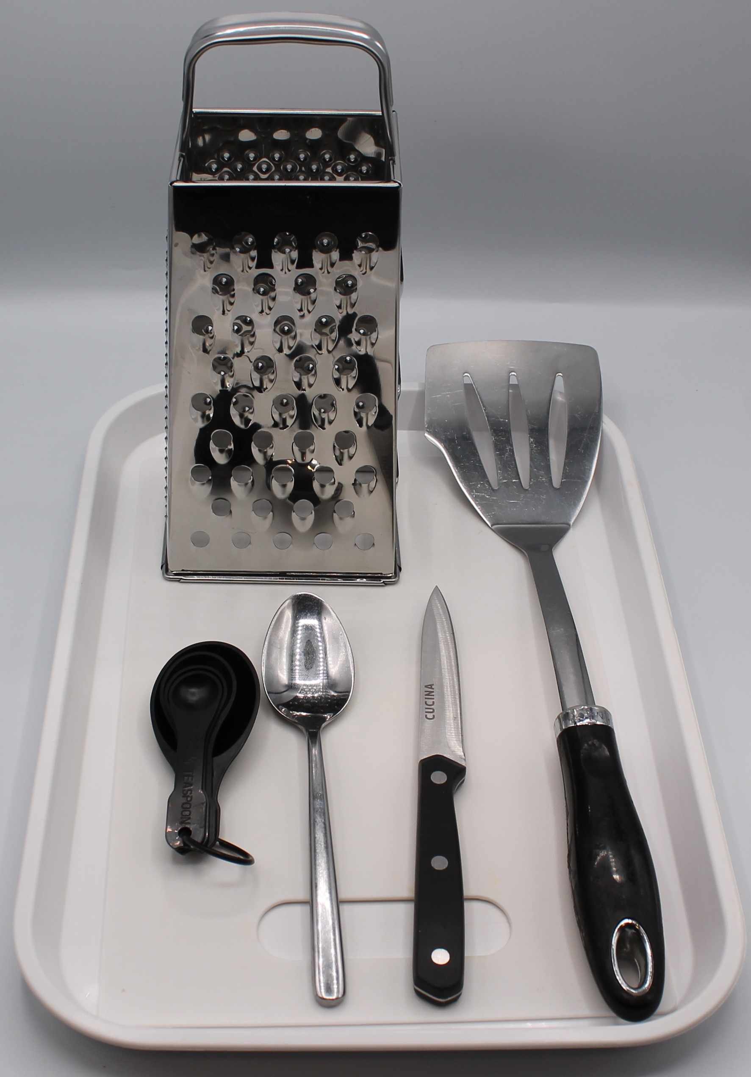
Equipment
Chopping board
Sharp knife
Grater
Fish slice
Measuring spoons

Slide 7
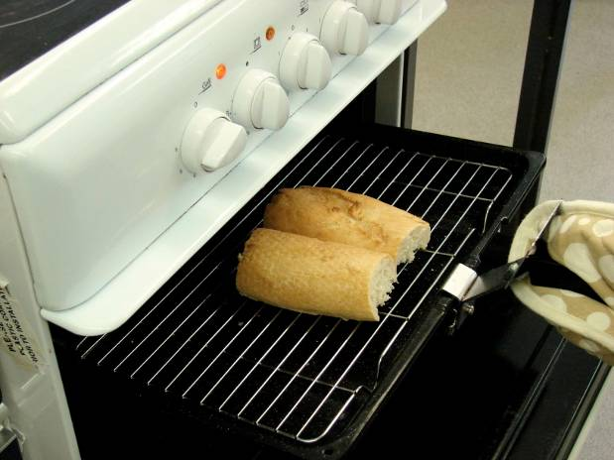
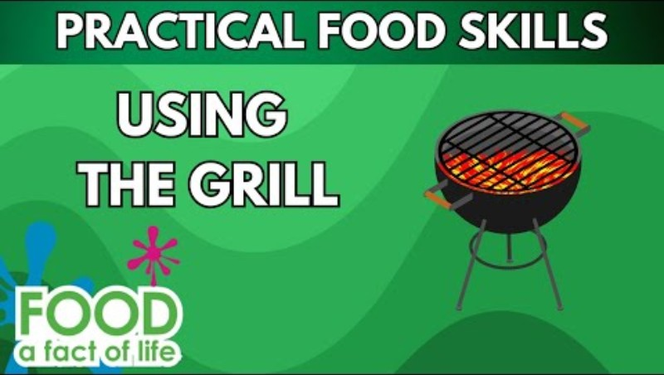
Food skills
Weigh
Measure
Cut
Slice
Dice and trim
Grate
Spread
Grill
Click below to watch how to use the grill safely

Slide 8
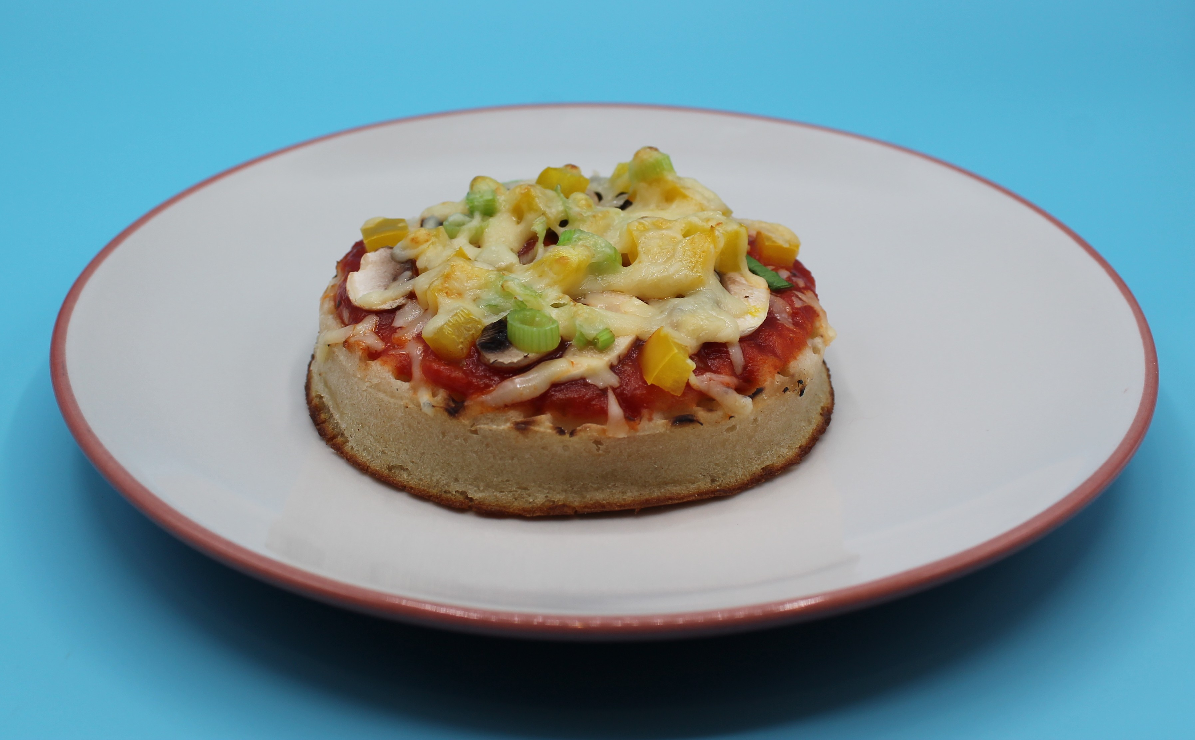
Method
1. Preheat the grill.
2. Prepare the pizza toppings:
deseed and dice the pepper;
slice the spring onion into rings;
slice the mushroom;
grate the cheese.
4. Place the bread under the grill and toast on one side.
5. Carefully remove the bread from the grill and place on the chopping board uncooked side-up.
6. Spread the tomato sauce over the bread using the back of the spoon.
7. Arrange the pepper, mushroom and onion over the bread.
8. Sprinkle the grated cheese on top.
9. Place under the grill until the cheese melts.

Slide 9
Top tips
Turn up the flavour: Add cooked chicken, canned tuna or canned sweetcorn.
Reduce food waste: Add leftover vegetables such as sweetcorn, tomatoes, olives.
Tomato purée could be used instead of pizza sauce or passata.

Slide 10
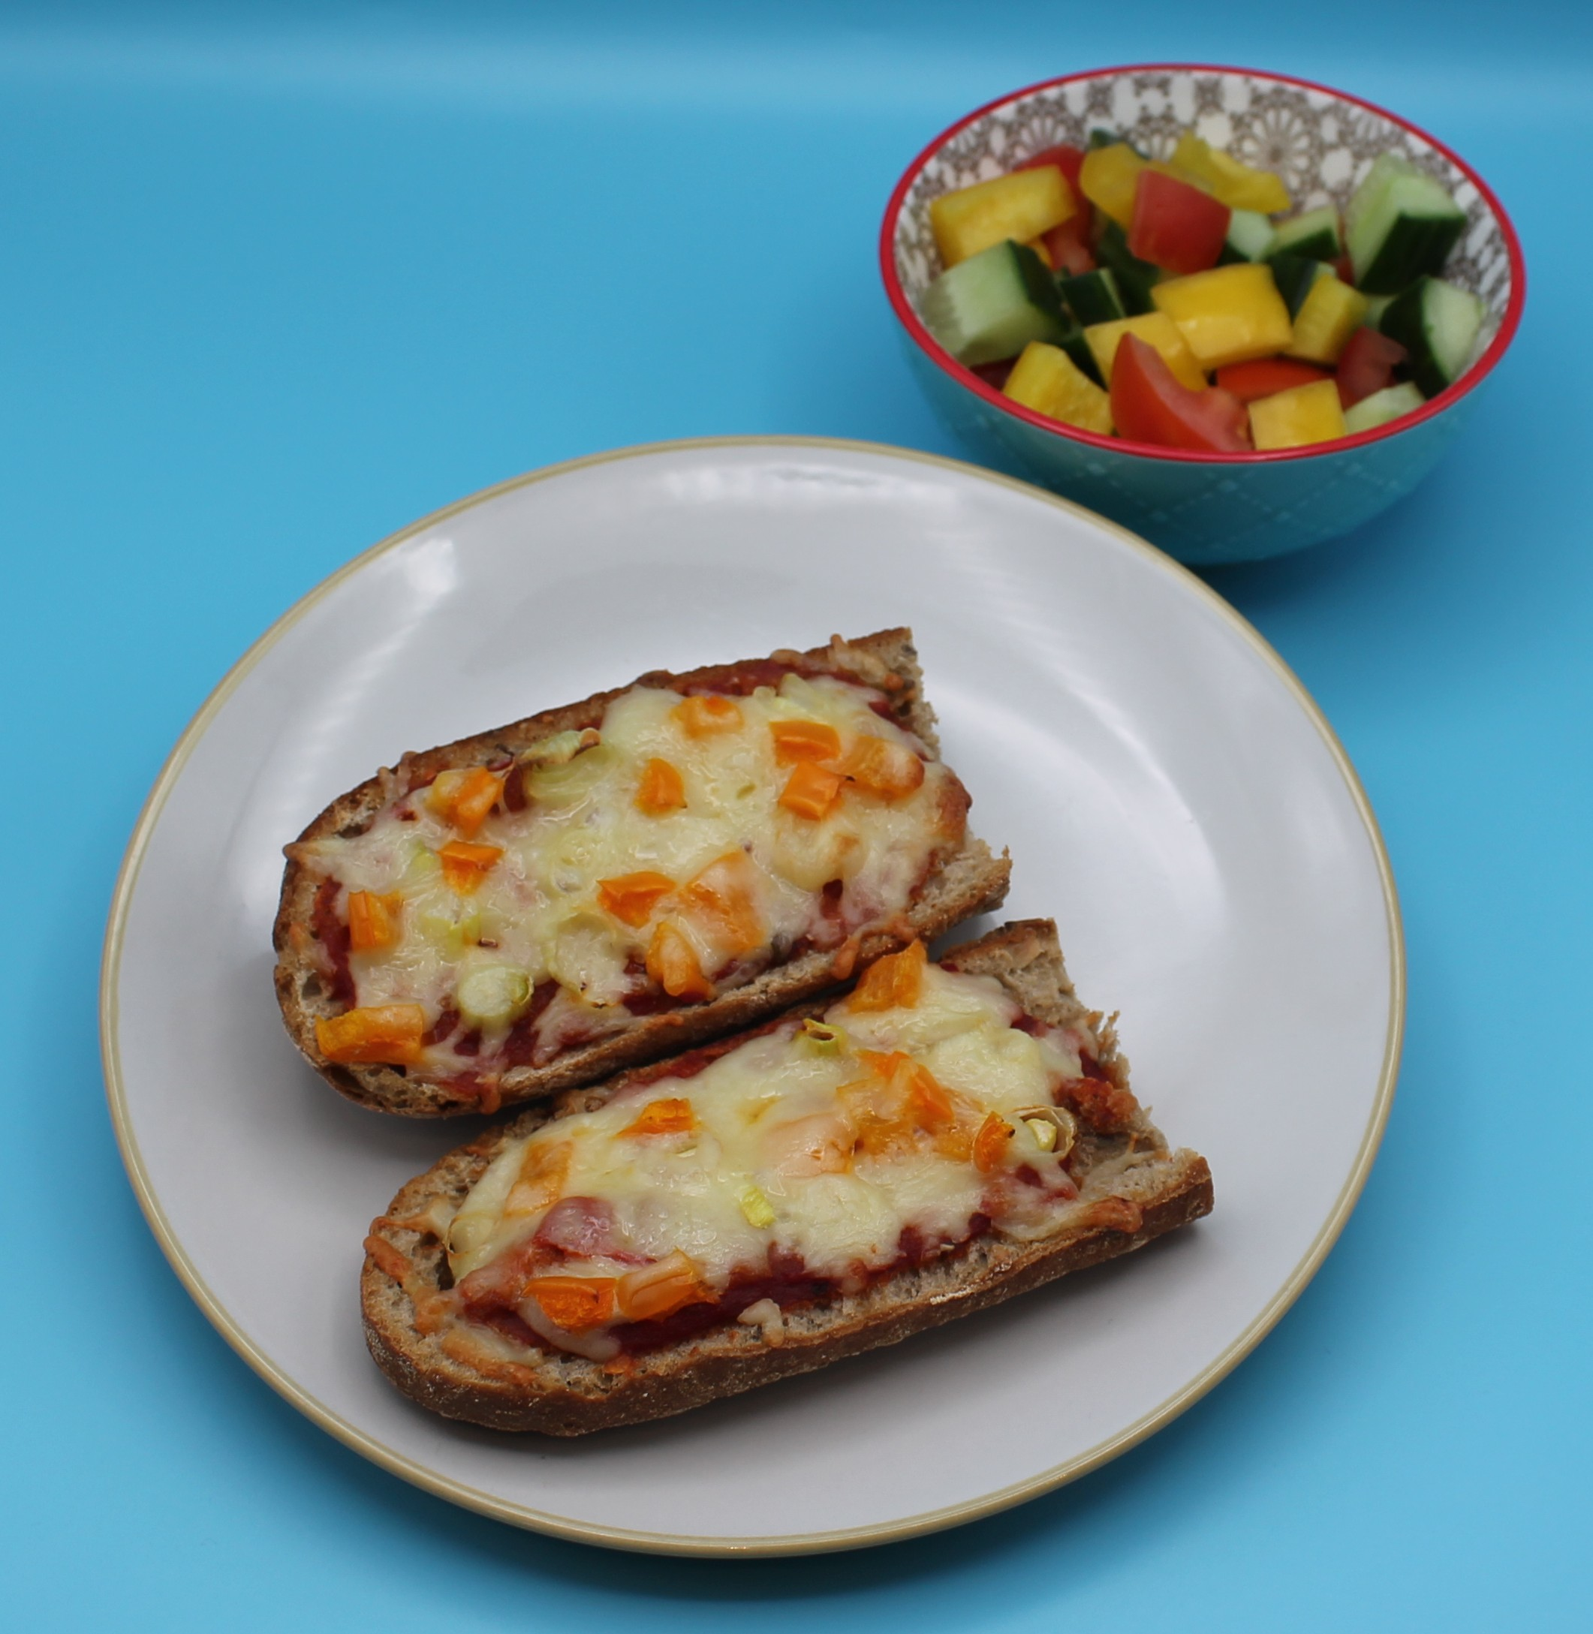
Food science
Dextrinisation
The starch in the flour (in the bagel) turns to dextrin under the application of dry heat (the grill) causing it to go brown.
Coagulation
The cheese melts, changing its structure and coagulating (sets) into a new structure.

Slide 11



Plenary
Evaluate how well you worked today.
 |  |  |  | Comments
Deseeding, slicing and dicing
Grating
Spreading and arranging
Grilling

Slide 12

Example responses
Evaluate how well you worked today.
 |  |  |  | Comments
Deseeding, slicing and dicing |  |  |  | My peppers were diced evenly, and my mushrooms and onion were evenly sliced.
Grating |  |  |  | My cheese was grated with no lumps.
Spreading and arranging |  |  |  | My sauce did not fully cover the bagel and my toppings were all at one side.
Grilling |  |  |  | My pizza toast was very brown and the cheese was rubbery. I left it in the grill too long.

Slide 13
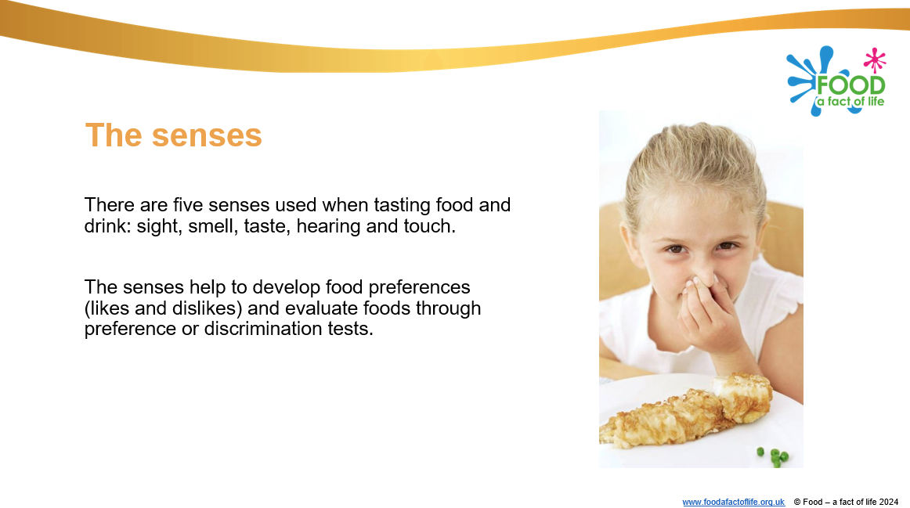
Looking for more…
Why not challenge your students to sensory evaluate the pizza toast?
Use our sensory evaluation presentation and teacher guide to help you plan your lesson.
If you would like your pupils to demonstrate safe use of the grill and temperature control, but with a more complex recipe, why not use this lesson for lamb or vegetarian koftas from the Food – a fact of life Schemes of Work?

Slide 14
Pizza toast
For further information, go to:
www.foodafactoflife.org.uk
This resource meets the Guidelines for producers and users of school education resources about food.

