Slide 1
Varieties of potatoes

Slide 2
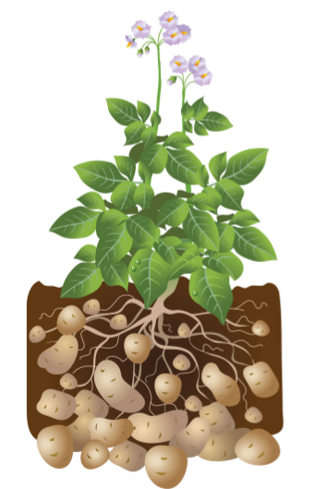
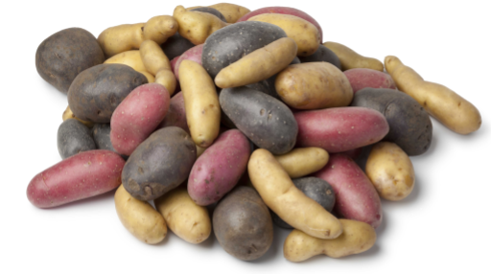
What is a potato?
Potatoes are tubers
Fleshy swelling on roots.
Grow underground.
Over 4000 edible varieties.
Many different colours, shapes and sizes.

Slide 3
A brief history
4000 BC - Discovered in Peru over 6,000 years ago.
1536 - Brought to Europe by Spanish, having conquered Peru.
1589 - Sir Walter Raleigh introduced to Ireland.
1840s - The Potato Famine – 1 million died in Ireland when ‘potato blight’ wiped out the potato crop.
1902 - King Edward potato variety introduced at time of the Coronation of King Edward VII.
1940s - Potato production doubled, potatoes replaced flour and other ingredients during WWII and Potato Pete character promoted potatoes.
1995 - Potatoes became the first food grown in space.
2016 - 300m tonnes potatoes grown globally.

Slide 4
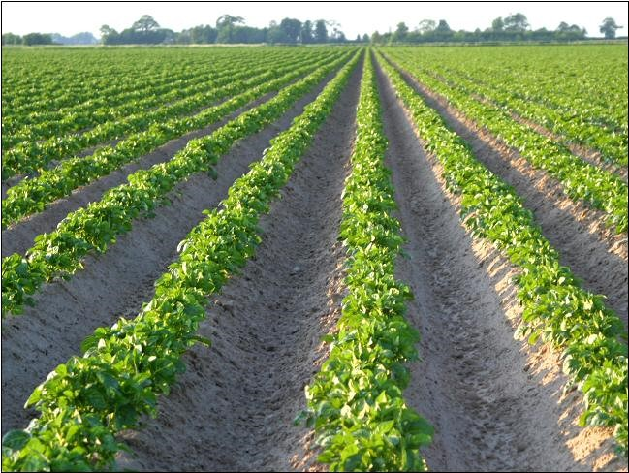
British potatoes
5.4 million tonnes grown every year.
100 varieties in 50 counties.
Availability depends on region and season.

Slide 5
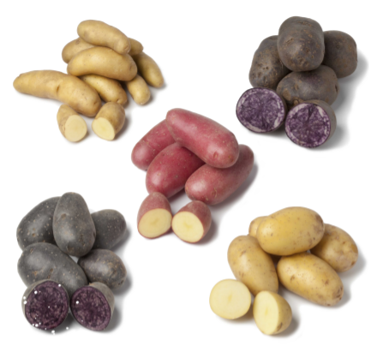
New varieties
Specialist breeders to develop new, improved varieties:
better resistance to pests and diseases;
better storage;
greater nutrition;
increased yield;
consistency for better processing;
improved quality, appearance;
reduced need for inputs such as water and fertiliser.

Slide 6
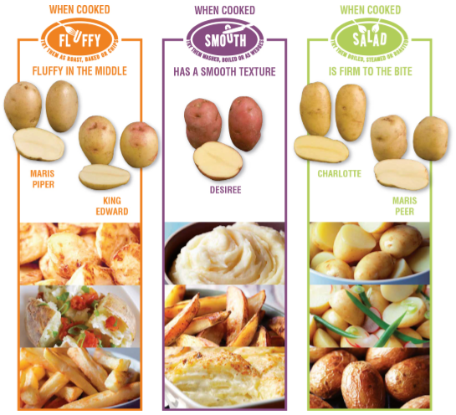
Know your potatoes
Three classification groups: fluffy, smooth, salad.
Different characteristics influence cooking performance.
Choose the right variety for the cooking method chosen.

Slide 7
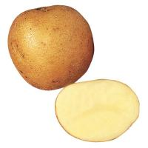
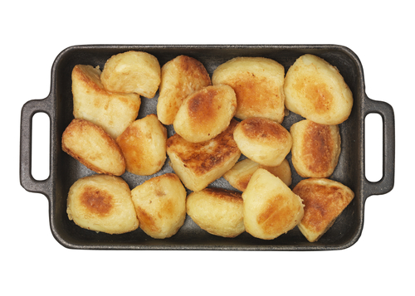
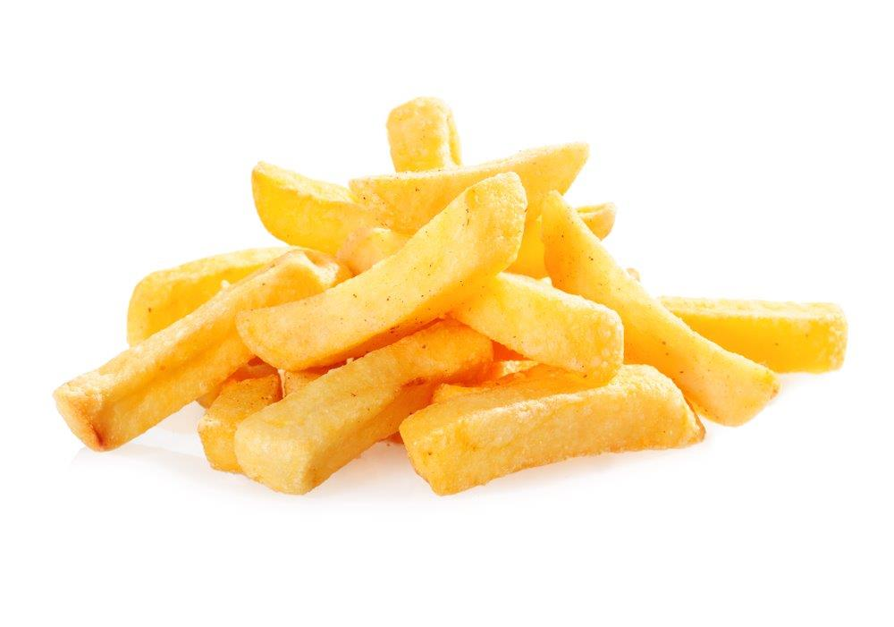
Fluffy potatoes
Fluffy potatoes are good for roasting, baking and making chips.
Before cooking: bright, granular with a drier feel.
When cooked: fluffy in the middle, soft dry texture.
Popular varieties: King Edward and Maris Piper.
Other varieties: Aaran Victory, Cara, Dunbar Rover, Fianna, Golden Wonder, Highland Burgandy, Innovator, Kerr’s Pink, Mayan Gold, Red Duke of York, Red King Edward, Rooster, Sante, Shetland Black, Violetta, Yukon Gold.

Slide 8
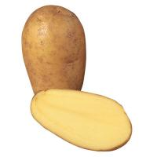
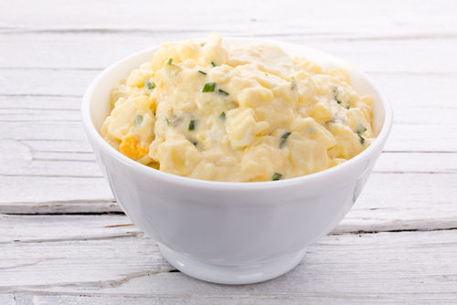
Salad potatoes
Salad potatoes are good for steaming, roasting and making potato salads.
Before cooking: translucent, firm, moist, pasty.
When cooked: hold their shape well, firm to the bite.
Popular varieties: Charlotte, Maris Peer.
Other varieties: Annabelle, Anya, Bambino, Carlingford, Corolle, Duke of York, Exquisa, Galante, Inca Dawn, Jazzy, Kestrel, Pink Fir Apple, Nicola, Pentland Javelin, Baby Gem.

Slide 9
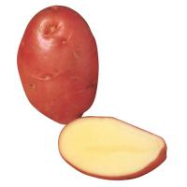
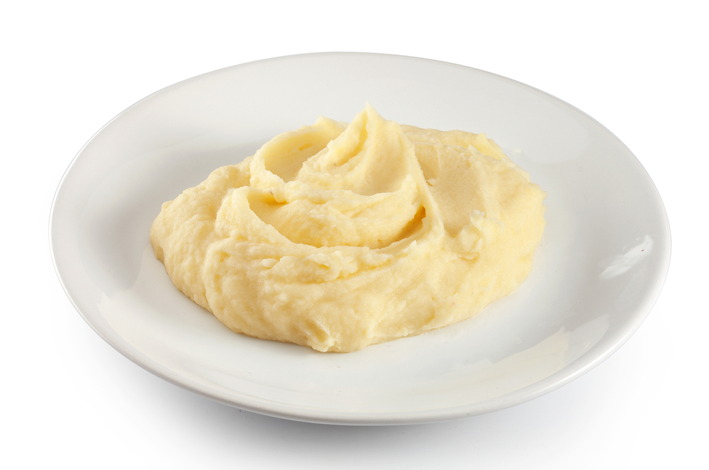
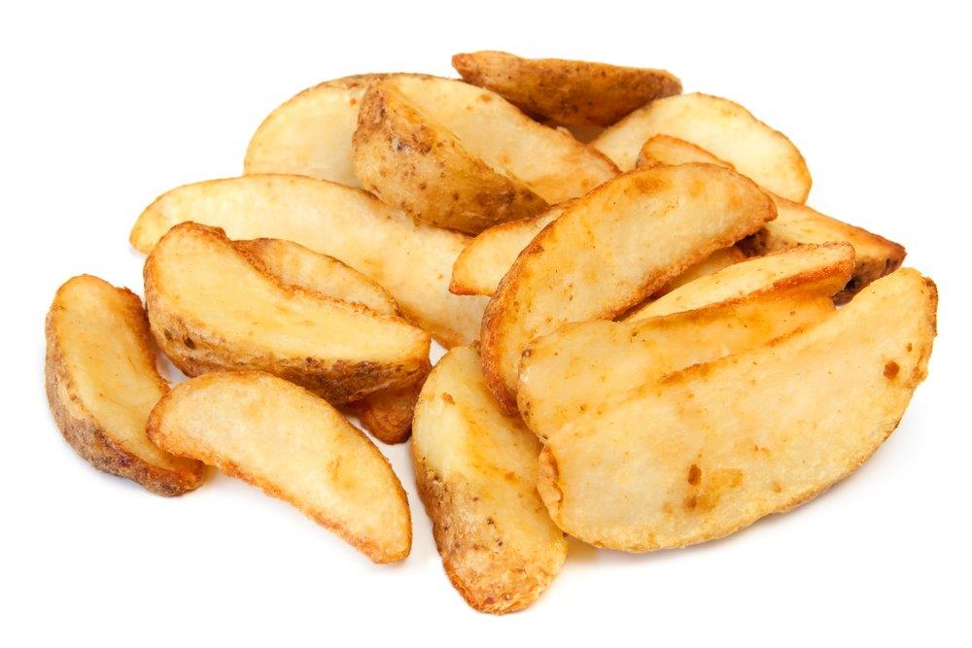
Smooth potatoes
Smooth potatoes are good for boiling, mashing and making potato wedges.
Before cooking: translucent, firm, moist, pasty.
When cooked: hold their shape well, firm to the bite.
Popular varieties: Desiree.
Other varieties: Accord, Apache, Chopin, Dunford, Estima, Harmony, Lady Balfour, Marabel, Marfona, Maris Bard, Melody, Mozart, Nadine, Vivaldi.

Slide 10
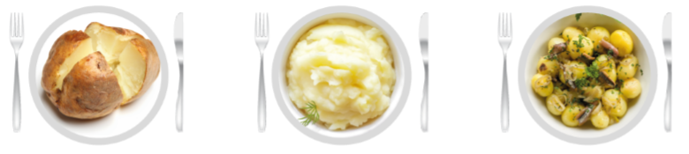
The science of potatoes
Different potatoes have different textures when cooked.
Vary from fluffy to smooth due to cell changes during cooking:
starch absorbs water;
starch cells swell;
cells begin to break down;
new potatoes hold their shape best because starch cells are less mature.

Slide 11
Varieties of potatoes
For further information, go to:
www.foodafactoflife.org.uk

